Slide 1
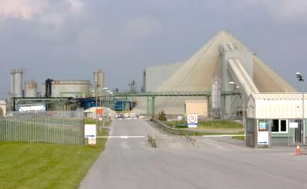
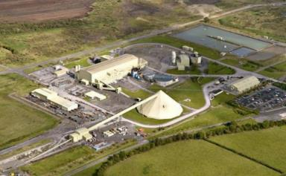
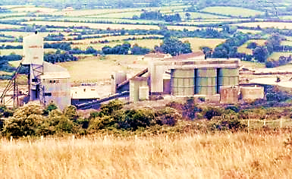
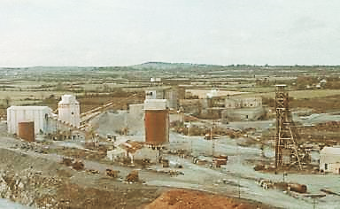
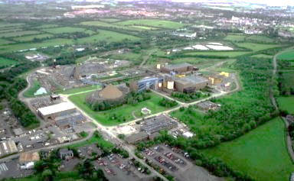


Irish Zn-Pb Deposits – a review of the evidence for the timing of mineralization - Constraints of stratigraphy and basin development.
https://media.giphy.com/media/d3yxg15kJppJilnW/giphy.mp4
Colin J Andrew
Irish-type Zn-Pb Deposits – Colin J Andrew

Slide 2


https://media.giphy.com/media/d3yxg15kJppJilnW/giphy.mp4
1976
Irish-type Zn-Pb Deposits – Colin J Andrew
Notes:
Take back to the mid 1970s

Slide 3
If it's in carbonates - it is an MVT !
“There are no significant differences between MVT deposits and the subset that is described in Ireland. Most features of the Irish deposits are not distinct from the family of MVT deposits.”
Simple - BLACK OR WHITE – MVT or SedEx
Irish-type Zn-Pb Deposits – Colin J Andrew
Notes:
The belief at the time

Slide 4
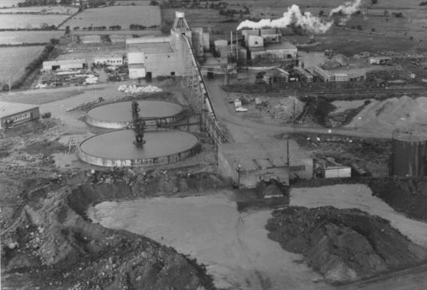
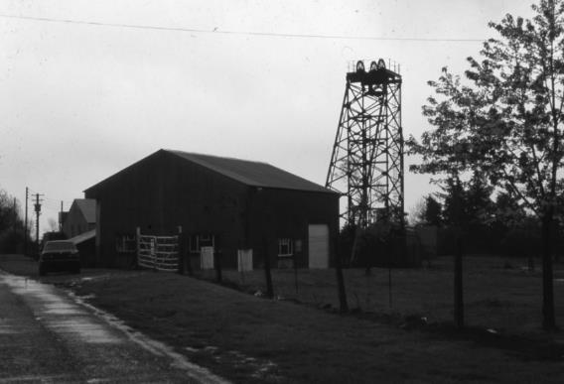
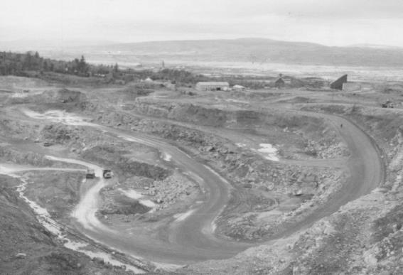
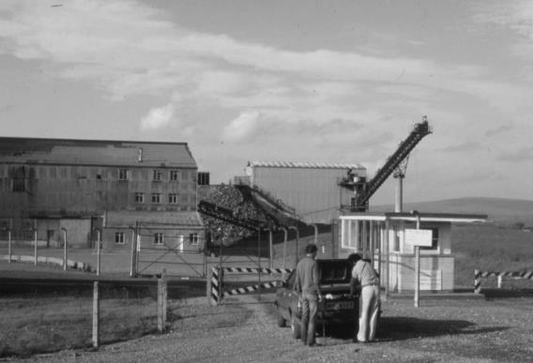
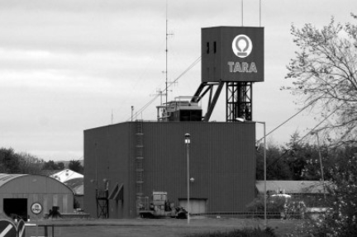
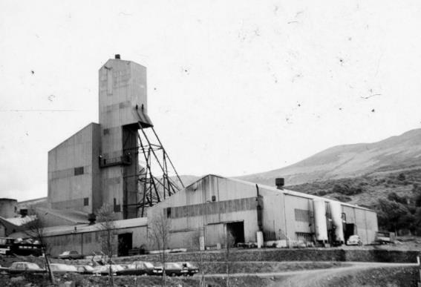
Derry et al (1965)
Schultz (1966)
Morrissey (1970)
Patterson (1970)
Watling (1972)
Rhoden (1958)
Barratt (1975)
Steed (1975)
O Brien & Romer (1971)
Graham (1970)
Coomer & Robinson (1976)
Irish-type Zn-Pb Deposits – Colin J Andrew
Notes:
Number of good papers but essentially only descriptive

Slide 5
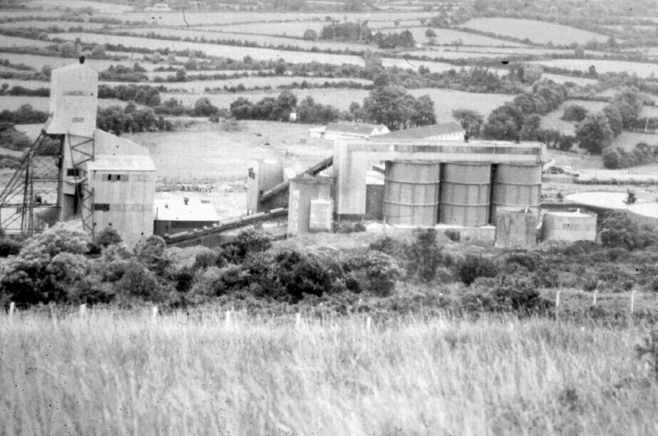
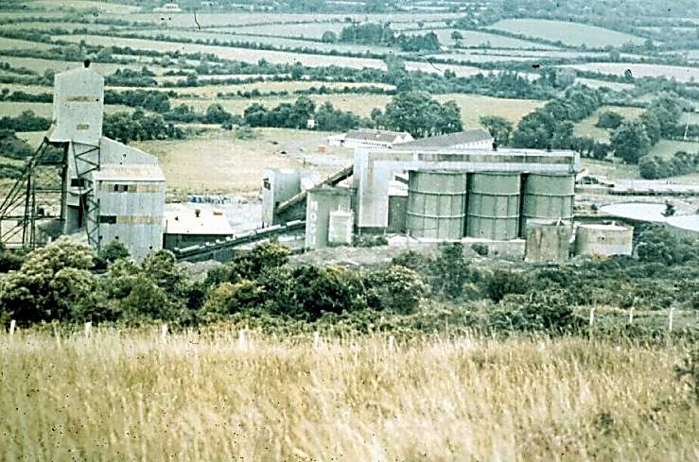
But maybe it was not all black and white!
But maybe it was not all black and white!
Irish-type Zn-Pb Deposits – Colin J Andrew
Notes:
But in the mid 1970s things took on a different perspective and in 1976 the term Irish-type was first proposed

Slide 6
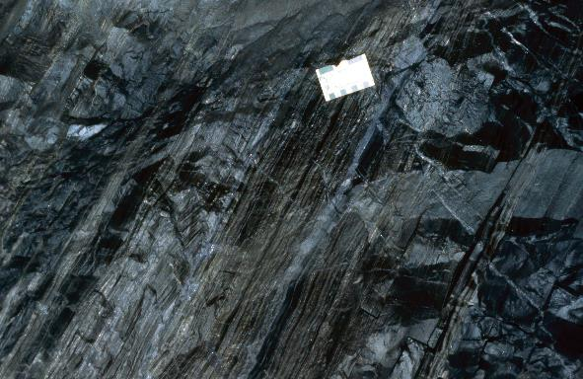
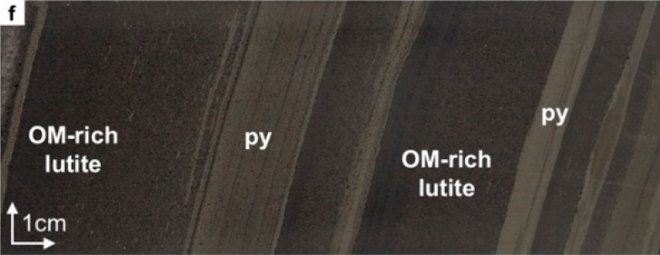
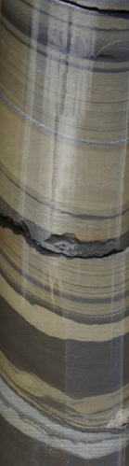
Zn-Pb deposits – MVT or SedEx ?
Organic matter-rich lutite replaced by ~0.5 to 1.5 cm layers of fine-grained pyrite parallel to bedding.
Navan Deeps
From Yesares et al (2019)
Finely laminated base-metal sulphides
Classic SedEx style.
Mt Isa 16 Lode.
Irish-type Zn-Pb Deposits – Colin J Andrew

Slide 7

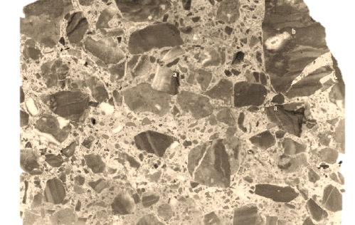
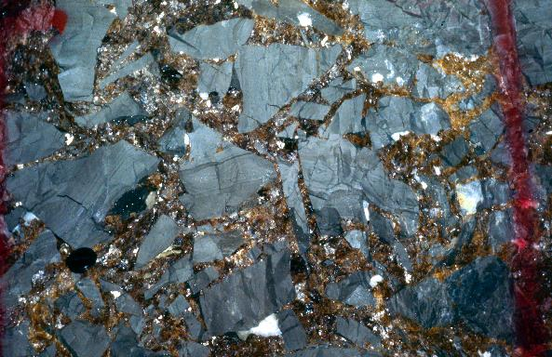
Zn-Pb deposits – MVT or SedEx ?
Angular fragments of laminated micrite in a matrix of micro-crystalline sphalerite.
Tynagh (From Boast (1979)
Breccia hosted coarse sphalerite.
Classic MVT Style.
Gordonsville, Tennessee.
Irish-type Zn-Pb Deposits – Colin J Andrew

Slide 8
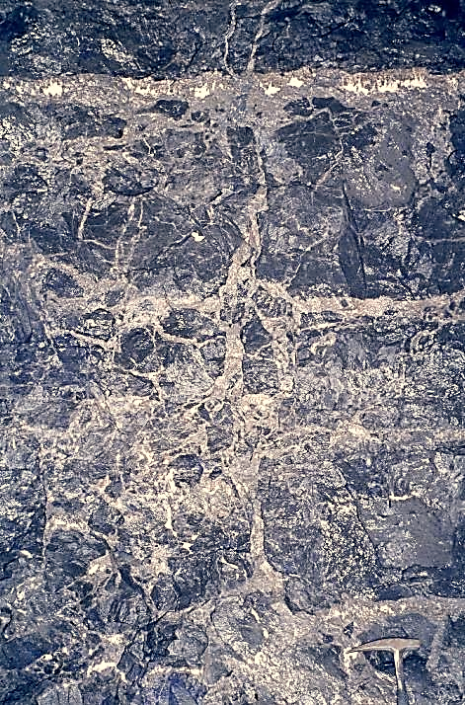
Finely laminated sulphides
Classic SedEx style.
Mt Isa 16 Lode.
Breccia hosted coarse sphalerite.
Classic MVT Style.
Gordonsville, Tennessee.
Bedding parallel and cross-cutting
Zn-Pb mineralization
Navan 4 Lens - 2 Zone
Irish-type Zn-Pb Deposits – Colin J Andrew

Slide 9
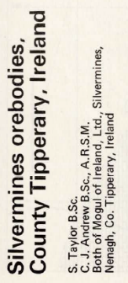
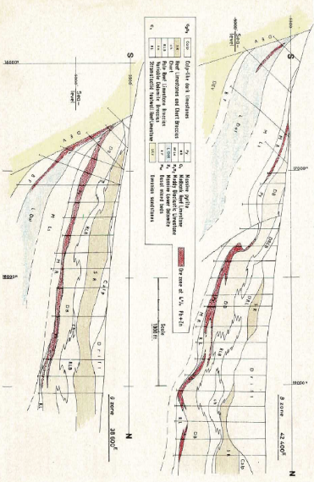
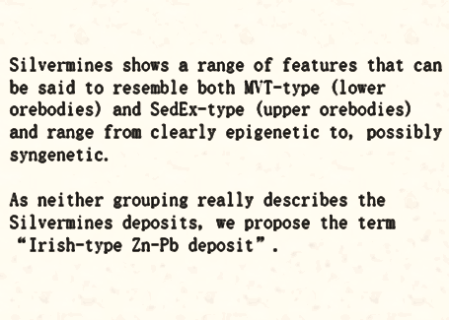
But maybe it was not all black and white!
But maybe it was not all black and white!
Nearly 50 years ago, at a meeting of the IAEG in Athlone, the term “Irish-type” was first coined in discussing Silvermines. The term gained its first international outing at Burlington House in London shortly after, in discussion on the 1978 paper on Silvermines in the IMM Transactions.
Irish-type deposits show a range of features that can be said to resemble both MVT and SedEx types and range from clearly epigenetic (in feeder zones) to exhalative and syndiagenetic.
Critical detail is the relative age of mineralization to the host-rocks.
Slides used in August 1976 at IAEG Meeting in Athlone
Irish-type Zn-Pb Deposits – Colin J Andrew
Notes:
But in the mid 1970s things took on a different perspective and in 1976 the term Irish-type was first proposed

Slide 10
MVT or SedEx – a matter of timing
MVT-type deposits are generally found in carbonate platform settings, typically in relatively undeformed orogenic foreland rocks, commonly in thrust belts, and rarely in rift zones. Mineral deposition is typically much later than the host sediments and typically formed post-basin closure.
SedEx or CD-type deposits are generally also formed in post-rift settings but as the name implies mineralization is often coeval with sedimentation.
Irish-type deposits formed shortly after sedimentation and mineralization occurred within a rifting environment.
Scatter plot of the age difference in mineralization to age of host rocks for 73 MVT deposits around the world.
(Avg 186 Ma)
Irish-type Zn-Pb Deposits – Colin J Andrew

Slide 11
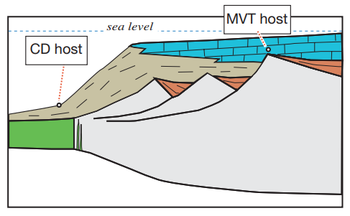
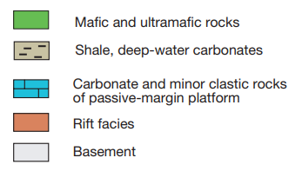
MVT or SedEx – a matter of timing
The tectonic setting in which the ore deposit forms is the defining moment in the formation of a sediment-hosted Pb-Zn deposit and which determines the deposit type and its depositional processes.
The MVT Pb-Zn deposits are located in the carbonate-platform sequences of the passive margin.
Irish-type deposits are syn-rift and located within active rift basins.
Irish host
Modified from Leach et al 2010
Irish-type Zn-Pb Deposits – Colin J Andrew

Slide 12
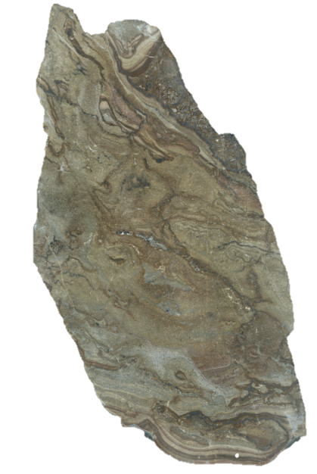

Constraints on the age of the “Irish-type” deposits
Existing dating methods - issues
Depositional environment of host-sediments and basin development.
Relative depth of mineralization.
Isotopic signatures constraining depth and timing of mineralization.
Navan Hi-Grade ore ~ 50% Zn+Pb
Irish-type Zn-Pb Deposits – Colin J Andrew

Slide 13
Deposit | Age dating method | Age | Source
Silvermines | Re:Os on Pyrite | 334±6.1 | Hnatysin et al (2015)
Silvermines | Rb:Sr on Sphalerite | 360±5.2 | Schneider et al (2007)
Silvermines | Contemporaneous Biota | ~352 | Boyce et al (2003)
Magcobar | Palaeomagnetic | 269±4 | Pannalal et al (2008)
Magcobar | U:Pb | 331±5.6 | Vafeas et al (2023)
Lisheen | Re:Os on Pyrite | 346.5±3.0 | Hnatysin et al (2015)
Navan | Stylolites | <336 | Pearse & Wallace (2000)
Navan | Palaeomagnetic | 333±4 | Symons et al (2002)
Courtbrown | Stylolites | 339 - 307 | Reed & Wallace (2001)
Galmoy | Palaeomagnetic | 290±9 | Pannalal et al (2008)
Lisheen | Palaeomagnetic | 277±7 | Pannalal et al (2008)
Gortdrum | Rb:Sr | 359±22 | Duane et al (1986)
Gortdrum | Pb:Pb and U:Pb | 340±20 | Duane et al (1986)
Tynagh | Pb:Pb | 348±22 | Boast et al (1981)
Tynagh | Contemporaneous Biota | ~352 | Boyce et al (2003)
Age Dating
Irish-type Zn-Pb Deposits – Colin J Andrew
Notes:
We can discount the magnetic ages as they all show evidence of syn-Hercynian remagnetization as seen at numerous locations throughout the Lr Carboniferous in the UK (McCabe & Channel 1984). Equally the “stylolite” dating can also be discounted due to erroneous assumptions.

Slide 14
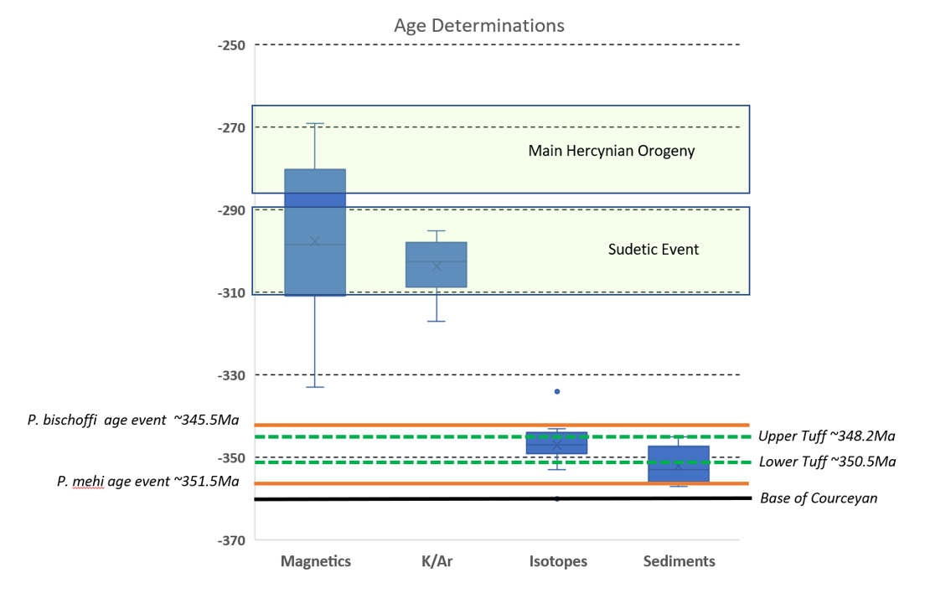
Issues with Magnetic Dating
Inversion ~331Ma
Irish-type Zn-Pb Deposits – Colin J Andrew

Slide 15
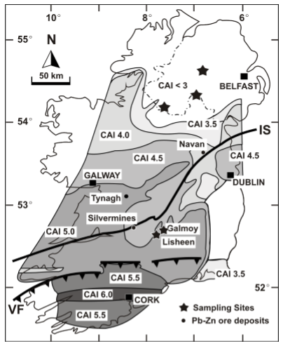
Issues with Magnetic Dating
8
16
50
58
80
71
Variscan Front
Wilkinson et al (2017) clearly demonstrated that re-magnetization of the rocks was probably independent of the ore-forming process and dates Variscan orogenesis, not Zn-Pb mineralization.
Map of CAI across Ireland with the difference in magnetic ages to host rock actual ages shown in yellow.
Irish-type Zn-Pb Deposits – Colin J Andrew

Slide 16
Deposit | Age dating method | Age | Source
Silvermines | Re:Os on Pyrite | 334 ± 6.1 | Hnatysin et al (2015)
Silvermines | Rb:Sr on Sphalerite | 360 ± 5.2 | Schneider et al (2007)
Silvermines | Contemporaneous Biota | ~352 | Boyce et al (2003)
Magcobar | Palaeomagnetic | 269 ± 4 | Pannalal et al (2008)
Magcobar | U:Pb | 331±5.6 | Vafeas et al (2023)
Lisheen | Re:Os on Pyrite | 346.5 ± 3.0 | Hnatysin et al (2015)
Navan | Stylolites | <336 | Pearse & Wallace (2000)
Navan | Palaeomagnetic | 333 ± 4 | Symons et al (2002)
Courtbrown | Stylolites | 339 - 307 | Reed & Wallace (2001)
Galmoy | Palaeomagnetic | 290 ± 9 | Pannalal et al (2008)
Lisheen | Palaeomagnetic | 277 ± 7 | Pannalal et al (2008)
Gortdrum | Rb:Sr | 359 ± 22 | Duane et al (1986)
Gortdrum | Pb:Pb and U:Pb | 340 ± 20 | Duane et al (1986)
Tynagh | Pb:Pb | 348 ± 22 | Boast et al (1981)
Tynagh | Contemporaneous Biota | ~352 | Boyce et al (2003)
Age Dating
Irish-type Zn-Pb Deposits – Colin J Andrew
Notes:
We can therefore discount the magnetic ages as reflecting the Variscan heating and most other indirect “interpretive” methodologies seem to relate to basin inversion at the end of the Asbian. The remaining age dates average 348.9Ma Also note that Sm-Nd garnet dating of basement rocks shows that the lower crust remained hot or was re-heated to ∼600◦C at ∼345Ma associated with extension and, in part, coincident with the mineralization.

Slide 17
Zircon dating
Lisheen Bog
Zone
Arundian
343.5Ma
345.5Ma
359.2Ma
v v v v v v v v
Early Arundian tuff
Late Chadian
Late Courceyan
Tuff
Base WRL
Tuff
Lisheen Main
Zone
345.0Ma
350.0Ma
355.0Ma
Early Chadian
M. beckmanni
G. texanus
P. mehli
Courceyan
P. bischoffi
Sc anchoralis
P. m. mehli
Sc. anchoralis
P. m. latus
P. c. carina
G. punctatus
P. multistriatus
P. inornatus
Dating of zircon in tuff horizons around Lisheen
Koch et al 2022
Condont biozones from Riley (1993) and Jones & Sommerville (1996)
P. spicatus
Irish-type Zn-Pb Deposits – Colin J Andrew

Slide 18
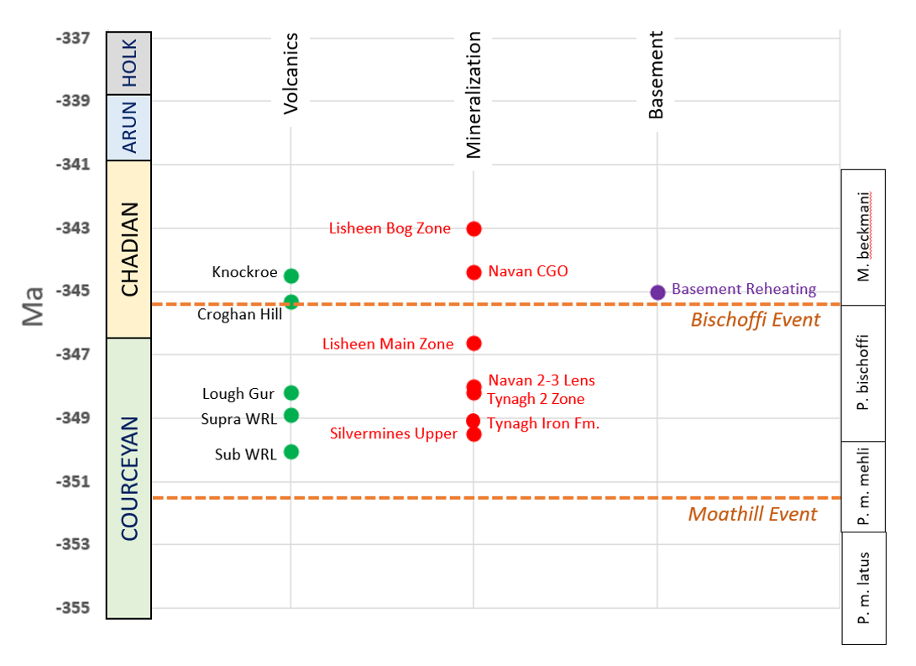
Age determinations by various isotopic methodologies plotted on conodont biostratigraphy.
Volcanic dates from Koch et al (2022) and Timmerman (2004), Mineralization dates from Hnatyshin et al (2015, 2020), Boast et al (1981a) and Duane et al (1986), Basement reheating date from Daly et al (2016).
Note – error bars on isotopic dating methods removed for diagrammatic simplicity
Limerick Syncline
348.9Ma
Irish-type Zn-Pb Deposits – Colin J Andrew
Notes:
So this time period is clearly of specific interest and strongly suggests that the P. mehli and P bischoffi biozones are highly significant.

Slide 19
Constraints on the age of the “Irish-type” deposits
Existing dating methods – issues.
Depositional environment of host-sediments and basin development.
Relative depth of mineralization.
Isotopic signatures constraining depth and timing of mineralization.
Navan Hi-Grade ore ~ 50% Zn+Pb
Irish-type Zn-Pb Deposits – Colin J Andrew

Slide 20
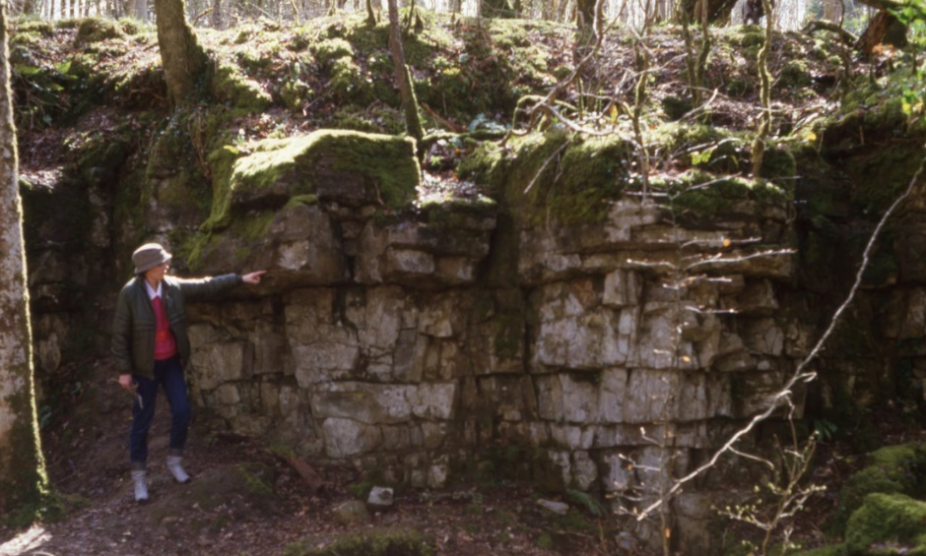
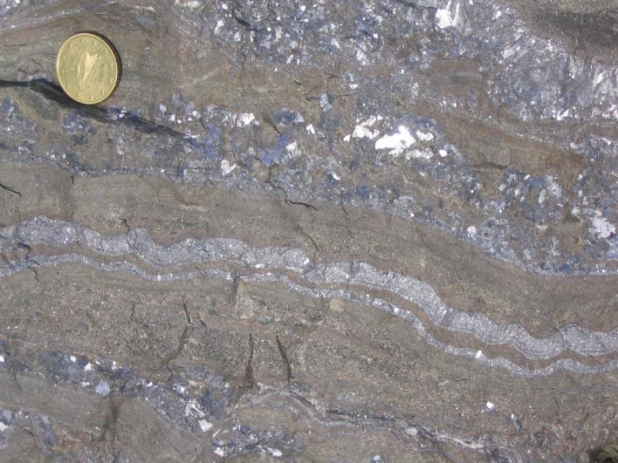
Critical aspects of what constitutes an “Irish-type” deposit
Waulsortian “Reef” Limestone
ABL Group
Navan Group
Red Beds
Irish-type Zn-Pb Deposits – Colin J Andrew

Slide 21
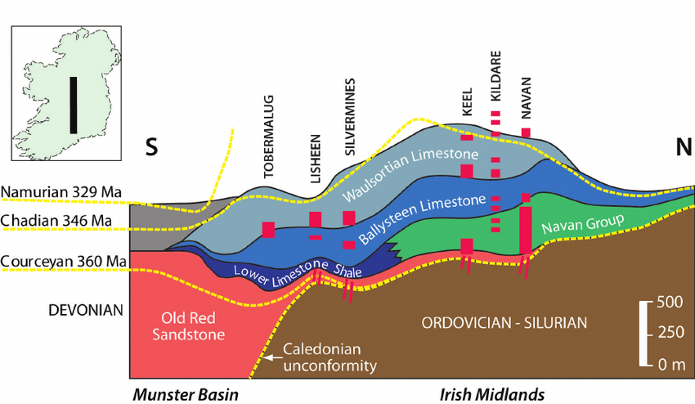
Simplified Midlands Stratigraphy
P. bischoffi
P. m. mehli
P. bischoffi
P. m. latus
P. m. latus
Irish-type Zn-Pb Deposits – Colin J Andrew

Slide 22
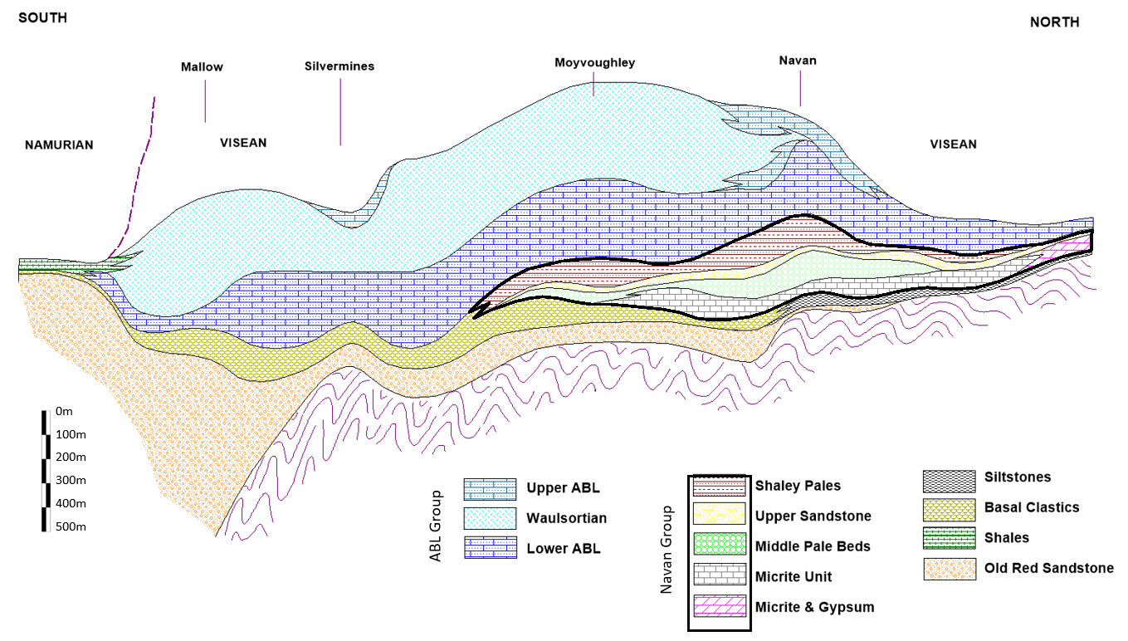
WRL
WRL
ABL Group
Navan Group
Irish-type Zn-Pb Deposits – Colin J Andrew

Slide 23
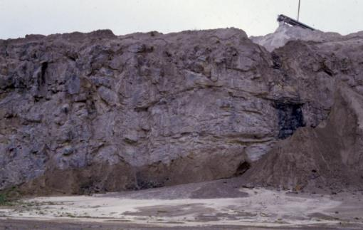
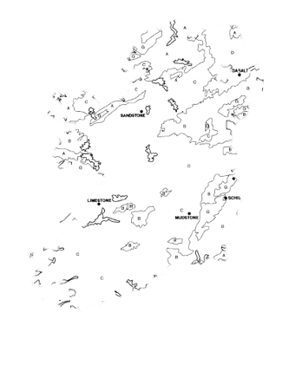
Stratigraphic variation
Waulsortian in Bray Hill Quarry
Irish-type Zn-Pb Deposits – Colin J Andrew

Slide 24
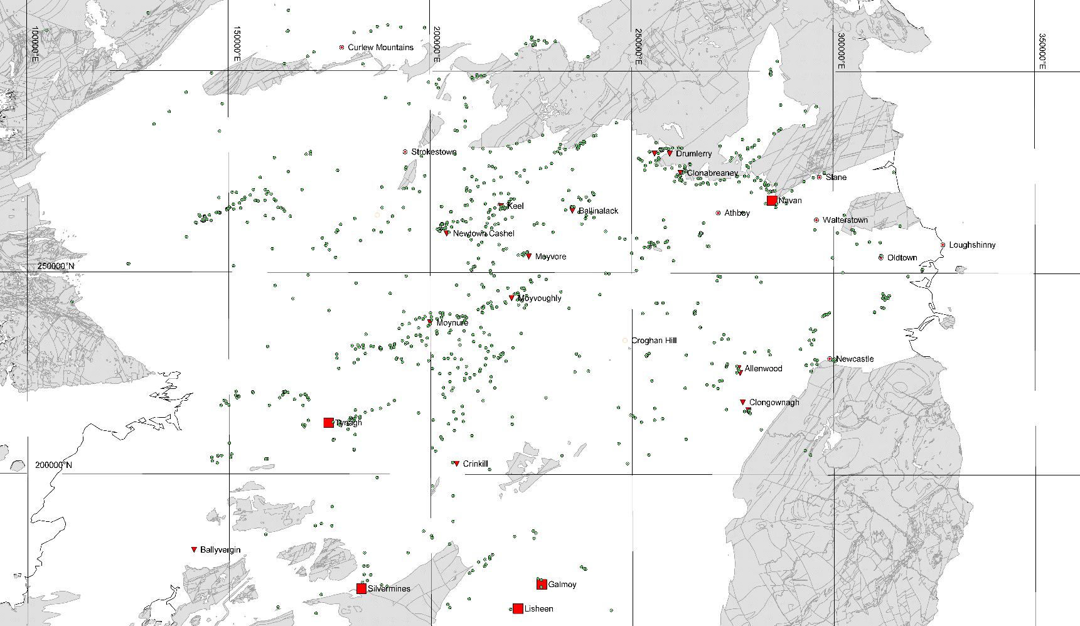
Drillholes used in study
In order to evaluate the controls to the development of the Lower Carboniferous Irish Midlands basins a database was compiled comprising 1,255 summary drill logs of exploration diamond drill hole cores greater than 100m in length. This data was captured from individual logs downloaded from the Geological Survey of Ireland “Goldmine” database, the stratigraphy then being captured as simplistic stratigraphic unit thicknesses with lithological notations and any biostratigraphic data. Any angle holes or logs reporting steep dips were discounted.
The data was sorted using Excel and MapInfo software and each unit contoured using 3D-Field software within a geographically defined polygon using a nearest neighbour algorithm. The resultant contours were then gridded to enable the generation of standardized cross sections showing the thickness variation of the individual and composite unit.
Data from GSI Open File
Irish-type Zn-Pb Deposits – Colin J Andrew
Notes:
1255 borehole logs (>100m of strat intersected) for GSI Goldmine

Slide 25
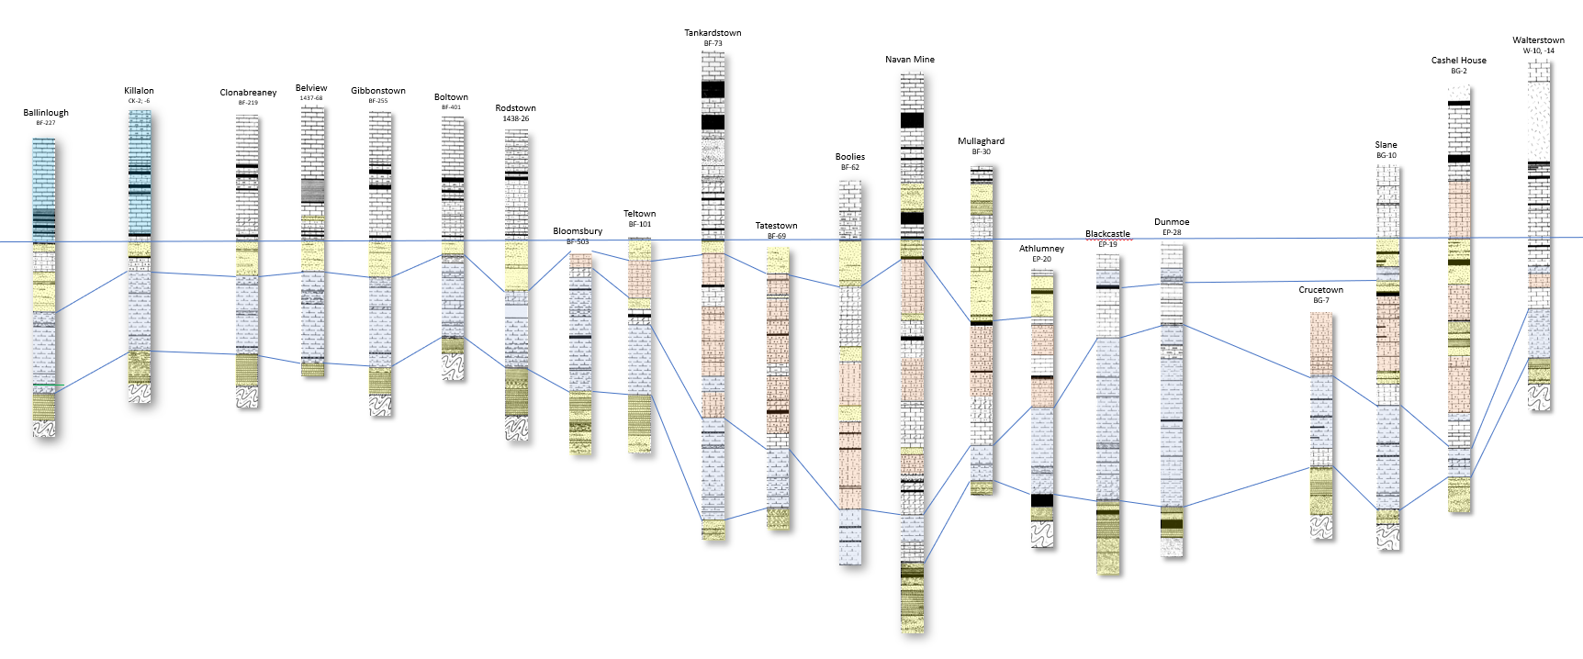
Local systematic thickness variation
WEST
~40km
EAST
Sandstones (UPB)
Grainstones (MPB)
Micrites
Zn-Pb Mineralization
0 m
25 m
50 m
75 m
Pseudo-section facing north from Clonabreaney across to Slane through Navan,
Stratigraphy ‘hung’ from base of Shaley Pales
(c. P. mehli mehli biozone)
From Andrew (1983)
Irish-type Zn-Pb Deposits – Colin J Andrew
Notes:
Point out lateral changes white qtzite in SP, no sst east of Navan, thinning of MU, thickening of MPB grainstones

Slide 26
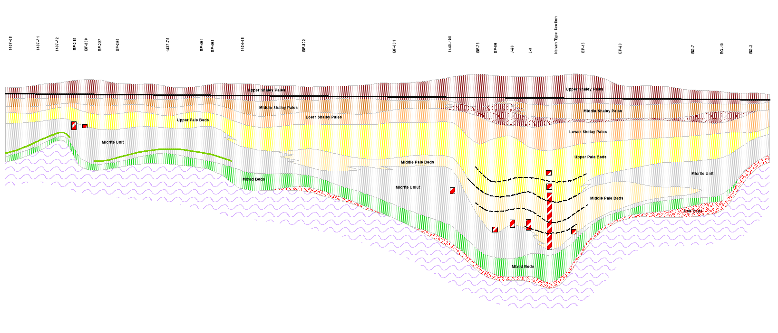
Local systematic thickness variation
1437-64 1437-71 1437-72 BF-219 BF-239 BF-227 BF-255 1437-75 BF-401 BF-403 1438-26 BF-802 BF-501 1440-100 1440-73 1440-60 J-26 L-3 EP-16 EP-20 BG-7 BG-10 BG-2
| | | | | | | | | | | | | | | | | | | | | | |
Clonabeany Kells Tatestown Liscarton NAVAN Slane
WEST
EAST
Brachiopod Marker
Green Silt
0 m
25 m
50 m
75 m
Pseudo-section facing north from Clonabreaney across to Slane through Navan,
Stratigraphy ‘hung’ from Brachiopod Marker in Upper Shaley Pales (c. P. mehli mehli biozone)
From Andrew (1983)
~40km
Irish-type Zn-Pb Deposits – Colin J Andrew
Notes:
Simplified version note green loess in MU lateral equiv of evaps

Slide 27
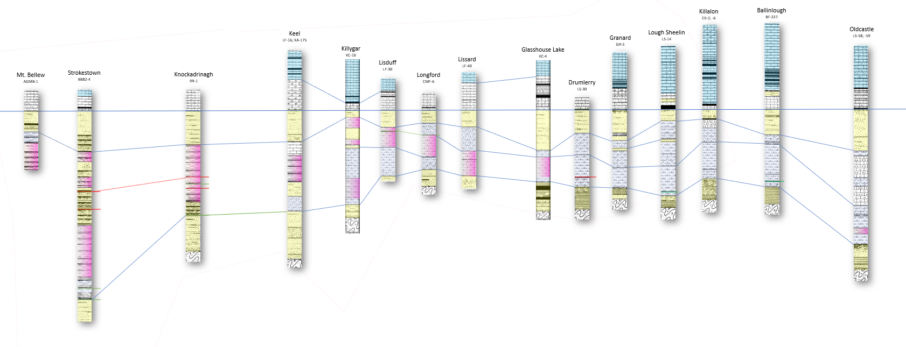
Local systematic thickness variation
WEST
~50km
EAST
0 m
25 m
50 m
75 m
Lower ABL / ABC
Sandstones (UPB)
Evaporites
Micrites
Zn-Pb Mineralization
Pseudo-section facing north from Mount Bellew across to Oldcastle,
Stratigraphy ‘hung’ from base of Shaley Pales
(c. P. mehli mehli biozone)
Irish-type Zn-Pb Deposits – Colin J Andrew

Slide 28
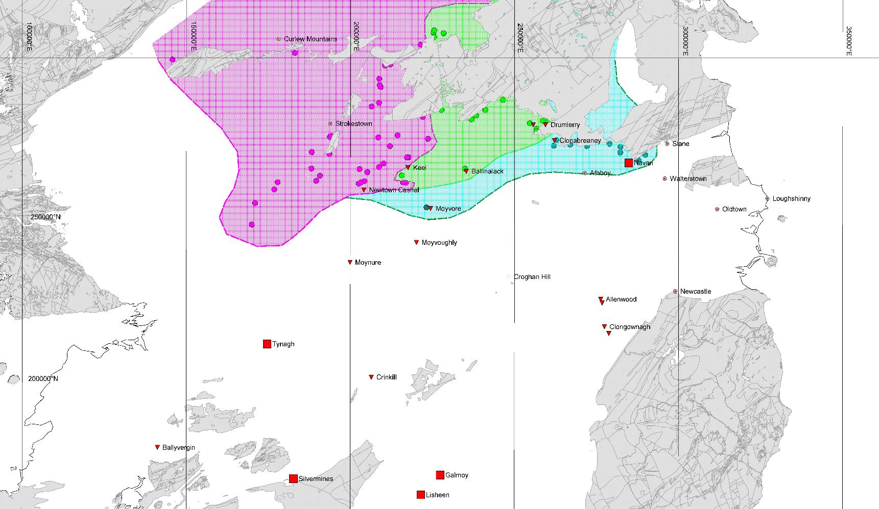
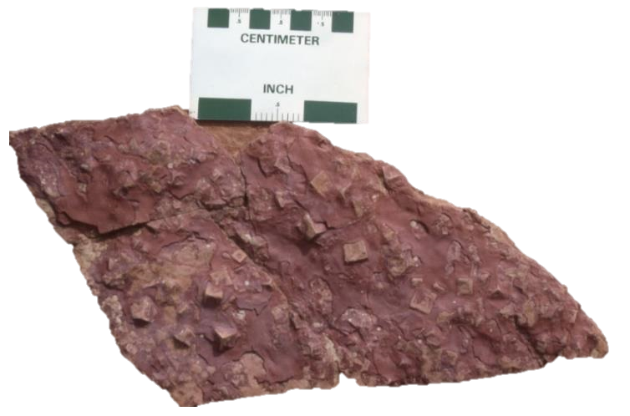
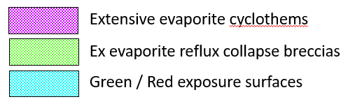
Micrite Facies
Data from GSI Open File
Irish-type Zn-Pb Deposits – Colin J Andrew
Notes:
Note initial structural control on sedimentation

Slide 29
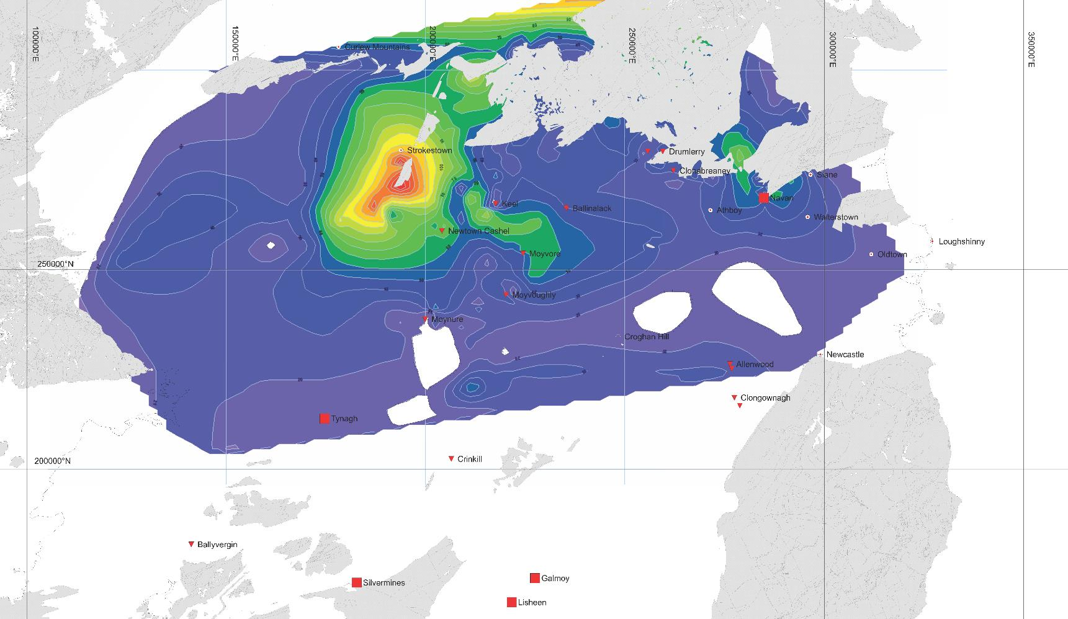

Micrite Unit (PB)
Data from GSI Open File
Irish-type Zn-Pb Deposits – Colin J Andrew
Notes:
Note initial structural control on sedimentation

Slide 30
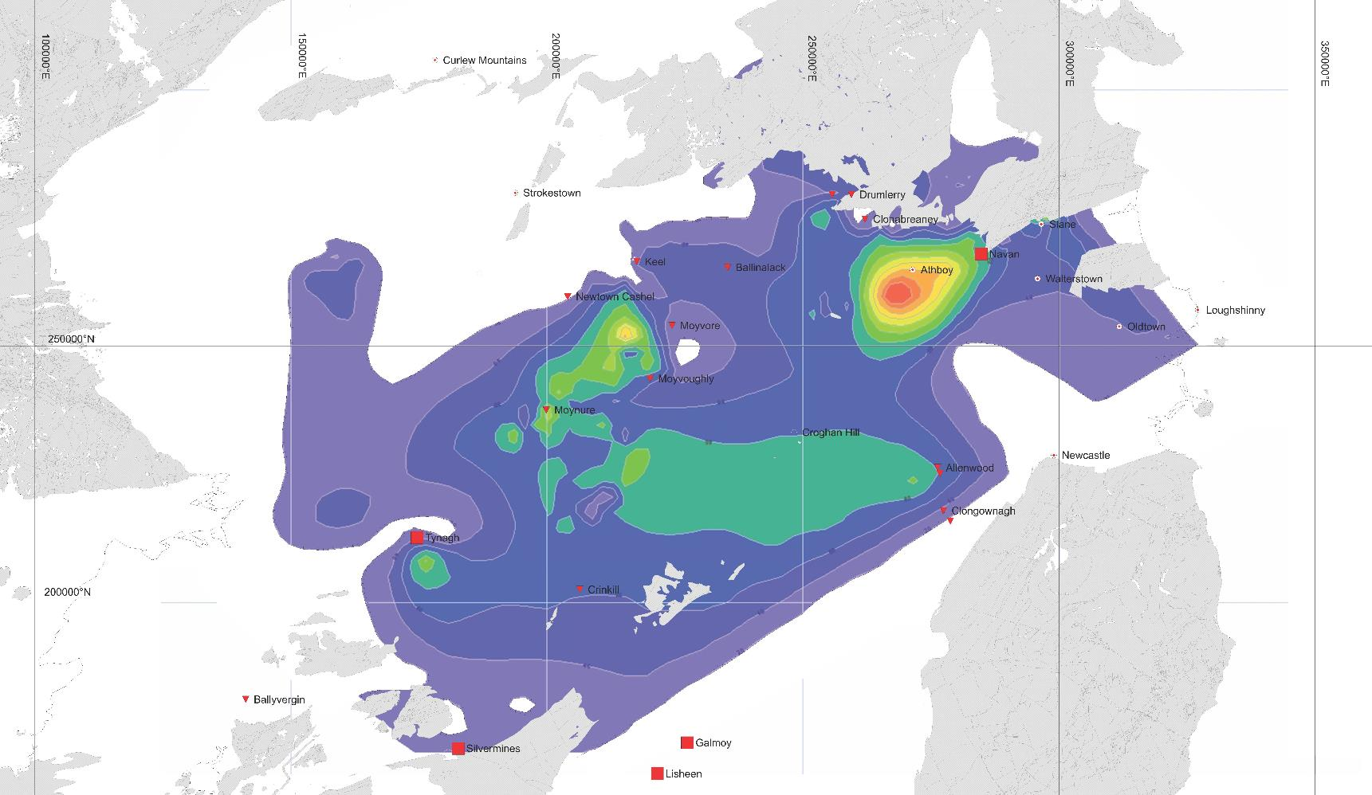

MPB Grainstones
Data from GSI Open File
Irish-type Zn-Pb Deposits – Colin J Andrew
Notes:
Note initial structural control on sedimentation

Slide 31
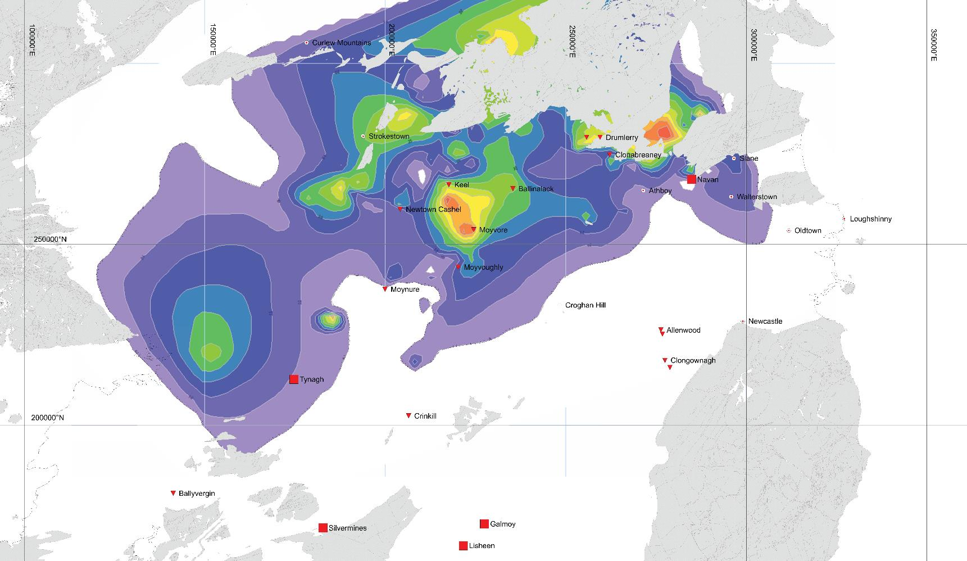

UPB Sandstone
Data from GSI Open File
Irish-type Zn-Pb Deposits – Colin J Andrew
Notes:
Note initial structural control on sedimentation

Slide 32
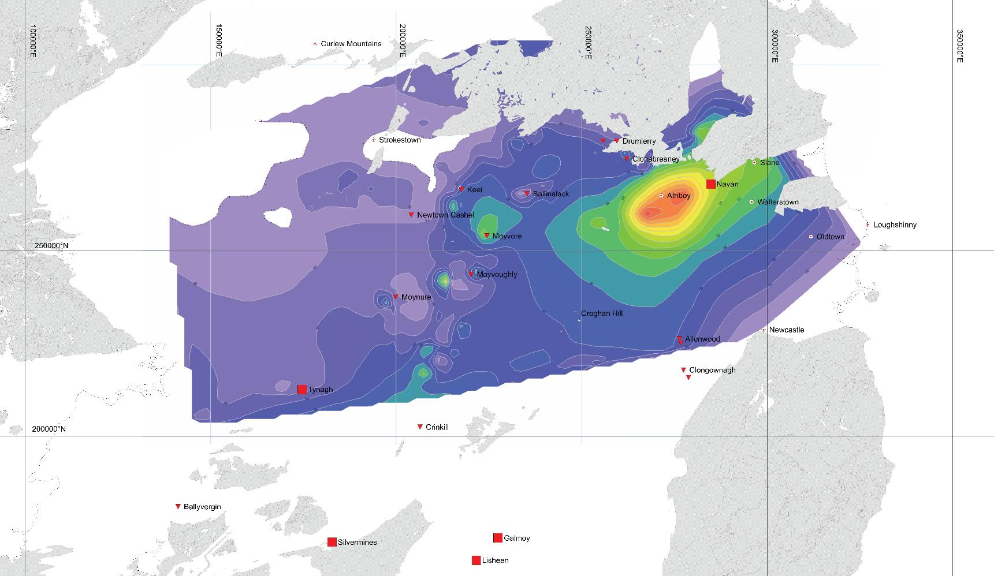

Shaley Pales
Data from GSI Open File
Irish-type Zn-Pb Deposits – Colin J Andrew

Slide 33
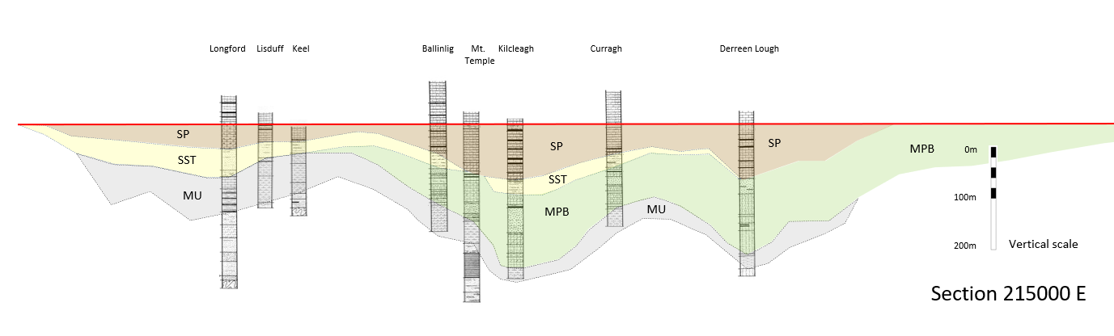
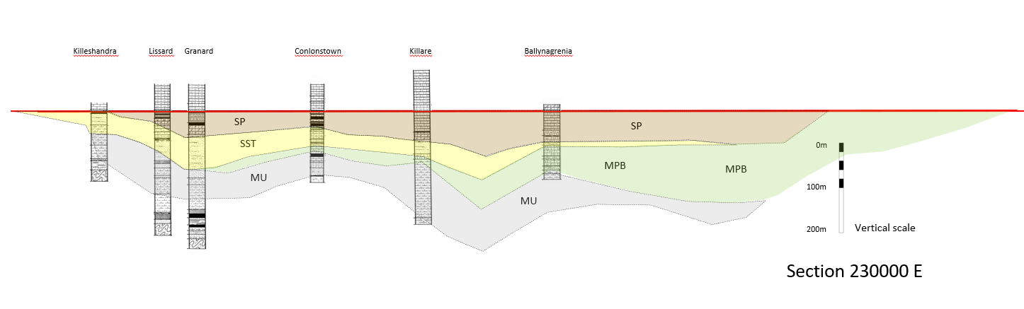
North
South
North
South
Irish-type Zn-Pb Deposits – Colin J Andrew

Slide 34
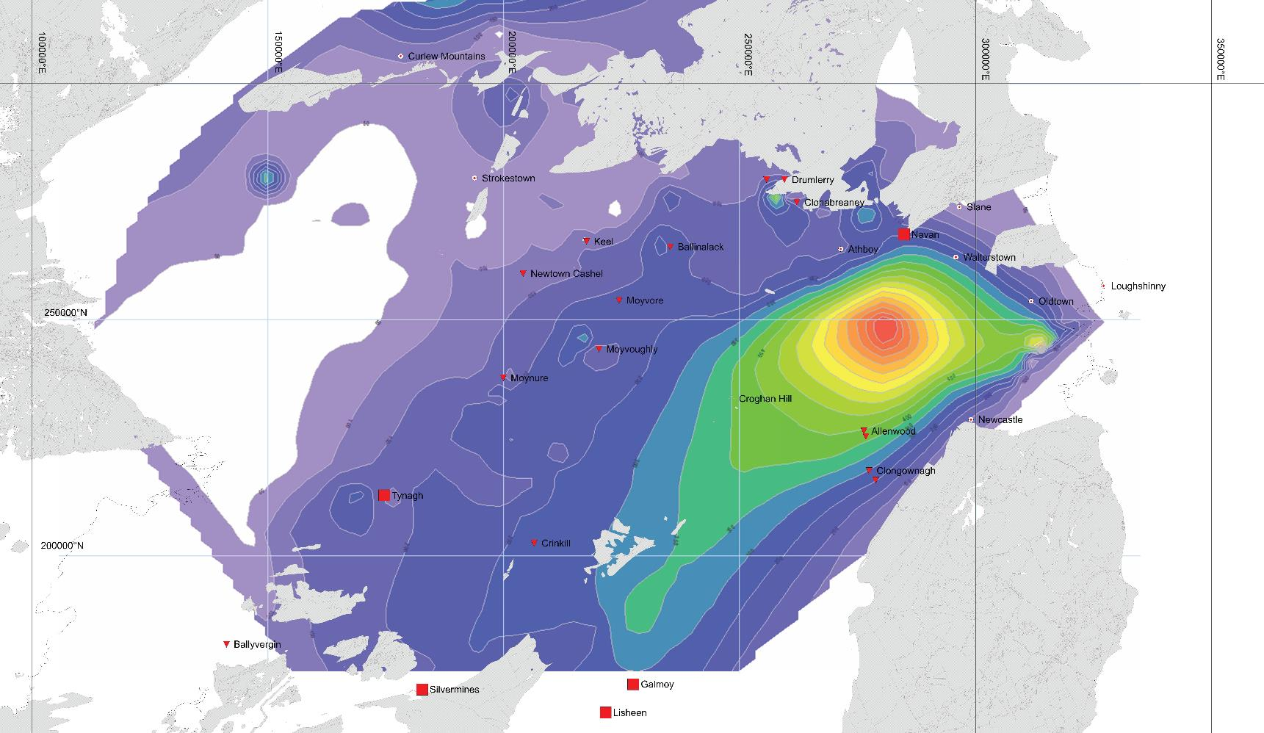

Lower ABL
Data from GSI Open File
Irish-type Zn-Pb Deposits – Colin J Andrew
Notes:
Note initial structural control on sedimentation

Slide 35
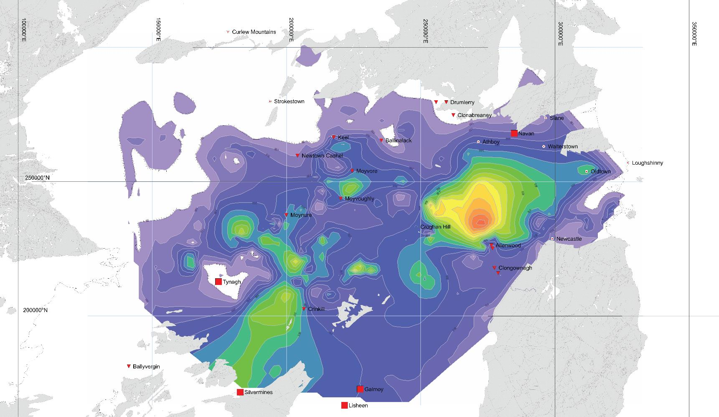

Scattered knolls within ABL
Waulsortian isopach
Scattered knolls within ABL
Reef Equivalent calcarenites
Data from GSI Open File
Irish-type Zn-Pb Deposits – Colin J Andrew

Slide 36
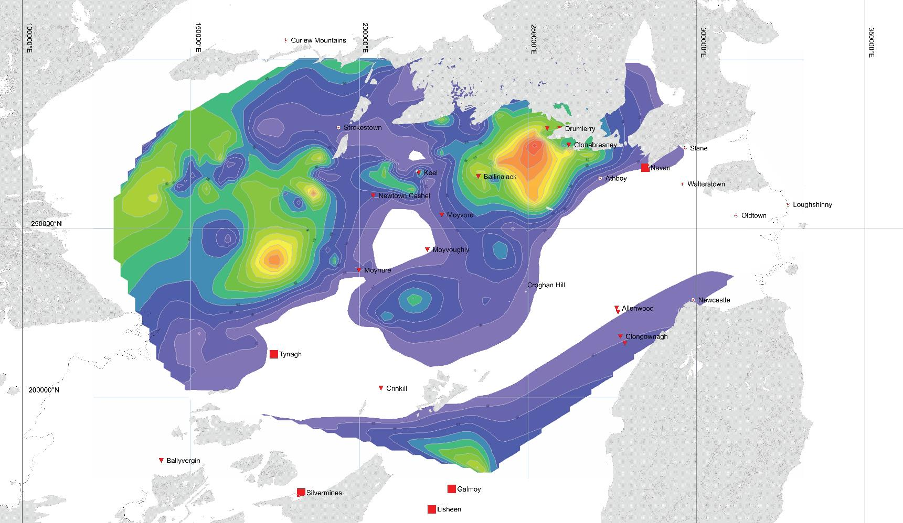

Upper ABL
Scattered knolls within ABL
Scattered knolls within ABL
Deep
Grey Calp
Scattered knolls within ABL
Scattered knolls within ABL
Deep
Grey Calp
Reef Equivalent calcarenites
Reef Equivalent calcarenites
Waulsortian contoured from 300m
Data from GSI Open File
Irish-type Zn-Pb Deposits – Colin J Andrew

Slide 37


Oakport / Allenwood
Data from GSI Open File
Irish-type Zn-Pb Deposits – Colin J Andrew
Notes:
Note initial structural control on sedimentation

Slide 38


Biostratigraphy
Arundian
Arundian
343.5Ma
345.5Ma
359.2Ma
v v v v v v v v v v v v v v
Early Arundian tuff(s)
Late Chadian
Waulsortian mudbank
Condont biozones from Riley (1993) and Jones & Sommerville (1996)
Early Chadian
M. beckmanni
G. texanus
P. mehli
Courceyan
P. bischoffi
Sc anchoralis
P. m. mehli
Sc. anchoralis
Navan Group calcareous sandstones
~348Ma
P. m. latus
P. c. carina
G. punctatus
P. multistriatus
P. inornatus
PC miospore
P. spicatus
VI miospore
Irish-type Zn-Pb Deposits – Colin J Andrew
Notes:
Note extensional events and that the widespread tuff horizons seen in the central and NE Midlands appear significantly later than the tectonism related to mineralization

Slide 39
P. bischoffi
P. m. mehli
P. bischoffi
P. m. latus
P. m. latus
Irish-type Zn-Pb Deposits – Colin J Andrew

Slide 40



Schematic vertically exaggerated N-S cross-sections through the Central Midlands demonstrating the variation in the thicknesses of the various units to illustrate differential subsidence.
Irish-type Zn-Pb Deposits – Colin J Andrew

Slide 41



Stratigraphic pseudo-sections
N
S
N
S
Base of P. bischoffi zone
Base of P. mehli mehli zone
Base of P. mehli latus zone
Irish-type Zn-Pb Deposits – Colin J Andrew

Slide 42


Sequential cross-sections
This shows a series of N-S pseudo-sections with large vertical exaggeration to show the nature of facies and thickness variations across the Central Midlands
Irish-type Zn-Pb Deposits – Colin J Andrew

Slide 43



P. mehli latus biozone
Faults active during P. mehli latus
Data from GSI Open File
Irish-type Zn-Pb Deposits – Colin J Andrew
Notes:
Note initial structural control on sedimentation

Slide 44


P. mehli mehli biozone
Faults active during P. mehli mehli event
Data from GSI Open File
Irish-type Zn-Pb Deposits – Colin J Andrew

Slide 45



P. bischoffi biozone
Westmeath Basin
Dublin Basin
Faults active during P. bischoffi event
Data from GSI Open File
Irish-type Zn-Pb Deposits – Colin J Andrew

Slide 46





Total Courceyan
Isopachous Plot
Westmeath Basin
Westmeath Basin
Dublin Basin
Dublin Basin
Data from GSI Open File
Irish-type Zn-Pb Deposits – Colin J Andrew

Slide 47

Waulsortian & Faulting
Westmeath Basin
Roscommon Shelf
Dublin Basin
Kildare Shelf
Data from GSI Open File
Irish-type Zn-Pb Deposits – Colin J Andrew

Slide 48

Depocenters
Depocenter Sub Shaley Pales
Depocenter P. m latus
Depocenter P. m. mehli
Depocenter P. bischoffi
Irish-type Zn-Pb Deposits – Colin J Andrew

Slide 49


Late Chadian lithofacies
Roscommon Shelf
Westmeath Basin
Roscommon Shelf
Dublin Basin
Dublin Basin
Tober
Colleen Fm
Tullamore
Shelf
Edenderry Shelf
Kildare Shelf
Kildare Shelf
Borrisokane Shelf
Data from GSI Open File
Irish-type Zn-Pb Deposits – Colin J Andrew

Slide 50


Limit of evaporites
Depocenters
Limit of evaporites
D U B L I N B A S I N
Depocenter Sub Shaley Pales
Depocenter P. m latus
Depocenter P. m. mehli
Depocenter P. bischoffi
Principal Active Faults
Debris Flows
Limit of evaporites
Irish-type Zn-Pb Deposits – Colin J Andrew

Slide 51



Hercynian Faulting
From Othen et al 2022
Irish-type Zn-Pb Deposits – Colin J Andrew

Slide 52


Hercynian Faulting
Magnetics data from GSI TELLUS Programme
Irish-type Zn-Pb Deposits – Colin J Andrew

Slide 53
Tectonic Events
Arundian
Arundian
341Ma
345.5Ma
359.2Ma
v v v v v v v v v v v v v v
Early Arundian tuff
Late Chadian
P. bischoffi Event
Basin margin collapse and major extension.
P. mehli Event
Extension and simple dip-slip faulting.
(“Moathill Event”)
Early Chadian
M. beckmanni
G. texanus
P. mehli
Courceyan
P. bischoffi
Sc anchoralis
P. m. mehli
Sc. anchoralis
~348Ma
P. m. latus
P. c. carina
G. punctatus
P. multistriatus
P. inornatus
PC miospore
Condont biozones from Riley (1993) and Jones & Sommerville (1996)
P. spicatus
VI miospore
Irish-type Zn-Pb Deposits – Colin J Andrew
Notes:
Note extensional events and that the widespread tuff horizons seen in the central and NE Midlands appear significantly later than the tectonism related to mineralization

Slide 54
Cumulative subsidence and sediment fill curves for the Dublin Basin and Shannon Trough.
Sediment thickness data from Shephard-Thorn (1963), Jones et al (1988), Strogen (1988), Nolan (1989), Strogen et al (1990), Pickard et al (1992) and Somerville et al (1992).
Ramp Phase Rift Phase Sag Phase
0
500
1000
1500
2000
2500
3000
Walterstown
Ardagh
Dublin Platforms
Inversion
Cumulative subsidence and sediment infill (m)
Shannon Trough
P. bischoffi Event
P. mehli Event
Dublin Basin
Sediment Fill
Courceyan Ch. Ar. Ho. As Namurian
Subsidence
363Ma 350Ma 345Ma 330Ma 324Ma
Irish-type Zn-Pb Deposits – Colin J Andrew
Notes:
From this we can establish beyond doubt two significant tectonic pulses within the ore-hosting sequences

Slide 55

Navan
P. bischoffi Event
Basin margin collapse and major extensional slide complex leading to erosional degradation of FW.
P. mehli Event
Extension and simple dip-slip listric faulting.
Overriding and stratigraphic inversion.
From Blakeman et al, (2002)
Irish-type Zn-Pb Deposits – Colin J Andrew
Notes:
So we have established that the mineralization clearly occurred as the sedimentary basin subsided from an open platform to a deepening marine basin within an extensional tectonic setting. This mirrors many similar deposits around the world such as Dengjiashan (Ma et al 2007).

Slide 56

Newcastle
P. bischoffi Event
Basin margin collapse and major extension.
P. mehli Event
Extension and simple dip-slip listric faulting
SW-NE Schematic Section across the basin margin at Newcastle, Co. Dublin.
From Andrew, (1986)
Irish-type Zn-Pb Deposits – Colin J Andrew

Slide 57

Walterstown
North-South
Early Chadian Erosion Surface
Chadian Shelf Lsts
Tober Colleen Fm.
P. bischoffi Event
Basin margin collapse and major extension. Uplift and erosion at Walterstown.
P. mehli Event
Extension and simple dip-slip faulting
Pedogenic calcretization
Shaley Pales
Upper Pale Beds
Middle Pale Beds
Micrite Unit
Red Beds
Lower Palaeozoic
N-S section through drilling at Walterstown.
(modified after Pickard et al 1992 &
de Morton et al (2015)
Irish-type Zn-Pb Deposits – Colin J Andrew

Slide 58




Navan – geological constraints
Blakeman et al (2002) showed that extensional faults, active during deposition of the Pale Beds, acted as conduits for the hydrothermal fluids and have a significant control on the lateral development of mineralization, yet these faults are terminated by the Chadian erosion surface confirming that mineralization was present at the time under relatively shallow burial depths.
Post ore, pre-Chadian fault plane.
Navan Long Section
Facing NW
From Ashton et al (2015)
597NW
From Ashton et al
597NW
From Ashton et al (1992)
Irish-type Zn-Pb Deposits – Colin J Andrew
Notes:
Blakeman et al. (2002) showed that
extensional faults, active during and after deposition of
the Pale Beds, acted as conduits for the hydrothermal fluids,

Slide 59


Definitive geological constraint of age - Navan
Lithified clasts of pre-existing mineralization included in debris-flow conglomerate confirming existence of such mineralization at depths NO GREATER than~250m.
Thus this must constrain mineralization to a narrow time interval initiating in the P. mehli mehli biozone.
Tuff Horizon
~250m
From Ashton et al (2015)
Irish-type Zn-Pb Deposits – Colin J Andrew

Slide 60



Debris flows
Irish-type Zn-Pb Deposits – Colin J Andrew

Slide 61





Late Chadian Post Rift
Westmeath Basin
Roscommon Shelf
Dublin Basin
Tober
Colleen Fm
Possible
Inversion
Kildare Shelf
Borrisokane
Shelf
Data from GSI Open File
Irish-type Zn-Pb Deposits – Colin J Andrew
Notes:
At the end Chadian the basin was fragmenting with both uplift and sag and volcanism occurred.

Slide 62





Debris flows
Waulsortian clast
Tynagh 2 Zone
Barite Clast
Massive sulphide clasts
Silvermines B Zone, 4500 Decline
Conglomerate containing both haematized and unaltered micrite clasts. - Tynagh
Navan CGO, 3 Zone
Irish-type Zn-Pb Deposits – Colin J Andrew

Slide 63







Black Matrix Breccias
Lisheen
(Eyre, 1999)
Lismore, Waterford
Tobermalug, Limerick
(Elliot et al, 2019)
Silvermines, Tipperary
Cooleen, Tipperary
The so-called “Black Matrix Breccias” were first described at Harberton Bridge by Holdstock (1982) in a clear collapse breccia setting. Subsequently the term gained traction at Lisheen and Galmoy and more latterly in the Limerick prospects.
Unfortunately attempts to use such nomenclature has retrospectively been applied to Silvermines and other occurrences in a “one size fits all” approach.
Breccias or even “Black Matrix Breccias” are common in the Irish Midlands but are not always associated with mineralization and do NOT share a common origin.
Polymictic fine debris flow
Clastic pyrite
Rebrecciated limestones
Irish-type Zn-Pb Deposits – Colin J Andrew

Slide 64



Lisheen – geological constraints
~100m
Crosspatrick Fm
Section through Lisheen showing the Crosspatrick Fm infilling the hanging-wall sag on the fault.
Plan of Lisheen showing the distribution of the ore lenses and the location of the Crosspatrick Formation
Lisheen high grade ore
From GSI Open File Resource
Irish-type Zn-Pb Deposits – Colin J Andrew

Slide 65

Slumping in debris flows of HW breccias (Magcobar)
Supra-Waulsortian Equivalent
“DB2 Debris Flow” of polymictic dolomitized clasts.
Note slump folds and detachment planes.
Occasional rip-up clasts of barite within breccias
Barite orebody
Muddy Reef
North wall of Magcobar Pit.
Irish-type Zn-Pb Deposits – Colin J Andrew

Slide 66




Major debris flows
Clast of breccia
Waulsortian clasts
Barite clast
Polished slab of angular RLB, 4500 Decline, B-Zone
B-Zone, 49-2 Stope HW Drive
Irish-type Zn-Pb Deposits – Colin J Andrew

Slide 67





Breccias – collapse / dissolution or sedimentary ?
Debris Flow Isopach
There is no doubt that the breccias are thicker overlying the Upper ore zones at Silvermines.
In these areas the entire Waulsortian Equivalent is thickened.
If they were collapse or dissolution the sequence would have to be thinner over mineralization as at, for example, Lisheen and Galmoy.
Thus they must be sedimentary deposits and probably debris flows.
Upper Ore Zones & Debris Flow isopach contours
DB-1 thickness
Debris Flow Isopachous Axes
Andrew (2019)
Irish-type Zn-Pb Deposits – Colin J Andrew

Slide 68


Structural Details
0m 500m 700m 1000m
Trend of maximum
displacement
0m
50m
100m
150m
200m
250m
300m
Fault displacement profiles
Displacement profiles show the changes in vertical displacement, or fault throw, for each of the segments.
Modified from Kyne et al, 2019)
G-Zone Magcobar B-Zone
Irish-type Zn-Pb Deposits – Colin J Andrew

Slide 69
Structural Details
0m 500m 700m 1000m
Trend of maximum
displacement
0m
50m
100m
150m
200m
250m
300m
Thickness profiles of HW debris flows
Debris Flow DB2
Debris Flow DB1
Debris Flow RLB
Upper Ore Zones
G-Zone Magcobar B-Zone
Modified from Kyne et al, 2019)
Irish-type Zn-Pb Deposits – Colin J Andrew

Slide 70

Contoured Surface - Base of Supra Waulsortian
0m 500m 700m 1000m
Notes:
Note that there is no indication of collapse on the basal contact and that the faulting shows well developed compartmentalization. No correlation with breccia thickness or location.

Slide 71

Newtown Cashel
P. bischoffi Event
Basin margin collapse and major extension. Uplift and erosion at Walterstown.
P. mehli Event
Extension and simple dip-slip faulting
50m
Irish-type Zn-Pb Deposits – Colin J Andrew

Slide 72


Limerick Basin
Legend
Knockroe Formation (diatreme sourced)
Lough Gur Greywacke
Waulsortian Mudbank
Sub-Waulsortian off-bank facies
Lower Argillaceous Bioclastic Lsts
Black Matrix Breccia
Red diatreme fill
Dyke / sill intrusion
Transition from grey to red diatreme infill
Massive sulphide mineralization
Elliot et al (2015)
The dykes and diatremes cut the “Black Matrix Breccias” which host the ore although some admixing is seen suggesting that intrusion was, at least partially, coeval with mineralization and dating it to the late Courceyan - early Chadian (P. bischoffi zone).
Collomorph sphalerite from the Stonepark Prospect.
Wilkinson (2010)
Blaney & Redmond (2015)
Irish-type Zn-Pb Deposits – Colin J Andrew

Slide 73
Age of mineralization
Arundian
Arundian
341Ma
345.5Ma
359.2Ma
v v v v v v v v v v v v v v
Early Arundian tuff
Late Chadian
Principal mineralizing phases
P. bischoffi Event
Basin margin collapse and major extension.
P. mehli Event
Extension and simple dip-slip faulting.
(“Moathill Event”)
Early Chadian
M. beckmanni
G. texanus
P. mehli
Lisheen,
Galmoy,
Pallas Green
Courceyan
P. bischoffi
Sc anchoralis
P. m. mehli
Sc. anchoralis
~348Ma
P. m. latus
P. c. carina
Navan, Tynagh,
Silvermines
G. punctatus
P. multistriatus
P. inornatus
PC miospore
Condont biozones from Riley (1993) and Jones & Sommerville (1996)
P. spicatus
VI miospore
Irish-type Zn-Pb Deposits – Colin J Andrew
Notes:
Note extensional events and that the widespread tuff horizons seen in the central and NE Midlands appear significantly later than the tectonism related to mineralization

Slide 74


Limerick Basin
Clasts of Black Matrix Breccia with clast of sphalerite in Knockroe Volcanics diatreme breccia
Float blocks from Longford West Prospect located in 1983.
343.5
Sphalerite, pyrite, galena clast in diatreme breccia
Irish-type Zn-Pb Deposits – Colin J Andrew

Slide 75

Timing Summary Points
ASBIAN
Mineralization
Ballywire (Limerick)
Navan Deeps Exhalite
Irish-type Zn-Pb Deposits – Colin J Andrew

Slide 76
Timing Summary Points
In the Central Midlands Mineralization is related to two extensional pulses around 348Ma and 345.5Ma (late Courceyan to early Chadian).
Sedimentation patterns of both lithology and thickness are strongly influenced by active basin rift evolution around these times.
Mineralization is geologically constrained to have occurred at relatively shallow depths and is largely contemporaneous with diagenesis.
Mineralization commences prior to late Chadian-aged volcanism in the Midlands and Limerick Basin.
Reliable isotopic dating of the onset of mineralization averages ~346.9Ma within the extensional periods.
Irish-type Zn-Pb Deposits – Colin J Andrew

Slide 77


Regional Structural Setting
Tyndrum
Note dextral shear and extension
Dextral
Sinistral
Irish-type Zn-Pb Deposits – Colin J Andrew

Slide 78




Local Structural Impact
Irish-type Zn-Pb Deposits – Colin J Andrew
Notes:
Impact on this dextral transtension causing a mixture of synsedimentary faults systems such as cymoid loop and segmented relay-ramp fault arrays. Influence of the trend of the local basement to the extension direction.

Slide 79
Constraints on the age of the “Irish-type” deposits
Existing dating methods – issues.
Depositional environment of host-sediments and basin development.
Relative depth of mineralization.
Isotopic signatures constraining depth and timing of mineralization.
Navan Hi-Grade ore ~ 50% Zn+Pb
Irish-type Zn-Pb Deposits – Colin J Andrew

Slide 80
Lithification & Diagenesis
Lithification depends on many factors including permeability, porosity, grain size of the sediment and especially the percentage of microspar.
Schlager & James (1978) have shown that carbonate oozes can, if covered by later sediments, remain unlithified for 200,000 to 400,000 years and in some cases tens of millions of years.
Diagenetic potential still present in carbonate grainstones at 300m burial depths. (Dix & Mullins (1992).
Most dolomite precipitates after initial aragonite dissolution, typically in the upper 70m, with Mg derived from alteration of magnesian calcite and diffusion from overlying sea water.
Irish-type Zn-Pb Deposits – Colin J Andrew
Notes:
Deposition in the Navan Group was not continuous and was punctuated by relative changes in sea-level, causing emersion, and resulting in the formation of a variety of emersion surfaces including breccias, palaeosols, and karst-modified sub-aerial palaeotopography.
Palaeosols have also been reported in the Navan Group at Moyvoughly, and meniscus cements and rhizoliths have been reported from Kentstown and Walterstown coupled with early very shallow stylolite development.
These ‘hard grounds’ acted as barriers to hydrothermal fluid migration causing lateral development of massive sulphides within the breccia zones and resultant cavitation.

Slide 81


Hydraulic fracturing
Precipitation from a brine pool
Dissolution and replacement during early
Diagenesis and precipitation in fenestral
porosity.
Hydraulic jacking of hardgrounds, lateral
Replacement under impermeable layers.
Moderately forceful hydraulic fracturing
and dissolution and replacement.
Semi-brittle fracture adjacent to active faults
and infill of pre-sulphide phase secondary
porosity.
Potential site of exhalation
Effervescence – Depth curves showing the relative shallow depths at which degassing and mineralization may occur.
After Wilkinson et al (2003)
Irish-type Zn-Pb Deposits – Colin J Andrew

Slide 82



Pyrite chimneys and vents
The fossil polychaete worms, which occur in Lower Carboniferous pyrite mounds at Tynagh and Silvermines in Ireland, have affinities to Paralvinella, an organism that lives attached to hydrothermal chimneys at the Juan de Fuca hot spring site in the Northeast Pacific.
Larter et al. (1981) reported the occurrence of fossil hydrothermal vents and a highly pyritic vent field at the Magcobar pit. These were among the first reported fossil vents in the world
Fossil evidence of the presence of a vent-related worm tube provides compelling evidence that sea-floor exhalative hydrothermal activity did occur at Silvermines and Tynagh around 352Ma.
(Boyce et al., 1983).
Irish-type Zn-Pb Deposits – Colin J Andrew
Notes:
Fossil evidence of the presence of a vent-related worm
tube in the Ballynoe barite deposit provides strong evidence
that sea-floor exhalative hydrothermal activity did occur at
Silvermines. This implies that at least some of the mineralization
occurred contemporaneously with deposition of the
carbonate host rocks during late Tournaisian, about 352 Ma

Slide 83



Sulphidic seafloor fauna
a
d
A
A) Pyrite botryoids (bubbles) formed at surface at a warm spring feeding part of the Tynagh lead-zinc deposit.
B) Microbialite mound in the Magcobar Pit, Silvermines
b
e
c
B
Photographs of pyrite microbialites from Silvermines.
(a) Top view of the sulphide microbialite, encrusted with elongate dome structures. (b) Vertical section showing pyritized lamination, concentric lines, and circular growth laminae. (c) Finely repetitive lamination and microstructure alternating with dark coloured and bright pyrite layers. (d) Finely laminated microbial mat. (e) Sulphide microbialites that grew around pyrite breccia, showing pyrite in interclast areas.
Irish-type Zn-Pb Deposits – Colin J Andrew

Slide 84



BSR and microbial mats
The presence of sub-micron, filamentous hollow tubes of hematite cemented by quartz suggest fossil iron-oxidising bacteria, supporting the existence of a chemoautotrophic, near-seafloor habitat that is typical of both fossil and modern seafloor hydrothermal systems.
SEM picture showing complex 3D architecture of iron sulphide bacterial mat with permeability channels filled originally by Mg-Zn-calcite.
SEM picture showing details of micro-porosity architecture of iron sulphide bacterial mat
Reflected light bacterial sphalerite (light grey) and less galena (white) composed from single to multiple coalesced peloids in the dolomite / Zn-calcite / siderite matrix .
All from (Kucha 2018)
Irish-type Zn-Pb Deposits – Colin J Andrew

Slide 85






Silvermines Upper G-Zone pyrite textures
Photomicrograph showing different styles of pyrite and sphalerite as clastic grains. (Ashton, 1975)
Clear down slope facies variation
Main Silvermmines Fault
Graded sulphide-carbonate particulate sediments.
2mm
0.5mm
Ashton (1975)
1cm
Collomorph marcasite with open space textures and later base-metal sulphides – “Pyrite Mound”
Clastic sulphides as talus breccias and re-sedimented fragments.
Laminated and graded sulphide sediments with sub-surface plumose growths of marcasite.
Irish-type Zn-Pb Deposits – Colin J Andrew

Slide 86






Framboidal pyrite
Massive framboidal pyrite in CGO at Navan
Pyrite framboid formation may be the result of four consecutive processes: (1) nucleation and growth of initial iron monosulphide microcrystals; (2) reaction of the microcrystals to greigite (Fe₃S₄; (3) aggregation of uniformly sized greigite microcrystals, i.e., framboid growth; and (4) replacement of greigite framboids by pyrite.
Framboidal pyrite from CGO and from within UDL at Navan
Yesares et al (2019)
Silvermines - Framboidal pyrite in limestone matrix
B Zone 4700 Hlge
Andrew (2018)
Irish-type Zn-Pb Deposits – Colin J Andrew
Notes:
pyrite framboids are typically found associated with microbial mats. : submerged mats overlaying clay-rich sediments, floating mats developed at the water-gas (sulphide/carbon dioxide) interface, and detrital FeS-rich sediments associated with floating microbial mats.

Slide 87



Exhalite pyrite
Slumped and deformed massive pyrite overlain by debris flow – CGO Navan
Complex exhalite massive pyrite clastite.
Upper G Zone, Silvermines
Well laminated pyrite exhalite, in CGO, Navan
1CM
Irish-type Zn-Pb Deposits – Colin J Andrew

Slide 88



Exhalation – Navan CGO
Clear evidence of exhalation within the Lowermost Fingal Group (late Chadian to early Arundian)
From Yesares et al (2022)
Irish-type Zn-Pb Deposits – Colin J Andrew

Slide 89






Tynagh
Black Calp
31 33 72 65 96 146 152 149 153 157A
Encrinites
Waulsortian Debris Flow
Waulsortian Debris Flow
Well bedded Black Calp in Pit
Waulsortian
Mudbank
Waulsortian Debris
Flow Breccias
Black Calp
Tuff horizon
Zn-Pb Zone II & III
Encrinites
100 metres
Iron Formation
Grey Calp
Typical rich Zn mineralization
Sphalerite along bedding
Tynagh Fe Formation
Irish-type Zn-Pb Deposits – Colin J Andrew

Slide 90



Tynagh Iron Formation
Haematite and chert are the most abundant constituents of ironstone beds, which also contain small amounts of chlorite, magnetite, pyrite, stilpnomelane and minnesotaite. The unit comprises up to 15 individual ironstone beds each up to a maximum of 6m and containing up to 40% Fe within a sequence up to 50m in thickness
Note biotic change with abundant crinoids in argillaceous limestones and the absence of biota in intense ironstone bands.
From Cruise (1996, 2000)
Irish-type Zn-Pb Deposits – Colin J Andrew

Slide 91
Tynagh Iron Formation
Oxygen isotope values from the Iron Formation can only be reasonably explained if the fluids from which the haematite formed contained isotopically very heavy oxygen. The only widely available oxygen sufficiently isotopically heavy would have been atmospheric oxygen dissolved in seawater. Therefore the haematite mineralization involved ingress of seawater containing dissolved atmospheric oxygen; which can reasonably only have occurred within the upper few metres of the sedimentary column.
Cruise (1996)
Haematite
Magnetite
From Cruise (1996, 2000)
Irish-type Zn-Pb Deposits – Colin J Andrew

Slide 92



Sulphide mineralization of very early diagenetic age
Ballinalack - ddh B-67
Stromatactid Waulsortian cut by early pyrite & sphalerite veins later infilled by white ferroan calcite
Sphalerite
Silvermines – B Zone, Waulsortian micrite (black) with early stromatactis infill of sphalerite and later ferroan calcite (blue).
Irish-type Zn-Pb Deposits – Colin J Andrew

Slide 93


Early soft sediment replacement
Early pale sphalerite in silicified Muddy Reef (ABL) below FW Green Shale. Silvermines, Upper G Zone.
Irregular almost enterolithic sphalerite, 2-4 Lens, Navan.
Irish-type Zn-Pb Deposits – Colin J Andrew

Slide 94


Ponding and replacement below impermeable or lithified units
Sphalerite lens with dissolution margins, Tynagh Zone III
Sphalerite lens with dissolution margins, Navan 2-3 Lens
Irish-type Zn-Pb Deposits – Colin J Andrew

Slide 95




Ponding and replacement below impermeable or lithified units
Stalactitic sphalerite and pyrite under LDM, Navan.
Polished section of pyrite “stalactite”, note framboids Navan.
Irish-type Zn-Pb Deposits – Colin J Andrew

Slide 96



Microscopic textural evidence
Sph after RFMC
FC
Oolith (O) surrounded by RFMC (R) very shallow meteoric aragonite and later ferroan calcite (FC), Tatestown.
Sphalerite replacing oolith with later recrystallization and later ferroan calcite. Note RFMC replaced by finely laminated sphalerite Navan 2-5 Lens. Later ferroan calcite infilling remnant porosity.
Irish-type Zn-Pb Deposits – Colin J Andrew
Notes:
On the basis of detailed cathodoluminescence and geochemical data, four main phases of calcite cementation have been described from interparticle pore systems. They record the evolution of pore ﬂuids from the meteoric phreatic shallow diagenesis into deeper burial realms.

Slide 97


Slumped dissolution cavity fill
Slumped banded sphalerite in WRL, Tynagh Zone III
Complex slumped sphalerite and galena, 2-5 Lens Navan.
Irish-type Zn-Pb Deposits – Colin J Andrew

Slide 98


Cross-cutting veins
Discordant fracture infilled with microcrystalline sphalerite
and galena displaying crude banding.
4912 Level, Tynagh Zone III.
From Boast (1979)
So-called “Feeder Vein” exhibiting crustiform textures Navan, 227N 2-5 Lens.
Irish-type Zn-Pb Deposits – Colin J Andrew

Slide 99



Dissolution & Replacement
BMB
Massive Pyrite
WRL
Diss.
Pyrite
WRL
Massive Sulphides
WRL
WRL
WRL
Disseminated Pyrite
Complex intergrowths of Waulsortian mudbank micrites, disseminated pyrite and massive sulphides. Lisheen.
After Fusciardi et al (2003)
Irish-type Zn-Pb Deposits – Colin J Andrew

Slide 100


Hydraulic fracture breccias and veining
Sphalerite infilling hydraulic fracture breccia, Tynagh Zone II
Sphalerite infilling hydraulic fracture breccia, Navan 2-5 Lens
Irish-type Zn-Pb Deposits – Colin J Andrew
Notes:
Of course this is more a factor of the difference of hydraulic pressure against lithostatic pressure

Slide 101

Fluidized breccias
Sensu - Y. Branquet, et al. (1999)
Dolomitic mud matrix to a breccia of clasts of pre-existing mineralization formed during a fluidization process in which a hydrothermal pulp was injected into dilatant sites. The opening of which occurred during extensional tectonics and the combination of fluidization and hydraulic fracturing suggests that these pulses may be related to successive build-up and drop of the fluid pressure.
Contact
Navan, 1-5 Lens
Calcareous bioclastic wackestone
Irish-type Zn-Pb Deposits – Colin J Andrew

Slide 102
Maximum burial depth at Navan
Lithified clasts of pre-existing mineralization included in debris-flow conglomerate confirming existence of such mineralization at depths NO GREATER than~250m.
Tuff Horizon
~250m
From Ashton et al (2015)
Irish-type Zn-Pb Deposits – Colin J Andrew

Slide 103






“Feeder Zones”
Keel Headframe
Disseminated sphalerite (honey colour) in sandstone
matrix of Quartz Pebble Conglomerate. Hand specimen and photo of West wall,
Keel Shaft.
Section 44400mE through the Keel Deposit.
Patterson (1970)
Irish-type Zn-Pb Deposits – Colin J Andrew

Slide 104



“Feeder Zones”
Section on 38540E facing West
Note early fine pyrite and
later cross-cutting galena.
Silvermines Lower G Zone
Irish-type Zn-Pb Deposits – Colin J Andrew

Slide 105
Depth of Mineralization
 | Minimum |  | Maximum | Maximum
Navan CGO (1) | Exhalation of laminated Pyrite | 0-5m | Erosion Surface to metalliferous horizons in UDL | 80m
Tynagh (2) | Exhalation of Fe Formation | 0-5m | Base WRL to anomalous Mn-rich level in Calp | 150m
Silvermines (3) | Exhalation of Pyrite-Siderite-Barite | 0-5m | WRL Equivalent breccia thickness | 200m
Navan Main (4) | “U” Lens to Erosion Surface | 50-80m | “1-5” Lens to Erosion Surface | 200m
Lisheen (5) | Base of WRL to base of Crosspatrick Fm | 190m | Base of WRL to top of Crosspatrick Fm | 250m
Pallas Green (6) | Base WRL to HW Tuff Horizon | 200m | Base WRL to Knockroe Volcanic Fm | 350m
Add to water depth of around 200m.
Yesares et al, 2022.
Boast et al, 1981.
Andrew (1986).
Blakeman et al, 2002.
Wilkinson et al, 2003.
Blaney & Redmond, 2015.
Irish-type Zn-Pb Deposits – Colin J Andrew

Slide 106
Depth of Mineralization
(Exclusive of water column)
Deep Intermediate Shallow Near Surface
Relative Timing
Assemblage
0m
5m
10m
250m
500m
Early Mid Late
Internal micrite
RFMC
Nail-head spar
Sparry calcite
Silica
Haematite
Barite
Colloform Pyrite-Marcasite
Fine Dolomite
Coarse Dolomite
BMB Dolomite
WMB Dolomite
Py – Sph
Sph – Gal – Py
Cpy – Aspy –Tn
White dolomite
White calcite
Pink Dolomite – Cpy
Blocky Calcite
(Lower) Silvermines (Upper)
Tynagh
(NG) (WRL) Ballinalack
Lisheen / Galmoy
Navan
Navan (CGO)
Gypsum - Halite
Disseminated Pyrite
Dissolution (Organic Acids)
Sedimentary Breccias
Solution Seams
Hydrothermal Stage
Post Mineralization
Modified After Wilkinson (2010)
Irish-type Zn-Pb Deposits – Colin J Andrew

Slide 107
Hydraulic fracturing
Precipitation from a brine pool
Dissolution and replacement during early
Diagenesis and precipitation in fenestral
porosity.
Hydraulic jacking of hardgrounds, lateral
Replacement under impermeable layers.
Moderately forceful hydraulic fracturing
and dissolution and replacement.
Semi-brittle fracture adjacent to active faults
and infill of pre-sulphide phase secondary
porosity.
Potential site of exhalation
Effervescence – Depth curves showing the relative shallow depths at which degassing and mineralization may occur.
After Wilkinson et al (2003)
Irish-type Zn-Pb Deposits – Colin J Andrew

Slide 108

Two fluids
Fluid inclusions from all of the Irish-type deposits show two distinct end-members – a hot moderate salinity fluid of basement affinity and a cooler, highly saline connate brine derived from contemporaneous evaporitic sediments
They all reveal a well developed temporal or spatial mixing curve across the mineralized zones.
Connate waters 40-100ºC
20-25 wt% NaCl Equiv.
High ⁸⁷Sr/⁸⁶Sr ratio and low ¹⁴³Nd/¹⁴⁴Nd ratio
Navan Late
Lisheen
Navan
Kildare
Navan Early
Deep Fluid 180-240ºC
4-8 wt% NaCl Equiv.
Low ⁸⁷Sr/⁸⁶Sr ratio and high ¹⁴³Nd/¹⁴⁴Nd ratio
Data from multiple sources but all summarized in Wilkinson (2010)
Sr and Nd isotopic results from Walshaw et al (2006)
Irish-type Zn-Pb Deposits – Colin J Andrew
Notes:
These temperatures are significantly higher than for most MVT deposits which commonly form at temperatures between 100-150°C (Sangster, 1990).

Slide 109
Constraints on the age of the “Irish-type” deposits
Existing dating methods – issues.
Depositional environment of host-sediments and basin development.
Relative depth of mineralization.
Isotopic signatures constraining depth and timing of mineralization.
Navan Hi-Grade ore ~ 50% Zn+Pb
Irish-type Zn-Pb Deposits – Colin J Andrew

Slide 110

Sulphur Isotopes
As at Silvermines at Tynagh two fluids can be discerned. Phases 1 (pyrite) and 2 (sphalerite) show mixing with biogenic seawater sulphate whilst the later epigenetic galena-chalcopyrite-tennantite phase 3 is dominated by a more deep-seated sulphur signature.
-24
-22
-24
-20
-18
-22
-16
-20
-14
-18
-16
-14
Phase 2 (sphalerite)
Data from Boast (1979)
Irish-type Zn-Pb Deposits – Colin J Andrew

Slide 111
Sulphur Isotopes
At Silvermines there was at least two sources of sulphur, seawater sulphate and deep-seated sulphur. The former was the dominant source of all sulphate and, via biogenic reduction, of the sulphur in the bulk of the upper stratiform orebodies. The latter was the source of the sulphur in the lower orebodies.
-5
-15
Supra Reef
0
Cherty Limestones
+5
Upper G Zone
-10
-15
-15
-20
-25
-10
Dolomite Breccias
+5
-15
Lower G Zone
-20
-30
-35
0
-25
0
-30
-35
+5
Muddy Limestone (ABL)
Lower Dolomite (ABL)
Data from Coomer & Robinson (1976)
Irish-type Zn-Pb Deposits – Colin J Andrew
Notes:
In simple terms the greater the contact with seawater the lighter the sulphur

Slide 112
Depth of Mineralization –
S isotopic Evidence
Deep Intermediate Shallow Near Surface
δ³⁴S per mille
(Lower) Silvermines (Upper)
Tynagh
(NG) (WRL) Ballinalack
Lisheen / Galmoy
Navan
Navan (CGO)
-40 -30 -20 -10 0 +10 +20 +30
0m
5m
10m
250m
500m
OPEN SYSTEM
CLOSED SYSTEM
Dominated by bacteriogenic sulphur
Dominated by deep seated sulphur
Post Mineralization
Irish-type Zn-Pb Deposits – Colin J Andrew
Notes:
There is some evidence to show a gradual increase in heavier sulphur with depth of mineralization as well as timing

Slide 113
Depth of Mineralization –
⁸⁷Sr/⁸⁶Sr isotopic Evidence
Veins in Lr. Palaeozoic under Navan
Data from Lee (2003)
Silvermines and Magcobar Upper Orezones
⁸⁷Sr/⁸⁶Sr ratios range for seawater range from a high of 0.707908 in the early Courceyan to a low of 0.707650 in the late and mid-Chadian, with an early Chadian maximum at 0.707800.
(Douthit et al 1993 and Walshaw et al 2006)
Navan early sulphides
Tynagh Stage 2
Irish-type Zn-Pb Deposits – Colin J Andrew
Notes:
Data display trend consistent with mixing between crustal and seawater strontium reservoirs. Note the most exhalate type zones have Sr ratios closest to Lr Carb seawater.

Slide 114













Depth of Mineralization
Navan Silvermines Upper Tynagh Lisheen Pallas Ballinalack
Major Deposits - SHALLOW
Moyvoughly B’lack Navan Group Tatestown Keel Silvermines Lower
Minor Deposits - DEEP
Shallow loci of mineralization enabled rapid bacteriogenic sulphate reduction (“BSR”) from the abundant evaporite rich pore fluids. In “tighter” or more closed systems such as the Navan satellite deposit at Tatestown and at Moyvoughly, Keel and the Ballinalack Navan Group mineralization lower rates of BSR and higher TSR restricted the development of mineralization.
Kildare MVT’s
Kildare MVT Deposits - VERY DEEP
Irish-type Zn-Pb Deposits – Colin J Andrew

Slide 115






Sulphur Isotopes
Silvermines Upper
Tynagh (All)
Silvermines (All)
Fallick et al (2001) concluded that ≥90 percent of the Navan sulphides were derived through bacteriogenic reduction of Courceyan seawater sulphate. Enhanced bacterial activity was fundamental to ore deposition at Navan: in essence no bacteria, no giant ore deposit.
Tynagh Stage 1 & 2
Ballinalack - WRL
Navan (All)
Ballinalack – Navan Gr
Lisheen
Moyvoughley
BSR using seawater sulphate
TSR with fractionation ~15 %o
Closed restrictive systems
Tynagh Stage 3
Pallas Green
Keel
Silvermines Lower
Kildare MVT’s
Tatestown
345Ma seawater sulphate
Data from Caulfield et al (1986); Anderson 1990; Coomer & Robinson (1976); Yesares et al (2019) and Wilkinson et al (2005).
Irish-type Zn-Pb Deposits – Colin J Andrew

Slide 116

Recent U-Pb dating
Vafeas et al (2023) recently reported U-Pb dating from apatite crystals recovered from within hangingwall sequence breccias yielding an age of 331 ± 5.6 Ma (Late Asbian to Brigantian) interpreted as being the crystallization age.
The horizon the apatite samples were taken from is quite high in the breccia succession and NOT at the ore horizon.
Such apatite crystals occur within a matrix comprising fine-grained, slightly ferroan dolomite to Waulsortian Limestone Formation clasts exhibiting angular, dissolved edges suggestive of abrasion during transport prior to final deposition. The apatite appears to have intergrown within the surrounding fine-grained matrix dolomite which is Iikely to have been deposited by infiltration from higher units.
This age is coincident with the timing of the onset of inversion of the Limerick Basin and contemporaneous with the development of a major unconformity (Shelford, 1967) within contemporaneous sediments around 330Ma (D₁ to D₂ macrofossil zones).
Thus the age date is probably unrelated to the Zn-Pb-Ba mineralization and related to phosphate-bearing pore water migration during inversion. This is similar to Howards Pass where Gadd et al (2016) concluded that phosphorite (apatite) formation is of hydrogenous origin and is not hydrothermal.
From Vafeas et al, 2023.
Irish-type Zn-Pb Deposits – Colin J Andrew
Notes:
Mao et al (2016) in a wide ranging investigation revealed that hydrothermal apatite was exceedingly rare in VHMS, MVT and SedEx deposits and concluded that it is not a useful accessory mineral for identifying these types of deposits.

Slide 117
Conclusions
There is overwhelming evidence as to the timing of the development of the Irish Zn-Pb deposits based upon detailed evaluation of the host sedimentary package. We can thus state with a degree of confidence that mineralization occurred within a very narrow time window between 340-350Ma (late Courceyan to latest Chadian) contemporaneous to broad low magnitude extension.
This conclusion confirms that mineralization must have occurred at relatively shallow depths between the sediment-water interface and less than 400m.
Isochemical data confirms that two fluids mixed – a deep hydrothermal metal-bearing fluid and a shallow seawater derived saline brine.
The degree of “openness” of the mineralizing system is the dominant control on size thus unroofing is a critical aspect. Closed deep systems will not be economic.
Unless tectonically induced erosional surfaces incise down and remove some cover you will not get economic mineralization at lower stratigraphic levels.
Irish-type Zn-Pb Deposits – Colin J Andrew
Notes:
Mineralization is geologically constrained to have occurred at relatively shallow depths and is largely contemporaneous with diagenesis and dominantly occurred before locally catastrophic basin breakup (rifting) occurred setting the shape of later (post-ore) carbonate sedimentation.
In the Irish Midlands there is an abundance of geological and isotopic evidence that places the age of the mineralization within a short time frame related to two extensional periods around 347Ma and 345Ma in the late Courceyan to early Chadian.
Timing is everything – Irish-type deposits formed in a very tight time window contemporaneous to low extension rifting and elevated heat flow.
The critical factor in the size of the mineralized bodies appears to be the degree of “openness” of the mineralizing system. Thus, near surface fluid mixing and/or the unroofing by erosion of, or dissolution and collapse of hangingwall units, appears to be a critical aspect in the development of large-scale mineralizing systems. Closed “tight” deep fracture-controlled systems where lithification had advanced will not attain economic levels.

Slide 118

Anyway whatever the model it always comes down to fluids
Colin Andrew
Jim Geraghty
John Ashton
Kerr Anderson
Irish-type Zn-Pb Deposits – Colin J Andrew

