Slide 1
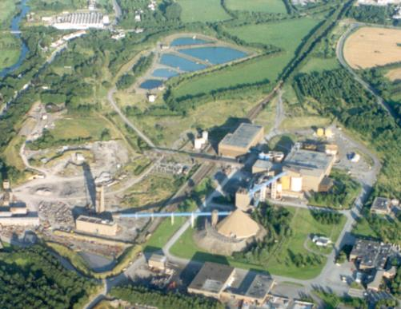
Navan
Lisheen
Galmoy
Irish Type Zn-Pb Deposits
What Are They and Can We Find More?
John H. Ashton¹, Colin J. Andrew² & Murray W. Hitzman³
¹Indpendent Consultant, Dingle, County Kerry, (jhashton@hotmail.com), ²Independent Consultant, Navan, County Meath, ³iCRAG - SFI Research Centre in Applied Geosciences, UCD School of Earth Sciences, Dublin.
“A review 50+ years of knowledge, with focus on some key areas to initiate discussion and generate new ideas for exploration and research needed into the next decades”

Slide 2
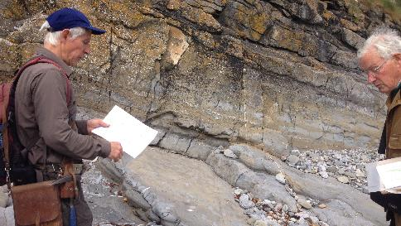
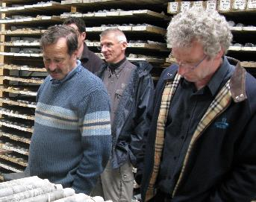
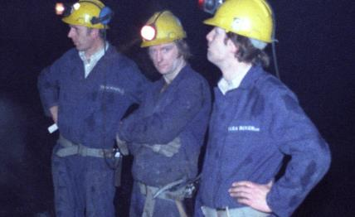
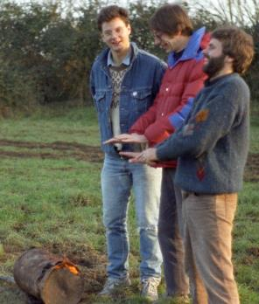
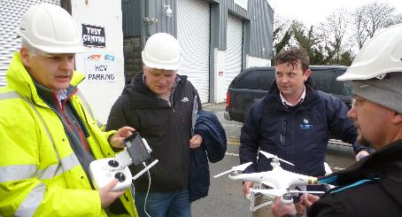
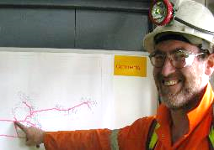
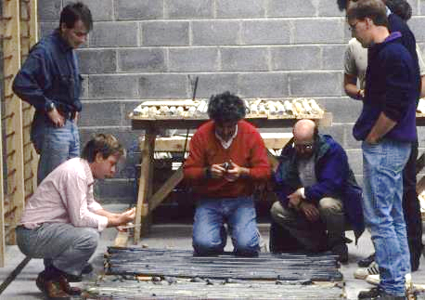
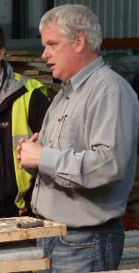
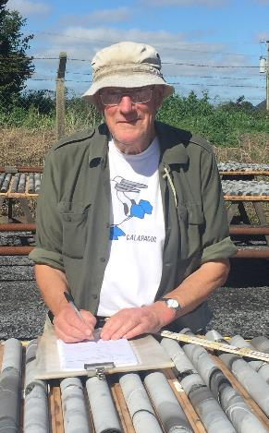


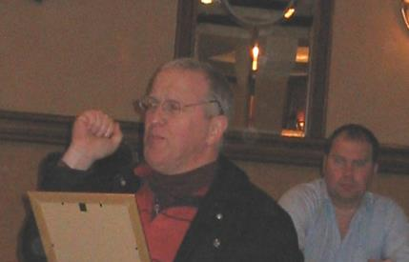
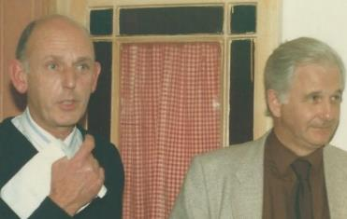

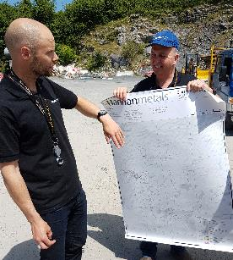

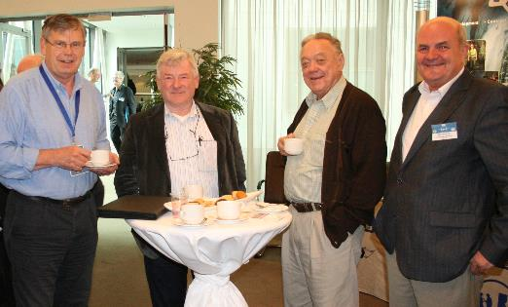
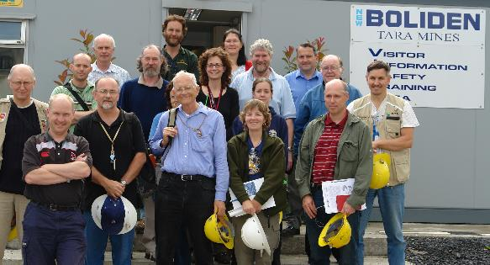
ACKNOWLEDGEMENTS

Slide 3

Irish Type Zn-Pb Deposits
What Are They and Can We Find More ?
- Background
- What Are IT Deposits ?
(+ focus on Regional Location, - laboratory studies)
- Exploration Recommendations

Slide 4
IT Deposits – Discovery Timeline
1950s Financial conditons right Abbeytown / Shallee / Magcobar
1962 - Tynagh Discovered Keel
1963 - Silvermines, Gortdrum Discovered
1970 - Navan, Ballinalack
1972 - Tatestown
1973 - IAEG Founded
1975 - Harberton Bridge
1984 - IAEG Conference GGMDI
1986 - Galmoy Discovered
1990 - Lisheen Discovered
1996 - Navan - SWEX
2002 - Pallas Green
2007 - Stonepark
2008 - Kilbricken
2012 - Navan - Tara Deep
Effect of Irish Expats
Elephant Country Confirmed
The Orefield matures
Discoveries below cover
A volcanic link ?
Use of seismics
2023 – IAEG 60 YEARS OF IRISH-TYPE Zn-Pb DEPOSITS FURTHER DISCOVERY?

Slide 5
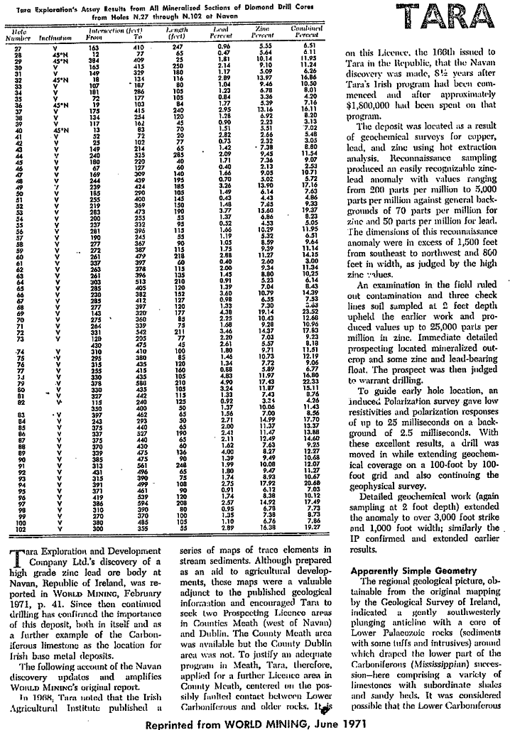
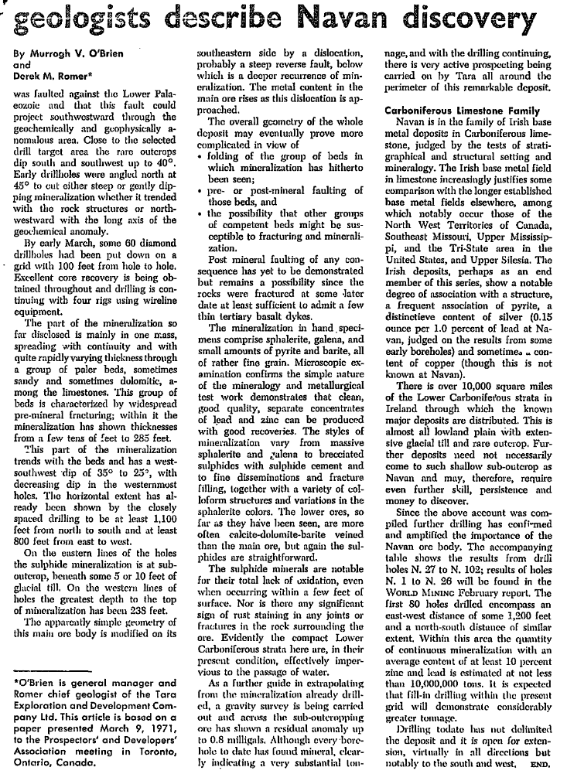

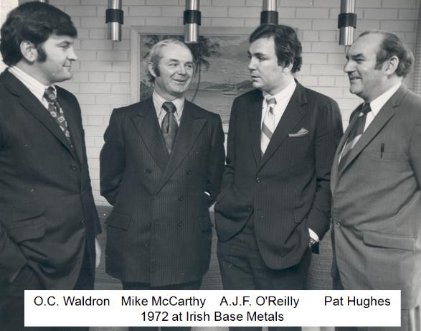
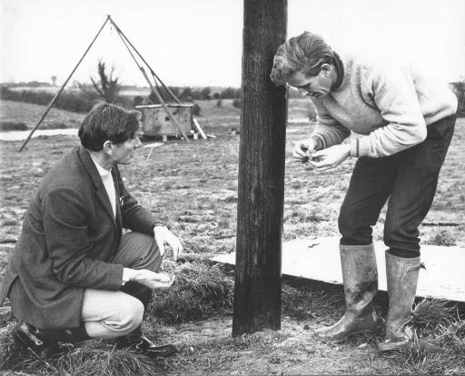
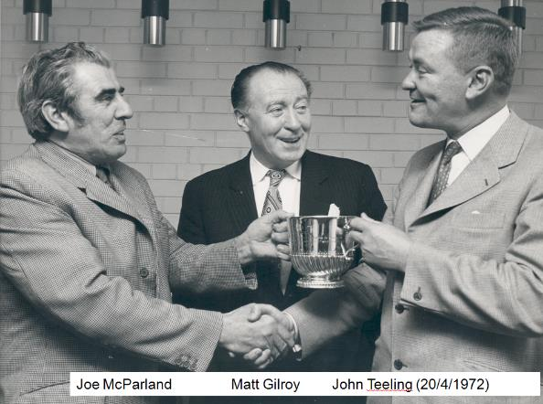
World Mining June 1971
Murrogh OBrien & Mike Robinson

Slide 6
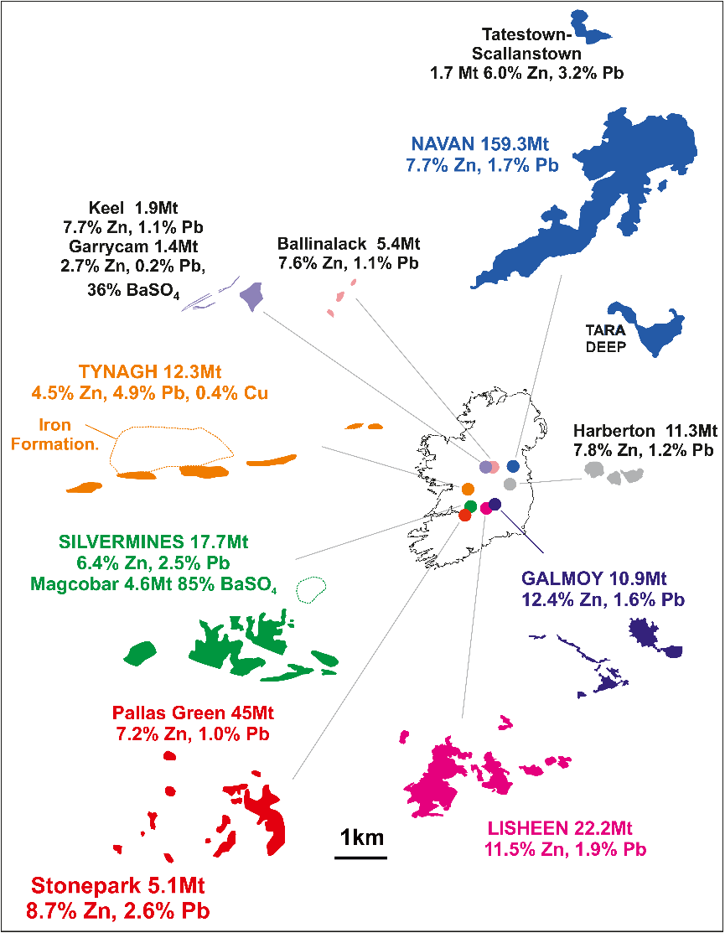
Footprints of Larger
IT Deposits
Footprints and approximate sizes of the larger IT deposits. The deposits are shown in their approximate relative geographical positions (unscaled) with 1km scale bar applying to each deposit.

Slide 7
Social, Environmental & Economic Assessment of Galmoy & Lisheen
Report by AECOM for Department of Communications, Climate Action and Environment, 2020
Navan in 2013 (presentation to IMQS in 2014)
Contributing to Navan and Irish economy since early 70s.
~ 600 employees + >100 contractors. Multiplier of 2.5; ~ 2000 jobs?
Wages & salaries ~ €65mpa, approx €35-40m into local economy
+ ~ € 25m on local goods/services. ~ € 20m energy costs.
Net Sales €178.6 million. 297,944t Zn Conc. 38,604t Pb Conc .

Slide 8
Irish Type Zn-Pb Deposits - What Are They ?

Slide 9
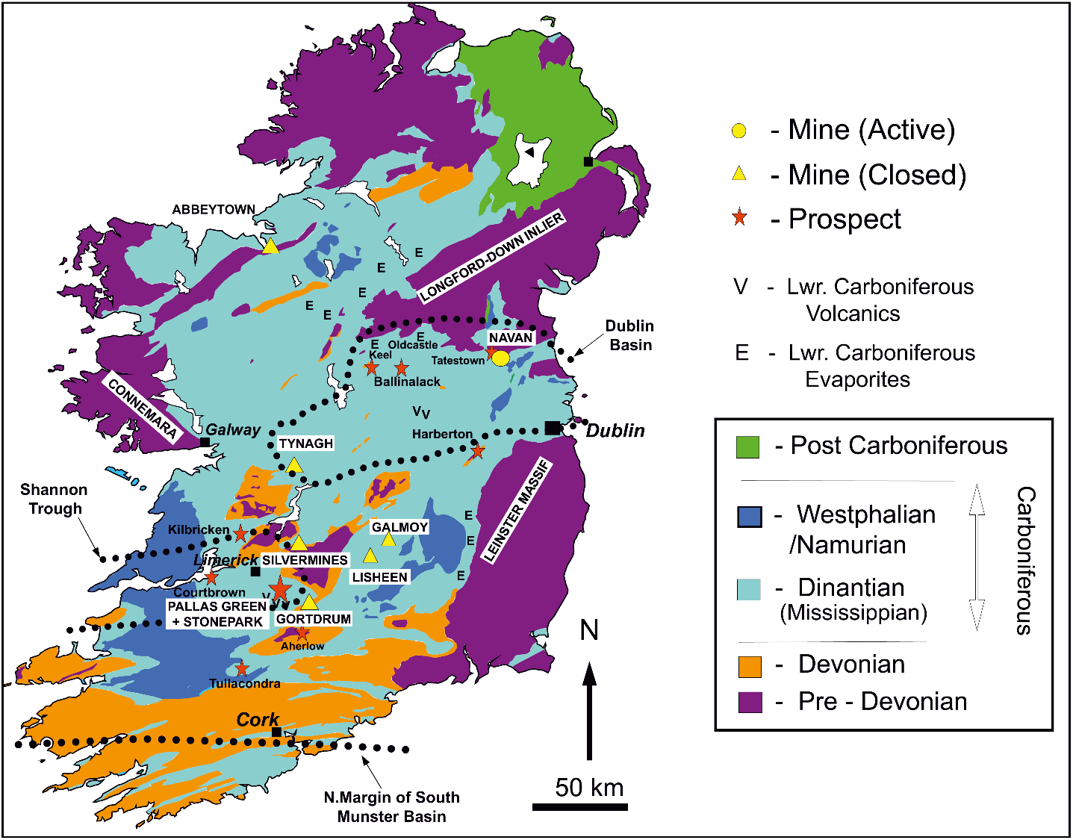
Geology of Ireland
+ Carbonate-Hosted ‘IT’
Zn-Pb Deposits
Central Irish
Orefield
After the Geological Survey of Ireland.
Approx Carboniferous basin locations
after Strogen et al. (1996).

Slide 10
Simplified Lower Carboniferous Stratigraphy of Central Ireland
SW
NE
Navan
Boulder
Conglomerate
Waulsortian Limestones
Pale Beds
after Andrew, this volume

Slide 11
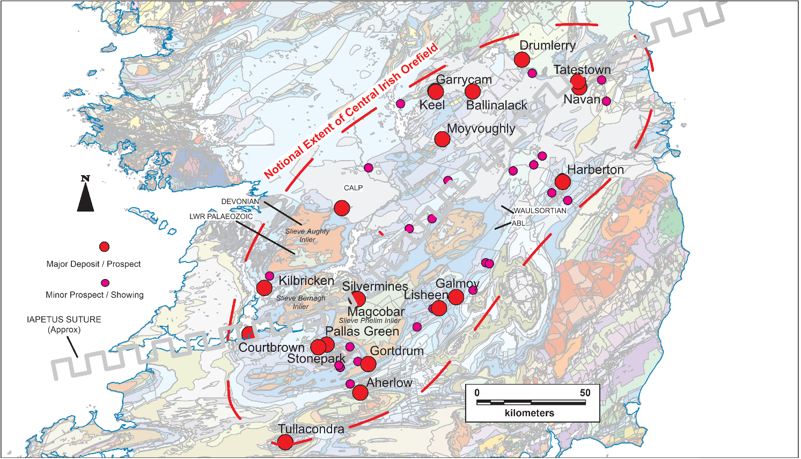
Approx Extent of Irish Central Midlands Orefield
PALE BEDS
HOSTED
Tynagh
KILDARE MVT?
SUB-GROUP
WAULSORTIAN
HOSTED
Cu - RICH
SUB-GROUP
Central Irish Orefield with deposits showing notional outline of Orefield, mines, major and minor prospects, and the location of the Iapetus Suture. Note that Abbeytown is further north and off the diagram. The background geological map is after the Geological Survey of Ireland.

Slide 12
Total Sizes of Some Irish-Type Zn-Pb (Ag, Cu, Ba) Deposits
ECONOMIC
Host Rocks:
- Waulsortian Limestones
- Pale Beds (part of Navan Group)
Approximate total sizes of Lower Carboniferous hosted base metal deposits in Ireland. (Diverse sources, sizes and grades are approximate and where possible include ore extracted to give a geological indication of total size, consequently this data should not be regarded as JORC or NI43-101 compliant). Navan figure comprises total production plus resources at end 2022 and includes Tara Deep. Abbreviations: WAL- Waulsortian limestones, PB, Pale Beds, BC - Boulder Conglom-erate, ABL - Argillaceous Bioclastic Limestones, BAS/BCL - Basal Clastics.

Slide 13
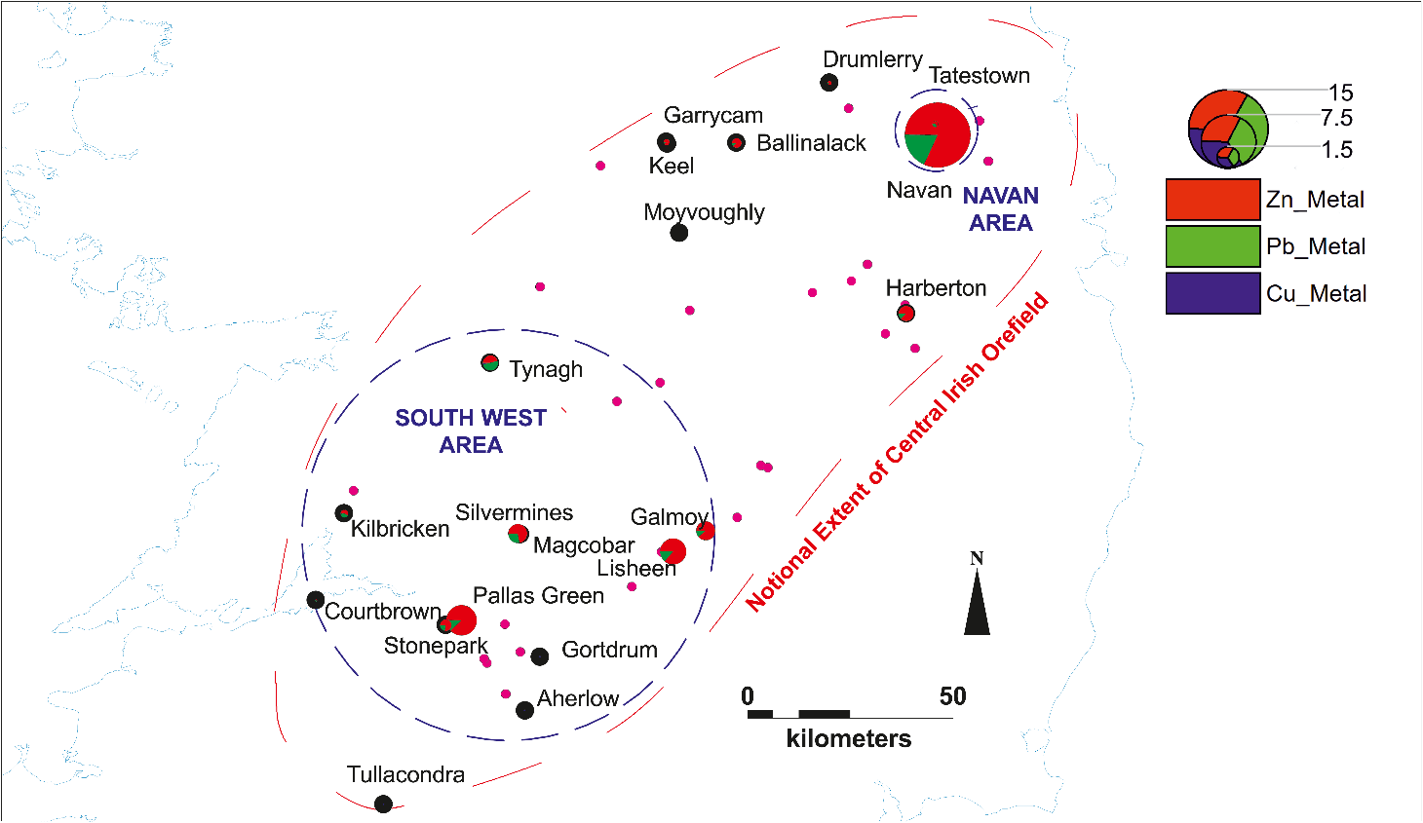
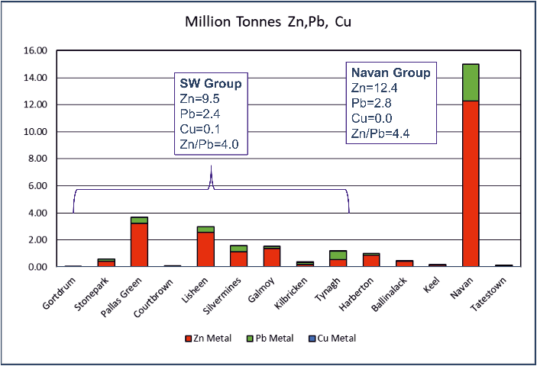
Metal Content of IT Deposits
NE AREA
Economic Deposits Metal
Content RESTRICTED?
to 2 Areas ??? !!!!
SW AREA
Central Irish Orefield showing deposits but with graphical representation of total Zn, Pb, Cu metal tonnes (Mt) as pies.

Slide 14
IT Deposits – At their Simplest – Cartoon Section
Mineralogically simple, texturally complex Pyrite/barite/dolomite gangue
Sphalerite, galena ores (Ag, Cu) local barite
Navan is more complex
but broadly comparable
Syndepositionally active
Normal Fault (local)
Significant but variable
hydrothermal dolomitization
Limestones varying from shelf to basinal, Some chert, regional dolomitization in SE
Lower
Carboniferous
Significant brecciation
sedimentary to hydrothermal
Usually minor, early silica-haematite – ‘iron formation’
Host rocks are clean, pale limestones. (Often micrites but also grainstones e.g. Navan)
+/- Higher temp + cross-cutting mineral
Argillaceous Limestones,
Basal Clastics, Red Beds
Lower
Palaeozoic
Base Carboniferous
Regional Unconformity
? ?
Greywackes, siltstones, mudstones,
volcanics localized intrusives/granites
Major Regional
Caledonian Fault Zone

Slide 15
Paleogeographic Maps (after Hitzman, 1995)
N - Navan; B - Ballinalack; K - Keel/Garrycam; T - Tynagh; S - Silvermines; G - Galmoy; L - Lisheen.

Slide 16
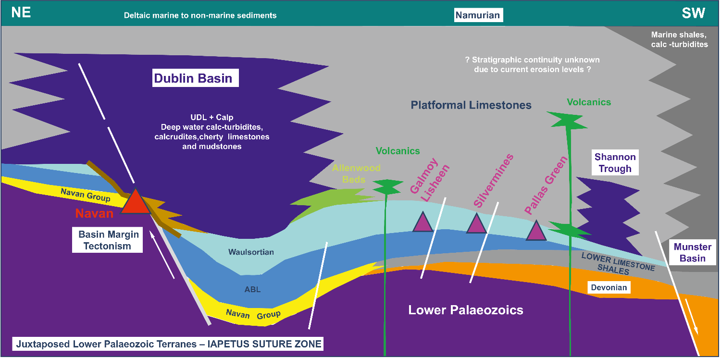
Cartoon Showing Simplified Stratigraphic
Relationships in Central Ireland (Pre-Inversion)
Cartoon section from NE to SW through the Central Irish Orefield showing stratigraphical relations and location of mineralization. The stratigraphic relationships are greatly simplified and diagrammatic

Slide 17
Favourable Host Rocks
Pale clean limestones/dolomitized limestones
Pure limestones chemically reactive
Low competency/strength
NOT so homogenous . .
  - Sedimentary structures, channeling
  - Shale layers, stromotactis textures
  - Emersion surfaces,
  - Sedimentary breccias,
  - Remnant porosity,
  - Syn-sedimentary+early faulting
Waulsortian Limestone (micrite) Limerick
THEREFORE:
Susceptible to creation of fracture permeability, dissolution, hydrothermal alteration, dolomitization, brecciation, replacement
Breccias are a key component of all economic IT Deposits sedimentary breccias, fault talus breccias, debris flows, dolomite breccias = black matrix breccias clearly a prime mechanism for creating and maintaining permeability and a focus for sulphide and gangue deposition
Pale Beds birdseye micrite, Navan

Slide 18
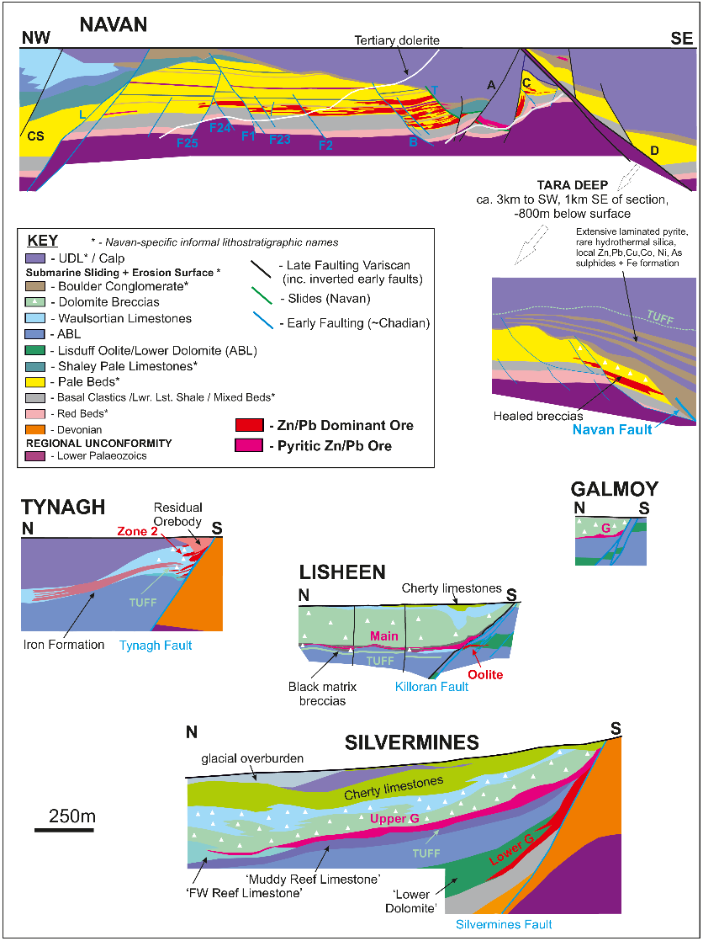
Sections Across Larger
IT Deposit: BRECCIAS
Debris Flow and Fault Talus Breccias
BOULDER CONGLOMERATE
Healed Breccias in Pale Beds
Related to Early Faulting?
Extensive Dolomite Breccias
+ Hydrothermal
‘Black Matrix Breccias’
Fault-Related
Breccias
Sedimentary Breccias
fault talus/debris flows

Slide 19
Breccia Examples
Debris flow breccias, B Zone Silvermines
Debris flow breccias, B Zone Silvermines
Fine PbS/Zns matrix of Waulsortian limestone breccias (undolomitized) - B Zone, Silvermines
Origin disputed by some workers

Slide 20
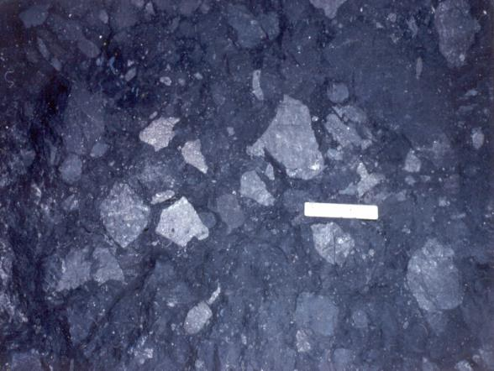
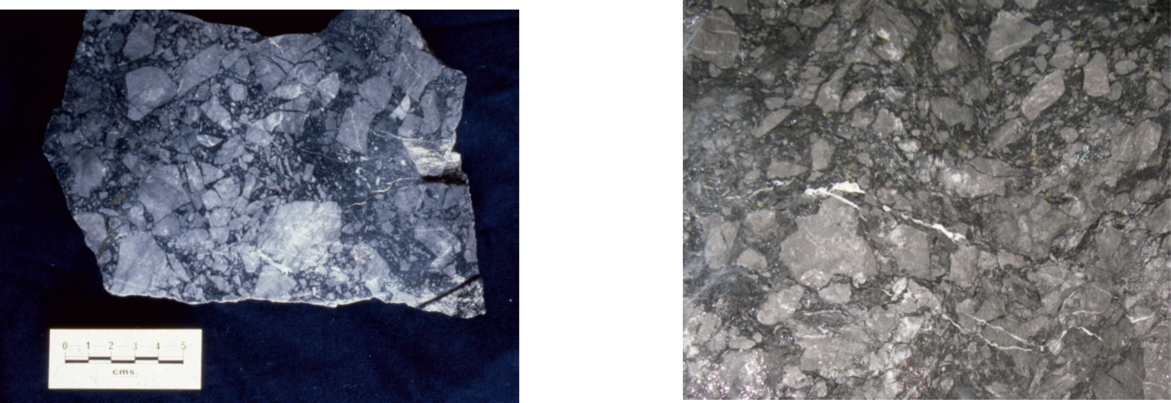
Breccias
‘Healed’ breccias in Pale Beds, Navan
Boulder Conglomerate, Navan
Dolomite Breccia
Magcobar
Silvermines
Black Matrix Breccia – Dolomite Breccia
Lisheen

Slide 21
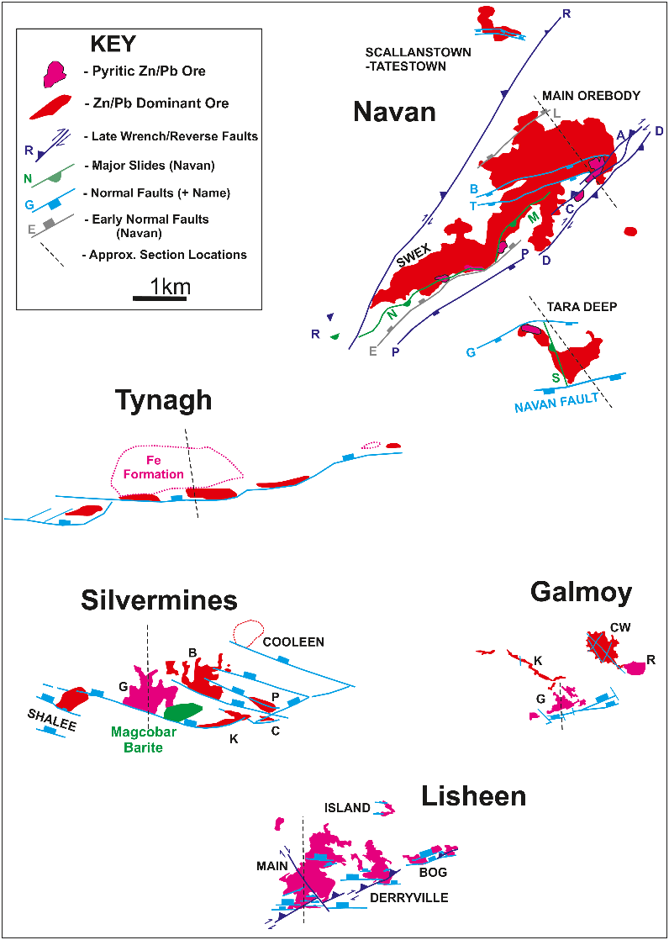
Footprints of Larger
IT Deposits: FAULTING
Normal faults initiated during
growth of ABL and Waulsortian
NOT ‘upwardly constrained
due to erosion levels’
Typically oriented with clockwise strikes to
main NE-ENE Caledonide trends
N
Significant dextral-reverse inversion
on existing structures
(measured at Lisheen)
Summary plans of main deposits showing principal ore zones and faults. Data sources: Tynagh - Clifford et al. (1986); Silvermines – Andrew (1986), Kyne et al. (2018); Navan - Ashton et al. (2015) and Ashton et al. (2018); Galmoy - Lowther et al. (2003); Lisheen – Hitzman et al. (2002); and Kyne et al. (2018).

Slide 22
Sections Across Larger
IT Deposit: FAULTS
Major dextral-reverse inversion
on existing structures that
DISPLACES ORE
Pre-Arundian normal faults truncated
by Chadian sliding + erosion Surface
(~SYN-MINERAL AGE)
Normal faults initiated during
growth of ABL and Waulsortian
NOT ‘upwardly constrained
due to erosion levels’
Ore deposits at points of Max. Throw.
Significant dextral-reverse inversion
on existing structures
(measured at Lisheen)

Slide 23
Local Fault Control = Dominant control on localization of IT deposits
Feeder mineralization at Silvermines (Lwr. G + K Zones in ABL, veining in ORS).
Oolite Zone in FW ABL and high temp mineralogy near faults at Lisheen.
Metal distribution studies demonstrate correlation with faults/fractures.
Relay ramps, breached relays – mechanisms for fluid flow along/up structural zones.
Upwards stratigraphic range of faults is unclear (exploration implications).
At Navan low angle slides degrade a particularly large normal fault and overlain by
debris flow and talus breccias known as ‘Boulder Conglomerate)
Breached Relay Ramp Model
after Kyne et al 2019

Slide 24
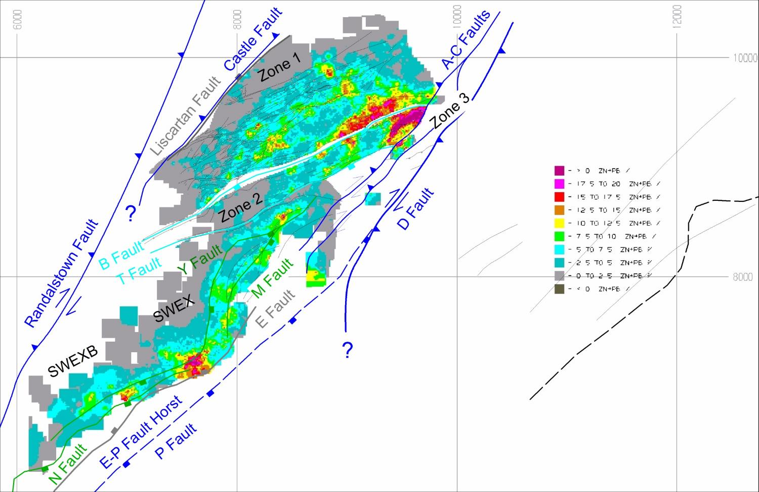
Early NW Fault
Late Inverted Faults
RELAY RAMP ?
SLIDES
FW AREA OF MAJOR SE DIPPING
NORMAL FAULT
SLIDES
Early NW Fault
Zn+Pb Metal Distribution, 5, Lens, U Lens, NAVAN
Relay Ramp Interpretation after D. Coller
Notes:
Zn+Pb 5 lens 3-U Lens and CGO
SWEX broad trend with hotspots

Slide 25
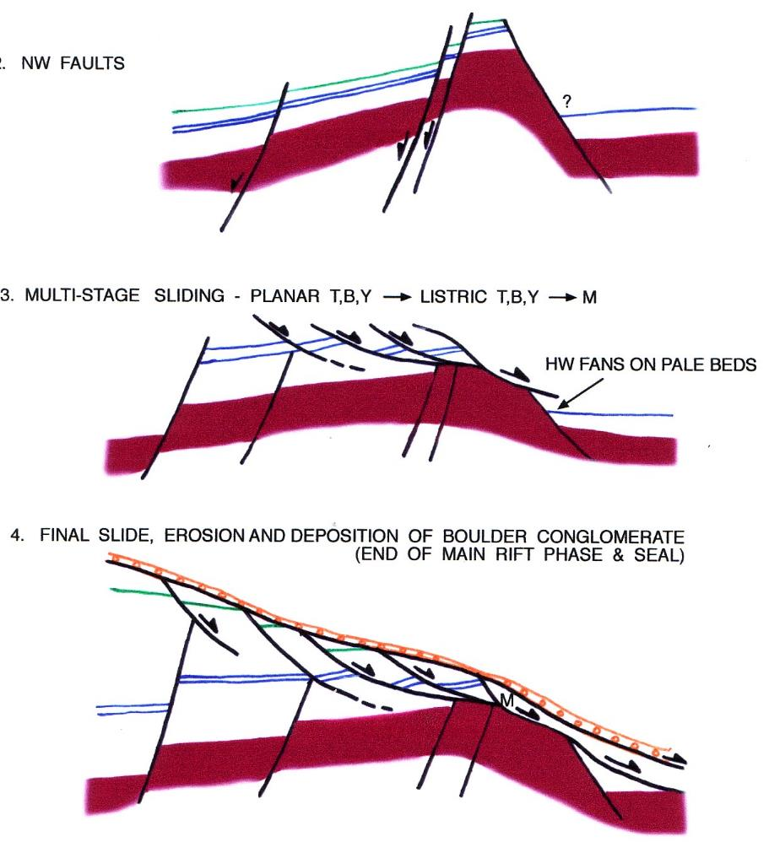
Simplified Extensional Fault Sequence at Navan
(A.Beach, D.Coller, unpublished)
Early Fault Ramp
Uncertain here
Major NW facing faults
L
E
Polarity switch to
major SE faulting, sliding
& foot-wall degradation
E
D
MAJOR SE DIPPING
NORMAL FAULT
End stage footwall
degradation of tilt block
E
Notes:
So to summarise the main rift stages at Navan
NW facing fault relay
Polarity switch and major tilt block, major fracture permeability generated
Erosion of footwall and deposition of conglomerate

Slide 26
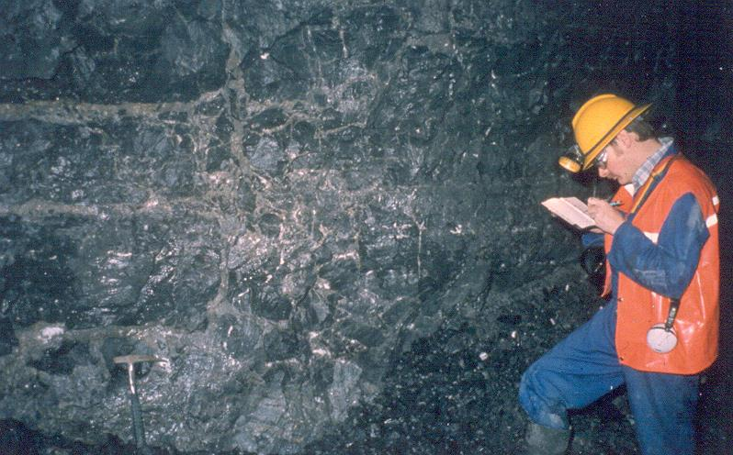
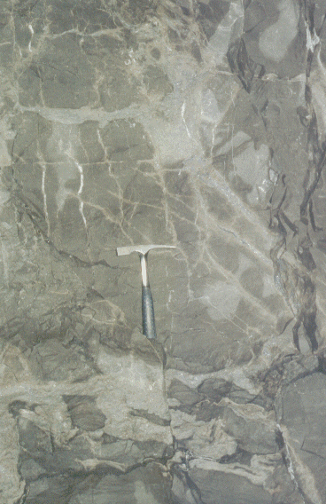
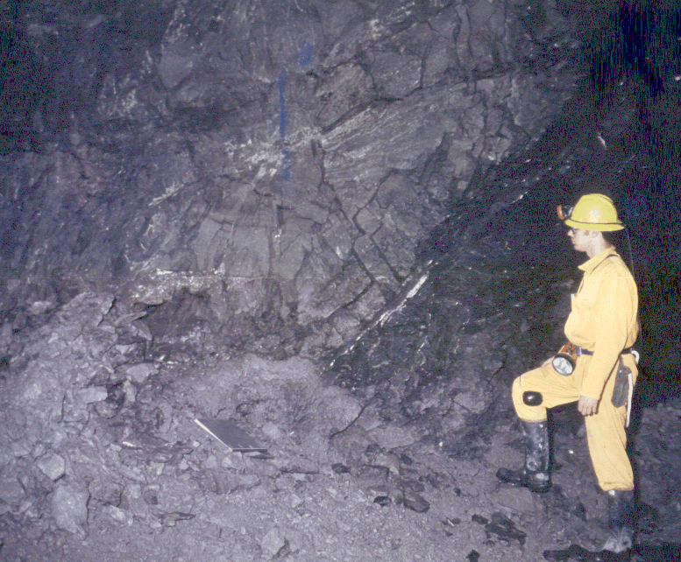
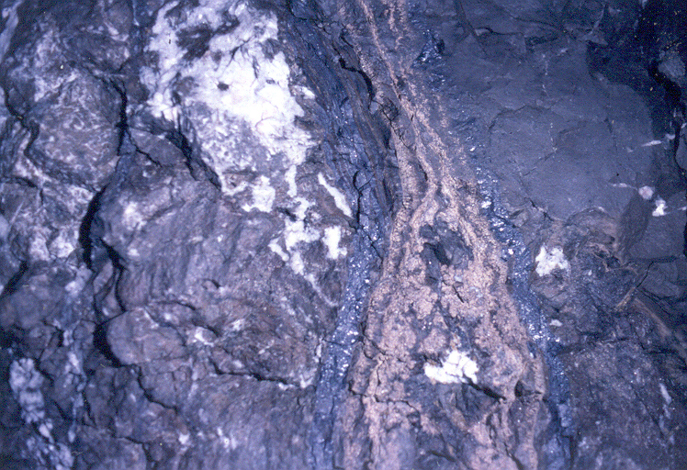
Ore Textures in Pale Beds, Navan – Cross-Cutting
widespread, intense, episodic and variable phases of NE-ENE trending fracture-controlled mineralization
coarse sulphides exhibit heavy δ³⁴S
can be dominant ore-type close to some major faulting
B Fault Plane, Navan
Notes:
How did fluids get in
various veins, mineralized extension features and breccia zones
trending NE and ENE

Slide 27
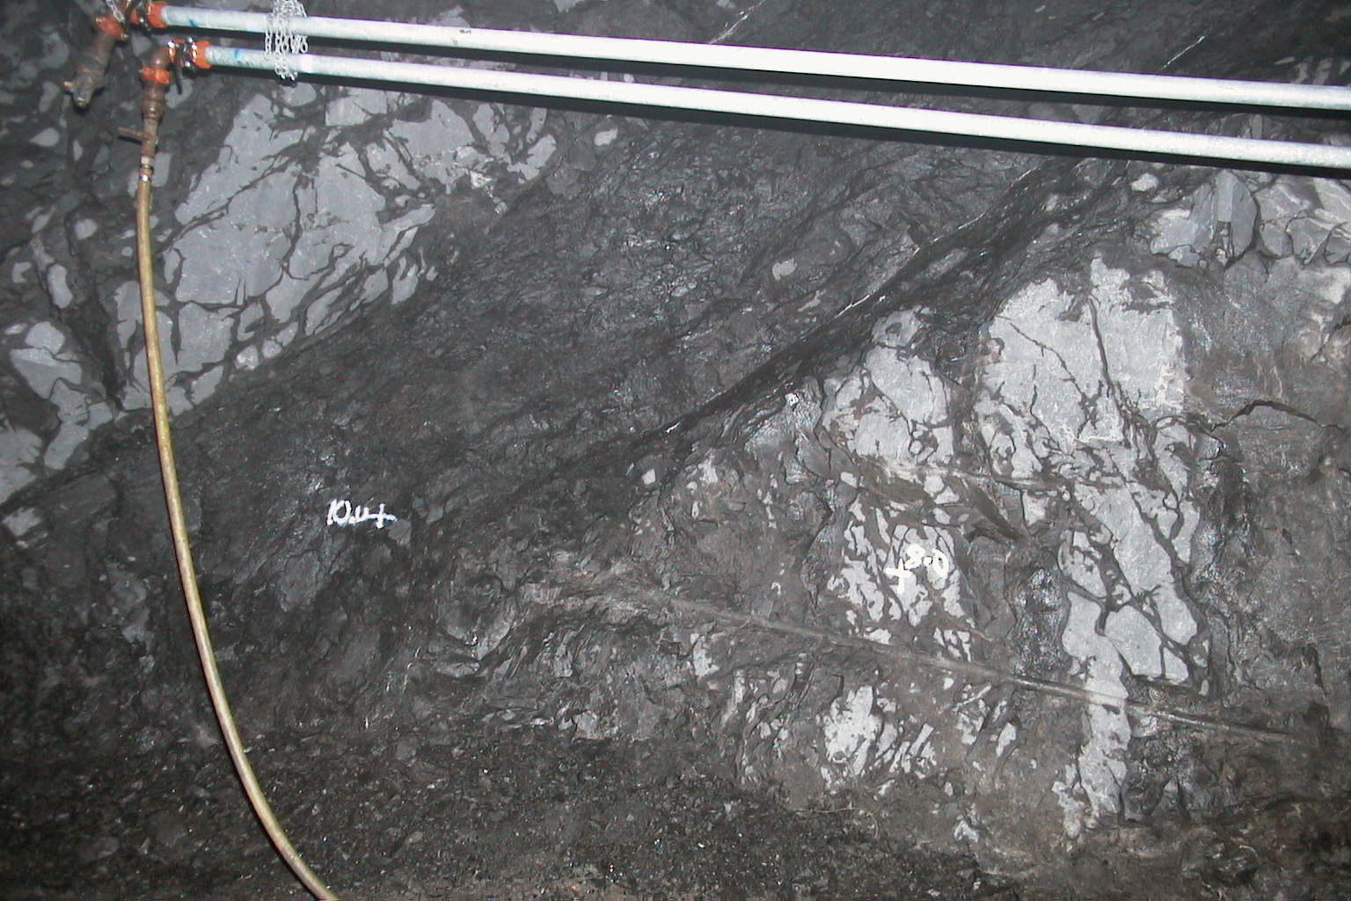
Faults - Slides Navan –Timing in Relation to Mineralization?
M Fault Slide 1020 Level, Looking SW

Slide 28
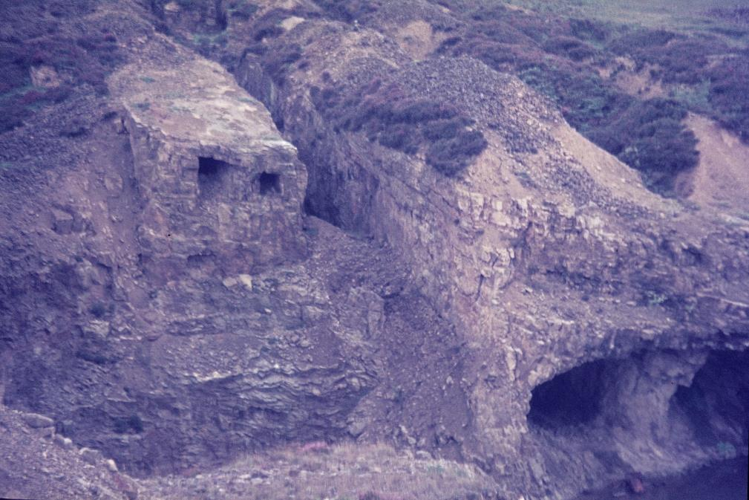
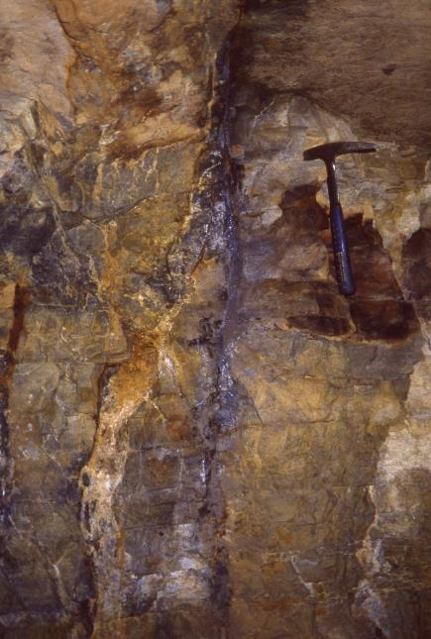
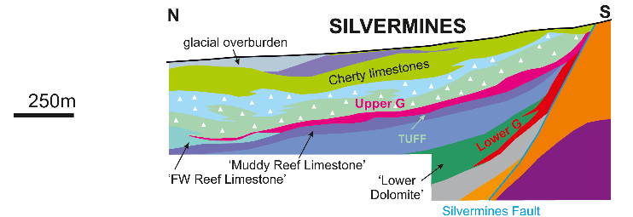
Faults – Mineralization in FW rocks Shallee, Silvermines
Old Vein workings Shallee Silvermines
(PbS in Devonian sdst)
PbSVeins Shallee

Slide 29
Footprints of Larger
IT Deposits
MINERALIZATION
Relatively small lenses of massive ZnS/PbS in Massive Pyrite within Boulder Conglomerate ‘CGO’
N
PRINCIPALLY ZnS-PbS Zn:Pb 5:1
in limestone/dolomite ‘PBO’
(variable barite-pyrite)
PRINCIPALLY: ZnS-PbS Zn:Pb 5:1
in Massive – Semi Massive Pyrite +/- Dolomite Breccias
Some lenses are less pyritic and have barite/siderite/dolomite /limestone gangue.
(Tynagh, Silvermines G Lower/K/B/Magcobar, Galmoy: K, CW)

Slide 30
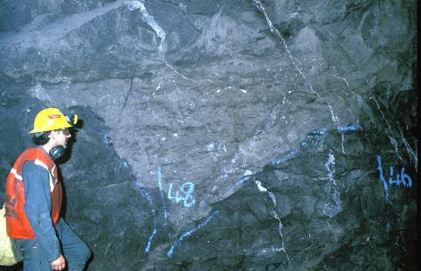
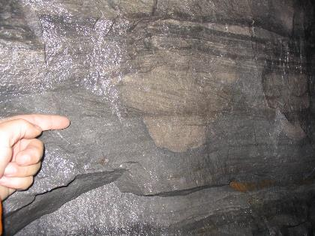
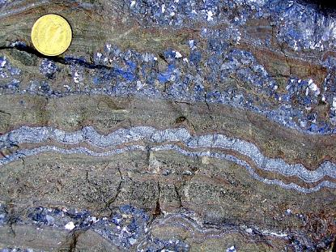
PALE BEDS ORE, NAVAN
PALE BEDS ORE (Low Fe)
CONGLOMERATE GROUP ORE (High Fe)
NW
SE
Mineralogically simple, ZnS/PbS 4:1, variable, mostly low pyrite, Ag sulphosalts, variable barite/dolomite. Texturally complex.
Notes:
Describe PBO, Simple mineralogy, complex textures. Extension veining, replacement, open space fill.

Slide 31
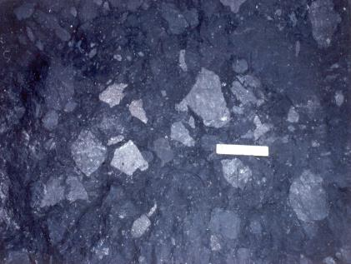
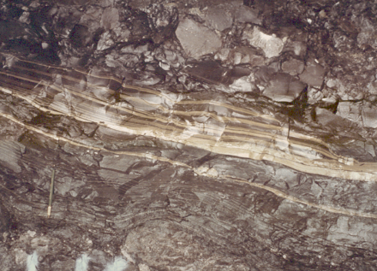
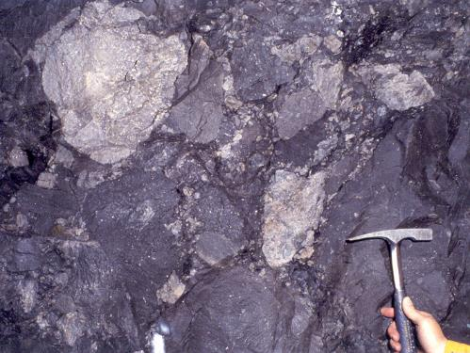
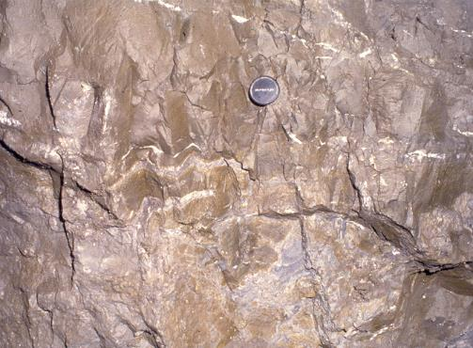
NW
debris-flow conglomerate
framboidal pyrite layers
clast deforming lam pyrite
CONGLOMERATE
GROUP ORE
PALE BEDS ORE
massive Fe(Zn/Pb) sulphide
massive Fe(Zn/Pb) sulphide (laminated& layered)
clasts of Zn/Pb sulphide
ZnS/PbS 4:1, Mostly massive pyritic sulphides, abundant framboidal pyrite (light δ³⁴S)
Notes:
Conglomerate / framboidal py / clasts of mineralized Pale Beds / massive sulphide

Slide 32
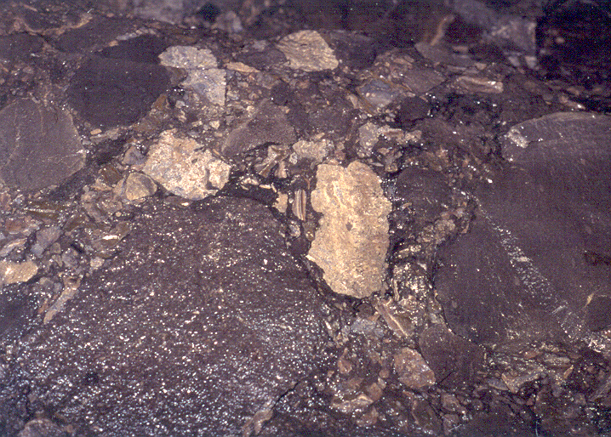
Boulder conglomerate and Sulphide Clasts (Zone 2), Navan
(Field of view ca0.5m)

Slide 33
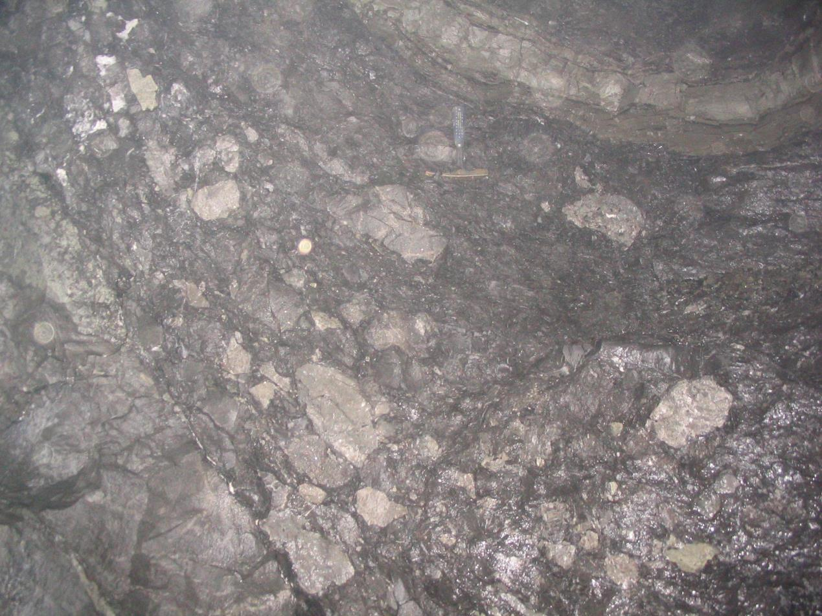
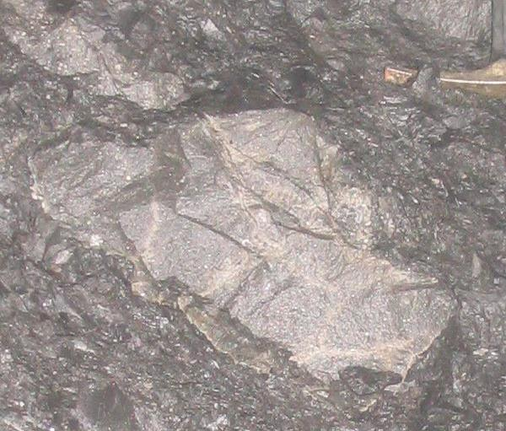
3-U Lens Sulphide Clasts in Boulder Conglomerate (Navan, SWEX)
BC
PYRITE
M Fault
3-U Lens

Slide 34



Laminated Framboidal Pyrite in Boulder Conglomerate, Navan
isotopically light δ³⁴S from bacteriogenic reduction of Lower Carboniferous Seawater
Notes:
Framboidal laminae deformed by clasts
Near sea-floor generation of pyrite and reduction of sulphur

Slide 35


Stratiform Fine Grained ZnS/PbS
in TBU (basal UDL)
Zone 3, Navan
Notes:
Banded sulpides in UDL
Mineralization still going on

Slide 36
Ore Textures – SW Deposits
Massive pyritic sulphides overlying sheared ABL
Lisheen
Massive pyritic sulphides in
dolomite breccias Pallas Green

Slide 37

Ore Textures
Massive Pyritic Sulphides
Upper G Silvermines
Roll in FW of B Zone, Silvermines, massive siderite
with ZnS above cherty ABL with ZnS
Fine PbS-ZnS forming matrix of undolomitized
Waulortian limestone breccia. B Zone, Silvermines

Slide 38


Ore Textures
ZnS in spar-filled vughs – Lower Dolomite (ABL)
K Zone Silvermines
Massive barite - Magcobar, Silvermines
Spahlerite replacing dolomite Lisheen

Slide 39


Hydrothermal Fauna (?) from Silvermines and Tynagh
Boyce et al, 2003
Larter et al, 1981

Slide 40

Silvermines stratiform B Zone Ore Horizon (Taylor, 1984)
Palaeo-bathymetric setting of siderite/pyrite/barite Zn/Pb ?

Slide 41
Sections Across Larger
IT Deposit: Fe Formation
Very approx. locations!
Navan examples at BC and base UDL
Waulsortian-hosed elsewhere
Some occurrences at distal locations
Others with no systematic distribution
Tynagh Iron Formation
Stratiform Haematite-Magnetite
Distal from Zn-Pb ore
Cruise, (2000) interpreted the ‘Iron Formation’ to be of early diagenetic origin in very shallow carbonate sediments pre-dating sulphides and hydrothermal

Slide 42
Silica-Haematite +/- Magnetite (Fe Formation)
Tynagh Iron Formation
Tynagh Iron Formation
Silica Haematite Nodule in Waulsortian Limestone
Breccia, B Zone, Silvermines
Silica Haematite Overlying fine grained ZnS
Top of ABL G Zone, Silvermines

Slide 43


Silica-Haematite +/- Magnetite (Fe Formation)
Silica Haematite Nodule in Waulsortian Limestone
Breccia, Lisheen
Silica Haematite Navan,
near Boulder Conglomerate-UDL contact
Silica Haematite Navan,
at Massive Pyrite CGO – UDL contact
Silica Haematite Navan,
In deformed basal UDL

Slide 44
Sections Across Larger
IT Deposit: Dolomite
Locally complete but mostly
partial dolomitization
of oolites and grainstone host rocks
To Pale Beds Mineralization
Massive dolomitized sandy oolites/
Siltstones form ‘impermeable’ HWs
to ore bands (locally ‘breached by
mineralized breccias/veins’)
Dolomite Breccias In
HW of Stratiform
Ore Lenses
Massive dolomite forms compact
HWs to some ore lenses

Slide 45
Genetic Model – (Fluid Mixing)
Extensive Pb - S isotope, fluid inclusion, studies etc indicate that sulphides precipitated by mixing of:
+
Sulphur in ‘local’ fluids sourced from bacteriogenic reduction of Lwr. Carboniferous seawater.
Rising hydrothermal fluids with
metal sourced from basement.
Cyclical, structurally active system, brecciation, replacement of host-rock
and open-space fill.
Cartoon Genetic Model LOCAL SCALE<10km
LOCAL LEVEL
Sea Level
Syn-sedimentary faulting creates palaeo-bathymetry and brecciation
Enhanced salinity brines migrate through shallow fractured, permeable carbonates cause dolomitization and/or collect in seafloor depressions
Brittle chemically reactive carbonate
Bacteriogenic reduction of seawater sulphate generates reduced sulphur reservoir, in seafloor depression and/or permeable carbonates
500m - 1000m
Shaley Limestones
BASE CARBONIFEROUS
Sulphide deposition in permeable carbonate trap due to episodic fluid mixing
Structurally controlled
discordant mineralization
Pulses of metal-rich hydrothermal fluids breach sealed fault system during on-going extension and fluid supply from depth
Heterogenous Lower Palaeozoic
greywackes, volcanics and intrusives. Caledonian fracturing/folding/cleavage
* Amongst others: Coomer & Robinson, 1976; Boast et al., 1981; Caulfield et al., 1986; O’Keeffe, 1986; Le Huray et al., 1987; Dixon et al., 1990; Hitzman & Beaty, 1996Anderson et al., 1998; Everett et al. 2003; Wilkinson et al., 2005; Wilkinson, 2014; Hollis et al., 2019).

Slide 46
Irish Type Zn-Pb Deposits - ALTERNATIVE TIMINGS
Early Timing - ‘Syn-Diagenetic Model’ (deposits form near seafloor, Courceyan to early Arundian)
Fossil Vents/Fauna that sea-floor exhalative (Silvermines, Tynagh).
Iron Formation - a likely indicator of exhalative Fe mineralization.
Contemporaneous faulting.
Palaeo-bathymetric Waulsortian mudbank redox control of major gangue mineralogy
(barite-pyrite-siderite zones) Silvermines. Cryptocrystalline barite at Magcobar.
Dislocated sulphide clasts in BC (Navan) indicates some mineralization c.a. Chadian.
Deformed soft-sediment appearance of sulphides layers + veins at Navan.
Abundant laminated framboidal pyrite with minor ZnS + hydrothermal cherts.
Late Timing - ‘Burial Model’ (significant burial, Post Chadian to Asbian?)
Carbonate-sulphide-stylolite cement histories indicate significant burial.
Breccia and sulphides deposition in large cavity systems (‘hydrothermal karsting’).
Geochronology suggests post Courceyan and even Asbian age mineralization.
Considerable peer-reviewed publications support either view
Agreement on Lower Carboniferous age
Exploration-wise the former model is easier to conceptualize
A burial model permits targeting of younger rocks in theory . .

Slide 47
Navan Structural Development
Not scaled but sections are approximately 6 km long.
COURCEYAN
Early Extension, FW Uplift, Tilt Block
M
TD
FW Degradation slides start
SW
M
SW
FW Major Sliding
TD
M
On Going Faulting
SW
TD
CHADIAN - ARUNDIAN ……
LONG LIVED EXTENSIONAL SYSTEM
Inversion (END CARBONIFEROUS ?)
M
SW
Ashton et al. (2015) incorporating work by A.Beach, D.Coller and M.Philcox
TD
M – Main SW- SWEX TD - Tara Deep Mineralization

Slide 48
Irish Type Zn-Pb Deposits
Is there an Unrecognized Regional Basement Control?

Slide 49
Metal Content of IT Deposits
NE AREA
Economic Deposits Metal
Content RESTRICTED?
to 2 Areas ??? !!!!
SW AREA
Central Irish Orefield showing deposits but with graphical representation of total Zn, Pb, Cu metal tonnes (Mt) as pies.

Slide 50
Pre-Carboniferous
Basement Terranes
(after Long, 2003*)
ABBEYTOWN
Keel
Ballinalack
NAVAN
Harberton
IAPETUS SUTURE ZONE
TYNAGH
SILVERMINES
GALMOY
PALLAS GREEN
+ STONEPARK
LISHEEN
GORTDRUM
* Long, B. (2003).
Irelands Vanished Ocean.
ES2k Newsletter
Spring 2003 Issue 7, 7-9.

Slide 51
Iapetus Suture – Convergence in Ordovician ?
Phillips, W.E.A., Stillman, C. J. & Murphy, T., (1976) A Caledonian plate tectonic model. Journal of the Geological Society, London, v.132, p. 579 - 609.

Slide 52
Iapetus Suture – Convergence in Ordovician ?
McConnell, B., Riggs, N. & Fritschle, T. (2020) Tectonic history across the Iapetus suture zone in Ireland. In: Murphy, J. B., Strachan, R. A. and Quesada, C. (eds.). Pannotia to Pangaea: Neoproterozoic and Paleozoic Orogenic Cycles in the Circum-Atlantic Region. Geological Society, London, Special Publication. 503. 333–345.

Slide 53


Iapetus Suture – Convergence
Chew, D.M. & Stillman, C. (2009). Late Caledonian Orogeny and magmatism In: The Geology of Ireland. Holland, C.H. and Sanders, I. (2009). (Eds.). Dunedin Academic Press, 143-173.
NAVAN

Slide 54
Iapetus Suture in N.England ?
Chadwick, R.A. & Holliday, D.W. (1991). Deep crustal structure and Carboniferous basin development within the Iapetus convergence zone, northern England. Journal Geol. Soc. London, v.148, 41-53.

Slide 55
Iapetus Suture - Western Ireland ?
Klemperer, S.L., Ryan, P.D., & Snyder, D.B. (1991). A deep seismic reflection transect across the Irish Caledonides. Journal of the Geolog-ical Society, London. 148, 149-164.

Slide 56
Residual Gravity
Data courtesy of Dublin Institute of Advanced Studies and re-processed by B.O’Donovan. T-Tynagh, S-Silvermines, N–Navan, G-Galmoy, L-Lisheen, GT-Gortdrum, P-Pallas Green, SP-Stonepark, H-Harberton, K–Keel, B-Ballinalack, KB-Kilbricken).
IAPETUS SUTURE ZONE
Aeromagnetics
RTP
Huntings aeromagnetic data set courtesy of Geological Survey of Ireland and re-processed by B.O’Donovan. The 1;500.000 fault data set of the Geological Survey of Ireland is also included
IAPETUS SUTURE ZONE

Slide 57
Various Proposals on Iapetus Suture Location
in Relation to IT Deposits
Could Bends on the Suture Have
Caused Enahced Permeability
+Metal Fertility of the Basement ?
Grampian Terrane
Midland Valley Terrane
Deep Caledonide I.S.
Structure Interpretations
Central Terrane
Navan
Phillips et al 1988
Todd et al 1991
Connemara
Terrane
Klemperer et al 1991
Chew and Stillman 2009
Long 2003
SW
Waldron et al 2014
Rao et al 2014
Leinster Terrane
Rosslare Terrane
Note some workers stress the suture zone could be 10s of kms wide. Terrane locations after Chew and Stillman, (2009) and Long (2003).
50km

Slide 58
Pb Isotopes
IT Deposits, prospects and showings and high metal areas superimposed on Pb isotope ratio (Pb208/Pb204) from Hollis et al. (2019). Pb sampled from galenas in wide range of deposits (black). Values range from ca. 36 in NW to 39 in SE.

Slide 59
Did Bends on the Iapetus Suture Localize Economic Zn/Pb ?
SW Area (Tynagh-Silvermines-Lisheen-Galmoy-Pallas):
• Pb isotope ratio data show a perturbation correlating with the SW area.
• Rao et al (2014) using 5 major magneto-telluric profiles noted deep compositional variations along strike near the IS.
• Wilkinson & Hitzman (2015) suggest that the deep structure of the IS and contemporaneous Lower Carboniferous igneous activity at depth may have triggered fluid flow and heating.
• Diminution in size of deposits going to NE from Lisheen to Galmoy and then to Rapla along the Rathdowney Trend.
• Group Eleven suggest that tectonism induced in the IS was an element in defining the ‘Limerick Basin’ mineralizing system.
• The SW area is loosely correlated with several pre-Carboniferous inliers - A developing high during the Courceyan/Chadian ?
NW Area (Navan):
• Navan appears to lie on a major basement terrane boundary with oblique volcanic/aeromagnetic trends intersecting at Navan.
• The buried late Caledonian Kentstown granite,10km SE of Navan, 5x5 km footprint could have controlled mineralization by providing fracture-controlled permeability.
• Navan anti-form represents part of a footwall uplift/degradation complex on the northern side of a regional-scale Courceyan-Chadian major normal fault (4km throw) a basin margin this - Takes a clockwise swing south of Navan, possibly following a line of weakness west of the buried Kentstown granite and Bellewstown inlier.
Both Areas Had Enhanced Vertical Crustal Permeability ?
Further Research and Geophysical Surveys may well allow better understanding of these controls and improve exploration models in Ireland and elsewhere

Slide 60
LOCAL <10km
LOCAL LEVEL
Sea Level
Brittle chemically reactive carbonate
Simplified Cartoon
Showing
Genetic Model
500m - 1000m
Shaley Limestones
BASE CARBONIFEROUS
REGIONAL LEVEL ‘Collection Zone’
REGIONAL >50km
Slow down-flow of dense brines from peri-tidal environments sinking through re-opened Caledonian fracturing under extension
Episodic
fluid
release
Source area comprising fractured, permeable greywackes, and volcanics where hot saline fluids leach metals.
Heterogenous structural and lithological characteristics combine to define a collection zone in root area of major fault, possibly reflecting a complex Caledonian terrane boundaries.
Heat flow from contemporaneous igneous activity.
Lateral flow of heated dense brines at depth leaching metals from Lower Palaeozoic rocks
5-10 km
SLOW fluid pressure buildup, FAST release
INFLOW
LEACHING
Fluids focused along deep seated heterogenous terrane boundaries
ENHANCED HEAT FLOW

Slide 61

Irish Type Zn-Pb Deposits - Exploration Musings
We Have Confidence in Further Discoveries!
- Successful Near - Mine Exploration at Navan
The result of confidence in geological knowledge
- Regional Discovery
Needs confidence, new ideas + enterprise
Depth of Navan suggests a > 2km depth search space
IAEG 50
Surface exploration drilling at Navan - headframes and concentrator infrastructure in far background
Boliden Tara Mines Limited EXPLORATION

Slide 62

WSW
WSW-ENE Dip Section from the Western End of the
SWEX to the Eastern End of the Navan Orebody
ENE
River
Blackwater
SWEX B
South West Extension
Main Orebody
Nevin-stown
Scale Image
Eiffel Tower
(300m)
Zone 3
A Fault
N Fault
Zone 2
T Fault
Y Fault
Zone 3
E Fault
ARUNDIAN
- Upper Dark Limestones
SOUTH-WEST EXTENSION
DRILLING GEOLOGICAL TARGETS
- Boulder Conglomerate
CHADIAN
Erosion Surface
- Shaley Pales
- Pale Beds
- Conglomerate Group Ore
- Fault
COURCEYAN
- Muddy Limestone
500m
- Laminated Beds
- Pale Beds Ore
- Basalt Dyke
- Red Beds
Major Unconformity
SILURIAN/
ORDOVICIAN
- Lower Palaeozoics

Slide 63



Geologica Targeting (1) Late Wrench Faulting Dislocates Ore
Recognition of post-ore dextral wrench
along the A-C Fault Zones led to directed drillng
stepping SW on the SE side of the faults and
discovered ~1Mt displaced ore.
>500m
Dextral
Wrench

Slide 64



SW-NE Section Along Seismic Line 2
Success With 2D Seismics
Navan (Tara Deep)
Mine Site
Navan Town
M3 Motorway
N02201 6m 4.6% Zn, 4.4% Pb
N02219 3m 6.9% Zn, 0.6% Pb
N02224 5m 4.5% Zn, 0.9% Pb
Operating Tara Mine
South West Extension
TARGET
N02176 32.5m 11.1% Zn, 3.0% Pb
N02195 33.9m 11.1% Zn, 4.0% Pb
(SW of Seismic Line)
N02227 5.6m 9.6% Zn, 1.4% Pb
6.0m 6.4% Zn, 0.7% Pb
N02240 67.7m 8.2% Zn, 1.7% Pb
1.5 km
64
PDAC March 2017

Slide 65
Total Sizes of Some Irish-Type Zn-Pb (Ag, Cu, Ba) Deposits
Discovery Methods:
- Soil Geochemistry
- Outcrop/Old Mine etc
Potential remains near old mines and many legacy showings
Have they been sufficiently drilled ?

Slide 66
How Can New Deposits be Found ?
Some Ideas and Discussion Points
Confidence, open to new ideas and enterprise.
Understand the regional basement source control.
Early mineralized faults may not extend to surface therefore drilling+seismics needed to locate.
Huge amount of new scientific work is becoming available: Tellus Geochem/geophysics, seismics, drilling, blue book, regional stratigraphy, science. Unprecedented opportunity for 4D basin analysis of Irish Midlands.
Improve logging, more data and usage of cores, core scanning, petrophysics.
Massive geochemical databases could be improved to combine/categorize/search and analyse data using AI-type concepts.
Lithogeochem/alteration studies have big potential but existing work is so local, diverse, mixed sampling and analytical strategies. How to improve?

