Slide 1
Machine Learning in Domain Modelling
IAEG 50
Galway, Ireland. 2023.
Notes:
Good afternoon, thank you for having Maptek here today. My name is Gary Buchanan, I’ve been at Maptek for the last 15 years and right now my primary focus is helping Maptek bring our latest geology related technology to our customers. Today I will discuss one of those technologies: a software called DomainMCF, which is a machine learning powered domain modelling software.

Slide 2
24 locations worldwide with 400 employees
Title require
Notes:
For those not familiar with Maptek, we’re a global mining technology company with 24 locations worldwide and around 400 employees.

Slide 3
DomainMCF
Machine learning approach to domain modelling
Rapid, accurate resource modelling
Run multiple solutions in parallel in the cloud
Update models as new data becomes available
Evaluate scenarios to better inform project decisions
Free up geologists for interpretation and analytical tasks
Output: human readable blockmodel
Notes:
Firstly, what is DomainMCF?
DomainMCF uses machine learning to generate domain boundaries direct from drillhole sample data for rapid creation of resource models. The neural net model is output to a block model, which is a standard data type across mine planning activities. Processing is handled by the cloud-hosted Maptek Compute Framework, shifting processing away from desktop machines to cloud servers.
It is designed to:
Improve productivity Reduce costs Standardised process Manage risk all with Minimal setup and operator training.

Slide 4
About this presentation
Caveats
Technology is proprietary
Previous case study on the Lisheen Orebody
Lishen Case Study
Reservations on the ML approach
Subsequent work
Where can this technology fit?
Notes:
Some background on this presentation. The technology deployed by DomainMCF is proprietary and confidential, so we will not be covering details on the algorithms or technology powering DomainMCF.
For anyone who is interested, we have a previous case study where DomainMCF was applied to the open-source data from the Lisheen operation
For this presentation, the primary discussion point will be about where and under which circumstances DomainMCF can fit within the mine planning process.
We’ll look at some issues with poorly deployed algorithm-driven solutions to discuss the risks involved with deploying such technologies. And, we’ll look at how geologists can evaluate DomainMCF in mind of the typical concerns with this kind of technology. We’ll also consider how these technologies may impact people, jobs, the outcomes delivered by geology teams.

Slide 5
Technology and Mining
Why is technology needed?
Mine planning teams are under ever increasing pressure to:
Decrease the planning cycle time
React to changing circumstances
Provide alternative scenarios
Reduce risk
In an environment of
Increased orebody complexity
Reduced human resources
Decreasing supply of new talent and decreasing
Rapidly expanding market demand - particularly for clean tech minerals
Notes:
Mining has continually evolved due to the encroachment of technological solutions. Today,
Mine planning teams are under ever increasing pressure to:
Decrease the planning cycle time
React to changing circumstances
Provide alternative scenarios
Reduce risk
In an environment of
Increased orebody complexity
Reduced human resources
Decreasing supply of new talent
Rapidly expanding market demand - particularly for clean tech minerals
In mine planning cycles, Domain Modelling can be a challenging bottleneck in the in that mine planning process. It is an area that mine planning teams have continually sought out technological solutions that can streamline the task.
https://www.nature.com/articles/s43017-021-00216-1
https://www.americangeosciences.org/geoscience-currents/us-geoscience-enrollments-and-degrees-collapse-2019-2020

Slide 6
Domain boundary definition
A simplified evolution of technology
Pre-1980s: Analogue
2000s: Early AI and Simulation
Today: Cloud Computing / Industry 4.0
1990s: Early 3D Graphics
1980s: CAD Revolution
Notes:
This is evident from a very high-level snap-shot of technology evolution in domain modelling. The light table made way for the early CAD revolution, which was later followed by 3D graphics in the 90s, as desktop hardware became more powerful. Over the 2000s new algorithms were developed to provide implicit modelling of the geology, taking away some of the human drudgery. More recently, industry 4.0 and cloud computing along with advances in artificial intelligence algorithms have improved implicit modelling outcomes with cloud-powered AI solutions.
This is where DomainMCF comes in.
https://www.nature.com/articles/s43017-021-00216-1
https://www.americangeosciences.org/geoscience-currents/us-geoscience-enrollments-and-degrees-collapse-2019-2020

Slide 7
Machine Learning
Benefits to other industries
Healthcare: drug discovery, diagnosis, predictive molecular structures
AlphaFold
Email: Spam filters
Retail: supply chain optimization, customer service
Manufacturing: quality control, predictive maintenance
Audi: Predictive Maintenance
Security: photo, voice, fingerprint recognition
Rapid document processing
Notes:
This machine learning revolution is by no means unique to domain modelling. Machine Learning is encroaching into our lives and other industries too, from email spam filters, to the AlphaFold technology that is predicting the extremely complex protein structure from its amino acid sequence with a high level of accuracy, and predictive maintenance technologies for vehicle fleets and hardware units, that are decreasing downtime and costs.
But machine learning technologies are not magic bullets, and they should be deployed with a full understanding of the risks and consequences.

Slide 8
Machine Learning
Examples of Risks
Easy… Too Easy!
Dependency: Lack of professional oversight
Data limitations
Over reliance on technology
Bias/discrimination (Unfairness by algorithm)
Individual harms
Job displacement
Privacy concerns
Social Harms (Nature: ML for Medical Imaging)
Lack of transparency
Notes:
Firstly, machine learning algorithms can be really easy to develop and apply. There are widely available libraries that can be deployed with little to no domain knowledge and without adequate controls or oversight. Outcomes can even appear perfectly valid to an untrained eye, while an expert may be able to detect critical errors, problematic to real world deployment of the model. Critical edge-cases that would not fool a human can be challenging to eliminate from an algorithm, such as self-driving cars that can be confused by pigeons or traffic cones. Machine learning can reinforce biases, cause actual harms, risk jobs and risk the quality of deliverables.
What we need to make clear here is that like any technology, Machine Learning can present both benefits and risks. For mine planning teams, there is risk associated with taking away the professional oversight of qualified geologists if this technology was unwisely deployed. We believe that DomainMCF can be a powerful new tool to the mine planning team where it can free the geologists from time consuming work and instead focus on finding value from their deposit – provided it is implemented and managed in well conceived manner.

Slide 9
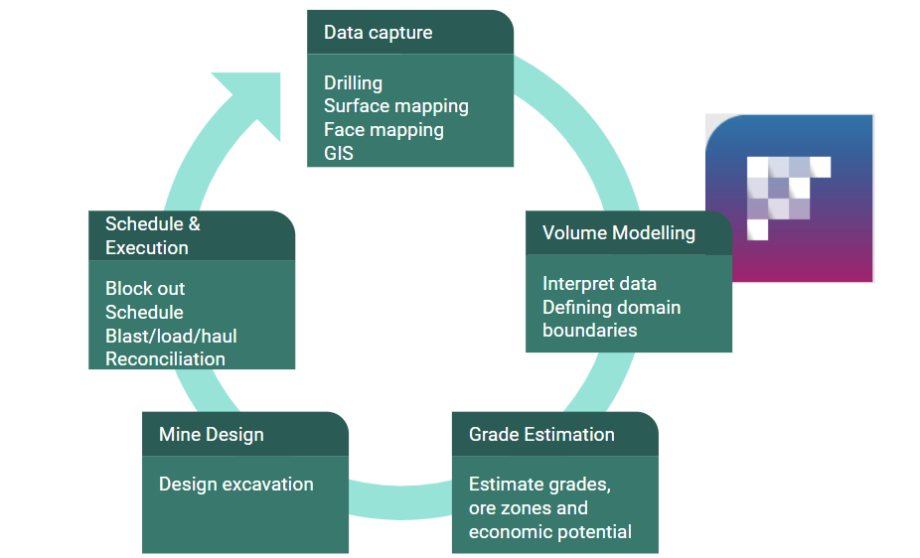
The Mine Planning Process
Where DomainMCF Fits
Notes:
DomainMCF fits here at the volume modelling stage within the Mine planning process. Domain boundaries and domain volumes are predicted from sample data with the results written to a block model, which is subsequently used for further geostatistical work, mine design and planning. The domain definition process can be time consuming and sometimes challenging component of the mine planning process and one that has been subject to recent productivity improvements through technical solutions such as implicit modelling. DomainMCF takes that one step further by generating results substantially faster than other implicit methods, with models showing strong relationships to the expected geology. Deploying DomainMCF into the mine planning process can substantially reduce the length of the over all cycle.

Slide 10
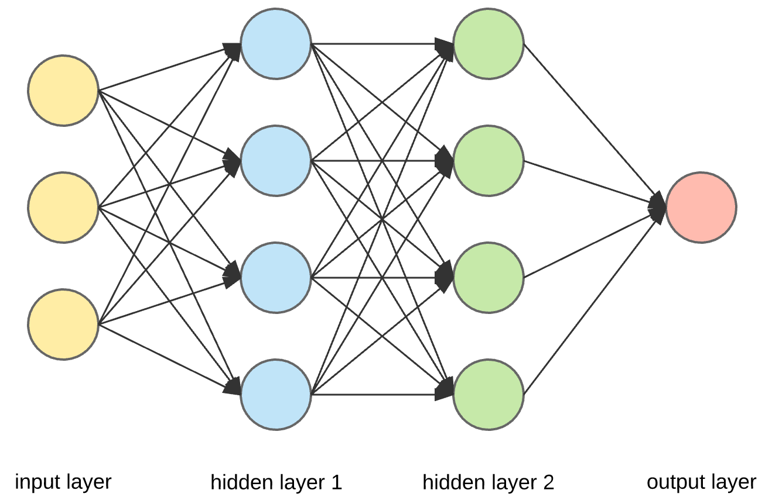
DomainMCF
The Machine Learning Approach to Domain Modelling
East | North | Elevation | Domain
12345 | 98765 | -335 | HD01
East | North | Elevation | Domain
12345 | 98765 | -350 | HD02
Notes:
DomainMCF reads spatial categorical data in the form of sample points and outputs the resultant model in an industry standard 3D block model.
Each sample point includes x,y,z or easting, northing, level coordinates along with at least one categorical value domain value, although it can also include numerical data.
These sample points are typically sourced from core logging, face and surface maps. The operator cannot control weighting within the algorithm, but can proportionately weight samples fed to DomainMCF. For example, filter samples from a less reliable source and over sample filters from another source, or of a specific domain.
Additional variables such as grade variables or other categorical variables can be included. These should be included where it is believed those variables might improve the prediction. For example, samples can be flagged by a structural control like a fold or fault, to help the algorithm understand the structure. The quality and density of the data will have a strong impact on the outcome of the predicted model.

Slide 11
Lisheen Mine Case Study
A review
Existing study from the Lisheen Mine (Case Study)
Update
Robustness
Repeatability
Reproducibility
Processing Time | 50 mins
Domains | 50
Volume Change | 4%
Notes:
The original Lisheen Mine Case study, which is linked in this presentation and can be made available to anyone who is interested to see it, reported the results of the machine learning process to define 50 domains from the original drilling data. The model took 50 minutes to generate with around a 4% change to the volumes reported by the geology team from the days of real-world production. That study was a wholistic review of all available domains on a singular, isolated run that might be similar to a process deployed at a working mining operation that had embedded DomainMCF in its processes.
For this paper we have looked at some of the typical challenges faced by Machine Learning including robustness, repeatability and reproducibility.
The purpose here is not to conclude if DomainMCF is “correct”, valid, or acceptable, but to demonstrate how an operator can generate multiple models for analysis before concluding whether DomainMCF is a suitable tool for their particular purpose, and under the operating constraints they face.
https://news.mit.edu/2019/how-tell-whether-machine-learning-systems-are-robust-enough-real-worl-0510
“Adversarial examples fool a neural network into making mistakes that a human wouldn’t,” says first author Vincent Tjeng, a graduate student in the Computer Science and Artificial Intelligence Laboratory (CSAIL). “For a given input, we want to determine whether it is possible to introduce small perturbations that would cause a neural network to produce a drastically different output than it usually would. In that way, we can evaluate how robust different neural networks are, finding at least one adversarial example similar to the input or guaranteeing that none exist for that input.”

Slide 12
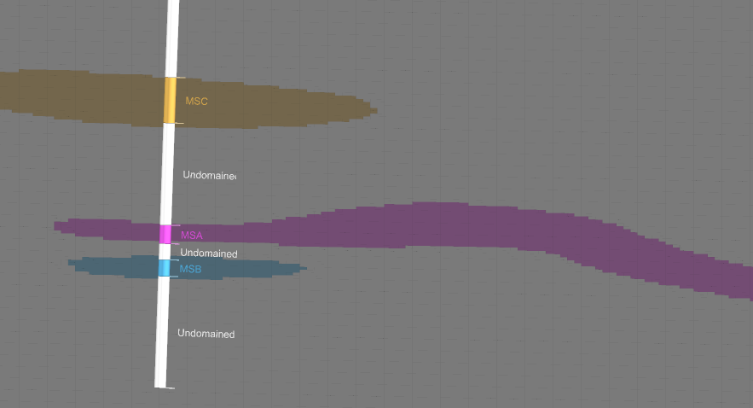
Lisheen Mine Case Study
Visual Validation
Notes:
Typically, DomainMCF customers will review the resultant model from DomainMCF visually, using sectional views to compare the validation of sample or drilling contacts to those of the model, as well as the structure shape of the domains.
For this paper, we did some experimentation with comparative block model reserve reports between multiple models.

Slide 13
Lisheen Mine Case Study
A review
Update
Robustness
Repeatability
Reproducibility
Domain | MSA | MSB | MSC | Undomained
Median Value (proportion of total block model) | 0.91664% | 0.15498% | 0.04032% | 98.86347%
Variation | 8.9237% | 22.0455% | 16.8866% | 0.0685%
Total volume variation between five models generated from randomised data.
Notes:
Robustness
Robustness is an important test for neural networks as these algorithms can have a tendency to make mistakes that a human wouldn’t. How well can the model be reproduced when the data is changed, where the software is denied access to certain data, or where there is adversarial data? For example, convolutional neural networks designed to process and classify images can be fooled by slight modifications resulting in incorrect classifications in a way that a human would not. What we do not want to see from DomainMCF are vast changes to the predicted model following relatively small changes to the data.
To test robustness we took a data set, made 5 copies then randomly removed 20% of the points from each data set.
Each model was downloaded and then post-processed in Maptek Vulcan software to calculate the variation across the five models. The three domains being studied, MSA, MSB and MSC, which each represent less than 1% of the blocks in the model, varied by 9, 22 and 17% across the 5 runs.

Slide 14
Lisheen Mine Case Study
A review
Update
Robustness
Repeatability
Reproducibility
Domain | MSA | MSB | MSC | Undomained
Median Value (proportion of total block model) | 0.91320% | 0.16119% | 0.04089% | 98.89363%
Variation | 6.6331% | 10.1369% | 19.4460% | 0.0583%
Total volume variation between five models generated from identical data.
Notes:
Repeatability
How repeatable is the model when the same data is processed by the same operator on the same machine?
Repeatability is important because it provides us with a sense of surety about the model that is being produced.
To test repeatability 5 replications of identical data was processed and the changes measured.
We took a selection of the drilling data and created 5 identical DomainMCF jobs with that data. All jobs were uploaded by the same operator from the same machine. The results in this case show variation of 7, 12 and 19%, with the very poorly represented MSC domain showing the highest level of variation.
In this case, the likely scenario is that the ‘Undomained’ Domain code is slightly overwhelming the smaller domains. To improve repeatability we could look at adjusting the block model definition so that our model is more focused around the ore zones. We don’t see such variation from the expected result in the old Lisheen Mine case study, because it looked at all 50 domains and therefore did not have this issue where one domain strongly influences the whole model.

Slide 15
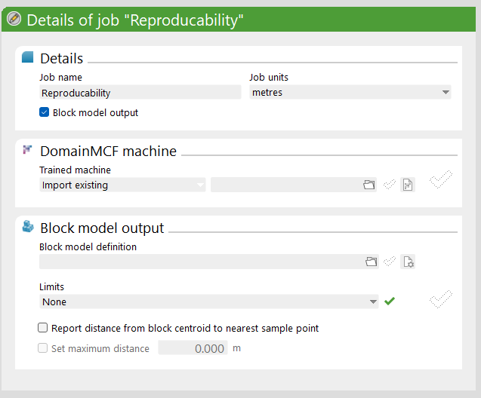
Lisheen Mine Case Study
A review
Update
Robustness
Repeatability
Reproducibility
The introduction of the Trained Machine option means that any model can be reproduced exactly.
Notes:
Reproducibility
How can we produce the same result from the same model, regardless of the operator or their location?
Since DomainMCF was first put through its paces for the original Lisheen paper, Maptek has resolved the reproducibility question by enabling the operator to download the “Trained Machine” model. The Trained Machine Learning Model allows the operator to bypass the training process and regenerate the final block model with matching domain boundaries, at any time in the future.
The key takeaways from the above examples are that it is
easy and fast to generate multiple models from a data set using identical data
Rapid to model updates as data changes, without necessarily seeing chaotic changes to the model.
Skilled geologists can validate visually within a 3D visualization application against the original sample data.
The resultant block model is immediately compatible with the next steps in the mine planning process.

Slide 16
Benefits and Features
To Date:
90 unique customers
2/3 customers returned more than 5 times
Over 1000 generated models
DomainMCF Summary
Low human input to model
Free the geologist to add value in more productive areas of mine planning
Rapid: more timely mine plans
Data driven: reduce subjective discrimination
Data imputation: infill missing values
Model anisotropy: use guide surfaces to influence and control anisotropy
Notes:
In summary, the benefits of using the machine learning approach to domain modelling as pioneered by Maptek with DomainMCF are:
Reduced the human input for the laborious tasks associated with domain modelling
Rapidly turn around new models as new data is generated
Decrease the overall mine planning process
Eliminate human subjectivity – leave the human to validate – accept/reject the generated models.
Refocus human effort on more valuable tasks

Slide 17
The Future
DomainMCF Development Pipeline
Continuous pipeline of development
Core Maptek market segment
Leveraging and driving the Maptek software ecosystem
Distance to samples (released)
Anisotropy control
Contact points
In-built fault block modelling
Increasing transparency
Notes:
Development is ongoing and updates are rapidly deployed, giving customers timely access to the latest features. Newly developed features include the distance to nearest sample being natively written to the block model from within DomainMCF. Future enhancements may include output to wireframe, integrated anisotropy control, fault block modelling, and reporting tools that improve transparency of the algorithm to the operator.
We see DomainMCF being deployed for a range of applications, from large scale mine-wide models down to individual blasts for rapid grade control modelling.
…
Thank you for your time and attention.

Slide 18
Changing the way mining is done forever

Slide 19
www.maptek.com

Slide 20
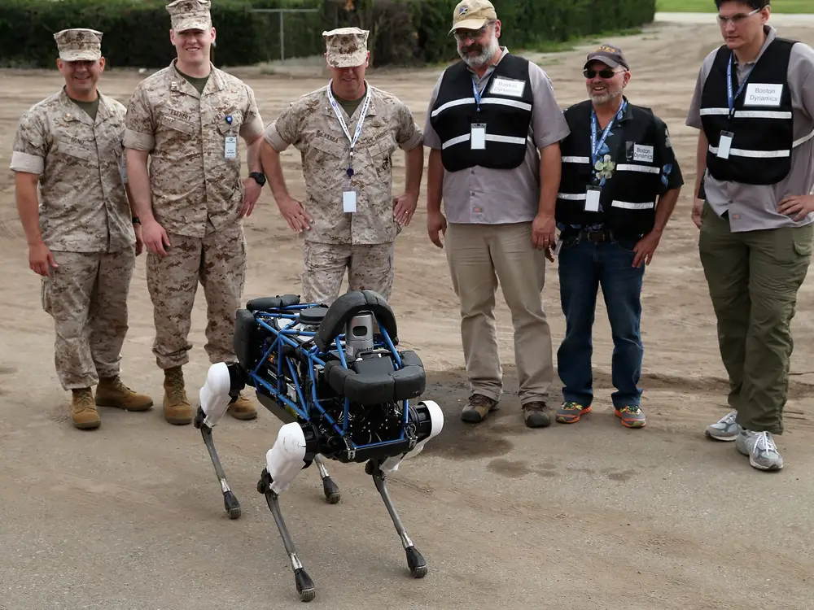
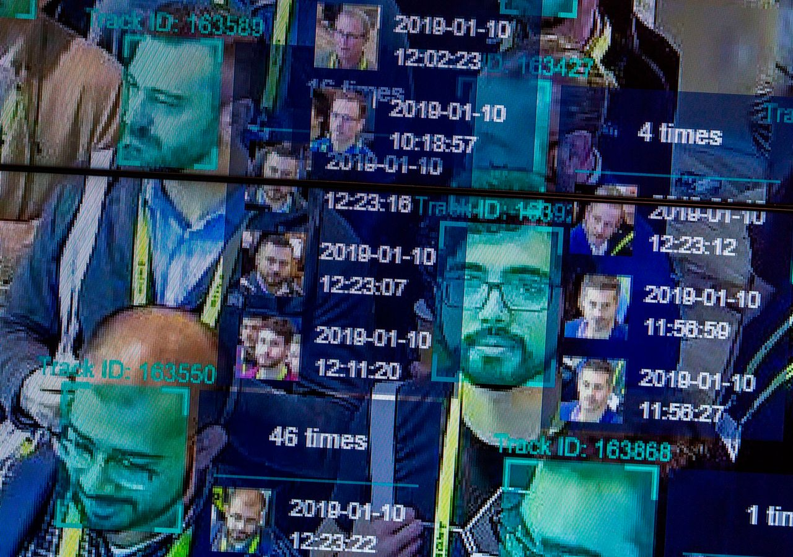
Machine Learning
Marines fool AI system by hiding in boxes and pretending to be trees
Marines fool AI system
Examples of Risks
Easy… Too Easy!
Dependency: Lack of professional oversight
Data limitations
Over reliance on technology
Bias/discrimination (Unfairness by algorithm)
Individual harms
Job displacement
Privacy concerns
Social Harms (Nature: ML for Medical Imaging)
Lack of transparency
Police AI image identification system recorded 81% failure rate.
Facial Recognition Failure
Notes:
Some of the failures of AI systems can be kind of funny, like the DARPA robot trained to detect humans, that walk like humans, that was fooled by marines who approached the robot by doing somersaults, hiding in boxes and loudly giggling, and holding a stick pretending to be trees.
Others are not so funny, such as the Met Police image recognition system that wrongly identified innocent people as criminals. Such systems have resulted in extremely traumatic experiences for innocent members of the public.
In the mining industry, several companies have seen drastic declines in their valuations after previously accepted implicit models had turned out to be overstating the reserve.
In short, it is easy to use a machine learning technology. To use it effectively requires a level of professional oversight to ensure that the results are acceptable.
https://www.forbes.com/sites/bernardmarr/2023/06/02/the-15-biggest-risks-of-artificial-intelligence/
https://coringmagazine.com/article/ai-take-geologists-jobs/

Slide 21
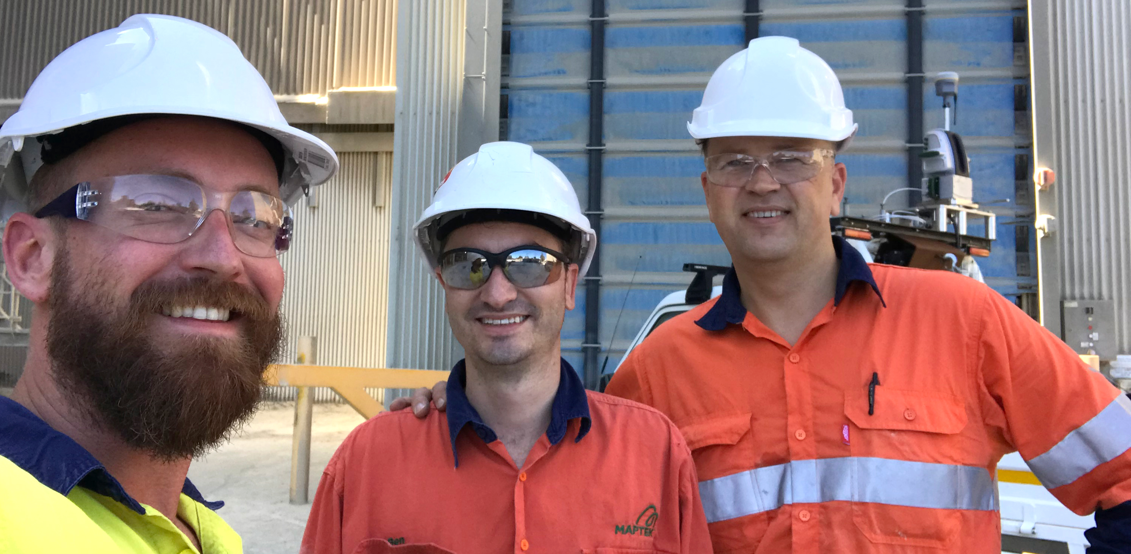
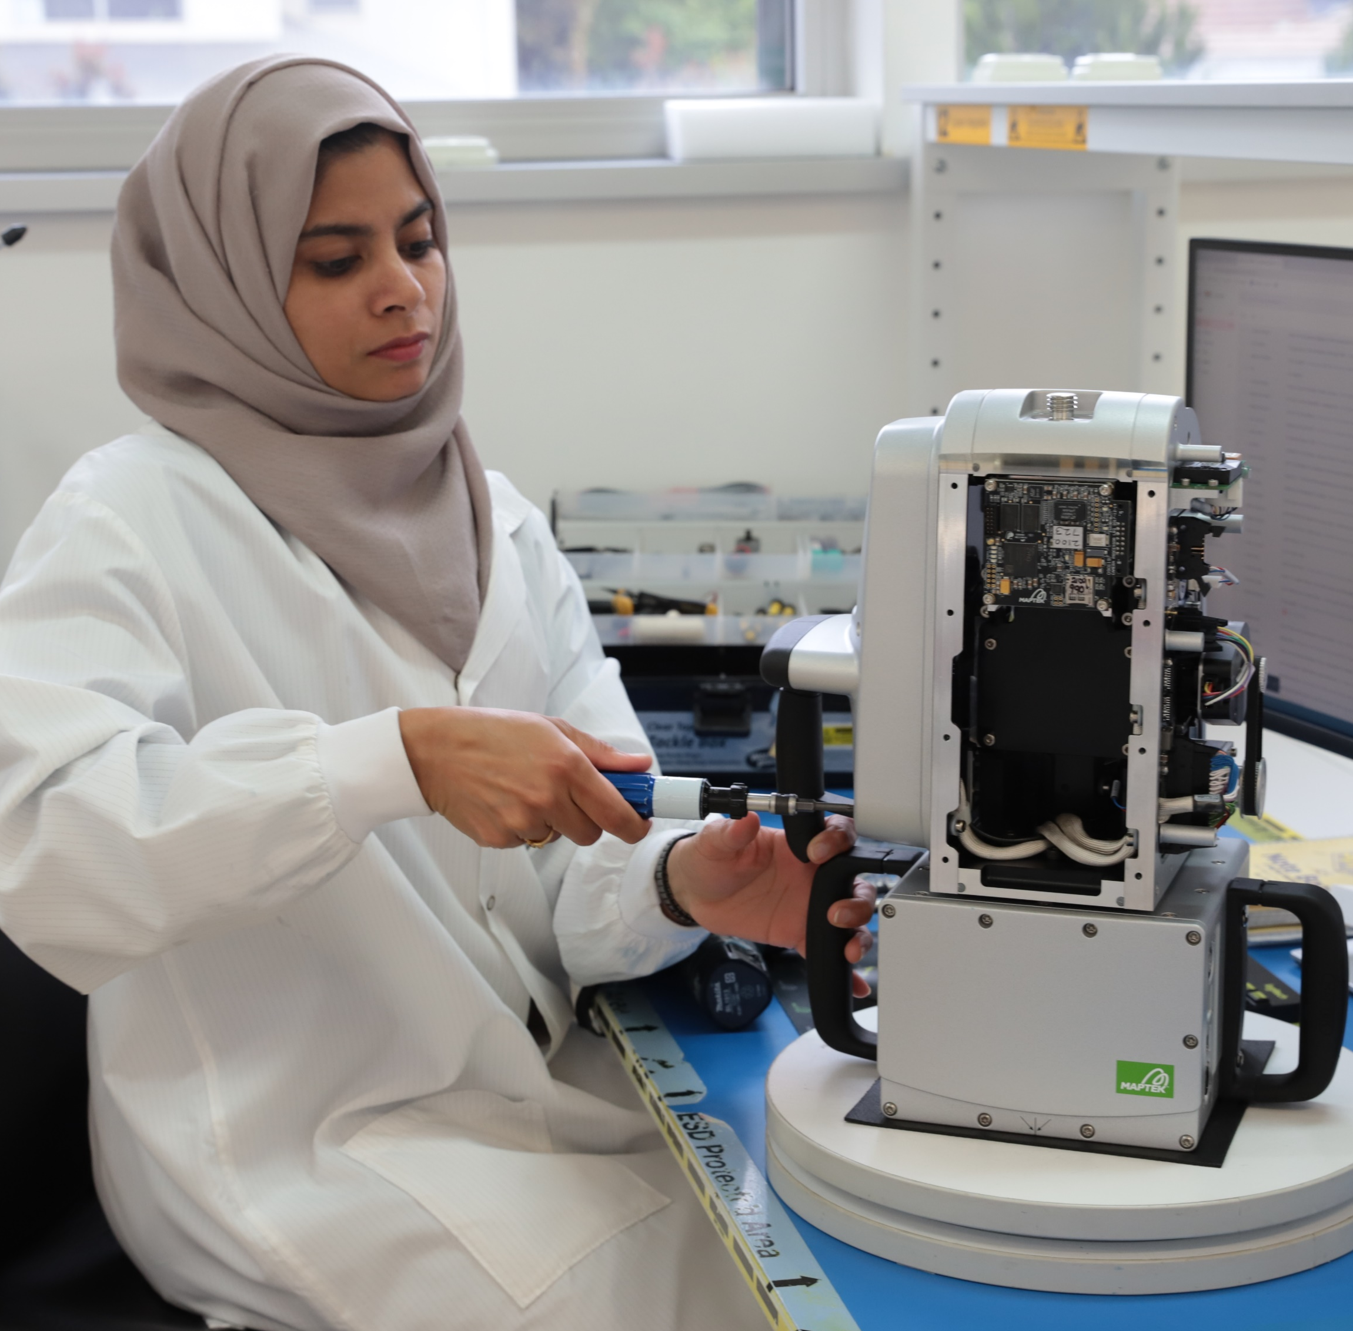
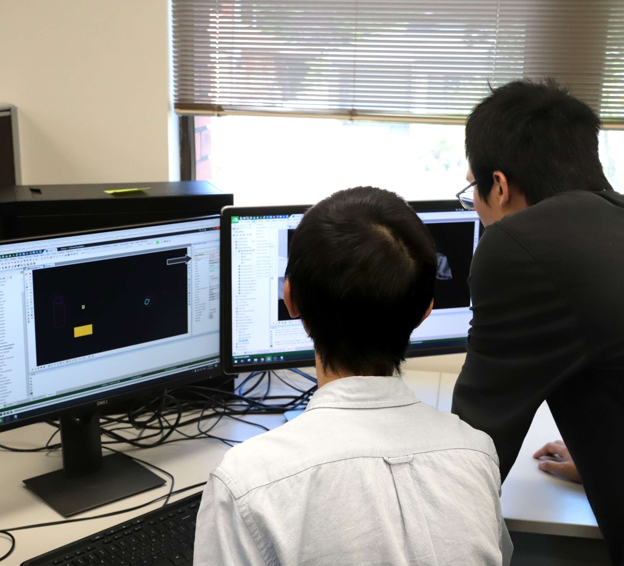
People – careers
Notes:
30% of staff in product development or R&D roles
Maptek is constantly working to improve and maintain all our existing products, and to develop and deliver new technology capability
Approximately 25% of revenue reinvested in product maintenance, research and development
34% of staff engaged in technical services – end user support, training and consulting
Experienced mining professionals with the ability to understand customer problems and work collaboratively to develop a solution
Management focused on reliable, sustainable delivery of the best technical solutions. Partnering with customers to add value where they need it – their success is our success

Slide 22
Maptek believes Miners should be enabled to make better decisions
Create tomorrow
Smarter together
Be courageous
Walk in their shoes
Make it simple
Notes:
In order to make mining more efficient, we believe that miners should be enabled to make better decisions.
That’s why all our effort is focused on providing integrated decision support capability.
This integration is particularly important as it enables us to turn data into knowledge at every stage of the mining life-cycle.
Ultimately, by fully integrating that knowledge we want to change the way mining is done, forever.
And we’ll create tomorrow by walking in their shoes, being smarter together making it simple and being courageous.

Slide 23
Notes:
For innovative miners
Maptek is the industry leader
That delivers optimised business performance
Because only Maptek does it all

Slide 24
The core business of our customers is mining.
Maptek core business is developing technology solutions for the mining industry.
Notes:
Our customers’ core business is mining.
Maptek core business is developing technology solutions for the mining industry.
Extensive mining domain knowledge combined with application development expertise
We partner with third party developers to integrate niche applications for a total, single source solution

Slide 25
Vulcan
3D geological modelling and mine planning solution
Single source of truth across technical mining processes
Feature-rich desktop solution founded on expert domain knowledge
In use across all mine and commodity types
More than 20,000 licences in more than 90 countries
Notes:
Vulcan
Vulcan has been leading the world in 3D geological modelling and mine planning software for almost 40 years
Exploration, resource modelling, mine design, mine planning, optimisation & scheduling applications cover the mining execution chain
Flexible solution for all commodities, mining methods surface and underground
>20,000 licences in more than 90 countries
Workbench provides a single technical data ecosystem for customers – soon to host additional product applications

Slide 26
Vulcan GeologyCore
Streamlined geological modelling workflow
Simple workflow automates daily tasks
Step through data validation to model generation
Choose implicit or machine learning modelling approach
Test scenarios with dynamic model updates before committing to changes
Create time for high value analysis and interpretation tasks
Notes:
Maptek Vulcan GeologyCore streamlines geology workflow from data validation to model generation, allowing geologists more time to focus on higher value work.
Choose from cutting-edge modelling techniques using cloud-based machine learning algorithms alongside conventional modelling approaches.
Simple workflow from data to model - Manage data validation across multiple files and avoid complex specification setup whenever changes are made.
Rapid model generation - Update resource models daily or more frequently, instead of quarterly or annually, to avoid bottlenecks.
Repeatable, non-destructive process - Test scenarios by editing domains and see dynamic model updates before committing to changes.
Improved productivity - Rationalise the geological workflow for easier assimilation of new staff and higher focus on analysis and interpretation.
Access to cutting-edge techniques - Take advantage of cloud-based machine learning modelling methods for rapid processing.
Process to suit your needs - Select the appropriate modelling method to suit databases or mining projects.

Slide 27
BlastLogic
Drill and blast design and reconciliation system
Developed in association with mining industry
Identify productivity gains and optimise mineral recovery
Pre-empt risk and cost issues before they emerge
Advanced drill & blast analysis improves performance
Notes:
BlastLogic
Maptek has invested more for systems that improve the d&b process than any other provider
Accuracy management system which integrates all of the processes surrounding drill & blast to identify productivity gains.
Developed in association with mining industry.
Measuring and analysing blast performance optimises mineral recovery.
Addresses lead indicators to pre-empt risk and cost issues before they emerge in the business.
Repeatable and scalable system across single or multiple operations.
Latest blast modelling tools allow advanced analysis to improve performance.
Electronic tieup, inventory management on the tablet and MWD functionality
OData Service provides customisable reporting compatible with enterprise reporting systems
Scaled depth of burial algorithm targets repeatable, accurate blast confinement
BlastLogic joined the Workbench in 2020

Slide 28
Evolution
Generate high value schedules throughout mine life
Rapidly assess thousands of scenarios
Schedule across all planning horizons from short term to strategic life-of-mine
Make informed, confident decisions
Reduce costs and maximise the resource
Generate multiple schedules for analysis
Consistency of tonnes and grade throughout the mine life
Optimise operation, meet product specifications per period
Notes:
Evolution
Practical high value schedules throughout the mine lifecycle
Rapidly assess thousands of scenarios based on the resource model and choose the best option
Block-by-block scheduling across all planning horizons generates data for dynamic modelling
Make informed, confident decisions regarding scheduling that reduce costs and maximise the resource
Generate multiple schedules from a single simulation run
Uses a single dataset to schedule across planning horizons, ensuring consistency of tonnes and grade throughout the mine life
Optimise the life of mine while meeting product specifications for each period
Evolution offers scheduling with blocks AND solids, stratigraphic deposit scheduling, multi-objective scheduling
Integrated with Workbench
Modules handle scheduling across the mine planning horizons
Strategy
Origin
Phase
Epoch

Slide 29
Laser Scanners
Feature rich systems with built in workflows
Safe, remote acquisition of survey data
Systems rated to IP65 for maximum durability
Development and testing meet international quality standards
Value-adding applications for slope monitoring & design compliance
Co-developed hardware-software provides best user experience
Notes:
Maptek laser scanning technology is feature rich without sacrificing ease of use and portability.
Developing hardware and software side-by-side allows us to build the workflow in > magnifying savings.
R3 hardware systems provide safe, accurate results for all mine survey applications.
Maptek approach provides a superior method of acquiring survey grade scan data.
Laser scanners are rated to IP65 for maximum durability and reliability in extreme conditions.
Laser imaging business – including R&D, manufacturing and service – ISO 9001 quality assured process.
Laser-based value added products include Sentry for surface movement tracking.
XR3 and SR3 MkII scanners provide a comprehensive survey, geology and face mapping and geotechnical analysis solution

Slide 30
PointStudio
Process, model and analyse point cloud data
Update pit surfaces and manage stockpile inventories
Map highwall geology, identify faults and other structures
Compare design surface to as-built and other surfaces
Intuitively define geology directly from 3D point cloud data
Calculate underdig, overdig and volume variances
Report accurate spatial data for mine planning and scheduling
Fragmentation and geotechnical analysis
Notes:
PointStudio takes advantage of the latest computational techniques to easily handle geospatial projects with hundreds of scans and millions of points.
Successfully apply 3D point cloud data to survey, geotechnical and engineering tasks within the mining, quarry and civil engineering industries.
Improve efficiency - create custom workflows and reporting options - improving efficiency and productivity for both surface and underground operations.
Easy to use - intuitive ribbon interface makes PointStudio easy to learn and complete tasks efficiently. Easily configurable reporting workflows and templates ensure results can be delivered to meet planning deadlines and aid decision making.
Interoperability/integration - delivered on the Maptek Workbench for interoperability with other Maptek applications.
Reasons to use PointStudio
Update pit surfaces and manage stockpile inventories
Accurately map highwall geology, identify faults and other structures
Perform kinematic analysis and analyse structures to manage risk
Extract discontinuities and analyse persistence across structural domains
Compare design surface to as-built and other surfaces
Intuitively define geology directly from 3D point cloud data
Calculate underdig, overdig and volume variances
Report on loss and dilution volumes for strip mining
Value-adding modules
Geotechnical tools, Fragmentation Analysis and various reporting add-ons

Slide 31
GeoSpatial Manager
Online service for visualising, analysing and dynamically updating surfaces
Single source of survey truth across your project
Efficiently manage survey data for your mine or project
Dynamic representation of full or partial surfaces
Apply the latest available data to downstream tasks
Improved cross-team and inter-department collaboration
Notes:
A new web-based platform allows all surfaces for a project to be accessed and dynamically visualised across the organisation. Knowing exactly what a mine looks like now and at certain points in time improves understanding, efficiency and collaboration. Many operations find it difficult to manage the volume of survey data, putting pressure on people, time and systems. There’s additional lost opportunity to automate other tasks if the data is not stored and made available in a systematic way.
GeoSpatial Manager allows users to download either a portion, or the entire full resolution of an area, for a specified date and time and apply it to any task in their mining or civil project. Surfaces can be dynamically visualised using a time slider.
Centralised storage on a cloud or network server avoids frustration and risk arising from locating survey files stored in various places, with the single source of survey truth improving efficiency and communication across teams.

Slide 32
Sentry
Safe, accurate monitoring solution
Monitoring and survey integrated in single product
Reliable and accurate results for monitoring risk
Automated, streamlined workflow
Monitor multiple zones in a scene
3D visualisation of surface changes in topographical context
Notes:
Sentry
Monitor surface movement and analyse trends to detect failures
Monitoring and surveying integrated in single product
Flexible deployment of expensive survey equipment – use laser scanning hardware investment 24/7
Versatile - can be used in fixed position or used to monitor various areas
Continuous monitoring history from a fixed position
Automated, streamlined workflow – setup and start monitoring in 15 minutes
Lower cost solution than radar systems with 3D visualisation of results
Captures 3D scene of surrounding topography for visualising surface changes in context
Various configurations handle the wide range of operatational and commodity types

Slide 33
MRT (Material Resource Tracking)
Real time production performance tracking and visualisation
Acquire, validate and report data for tracking and reconciling material across the mining value chain
Reconcile tonnes and quality, and track compliance to plan across your operation
Leverage the data and systems at your mine to gain understanding and opportunity
Deployed as an integrated enterprise system with centralised, live reporting to support your business.
Notes:
Maptek delivers a better understanding of production performance through load and haul, stockpiling and plant processes by connecting each of these processes with your resource model and reconciliation between each stage.
Transparency and accountability across the mining business
Centralised decision support framework for resource recovery and management
Improved stockpile planning, management and reconciliation
Reconciliation against the resource model and strategic mine plan

Slide 34
MMP (Mine Management Platform)
Fleet management and vehicle interaction management systems
Decentralised system works anywhere and everywhere at any time
Rich functionality and situation awareness alongside collision avoidance
Advanced ranging capability with metre accuracy for underground deployment
Intuitive operator interface incorporates human-system ergonomic expertise
Notes:
Maptek delivers a better understanding of production performance through load and haul, stockpiling and plant processes by connecting each of these processes with your resource model and reconciliation between each stage.
Transparency and accountability across the mining business
Centralised decision support framework for resource recovery and management
Improved stockpile planning, management and reconciliation
Reconciliation against the resource model and strategic mine plan

Slide 35
Maptek Ecosystem
Integrated platform for Maptek products and services
Workbench streamlines access to Maptek applications and common tools
Single eco-system for working with mine technical data
Maptek Account delivers flexible licensing options and simplified software deployment
Notes:
Maptek Account licensing streamlines access to Maptek applications and communications
Maptek Workbench provides an integrated platform for delivering Maptek products, supported by online delivery
Benefits of the Maptek ecosystem include:
Tied views and data transfer
Tighter integration and interoperability between Maptek applications
Workflow Editor for customer workflows (inc. functionality across all supported apps and plugins)
Maptek Account benefits
Streamlined licensing, including borrowing and fail-safe modes for offline work
Simplified software deployment and management, and software updates
Manage, assign and view software usage within your user base
Report issues and track support cases for easy retrieval/reference

Slide 36
Partnerships
Technology that enhances customer value proposition
Ensuring technical systems interoperability and data integration
Connecting orebody knowledge with mine optimisation, plant performance, resource governance and lifecycle sustainability
Delivering digital data to all parts of your business, where and when it is needed to support decisions
Notes:
Just some of our technology partnerships that aim to enhance the value proposition for customers and contribute to future-proofing mining
CEEC
3-year sponsorship of CEEC, objectives to drive efficiency, productivity and sustainability throughout the whole mining life cycle
PETRA
Interoperability between optimised mining and beneficiation plants, and connections with geological models, mine design and scheduling capabilities.
Maptek expertise around orebody knowledge and mine planning alongsidePETRA’s advanced predictive and machine learning technologies to deepen the understanding of impacts on mine and processing performance.
Planning is based on a better understanding of the real performance of downstream processes
Insight Australia
Co-development with BMA and MEC Mining of a digital drill &blast dashboard for BMA
Cohda Wireless
Vision (MMP) solution for underground proximity awareness and collision avoidance, implemented at Rio Tinto Oyu Tolgoi mine
Emesent
Collaboration around PointStudio ribbon/add-on to handle las data within PS
K2fly
Maptek investment in resource, reserve and reporting governance solution developer K2fly solution. WIP - integration with Vulcan block models (anticipated for release in Q4 2022)

Slide 37
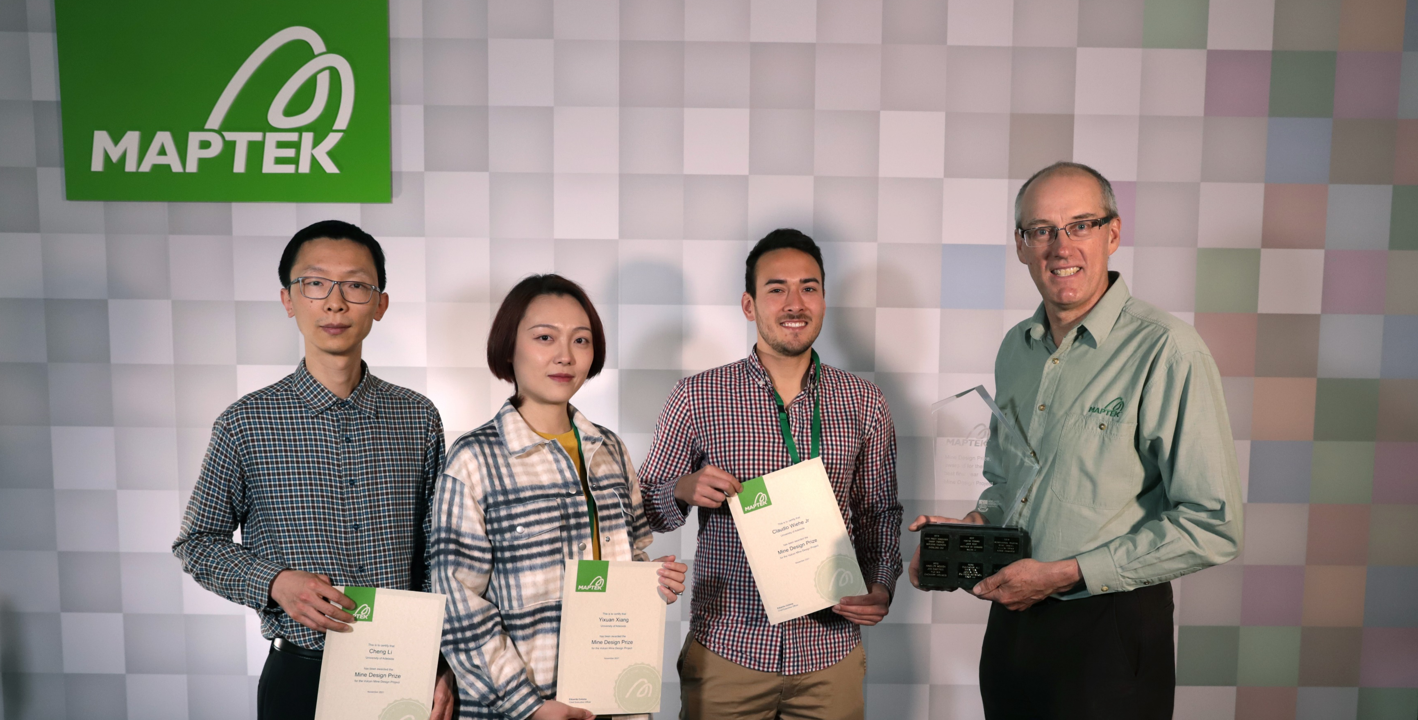
University partnerships
Dynamic and vibrant global academic program
Educational licences
Masterclasses and advanced workshops
Scholarships and internships
Postgraduate study – Citation in Geostatistics and Masters in Geostatistical Modelling of Mineral Deposits
Notes:
Dynamic and vibrant academic program in every region in which we operate
Nurturing the mining professionals of the future
Providing advantage for their careers through use of modern technology with real world data

Slide 38
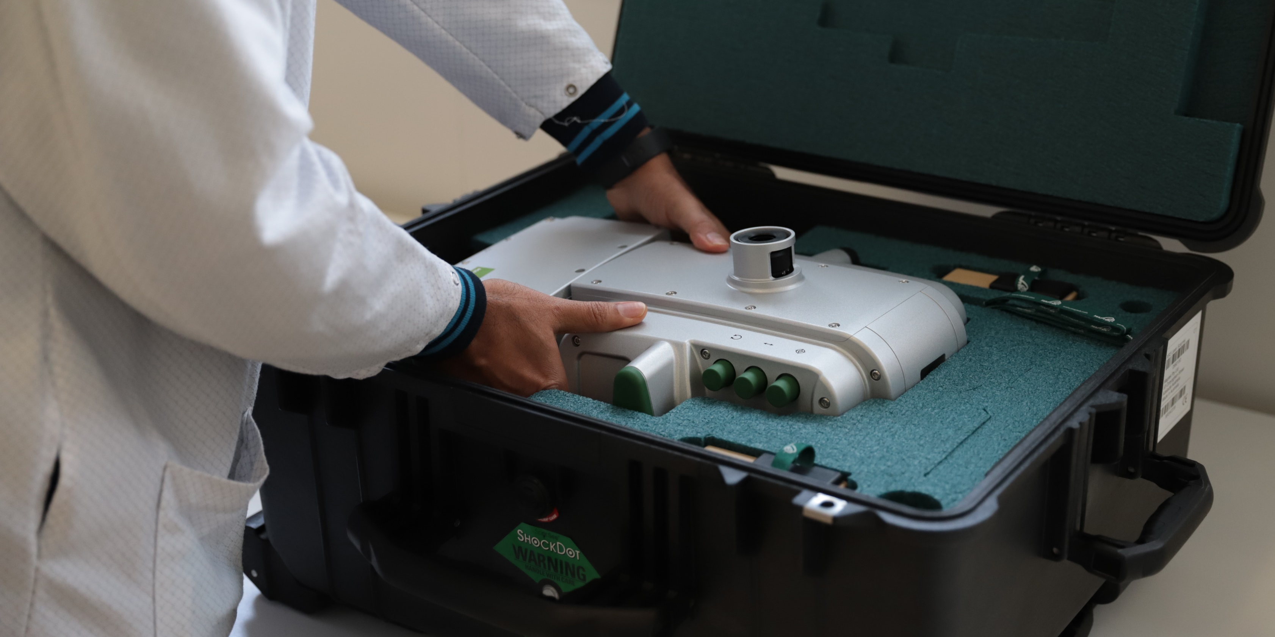
Services
Maptek develops and supports all our solutions
Mining is in our DNA – serving customers and industry for more than 40 years
Experienced, local staff provide technical support to ensure customer success
Services delivered through regional networks with global support
Notes:
Maptek develops, markets and supports all of our products.
Mining is in our DNA. We have partnered with industry for 40 years.
We will continue to develop solutions that help our customers improve productivity and productivity.
Consulting and services delivered by local staff with mining experience.
Services delivered through local networks while drawing on global pool of experts.

Slide 39
Web-based solutions
Integrated platform for delivering all Maptek products and services
Workbench streamlines access to Maptek applications and common tools
Single eco-system for working with mine technical data
Maptek Account delivers flexible licensing options and simplified software deployment
NEW IMAGE NEEDED

