Slide 1
Sedimentary-rock-hosted Zn-Pb deposits of the Maritimes Basin, Atlantic Canada: Comparison with Irish-type, MVT and SEDEX/CD deposit models
James Conliffe¹, Daniel J. Kontak², Chaneil J. Wallace² and Elizabeth C. Turner²
¹ Geological Survey of Newfoundland and Labrador, St. John’s, Newfoundland,
² Harquail School of Earth Sciences, Sudbury, Ontario, Canada

Slide 2
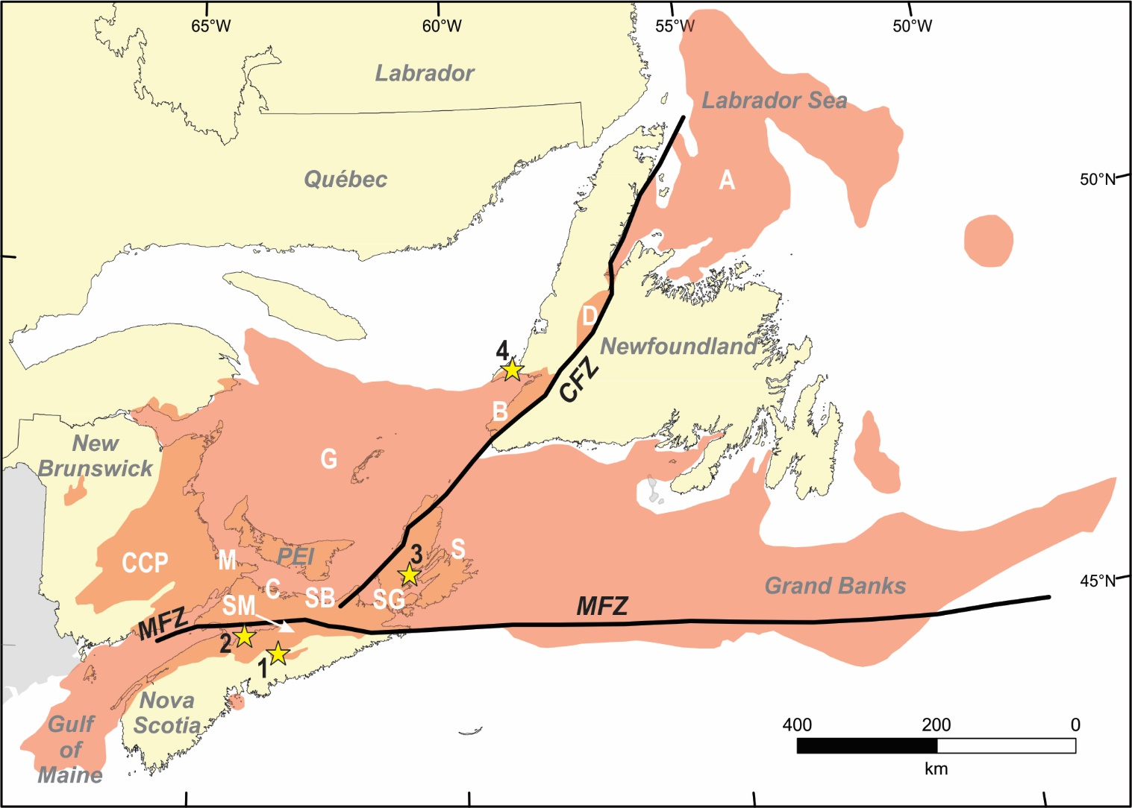
Maritimes Basin
Maritimes Basin sedimentary rocks underlie much of eastern Canada, from New Brunswick to Newfoundland and Labrador
Represents a > 12km thick succession of Devonian to early Permian strata deposited during the Neoacadian to Alleghanian orogenies (Murphy et al., 2011; Waldron et al., 2015; Gibling et al., 2019)
Extent of the Maritimes Basin, showing location of deposits studied (modified from Gibling et al., 2019)

Slide 3
Maritimes Basin
Forms number of discrete, structurally controlled depocentres recording complex tectonic history
Dextral strike-slip transtensional motion along NE-trending Cabot Fault Zone and the E-trending Minas Fault Zone (up to 250 km of dextral motion; Waldron et al., 2015)
Punctuated by more localized episodes of crustal thickening, extension, and salt tectonics
Extent of the Maritimes Basin, showing location of deposits studied (modified from Gibling et al., 2019)

Slide 4
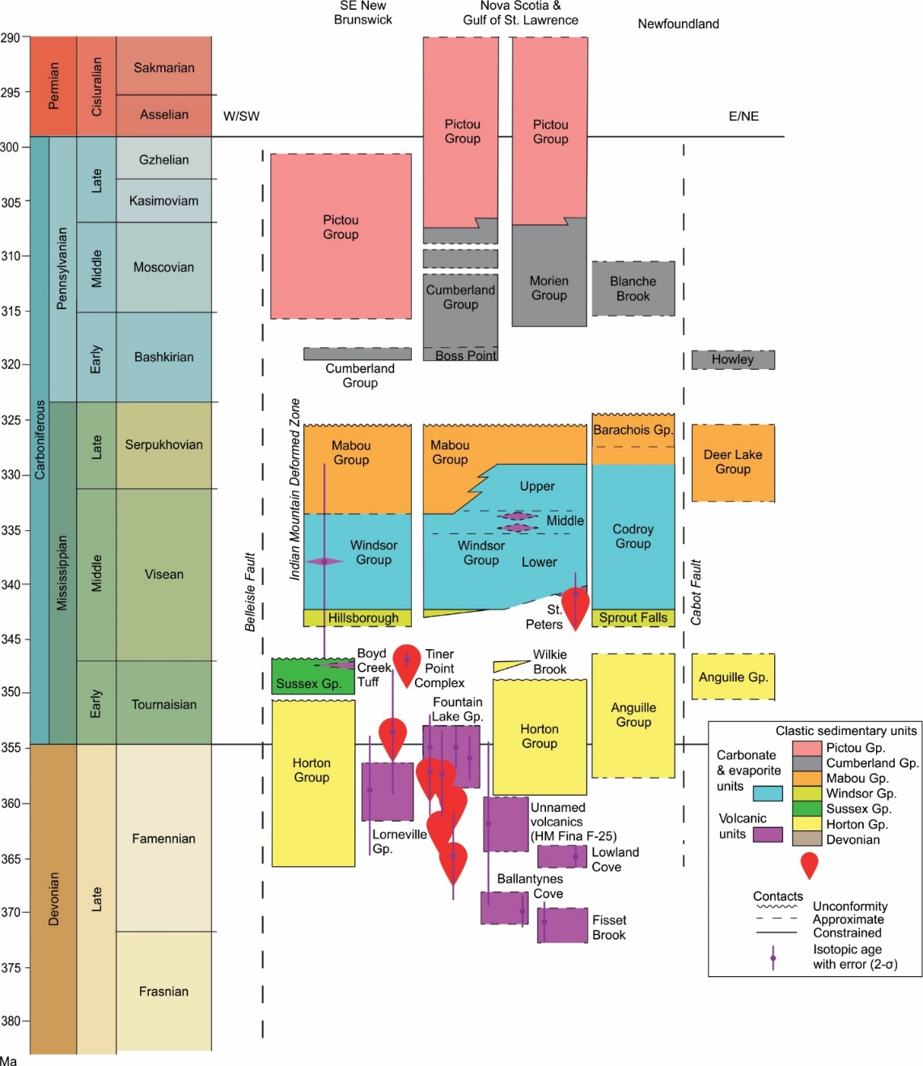
Maritimes Basin
Base of Maritimes Basin marked by late Devonian volcanism, overlain by late Devonian to early Carboniferous mainly lacustrine clastic rocks of the Horton and Anguille groups
Regional marine transgression in the Viséan marked by deposition of the Windsor Group
Basal thin bedded carbonates (e.g. Macumber Formation), laterally grade into biohermal mounds (e.g. Gays River Formation)
Overlain by a thick succession of interlayered evaporitic, clastic, carbonate and minor volcanic rocks
Windsor Group followed by Carboniferous to early Permian clastic rocks of the Mabou, Cumberland, and Pictou groups
Zn-Pb-Ba
modified from Gibling et al., 2019

Slide 5
Sedimentary hosted Zn-Pb-Ba Deposits
More than 150 Zn-Pb-Ba occurrences recorded in the basal carbonates of the Windsor Group
Scotia Deposit
Walton Deposit
Jubilee Deposit
Port au Port occurrences
modified from Gibling et al., 2019

Slide 6
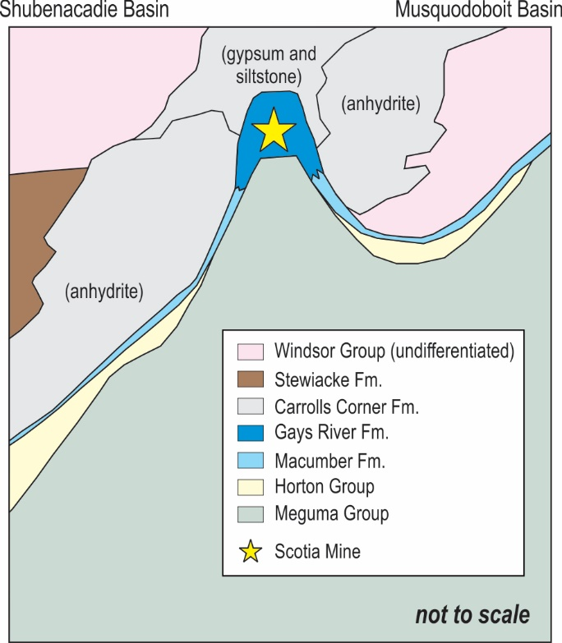
Scotia Deposit
Formerly known as the Gays River Deposit
Mined intermittently from 1979 to 2007, with current NI 43-101 proven and probable reserves of 13.7 Mt of 2.03% Zn and 1.10% Pb (Hannon, 2021)
Deposit located on basement high between Shubenacadie and Musquodoboit sub-basins
Mineralization hosted in carbonate mounds and intermound facies of the Gays River Formation, which laterally grade into laminated carbonated of Macumber Formation
Overlain by thick sequence of anhydrite and gypsum of Carrolls Corner Formation
Simplified local stratigraphy near the Scotia deposit, (modified from Giles and Boehner, 1982).

Slide 7
Scotia Deposit
Massive and disseminated mineralization is hosted by carbonates of the Gays River Formation (Kontak, 1992, 1998)
Massive ore composed of finely crystalline beige sphalerite and mm- to cm-sized galena, restricted to the carbonate-evaporite contact
Disseminated ore occupies primary porosity in the dolomitized carbonates, and consists of millimetric yellow to orange euhedral sphalerite and millimetric to centimetric euhedral galena
Early dolomitization of the host carbonates, followed by precipitation of dolomite cements, sphalerite and galena
Timing of mineralization indirectly determined using paleomagnetic evidence (300-330 Ma) and K-Ar (345-359 Ma;) and Ar-Ar (≤330 Ma) geochronology

Slide 8
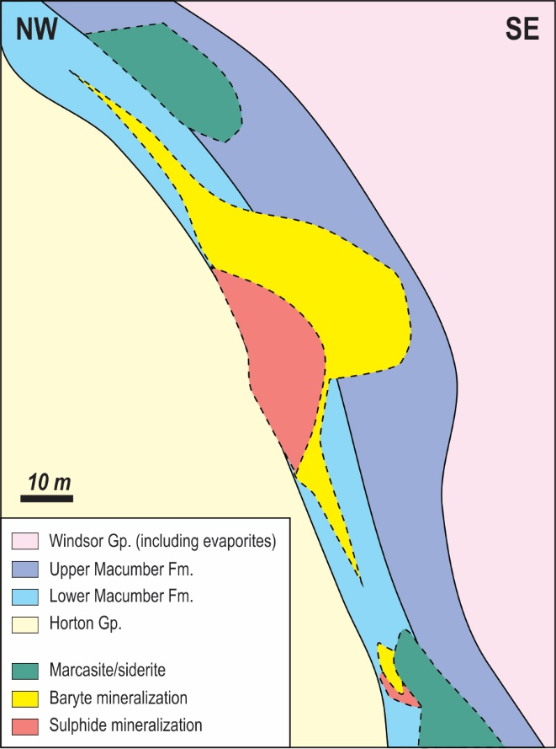
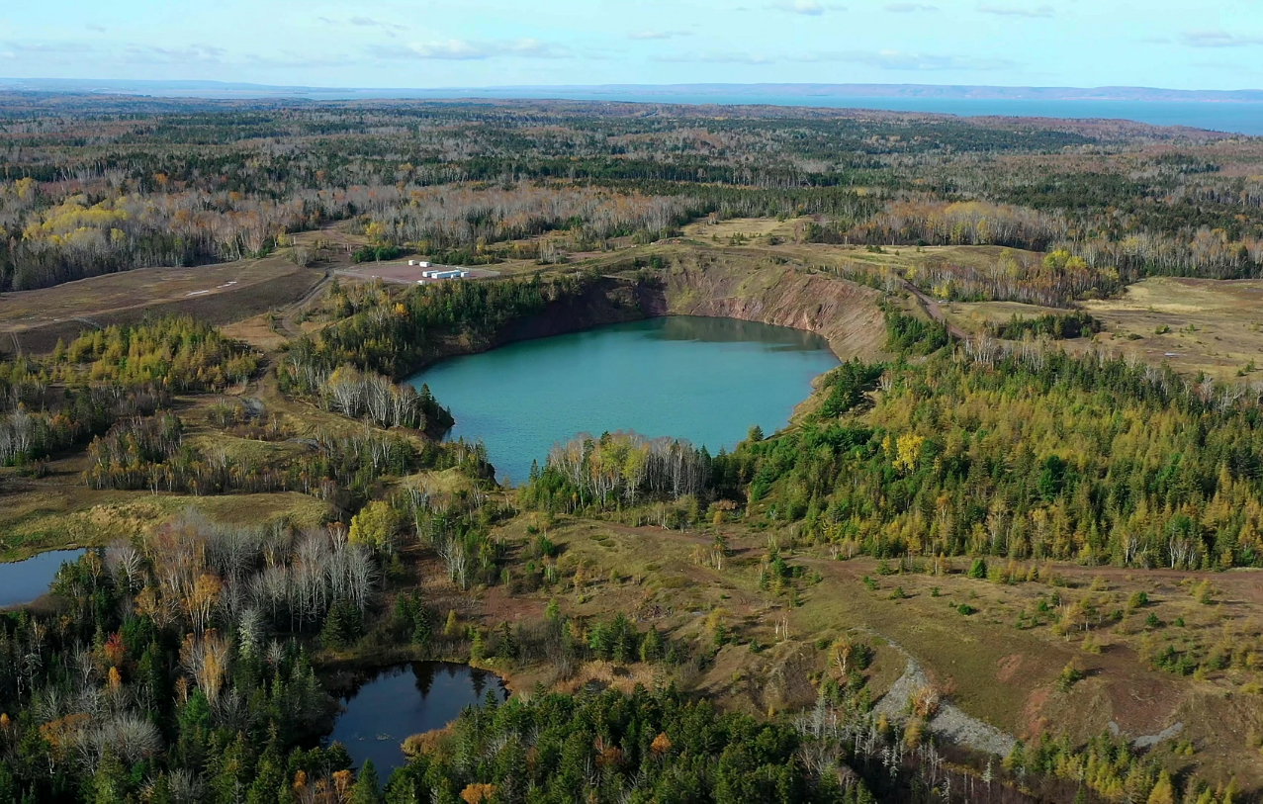
Walton Deposit
Walton Deposit active from 1955 to 1978 and produced approximately 4.5 Mt of >90% baryte and 0.4 Mt of sulphide (4.28% Pb, 1.29% Zn, 0.52% Cu and 348 g/t Ag; Cranstone, 1982; Patterson, 1987)
Mineralization is hosted primarily by the Macumber Formation, which conformably overlies Horton Group sandstone
Deposit is located in a fault-bounded fold and consists of a sulphide body (Pb-Zn-Cu-Ag) overlain by a barium sulphate body
Ore bodies overlain by dense, finely crystalline grey anhydrite of the White Quarry Formation
Walton Deposit in 2019 (from Mindat, copyright David Stredulinsky)
Diagrammatic representative cross-section through a distal part of the Walton Deposit (after Sangster et al., 1998).

Slide 9
Walton Deposit
Host carbonates extensively siderized fluids prior to mineralization, and multiple phases of brecciation
Early baryte mineralization, followed by main-stage sulphide mineralization (pyrite/marcasite-sphalerite-galena-chalcopyrite-rammelsbergite)
Secondary sulphide mineralization phase consists of siderite, baryte, tennantite, and chalcopyrite
Timing of mineralization poorly constrained, but predated deformation and early brecciation (between 330 and 307 Ma: Lavoie et al., 1998; Sangster et al., 1998a, 1998b)

Slide 10
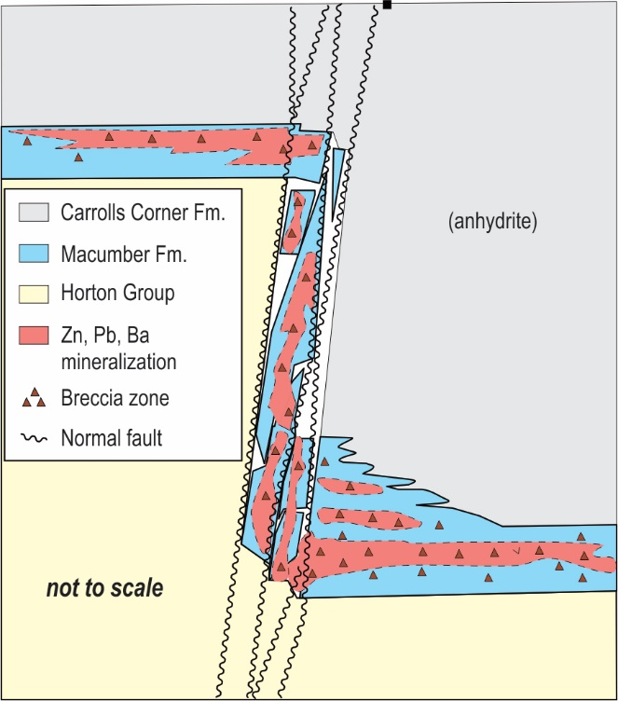
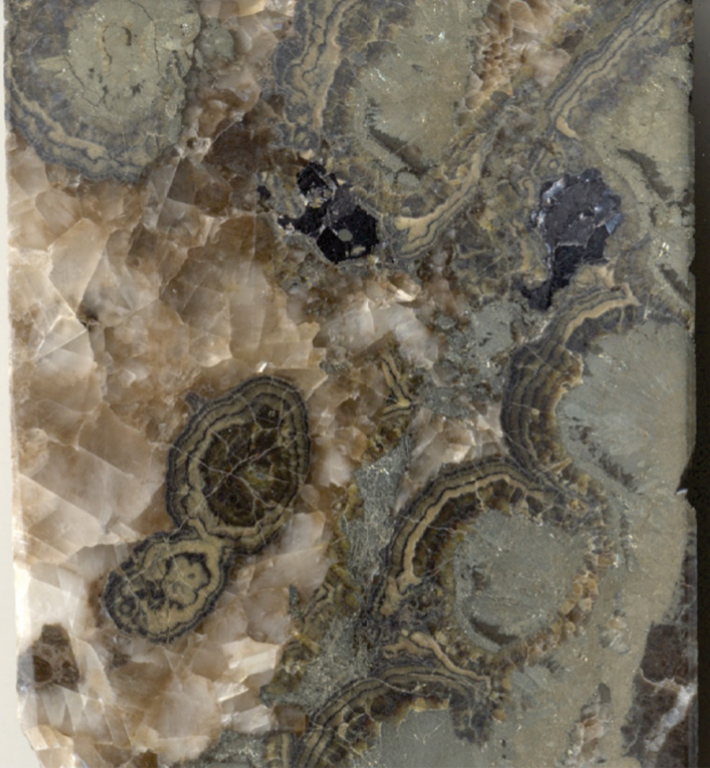
Jubilee Deposit
Inferred NI 43-101 mineral resource of 3.1 Mt containing 3.81% Zn and 0.89% Pb (Webster, 2009)
Hosted in Macumber Formation limestone, overlain by anhydrite and gypsum of the Carrolls Corner Formation
Mineralization is confined to tectono-hydraulic breccia concentrated around subvertical normal faults
Abundant bitumen staining indicate that hydrocarbon migration began after brecciation but predated mineralization
Main mineralization phase consists of early pyrite-marcasite followed by sphalerite and galena (trace chalcopyrite)
No direct age constraints for Jubilee mineralization, postdates extension during the Westphalian (~330 Ma; Fallara et al., 1998).
High grade Zn-Pb mineralization at Jubilee
Cross-section through the Jubilee deposit (modified from Webster, 2009).

Slide 11
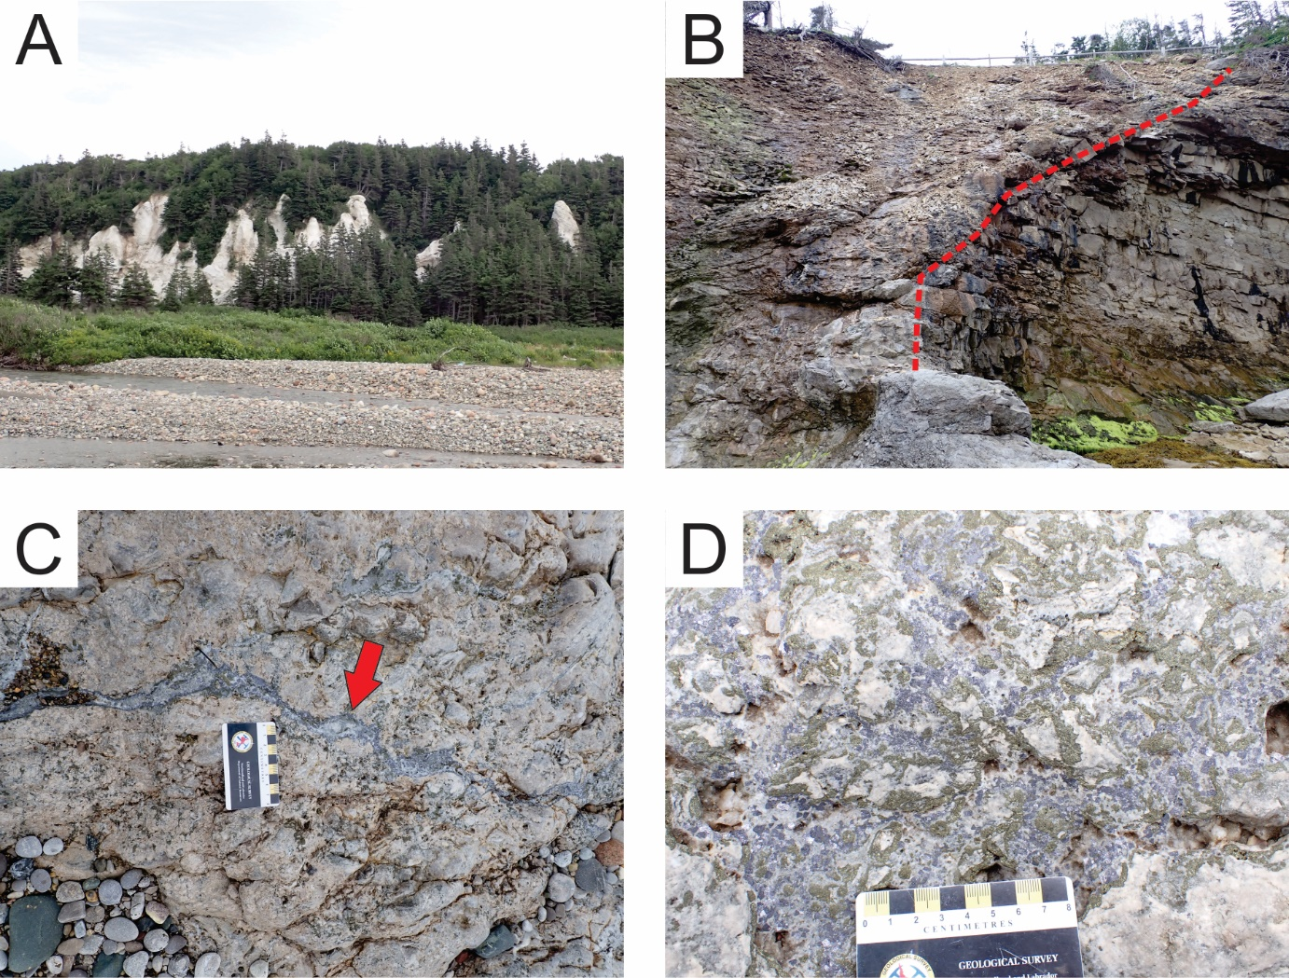
Port au Port occurrences
Numerous Zn-Pb occurrences hosted in limestone and limestone breccia of the Mississippian Big Cove Formation (correlated with Gays River Formation)
Limestone breccias formed in fault bounded grabens on margin of Maritimes Basin
Overlain by thick sequence of gypsum and anhydrite of the Codroy Road Formation
Mineralization postdates brecciation, with early marcasite-calcite precipitation, main stage galena-sphalerite-chalcopyrite and later sulphate (baryte-celestite) mineralization
Timing of mineralization unknown, inferred to be epigenetic soon after deposition of limestone (Dix and Edwards, 1996)

Slide 12
Fluid Inclusions: Scotia Deposit
Pre-ore
Main Stage
Post-ore
High salinities (~24 wt% eq. NaCl), moderate temperature (~100 to 150°C) fluids
Influx of metal bearing, high-temperature (up to 250°C), high-salinity (> 27 wt% eq. NaCl) fluids, mixed with pre-ore fluids
Lower-salinity (<20 wt% eq. NaCl eq.) and temperature (<90°C) aqueous fluid and coeval hydrocarbon fluid inclusions
Ore stage calcite and sphalerite
Sph hosted, I-type,
Th=171C, 24 wt. % NaCl eq.
Sph
Ore-stage calcite I-type
Sph hosted, S plane,
Th=170C, 24 wt. % NaCl eq.
Eaton, 1980; Akande, 1982; Ravenhurst et al., 1987; Ravenhurst et al., 1989; Chi and Savard, 1995; Chi et al., 1998; Kontak, 1998

Slide 13
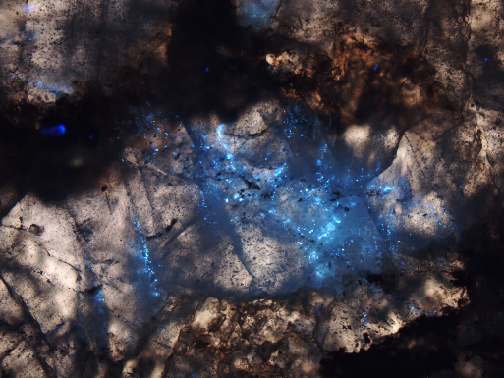
Fluid Inclusions: Walton Deposit
Pre-ore
Main Stage
Post-ore
n/a
n/a
Limited FI studies, data from ore-stage barite
Hetrogeneous trapping of predominantly high salinity (20-28 wt% eq. NaCl) aqueous fluids and abundant liquid hydrocarbon inclusions trapped at high temperatures (250-300°C)
Barite-hosted, aqueous FI Th=200C, 26 wt. % NaCl eq.
barite hosted,
CO2 rich inclusions
Kontak and Sangster, 1998
Barite-hosted liquid hydrocarbon FI (UV light)

Slide 14
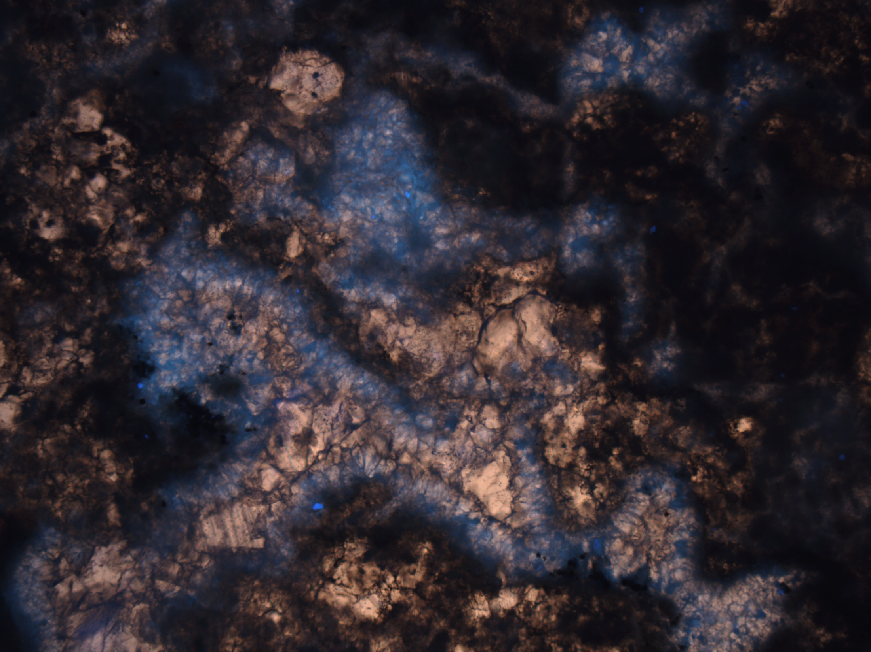
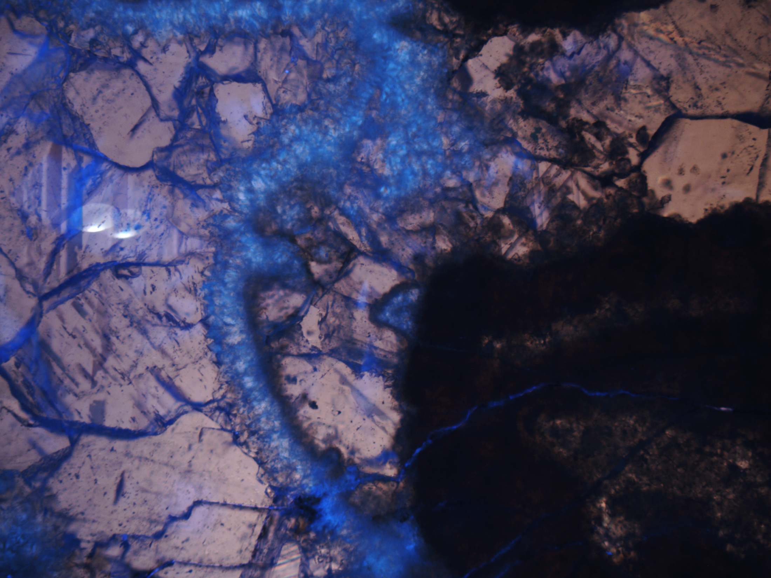
Fluid Inclusions: Jubilee Deposit
Pre-ore
Main Stage
Post-ore
High salinity (21 to 27 wt% eq. NaCl + CaCl2) and low temperatures (53 to 79°C) aqueous fluids and coeval low temperature (< 90°C) hydrocarbon fluid inclusions
Low-temperature (70-90°C), moderate-salinity (13-14 wt% eq. NaCl + CaCl2) brine
Influx of low temperature (generally <100°C) and high salinity (~ 24 wt% eq. NaCl + CaCl2) metalliferous brine, mixed with pre-existing aqueous and hydrocarbon fluids
UV showing petroleum/bitumen in calcite cement post marine cementation
Post-ore calcite, low T FI based of l:v ratios
Chi et al., 1995

Slide 15
Carbon and oxygen isotopes
(data from Akande and Zentilli, 1984; Fallara et al., 1998; and Savard and Kontak, 1998)
Scotia Deposit
Carbonates associated with all stages of mineralization are depleted in ¹³C compared to the host carbonates
Calcite intergrown with sulphides is characterized by lower δ¹⁸O values than pre- and post-ore carbonates, interpreted to reflect the higher temperature of mineralization in this stage

Slide 16
Carbon and oxygen isotopes
(data from Akande and Zentilli, 1984; Fallara et al., 1998; and Savard and Kontak, 1998)
Jubilee Deposit
Decrease in δ¹³C values in the pre-mineralization carbonates due to oxidation of hydrocarbons, consistent with low δ¹³C values hydrocarbon fluid inclusions (-30.1 to -30.8‰; Rogers and Savard, 2002)
Subsequent increase in δ¹³C values during mineralization phase due to buffering of carbon isotopes by the host carbonates
Decrease in δ¹⁸O values associated with the main mineralization phase associated with an influx of higher-temperature metalliferous fluid, but not to the same extent as at Scotia

Slide 17
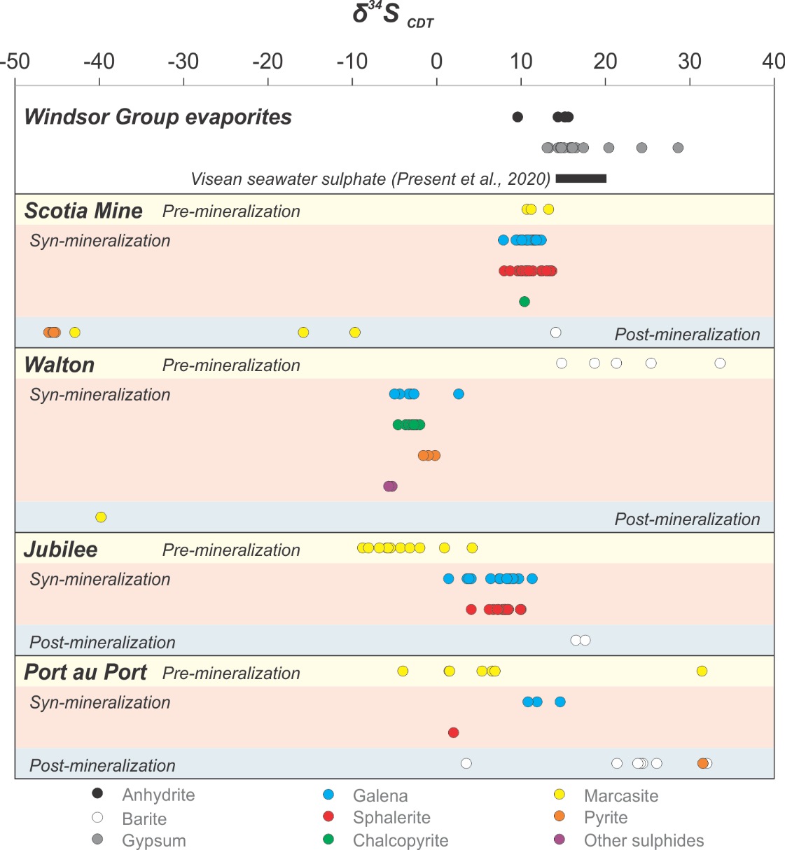
Sulphur isotopes
Sulphur isotope data from evaporites show narrow range of δ³⁴S (14.4 to 17.4‰), typical of Viséan seawater sulphate
Scotia Deposit
Pre and main-stage sulphides at Scotia Deposit show narrow range of δ³⁴S values are 7.9 to 13.7‰
TSR at high temperatures (> 200°C) is the most likely process of sulphate reduction during mineralization, sulphate sourced from overlying evaporates
Lack of strong fractionation between sulphate and sulphide may be due to excess dissolved sulphate and rapid precipitation of sulphides (Meshoulam et al., 2016)
Late sulphide mineralization due to BSR at lower temperatures (< 100°C)
(data from Boyle et al., 1976; Akande and Zentilli, 1984; Kontak, 1992; Dix and Edwards, 1996; Fallara, 1996; Gibling et al. 1989; Present et al., 2020)

Slide 18
Sulphur isotopes
Walton Deposit
Baryte enriched in ³⁴S (14.8 to 33.6‰), whereas sulphides are characterized by negative δ³⁴S values (-0.2 and -5.7‰)
High mineralization temperatures (up to 300°C) indicate negative ³⁴S values cannot be related to BSR
Alternative source from pre-existing reservoir of sediment-derived, bacteriogenic reduced sulphur in underlying Horton Group
Jubilee and Port au Port
Negative δ³⁴S values in pre-mineralization sulphides are consistent with early BSR (during hydrocarbon generation?)
TSR of sulphate from overlying evaporites the dominant process during the main phase of mineralization
(data from Boyle et al., 1976; Akande and Zentilli, 1984; Kontak, 1992; Dix and Edwards, 1996; Fallara, 1996; Gibling et al. 1989; Present et al., 2020)

Slide 19
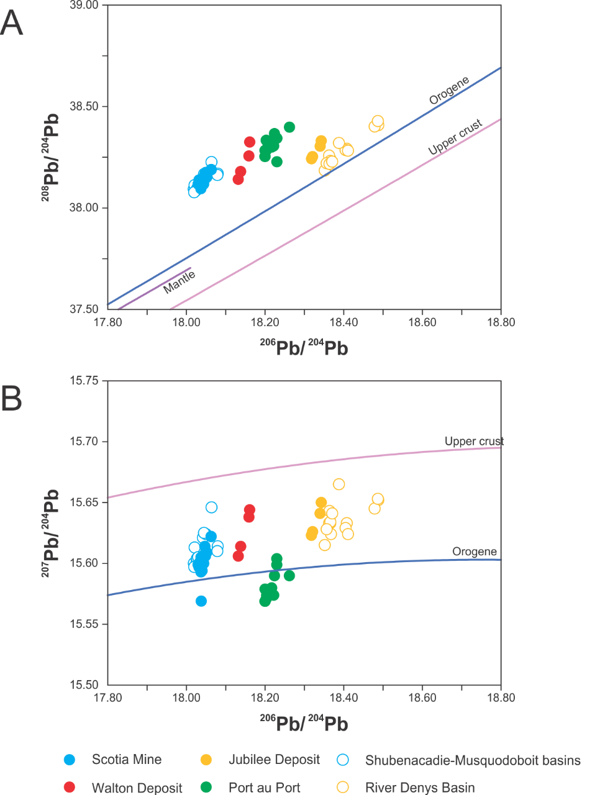
Lead isotopes
Data from individual deposits define discrete, tightly spaced grouping, and overlap data from smaller occurrences in individual sub-basins
Homogeneous Pb isotope signature from individual deposits reflecting a local lead source specific to each sub-basin, with deeply circulating brines leaching metals from underlying basement rocks
Variability in the sedimentary provenance of the source rocks led to variable lead isotopic signatures in each sub-basin
More radiogenic signature of galena in the River Denys sub-basin related to exhumation and erosion of Devonian to Neoproterozoic igneous rocks of the adjacent Mira terrane (Sangster et al., 1998c; Force and Barr, 2012).
(data from Akande, 1982; Akande and Zentilli, 1984; Swinden et al., 1988; Ravenhurst et al., 1989; Sangster and Vaillancourt, 1990; Dix and Edwards, 1996; and Sangster et al., 1998)

Slide 20
Summary of deposit features

Slide 21
Summary of deposit features

Slide 22
Classification of sedimentary hosted Zn-Pb occurrences: MVT, Irish Type or SEDEX/CD?
Scotia Deposit
Epigenetic Zn-Pb deposit, TSR the dominant sulphur reduction process: MVT deposit
Higher mineralization temperature than typical MVT deposits (> 250°C)
May represent super-deep, high-temperature MVT end-member, as recently described from the Lower Saxony Basin, Germany (Sośnicka and Lüders, 2019)
Jubilee and Port au Port
Structurally controlled epigenetic mineralization, low to moderate temperature (< 150°C) with TSR the dominant sulphur reduction process
More typical of MVT mineralization
Walton Deposit
Early baryte mineralization, high mineralization temperature (> 300°C) and Cu enrichment
Timing unknown but postdates diagenesis (siderization), importance of hydrocarbons in metal transport (Wallace et al., 2023)
Intermediate deposit type between the SEDEX/CD and MVT end-members (akin to Silvermines; Reed and Wallace, 2004), Anarraaq deposit, Alaska (Kelley et al., 2004)

Slide 23
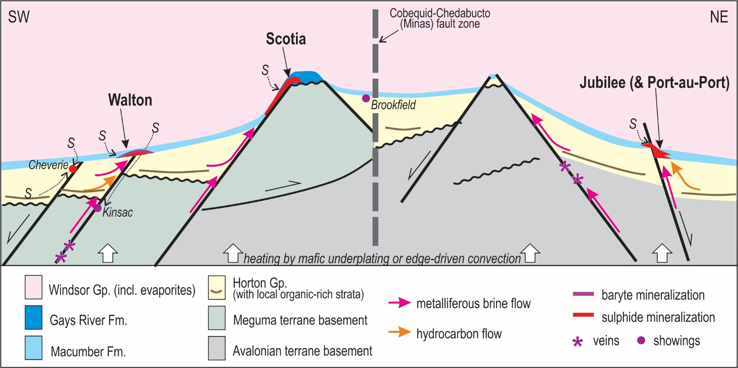
Generalized genetic model for Zn-Pb mineralization in Maritimes Basin
Deposition of a regional carbonate unit at the base of the Windsor Group, overlain by a thick evaporite succession representing a proximal source of sulphur for later mineralizing systems
Local conditions at the time of deposition or during later alteration and tectono-hydraulic fracturing created significant porosity and/or permeability

Slide 24
Generalized genetic model for Zn-Pb mineralization in Maritimes Basin
Deep circulation of basinal brines along extensional and strike-slip structures
Brines heated during regional thermal event (edge-driven convection or mafic underplating)
Hydrothermal brines leach metals from clastic strata of the Horton Group or basement rocks

Slide 25
Generalized genetic model for Zn-Pb mineralization in Maritimes Basin
Hydrothermal metalliferous brines became overpressured and were expelled during sudden release of pressure due to tectonic events
Fluids ascended along faults and encountered a suitably porous stratigraphic unit (Windsor Group) and source of reduced sulphur (evaporitic units

Slide 26
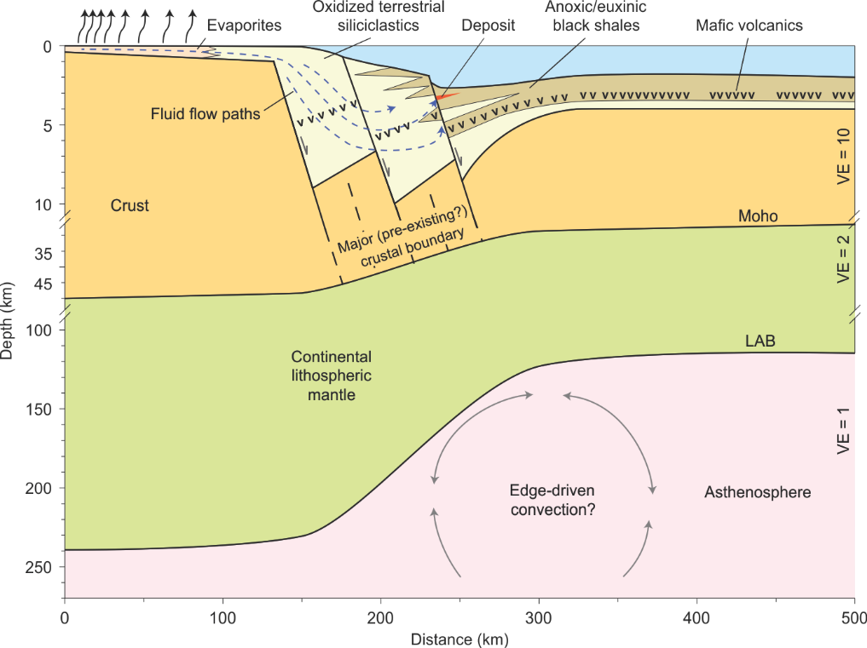
Generalized genetic model for Zn-Pb mineralization in Maritimes Basin
Generation of metalliferous brine and its migration through the stratigraphy was a basin-wide phenomenon (> 150 occurrences)
High mineralization temperature in some deposits (e.g. Walton) indicate significant heat anomaly in crust
May be related to edge driven convection at boundary the ancient continental margin of Laurentia and thinner peri-Gondwanan plates (Ganderia, Avalonia, and Meguma)
Dextral strike-slip transtensional motion on major faults facilitated the upwelling of asthenospheric material and created a significant heat anomaly and associated alkaline magmatism
May also be responsible for 330-300 Ma vein barite and IOCG/IOA mineralization in Nova Scotia
Development of significant accumulations of base metals reflects the development of a suitable local mineralizing environment
Edge driven convection in extensional environment (from Hoggard et al., 2020)

Slide 27
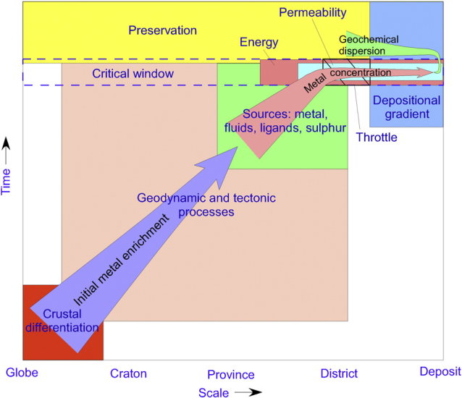
Regional scale exploration for sedimentary hosted Zn-Pb deposits
Inter-deposit heterogeneity also evident in the Irish Midlands
Syngenetic Zn-Pb deposits with characteristics similar to SEDEX/CD deposits (e.g., Silvermines), Irish-type deposits (e.g., Navan, Lisheen) and minor occurrences with MVT-like characteristics
Local-scale heterogeneity may overprint a regional-scale consistency of the entire mineralizing system
Exploration for sedimentary-rock-hosted Zn-Pb deposits using a broader mineral systems approach
Identifying fundamental geological criteria needed to create an economic mineral deposit, including tectonic trigger events, suitable sources for metals, fluids, and heat, favourable crustal architecture, and presence of suitable physical or chemical traps to host the ore bodies
After Hagemann et al. (2016)

Slide 28
Outstanding questions and ongoing research
Most studies on sedimentary hosted Zn-Pb deposits in the Maritimes Basin are > 25 years old, can be improved using modern analytical techniques and protocols
Constraining the absolute time of ore-fluid migration (in-situ U-Pb of carbonates, Rb-Sr of sphalerite, Re-Os)
Better understand ore-fluid chemistry and P-T conditions during mineralization
Improved fluid inclusion studies using FIA protocols
In situ isotope analysis and clumped isotopes
In-situ analysis of fluid chemistry (LA-ICP-MS)
Improved understanding of deep crustal architecture of Canadian Appalachians (passive seismic, magnetotelluric survey)

Slide 29
References
Cranstone, D.A., 1982, An analysis of ore discovery cost and rates of ore discovery in Canada over the period 1946 to 1977: Unpublished Ph.D. thesis, Cambridge, Massachusetts, Harvard University, 607 p.
Dix, G.R., and Edwards, C., 1996, Carbonate-hosted, shallow-submarine and burial hydrothermal mineralization in the Upper Mississippian Big Cove Formation, Port au Port Peninsula, Western Newfoundland: Economic Geology, v. 91, p. 180−203.
Fallara, F., Savard, M.M., and Paradis, S., 1998, A structural, petrographic, and geochemical study of the Jubilee Zn-Pb deposit, Nova Scotia, Canada, and a new metallogenic model: Economic Geology, v. 93, p. 757–778.
Force, E.R., and Barr, S.M., 2012, Provenance of the Lower Carboniferous Horton Group, Petit-de-Grat Island, Nova Scotia, as revealed by detrital zircon ages. Atlantic Geology, v. 48, p. 137-146.
Gibling, M.R., Culshaw, N., Pascucci, V., Waldron, J.W.F., and Rygel, M.C., 2019, The Maritimes basin of Atlantic Canada: Basin creation and destruction during the Paleozoic assembly of Pangea. In: Miall, Andrew D. (Ed.), The Sedimentary Basins of the United States and Canada (Second Edition). Elsevier, p. 267–314.
Giles, P.S., and Boehner, R.C., 1982, Geological map of the Shubenacadie and Musquodoboit basins, central Nova Scotia: Nova Scotia Department of Mines and Energy Map 82-4, scale 1:50,000.
Hagemann, S.G., Lisitsin, V.A., and Huston, D.L., 2016, Mineral system analysis: Quo vadis. Ore Geology Reviews, v. 76, p. 504-522.
Hannon, P., 2021, Scotia Mine Pre-Feasibility Technical Report. Report completed for ScoZinc Limited, 396 p.
Hoggard M.J., Czarnota K., Richards F.D., Huston D.L., Jaques A.L., and Ghelichkhan S., 2020, Global distribution of sediment-hosted metals controlled by craton edge stability. Nature Geoscience, v. 13, p. 504–510.
Kontak, D.J., 1992, A preliminary report on the geological, geochemical, fluid inclusion, and isotopic study of the Gays River Zn-Pb deposit, Nova Scotia: Nova Scotia Department of Natural Resources, Open File Report 92-014, 214 p.
Kontak, D.J., 1998, A study of fluid inclusions in sulfide and non-sulfide mineral phases from a carbonate-hosted Zn–Pb deposit, Gays River, Nova Scotia: Economic Geology, v. 93, p. 793–817.
Lavoie, D., Sangster, D.F., Savard, M.M., and Fallara, F, 1998, Breccias in the lower part of the Mississippian Windsor Group and their relation to Zn-Pb mineralization; a summary. Economic Geology, v. 93, p. 734–745
Meshoulam, A., Ellis, G.S., Ahmad, W.S., Deev, A., Sessions, A.L., Tang, Y., Adkins, J.F., Jinzhong, L., Gilhooly, W.P., Aizenshtat, Z., and Amrani, A., 2016, Study of thermochemical sulfate reduction mechanism using compound specific sulfur isotope analysis. Geochimica et Cosmochimica Acta 188, 73–92.
Murphy, J.B., Waldron, J.W.F., Kontak, D.J., Pe-Piper, G., and Piper, D.J.W., 2011, Minas Fault Zone: Late Paleozoic history of an intra-continental orogenic transform fault in the Canadian Appalachians: Journal of Structural Geology, v. 33, p. 312–328.
Patterson, J.M., 1987, Investigation of the argentiferous base metal potential at the Walton deposit, Hants County: Nova Scotia Department of Mines and Energy Report 87-5, p. 79-81.
Reed, C., and Wallace, M., 2004, Zn-Pb mineralisation in the Silvermines district, Ireland: A product of burial diagenesis. Mineralium Deposita, v. 39, p. 87-102.
Rogers, K.M., and Savard, M.M., 2002, Geochemistry of oil inclusions in sulfide-related calcites-fingerprinting the source of the sulfate-reducing hydrocarbons of the Pb–Zn carbonate-hosted Jubilee deposit of Nova Scotia, Canada. Applied Geochemistry, v. 17, p. 69-77.
Sangster, D.F., Savard, M.M., and Kontak, D.J., 1998a, A genetic model for mineralization of Lower Windsor (Viséan) carbonate rocks of Nova Scotia, Canada: Economic Geology, v. 93, p. 932–952.
Sangster, D.F., Burtt, M.D., and Kontak, D.J., 1998b, Geology of the B baseline zone, Walton Cu-Pb-Zn-Ag-Ba deposit, Nova Scotia: Economic Geology, v. 93, p. 869–882.
Sangster D.F., Savard M.M., and Kontak D.J., 1998c, Sub-basin-specific Pb and Sr Sources in Zn-Pb deposits of the Lower Windsor Group, Nova Scotia, Canada: Economic Geology, v. 93, p. 911–919.
Sośnicka, M., and Lüders, V., 2019, Super-deep, TSR-controlled Phanerozoic MVT type Zn-Pb deposits hosted by Zechstein-2 gas reservoir carbonate (Ca2), Lower Saxony Basin, Germany. Chemical Geology, v. 508, p. 62-77.
Waldron, J.W.F., Barr, S.M., Park, A.F., White, C.E., and Hibbard, J., 2015, Late Paleozoic strike-slip faults in Maritime Canada and their role in the reconfiguration of the northern Appalachian orogen. Tectonics v. 34, p. 1661–1684.
Webster, P.C., 2009, Technical Report on Valuation of Jubilee Zinc - Lead Deposit Exploration Properties of Merrex Gold Inc., 42 p.

Slide 30
Acknowledgements
The studies referred to herein for the Maritimes Basin deposits of Nova Scotia done by D.J. Kontak were supported through funding from the Nova Scotia government while he was employed by the Nova Scotia Department of Mines and Energy (now the Department of Natural Resources and Renewables). Studies on occurrences in Newfoundland were carried out by the Geological Survey of Newfoundland and Labrador (J. Conliffe, with the field assistance of Robert King and Noah Slaney). Current work on these deposits by C. Wallace, E.C. Turner and D.J. Kontak is supported by funding from the Harquail School of Earth Sciences (Wallace) and NSERC Discovery Grants (Turner, Kontak).

