Slide 1
The Rathdowney Trend, Ireland: Geological evolution and controls on Zn-Pb mineralization.
John Güven,
Koen Torremans, Sean Johnson, Murray Hitzman.
IAEG 2023

Slide 2
Rathdowney Trend deposits - classic Irish-Type deposits
Strong structural control: - by extensional faults related to basin formation
Strong stratigraphic control: - lithological permeability, rheology and critically, their availability during mineralisation
Strong fluid control: - physical and chemical properties of mineralising fluids important control on geometry
Timing: - Extremely early
 | Mt | %Zn | %Pb
Navan | >135 | 8.2 | 2
Pallas Green | 45.1 | 7.2 | 1.2
Lisheen | 23 | 13.3 | 2.3
Silvermines | 18 | 6.4 | 2.5
Galmoy | 10 | 12.8 | 1.3
Tynagh | 9 | 5 | 6.2

Slide 3
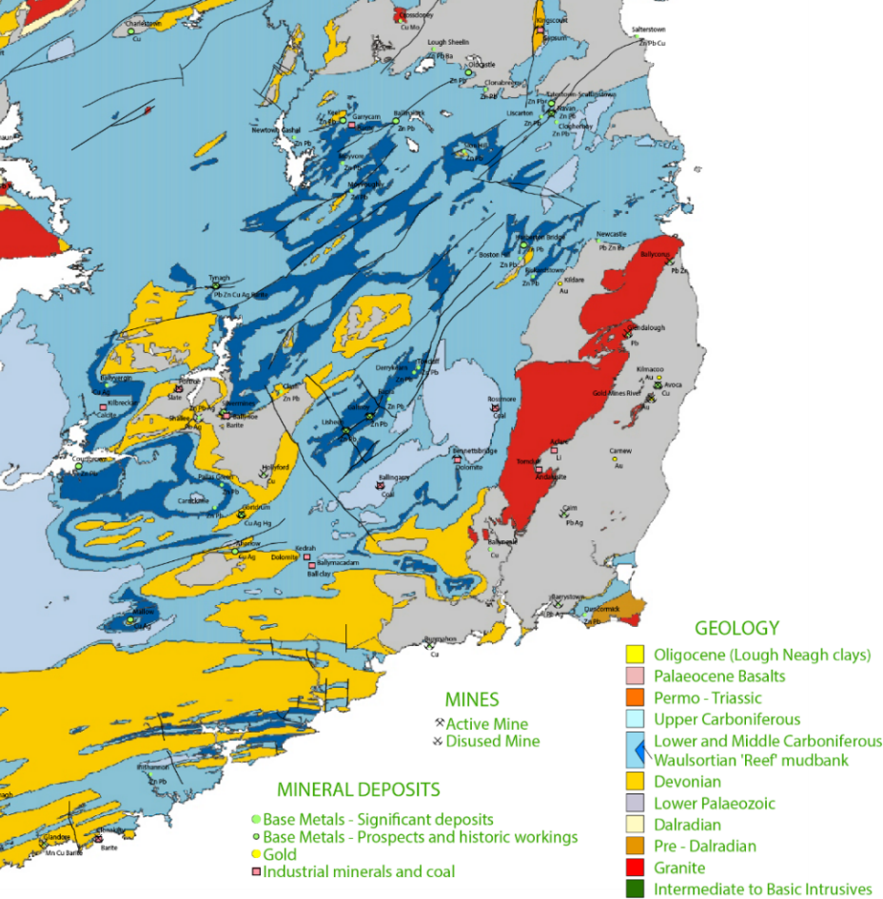
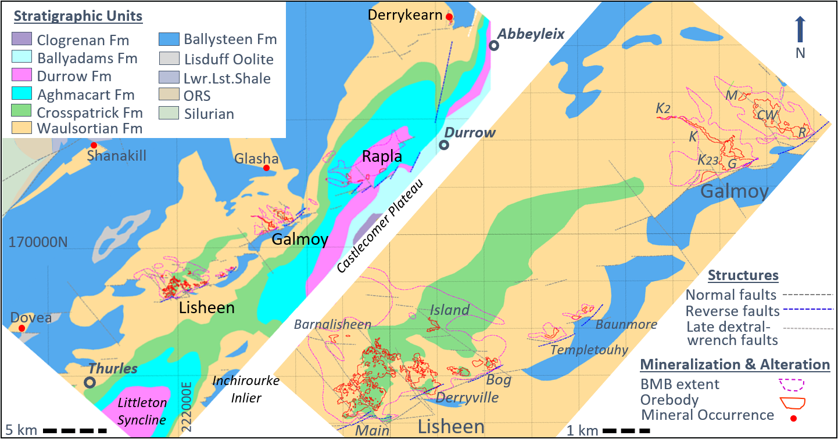
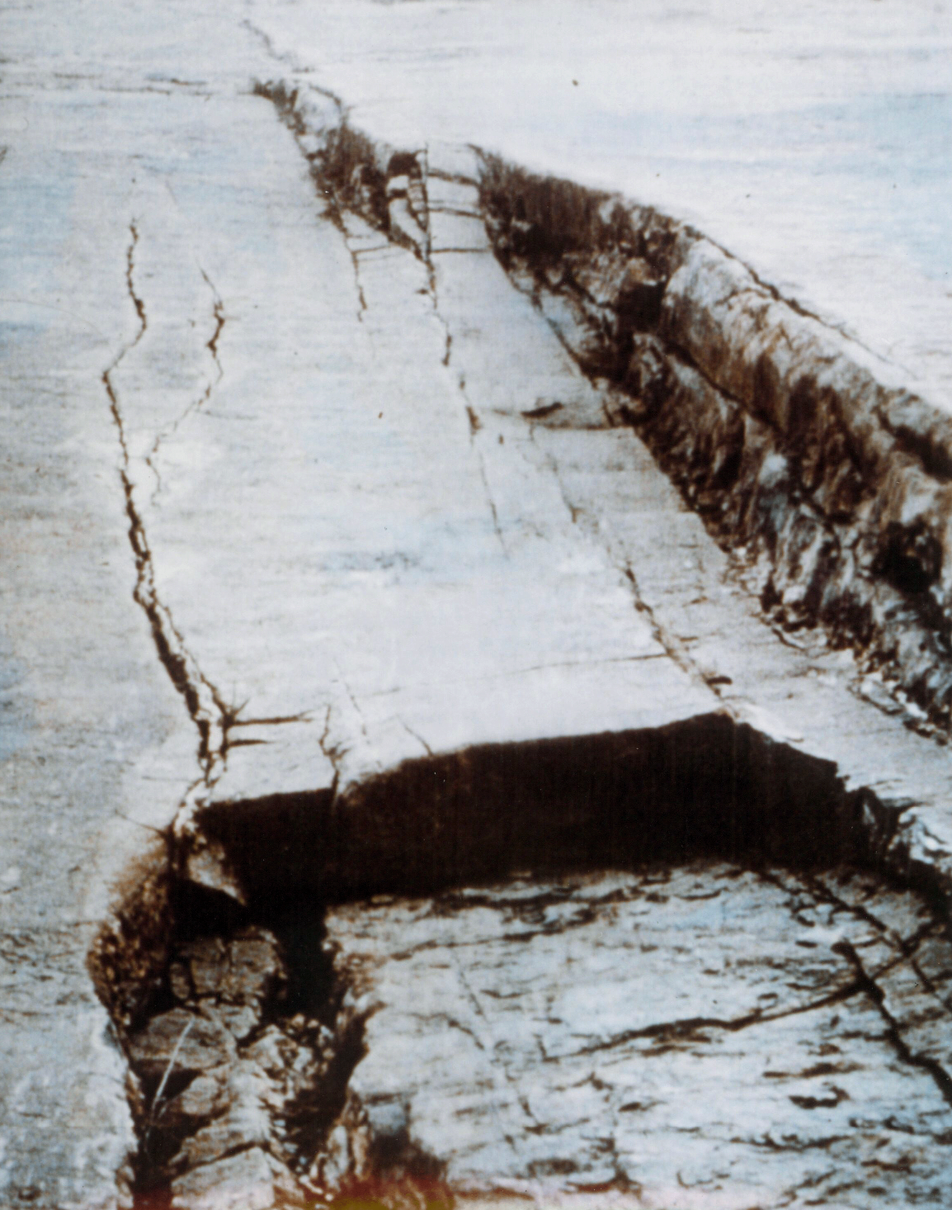
Regional and Structural Setting
Navan
Dublin
Galway
Tynagh
Silvermines
Rapla
Rathdowney Trend
Galmoy
Lisheen
Pallas Green
Gortdrum
Left-stepping en-echelon ramp-relay extensional fault zone.
Ore largely confined and thickest on hanging-wall side of structures
Orebodies generally located on the major displacements – not on the ramps
Cork
Geological Survey of Ireland
Notes:
Rathdowney Fault trend:
Location of RT & deposits that define the trend
on southern side of basin centre
RT is controlled by a left-stepping en-echelon array of extensional faults.
Faulting on the RT initiated later, than in central basin and displacements are not as large.
RT is however sited on large basement structural trend with strong gravity and magnetic signatures
Carb structures inherited due to reactivation by N-S extension of basement structures
extent of trend arguably extends as far as Gortdrum and Derrykearn.
Faults may be small (180m) but are sited on much larger Caledonian structures (skin on rice pudding)
Faults have a Ramp-Relay geometry (see pic).
Ore is largely confined to, and thickest on the hanging-wall side of structures
Orebodies generally located on the major displacements – not on the ramps
To the SW of Lisheen trend steps to the right (along western ramp to Barnalisheen)
this possibly related to basement structural control
Orebodies clusters:
occur in and within each cluster bodies of varying size
this despite all bodies sharing the very same structural and stratigraphic control (e.g. Main vs Baunmore pod)
Deep seated structural control on hydrothermal fluid plumbing is likely responsible
although very important and interesting, is not the focus of this talk.

Slide 4
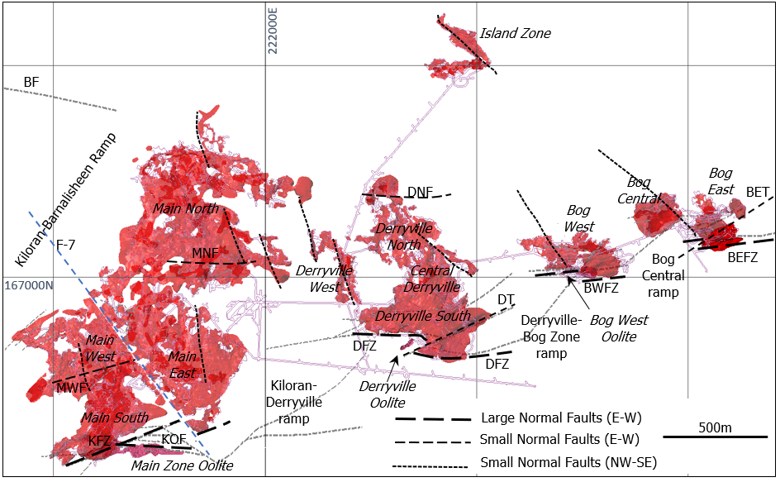

Slide 5
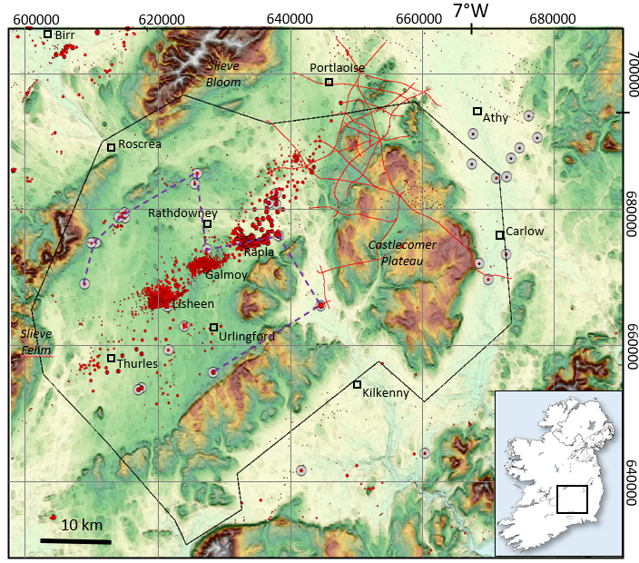
Stratigraphy and fault development
Pre, syn and post -rift sequences
Pre-rift marine transgression
Rifting likely commenced very end-Ballysteen or early-Waulsortian and continued into Aghmacart. Durrow and above post-rift.
Fault growth very slow
Paralleling fault trends likely exist
After R. Doyle 2023
Notes:
Stratigraphy
ORS unconformable on Silurian metasediments.
Marine transgression with development of shelf carbonates.
progressively deepening but periods of shallowing during Ballysteen – Lisduff Oolite member
deepest period during development of Waulsortian mudmound bioherms
Shallowing again after this through Crosspatrick to littoral facies carbonates in Aghmacart.
Fault Development:
Subject of PhD research project at iCRAG
First rifting possibly at end of Ballysteen – possible FW\HW - true in basin centre -huge thickness differences related to fault growth.
Variable Waulsortian thicknesses regionally
despite this - good evidence at Rapla where FW\HW are preserved rapid thicknesses changes - doubly true for Crosspatrick
thickness differences in the Aghmacart not available on either side of the fault but interesting facies changes (work ongoing)
Durrow and above likely post-rift.
Fault growth:
very slow (180m) over millions of years. - surely too slow to effect change in Waulsortian facies development?
Stratigraphy trends & parallel fault trends:
typically dipping to SE so ore horizon eroded to north and deeply buried to SE
Consequently, very little drilling done in these areas but similar paralleling fault trends to RT almost certainly exist
Mineral occurrence at Shanakill has fault associated oolite and Waulsortian hosted Zn\Pb.
Derrykearn is likely on a paralleling fault trend.

Slide 6
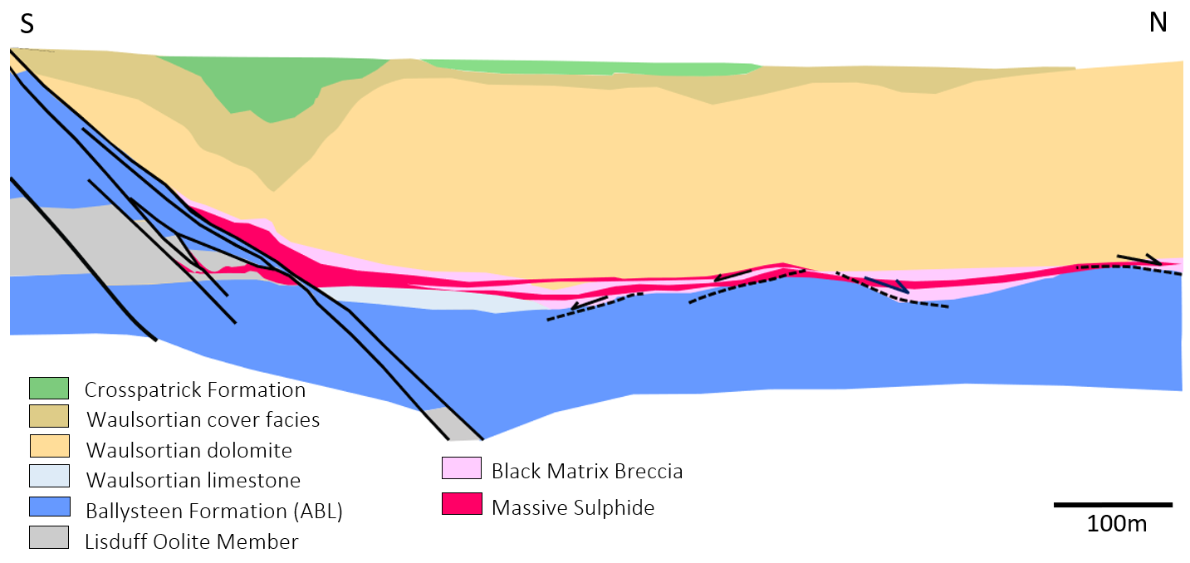
Structural and Stratigraphic Control on Mineralisation:
Waulsortian dolostone
Stratiform, developed in Waulsortian on or close to contact with ABL
Mineralisation mainly by replacement of hydrothermal dolomite, BMB and favoured host-rock facies. Minor cavity filling sulphides and no significant remobilisation. Lisduff Oolite mineralised locally on FW of major structures
Variable ore thickness and grade: depending on structure, lithology, breccia development and proximity to fluid feeder or conduit
Host-rock permeability and rheology important controls on structural development fluid access
ABL
Notes:
Description of lithologies:
ABL – bedded and argillaceous
Lisduff Ooilte – the first clean Limestone – yet only mineralised in and adjacent faults.
Green Tuff
variability at NUM contact
Waulsortian (main ore host rock and regionally dolomitised) and description of facies: Core, Flank and Cover
Development of majority cover facies towards end of Waulsortian into Crosspatrick
Top units not preserved at Galmoy
Position and controls on mineralisation :
Stratiform, developed in Waulsortian on or close to contact with ABL
Mineralisation mainly by replacement of hydrothermal dolomite, BMB and favoured host-rock facies.
Minor cavity filling sulphides and no significant remobilisation.
Lisduff Oolite mineralised locally on FW of major structures
Variable ore thickness and grade:
depending on structure, lithology, breccia development and proximity to fluid feeder or conduit
Host-rock permeability and rheology:
important controls on structural development fluid access

Slide 7
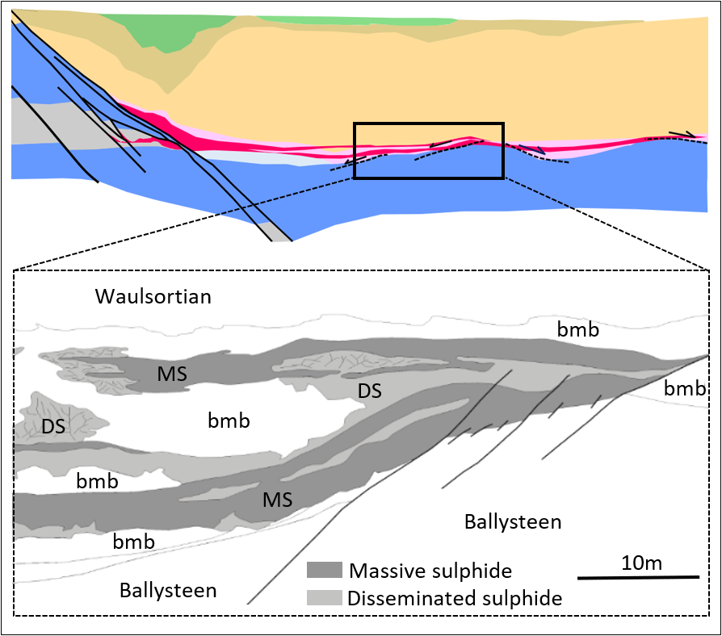
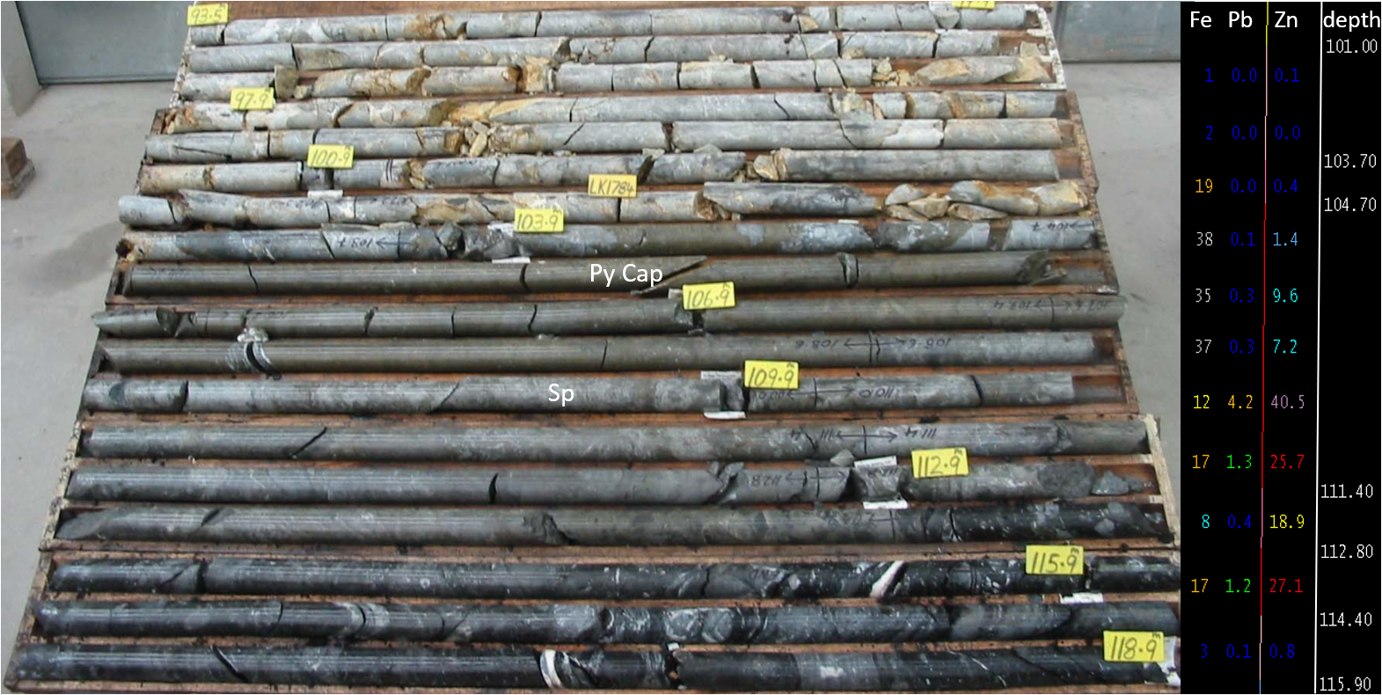
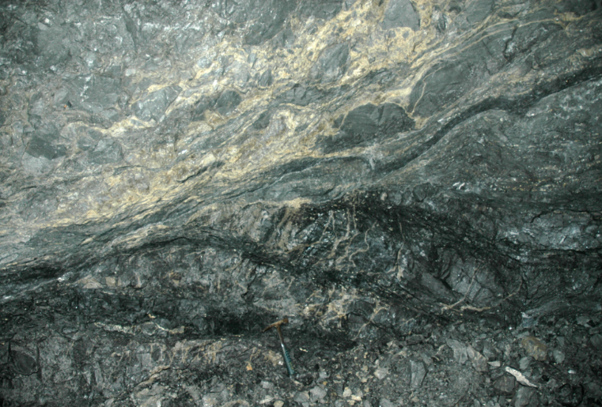
Extensional faulting on ABL \ Waulsortian contact
Low-angle extensional structures widely developed on ABL \ Waulsortian contact.
Important fluid conduit
- initial permeability augmented by dolomitization and dissolution
Unique to Rathdowney Trend?
- at Lisheen and Galmoy but appear less so at Rapla (data?)
Notes:
Low-angle extensional structures widely developed on ABL \ Waulsortian contact.
(describe mineral intersection pic)
Important fluid conduit
initial permeability augmented by dolomitization and dissolution (describe grade distribution about the structures in pic)
Unique to Rathdowney Trend?
at Lisheen and Galmoy but appear less so at Rapla (data?)

Slide 8
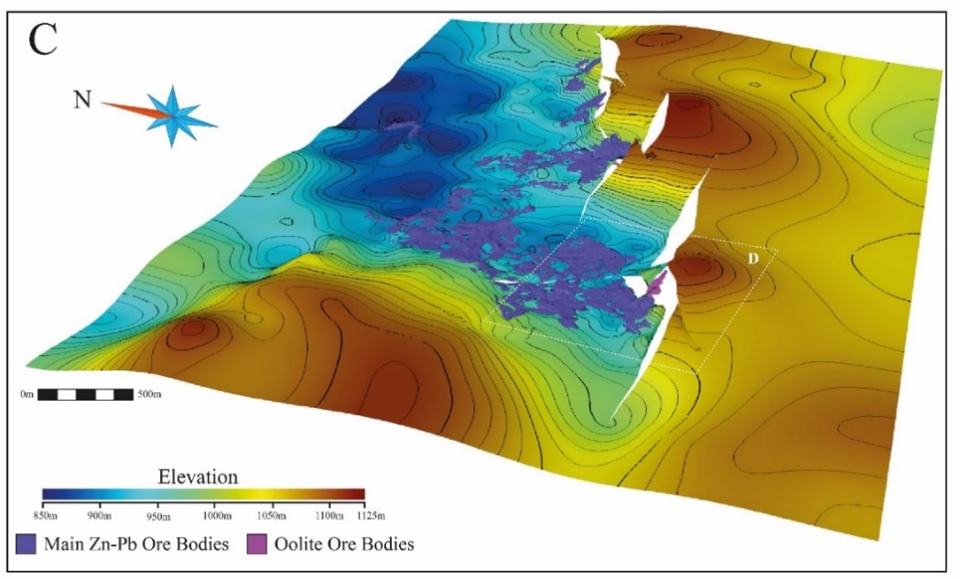
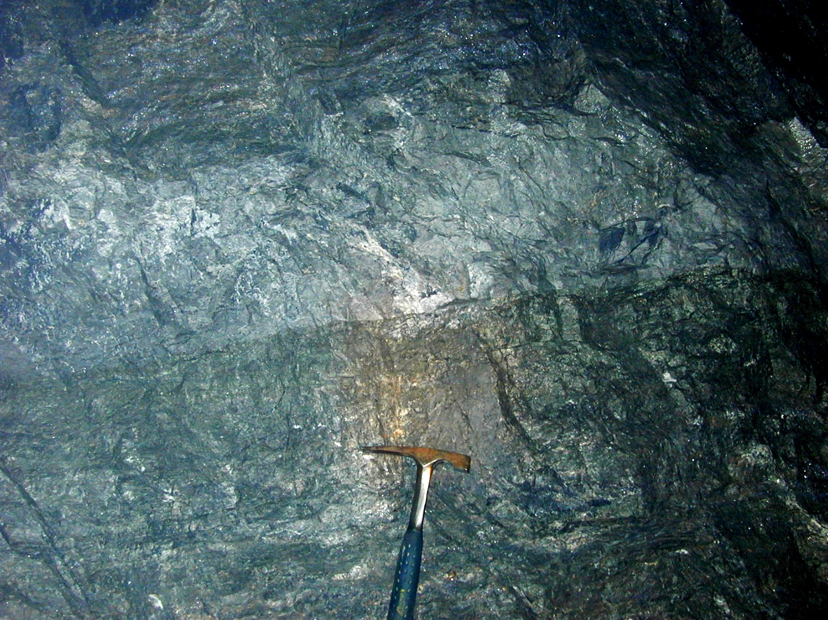
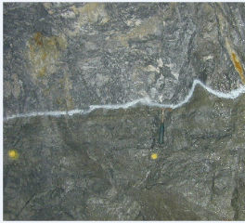
Permeability control and nature of fluids
Fluids bound by impermeable ABL
No anomalous mineralisation in lithologies on structural FW or higher up in Waulsortian
Strong fluid control on ore geometry
Sharp stratiform HW contacts
Banded sulphides replacing heterogeneous breccias
HW ore contact commonly stratiform despite structural irregularity
Notes:
Fluids must have been dense:
Bound by footwall ABL beneath and in fault juxtaposition to south.
No anomalous mineralisation in lithologies to south or higher in Waulsortian
(describe figures)
Kyne et al. – Ore developed in on contact lows
Stratiform HW geometry despite structural irregularities
Fluid control on Mineralisation
banded sulphide replacement of heterogeneous breccias.

Slide 9
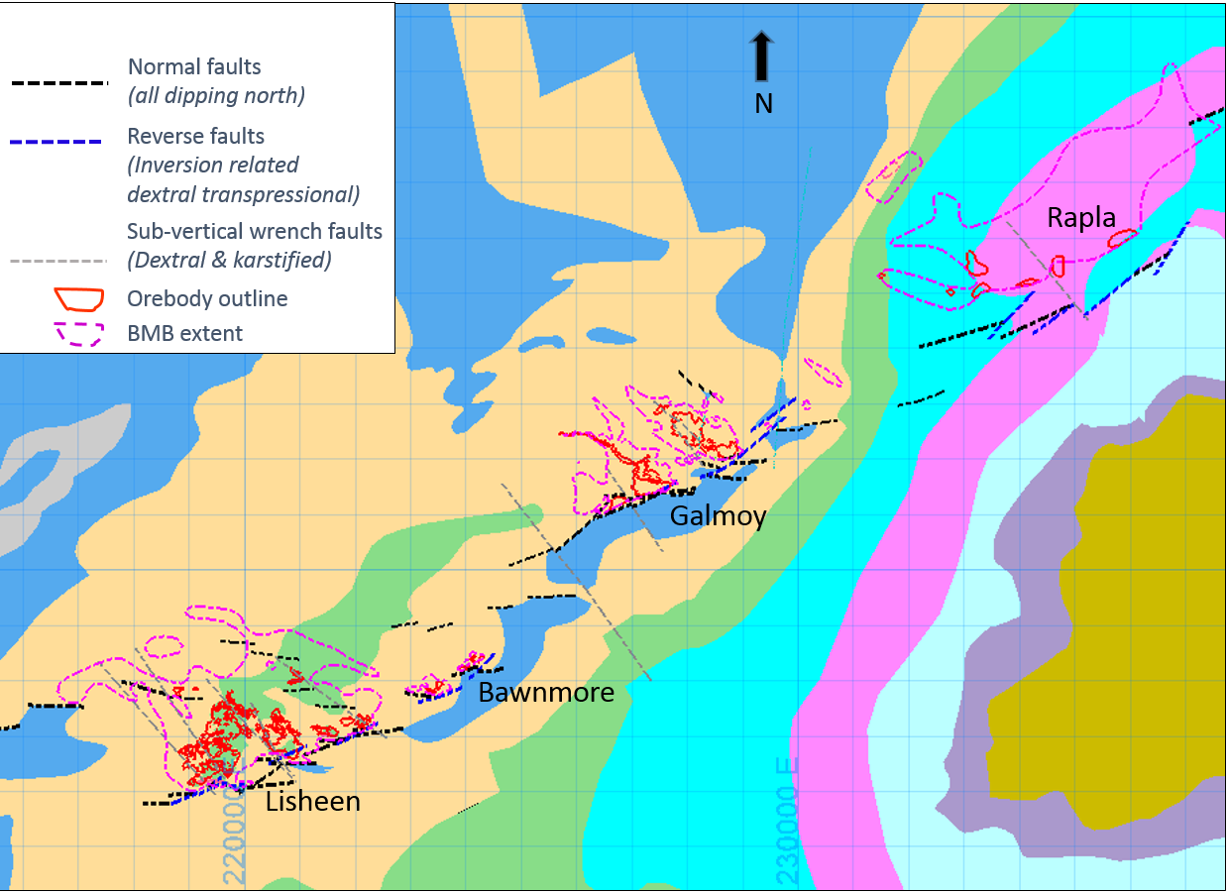
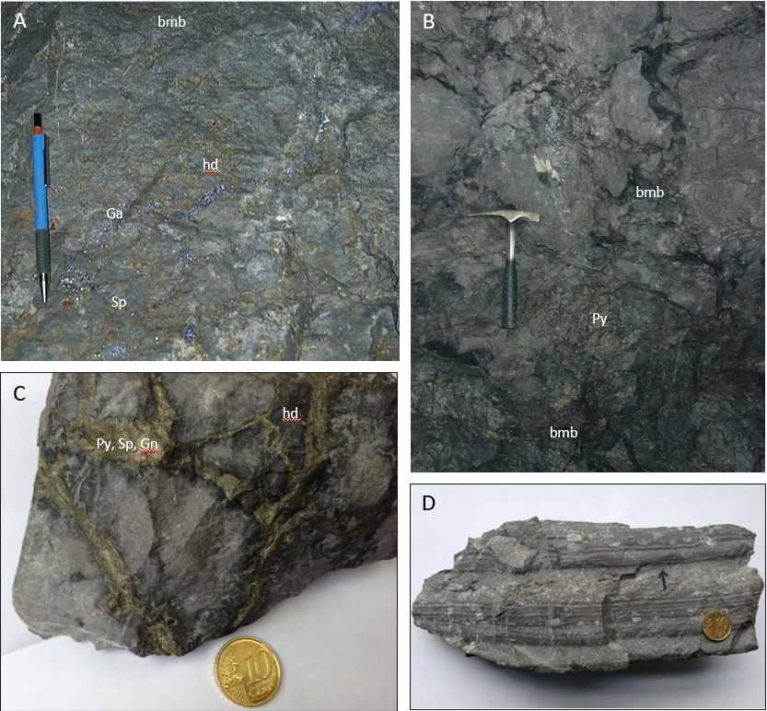
Black matrix breccia
Waulsortian
dolostone
Insert figure here of bmb \reef cnt
BMB
1m
massive sulphide
Hydrothermal dolomite intimately associated with mineralisation
Not always a breccia
Degree of its development a good indicator of the strength of the mineralising system
Forms a halo laterally around the orebodies but usually tight or a few metres above ore hanging-wall.
Dark-grey, black hydrothermal dolomite
- extremely fine-grained dolomite
- coarse or fine, corroded or angular clasts
- clast or matrix-supported
Processes:
- replacement (of earlier dolomites?)
- dissolution and collapse (stoping)
- dolomite precipitation

Slide 10
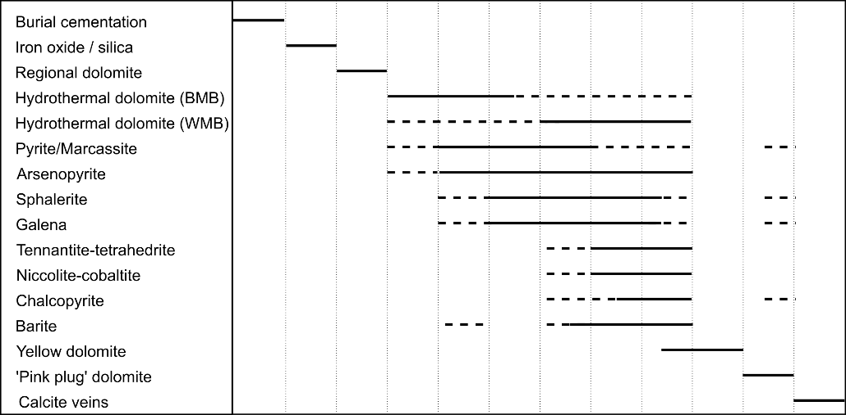
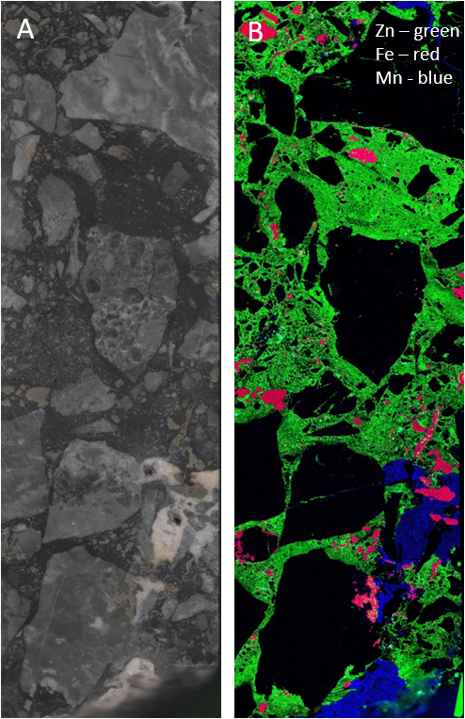
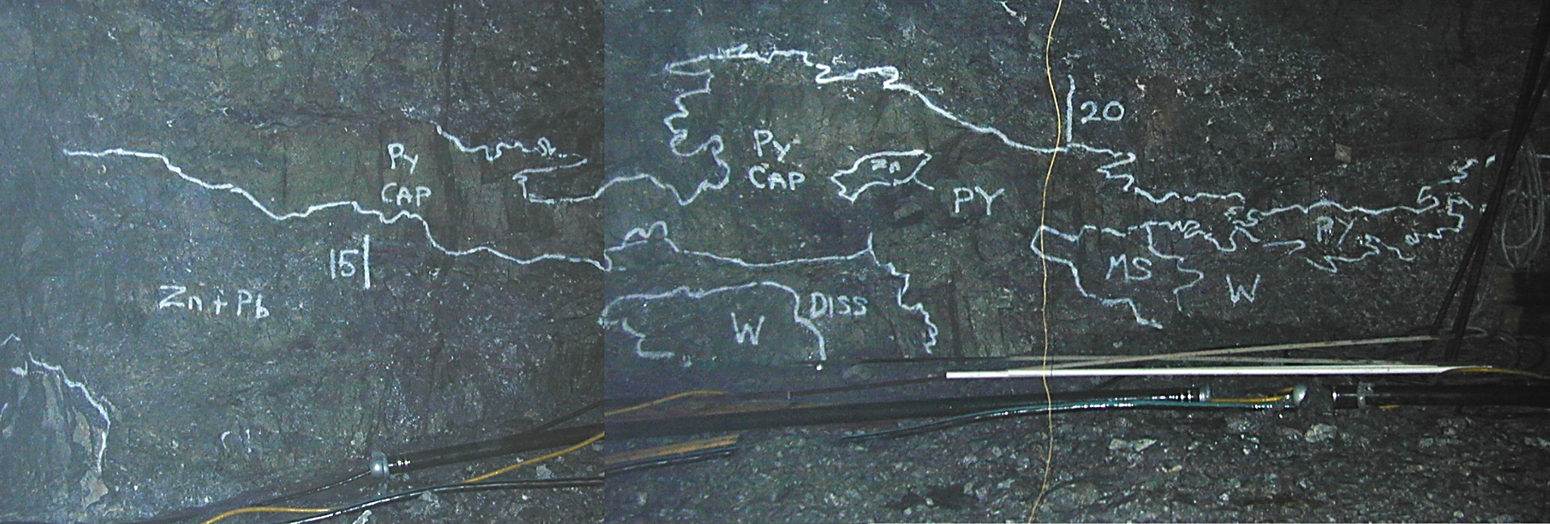
Paragenesis of Black matrix breccia
Paragenetically: before, during and possibly after sulphides
Matrix usually replaced before clasts but complete replacement of breccia if mineralisation is strong enough.
Maia mapper (micro-XRF map): BMB’s associated with base metals have trace Zn in matrix but others barren.
Paragenesis complicated but in summary: dol, Pyrite, Zn-Pb
Early pyrite extensively replaced by later Zn-Pb

Slide 11
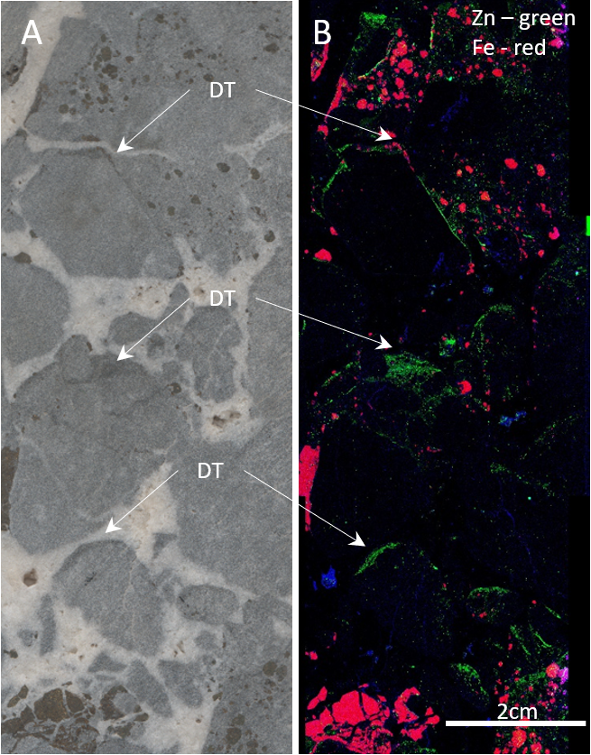
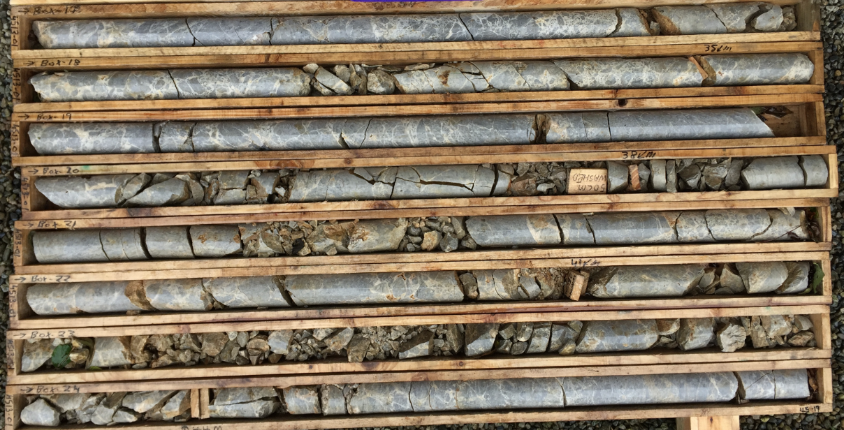
White matrix breccias
Coarse, white, crystalline, hydrothermal dolomite
- sometimes with trace mineralisation proximal to orebody.
Links to BMB but much less restricted distribution vertically and laterally.
Formation:
- Normal fault association – brittle fracture - extension of massive dolostones?
- Dissolution collapse related to mineralisation?
Maia mapper micro-XRF map, fractures open during mineralisation.

Slide 12
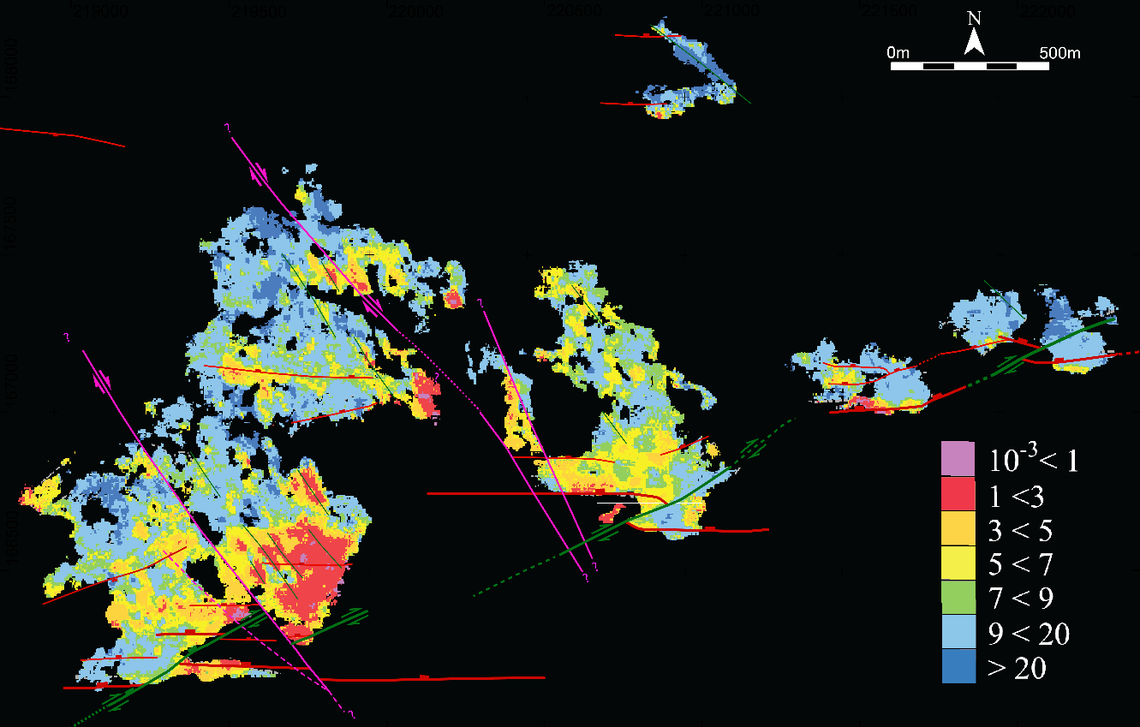
Faulted oolite conduit and feeder
Faulting primary importance as conduits for mineralising fluids from source rocks (basement) to the Waulsortian host-rock
Fractured oolite important fluid pathway to Waulsortian host:
Multiple pulses of mineralisation
- complex paragenesis
- brecciated sulphide textures common
- high Ni & Cu in oolite
Rapid precipitation of sulphides
Microcrystalline inter-grown sph. & gal. Both sulphide sediment and replacement
Massive niccolite in oolite at contact with Waulsortian 3Kt @ 10% Ni (resource)
42Kt @ 7.5% Cu (tennantite) in Waulsortian.
Zn:Pb

Slide 13
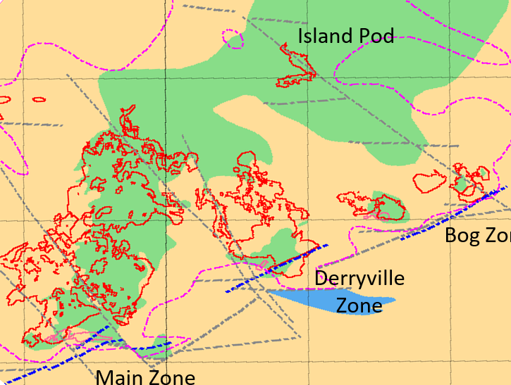
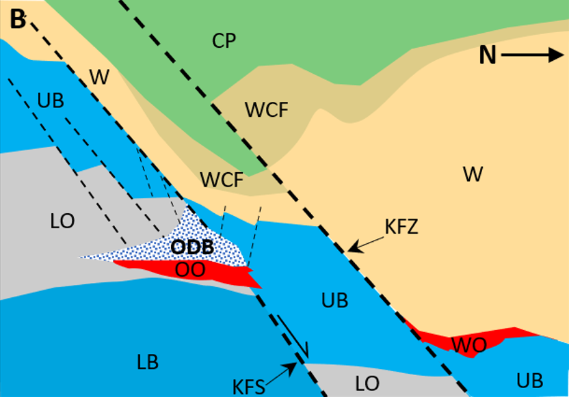
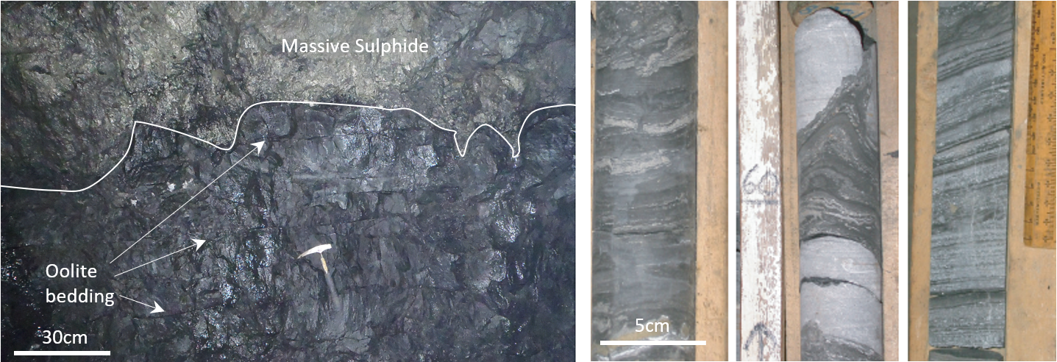
Dissolution associated with mineralisation
Strong inverse relationship between Waulsortian thickness and ore thickness
Dissolution greatest where massive sulphide and hydrothermal dolomites are best developed.
Influence on overlying stratigraphy and depositional lithofacies
→ TIMING

Slide 14
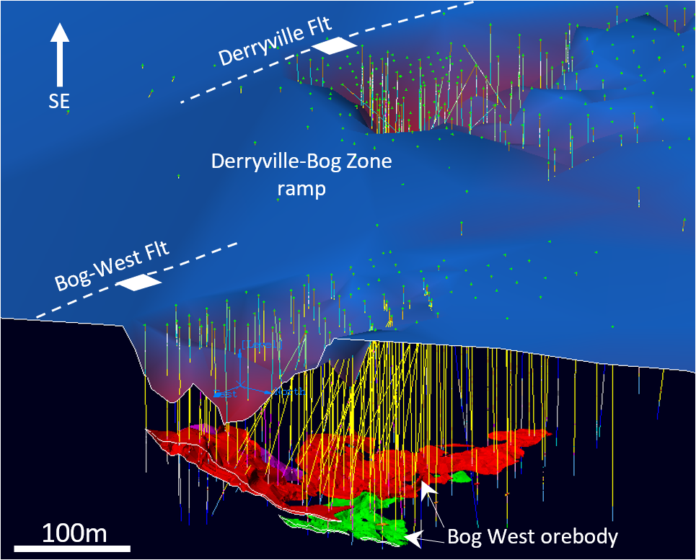
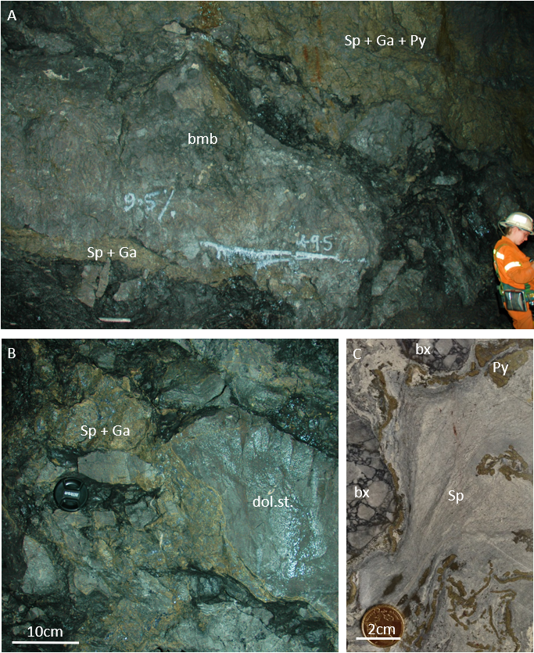
Dissolution associated with mineralisation

Slide 15
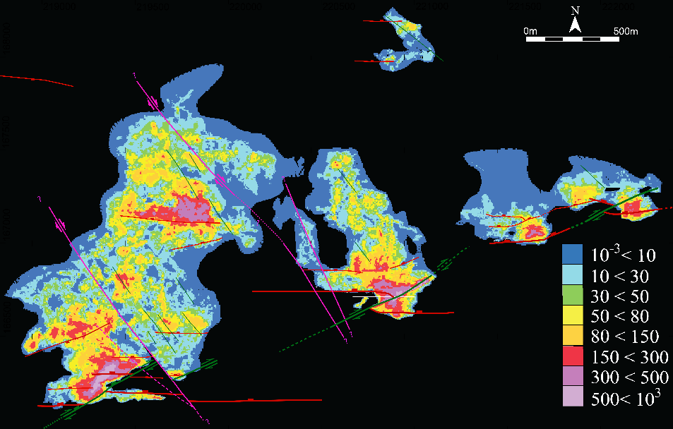
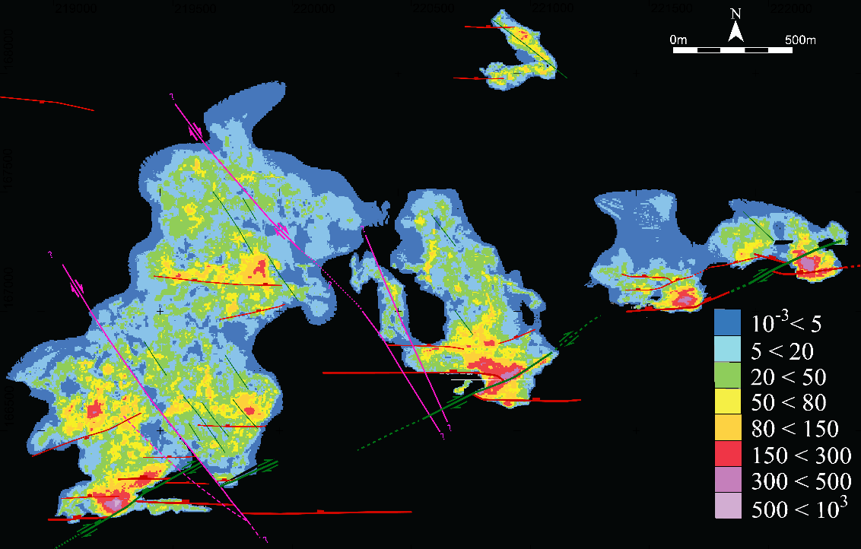
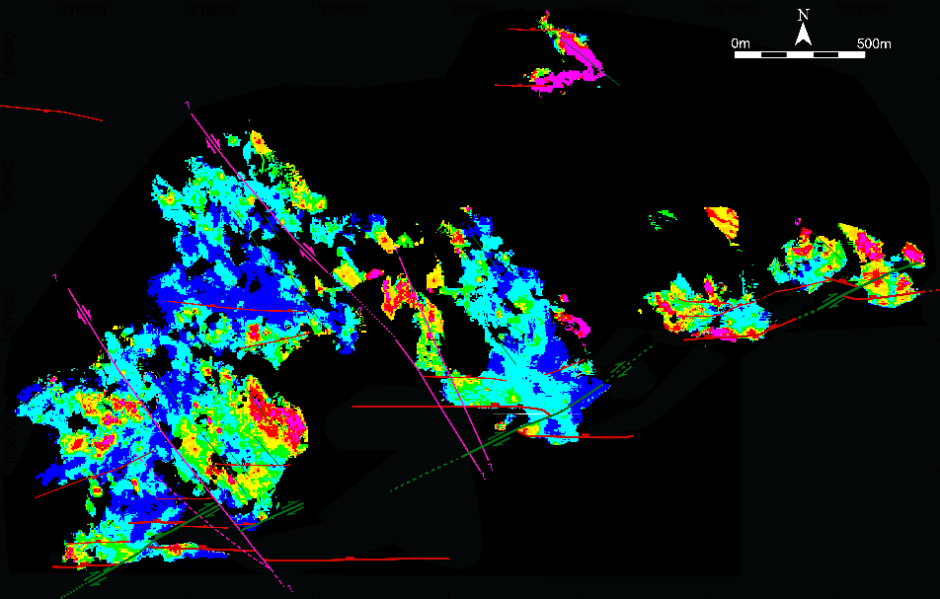
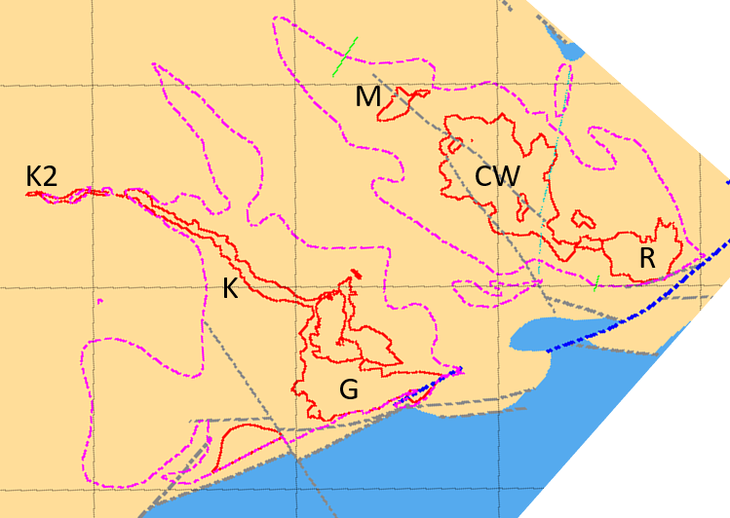
Evolving structural control
Fe
Zn
Zn/Fe
Mineralisation appears to be syn-tectonic
Early E-W trending extensional faults
Dissolution and bmb development
Early pyrite mineralisation replacing bmb and with continuing dissolution
Extension continues with displacement confined to main fault array.
Zn-Pb mineralisation replaces pyrite and bmb on these trends
Developing NW trending arrays available to paragenetically later Zn-Pb mineralisation

Slide 16
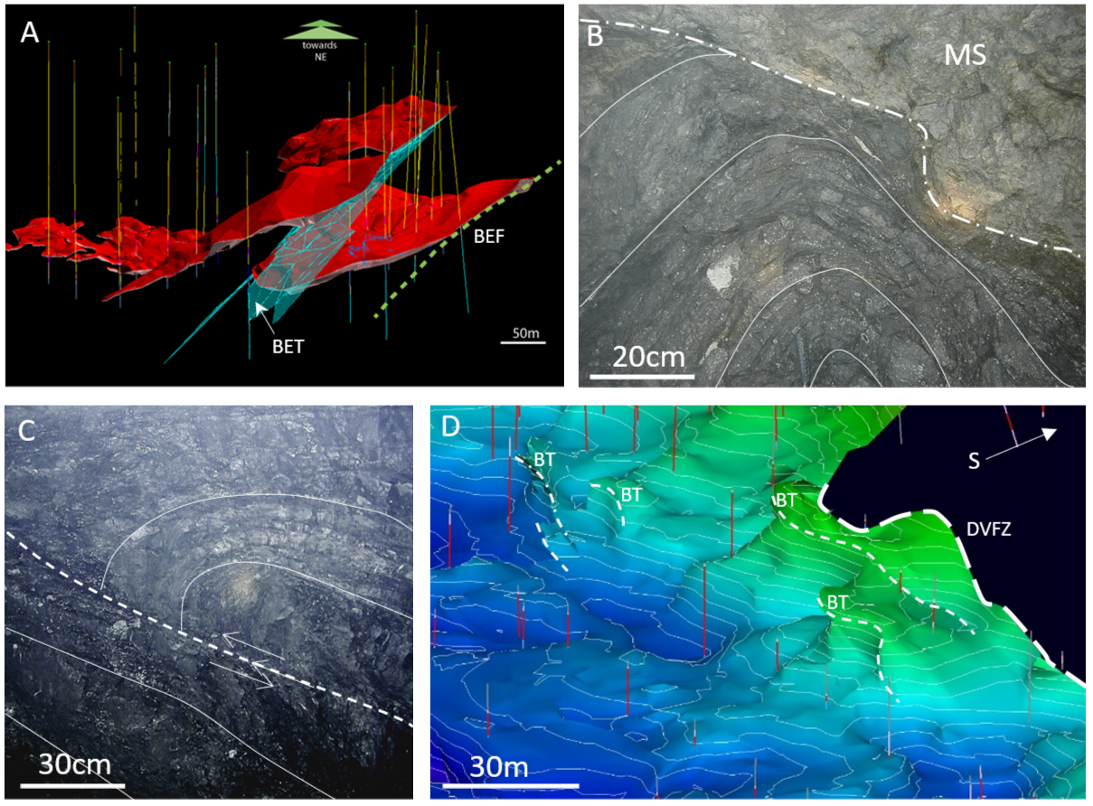
Inversion

Slide 17
Genetic Model and Summary

Slide 18
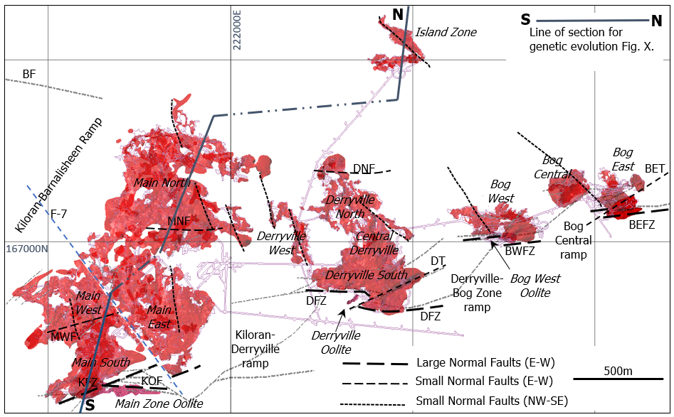

Slide 19
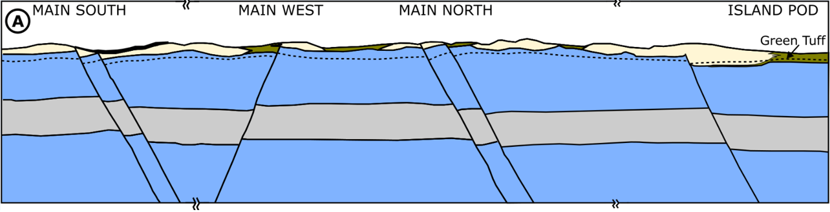
Early fault development
Extension initiates during late-Ballysteen to early Waulsortian - many small displacement faults.
Diachroneity of the contact. Bioherm development synchronous with Ballysteen, nodular micrite facies.
Earliest Waulsortian development at Island Pod where the Green tuff is within inter-mound facies.
Shale band developments locally in the Waulsortian possibly in HW of structures.

Slide 20
Early hydrothermal Phase
Regional dolomitization soon after lithification. Preservation of Waulsortian limestone beneath shale bands.
Continued extension resulting in development of low-angle faults at contact.
Fault death: Most displacement on just a few structures. Smaller structures cease development.
Breaching between fault segments on larger structures provides good conduits for fluid flow. Faulted Oolite becomes an important conduit and focus for dissolution.
Hydrothermal dolomitization and dissolution at base of Waulsortian generating black matrix breccias. Fluids access faults at contact and are contained by impermeable Ballysteen beneath and in fault juxtaposition to south.
Despite their high temperature, the hydrothermal fluids are stratified at the base of the Waulsortian.
Extension and dissolution promotes development of white dolomitic breccias in Waulsortian above.
Mineralization at Island Pod largely off the base Waulsortian contact.

Slide 21
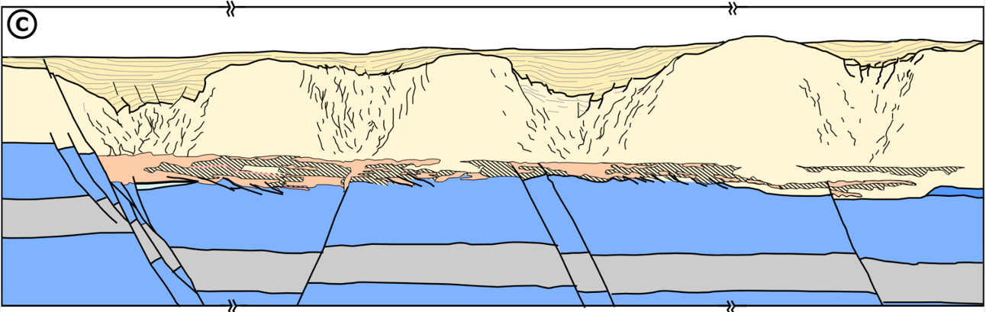
Late Waulsortian, Pyrite mineralization
Massive pyritic bodies develop largely by replacement of black matrix breccias. This is strongest in the hanging-walls of structures where fluid flow is most intense. Stratiform pyrite lenses also develop out into breccias from controlling fault conduits. Hydrothermal dolomitization continues.
Intense dissolution of Waulsortian in areas of most intense mineralization creating depocenters for increased thicknesses of cover facies developing above. These are also the sites of intense white matrix breccia development.
All displacement now on ore-controlling structures to south.
Dissolution in the Lisduff Oolite initiates collapse and fault development above.
Re-Os geochronology (Hnatyshin et al. (2015; 2020) on ore-stage pyrite from the Lisduff Oolite 346.6 ± 3.0 Ma
Waulsortian at Lisheen (353–347 Ma; Sevastopulo & Redmond, 1999; Waters et al., 2011; Somerville et al., 2012)

Slide 22
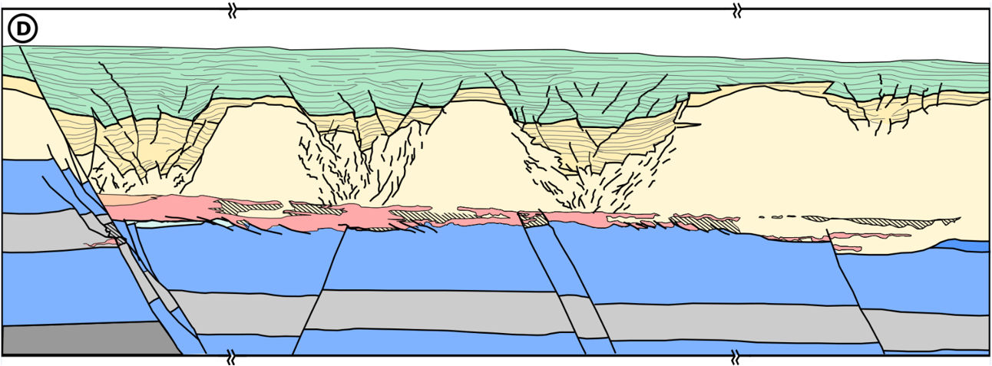
Crosspatrick, base metal mineralization
Last Waulsortian bioherm gives way to Crosspatrick development.
Continued extension on main ore-controlling structures
Zn-Pb mineralization replaces mainly massive pyrite bodies and hydrothermal breccias but also certain permeable dolomitized Waulsortian facies. Synchronous ongoing going hydrothermal dolomitization and breccia development.
Strongest fluid flow and consequently replacement and grade at base contact of pyrite bodies.
Development of new, northwest – southeast trending extensional fault arrays that provide additional conduits for base metal fluids.
Associated dissolution affects Crosspatrick sedimentation.
Replacement of oolite pyrites and dissolution breccias. Now in close juxtaposition with Waulsortian in hanging-wall.

Slide 23
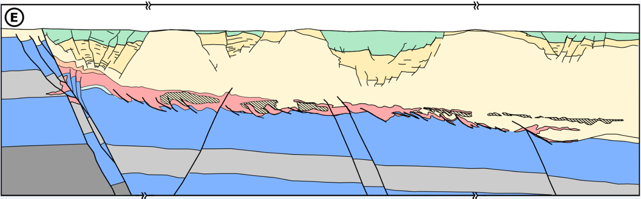
E. Cessation of extension, mineralization and post ore events
Full displacement approx. 180m.
Mineralization likely continues to end of extensional tectonic phase.
Waulsortian thickness greatly reduced in areas of most intense mineralization.
Late-stage Ni and Cu minerals develop in the oolite breccias and adjacent Waulsortian, now juxtaposed in the structural hanging-wall.
Later inversion reactivates the extensional structures. Contact low-angle extensional structures are folded and the orebody is deformed up against ore-controlling faults as old fault segments are reactivated.

Slide 24
Acknowledgments
With support from:
This presentation has emanated from research supported in part by:
a research grant to iCRAG from Science Foundation Ireland (SFI) under Grant Number 13/RC/2092 and co-funded under the European Regional Development Fund and by iCRAG industry partners
a research grant to iCRAG2 from Science Foundation Ireland (SRI) under Grant Number 13/RC/2092_2
the Horizon 2020 research and innovation programme under the Marie Skłodowska-Curie Individual Fellowship grant agreement No. 745945,
a research professorship grant to UCD from Science Foundation Ireland (SFI) under Grant Number 16/SP/4319,
an SFI Industry Fellowship research grant from Science Foundation Ireland (SFI) under Grant Number 18/IF/6330 and co-funded by Teck,
a grant to contribute to the Blue Book project from Geological Survey Ireland through a Memorandum of Understanding with UCD.
The authors would like to thank the Geological Survey Ireland (GSI), Exploration and Mining Division (EMD), and Petroleum Affairs Division (PAD) of the Department of Communications, Climate Action and Environment (DCCAE), Ireland, for providing access to released well, seismic and potential field datasets.
All rights reserved on the content, images and data within this presentation.
Academic Software licences

