Slide 1
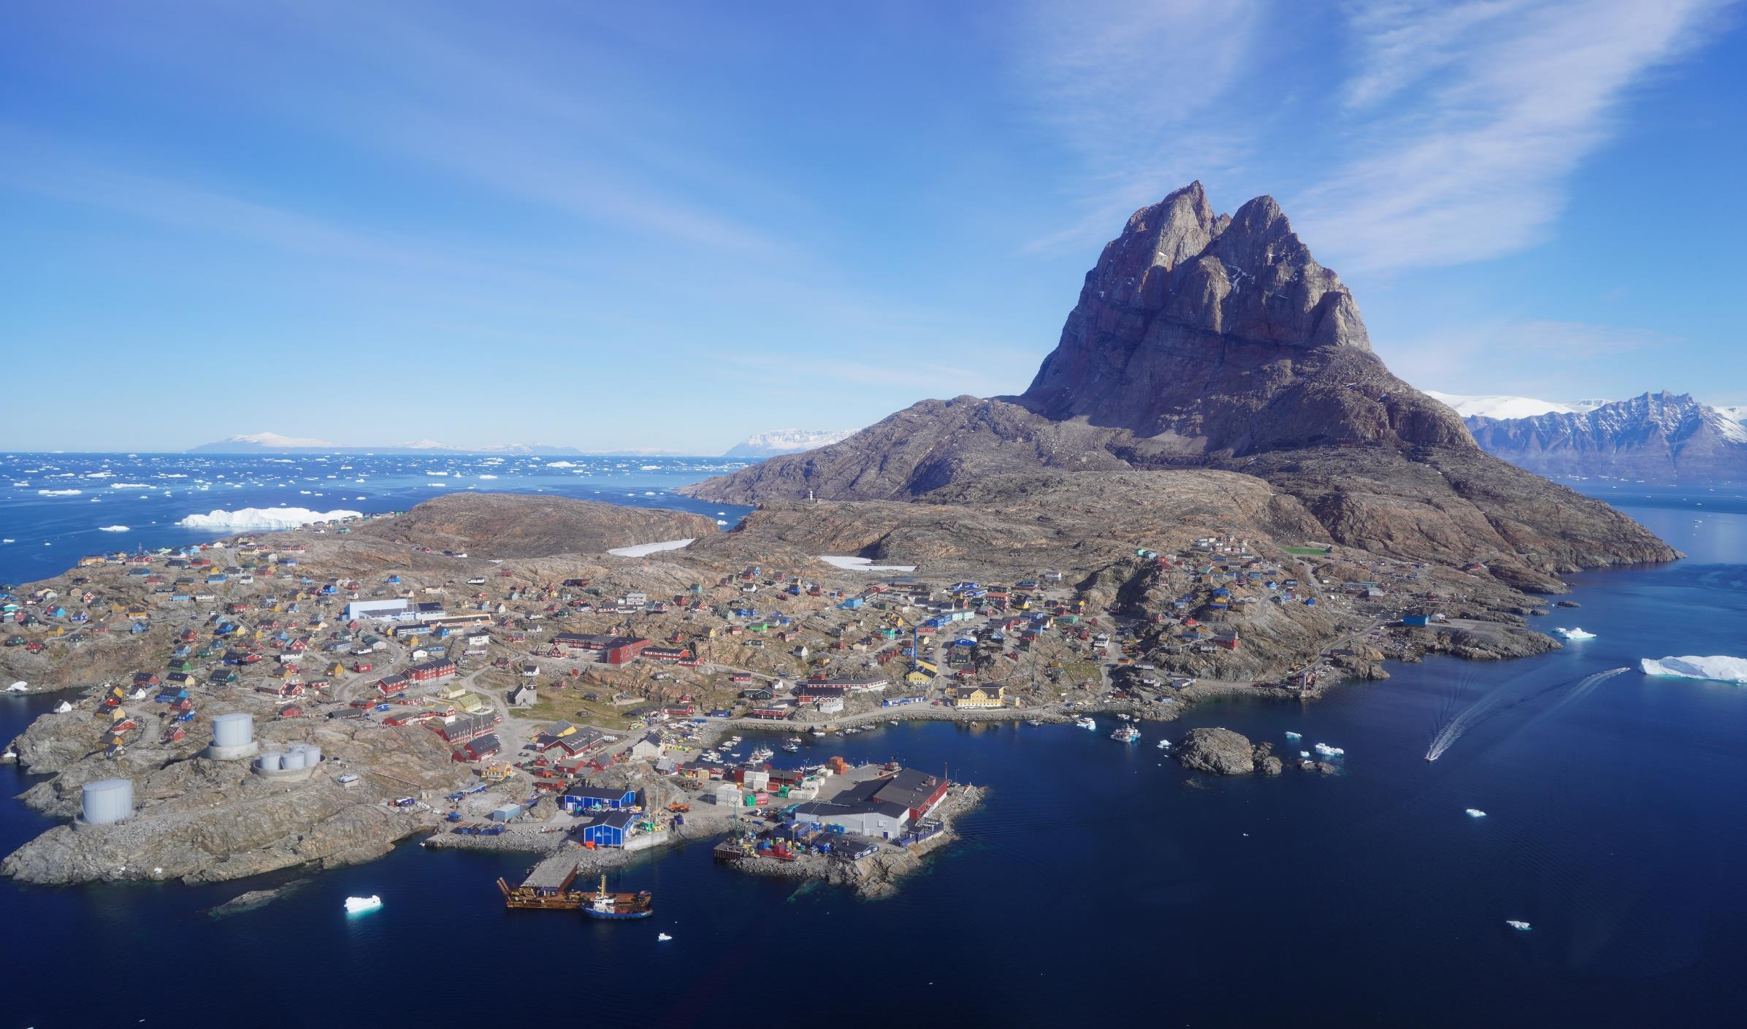


Paleoproterozoic Zn-Pb-Ag (± Cu, Critical Metal) mineralisation in the Karrat Group, Central West Greenland
Joshua W. Hughes¹*, Urpo Kuronen¹, Turo Ahokas³, Prof. Jochen Kolb², Prof. Pierpaolo Guarnieri⁴, Nigel Baker⁴, Dr Bo Møller Stensgaard¹ and Michael Eigler²
¹ Bluejay Mining plc, United Kingdom
² Karlsruhe Institute of Technology, Germany
³ Astrock Oy, Finland
⁴ Geological Survey of Denmark and Greeland
* e-mail, joshua@bluejaymining.com

Slide 2
Cautionary Statements
This presentation (‘Presentation’), and the information contained herein, is not for viewing, release, distribution or publication into or in the United States or any other jurisdiction where applicable laws prohibit its release, distribution or publication. This Presentation is being issued by Bluejay Mining plc (the ‘Company’ or ‘Bluejay’) for information purposes only. The content of this Presentation has not been approved by an authorised person for the purposes of Section 21(2)(b) of the Financial Services and Markets Act 2000. Reliance on this Presentation for the purpose of engaging in any investment activity may expose an individual to a significant risk of losing all of the property or other assets invested. This Presentation is not an admission document or an advertisement and does not constitute or form part of, and should not be construed as, an offer or invitation to sell or any solicitation of any offer to purchase or subscribe for any shares in the Company (‘Shares’) in the United States or any other jurisdiction.
Neither the Presentation, nor any part of it nor anything contained or referred to in it, nor the fact of its distribution, should form the basis of or be relied on in connection with or act as an inducement in relation to a decision to purchase or subscribe for or enter into any contract or make any other commitment whatsoever in relation to any Shares. Whilst the Presentation has been prepared in good faith, no representation or warranty, express or implied, is given by or on behalf of the Company, its respective directors and affiliates or any other person as to the accuracy or completeness of the information or opinions contained in this Presentation and no responsibility or liability whatsoever is or will be accepted by the Company, its respective directors and affiliates or any other person for any loss howsoever arising, directly or indirectly, from any use of such information or opinions or otherwise arising in connection therewith. Any such liability is expressly disclaimed. The contents of this Presentation are confidential and may not be copied, distributed, published or reproduced in whole or in part, or disclosed or distributed by recipients to any other person. No reliance may be placed for any purpose whatsoever on the information or opinions contained in this Presentation or on its completeness, accuracy or fairness. Certain statements, beliefs and opinions in this Presentation are forward-looking, which reflect the Company’s or, as appropriate, the Company’s directors’ and/or proposed directors’ current expectations and projections about future events. By their nature, forward-looking statements involve a number of risks, uncertainties and assumptions that could cause actual results or events to differ materially from those expressed or implied by the forward-looking statements. These risks, uncertainties and assumptions could adversely affect the outcome and financial effects of the plans and events described herein. Although reasonable care has been taken to ensure the facts stated in this Presentation are accurate and that the assumptions expressed are fair and reasonable the information in this Presentation, which includes certain information drawn from public sources, does not purport to be comprehensive, and has not been independently verified and is liable to change. The date of this Presentation is November 2016. Forward-looking statements contained in this document regarding past trends or activities should not be taken as a representation that such trends or activities will continue in the future. The Company does not undertake any obligation to update or revise any forward-looking statements, whether as a result of new information, future events or otherwise. You should not place undue reliance on forward-looking statements, which speak only as of the date of this document. Recipients should not treat the contents of this Presentation as advice relating to legal, taxation or investment matters, and are to make their own assessments concerning these and other consequences of the various investments, including the merits of investing and the risks. Recipients are advised to conduct their own due diligence. Accordingly, recipients should note that the Brokers are neither advising nor treating as a client any other person and will not be responsible to anyone other than the Company for providing the protections afforded to clients of the Brokers under the COBS nor for providing advice in relation to the proposals contained in this Presentation. The promotion of the Shares and the distribution of this Presentation in the United Kingdom are restricted by law. Accordingly, this Presentation is directed only at (i) persons outside the United Kingdom to whom it is lawful to communicate it, or (ii) persons having professional experience in matters relating to investments who fall within the definition "investment professionals" in Article 19(5) of the Financial Services and Markets Act 2000 (Financial Promotion) Order 2005, as amended (the ‘Order’), or (iii) high net worth companies, unincorporated associations and partnerships and trustees of high value trusts as described in Article 49(2) of the Order and any other persons who fall within other applicable exemptions under the Order (together, ‘Relevant Persons’). Any investment or investment activity to which this Presentation relates is available only to, and will be engaged in only with, Relevant Persons. This Presentation must not be acted on or relied on by persons who are not Relevant Persons. You represent and agree that you are a Relevant Person. In receiving any information relating to the Company (whether in written or oral form), including the information in this Presentation, you will be deemed to have represented and agreed for the benefit of the Company and the other legal and financial advisers participating in this process (i) that you will only use such information for the purposes of discussions with the Company, (ii) to hold such information in strict confidence and not to disclose it (or any discussions with any of the Company) to any person, except as may be required by law, regulation or court order, (iii) not to reproduce or distribute, in whole or in part, (directly or indirectly) any of the information in this Presentation; (iv) that you will comply with all laws applicable to possessing such information, including without limitation insider trading laws, market abuse regulations and applicable regulations and recommendations of the UK Financial Conduct Authority or any other relevant regulator, and (v) that you are permitted, in accordance with all applicable laws of all applicable jurisdictions, to receive such information. This Presentation (including its contents) is confidential and is for distribution only to a limited number of companies or persons and their professional advisers selected by the Company and its financial adviser for that purpose. It is not intended to be distributed or passed on, directly, or indirectly, to, and may not be read by, any other persons without the express written consent of the Company. This Presentation is being supplied to you solely for your information and may not be copied, reproduced, further distributed to any other person or published, in whole or in part, for any purpose. The distribution of this Presentation in certain non-UK jurisdictions may be restricted by law and therefore persons into whose possession this document comes should inform themselves about and observe any such restrictions. Any such distribution could result in a violation of the law of such jurisdictions. Neither this document nor any copy of it may, subject to certain exemptions, be taken or transmitted into Australia, Canada, Japan, South Africa, Singapore, or the US or distributed to these countries or to any national, citizen or resident thereof or any corporation, partnership or other entity created or organised under the laws thereof. This Presentation does not constitute or form any part of an offer or invitation to sell or issue or any solicitation of any offer to purchase or subscribe or otherwise acquire, any ordinary shares in the Company in any jurisdiction. No person other than Company is authorised to give any information or to make any representation other than as contained in this document and, if given or made, such information or representation must not be relied upon as having been authorised by the Company. This Presentation has been delivered to interested parties for information only and on the express understanding that they shall use it only for the purpose set out above. The distribution of this Presentation shall not be deemed to be any form of commitment on the part of the Company to proceed with any transaction. Any dispute, action or other proceeding concerning this presentation shall be adjudicated within the exclusive jurisdiction of the courts of England. All material contained in this Presentation (including in this disclaimer) shall be governed by and construed in accordance with the laws of England and Wales. Please note that the information in this Presentation has yet to be announced or otherwise made public and as such constitutes inside information as defined by Market Abuse Regulation, relevant information for the purposes of section 118 of FSMA and non-public price sensitive information for the purposes of the Criminal Justice Act 1993. You should not therefore deal in any way in the securities of the Company until after the formal release of an announcement by the Company as to do so may result in civil and/or criminal liability. Issued by Bluejay, a company incorporated in the England and Wales under number 07245568.
The information in this presentation that relates to Exploration Results, Mineral Resources or Ore Reserves is based on information compiled by Mr. Joshua Hughes MESci (Hons), Vice President Exploration, and a full-time employee of Bluejay Mining plc, who is also a Member and Chartered Professional Geologist ("MAusIMM CP(Geo)") of the Australasian Institute of Mining and Metallurgy, a Fellow of the Society of Economic Geologists ("FSEG") and a Fellow of the Geological Society of London ("FGS"). Mr. Hughes has sufficient experience, relevant to the styles of mineralisation and type of deposits under consideration and to the activity that he is undertaking, to qualify as a Qualified Person ("QP") as defined by the AIM rules, and for the purposes of National Instrument 43-101 ("NI-43-101") Standards of Disclosure of Mineral Projects.

Slide 3


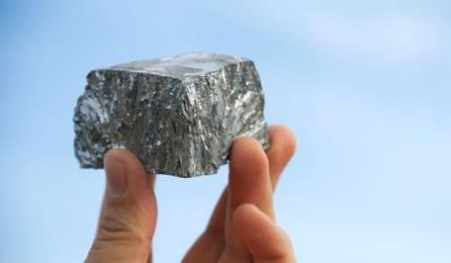
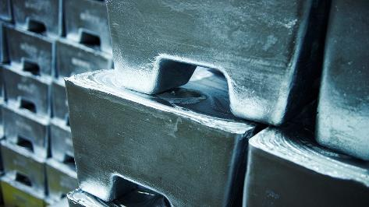
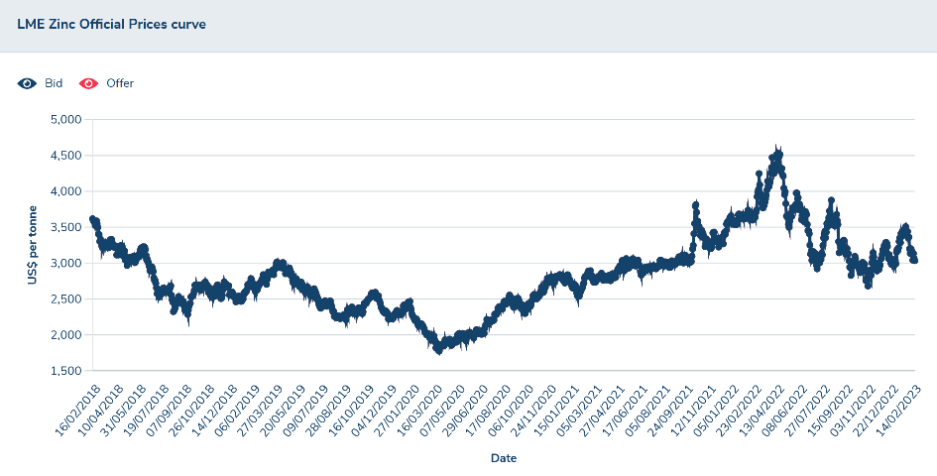
Why Zinc (from a junior's perspective)?
Bullish outlook: chronic shortages in zinc supply are forecasted. Depletion of many major zinc mines, coupled with limited new mine developments is leading to a nascent bull market for zinc. Zinc consumption c. 20 Mt by 2050.
An increasing focus and investment appetite for zinc exploration and development projects is expected.
Global stimulus incoming: fiscal stimulus will focus on infrastructure which is bullish for zinc.
The underplayed battery metal: whilst it hasn’t received the same attention as lithium, nickel, or cobalt, it will undoubtably play an essential role in global decarbonisation and the green energy revolution.
Already the fourth most mined metal by volume, alongside its traditional uses it has ever-increasing role in batteries, wind turbines, solar panels, fertilizers, and other new applications.
Increasing recognition of zinc as a critical metal: geopolitical conflict and resource nationalism are fuelling critical metal focus
Bluejay well positioned in the zinc space – with the Company’s Kangerluarsuk (this talk), Hammaslahti (VMS) and Outokumpu (Outokumpu type VMS) projects.
Zinc prices reached record highs in 2022
Zinc metal price 2018 - present
(figure from: London Metals Exchange)

Slide 4
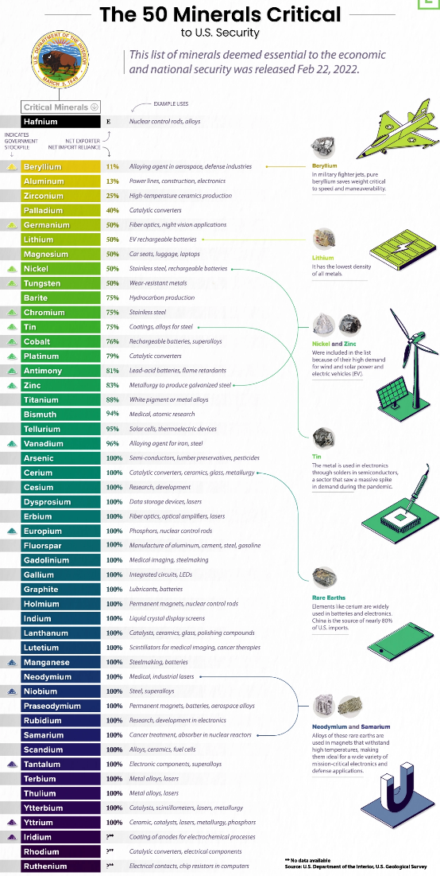
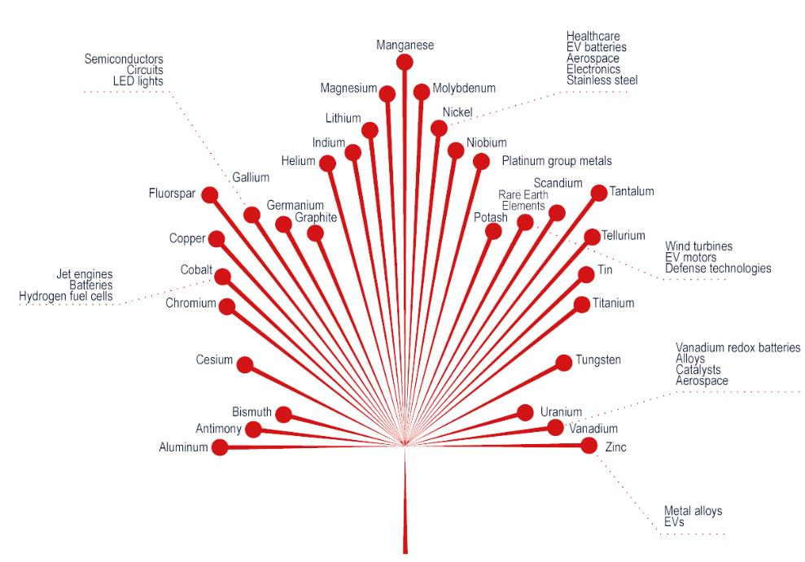
Increasing recognition of zinc as a critical metal
Zinc for the first time included in both the US and Canada’s most recent Critical Minerals Lists (minerals deemed essential to their economies and national security, whilst also facing significant supply risk).
Germanium is also considered a critical mineral by the US, Canada, UK and EU. Recent mineralogical work for the Karrat Group indicates a previously unrecognised potential for germanium associated with the Zn-Pb-Ag mineralisation.
U.S. Critical Minerals List, 2022
(figure from: Visual Capitalist)
Canada Critical Minerals List, 2021
(figure from: The Canadian Critical Minerals Strategy report)

Slide 5


Largest island in the world (roughly the size of Western Europe)
The most northerly country in the world
Around 80 % of the country is covered by permanent ice (the “Greenland Icesheet”). Ice-free area available for mineral exploration is roughly the size of Sweden.
The Greenland Icesheet is up to 3.5 km thick and contains approximately 7% of all the fresh water on earth
Greenland has a population of only 56,600 (of which 19,600 live in the capital city, Nuuk). For comparison, the population of Galway = 79,900!
Greenland

Slide 6

Largest island in the world (roughly the size of Western Europe)
The most northerly country in the world
Around 80 % of the country is covered by permanent ice (the “Greenland Icesheet”). Ice-free area available for mineral exploration is roughly the size of Sweden.
The Greenland Icesheet is up to 3.5 km thick and contains approximately 7% of all the fresh water on earth
Greenland has a population of only 56,600 (of which 19,600 live in the capital city, Nuuk). For comparison, the population of Galway = 79,900!
Greenland

Slide 7

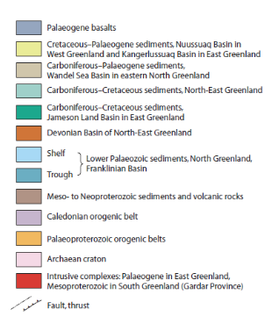
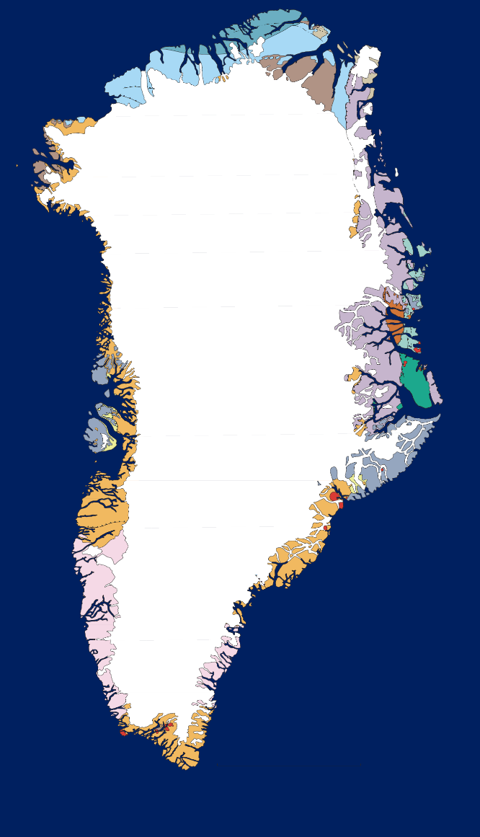



Bluejay’s Greenlandic Portfolio
Bluejay is one of the largest landholders in Greenland. Total area: 4731 sq km.
One of the few exploration companies with a permanent presence in Greenland & in-house logistical/operations team. One of the lowest cost explorers in Greenland.
Portfolio focussed on base metals (centered on Central West Greenland).
Projects are held under three separate subsidiaries:
  Dundas Titanium A/S (100% owned);
  Nikkeli Greenland A/S (49% owned, 52% KoBold Metals);
  Disko Exploration Ltd (100% owned).
Largest ever investment in Greenland infrastructure underway. Currently 2 international airports (Kangerlussuaq and Narsarsuaq) with 3 under construction (Ilulissat, Nuuk and Qaqortoq).
Dundas Project (ilmenite mineral sands - titanium) Exploitation Licence & Exploration Licence
99 sq km
Kangerluarsuk Project (Zn-Pb-Ag)
Exploration Licences
692 sq km
Ilulissat
Disko-Nuussuaq Project (Ni-Cu-Co-PGE-Au) Exploration Licences.
Bluejay is the Operator
3020 sq km
Kangerlussuaq
Nuuk
Bluejay In-Country Office & Warehouse Facilities
Thunderstone Project (Au, Base Metals) Exploration Licence
920 sq km
Narsarsuaq
& Qaqortoq
500 km

Slide 8
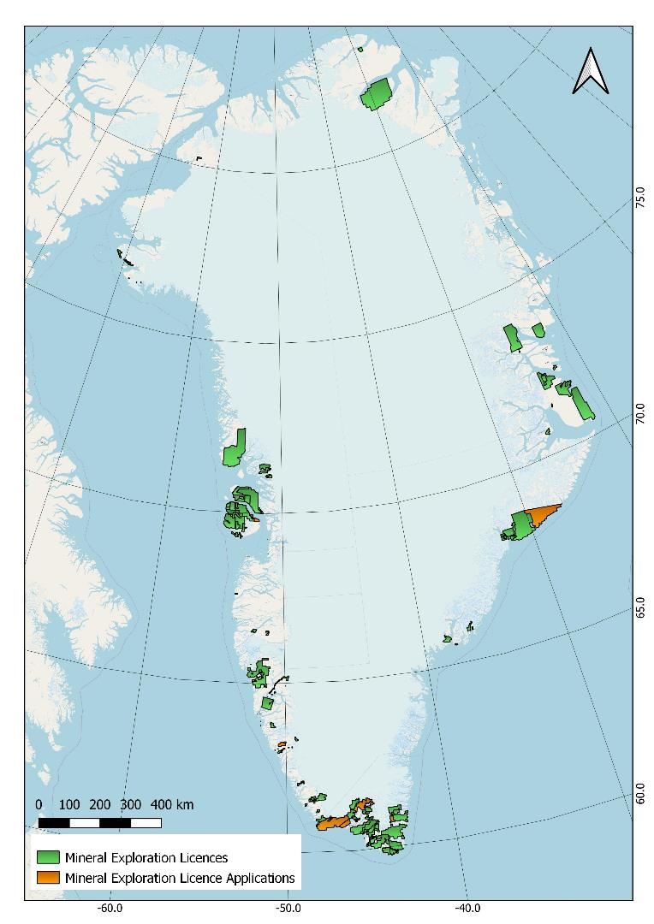














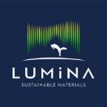








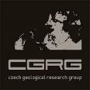



Status as of September 2023
Also shown are recently awarded mining licences and active mines. Central West and South Greenland are the current hotspots for mineral exploration (circled in blue).
Current Explorers
Mining Licence (Zn-Pb)
Thule Heavy Mineral Sands Province
(Ilmenite)
Proterozoic and Palaeozoic sedimentary basins, North and East Greenland
(Cu, Zn-Pb)
Mining Licence (Ti)
West Greenland Flood Basalt Province (Ni-Cu-Co-PGE)
Mining Licence (Mo)
Karrat Basin
(Zn-Pb-Ag)
East Greenland Flood Basalt Province
(Ni-Cu-Co-PGE-Au, Mo)
North Atlantic Craton
(Au, Fe, Ni-Cu-Co-PGE, anorthosite, REE, rubies)
Anorthosite Mine
Ketilidian Orogenic Belt and Gardar Alkaline Igneous Province
(Au, graphite, base metals, REE-Zr-Nb-Ta-U)
Mining Licence (Fe)
Ruby Mine
Mining Licence (REE-Zr-Nb-Ta)
Mining Licence (Au)

Slide 9
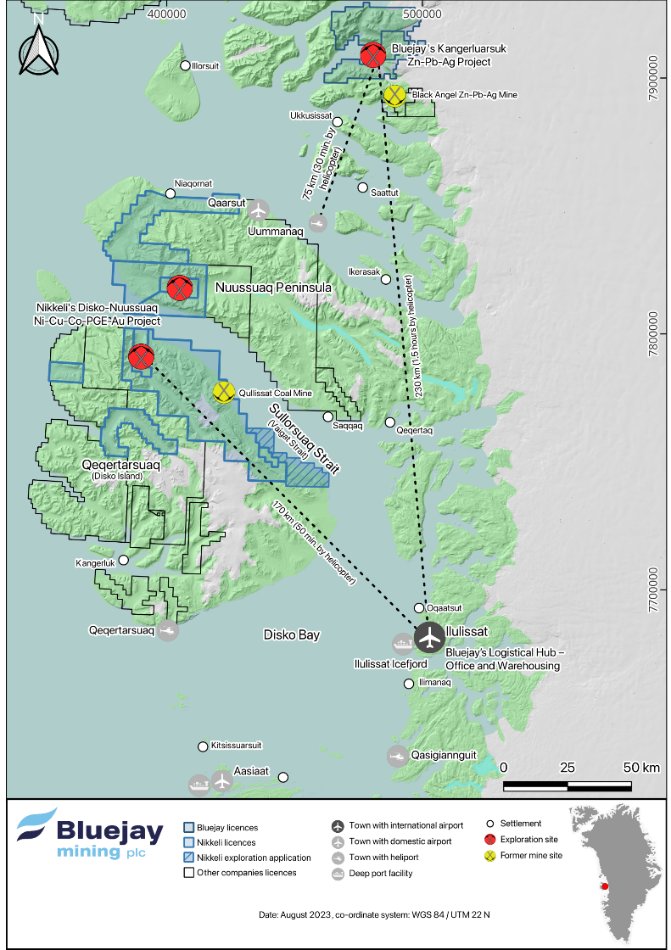
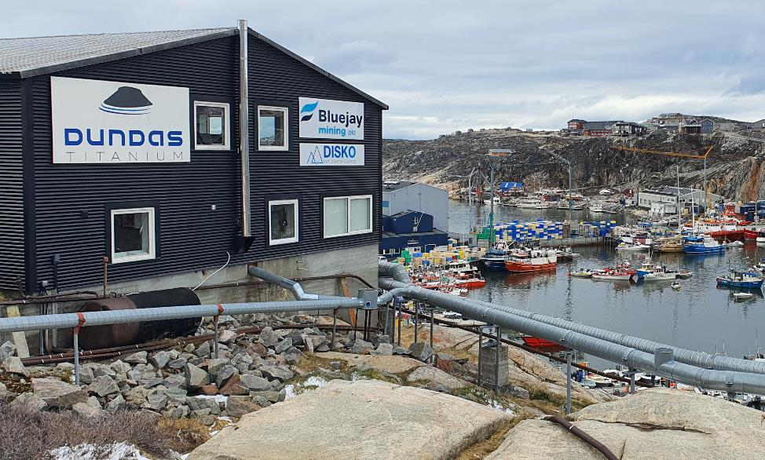
A trusted partner in West Greenland
Bluejay has a logistical hub based in Ilulissat (the capital of North Greenland) which includes an exploration office, accommodation and warehousing facilities.
Bluejay has been operating in the region for many years and has excellent relations with a wide range of suppliers and contractors. A well-known and trusted customer/partner/ employer in the region.
International airport under construction in Ilulissat, that will provide direct flights to Europe.
Bluejay’s Greenland office and accommodation building in Ilulissat
Ilulussat
Harbour

Slide 10
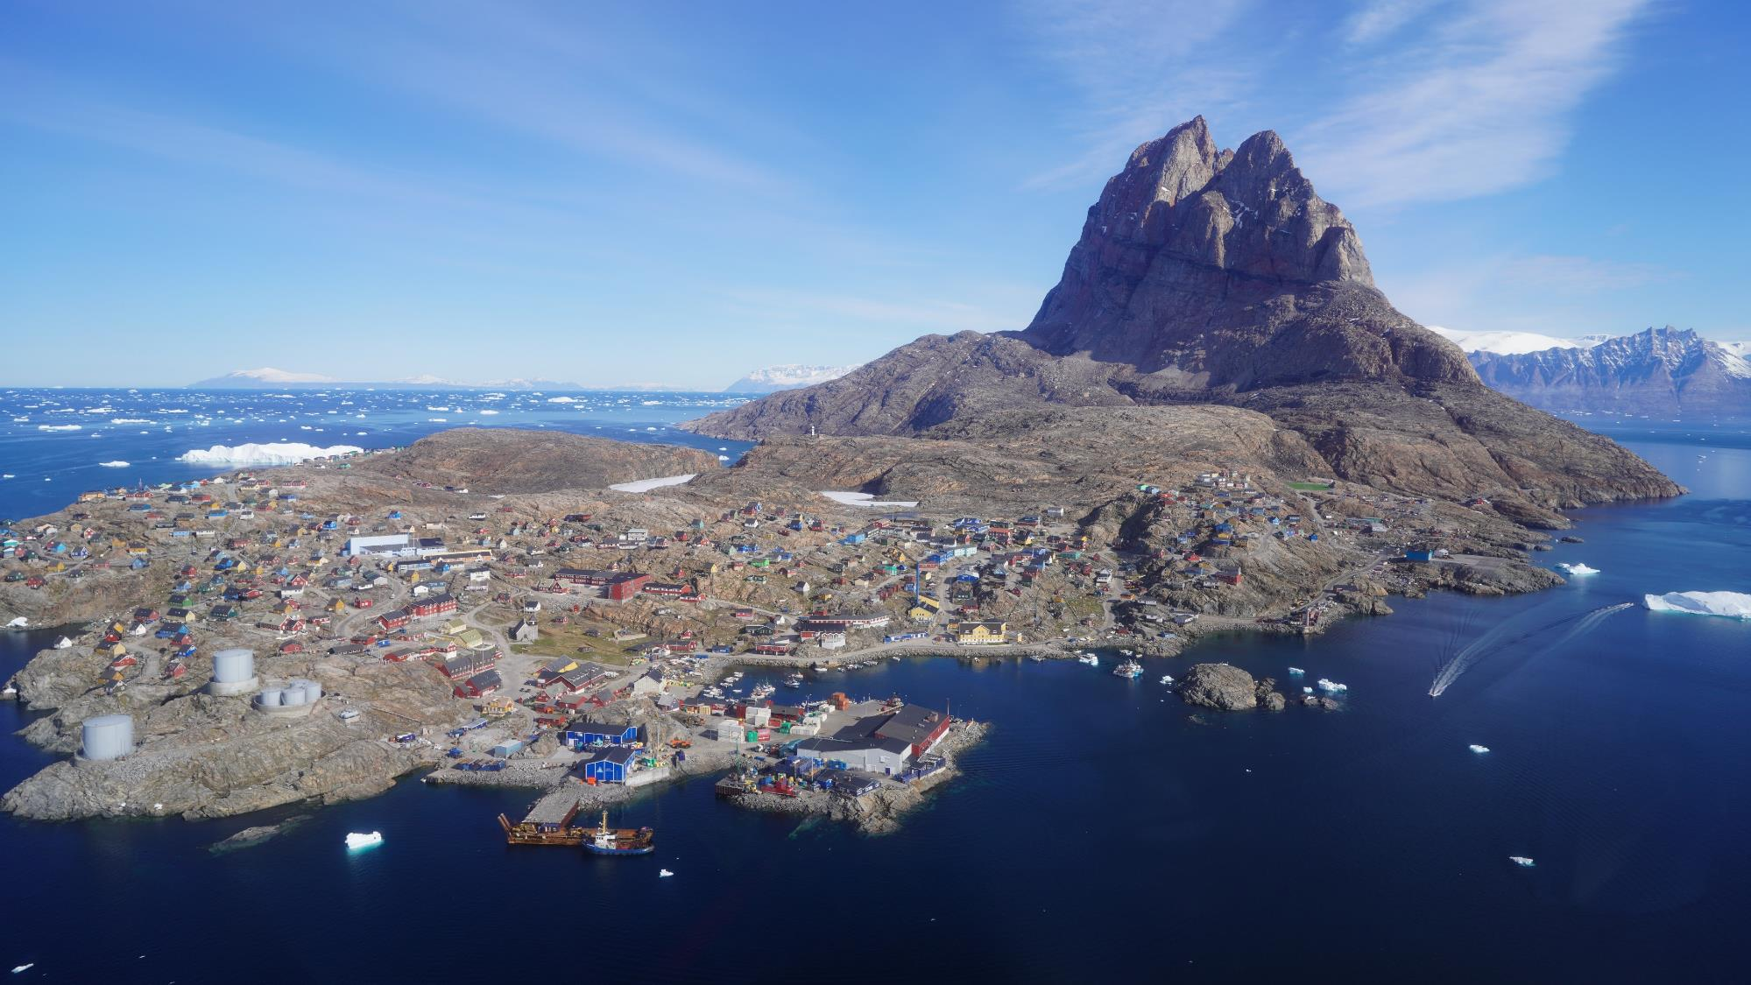
Nearest town:
Uummannaq (population 1400)

Slide 11
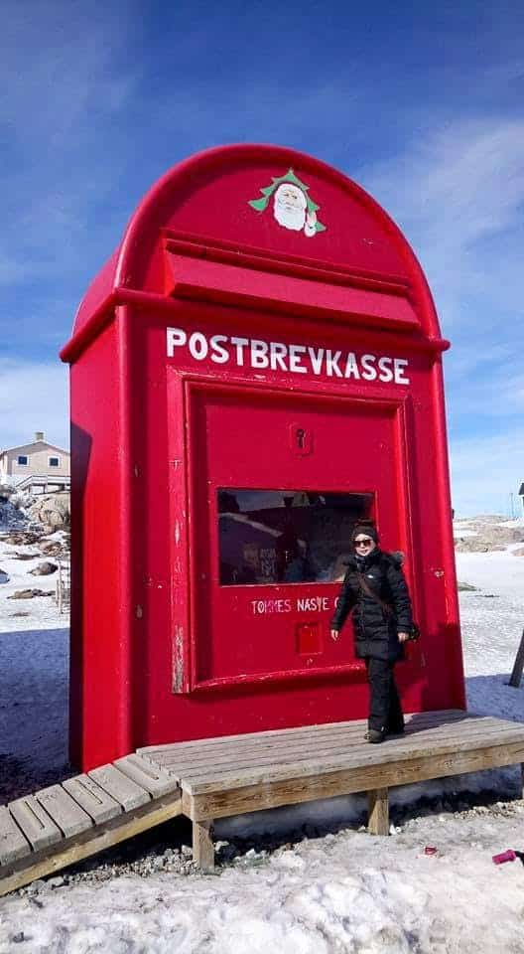
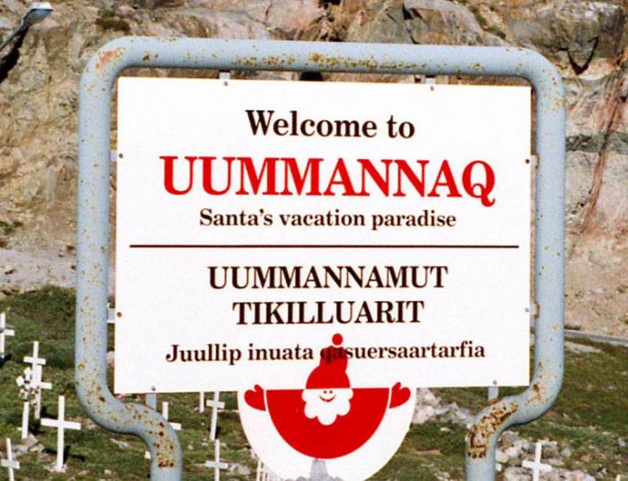
Nearest town:
Uummannaq (population 1400)
>> The official home of Santa Claus

Slide 12

Nearest town:
Uummannaq (population 1400)
>> The official home of Santa Claus

Slide 13
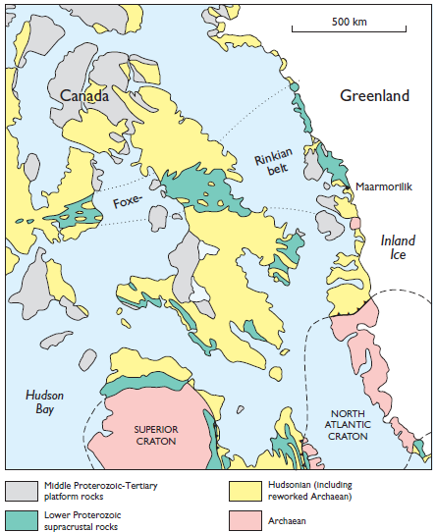
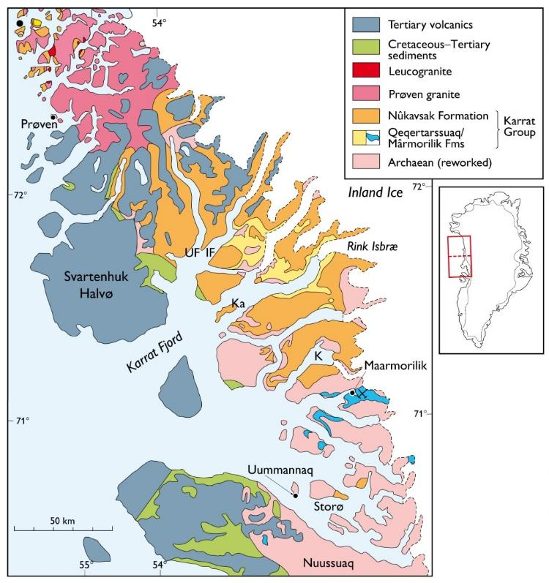
The Palaeoproterozoic Karrat Group, an important Zn-Pb basin. The Karrat Group correlates with the Foxe Belt in NE Canada (Penrhyn and Piling Groups).
Geological Setting: Karrat Group
Karrat
Piling
The Uummannaq District, Central West Greenland showing the southern portion of the Paleoproterozoic Karrat Group meta-sedimentary basin. Stars show known Zn-Pb mineral occurrences.
Penrhyn
Kangerluarsuk
Project
Black Angel Mine

Slide 14
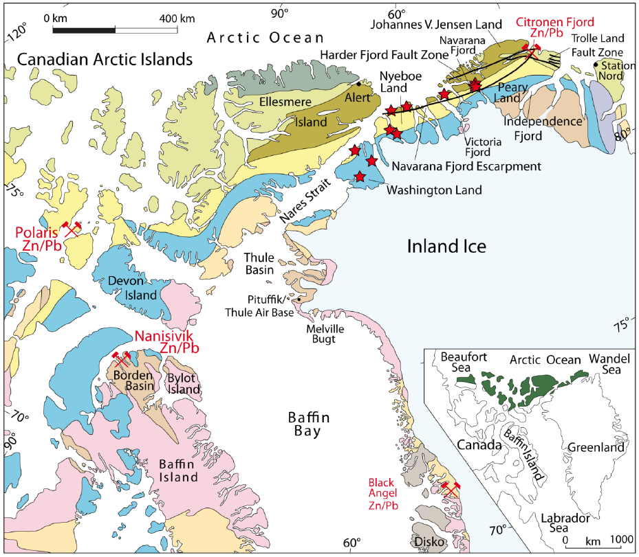
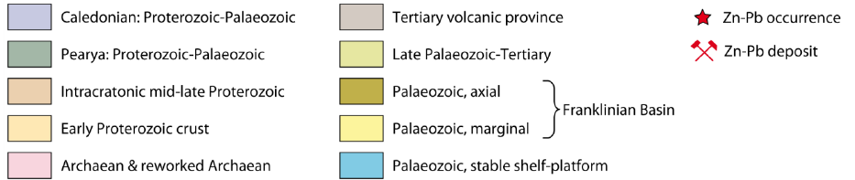
Geology doesn’t stop at borders… the Zn potential of Greenland
Citronen Fjord:
Mineral Resource of 85 Mt @ 4.7% Zn & 0.5% Pb
Ore Reserve of 48.8 Mt @ 4.8% Zn & 0.5% Pb
Additional Exploration target of 40 – 90 Mt @ 5.0 – 7.1% combined Zn+Pb
Black Angel Mine:
13.6 Mt @12.3% Zn, 4.0% Pb and 29 g/t Ag

Slide 15
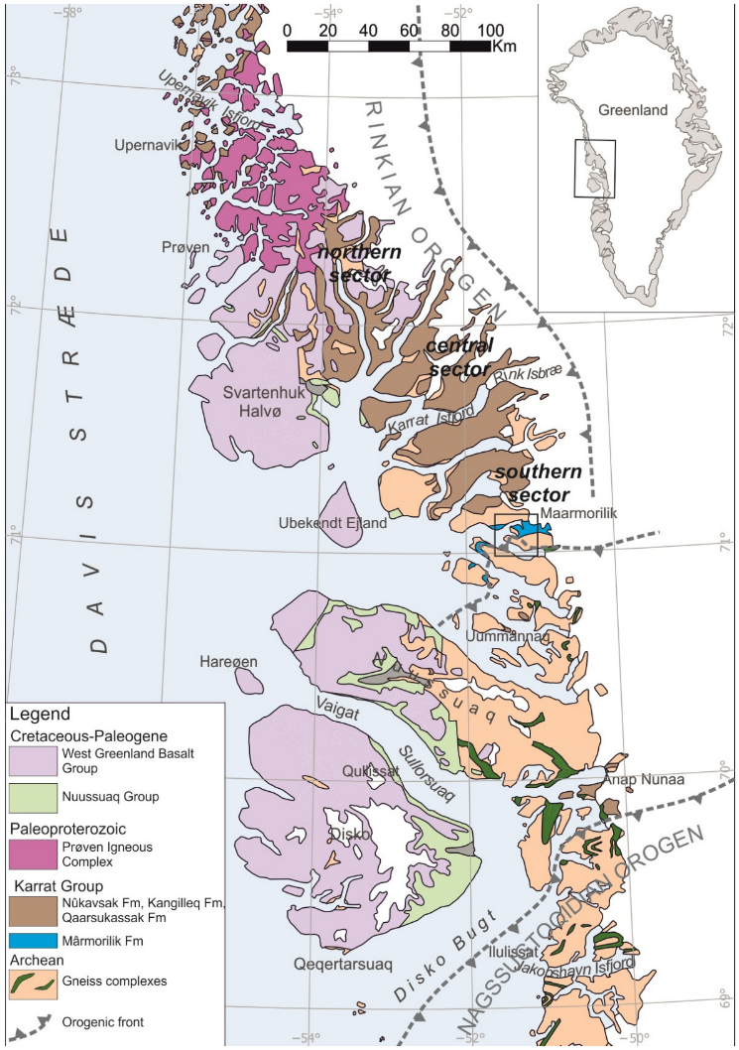

The ~8.5 km thick Paleoproterzoic Karrat Group metasedimentary sequence deposited after 2.0 Ga that extends from ~71° to ~75°N and is composed of the Qaarsukassak, Mârmorilik, Kangilleq, and Nûkavsak formations. It is exposed over a N-S distance of ca. 550 km and covers an area of >10,000 sq km.
The Karrat Basin: overview
Figure from: Guarnieri et al., 2022, Minerals

Slide 16
The lower part of the Karrat Group is represented by the Qaarsukassak and Mârmorilik formations. Both formations are overlain by the Nûkavsak fm. which is intercalated with metavolcanic rocks of the Kangilleq fm.
The Qaarsukassak fm. is a recently defined formation comprising of siliciclastic and carbonate rocks.
  Hosts the Zn-Pb-Ag mineralisation at Bluejay’s Kangerluarsuk project
The Mârmorilik fm., is dominated by calcite and dolomite marble; fine-grained locally graphite-bearing schist; quartzite; and metamorphosed evaporites in the form of anhydrite.
    Hosts the Zn-Pb-Ag mineralisation at the Black Angel Mine.
The ~5000 m thick Nûkavsak fm., contains metagreywacke and metapelite, which are interpreted as turbidite flysch sequence. Locally contains pyrrhotite-chert-graphite horizons.
Based on new geochronology data the former Qeqertarssuaq fm. (Henderson and Pulvertaft, 1987), has been removed from the Karrat Group and included in the Neoarchean gneiss complexes.
The Karrat Basin: overview
Figure from: Guarnieri et al., 2022, Minerals

Slide 17
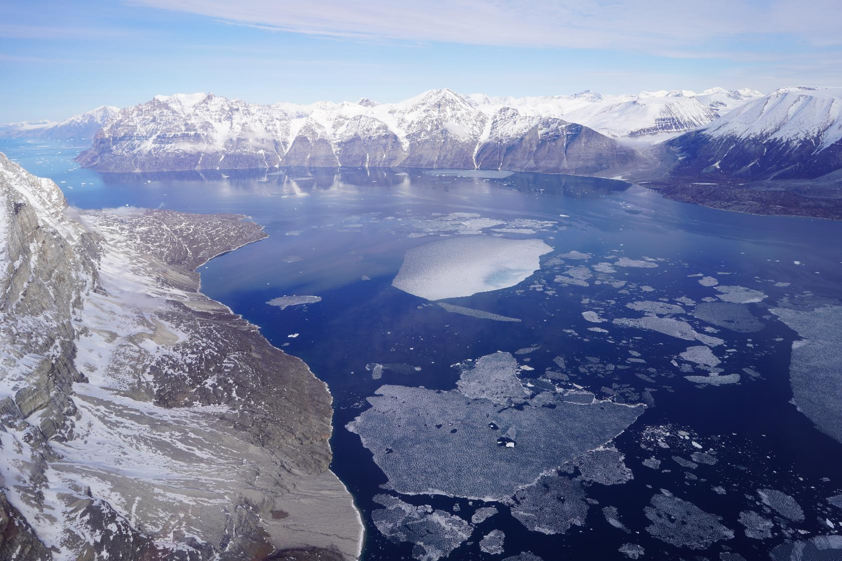

Slide 18
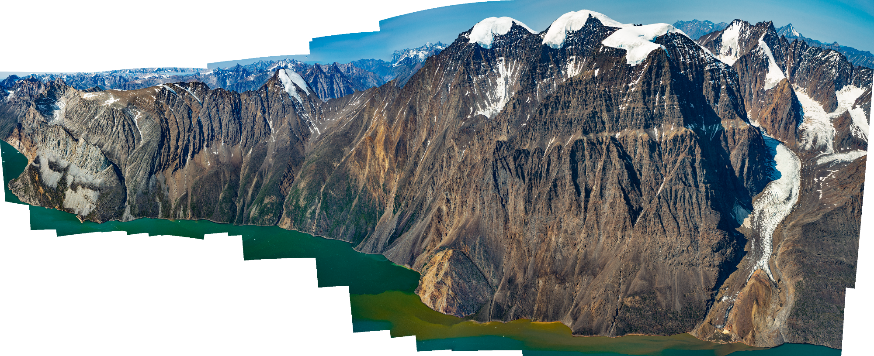

Slide 19
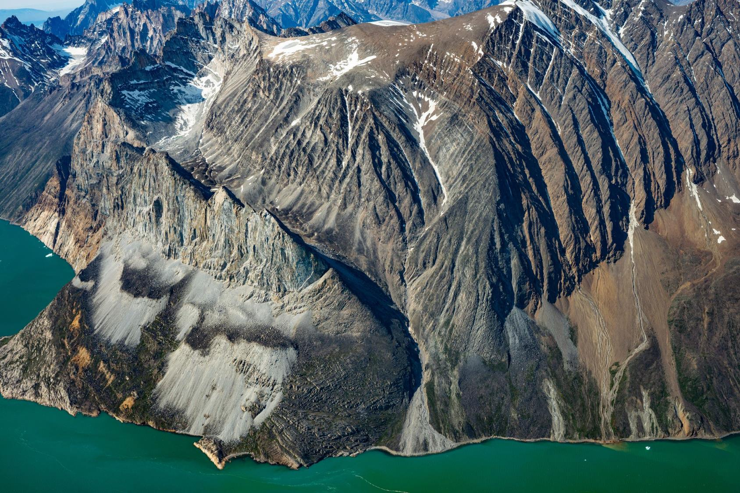

Slide 20
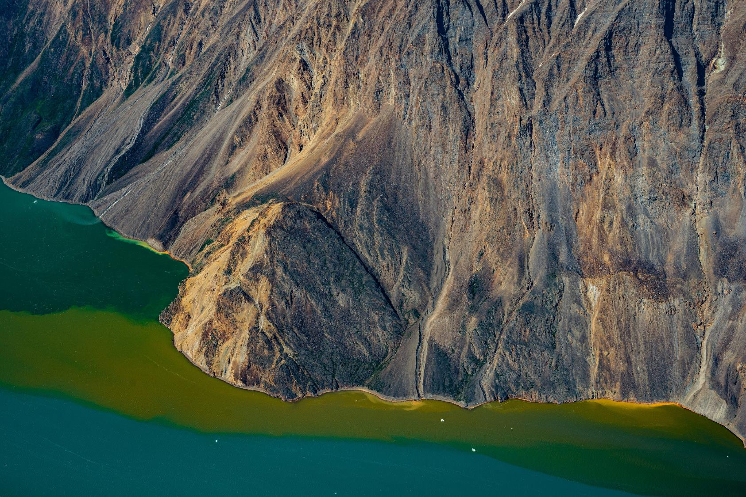

Slide 21
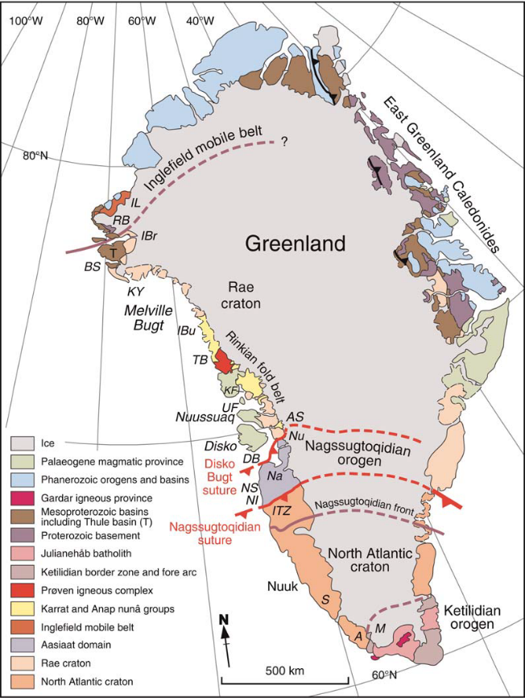
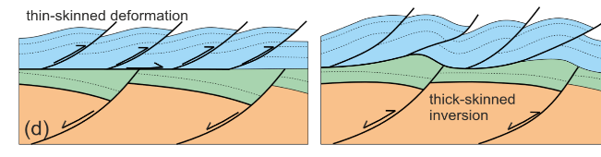
The lower units (Qaarsukassak and Mârmorilik fms.) of the Karrat Group formed in an intracratonic sag basin as the Rae Craton subsided.
The basin progressively evolved through an intracratonic rift stage, with associated volcanism (Kangilleq fm., alkaline member) and syn-rift siliciclastic sedimentation (Nûkavsak fm.) between 1950 and 1900 Ma, to a later stage back-arc geodynamic setting (Kangilleq fm., transitional member).
Between 1870 - 1850 Ma, the Karrat basin was intruded by calc-alkaline felsic intrusions of the Prøven Igneous Complex (‘PIC’).
The Karrat Basin: overview
(continued)
Figure from: St-Onge et al., 2009, Geol. Soc. London Spec. Pub.
Figure from: Guarnieri and Baker, 2022, J. Structural Geol.

Slide 22
The Karrat Group was affected by metamorphism during the collisional phase of the Rinkian Orogen (Cordilleran-type tectonics) between 1830 and 1800 Ma, reaching upper greenschist to lower amphibolite facies in the south (at Black Angel and Kangerluarsuk), to granulite facies in the north, where the metamorphism is associated with migmatization and emplacement of the S-type leucogranites.
The Rinkian orogen is interpreted as part of the Trans-Hudson Orogeny (St-Onge et al., 2009) and represents a back-arc fold and thrust system, resulting from the eastward collision between the magmatic arc PIC and the Karrat basin.
The inversion of the Karrat Basin involved a first stage of thin-skinned tectonics, with allochthonous metagreywackes emplaced during east-verging thrusting, followed by thick-skinned tectonics (inversion) with progressive involvement of the Archaean gneisses with basement nappes and metasediments transported toward the north-east (e.g., Guarnieri and Baker, 2022; Grocott and McCaffrey, 2017).
The Karrat Basin: overview
(continued)
Figure from: St-Onge et al., 2009, Geol. Soc. London Spec. Pub.
Figure from: Guarnieri and Baker, 2022, J. Structural Geol.

Slide 23
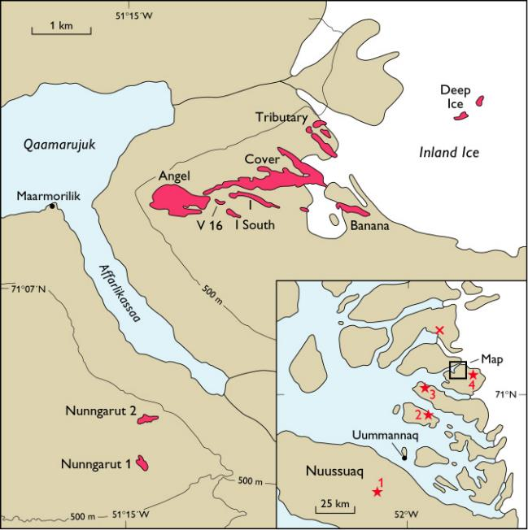
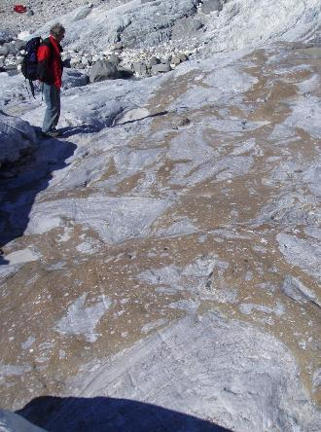
A Proven Zn-Pb-Ag Mining District
Bluejay’s Kangerluarsuk Zn-Pb-Ag project located only 12 km north of the former Black Angel mine.
At Black Angel, Zn-Pb-Ag mineralisation is hosted within the Paleoproterozoic Mârmorilik fm. of the Karrat Group (calcitic and dolomitic marbles with a basal quartzitic unit and intercalations of anhydrite-bearing marbles and semipelitic schists, deposited ca. 1.9 Ga in a carbonate shelf on the margins of an intracratonic sag basin). The Mârmorilik fm. represents a shallow-water, stromatolite-bearing marine carbonate platform.
The mine was operated by Cominco (now Teck) between 1973–1986 and later Boliden from 1986–1990.

Slide 24
A Proven Zn-Pb-Ag Mining District
The Black Angel deposit comprised of eight different orebodies and two satellite orebodies (the Nunngarut orebodies) with pre-mining reserves totalling 13.6 MT @12.3% Zn, 4.0% Pb and 29 g/t Ag. The mine produced 11.2 MT @ 12.6 % Zn, 4.1 % Pb and 29 g/t Ag during the 17-year mine life (Thomassen, 2003).
Approximately 2.4 Mt of ore remains in unmined pillars and other areas that were considered inaccessible to mining. Continued exploration following mine closure has identified several new satellite orebodies within the Mârmorilik Fm. (e.g., Glacier Zones and Ark).
Widely acknowledged as the most profitable mine in Greenland to date.
Within the Black Angel district there are numerous (>200) mineralised showings with mineralisation occurring in different stratigraphic positions.

Slide 25
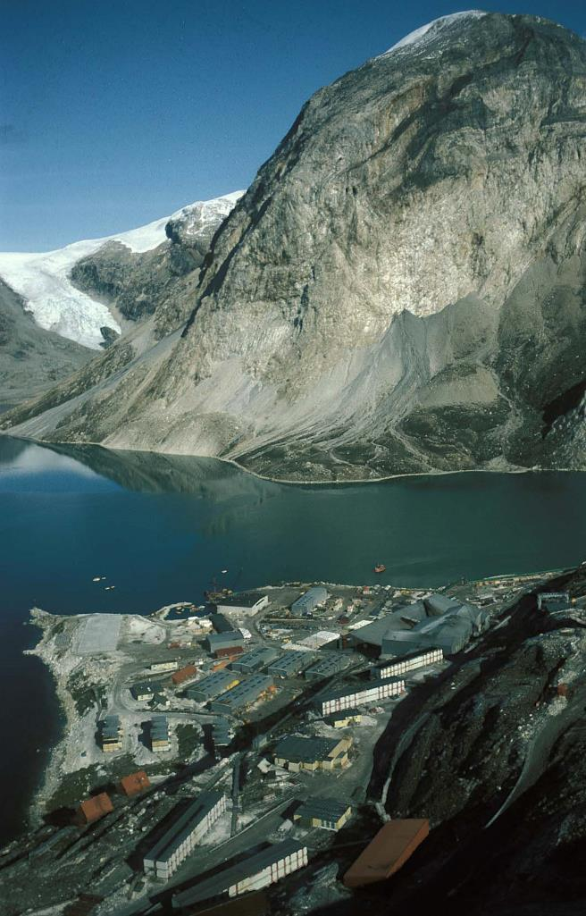
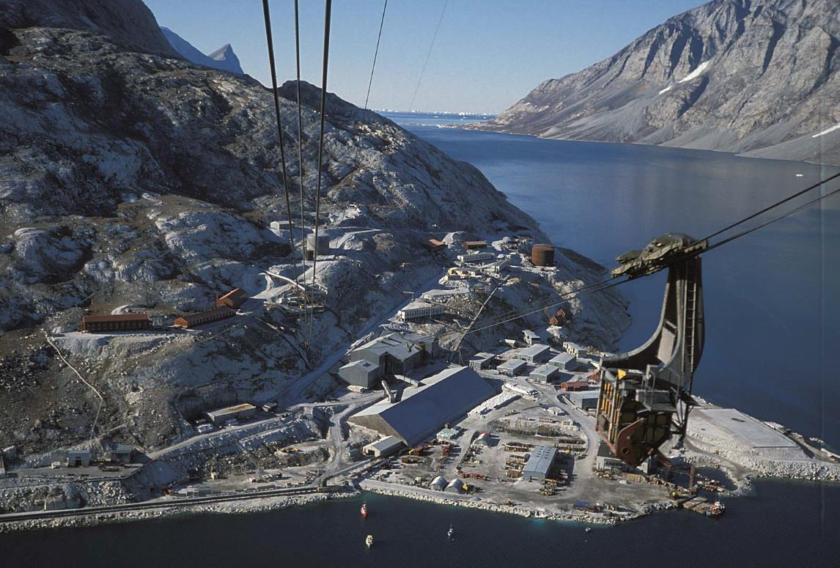
Black Angel Mine: infrastructure
Photos from: Bjørn Thomassen, GEUS

Slide 26
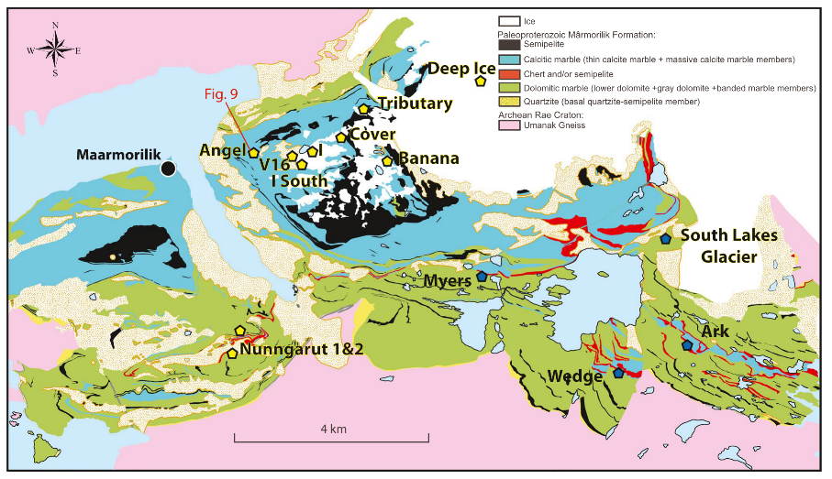
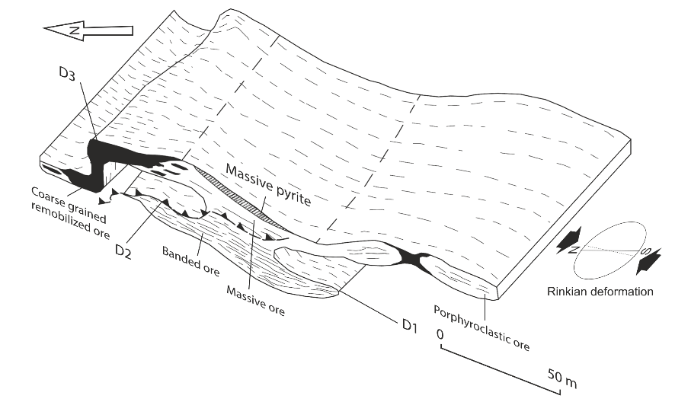
Black Angel Mine: Mineralisation
The stratabound orebodies at Black Angel are hosted in anhydrite-bearing marble and consist of massive to semi-massive sphalerite-galena-pyrite, with minor to trace amounts of chalcopyrite, arsenopyrite, tetrahedrite, freibergite, tennantite, stannite, briartite, enargite, loellingite, polybasite, magnetite, rutile, and graphite.
Despite a long exploration and mining history, the genetic model for the mineralisation remains debated (due to the effects of greenschist-to-amphibolite facies metamorphism and intense multi-stage deformation that have affected and remobilised the ore).
The deposit has been classified as an exhalative sediment-hosted massive sulphide (SEDEX) deposit (e.g., Leach et al., 2005); an epigenetic Mississippi Valley-type (MVT) deposit (e.g., Partin et al., 2021; Rosa et al., 2023); and a metamorphic Kipushi-style deposit (Horn et al., 2018).
Figures from: Rosa et al., 2023, Mineralium Deposita

Slide 27
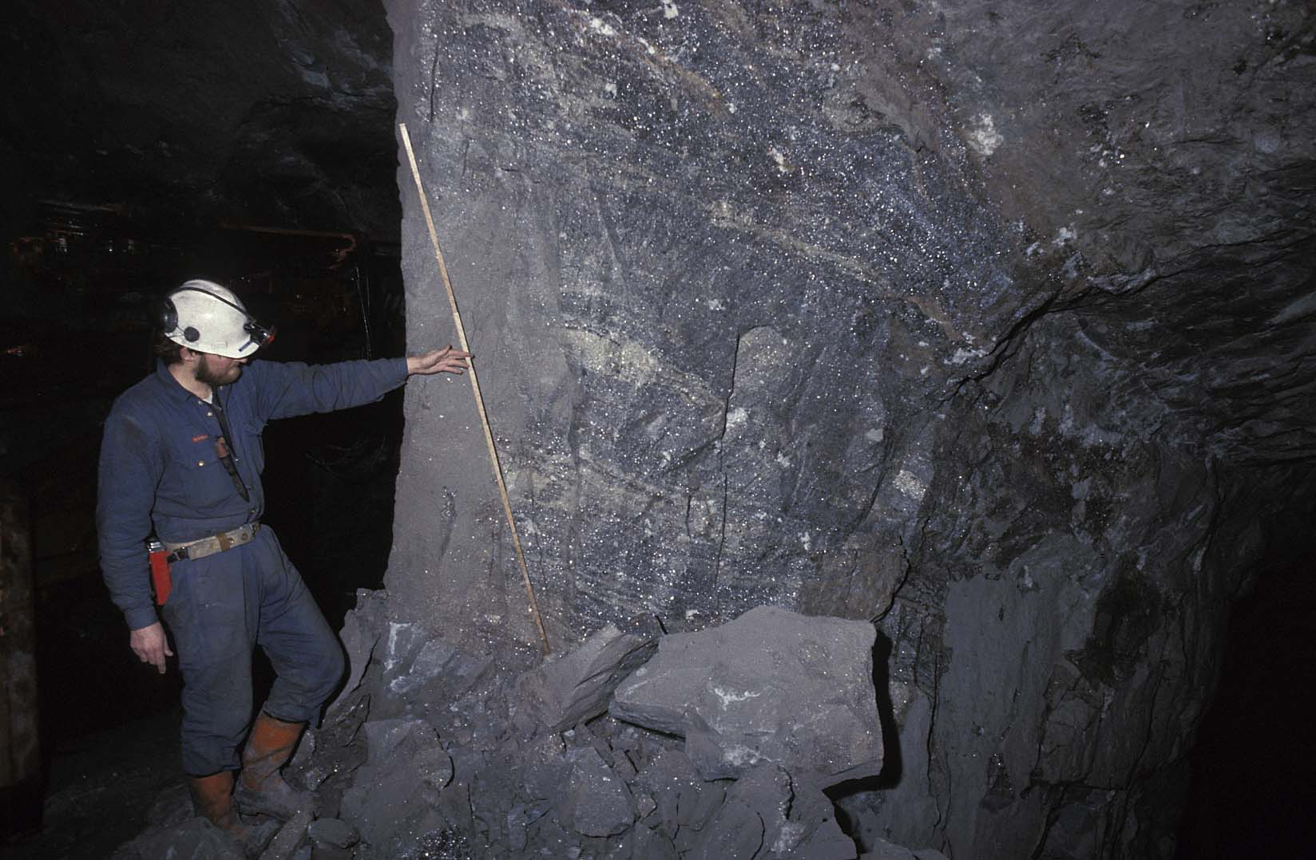
Black Angel Mine: high-grade ore
High grade banded ore in a rib pillar.
Photo from: Bjørn Thomassen, GEUS.

Slide 28
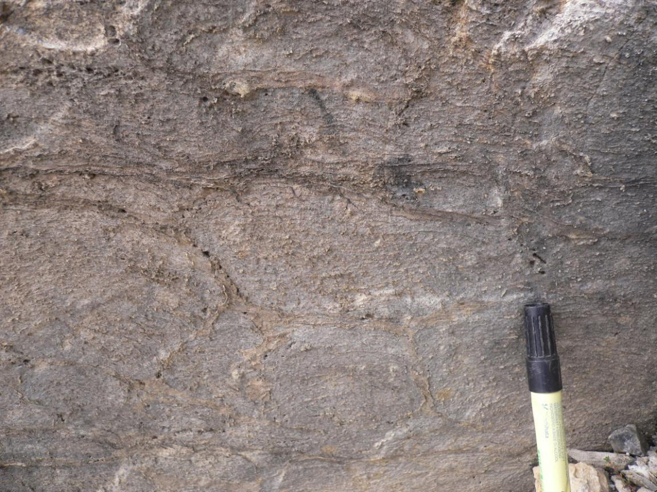
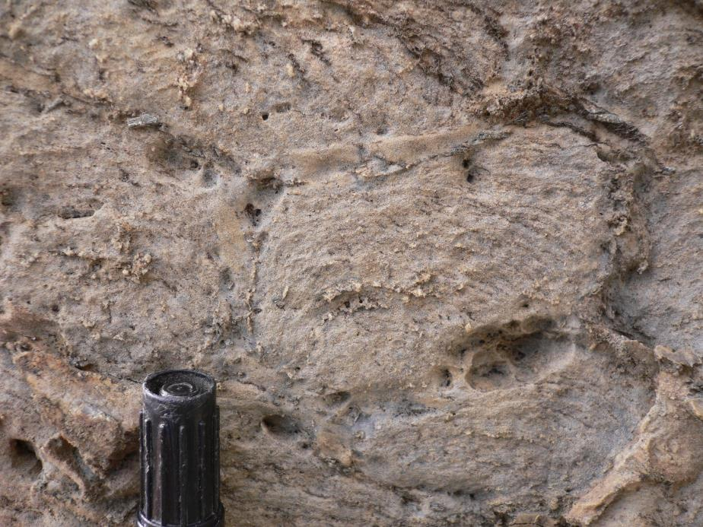
Black Angel: main host rock
Calcite marble
Paleoproterozoic stromatolite reef

Slide 29
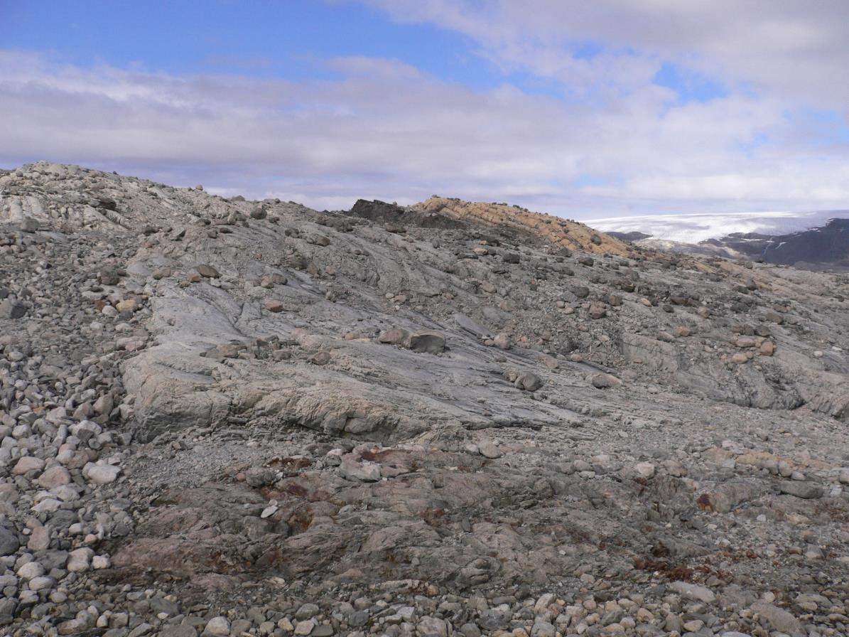
Black Angel: regional metamorphism
Tremolite-biotite-chlorite-calcite-K-feldspar assemblage in marble
Scapolite (after anhydrite, evidence of evapourites)
450-500°C
1.5 kbar
upper greenschist/lower amphibolite facies

Slide 30
Mechanical behaviour of common sulphides
Marshall & Gilligan (1993)
Most sulfides are weak – exceptions are pyrite and arsenopyrite
  Ductile deformation is partitioned into massive sulfides
  Mechanical separation of base metal sulphides and pyrite (exactly what we see at the Black Angel.. massive pyrite bodies close to massive sphalerite ± galena).

Slide 31
Massive sulphides: deformation and metamorphism
… the upper limit …
Tomkins et al. (2007)
Mechanical behaviour of common sulphides
Sulfides may melt in lower amphibolite facies
  Form As-, Bi-, Te-bearing sulphide assemblages

Slide 32

Banded ore: sulphide banding is parallel to fold axial plane
D₃
Black Angel: structural features
Figure from: Rosa et al., 2023 (modified from Pedersen, 1980)
D₂
D₁

Slide 33
Horn et al., 2018, OGR
Black Angel: Durchbewegung
Durchbewegung (texture/fabric):
Literal translation from German is “by movement/motion”
Applied to mixtures of silicates ± competent sulphides (commonly rounded) in a matrix of less competent sulphides.
Interpreted to form by tectonic processes involving disruption, separation, kneading, milling and rotational movement.
Occurs in shear zones within (or bounding) massive sulphides

Slide 34
Pyrite-2 annealing
Deformation twins in sphalerite
Durchbewegung
Black Angel: Microstructures
Deformation twins in Sph & Ccp
Euhedral quartz
Interstitial galena
Horn et al. (2018)
Pedersen (1981)

Slide 35
Primary growth zoning in pyrite (hydrothermal)
Homogeneous pyrite annealing (metamorphic)
Pyrite replacement by sphalerite + galena (hydrothermal)
In summary: massive sulfide at Black Angel has been modified by metamorphism, ductile deformation and hydrothermal remobilisation
Black Angel: Microstructures
Horn et al., 2018, OGR

Slide 36
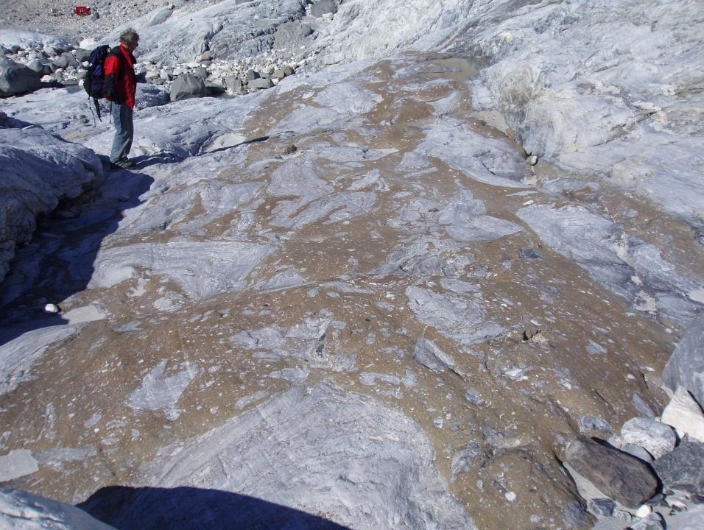
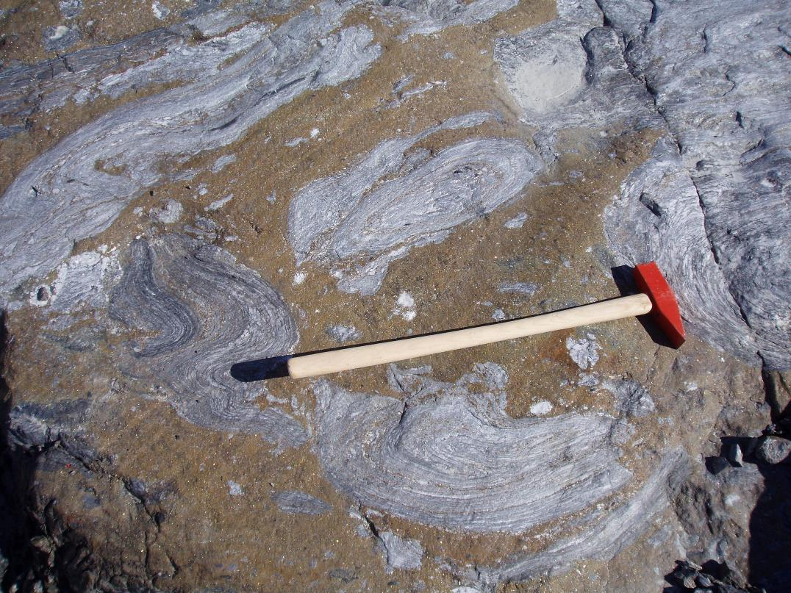
Folded marble fragments in massive sulfide matrix
Comparable to massive ore in the mine (cf. Pedersen, 1980).
Mineralisation is post- or syn-folding of marble
Black Angel: Regional Features
Photos from: Bjørn Thomassen, GEUS.

Slide 37
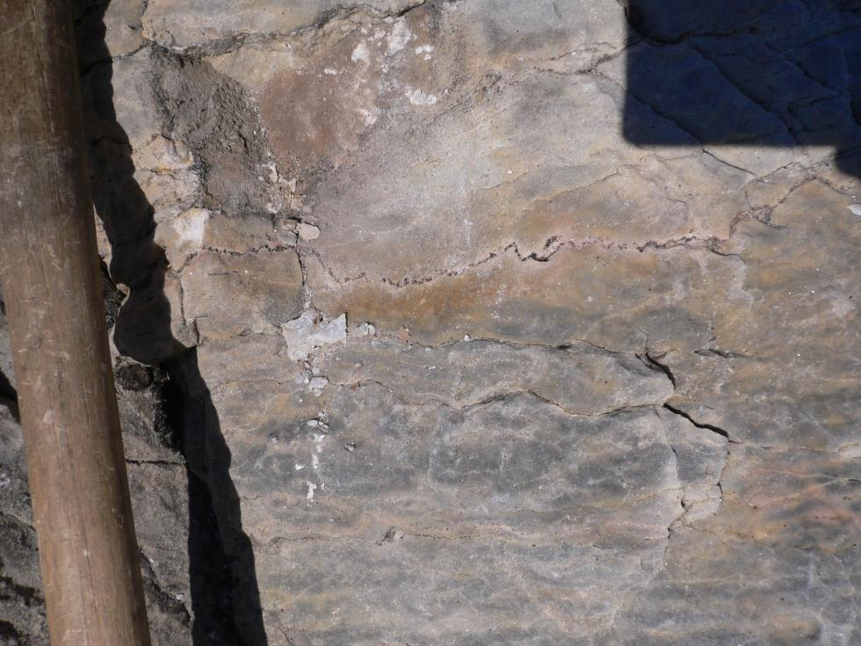
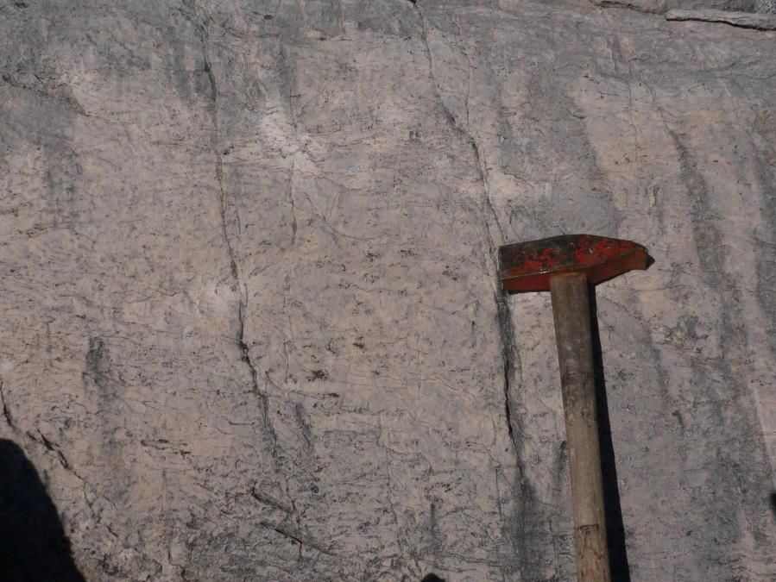
Disseminated sphalerite in foliation planes
Black Angel: Regional Features
Sphalerite in stylolites (D₃)
Solid-state ductile deformation (?)
Hydrothermal remobilisation (?)
Syn-tectonic sulfide mineralisation (?)

Slide 38
Importance for mineral exploration – why should we care?
Is the sulphide ore remobilised by solid-state ductile deformation?
Orebody in thickened fold hinge or parallel to mineral stretching lineation
Mechanical separation of sulphides: soft in fold hinge vs. strong in fold limb
Formation of rare minerals; e.g. briartite (Ge-mineral), see Horn et al., 2018
Is the sulphide ore remobilised by hydrothermal processes during deformation?
Orebody in veins and breccia controlled by shear zones and folds
Is the sulphide ore formed by hydrothermal processes during deformation and metamorphism? i.e., a syn-metamorphic/syn-tectonic model for mineralisation.
Subject of a new PhD project at KIT, Germany (Michael Eigler, supervised by Prof. Jochen Kolb), funded by the German Research Council and supported by Bluejay Mining plc.
Black Angel: Open Questions

Slide 39
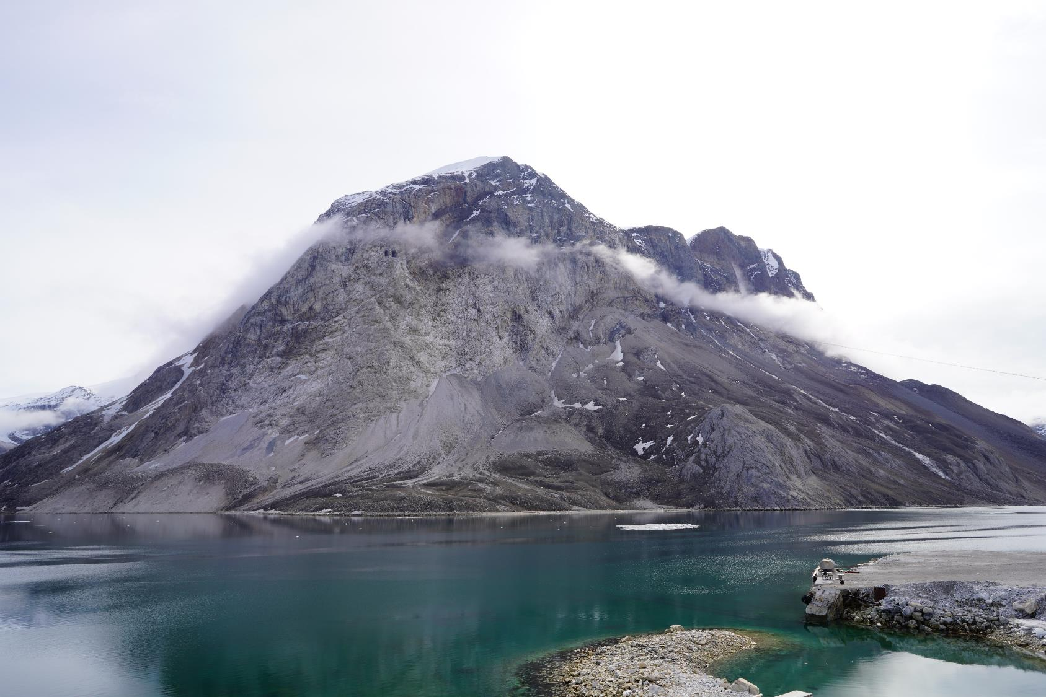
Extreme topography/excellent exposure – makes fieldwork difficult but lends itself to mapping by 3D photogrammetry and hyperspectral scanning….

Slide 40

World-class photogrammetry laboratory at the Geological Survey of Denmark and Greenland. Public funded oblique photograph collection from land, boat and helicopter (allows us to measure structures with centimetre accuracy in inaccessible areas)

Slide 41
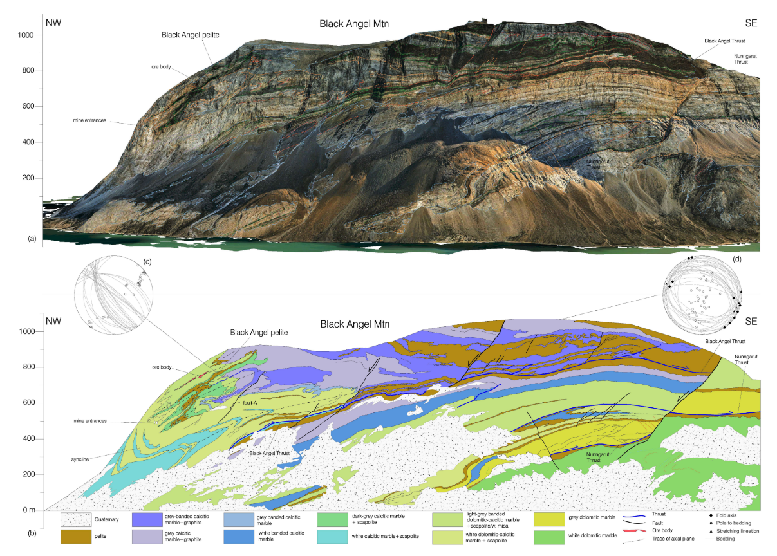
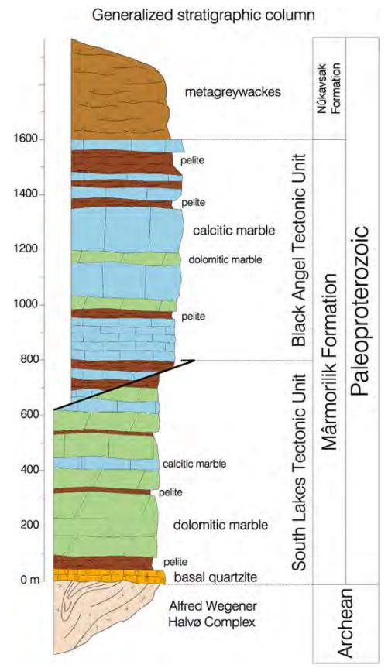
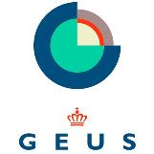

Black Angel Mine: 3D Geology
Figure from: Guarnieri and Baker, 2022, J. Structural Geol.
Figure from: Guarnieri et al., 2022, Minerals
Recent detailed photogrammetry, hyperspectral and structural work has dramatically improved the understanding of the Black Angel Deposit (esp. the stratigraphic and structural controls) on the mineralisation. Data incorporated into a recent industry-funded postdoctoral project at iCRAG (Dr Phil Rieger)

Slide 42
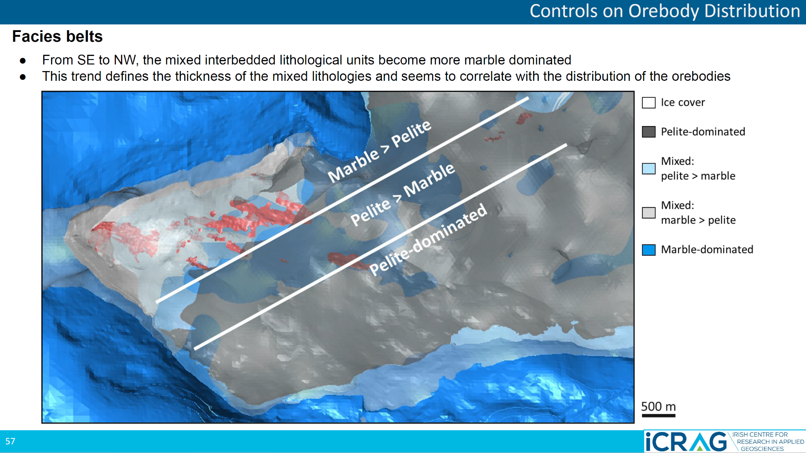
Slide from: Philip Rieger, John Güven, and Koen Torremans.

Slide 43
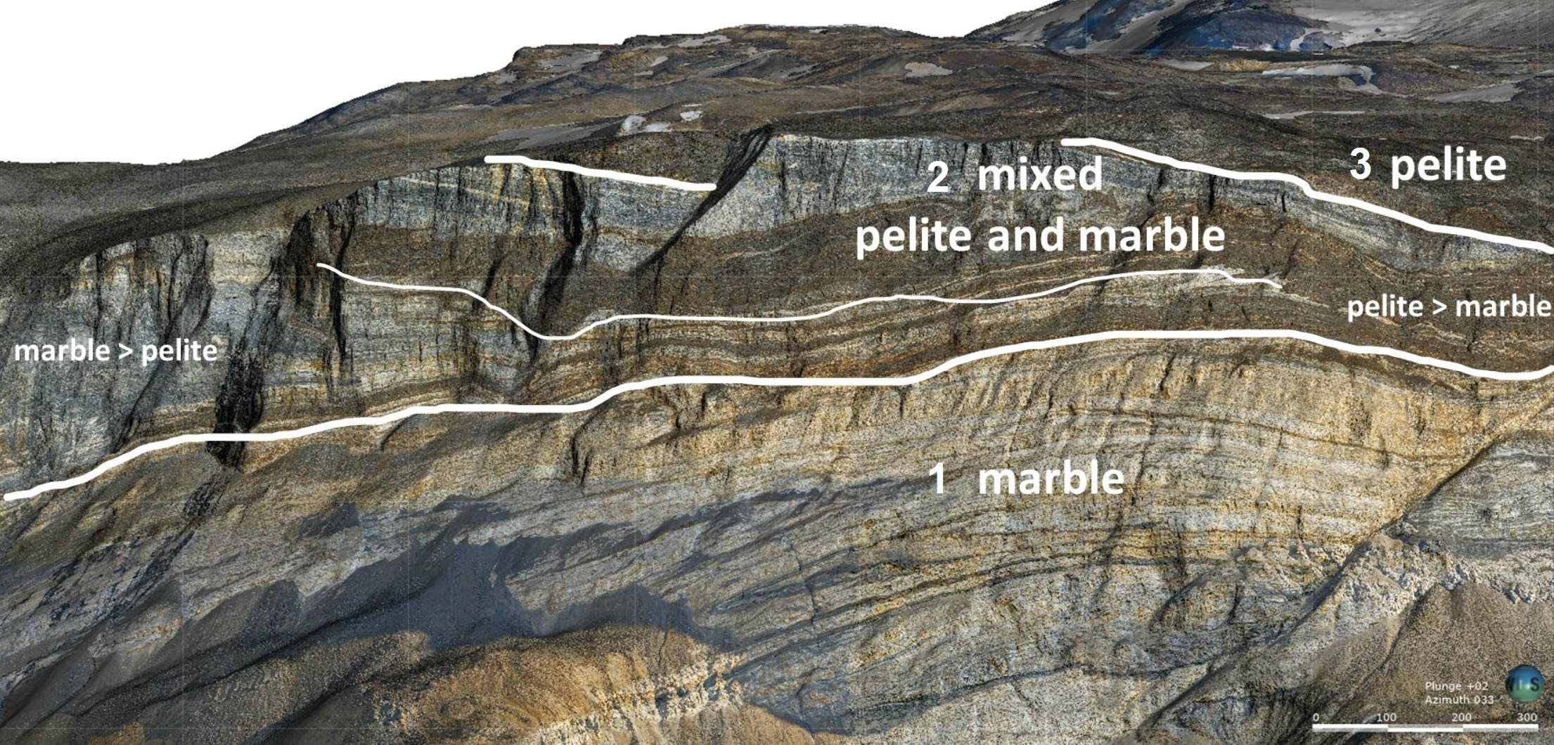
Slide from: Philip Rieger, John Güven, and Koen Torremans.

Slide 44
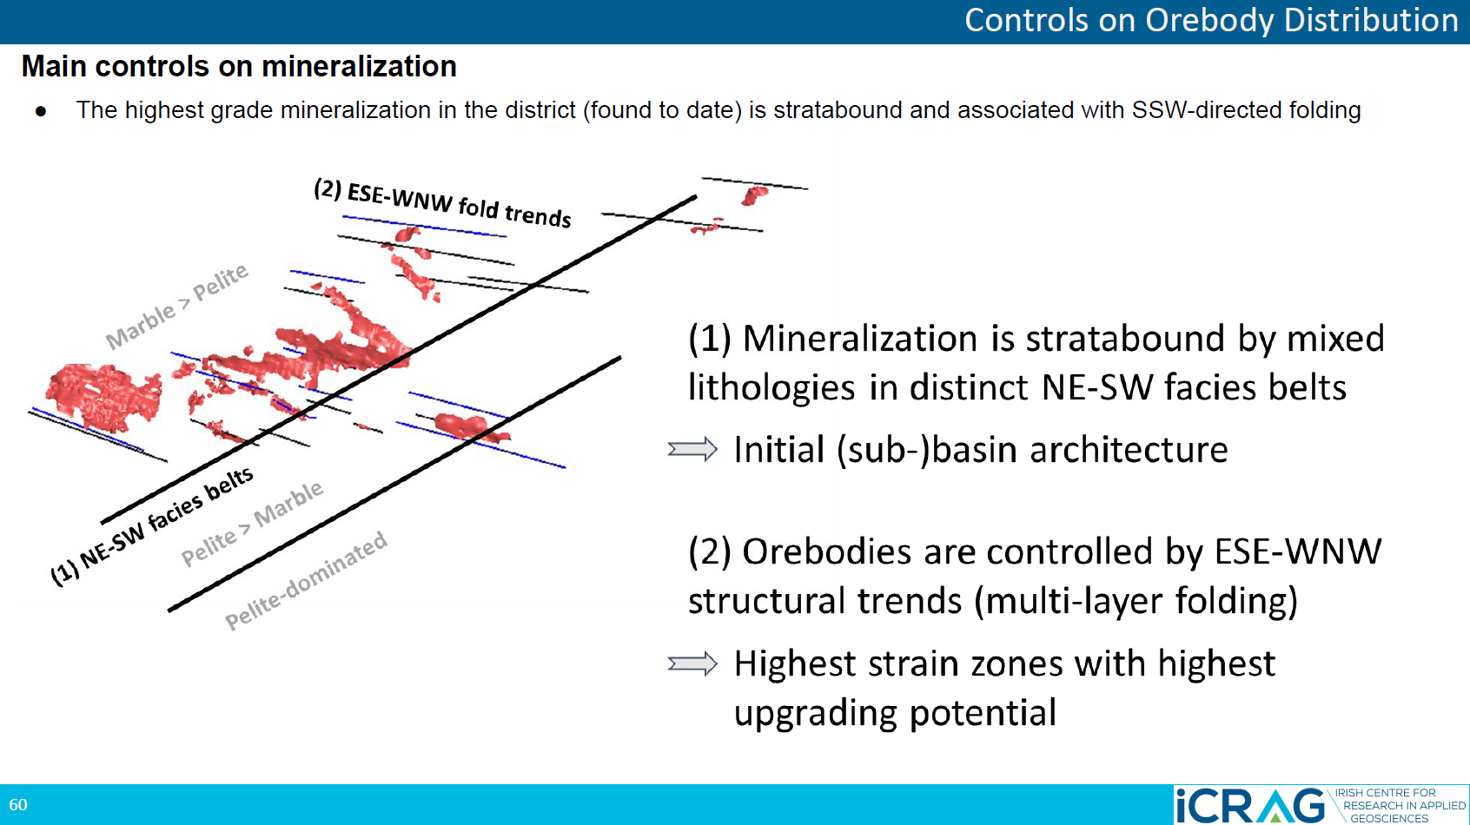
Slide from: Philip Rieger, John Güven, and Koen Torremans.

Slide 45
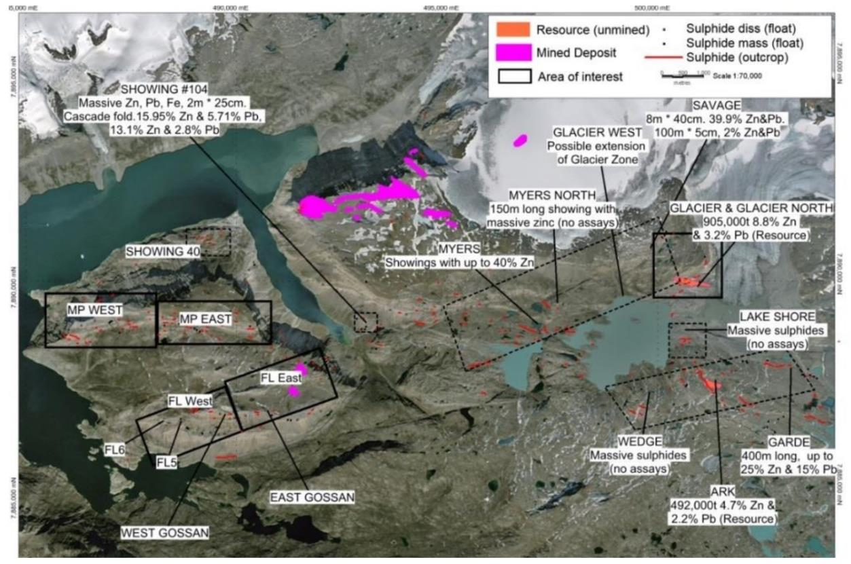
More than 200 mineralised (Zn-Pb) showings in the near mine area, many of which have not been drill-tested.
Resources defined at two satellite orebodies: Glacier Prospect (1.726 million tonnes @ 6.9 % Zn, 2.5 % Pb and 14.5 g/t Ag) and Ark prospect (0.492 million tonnes @ 4.73 % Zn, 2.2 % Pb and 20.5 g/t Ag).
Drilling at the Glacier Prospect only to a maximum depth of 350 m. The steeply dipping, E-W orientated mineralised structure is open along strike to the west and down-dip.
Airborne gravity (Air-FTG®) survey flown by Bell Geospace in 2014. 3D inversion of the has identified several significant gravity anomalies that have not yet been drill-tested – including under the inland ice.
Black Angel: near mine potential

Slide 46
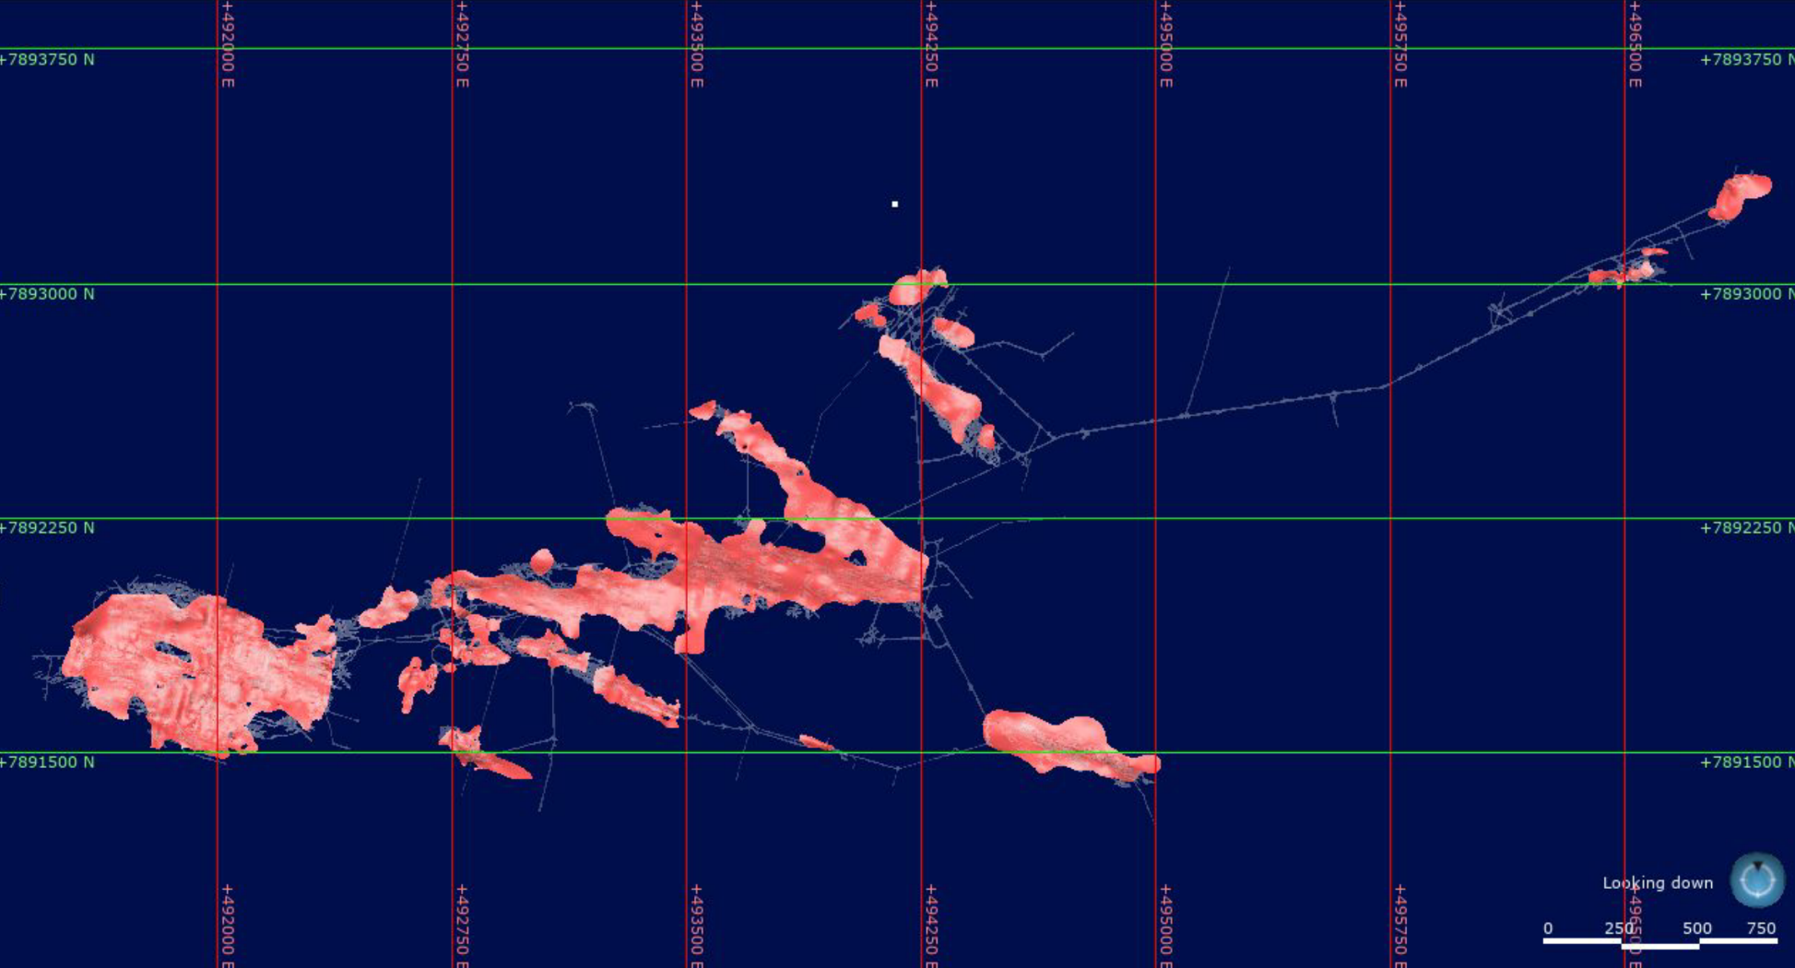

Slide 47

>160,000 m of surface drilling historically around the Black Angel Mine
Most surface drilling was on top of the Angel mountain in a grid pattern; much of this was through the ice cap.
New ore bodies located by surface drilling (e.g., “Deep Ice Zone”) were investigated further by underground drilling.
Several high-grade intersections east of the mine, beneath the inland ice remain untested, including e.g.,
V206: 8.5% Pb, 30.1% Zn - 3.6 m.
V216: 13.1% Pb, 19.5% Zn - 6.9 m
Black Angel: deep ice drilling

Slide 48



Located In A Proven Zn-Pb-Ag Mining District
Nuussuaq [1]
Several massive porphyroclastic sulphide layers (sphalerite with minor pyrite and galena) exposed in cliffs, individual layers continue over variable thickness for >100 m.
Chip samples returned up to 45.3% Zn and 1.0 % Pb over 0.9 m.
Appat [2]
A folded layer of massive porphyroclastic sulphides, up to 5 m thick exposed over 130 m in the upper part of a cliff face.
58 chip samples collected in 11 sections averaged 32.6% Zn and 0.5% Pb over 3.4 m true width.
Ukkusissat [3]
16 mineralised showings identified.
The largest is located in the upper limb of a major fold and forms a 210 m long continuous layer of massive sulphides.
Five channel samples from this zone average 27.6% Zn and 9.8% Pb over 6.7 m.
Photos from: Bjørn Thomassen, GEUS
Nuussuaq Prospect
Appat Prospect

Slide 49

The Kangerluarsuk Zn-Pb-Ag Project
Two 100% owned mineral exploration licences totalling 692 sq-km
Kangerluarsuk is located in a geologically favourable sub-basin immediately north of Black Angel that was previously targeted by Rio Tinto Zinc (RTZ) and Cominco.
Prospecting by RTZ located several locations with outcropping high-grade mineralisation with grab samples up to 41% Zn, 12.4% Pb, 1.2% Cu and 596 g/t Ag and chip and saw channel sampling results of up to up to 0.4 metres @ 45.4 % Zn and 1 metre @ 41.1% Zn respectively, within Bluejay’s licence areas.
Targets never drill tested (maiden drill programme by Bluejay scheduled for June to August 2024).

Slide 50



The Kangerluarsuk Zn-Pb-Ag project is favourably situated within a sub-basin immediately north of the basin margin fault that separates the Karrat basin to the north and the carbonate platform (and former Black Angel Mine) to the south.
Favourably located close
to former Zn-Pb-Ag mine
Kangerluarsuk
Zn-Pb-Ag Project
Black Angel Zn-Pb-Ag Mine
Model for the geological setting of cogenetic SEDEX and MVT deposit types in the Selwyn basin and the Mackenzie platform. Figure from: Goodfellow (2007).

Slide 51

Wide spread sulphidic chert horizons in the Karrat Group, as mapped by Comino
Form stratigraphic markers within the Karrat Gp.
Locally associated with massive sulphide (typically py, po)
Many are mylonites
Allen & Harris 1980

Slide 52

Wide spread sulphidic chert horizons in the Karrat Group, as mapped by Comino
Quartz-biotite-sulphides
Foliation defined by all minerals
Coarser grained band with sulphides and recrystallised quartz (triple junctions)
Sulphides deformed

Slide 53


Bluejay’s licence (MEL 2011/31) contains the strongest cluster of stream sediment zinc anomalies in the whole of Greenland!
Dundas
Project
Figures adapted from: Steenfelt, 1998, GEUS Report
Kangerluarsuk
Project
Kangerluarsuk
Project
Figures adapted from: Sørensen et al., 2013, GEUS Report
Disko-Nuussuaq
Project
Zinc
Lead
Bluejay’s licence areas are acknowledged by the Geological Survey of Denmark and Greenland as the strongest cluster of stream sediment zinc anomalies in the whole of Greenland! Multiple-metal and pathfinder element anomalies in stream sediments and heavy mineral concentrates (e.g., Cd, As, Au, Cs, Ba, Co, Y and REE) indicates the presence of polymetallic deposits.
Thunderstone
Project
GEUS stream sediment sample locations (n = 12027)
GEUS stream sediment zinc
> 200 ppm (n = 381)

Slide 54




Multiple-metal and pathfinder anomalies in stream sediments and heavy mineral concentrates indicates the presence of polymetallic mineralisation at Kangerluarsuk
Kangerluarsuk
Project
Figures adapted from: Steenfelt, 1998, GEUS Report
Ni
Note for Ni the left-hand side of the map relates to the West Greenland flood basalt province, hence the high Ni values. Kangerluarsuk is the strongest cluster of Ni anomalies in the Karrat Group. The cause of the Ni anomalism at Kangerluarsuk is yet unexplained.
As
Cd
Cs

Slide 55

Kangerluarsuk (looking northwest)

Slide 56

Kangerluarsuk (looking west)
Kangerluarsuk Fjord
(deep water, ice free for most of the year)
Umanak Gneiss
(Archean)
Nûkavsak fm.
Upernavik Amphibolite
(Archean)
Nûkavsak fm.
(Paleoproterozoic)

Slide 57

Outcropping, high-grade Zn-Pb-Ag mineralisation at the basin margins
NE
SW
Black Angel Zn-Pb-Ag Mine, ca. 15 km
Kangerluarssup Glacier Showings
c. 9 km
Discovery Zones
Nûkavsak fm.
(Paleoproterozoic)
Umanak Gneiss
(Archean)
Kangerluarsuk Fjord
(deep water access, ice free for most of the year)
Widespread outcropping ore-grade Zn-Pb-Ag mineralisation (red stars) close to the basement contact have been identified over a > 9 km strike length. Bluejay considers these occurrences to be the distal expressions of a large buried base metal deposit(s) within the Kangerluarsuk sub-basin.

Slide 58


1979 - 80
Cominco Ltd (now Teck) and Greenex A/S carried out regional exploration for Zn-Pb, Cu, Au and diamonds. Mapped extensive massive iron-sulphide horizons within the Nûkavsak fm. of the Karrat Group. First findings of Zn-Pb ± Cu mineralised boulders at the head of the Kangerluarsuk Fjord (within Bluejay’s current licence area).
Historical Exploration
1989 - 90, 92, 97
Geological Survey of Greenland (GGU) carried out regional geochemical reconnaissance, including stream sediment and HMC sampling throughout the Karrat Group. Stream sediment samples yielded up to 2200 ppm zinc within Bluejay’s licence areas (strongest zinc anomalies in the whole of Greenland).
Cominco’s 1979 mapping of outcropping sulphide formations within the Nûkavsak fm. and the discovery of mineralised boulders
1991 - 92
Joint Venture between Rio Tinto Zinc (‘RTZ Mining and Exploration Ltd.’) and Platinova Resources Ltd discovered several zones of high-grade outcropping mineralisation at Kangerluarsuk up to 41% Zn, 9.3% Pb, 1.2% Cu and 596 g/t Ag and channel samples assaying 45.4% Zn and 41.1% Zn over 0.4 and 1 metres respectively, within Bluejay’s current licence area.
1997
Platinova commissioned a 435 line-km helicopter-borne DIGHEM^{V} electromagnetic and magnetic survey over Bluejay’s current licence area.
Finely laminated Zn-Pb mineralisation from the Kangerluarssup Glacier Showings, Kangerluarsuk

Slide 59


2011
Avannaa Resources acquired the Kangerluarsuk Project (exploration licence 2011/31).
2011 - 2013
Between 2011-2013 Avannaa had carried out an aggressive campaign to advance the project, including: detailed geological and structural mapping; MMI (Mobile Metal Ion) and 2-acid digest bulk soil geochemistry; SGH (Soil Gas Hydrocarbon) analysis; a 348 line-km helicopter-borne magnetics and ZTEM (Z-Axis Tipper electromagnetics) survey; a pilot high-resolution reflection seismic survey.
Historical Exploration
2015 - 2017
Joint mapping project between the Geological Survey of Denmark and Greenland (GEUS) and the Government of Greenland’s Ministry of Mineral Resources of the Karrat Group. Much-improved understanding of the stratigraphy and structural evolution of the meta-sedimentary and meta-volcanic rocks of the Karrat Group that host Kangerluarsuk project. New geochronological, geochemical, structural, petrological, 3D-photogeological data collected. New 1:100,000 scale map sheets produced (2022). Several academic papers and research thesis published on the Karrat Group, including studies on the mineralisation within Bluejay’s licence area.
2017
EIT RawMaterials EU-funded UpDeep Project carried out an MMI and biogeochemical sampling programme at Kangerluarsuk.
2012 helicopter-borne ZTEM survey at Kangerluarsuk

Slide 60


2017
Bluejay Mining acquired the Kangerluarsuk project (mineral exploration licence 2011/31), when the Company purchased Avannaa Resources and its exploration assets, in an all-share transaction from Cairn Energy Plc.
2020
Bluejay increased its Kangerluarsuk licence area five-fold (awarded new mineral exploration licence MEL 2020/06) owing to the potential the company recognise within the Karrat Group for large scale base metal deposits. Licences now total 692 sq-km.
In partnership with Camborne School of Mines (University of Exeter), Bluejay completed a detailed prospectivity analysis, integrating both multivariate principal component analysis (PCA) of selective leach geochemistry datasets and airborne geophysics to assist with drill target delineation and ranking.
Historical Exploration
Bluejay geologists carrying out fieldwork at Kangerluarsuk in 2019
2022
Bluejay commissioned a FALCON® Airborne Gravity Gradiometer ('AGG'), magnetic and LIDAR survey by Xcalibur Multiphysics over Kangerluarsuk to further refine drill targets. Modelling and 3D inversion of the data by Astrock Oy and Mira Geoscience.
2024
Maiden drill programme at Kangerluarsuk planned for July-August 2024, alongside a regional field programme (reconnaissance, geological mapping, channel sampling, stream sediment and HMC sampling).
Bluejay CEO Dr Bo Stensgaard prospecting at Kangerluarsuk in 2019

Slide 61

The RTZ Discovery Zone

Slide 62

The RTZ Discovery Zone

Slide 63


The Qaarsukassak Formation in detail
The Qaarsukassak fm. was originally interpreted to represent a structurally displaced basal component of the Mârmorilik fm. (that hosts Black Angel mine). Recognised as a separate formation by Guarnieri et al., 2016.
The Mârmorilik and Qaarsukassak formations were both deposited directly on Archaean crystalline basement rocks and likely have similar depositional timing; however, they are separated by a basement topographic high (on Alfred Wegener Halvø) and are not observed in stratigraphic contact.
Qaarsukassak fm. (ca. 2.0 Ga) at the “Discovery Zone” ranges from 30 to 66 m thickness.
The lower contact with the Archean Umanak gneiss (ca. 2.9 – 3.0 Ga) is a planar to undulating erosional surface that preserves a depositional contact.
Laminated to massive quartzite fines upward into fine-grained metamorphosed sandstones and sandy mudstones, including calcite-cemented and graphitic quartzites (“Unit 1”). Asymmetrical ripple marks in the basal metasandstone suggest a fluvial to marginal marine setting.
Figure from: Guarnieri et al., 2016, GEUS Bulletin

Slide 64
The Qaarsukassak Formation in detail
These siliciclastic rocks are overlain in sharp contact by light grey to white calcitic metacarbonate rocks with pods of massive tremolite and in some horizons, minor graphite (“Unit 2”).
This is succeeded by another quartzite unit (“Unit 3”), followed by dark grey, laminated calcitic metacarbonate rocks with possible slump folds and minor tremolite veining (“Unit 4”).
The overlying, rusty weathering metasedimentary rocks including graphitic, metamorphosed mudstones and siliciclastic rocks (“Unit 5”) that represent the ore zone (e.g., Guarnieri et al., 2016; Partin et al. 2021).
The upper contact with the Nûkavsak fm. is not well exposed. The contact is now a structural (thrust contact) and the Nûkavsak fm. considered to be allochthonous. Also of note is a thin re-sedimented calcitic marble horizon within the basal part of the Nûkavsak fm., likely derived from contemporaneous erosion of the Qaarsukassak fm.
Variable thickness of the formation along strike suggests that deposition of the Qaarsukassak fm. was infilling post-unconformity basement paleo-topography (Guarnieri et al., 2016). Later thickening through structural repetition caused by thrusting is also recognised.
Figure from: Guarnieri et al., 2016, GEUS Bulletin

Slide 65


Known mineralisation generally occurs within 10’s of metres of the unconformable erosional contact with the Archaean basement (Umanak gneiss).
The metamorphosed/recrystallised Zn-Pb-Ag mineralisation at the Discovery Zone occurs intermittently at surface over a strike length of 9 km, is stratabound and contains massive, medium- to coarse-grained pyrite, pyrrhotite, “blackjack” sphalerite, galena and sulfosalts hosted by ferruginous horizons within the dominantly siliciclastic, uppermost unit (“Unit 5”) of the Qaarsukassak fm.
Finely banded texture of the Zn-Pb mineralisation from the Kangerluarssup Glacier Showings (KGS; approx. 9 km south of the discovery zone) are due to deformation rather than primary textures.
Mineralisation at the Discovery Zone
Gossanous ‘Discovery Zone’ at Kangerluarsuk

Slide 66
Discovery Zone and KGS showings considered by Bluejay to be the distal expressions of a large buried base metal deposit(s).
An exhalative sediment-hosted massive sulphide (SEDEX) model has been suggested as the most likely deposit model for Kangerluarsuk (e.g., Partin et al., 2021), which has been structurally modified and metamorphosed. However, based on the correlation with the Mârmorilik fm. (including the presence of calcitic metacarbonates in the Qaarsukassak fm.) and some characteristics atypical of SEDEX deposits, an MVT model has also been proposed (e.g., Dr. Diogo Rosa, Pers. Comm.).
Recent regional mapping by GEUS demonstrates the potential for Qaarsukassak fm. hosted Zn-Pb mineralisation throughout the Karrat Basin.
Mineralisation at the Discovery Zone
Gossanous ‘Discovery Zone’ at Kangerluarsuk

Slide 67



Example of Qaarsukassak fm.
deposited on paleo-topography
Figures from: Guarnieri, 2018, unpublished GEUS report for Bluejay Mining plc

Slide 68

Detailed geological & structural mapping completed
Recognised as a lower-strain and low-metamorphic grade zone (greenschist facies) within the Rinkian Orogen, which is otherwise generally intensely folded and thrusted.
The (allochthonous) Nûkavsak fm. forms a thick sedimentary pile overlying the Zn-Pb-Ag ± Cu mineralised Qaarsukassak fm., indicating a potential for a buried deposit(s) beneath the Nûkavsak fm. throughout Bluejay’s licence area.
Claystones (mapped in pink) and rusty pelite layers provide marker horizons within the metaturbidites (metasiltstones, metamudstones and fine-grained metagreywacke sandstones) of the Nûkavsak fm.
Relatively simple deformation style, could imply large deposit footprint(s)?
Subsequent mapping by GEUS defines the Qaarsukassak fm. (that hosts the Discovery Zone and KGS mineralisation) as a separate formation below the Nûkavsak fm., with a thrust contact between the two and the Nûkavsak fm. considered to be allochthonous.
Mapping by Dr Jeroen van Gool and Prof John Grocott, 2013 (for Avannaa Resources)

Slide 69

Detailed geological & structural mapping completed
Mapping by Dr Jeroen van Gool and Prof John Grocott, 2013 (for Avannaa Resources)

Slide 70

The finely laminated sulphide ore outcropping at the KGS-East showing, Kangerluarsuk, was invoked by RTZ in the 1990’s as being evidence for ‘SEDEX’ style mineralisation.
New petrology by KIT, Germany:
  Quartz-muscovite-(amphibole-rutile)
  Late quartz and calcite
  Sphalerite-galena-pyrite-chalcopyrite
  Banding: quartz-pyrite-sphalerite
  Sphalerite in folded veins at high angle to foliation/banding
  Lamination is structural, not primary.
KGS finely laminated ore?
Finely laminated Zn-Pb mineralisation from the Kangerluarssup Glacier Showings, Kangerluarsuk (GEUS sample: 402058)

Slide 71

Polygonal quartz
Metamorphic recrystallisation
KGS finely laminated ore?

Slide 72

Local deformation fabrics in quartz
Undulose extinction
Deformation bands
Subgrains
Recrystallized grains
400-500°C – upper greenschist facies
KGS finely laminated ore?

Slide 73


KGS finely laminated ore?
Galena-chalcopyrite on grain boundaries and fractures in sphalerite
Local replacement

Slide 74


KGS finely laminated ore?
Polygonal fabric in pyrite
Galena replaces polygonal quartz
In summary: very strong overprint by metamorphism and deformation

Slide 75




Principle Component Analysis
(MMI and 2AD geochemistry)
Licence MEL 2011/31 has been covered by an MMI (mobile metal ion) and 2-acid digest (2AD) bulk soil geochemistry on a 300 x 300 m grid, with later partial in-fill on a 150 x 150 m grid.
Interpretation by consultant Dave Heberlein (Heberlein Geoconsulting), a recognised expert in deep penetrating geochemical exploration methods.
In collaboration with Camborne School of Mines (University of Exeter, UK), Bluejay has completed prospectivity modelling of Kangerluarsuk project, integrating both multivariate principal component analysis (PCA) of the selective leach geochemistry datasets and airborne geophysics to assist with drill target delineation and ranking.
Results of this work along with a discussion of the 2023 drill targets will be discussed in subsequent presentations to be released by Bluejay ahead of the maiden drill program in 2024.
Total samples:
2AD – 887 samples
MMI – 954 samples

Slide 76


Soil Gas Hydrocarbons
(SGH) Analysis
Kangerluarsuk has been covered by a soil SGH survey (611 samples).
Interpretation reveals one highly significant anomaly (‘A’) which fulfils all top score requirements as a signature of a deeply buried (>500 m depth) SEDEX-type base metal deposit. Rating of 6.0 (the highest possible score in the SGH rating system)
‘B' and 'C' are of interest because: 'C' coincides with another geochemical proxies (MMI), and both 'B' and 'C' are both associated with highly conductive bodies (identified by electromagnetics) close to the modelled basement contact.
Verification by several independent geochemical and geophysical methods has now pinpointed multiple high-priority targets that are now ready to be drill-tested through a maiden drill programme in 2024

Slide 77



EU-funded UpDeep Project
Selected by the EIT RawMaterials European Union funded ‘UpDeep’ project as a case study area.
The UpDeep project was aimed at developing geochemical expertise and protocols for exploring for deeply buried mineralisation using surface geochemistry (e.g. MMI and biological sampling).
In 2017, an EU-funded soil and biological sampling orientation study at Kangerluarsuk (Johnsen et al., 2021).
Biological samples of Arctic Willow and Lapland Rose. Arctic Willow (Salix glauca) is a ‘hyper-accumulator’ of zinc (suitable medium for Zn-Pb exploration in northern latitudes) and ubiquitous throughout our project area.
UpDeep website and online data portal:
http://projects.gtk.fi/updeep/project/

Slide 78



EU-funded UpDeep Project
For target elements (e.g. Pb, Ag) elemental ratios of the biogeochemical sampling data allow reduction of analytical noise and provide the strongest signals.
The strongest signals came from the pathfinder elements, thallium and cadmium.
Anomalies agree with the strongest SGH anomaly previously identified on the property and support the presence of deep mineralisation.

Slide 79




New regional mapping facilitating exploration
Government-funded regional mapping and research initiative (co-funded by the Geological Survey of Denmark and Greenland (GEUS) and the Government of Greenland’s Ministry of Mineral Resources) on the Karrat Group, from 2015 to present.
This research programme has significantly enhanced the understanding of the stratigraphy, basin architecture and structural evolution of the meta-sedimentary and meta-volcanic rocks of the Karrat Group (that hosts Bluejay’s Kangerluarsuk project).
New geochronological, geochemical, structural, petrological, hyperspectral and 3D-photogeological data collected.
Three new 1:100,000 scale geological map sheets produced (published in 2022) and GIS package for the Karrat Group.
Several academic papers and MSc research thesis published on the Karrat Group, including studies specifically on mineralisation within Bluejay’s licence area.
Deliverables of the programme have allowed Bluejay to further refine the genetic model for the mineralisation at Kangerluarsuk (including an on-going dialogue and collaboration with GEUS).
New 1:100,000 scale geological map sheets for Nuugaatsiaq and Maarmorilik (GEUS, 2022)

Slide 80

Coverage of airborne geophysical surveys

Slide 81

2022 FALCON® Airborne Gravity Gradiometer (‘AGG’) Survey
A high-sensitivity, fixed-wing FALCON® Airborne Gravity Gradiometer ('AGG'), magnetic and LIDAR survey was flown by Xcalibur Multiphysics over the Kangerluarsuk project in September 2022.
Flight lines were flown at 300 metre spacing for a total of 587 line-kilometres.
The state-of-the-art system uses extremely sensitive accelerometres to produce low-noise, high-resolution gravity data from an airborne platform, providing several key advantages over other standard Full Tensor Gradiometer (FTG) systems.
The aircraft used in the FALCON® AGG Survey over Kangerluarsuk.

Slide 82

2022 FALCON® Airborne Gravity Gradiometer (‘AGG’) Survey
Positive gravity anomalies identified by the survey are coincident with conductive bodies recognised in earlier airborne electromagnetic surveys (ZTEM and DIGHEMV) and are independently supported by several geochemical proxies ((MMI, SGH and biogeochemical sampling).
Gravity profile modelling indicates the presence of dense bodies close to the inferred basement contact, dipping gently to the southeast. These are interpreted to represent downdip extensions of the "Discovery Zone" & "Discovery Zone South" Zn-Pb-Ag mineralisation.

Slide 83




A 587 line-km fixed-wing FALCON® Airborne Gravity Gradiometer ('AGG') , magnetic and LiDAR survey was flown over the Project in September 2022 by Xcalibur Multiphysics.
A 3D inversion of the AGG data completed by Mira Geoscience, a leading geophysical consultancy group.
Detailed profile modelling of the AGG data and historical airborne magnetic data by Astrock Oy has identified a c. 5 km x 1 km north-south orientated high-density and high magnetic susceptibility zone.
Interpreted as a paleo-valley containing thicker accumulations of mineralised Qaarsukassak Formation (host to all known mineralisation in the area), located down-dip of the outcropping high-grade Zn-Pb-Ag mineralisation at the Discovery Zone and Discovery Zone South.
Geological map of the Kangerluarsuk sub-basin showing assay results from historical exploration by Rio Tinto Zinc Mining and Exploration Ltd (e.g., as reported in Coppard et al., 1992 and Harris et al., 1992). Detailed profile modelling by Astrock Oy at 200 m line spacing has identified a north-south orientated high-density and high magnetic susceptibility zone covering an area of c. 5 x 1 km, located immediately east of the Discovery Zone and Discovery Zone South mineralisation. The three strongest soil gas hydrocarbon (‘SGH’) redox zones are shown. Also shown is the surface projection of three electromagnetic anomalies identified during the ZTEM and DIGHEM-V airborne surveys and modelled close to the basement contact (note that two of the conductors are coincident with the high-density and modelled high magnetic susceptibility zone and are also elongated in the same N-S orientation). Geological map after: Guarnieri et al., 2022.

Slide 84

The profile modelling of the AGG data and historical airborne magnetic data by Astrock also suggests that the Kangerluarsuk sub-basin may shallow again towards the east and south-east (in a broad synformal structure), far more so than indicated in earlier models of the basement contact.
This opens the possibility for further exposure(s) of the Qaarsukassak Formation in this portion of the sub-basin, close to the boundary with the inland icecap, significantly increasing the exploration search space within Bluejay’s licence areas.
May explain the presence of highly anomalous zinc concentrations (up to 733 parts per million (‘ppm’) Zn) in stream sediments taken from drainage in this area by GEUS and mineralised rock float samples reported by previous operators up to 0.29% Zn and 0.18% Cu.

Slide 85

Qujanaq
Thank you
Apeqqutissaqarpisi?
Any questions?

