Slide 1
Geological and textural characteristics as evidence for Irish-type mineralization in the Eastern Haft-Savaran deposit
Pouria Mahmoodi
Department of Geology, Faculty of Basic Sciences, Tarbiat Modares University, Tehran 14115-175, Iran
Jan M. Peter
Geological Survey of Canada, 601 Booth Street, Ottawa, Ontario, Canada K1A 0E8
Abdorrahman Rajabi
School of Geology, College of Science, University of Tehran, Tehran 14155-6455, Iran

Slide 2
OUTLINE AND Introduction
This talk will present the tectonic, geological, structural, textural and mineralogical characteristics of mineralization and host rock alteration of the Eastern Haft-Savaran deposit, Iran, to understand formational processes and conditions. We focus on paragenesis, mineral chemistry of different dolomite generations, lithological characteristics that control mineralization, and deposit type classification.
Sediment-hosted Zn-Pb Deposit Types and Brief Characteristics:
Two of the most important sediment-hosted Zn-Pb deposit types are SEDEX (“sedimentary exhalative”), also termed “clastic-dominated” (Leach et al., 2010) and Mississippi Valley-type (MVT) deposits (Leach et al., 2005)
SEDEX (CD type or shale hosted Zn-Pb) deposits occur in extensional setting (passive margin, sag basins, continental rift and back arc), hosted by organic matter-bearing clastic dominant rock units, during sedimentation (syngenetic) and diagenesis (syndiagenetic). Mineralization is controlled by selective replacement of host sediments (with high porosity) and reduced seawater sulfate. Mineralization styles are bedded, massive, replacement and vein-veinlet (Leach et al., 2005).
Mississippi Valley-type (MVT) deposits occur in foreland basins and form during extension after orogenic compression. They are hosted by carbonate platform rocks without any association with igneous activity. Timing of mineralization is epigenetic. Mineralization forms replacements and open space fillings (Leach et al., 2005).
Irish-type Zn-Pb deposits are the third important sediment-hosted Zn-Pb deposit-type, and these have been introduced and exploited for the last 50 years ago.
Irish-type deposits, however, occur in extensional settings within non-argillaceous carbonate rock in transgressive sequences (e.g., Lower Carboniferous shallow sea limestone covering Late Devonian terrestrial red bed sandstone), with intensive replacement features (Leach et al., 2005) and their relative timing is thought to be syndiagenetic (i.e., similar to SEDEX deposits; Hnatyshin et al., 2015).
Notes:
0

Slide 3
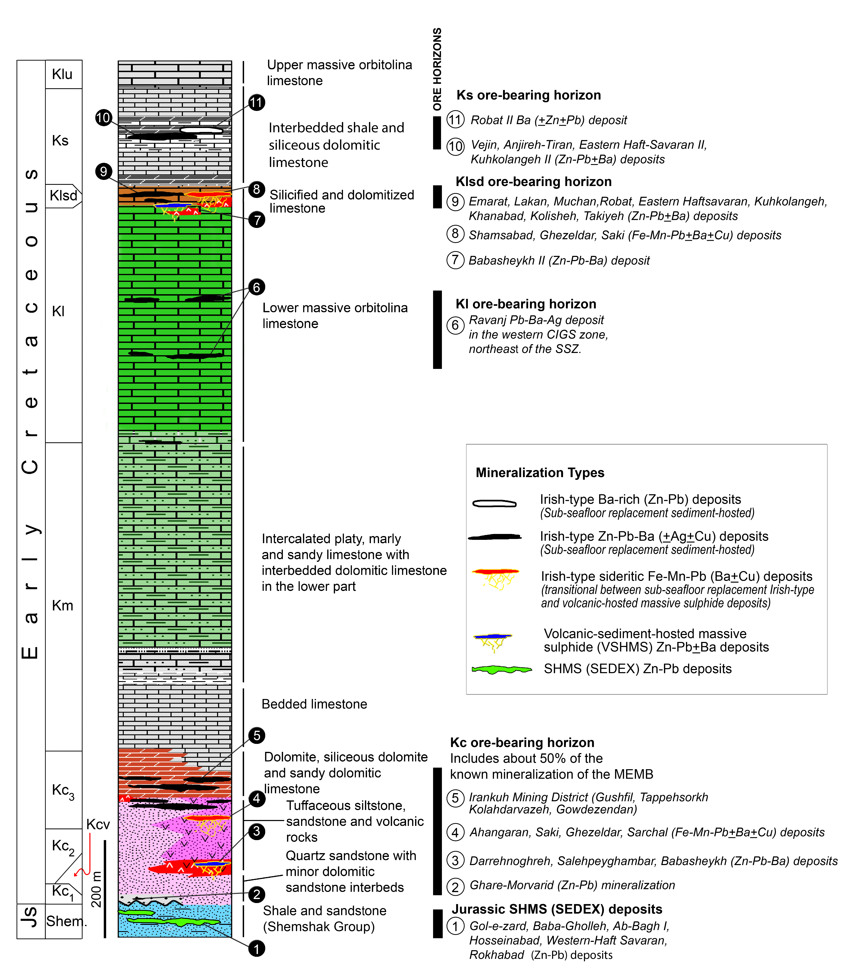
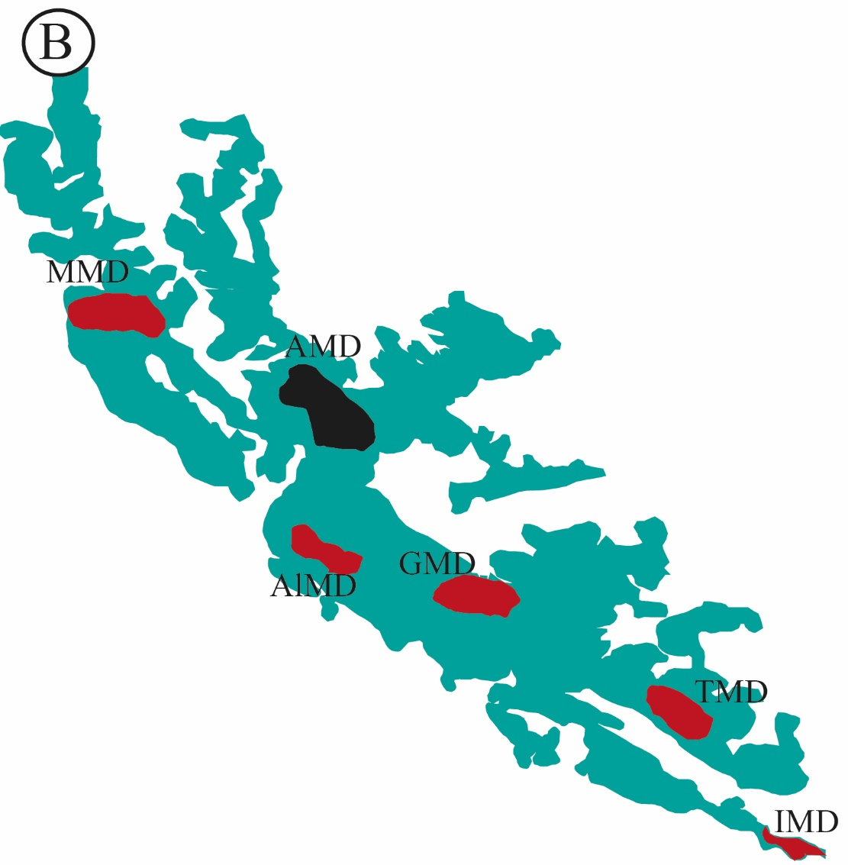
Regional Geology
Modified after Aghanabati (2004)
Modified after Momenzadeh (1976)
Modified after Momenzadeh (1976)
Notes:
(inset) map of structural zones of Iran (Aghanabati, 2004)
Irankuh Mining District; TMD: Tiran Mining District; GMD: Golpaygan Mining District; AlMD: Aligodarz Mining District; AMD: Arak Mining District; MMD: Malayer Mining District.
Stratigraphy and mineralization horizons of the MEMB

Slide 4
AMD Geology
Jurassic and Early Cretaceous units thrusted on Upper Cretaceous limestone
(Modified from Mahmoodi et al., 2018)
Notes:
Geology map of the Arak Mining District

Slide 5
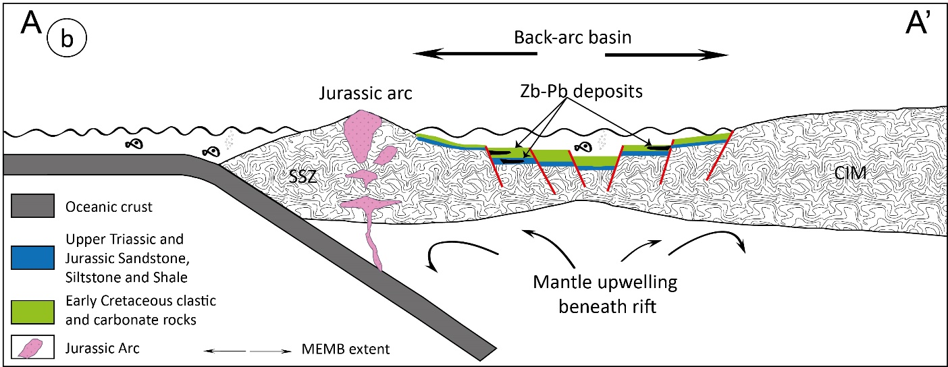
TECTONOSTRATIGRAPHY
(Modified from Rajabi et al., 2012; Mohajjel & Fergusson, 2014)
Notes:
a) Paleotectonic map depicting Neo-Tethys subduction under the Sanandaj-Sirjan Zone (SSZ) and formation of a Jurassic magmatic arc and back-arc basin in the Early Cretaceous (Modified from Bagheri and Stampfli, 2008; Ghasemi and Talbot, 2006; Rajabi et al., 2012a; Stampfli and Borel, 2002). Line A-A’ shows location of cross-section shown in “b”. b) Schematic Early Cretaceous paleotectonic cross-section of the southwestern Eurasian margin in the northwestern Sanandaj–Sirjan Zone (Modified from Mohajjel and Fergusson, 2014)

Slide 6
EH-S Geology
(Mahmoodi et al., unpubl. data)
Notes:
Geological map of the Eastern Haft-Savaran ore deposit. Line A-B shows location of cross-section of the deposit depicted in B.
B) Schematic cross-section of the Eastern Haft-Savaran deposit. Mineralogical zoning of the Eastern Haft-Savaran deposit is also shown.
C) Stratigraphic column of the Eastern Haft-Savaran deposit.

Slide 7
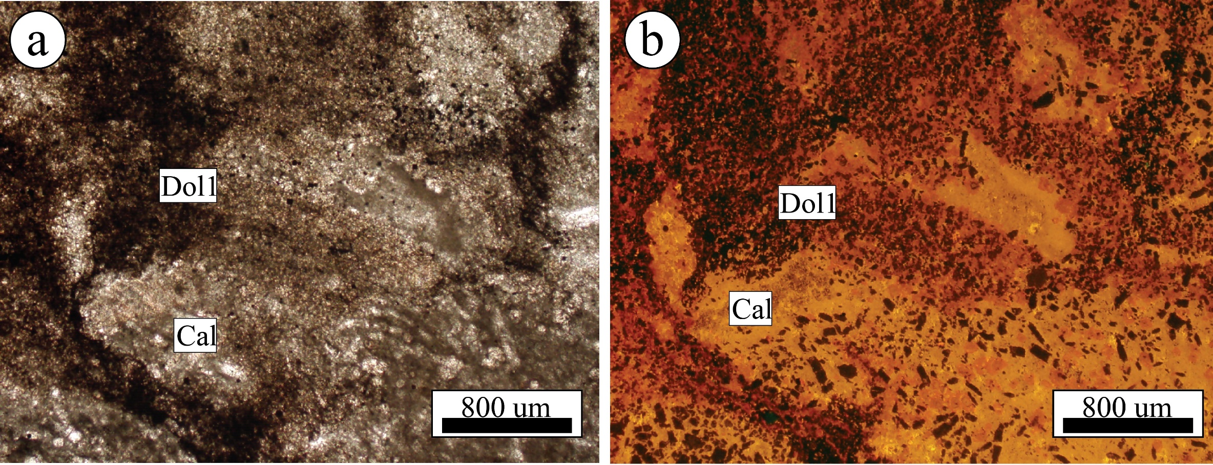
Carbonate alteration
Notes:
Plane-polarized light photomicrograph of low altered Kl unit. b) Cathodoluminescence photograph of weakly altered limestone with first generation dolomitization, minute euhedral barite and calcic Orbitolina fossil.
c) Cross-polarized transmitted light photomicrograph of dolomitized limestone that contains first generation dolomite, second generation dolomite and a calcite veinlet. First generation dolomite occurs as relict brecciated fragments in second generation dolomite. Calcite veinlets cross-cut first and second generation dolomite. The white dashed line outlines a remnant breccia fragment of first generation dolomite. The yellow dashed lines demarcate limits of a calcite veinlet.

Slide 8
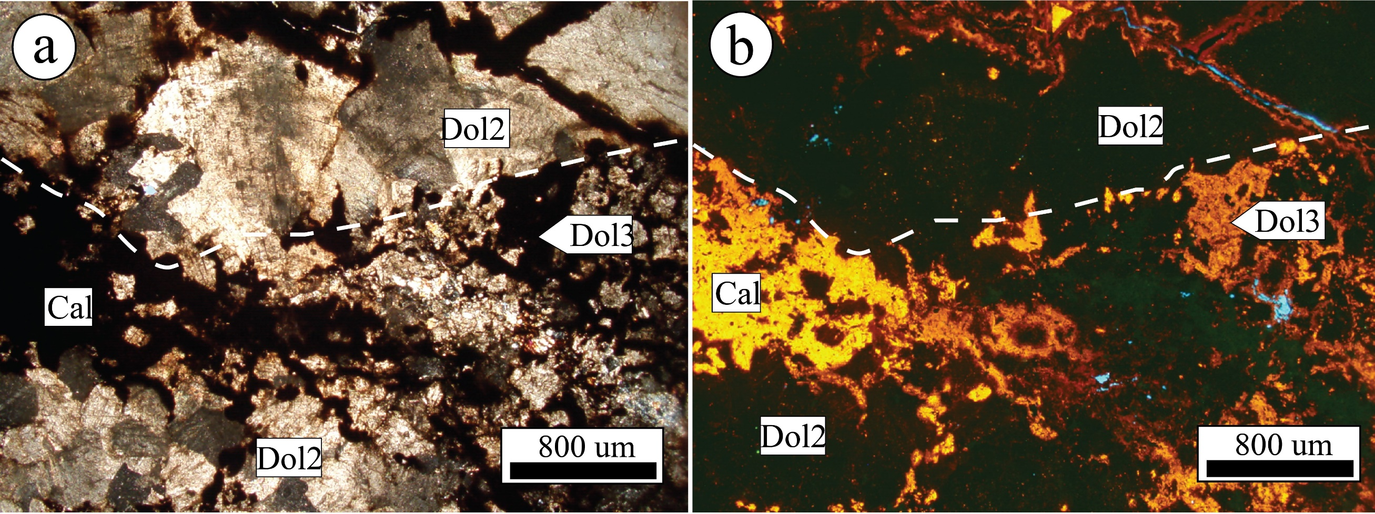
Carbonate alteration
Notes:
a) Cross-polarized light photomicrograph of second-generation dolomite and dolomitic vein (both are iron-rich). b) Cathodoluminescence photograph of dolomitic vein and matrix. White dashed line demarcates boundary of coarsely crystalline dolomite and dolomitic matrix.

Slide 9
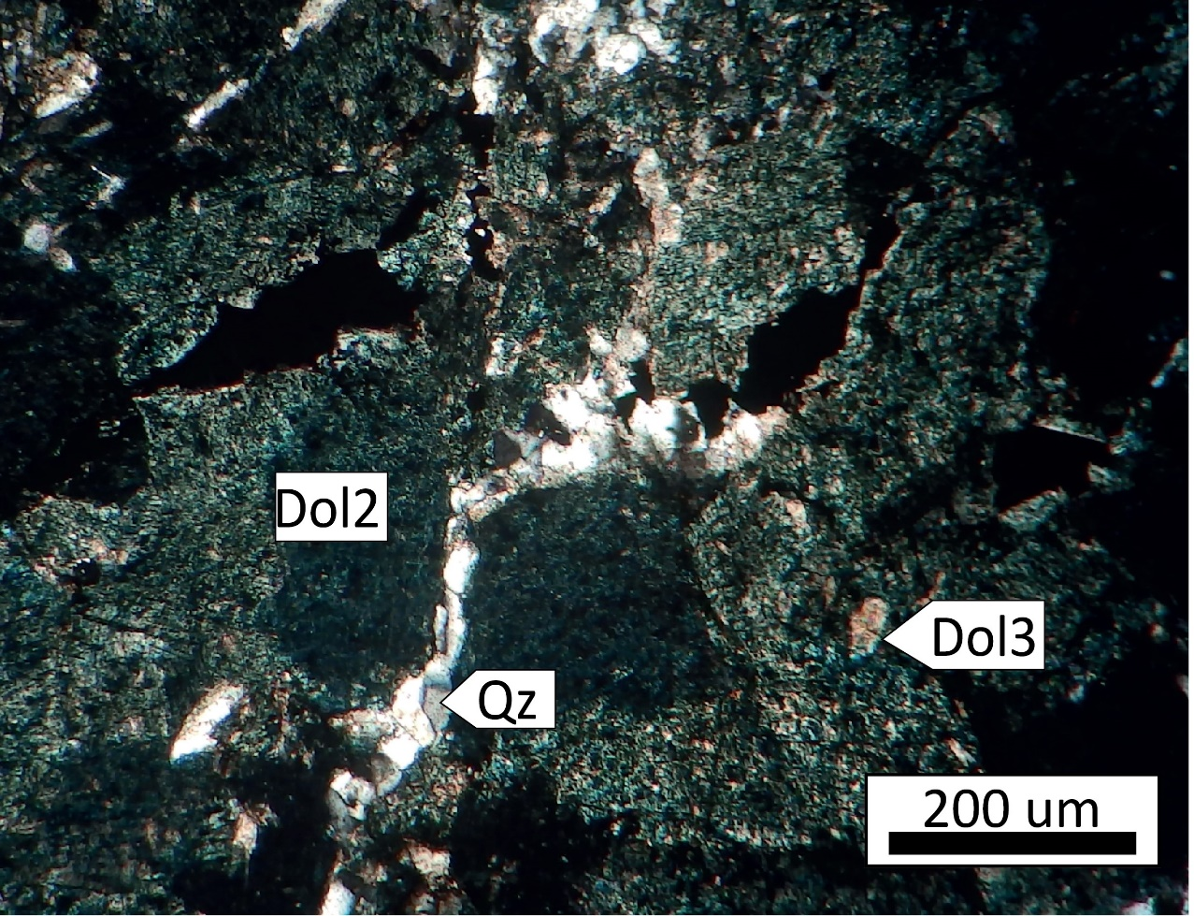
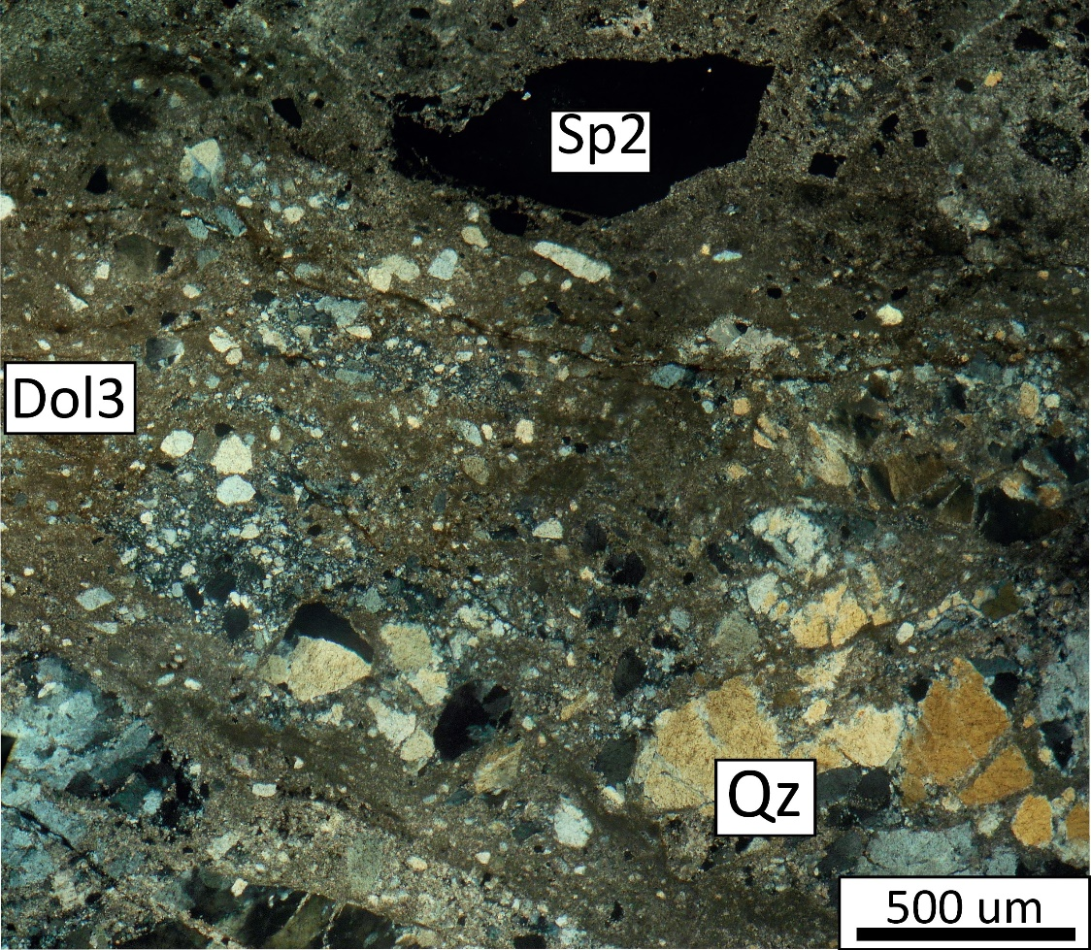
Carbonate alteration
Notes:
Cross-polarized light photomicrograph of second generation dolomitization cross-cut by quartz veinlet in uppermost Kl (Klsd). This PTS is stained a dark blue color, indicative of its iron-rich composition.
Cross-polarized transmitted light photomicrograph of hydrothermal quartz and sphalerite that are brecciated and replaced by third generation dolomite.

Slide 10
Carbonate alteration chemistry
 | First generation dolomite |  |  |  | Second generation dolomite |  |  |  | Third generation dolomite
 | N: 14 |  |  |  | N: 14 |  |  |  | N: 13
 | Min | Mean | Std | Max | Min | Mean | Std | Max | Min | Mean | Std | Max
Mn | 0.02 | 0.22 | 0.08 | 0.30 | 0.70 | 1.20 | 0.30 | 1.50 | 0.15 | 0.30 | 0.10 | 0.50
Fe | 0.30 | 1.01 | 0.50 | 1.90 | 7.50 | 8.32 | 0.40 | 9.02 | 1.02 | 2.00 | 0.60 | 3.06
Cu | 0 | 0.17 | 0.30 | 0.80 | 0 | 0.01 | 0.01 | 0.03 | 0 | 0.03 | 0.08 | 0.30
Zn | 0.01 | 0.05 | 0.03 | 0.10 | 0.01 | 0.05 | 0.04 | 0.16 | 0 | 0.01 | 0.01 | 0.02
Pb | 0.01 | 0.02 | 0.10 | 0.04 | 0.01 | 0.04 | 0.02 | 0.10 | 0 | 0.01 | 0.05 | 0.01
Mg | 6.40 | 8.70 | 0.90 | 9.80 | 6.60 | 7.20 | 0.30 | 7.97 | 10.15 | 11.58 | 1.00 | 13.36
Ca | 24.05 | 24.90 | 0.60 | 25.70 | 18.30 | 19.60 | 0.60 | 20.6 | 22.72 | 25.43 | 1.40 | 27.70

Slide 11
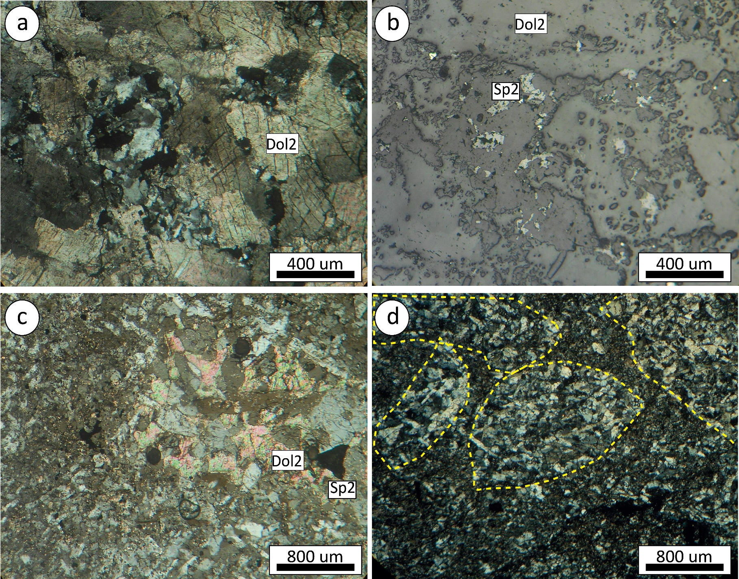
Silicification
Notes:
a) Cross-polarized light photomicrograph of second generation dolomitization cut and replaced by silicification
b) Reflected light photomicrograph of “a” showing that sphalerite is associated with silicification.
c) Cross-polarized light photomicrograph of intense silicification with relict second generation dolomite
d) Cross-polarized light photomicrograph of intensely silicified limestone. Yellow dashed line shows limits of Orbitolina fossils replaced by quartz. Quartz in fossils is coarser-grained than that in matrix.

Slide 12
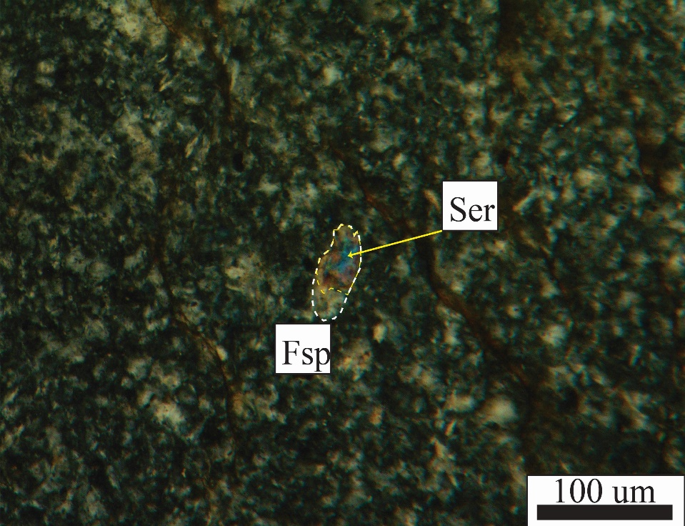
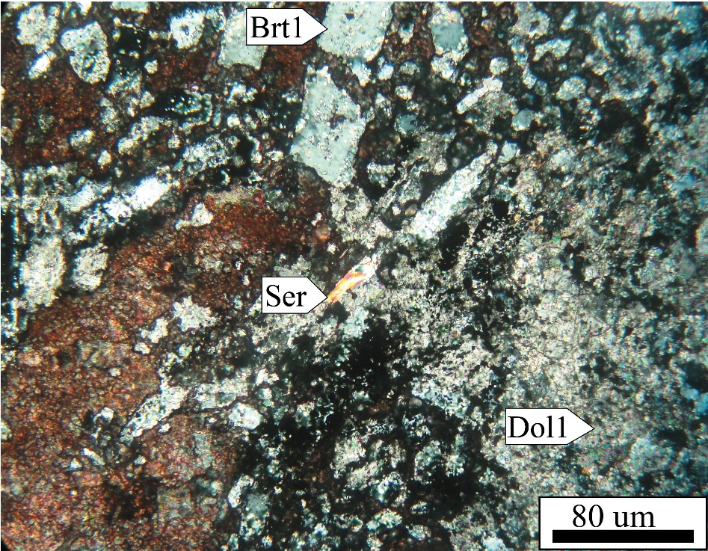
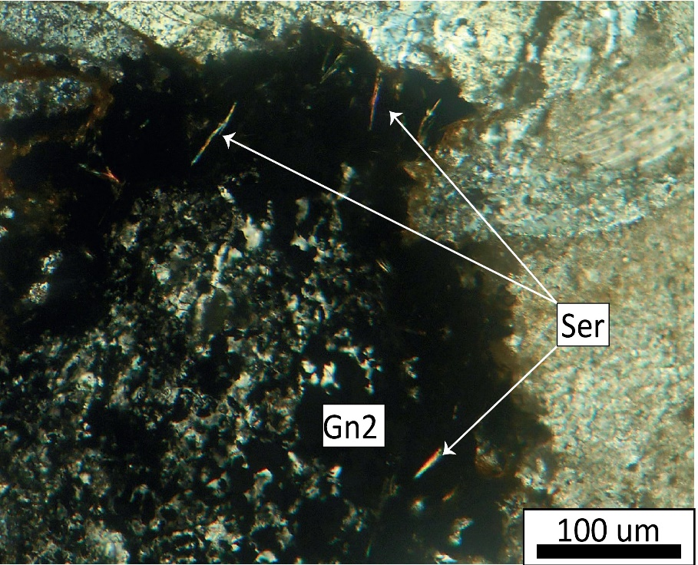
Sericite alteration
Notes:
Cross-polarized light photomicrograph of the alkali feldspar-phyric rhyodacite volcanic flow unit showing alkali feldspar partly altered to sericite with cryptocrystalline to microcrystalline matrix. Fsp: Feldspar; Ser: Sericite.
Cross-polarized light photomicrograph of first generation dolomitization, sericite alteration and minute euhedral barite in the southern part of the EH-S deposit.
Cross-polarized light photomicrograph of sericite with coarse crystalline barite, second generation weathered galena in the northern part of the EH-S deposit

Slide 13
Mineralization zoning
(Mahmoodi et al., unpublished data)
Notes:
Photograph of the Haft-Savaran (H-S) region looking southeast. The H-S region is a syncline that plunges to the southeast. Jurassic strata occur in the southwest and northeast limbs of the H-S, and intercalated limestone, shale and marl are in the center of the syncline. Volcanic rocks with sulfide mineralization occur in the southern part of the EH-S deposit, near the reverse fault; barite occurs in the northern part of the deposit.

Slide 14
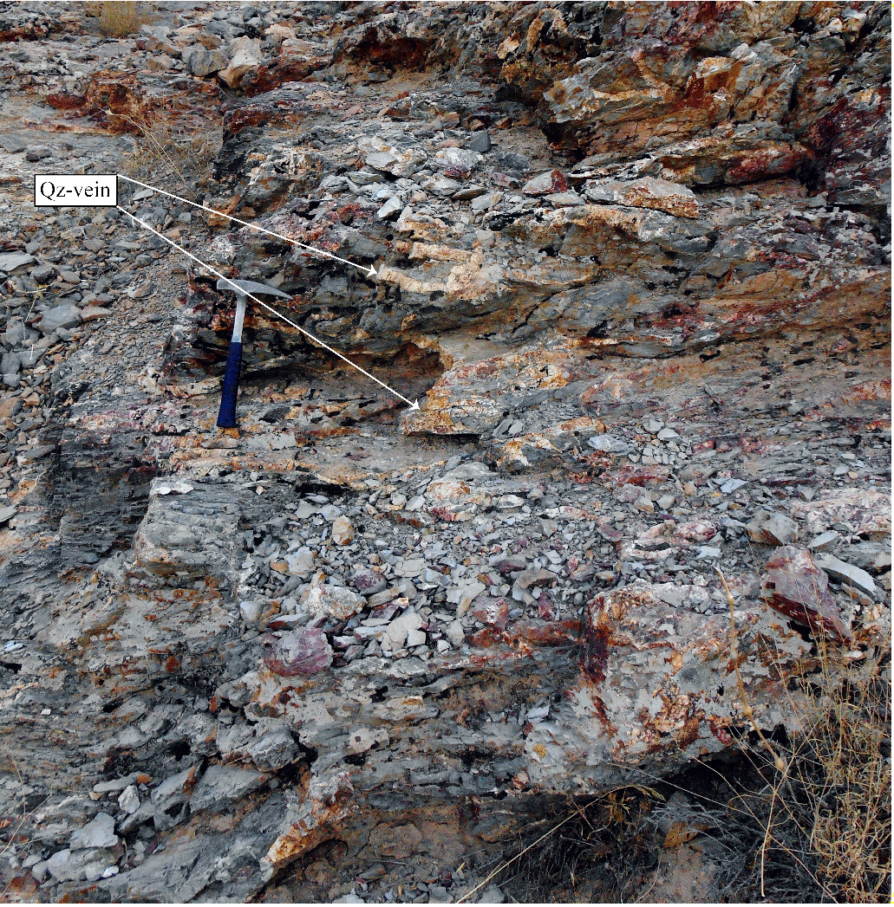
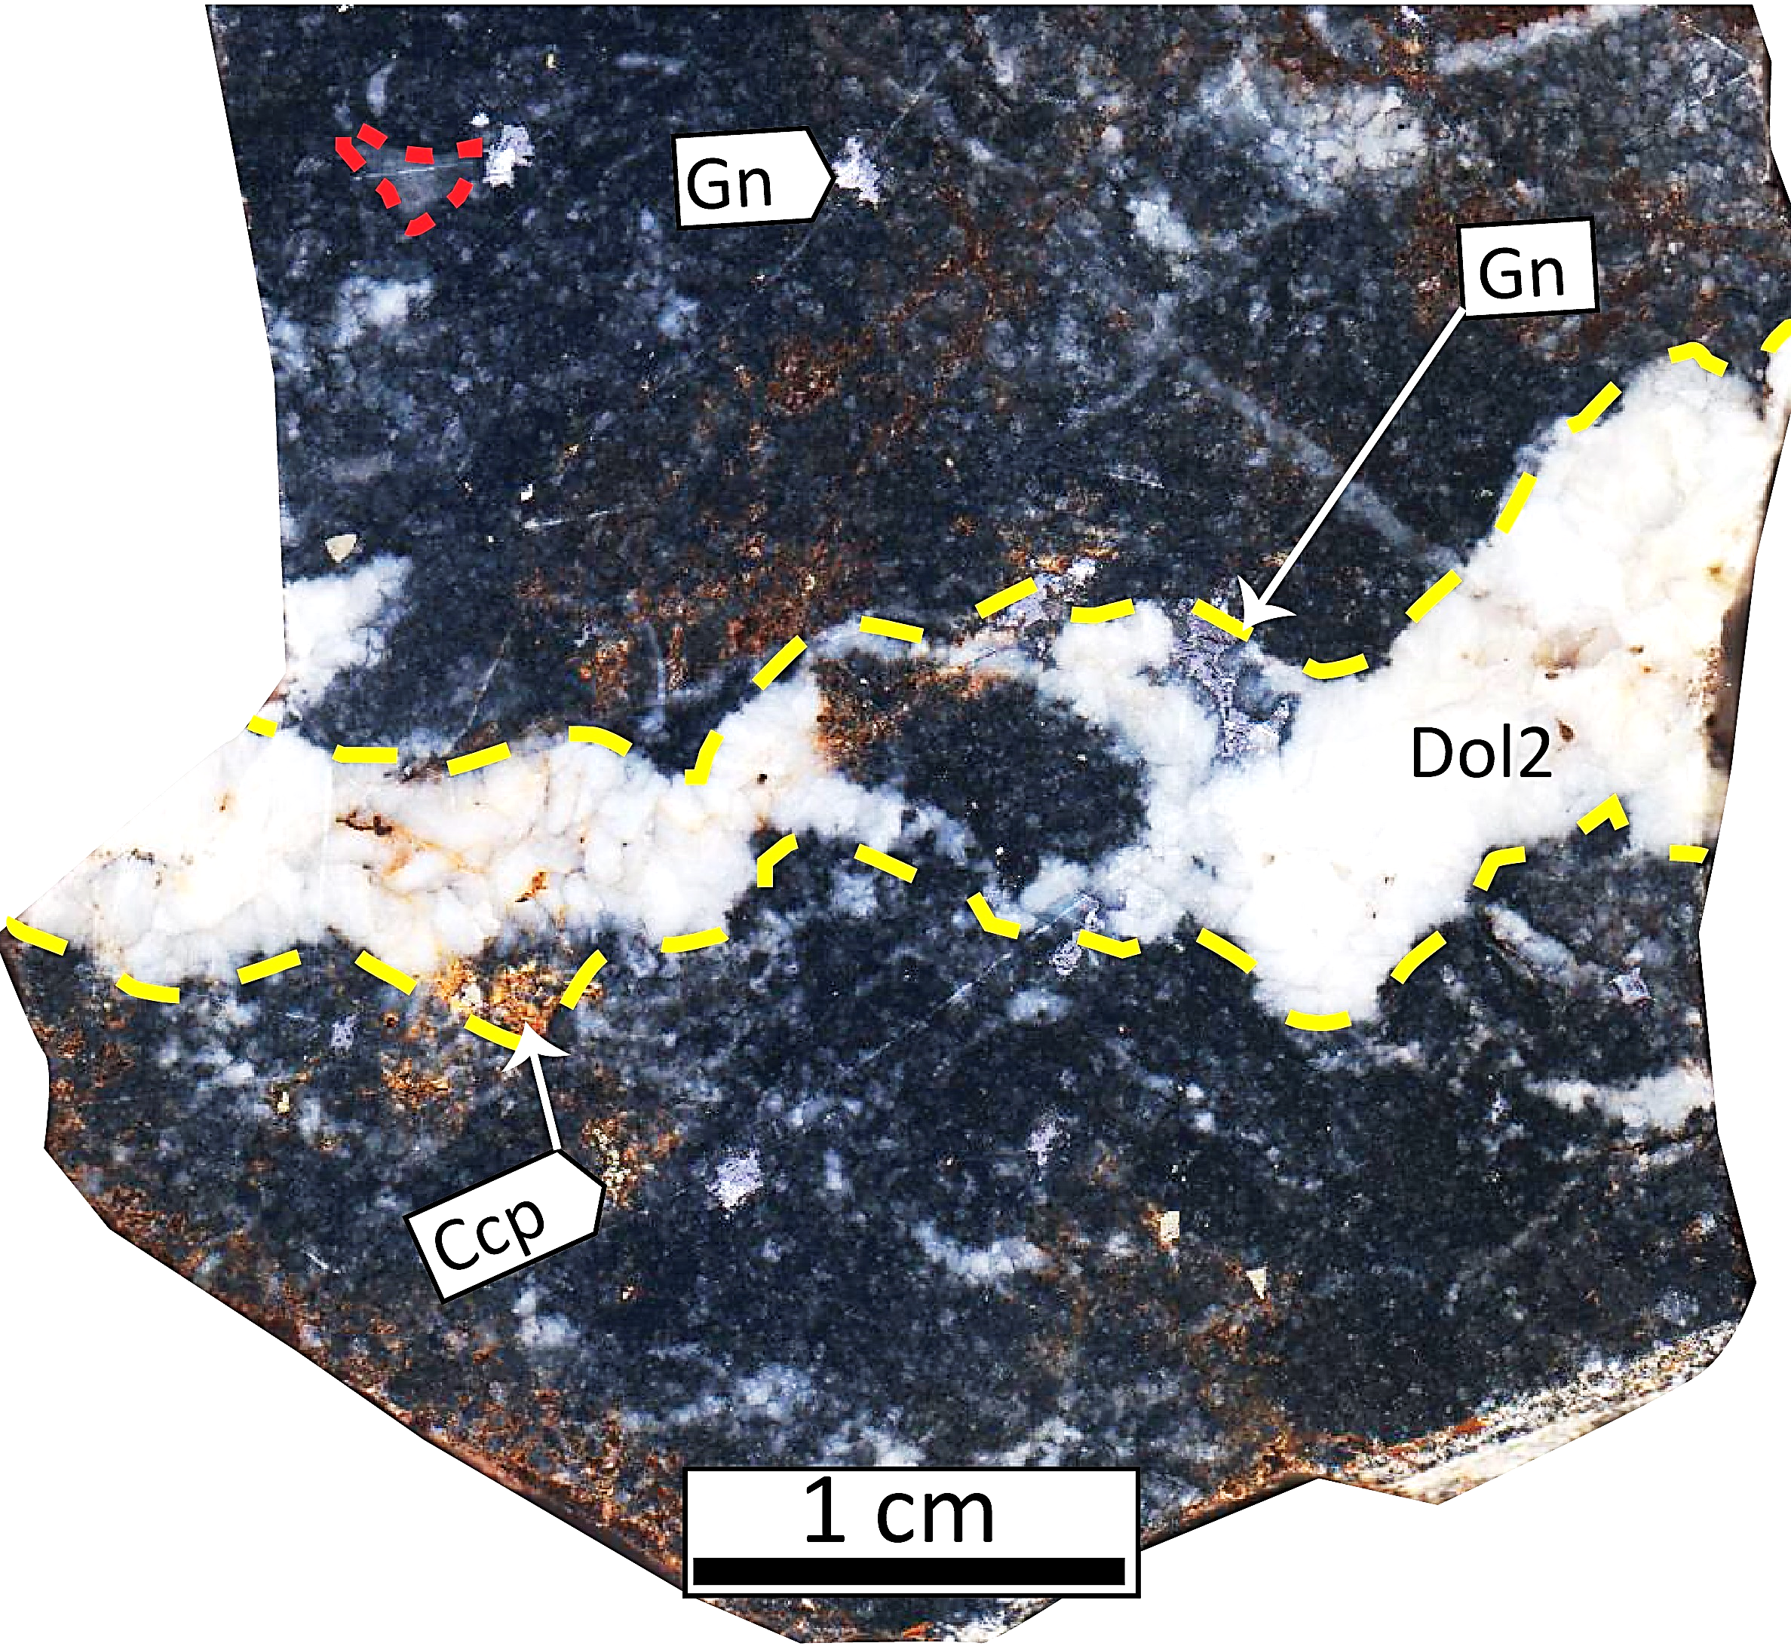
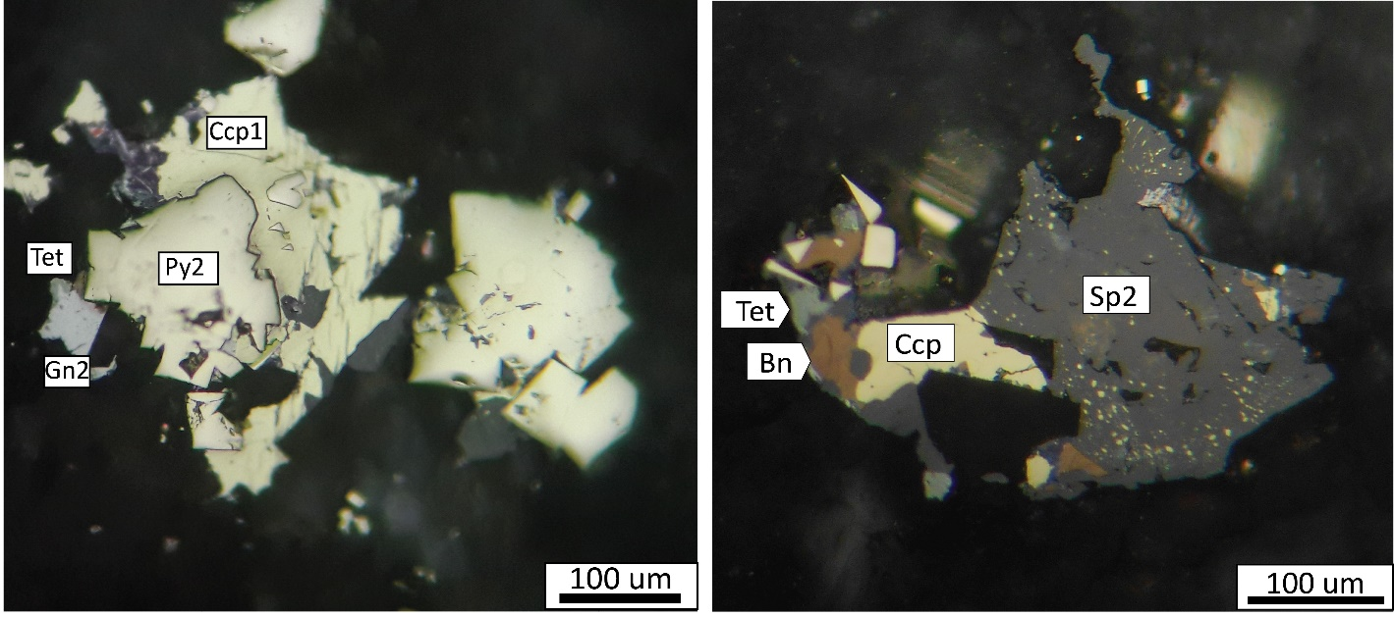
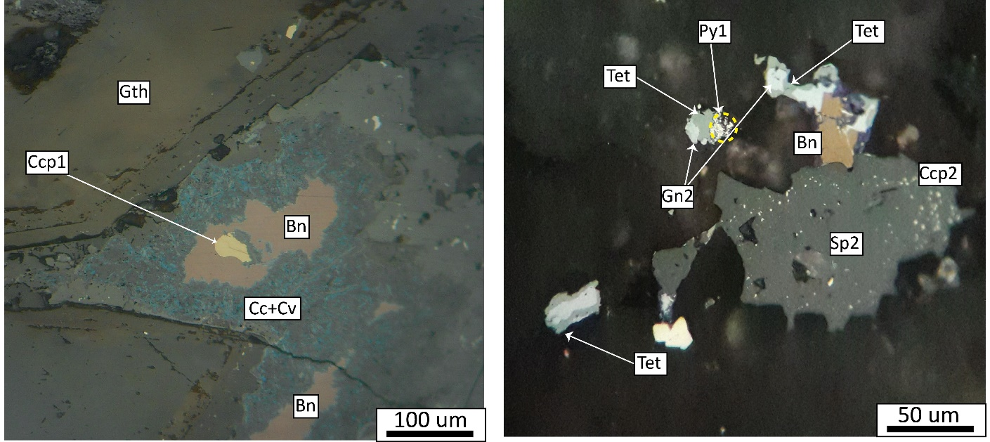
Southern part
Notes:
Photograph of the southern part of the EH-S deposit and location of inferred reverse fault looking to the northwest (right photo). Kl: Massive limestone; K1d: Intense altered uppermost part of Kl; Ks = Intercalated shale, marl and limestone. Width of field of view is 500 m. Close-up photograph of rhyodacite unit with quartz veins-veinlets in the southern part of the EH-S deposit (left photo).
Hand sample of dolomitized limestone and dolomite-galena vein. Yellow dashed line shows the limits of the sulfide-bearing dolomitic vein. Red dashed line demarcates Orbitolina fossil.
Reflected light photomicrograph of chalcopyrite, pyrite, sphalerite, tetrahedrite bornite, chalcopyrite disease and remain of framboidal pyrite.

Slide 15
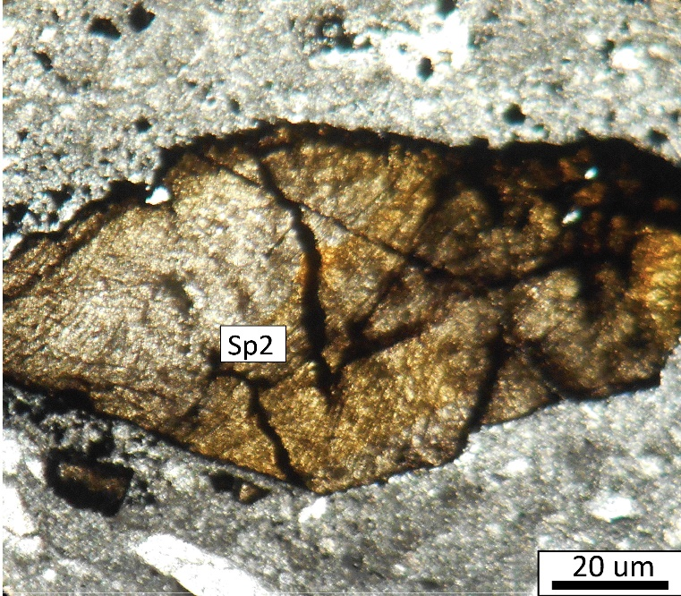
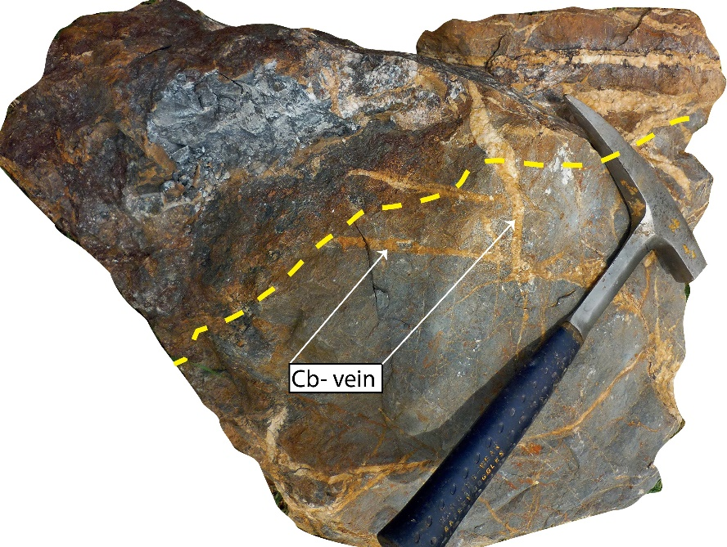
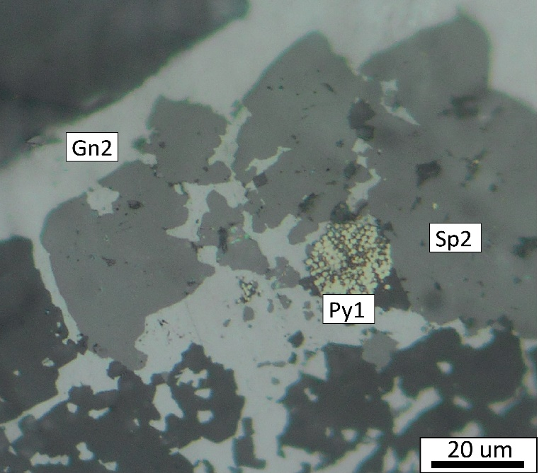
Central part
Notes:
Weakly altered limestone in the central part of the EH-S deposit. Dashed yellow line shows bedding and white arrows indicate load casts of sulfide mineralization and hydrothermal alteration in unconsolidated mud.
Plane-polarized light photomicrograph of second generation sphalerite with dolomitization
Photograph of vein-veinlet second generation dolomite in dolomitized limestone of the central part of the EH-S deposit. Yellow dashed line shows boundary between completely replaced limestone and only weakly altered limestone.
Reflected light photomicrograph of galena, sphalerite and framboidal pyrite. Framboidal pyrite is partly replaced by second generation galena and sphalerite.

Slide 16
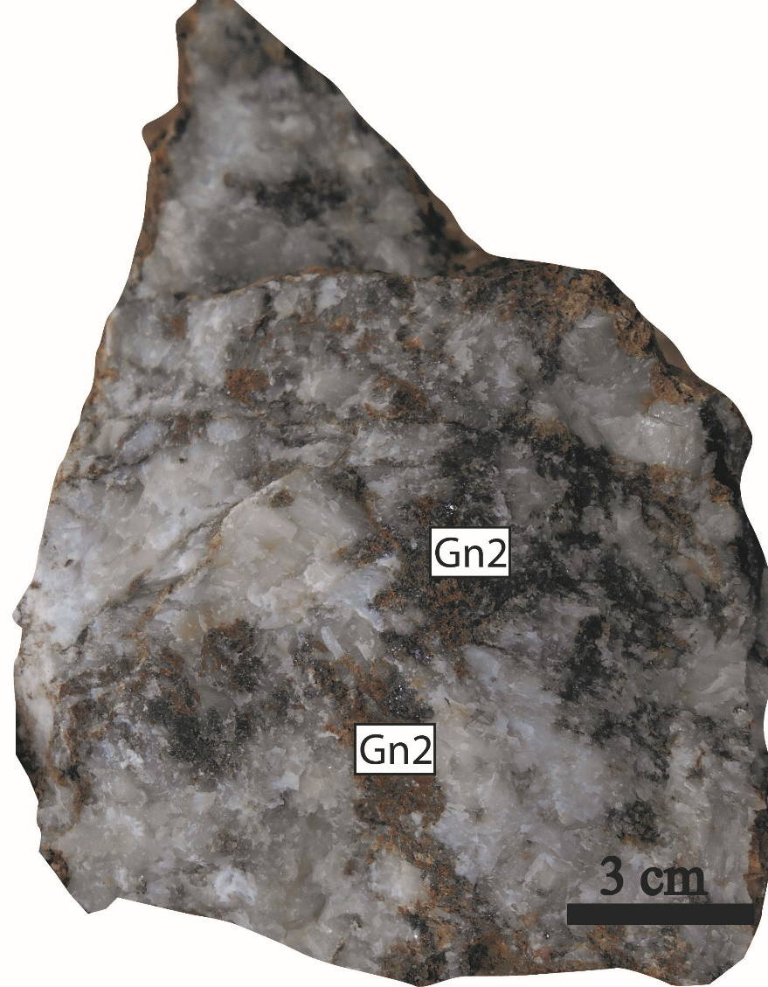
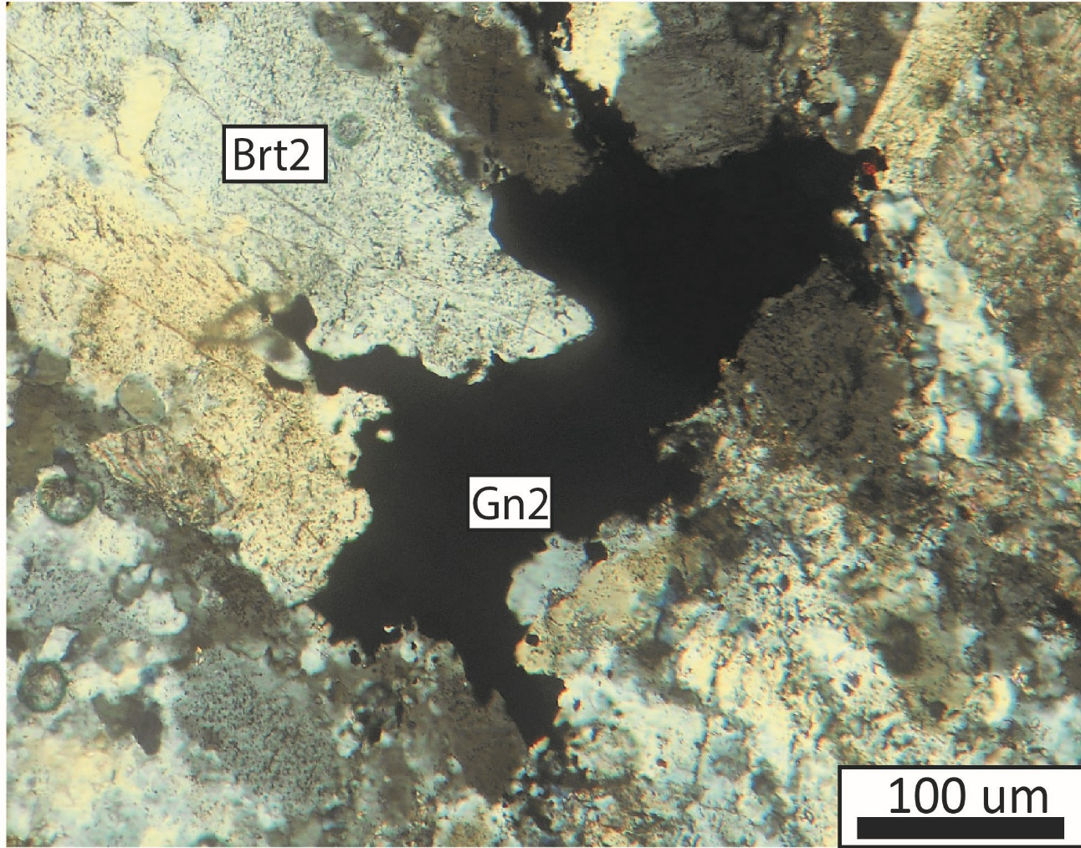
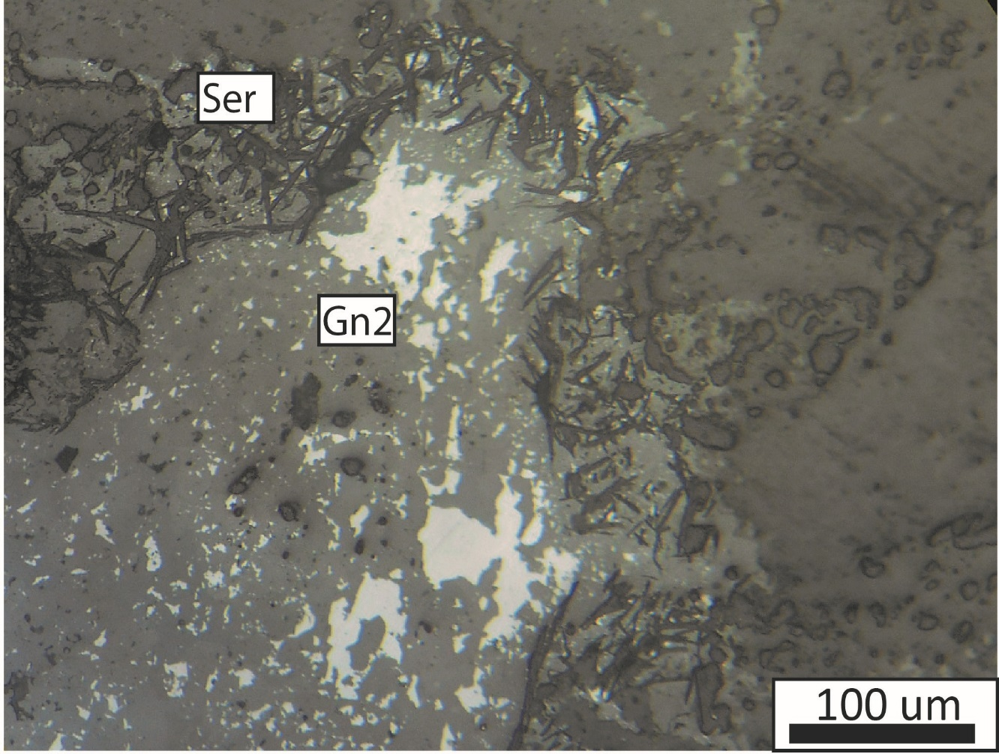
Northern part
Notes:
Massive barite lens at the Kl-Ks boundary. Baritic veins-veinlets stratigraphically below massive barite; these indicate that the baritic veins were the feeders for overlying hydrothermal massive barite.
Cross-polarized transmitted light photomicrograph of second generation barite and second generation galena.
Reflected light photomicrograph of second generation galena with sericite alteration around galena.

Slide 17
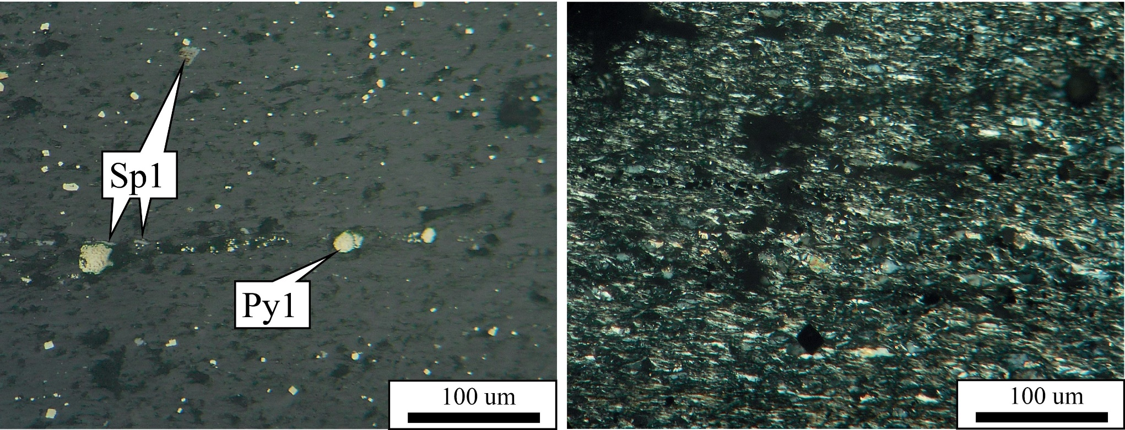
Mineralization in shale
Sulphide (pyrite and sphalerite)-bearing shale unit immediately above Klsd (main mineralization horizon)
Notes:
Bedded mineralization in shale unit upon Klsd in the EH-S deposit.

Slide 18
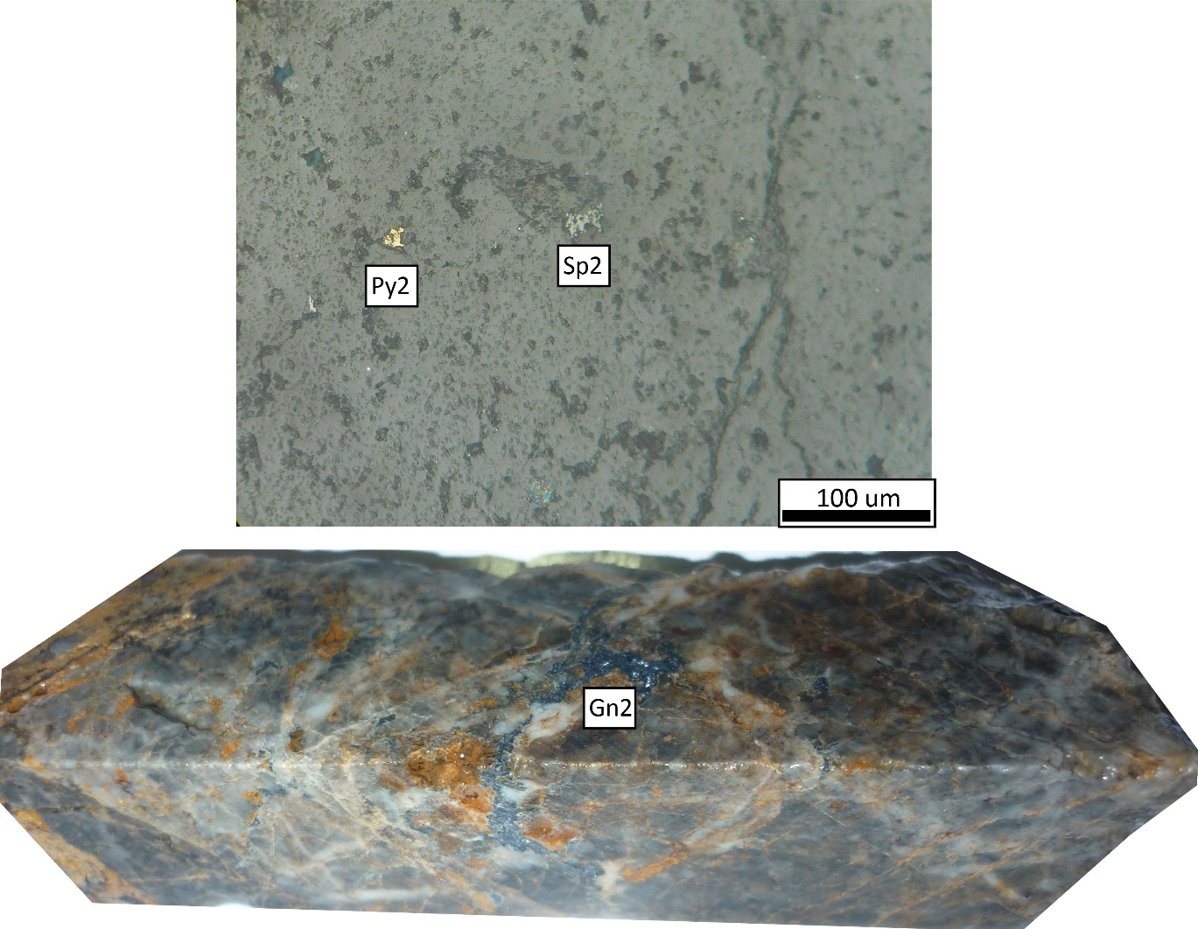
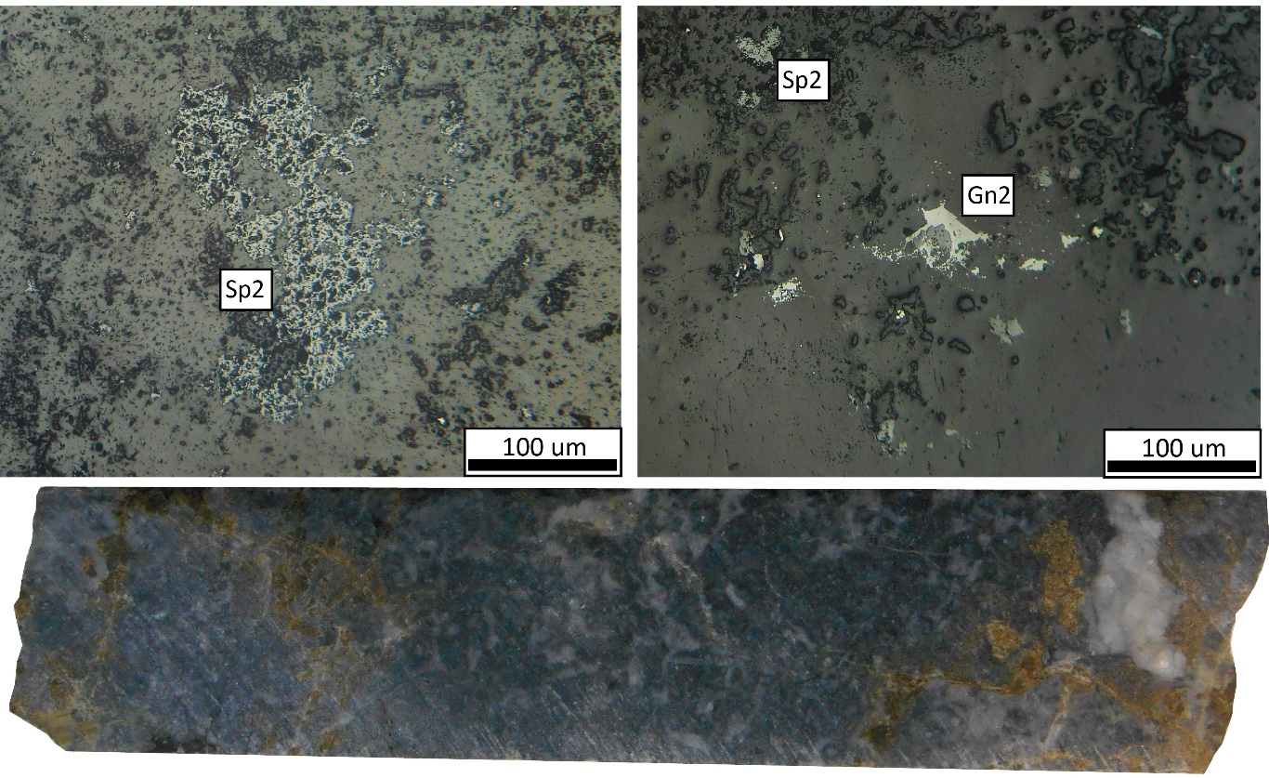
Mineralization in massive limestone
Notes:
Low altered limestion with weak mineralization near organic matter stylolite. Framboidal pyrite is mantled by sphalerite. Reflected light photomicrograph of framboidal pyrite (Py1) and sphalerite adjacent to stylolite demarcated by organic matter. Organic matter is crinkled via calcite recrystallization. White dashed boxs depicts region shown in ‘nearby photos’.
Most upper part of Kl completely replaced by dolomitization and silicification with disseminated mineralization (sphalerite, galena and pyrite)

Slide 19
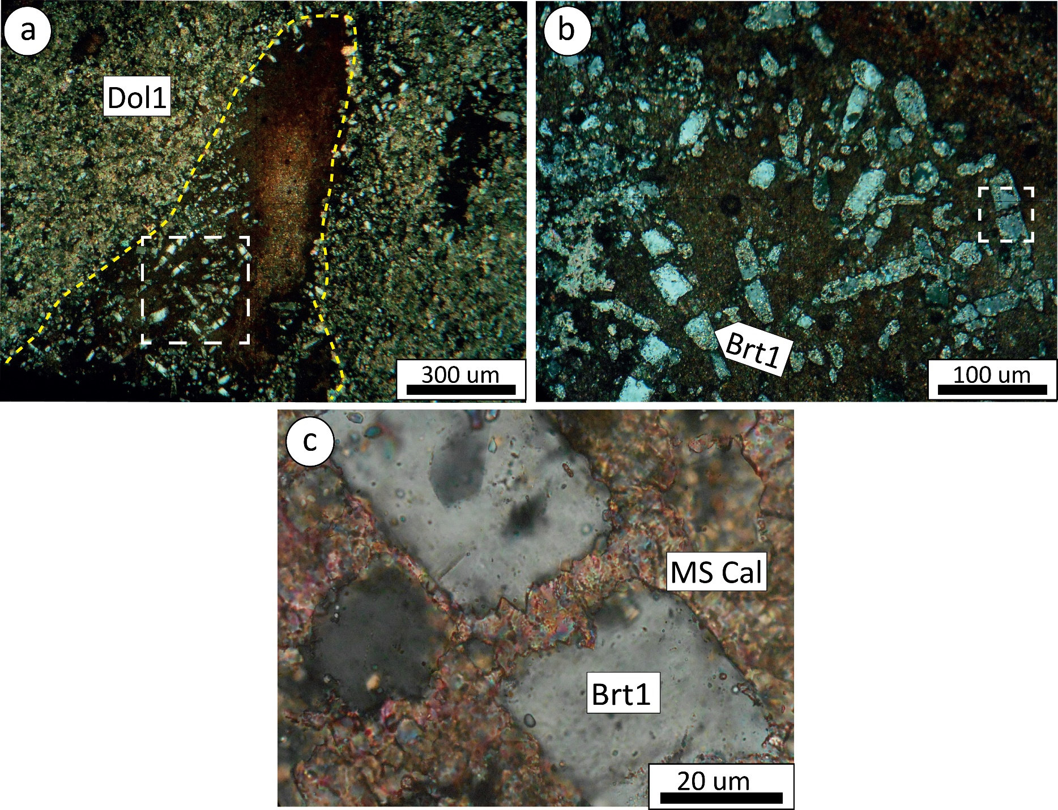
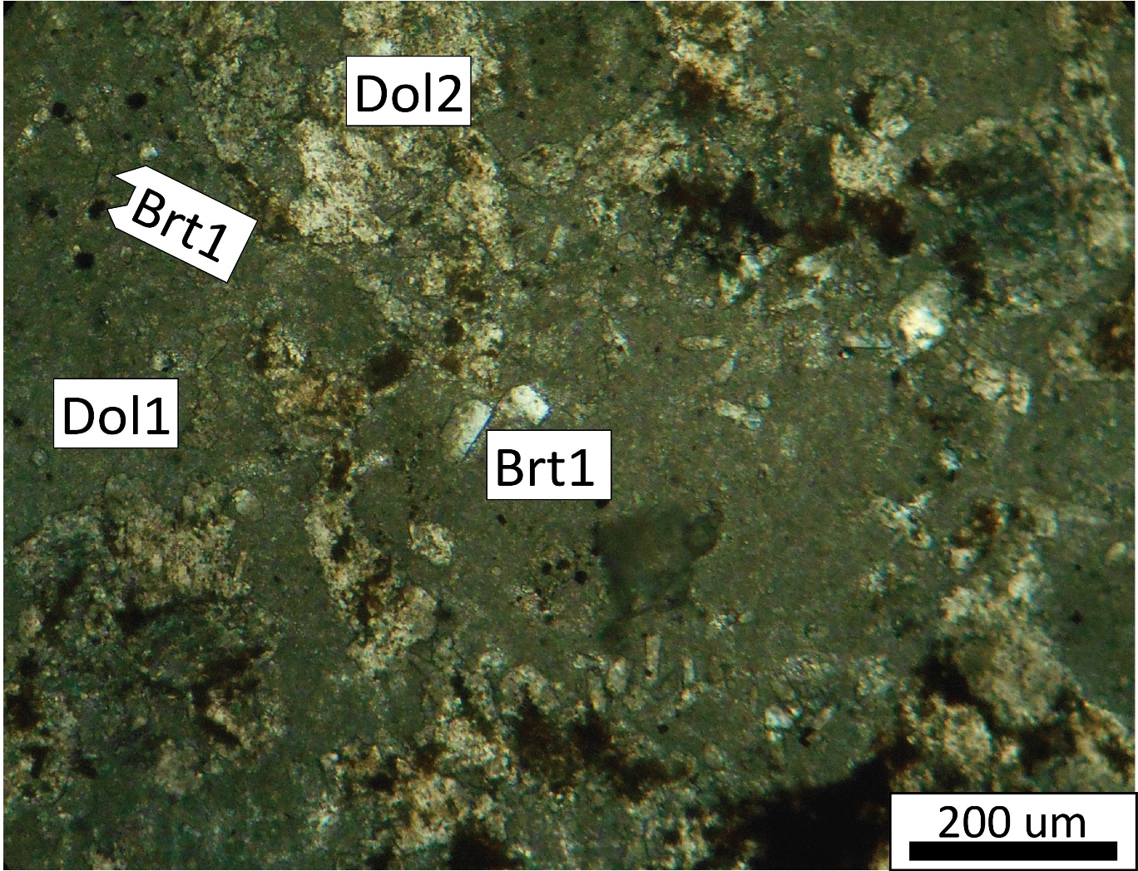
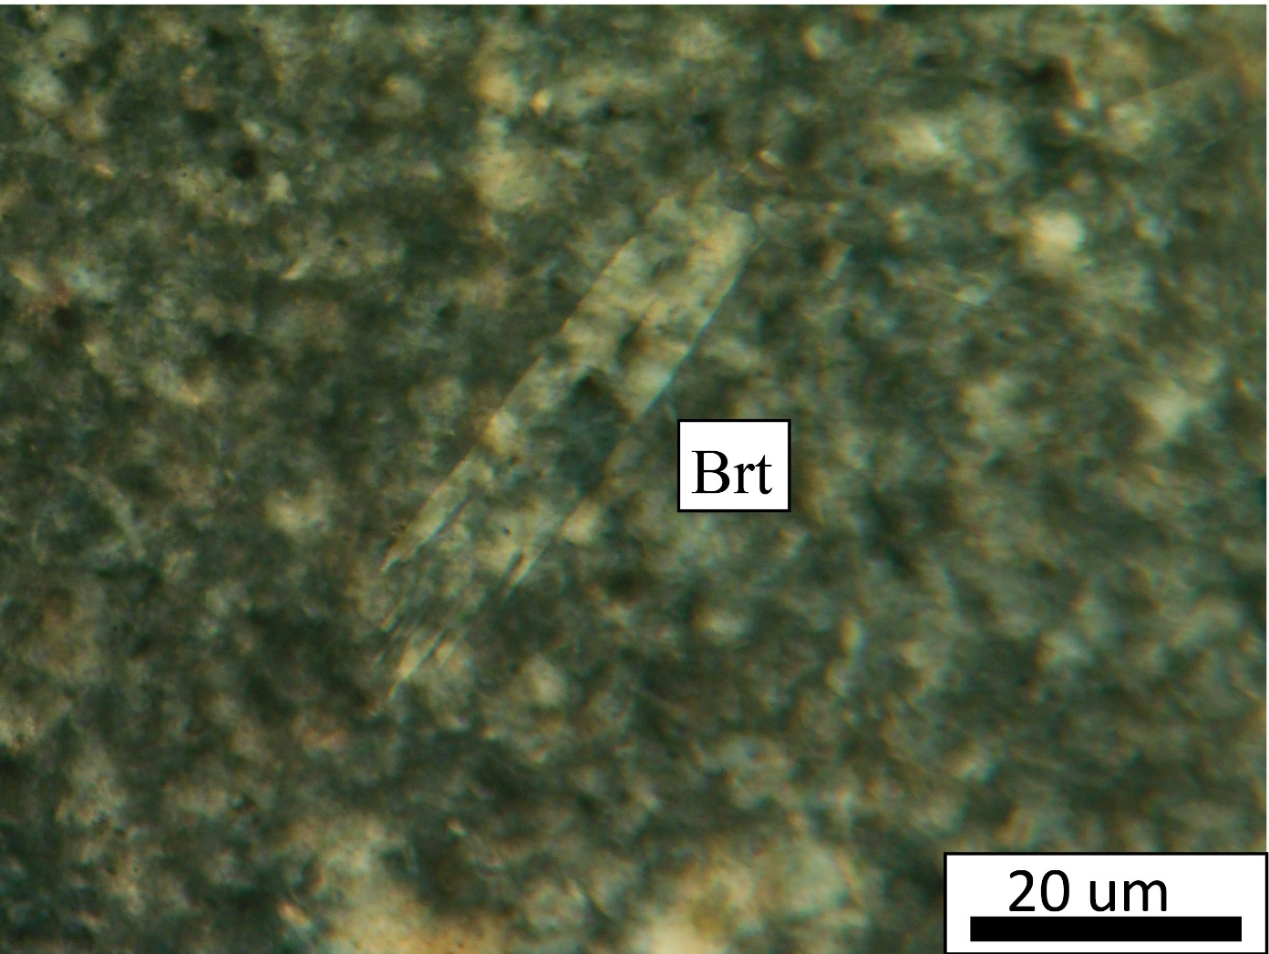
Minute euhedral barite
Notes:
Plane-polarized light photomicrograph of weakly altered area in the central part of the EH-S deposit that shows Orbitolina fossils, first generation hydrothermal barite and first generation dolomite. This PTS has been stained with alizarin red and potassium ferrocyanide, and Orbitolina fossils are colored red and first generation dolomites are colorless. Euhedral disseminated fine-grained barite is also present in the groundmass of the sample between fossils. Yellow dashed line show remain Orbitolina fossil. Outlined white box shows region of “b”. b) Cross-polarized light photomicrograph of dolomitized (first generation dolomite) minute euhedral barite in the Orbitolina fossil that cut by calcite. Dolomitization occurred completely and partly from the marginal part. Outlined white box shows region of “c”. c) Cross-polarized light photomicrograph of minute euhedral barite that cut by micro sparite calcite in the fossil.
Cross-polarized light photomicrograph of minute euhedral barite that replaced partly and completely by first generation dolomite. Cross-polarized light photomicrograph of minute euhedral barite in rhyodacite volcanic flow .

Slide 20
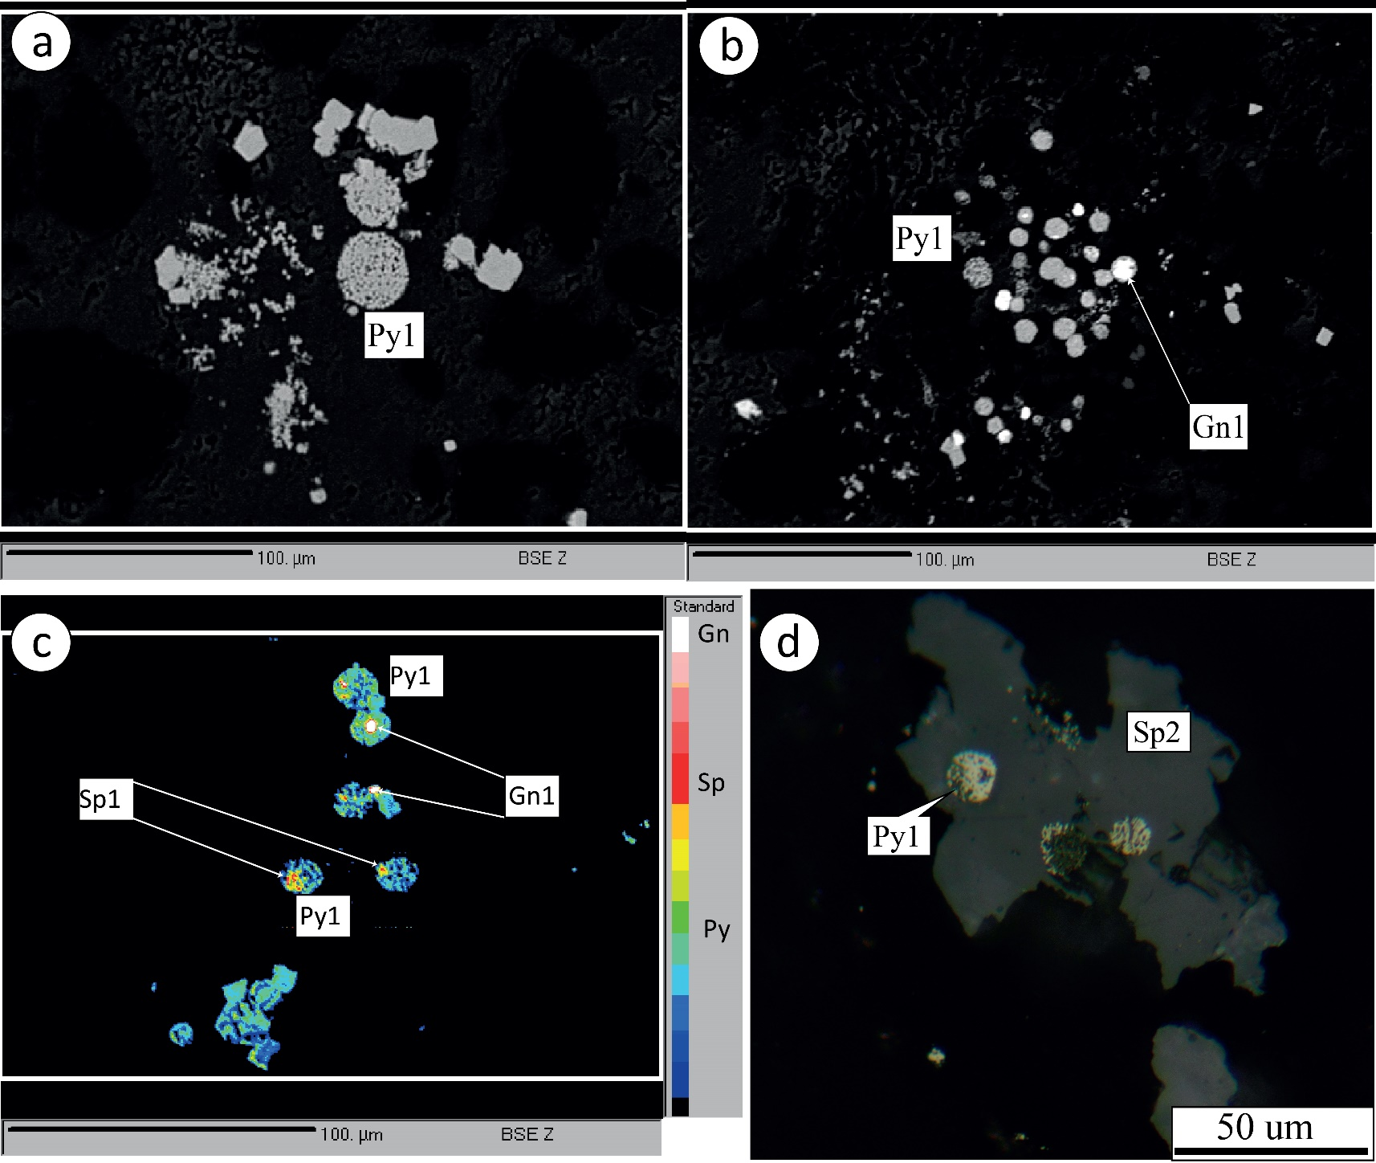
Framboidal pyrite
Notes:
1- Histogram of diameter of framboidal pyrites within Kl unit. b) Histogram of diameter of framboidal pyrites within limestone and marl in Ks unit. c) Plot of average size of framboidal pyrite vs. depth for samples from drill hole 1. The starred sample is weakly altered and from within a strongly silicified zone. Relatively homogeneous size of framboids within a polyframboid cluster indicates pore water iron concentration was homogenous.
a, b) BSE image of polyframboidal pyrite from low-grade mineralization in uppermost Kl.
c) Colored BSE image of polyframboidal pyrite from low-grade mineralization in uppermost Kl. Bluish green is pyrite, galena is white, and first generation dolomite is black. Red is either: 1) sphalerite (where red area is a discrete patch), or 2) substituted portion (if red portion forms a ring around galena (white color)).
Reflected light photomicrograph of framboidal pyrite mantled by sphalerite
d)

Slide 21
Paragenetic sequence
Notes:
Paragenetic sequence of the EH-S deposit, as determined by microscopic study.

Slide 22
Conclusions
The Eastern Haft-Savaran deposit formed as sub-seafloor replacement mineralization during early diagenesis, and can be classified as an Irish -type deposit based on the following criteria:
back-arc extensional tectonic setting of the Arak Mining District,
massive carbonate host rock,
mineralization controlled by stratigraphy,
minor volcanism,
load casts of mineralization in host rock,
mineralogical zonation within the mineralization
intensive replacement textures,
the presence of minute euhedral barite and framboidal pyrites (and their textural evolution),
ferroan dolomite alteration attendant with main stage of mineralization

Slide 23
Thank you

