Slide 1
Geological Survey Ireland
Irish Type Deposits
Eoin McGrath
8th September 2023

Slide 2
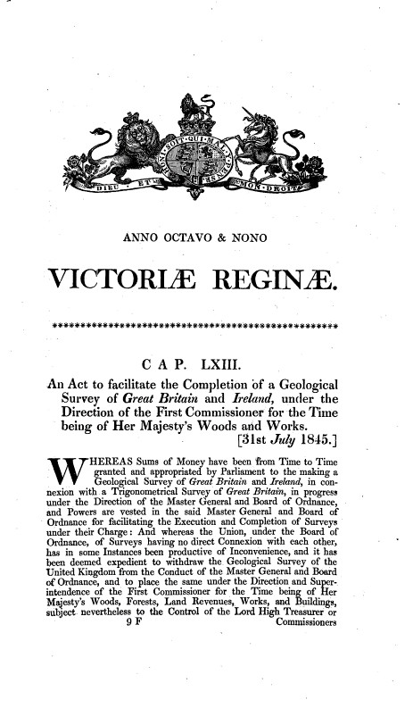
History of Survey
Founded 1845
Act of UK Parliament
Focus on minerals
Department of Environment, Climate & Communications

Slide 3
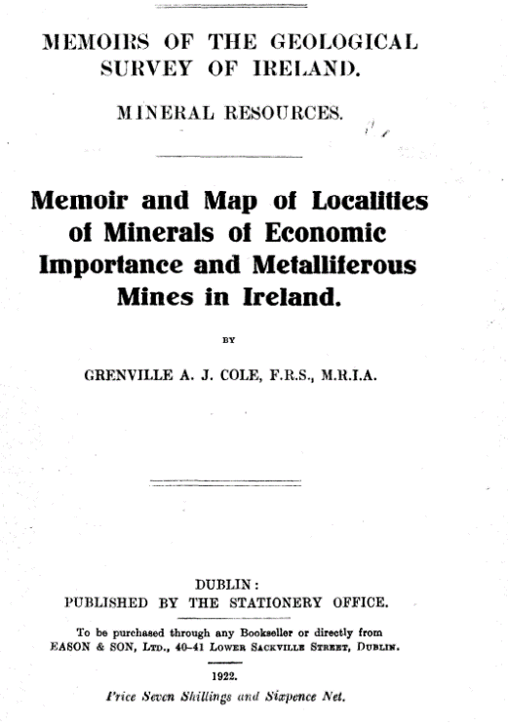
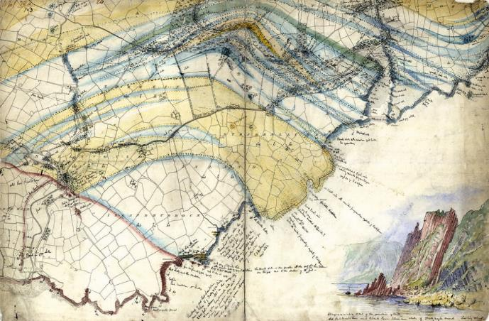
Mineral Exploration
Original 6” mapping sheets
Mineral Localities
Historic workings
Memoirs
Report Series

Slide 4
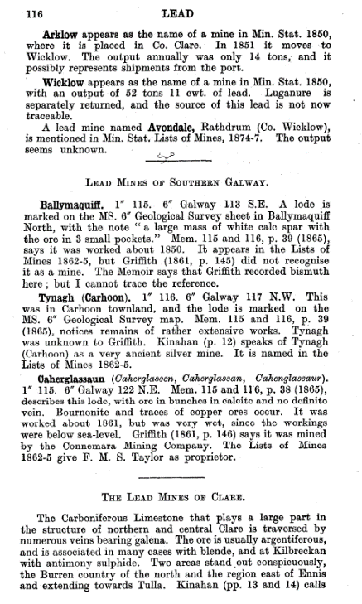
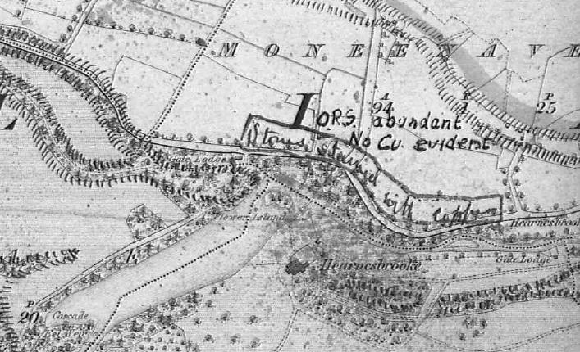
Tynagh
1859 geological map
1865 memoir
Cole (1922)
2km east of modern mine
1950s fieldwork
  Cu stained sandstone float
  Fault structure
Survey director Murrough O’Brien

Slide 5
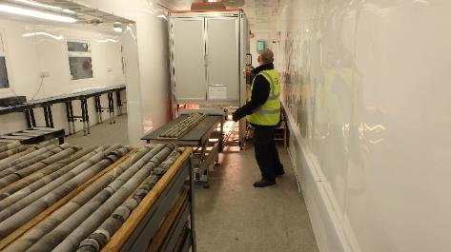
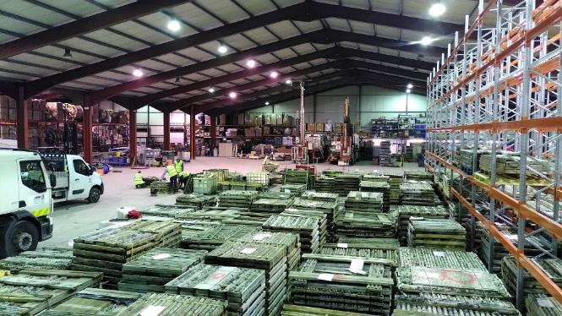
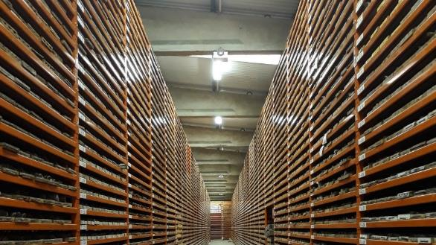
Corestore
How to support industry?
Glencree Corestore
Move to Sandyford
Acquisition of Scanner
Development of Birr
UCD Petrophysical Laboratory @ Geological Survey Ireland
New corestore in development
Still open for visitors
Notes:
Acquire industry core and save it from dumping

Slide 6
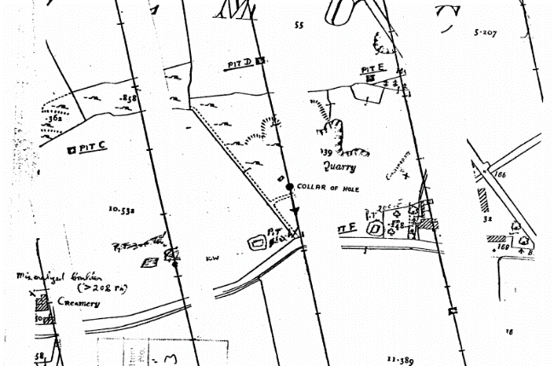
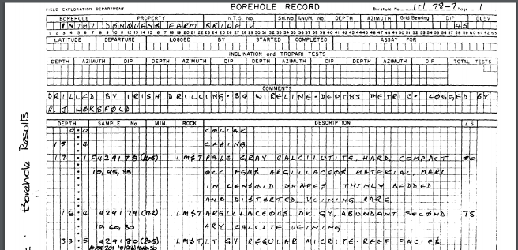
Open File
Next step in making data available
Published 1984
Collection of industry work programmes
Online publication (1990s)
Fully searchable
Notes:
Globally renowned

Slide 7
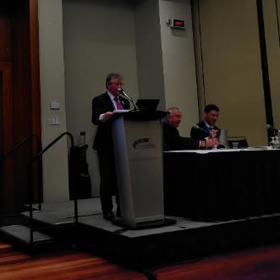
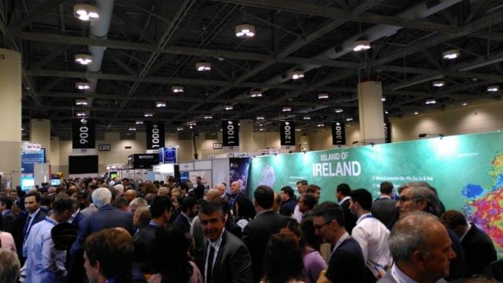
PDAC
International promotion
1989 delegation
Ever present
First country outside Americas
Ireland: Open for Business
Ministerial presence
Ireland Night

Slide 8
Fraser Report
Consistently high performance
Geological Database
Impact of data releases
Gradual increase in ranking of geological data
N Midlands
Tellus Border
N Ireland

Slide 9
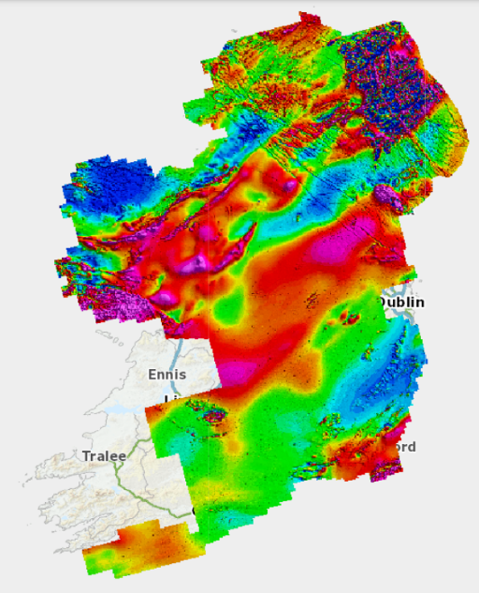
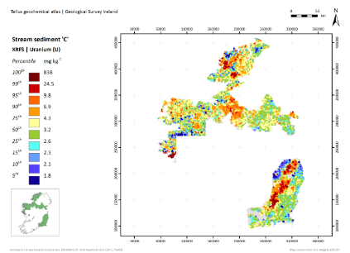
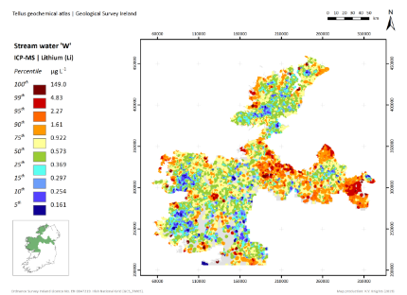
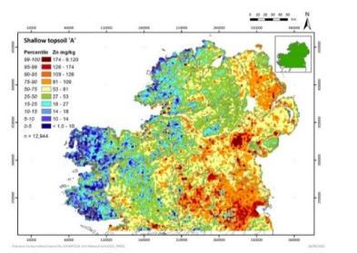
Tellus
Initial concept 1998
Northern Ireland
Tellus Border
Geochemistry
  Soils
  Stream Sediments
  Water chemistry
Geophysics
  Mag
  EM
  Radiometrics

Slide 10
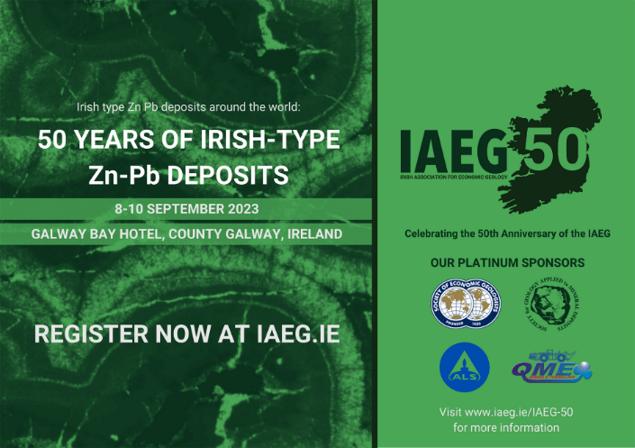
IAEG
Geological Survey Ireland support for IAEG
Committee Roles
Past Presidents
Editors of Anniversary Volumes
Blue Book

Slide 11
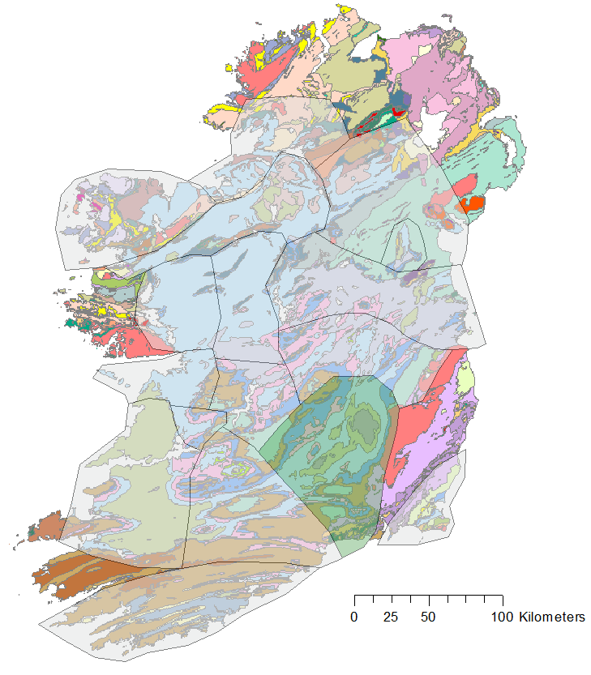

Blue Book
GSI & iCRAG collaboration
Update of Philcox 1984
~40 years of new work
Online resource
Linked to borehole database

Slide 12
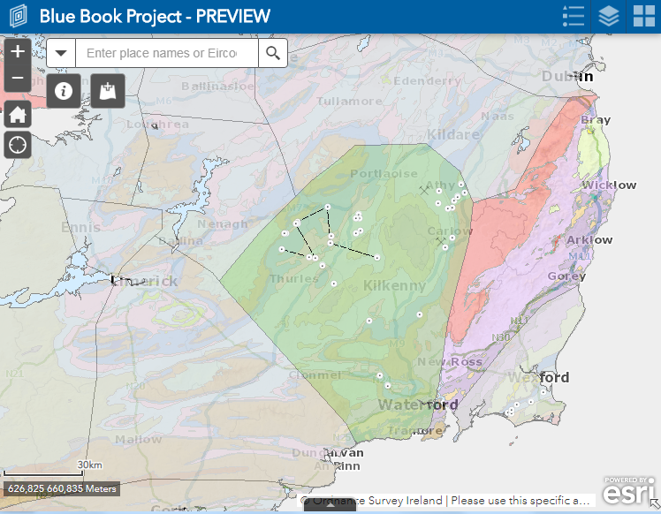
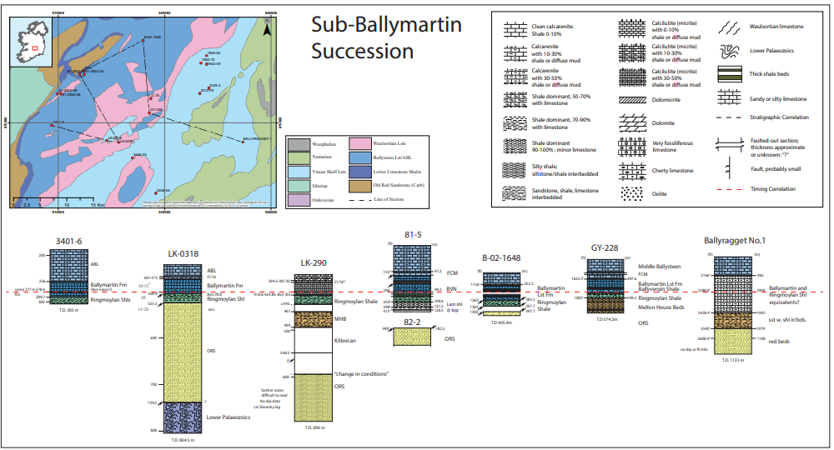

Blue Book
GSI & iCRAG collaboration
Update of Philcox 1984
~40 years of new work
Online resource
Linked to borehole database
Printed copies in Coreshack
Notes:
Basis of a new understanding of Irish stratigraphy
21st century survey

Slide 13

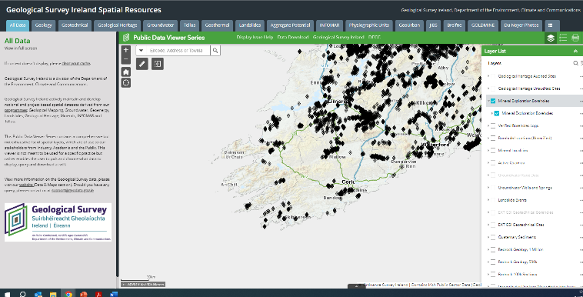
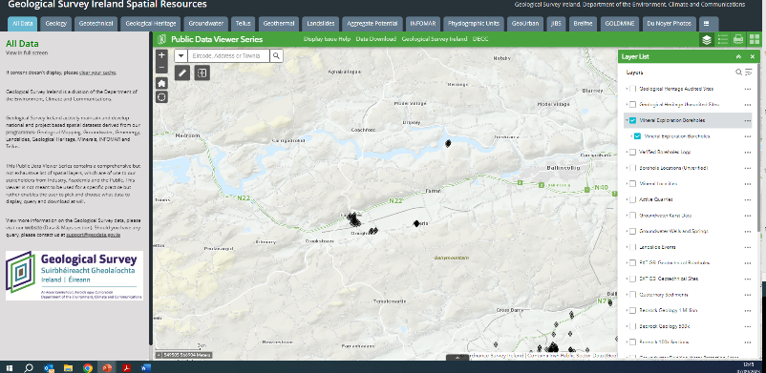
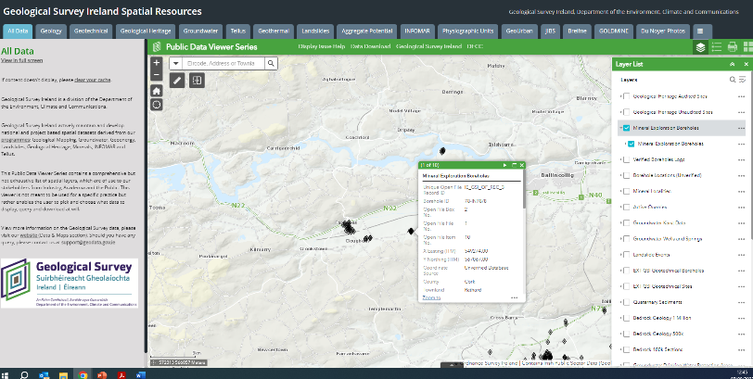

21st Century Survey
Accessible data
Harmonised
Web services
“How can Geological Survey Ireland help find the next Irish Type mine?”
Notes:
How is this going to help us find the next deposit

Slide 14
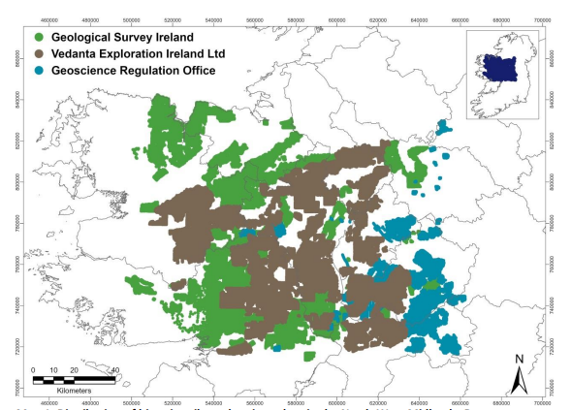
21st Century Survey
Accessible data
Harmonised
Web services
Large datasets
Innovative tools

Slide 15
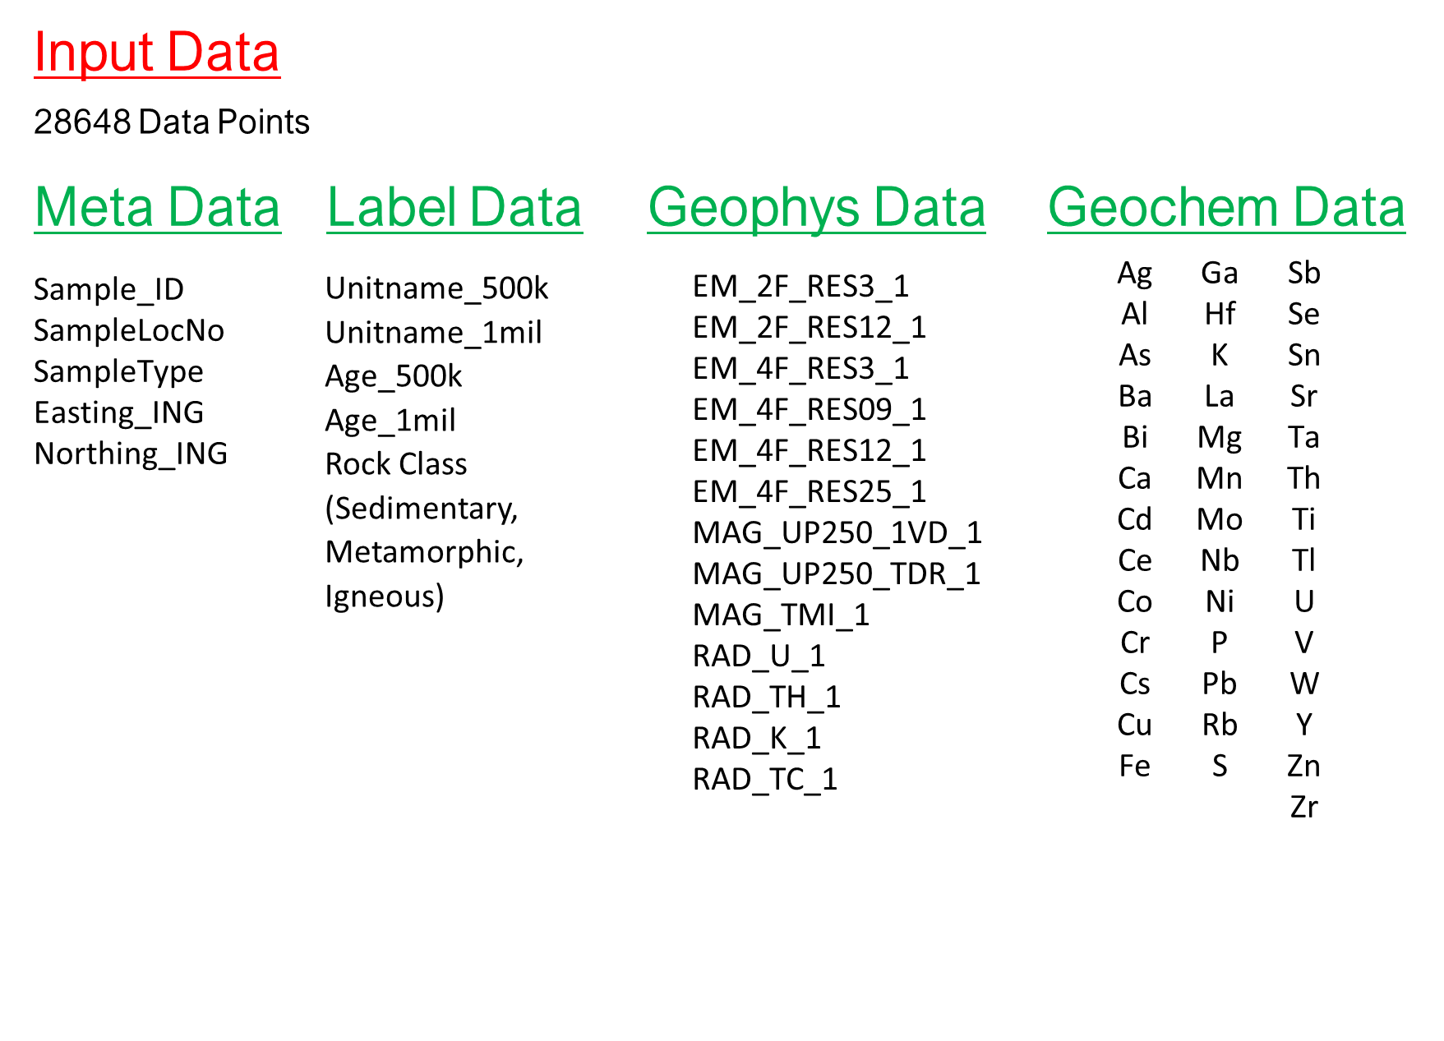
21st Century Survey
Accessible data
Harmonised
Web services
Large datasets
Innovative tools

Slide 16
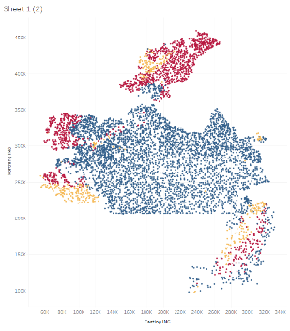
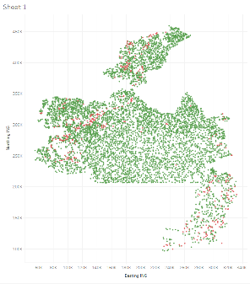
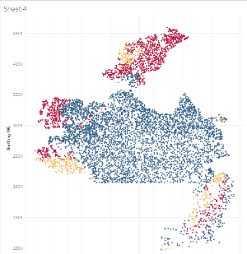
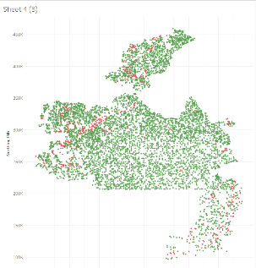
Modelled With Geophysics
21st Century Survey
95%
Accessible data
Harmonised
Web services
Large datasets
Innovative tools
Machine Learning
93%
Modelled Without Geophysics

Slide 17
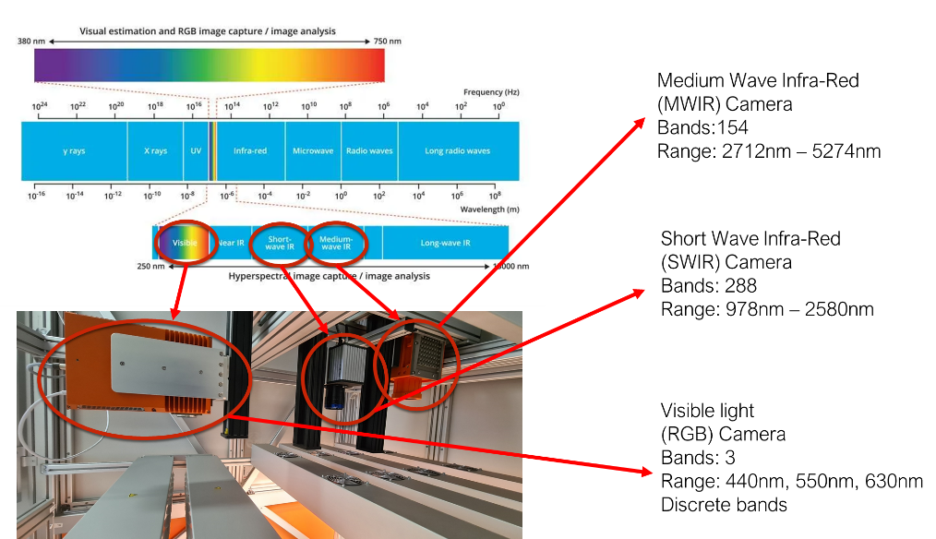
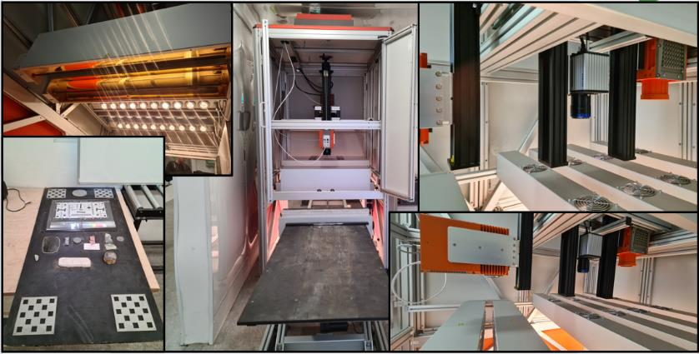
21st Century Survey
Accessible data
Harmonised
Web services
Large datasets
Innovative tools
Machine Learning
Hyperspectral

Slide 18
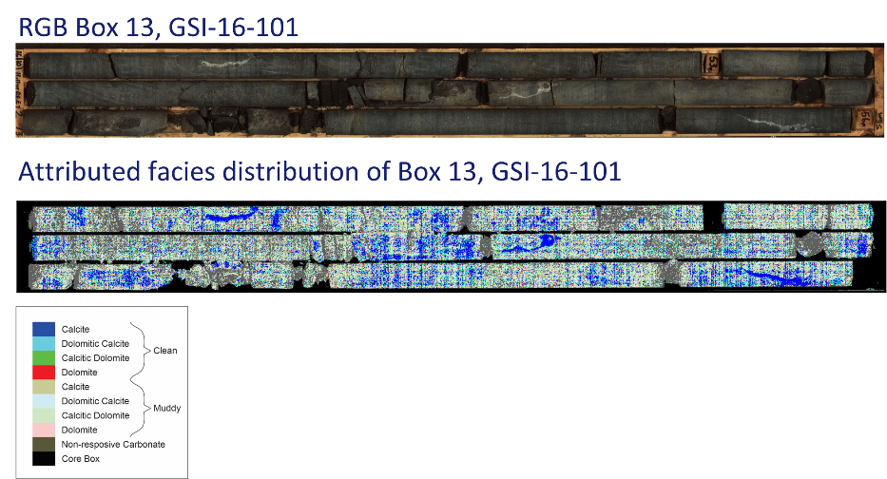
21st Century Survey
Accessible data
Harmonised
Web services
Large datasets
Innovative tools
Machine Learning
Hyperspectral

Slide 19
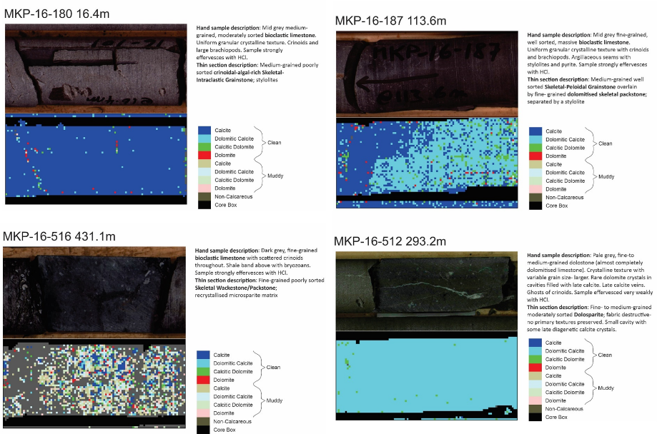
21st Century Survey
Accessible data
Harmonised
Web services
Large datasets
Innovative tools
Machine Learning
Hyperspectral

Slide 20
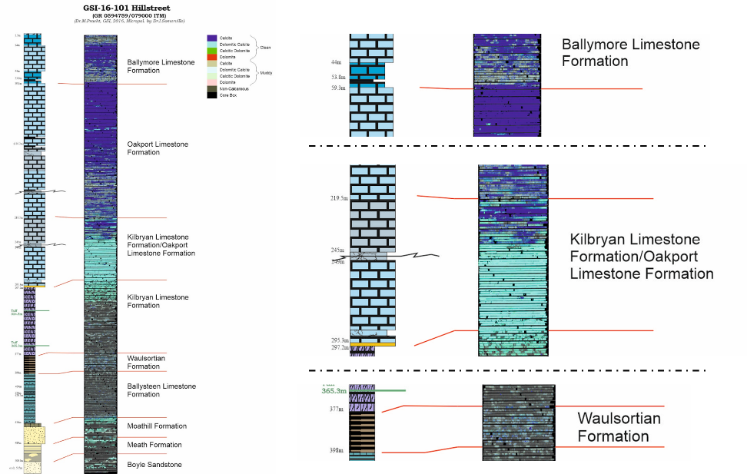
21st Century Survey
Accessible data
Harmonised
Web services
Large datasets
Innovative tools
Machine Learning
Hyperspectral

Slide 21
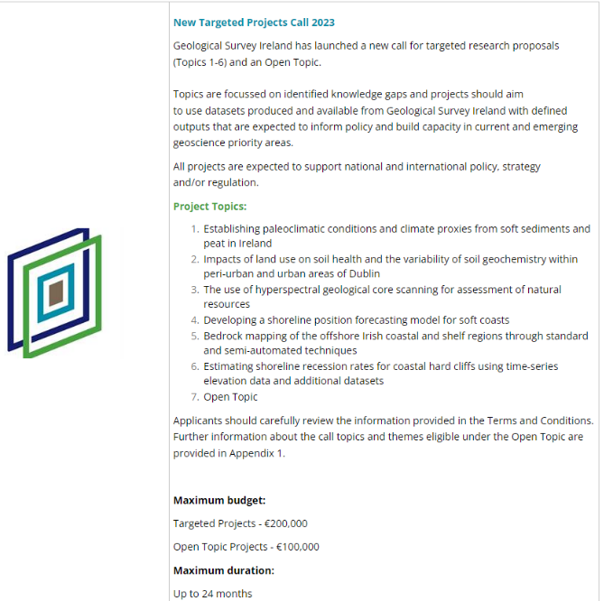
21st Century `Research
Research & Collaborations
EU Research projects
ECE’s in Irish Type deposits
Blue Book project
Seismic acquisition
Petrophysical research
Circular Economy

Slide 22
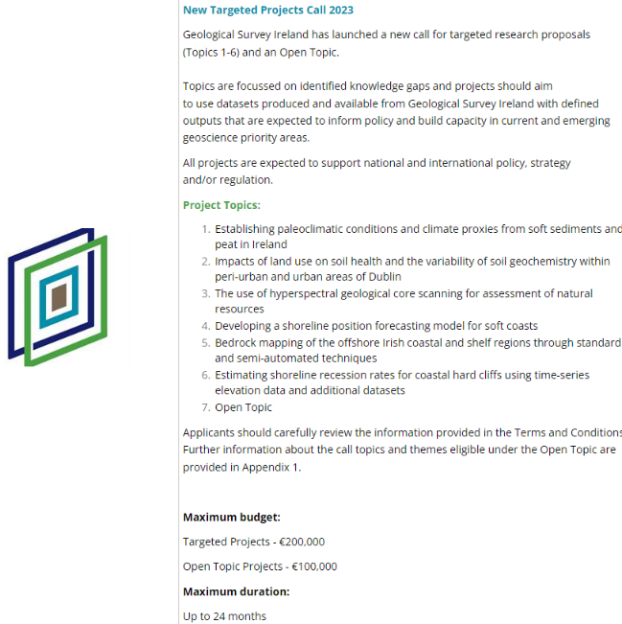
21st Century Research
Research & Collaborations
Open research call
  Topic 3 – “The use of hyperspectral geological core scanning for assessment of natural resources”
  €200,000 budget
  24 month projects
  Submission date October 5th

Slide 23
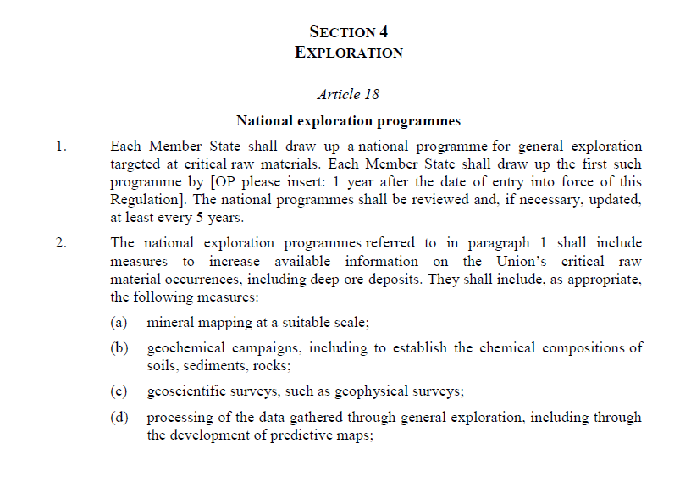
21st Century Survey
CRMA Act
Mandate for national exploration programmes
Prospectivity Assessments
“Strategic Raw Materials”

Slide 24
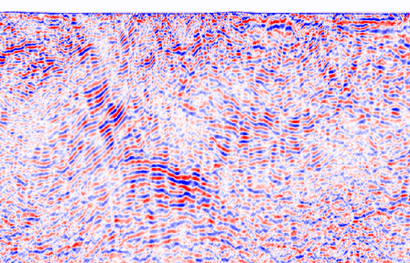
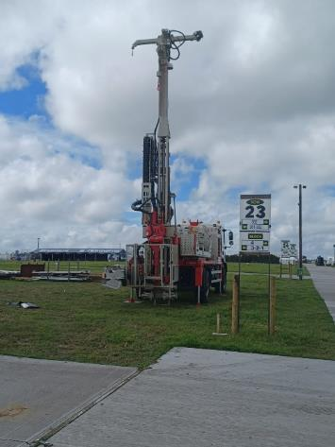
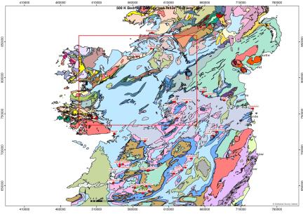
21st Century Survey
Future Direction
More data
More products
More interpretation
More collaborations
More public outreach work
More drilling

Slide 25


21st Century Survey
Future Direction
More data
More products
More interpretation
More collaborations
More public outreach work
More drilling

Slide 26
Thank you to the IAEG and all our past, present and future collaborators and partners

