Slide 1

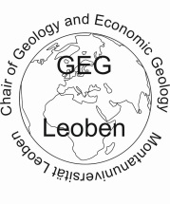
Carbonate-hosted Pb-Zn-(Ba-F) deposits of the Alpine-type in the Eastern and Southern Alps
Frank Melcher
Montanuniversität Leoben, Austria
MU Leoben: Viktor Bertrandsson Erlandsson, Veronika Gartner, Elisabeth Henjes-Kunst, Johann Raith, Gerd Rantitsch, Peter Onuk
BGR Hannover: Friedhelm Henjes-Kunst
University of Ljubljana: Barbara Potočnik Krajnc, Aleš Šoster
IAEG 50th Anniversary Conference
Sept 9, 2023

Slide 2
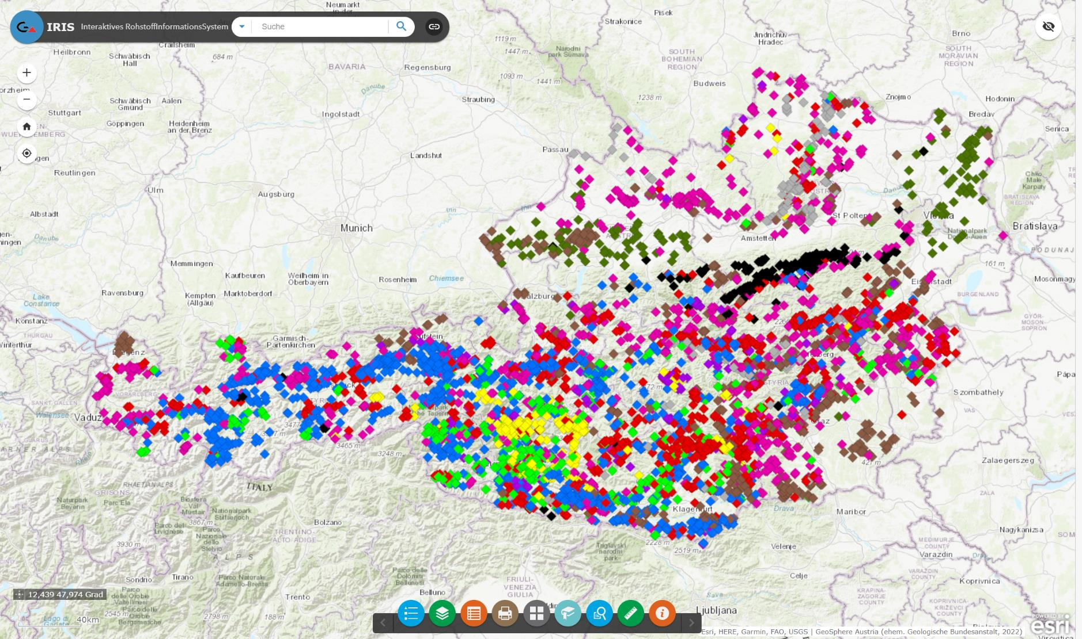
Interactive Raw Material Information System (Geosphere Austria): 455 Pb-Zn „deposits“ in Triassic carbonates (Austria)
Munic
Vienna
Lake Constance
Leoben
Graz
Bleiberg
Mežica
100 km
Salafossa
Raibl

Slide 3
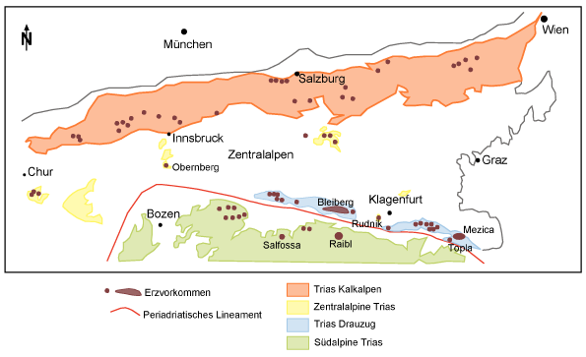
Interactive Raw Material Information System (Geosphere Austria): 455 Pb-Zn „deposits“ in Triassic carbonates (Austria)
Munic
Vienna
Lake Constance
Leoben
Graz
Bleiberg
Mežica
100 km
Salafossa
Raibl

Slide 4
Carbonate-hosted Pb-Zn deposits in Mesozoic host rocks
Mine | Country | Host rock | Resource | Grade | Production | Activity
Bleiberg-Kreuth | A (Carinthia) | Carn | 43 Mt (3.5 Mt metal) | 1.1% Pb, 5.9% Zn | 2.2 Mt metal | 1333-1994
Raibl | Italy | Carn | 18 Mt | 1.2% Pb, 6.0% Pb | 1.5 Mt metal | 14th-1991
Mežica | Slovenia | Carn | 34 Mt | 2.4% Pb, 3.4% Zn | 1.5 Mt metal | 1424-1993
Salafossa | Italy | Carn | 10 Mt | 0.95% Pb, 4.9% Zn | 0.5 Mt metal | 1957-1986
Gorno | Italy | Carn | 6 Mt | 3.5% Zn cut-off |  | -1980s
Lafatsch | Austria (Tyrol) | Carn | 4 Mt(?) (0.6 Mt prov) | 1.6% Pb, 6.2% Zn |  | -1550 (1963)
Silberleiten | Austria (Tyrol) | Carn |  |  |  | 15th-1921
Argentiera | Italy | Anis |  | 1% Pb, 6% Zn | 1 Mt ore | -1971
Topla | Slovenia | Anis |  | 3.3% Pb, 10% Zn | 0.25 Mt ore | 1974-1988
Hochobir | A (Carinthia) | Carn | 0.3 Mt |  |  | MA
Radnig | A (Carinthia) | Carn | 0.2 Mt |  |  | -ca. 1900
Jauken | A (Carinthia) | Carn | 0.05 Mt |  |  | -ca. 1900
Rauschberg | Germany | Carn |  |  |  | 1636 - 1894
  Total of 510 APT occurrences in Austria (89%), Italy (6%), Slovenia, Switzerland and Germany (<2% each)

Slide 5
Research question
Despite representing important mining districts until the 1990s, >200 years of scientific research have not been enough to fully understand these deposits and reach an accepted deposit model
APT versus MVT versus IRT
Deposit models range from syngenetic to epigenetic with or without magmatic influence
Age estimates ?
Triassic (Middle or Upper)
Jurassic
Cretaceous
Oligocene
Miocene
telemagmatic genesis
Lateral secretionary processes
secondary hydrothermal processes
Volcanogenic-exhalative
Super- and submarine weathering
Sabkha process
karst systems
weathering debris of non-ferrous metal mineralisations
formation waters

Slide 6
Bleiberg – type locality of APT
Erich Schroll (1923 – 2008)

Slide 7
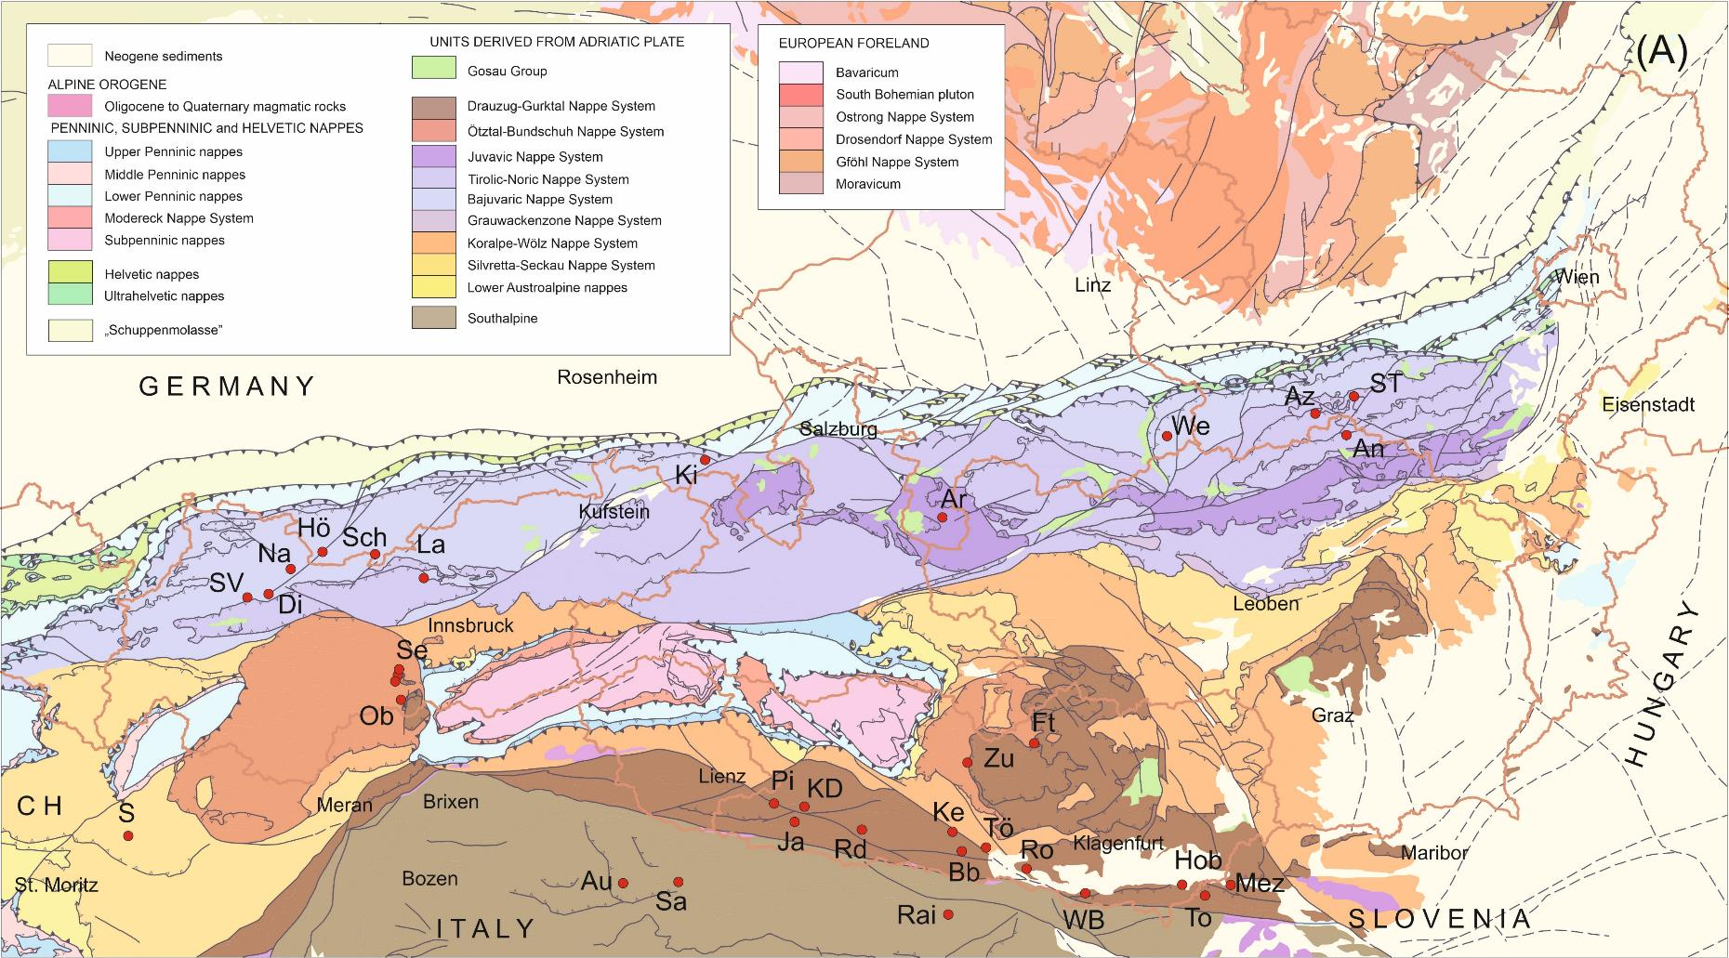
Tectonic map
Lafatsch
Bleiberg
Salafossa
Gorno
Mezica
Raibl

Slide 8
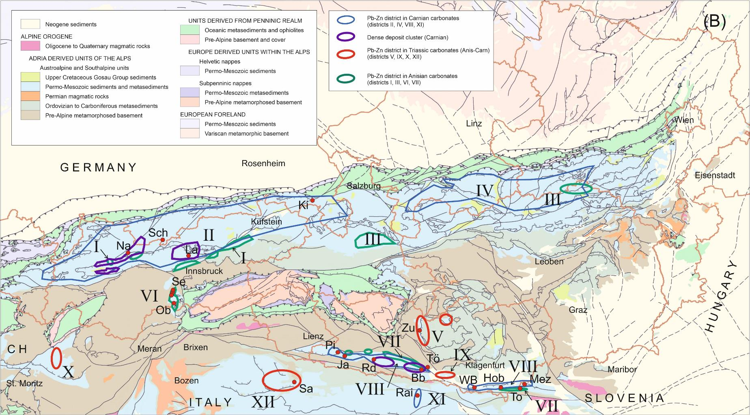
Stratigraphic map
Lafatsch
Drau – Karawanken Range
Bleiberg
Salafossa
Gorno
Mezica
Raibl

Slide 9
Pb-Zn distribution in the Drau and Karawanken Range
Nor
Carn
Carn
Anis
Anis
Bleiberg
Mezica

Slide 10
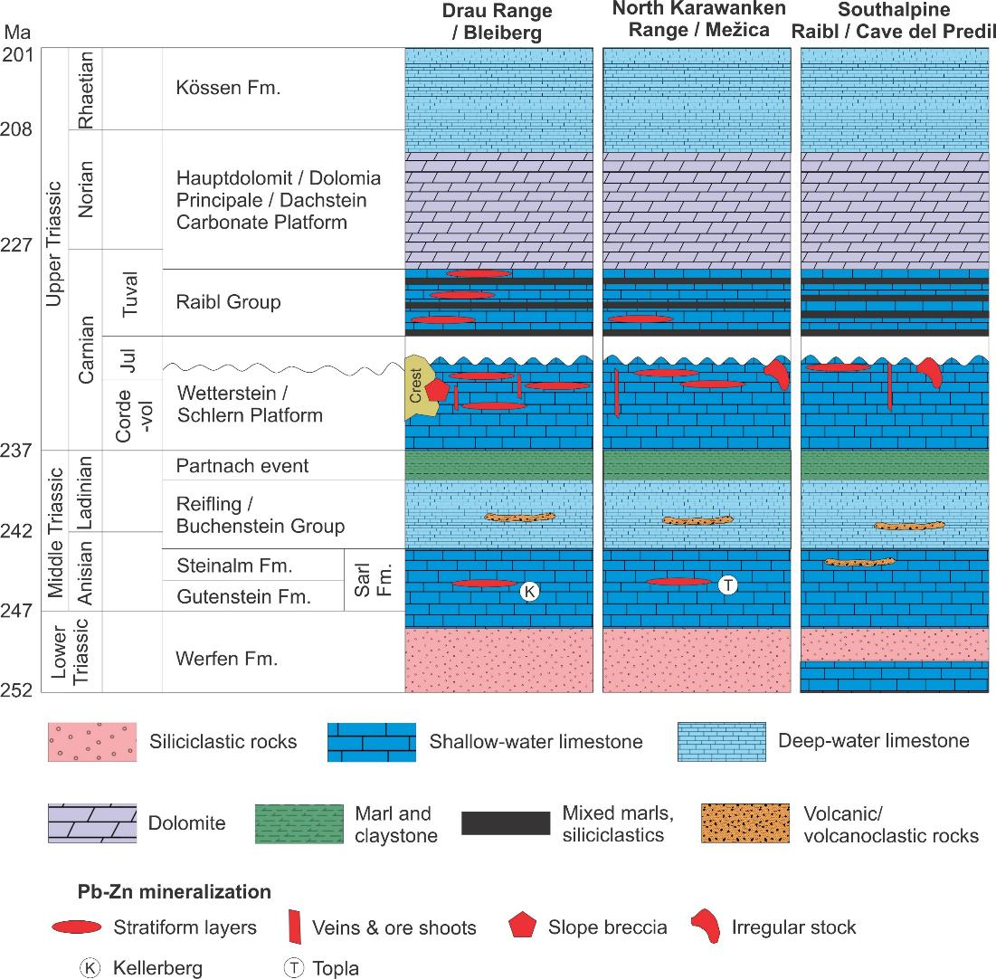

Slide 11
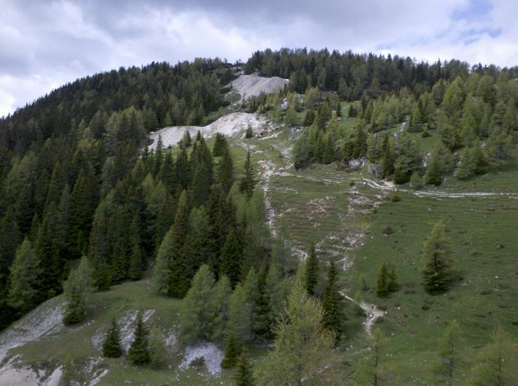
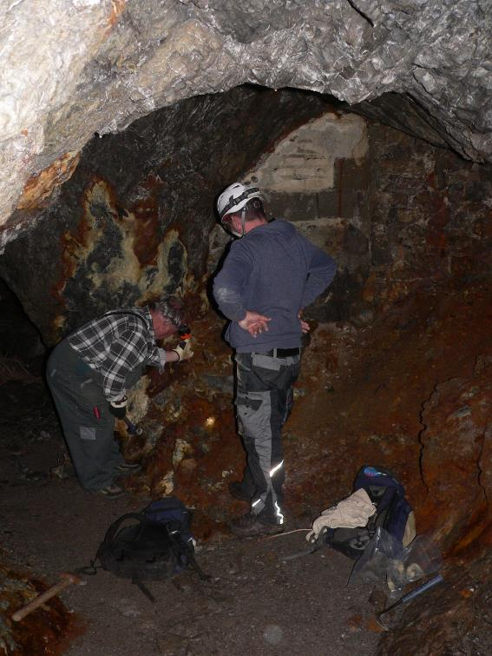
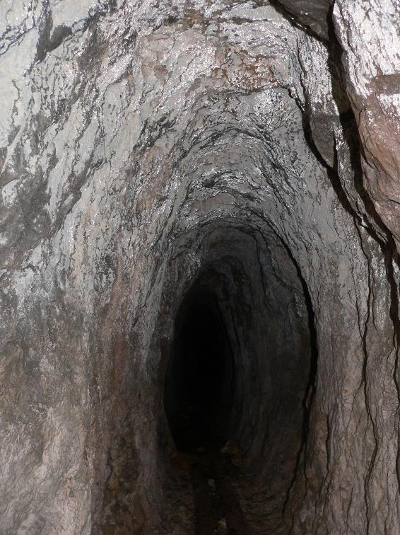
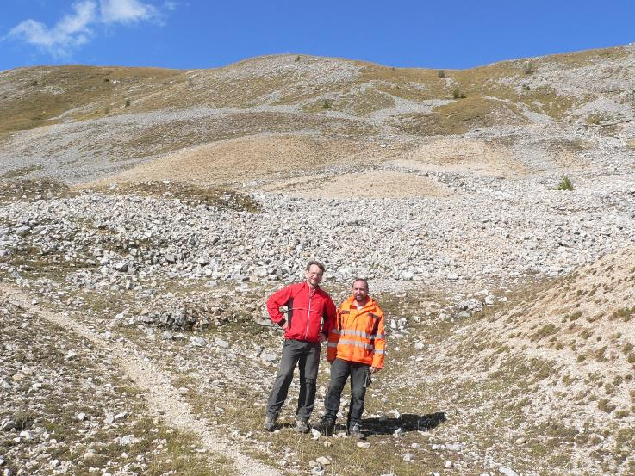
Hochobir
Jauken South slope
Pirkach, Mühlenstollen
Jauken North

Slide 12
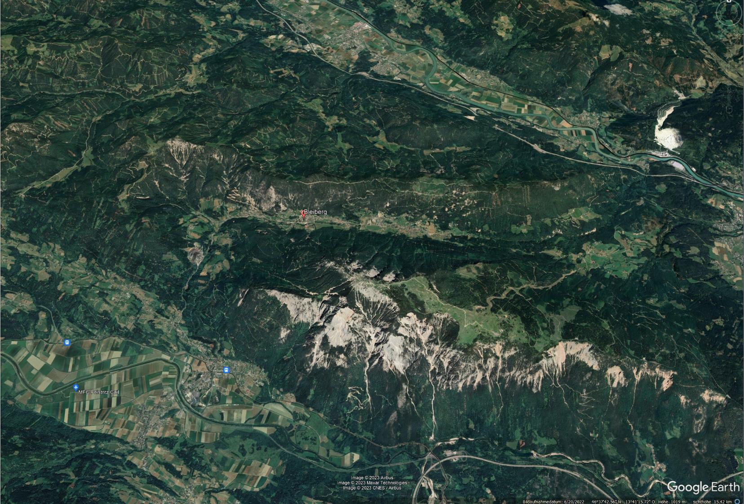
Drau valley (500m)
Gummern
Erzbergrücken (1500-1700m)
19-20th
Medieval
Hoffnungsgebiet
Bleiberg valley (900m)
Villach
Dobratsch (2160m)
Gail valley (550m)
5 km
Arnoldstein (former metallurgical plant)

Slide 13
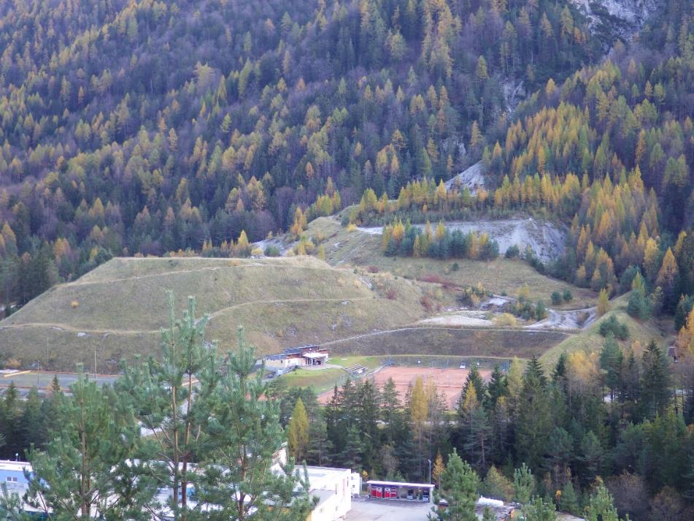
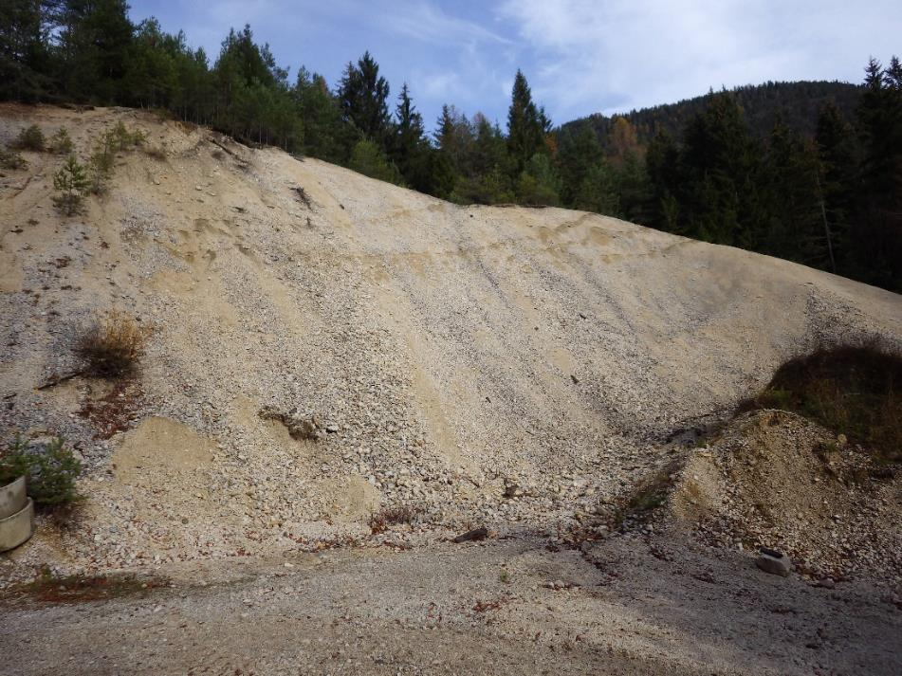
Flotation tailings
Bleiberg-Kreuth, Carinthia
Pb-Zn mining until 1993 (BBU)
By-products cadmium, germanium
Dumps from Medieval mining
Zn-Pb-Mo, Ge?

Slide 14
Medieval mine dumps
COMMBY project
MSc thesis S. Dollinger 2022

Slide 15
Mineralogy of waste rock dumps
pXRF result | wt%
Pb | 0.3
Zn | 0.54
Mo | 0.09
Pb cerussite
anglesite
galenite
Zn smithsonite
hemimorphite
fraipontite
limonite
(sphalerite)
Mo wulfenite
limonite
Barite
Fluorite

Slide 16
Zn-Pb-Mo content in waste rock dumps
Marousek et al. 2023

Slide 17
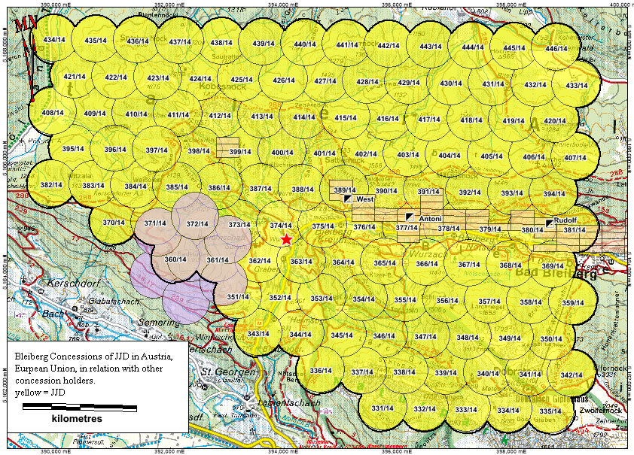

Multi Metal Development (Canada)
Bleiberg Project - Multi-Met (multimetdev.com)
Multi Metal Development Limited (MultiMet) (formerly American CuMo Mining Corporation) is a Canadian-based mining company ….
MultiMet is currently advancing two projects— …. and its newly-acquired Bleiberg Project in Austria. ….
(101 licences)
Mining licences:
October 26, 2022 MultiMet announced the signing of a joint venture agreement for the development of the Bleiberg Project, with Battery Age Metals (formerly Pathfinder Resources Ltd.) an Australian public company.

Slide 18
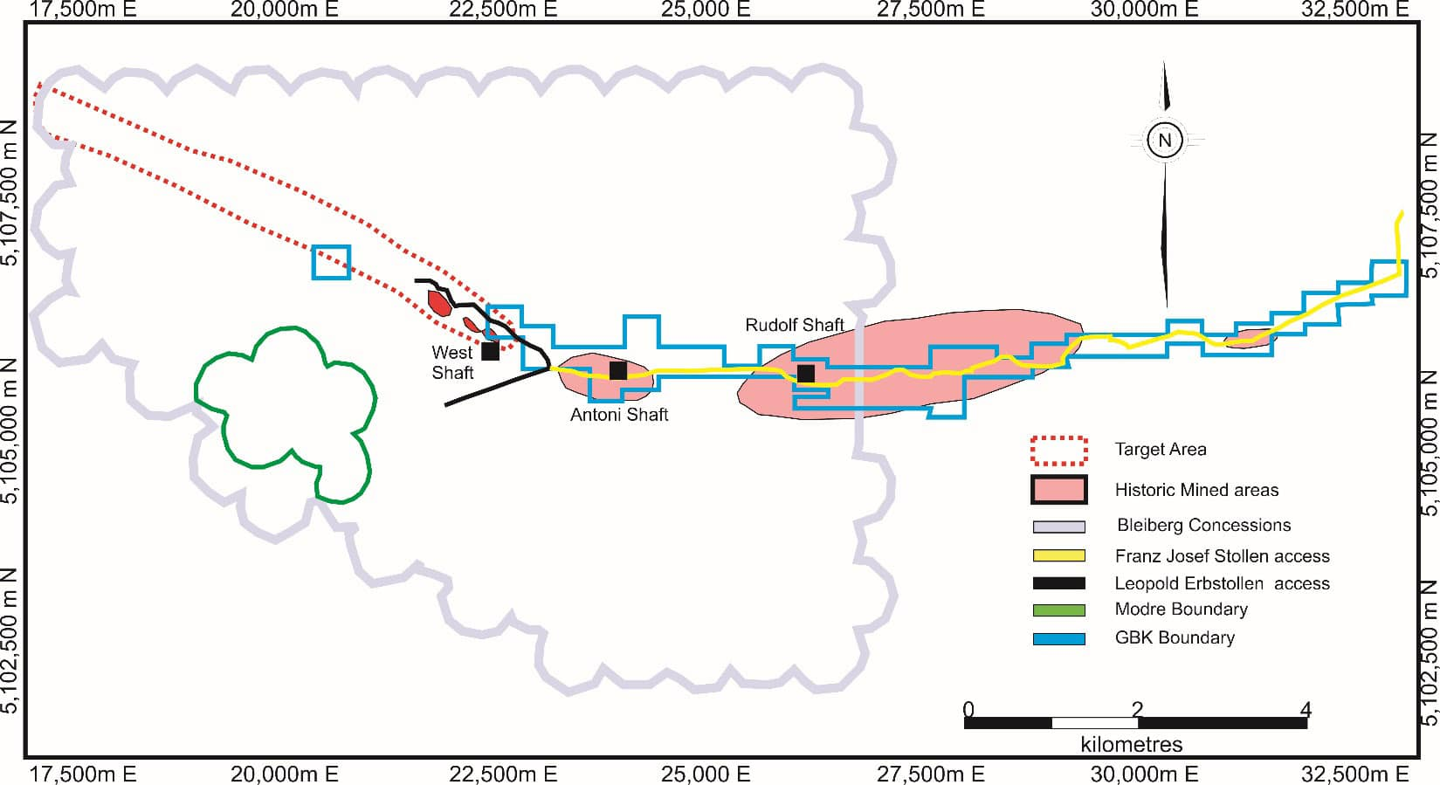
Multi Metal Development (US)

Slide 19
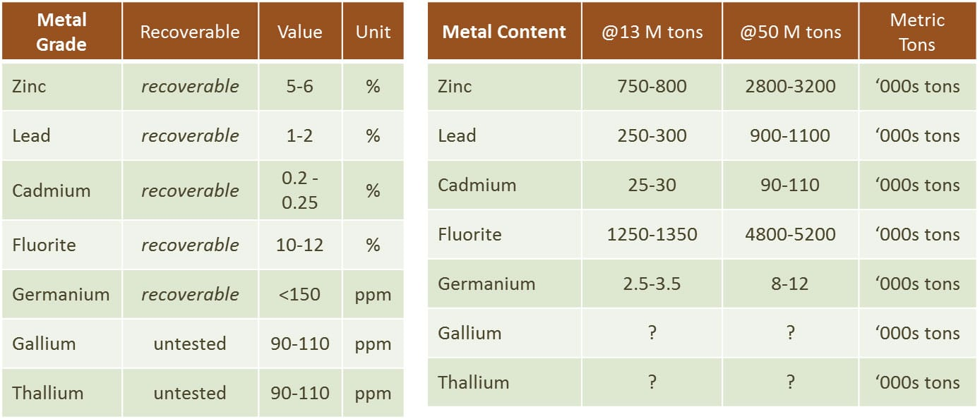
Multi Metal Development (Canada)

Slide 20
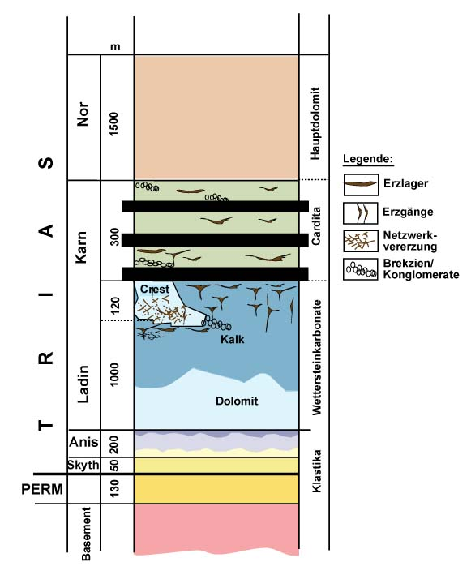
Bleiberg-Kreuth, Carinthia
Six ore horizons
Highest Pb-Zn in upper Wetterstein Formation
Various ore textures
  layers
  veins
  breccia
  Vein networks
>3 million tons of metal at Zn/Pb = 5-6
Germanium, cadmium, molybdenum as by-products
ca. 200 g/t Ge and 2000 g/t Cd hosted by sphalerite
Smelter nearby (Arnoldstein)
Modified from Cerny (1989) and Schulz & Schroll (1977)
Notes:
Erwähnen, dass auch in der anisischen Lage Pb-Zn vorkommt
Wettersteinkalk: Bleiberger Sonderfazies -lagunare Fazies mit 9 Emersionshorizonten an denen die Vererzung gebunden ist. Crest unklar was genau -evtl Riff?! Unterschiede in der Lagerstätte von West nach Ost.
Typuslokalität für Alpine Pb-Zn-LS --> MVT und SEDEX-Kram erwähnen:
Sedex: Sedex
Syndiagenetische/synsedimentäre Bildung
Massive polymetallische Buntmetallvererzungen (Cu-Pb-Zn) in marinen Sedimenten
Stratiforme Lagerstätten, z.B. Broken Hill (Australien), Rammelsberg (Deutschland)
auch SMS (massive Sulfidlagerstätten), Terminus ist veraltet. Sulfidlagerstätten in marinen Sedimenten/ Stratiform, große laterale Ausdehnung, laterale Cu-Pb-Zn- und vertikale Cu-Zn-Pb-Zonierung
Hauptmineralisation: Sphalerit, Galenit, Baryt, Kupfer und Silber. Feinkörnige und geschichtete Erze. Erze werden aus heißen (100-300°C) Fluiden gefällt durch Reduktion der Metalle mit Schwefel.
MVT: Epigenetische Bildung
Schichtgebundene Pb-Zn-(Ba-F)-Lagerstätten in Karbonaten
Vererzung sowohl in Schichten als auch in Gängen/Adern
z.B. Virburnum Trend (USA) Sulfidlagerstätten, die große Erzdistrikte in Plattformkarbonaten bilden. Stratiforme Vererzung in Schichten, Adern, Brekzien, etc. Meist grobkörniges Erz.
Einfache Mineralogie (Sphalerit mit wenig Fe, Galenit mit wenig Ag, Fluorit, Baryt, Cc, Dol). Vererzung sind v.a. epigenetische Hohlraumfüllungen. Erze werden durch Reduktion mit Schwefel aus moderat warmen (80-220°C) Fluiden gefällt.

Slide 21
Pb:Zn
1:2
1:6 to 1:4
1:2
1:1
Antoni
Stefanie
Rudolf
Franz-Josef

Slide 22
Tectonic structure of the Bleiberg deposit

Slide 23
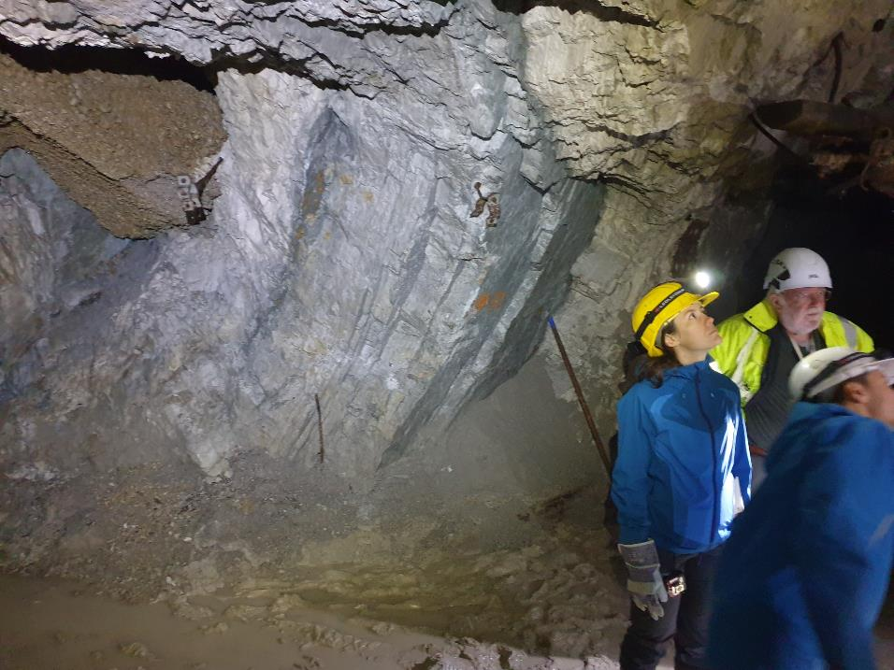
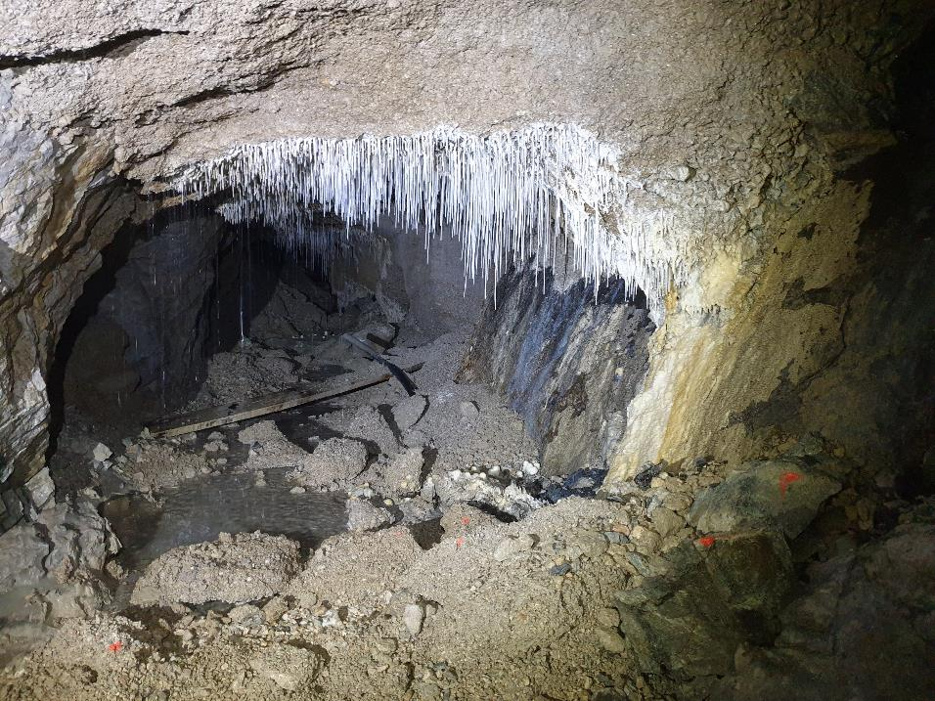
Bleiberg, Antoni Schacht, Bereich Max

Slide 24
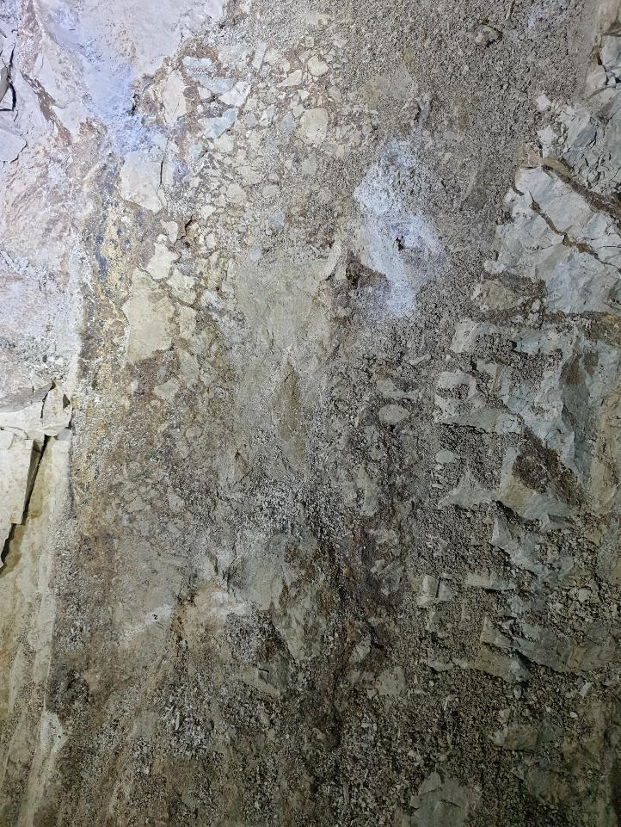
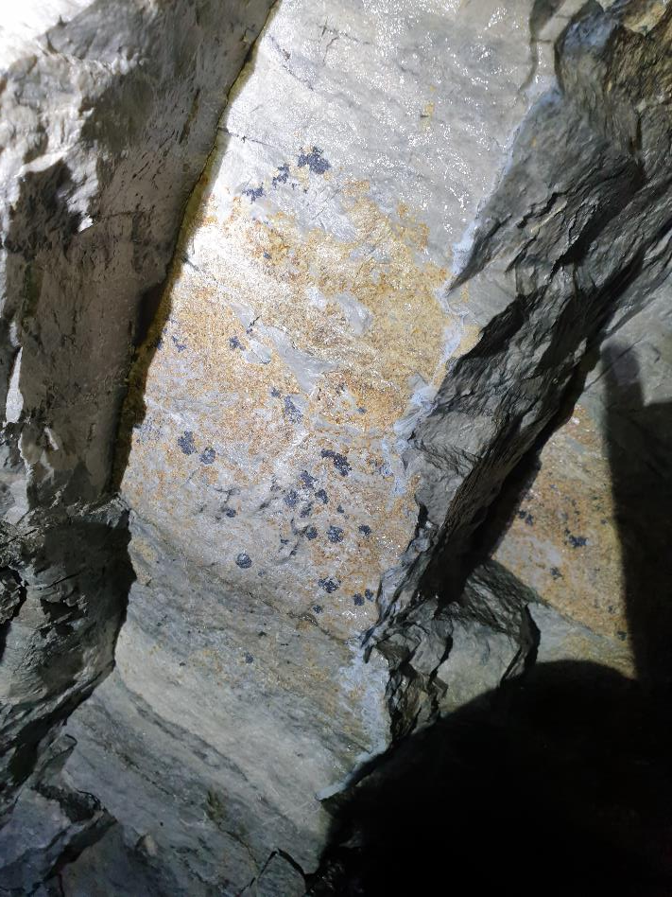
Maxer Bänke mineralization (lowermost ore horizon)

Slide 25
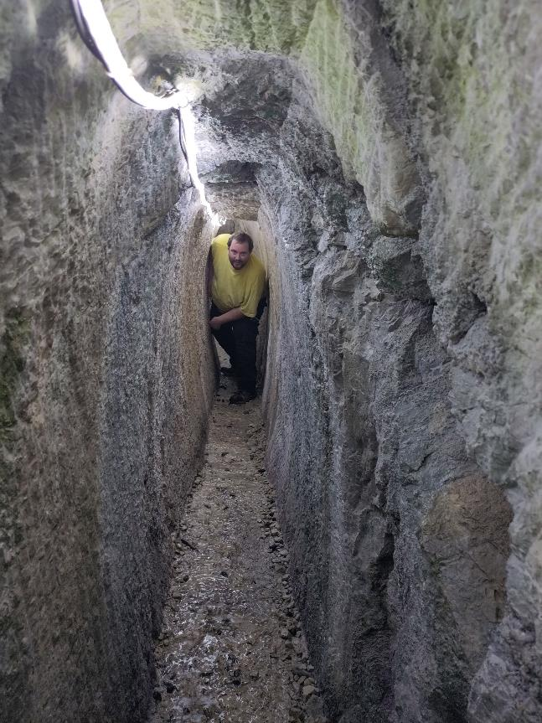
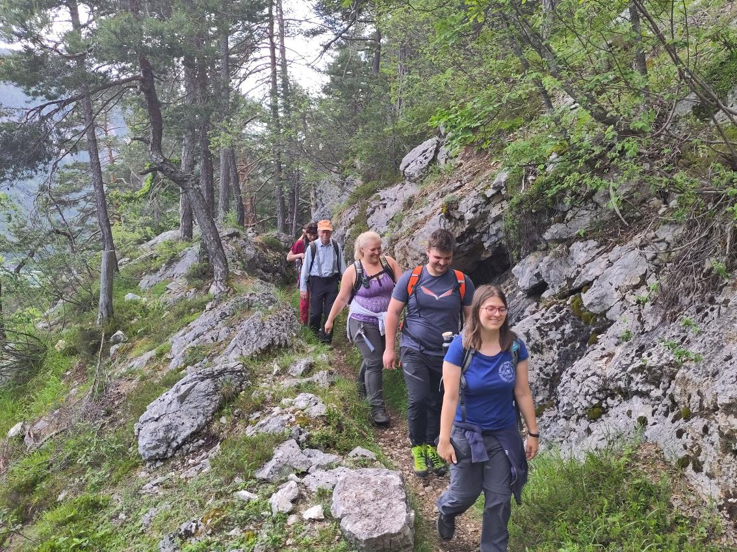
Stollenwanderweg Bleiberg: historical mine trail

Slide 26
Reconstruction of the Bleiberg mineralization during the Carnian

Slide 27
Lead horizons in the upper Wetterstein limestone

Slide 28
Ore sediment, spatially-rythmic, fine-grained, partly collectively crystallised, calcareous mud,
“Bodenerz”
(Schroll 2008)
Sph + Fluorite
Fluorite
Schalenblende
Ga
Barite
Sph
Erzkalk, Wetterstein limestone, Grube Rudolf, Bleiberg

Slide 30
„Erzwannen“ (Ore troughs)

Slide 31
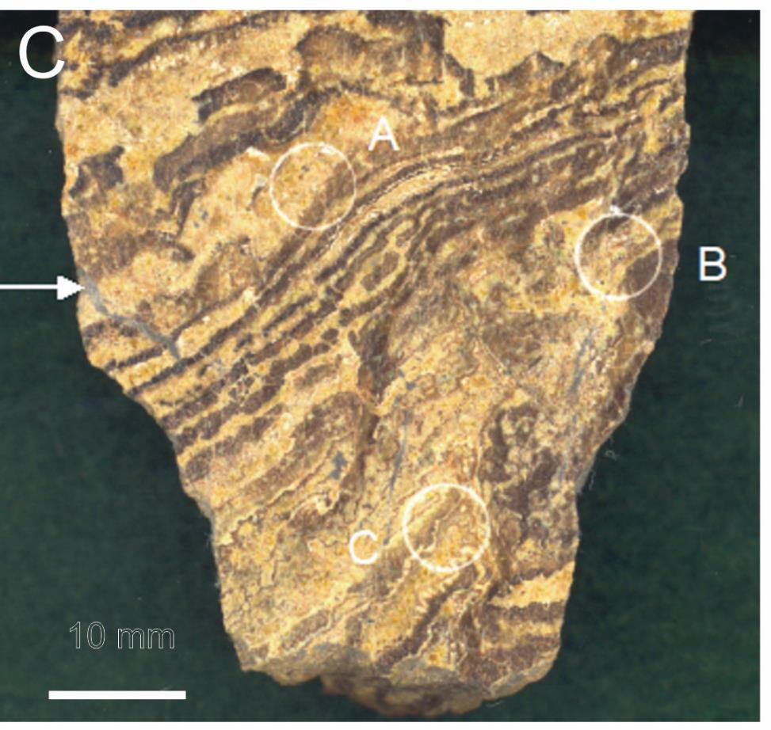
Microbial textures in sphalerite ores from Bleiberg, Crest horizon (“Kalkscholle”).
Massive sphalerite ore, Crest horizon (Schwellenfazies).
Dark brown sphalerite bands have been interpreted as mineralized microbial mats.
Anhydrite
Photo: H. Kucha

Slide 32
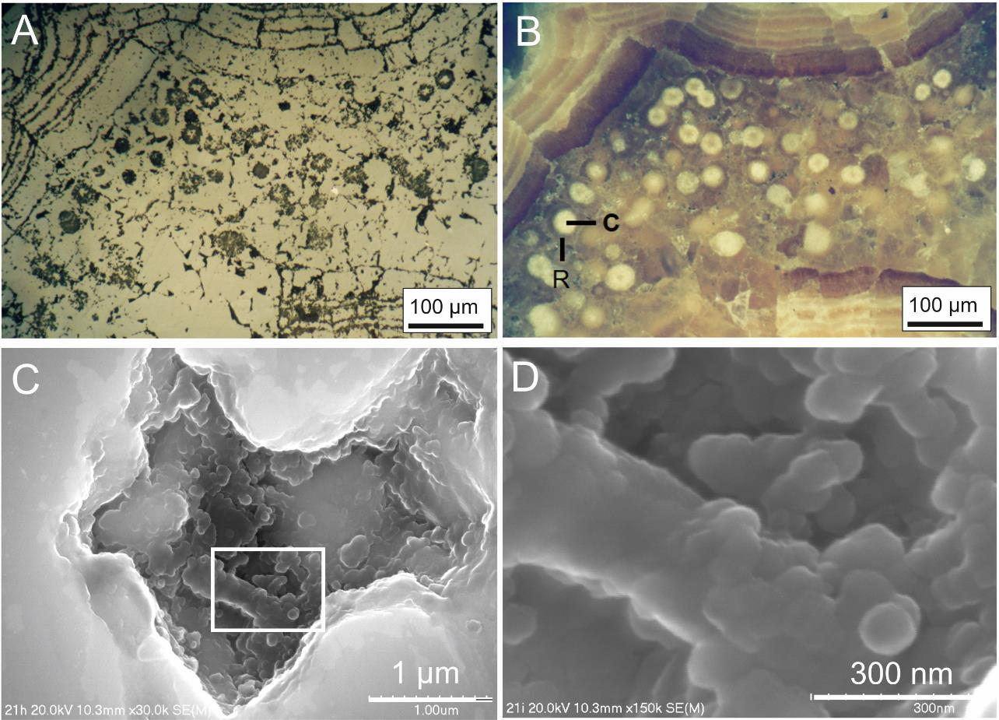
Microbial textures in sphalerite ores from Bleiberg, Crest horizon (“Kalkscholle”).
(A, B) Sphalerite band formed by replacement of former microbial mat. The band consists of circular biogenic (?) globules with core and rim (C, R).
Reflected light,
with crossed polars.
FE-SEM image of etched cavity within micro-globular sphalerite showing nano-globules of sphalerite.
FE-SEM image showing details of (C) with ZnS nano-globules and part of a mineralized bacterial filament. Photos H. Kucha.
Kucha et al. (2003, 2010)

Slide 33
Cave del Predil (Raibl)
VERONIKA GARTNER MSc thesis 2023c
Jadoul et al. (2002), ore bearing Schlern dolomite is marked in brown

Slide 34
Cave del Predil (Raibl)
Map of the Raibl mine in 1903, from Göbl (1903),
three color varieties of colloform sphalerite
VERONIKA GARTNER MSc thesis 2023c

Slide 35
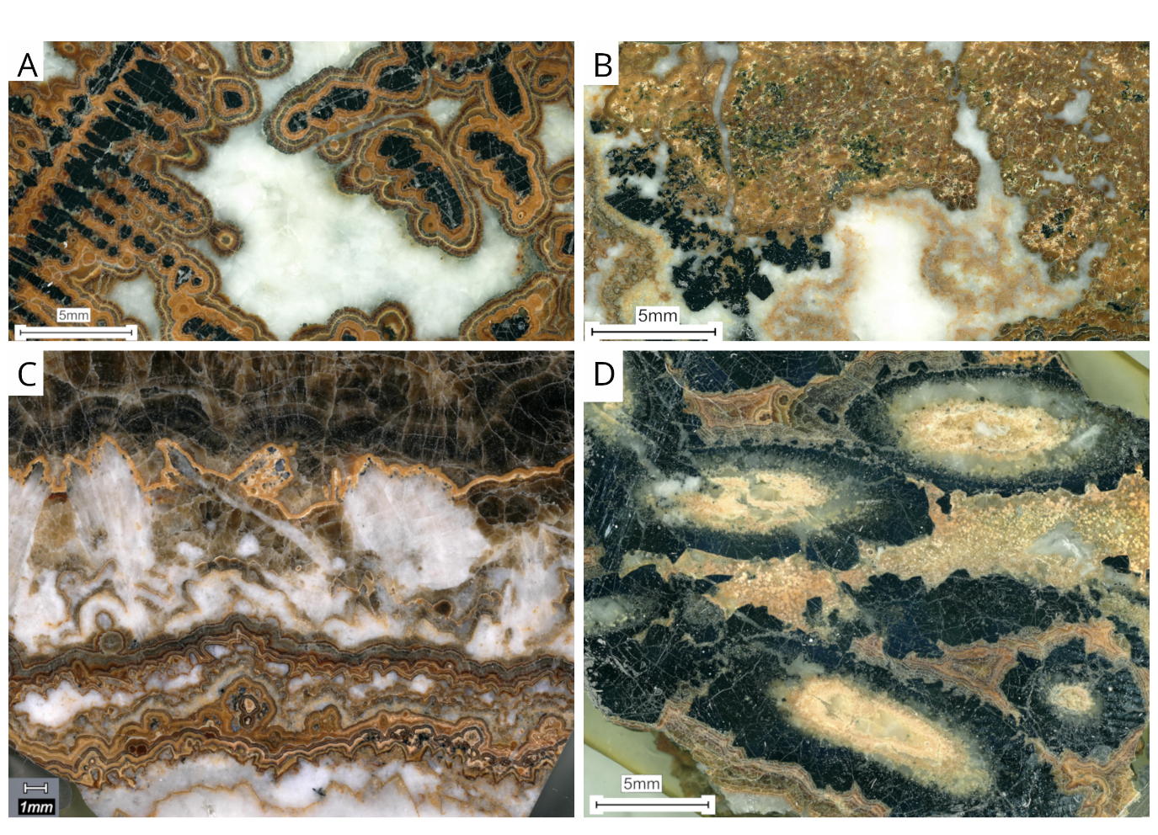
Raibl deposit, ore textures
Granular ore
Posepny 1873
10-16 cm long tubes
Stalactitic/Dendritic ore
Schalenblende
Röhrenerz (tubular ore)
V. GARTNER (2023)

Slide 36
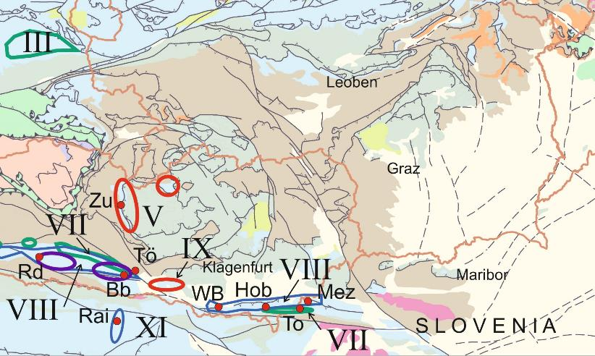
Mežica Pb-Zn mine
BARBARA POTOČNIK KRAJNC, MSc thesis 2021

Slide 37
A schematic cross-section through the Naveršnik mining area, Mežica deposit, showing the main geological features and distribution of mineralisation. Modified after Zorec (1955).
BARBARA POTOČNIK KRAJNC, MSc thesis 2021

Slide 38
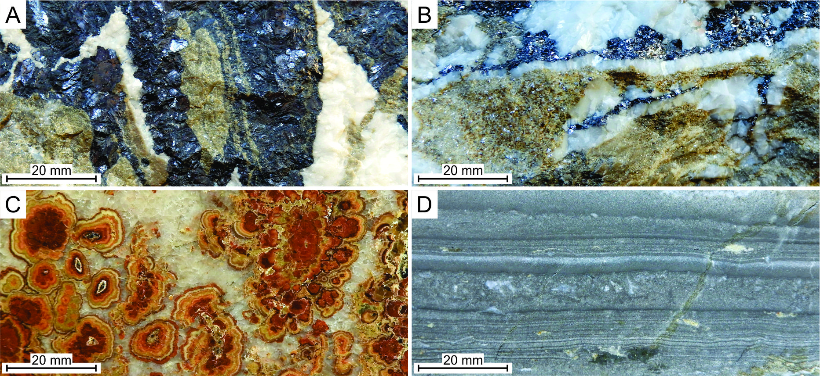
Mežica deposit, ore textures
Breccia and vein-type, replacement
Colloform sph in cockade breccia
Ore rhythmite

Slide 39
Brown colloform sphalerite type Sp1a, fragmented and subsequently cemented by sphalerite types Sp4a and Sp4b.
Vein-hosted ore, containing brown sphalerite Sp1b wrapped by colourless crystalline sphalerite Sp4a, and green crystalline sphalerite Sp4b.
Breccia ore containing unmineralised host-rock clast that is almost completely transformed into secondary hydrothermal dolomite. Colloform sphalerite type Sp1d and crystalline sphalerite type Sp2 form matrix and corrode galena.
Open space filled with colloform sphalerite Sp1. Open space was reactivated during later hydrothermal processes, reflected in the precipitation of saddle dolomite and marcasite.
Hand-specimen of sphalerite type Sp1c, which consists of a few cm thick spheroidal and irregularly shaped aggregates with differently coloured alternating bands, forming cockade texture.
BARBARA POTOČNIK KRAJNC, MSc thesis 2021

Slide 40
Kuhlemann et al., Econ Geol 96 (2001)

Slide 41
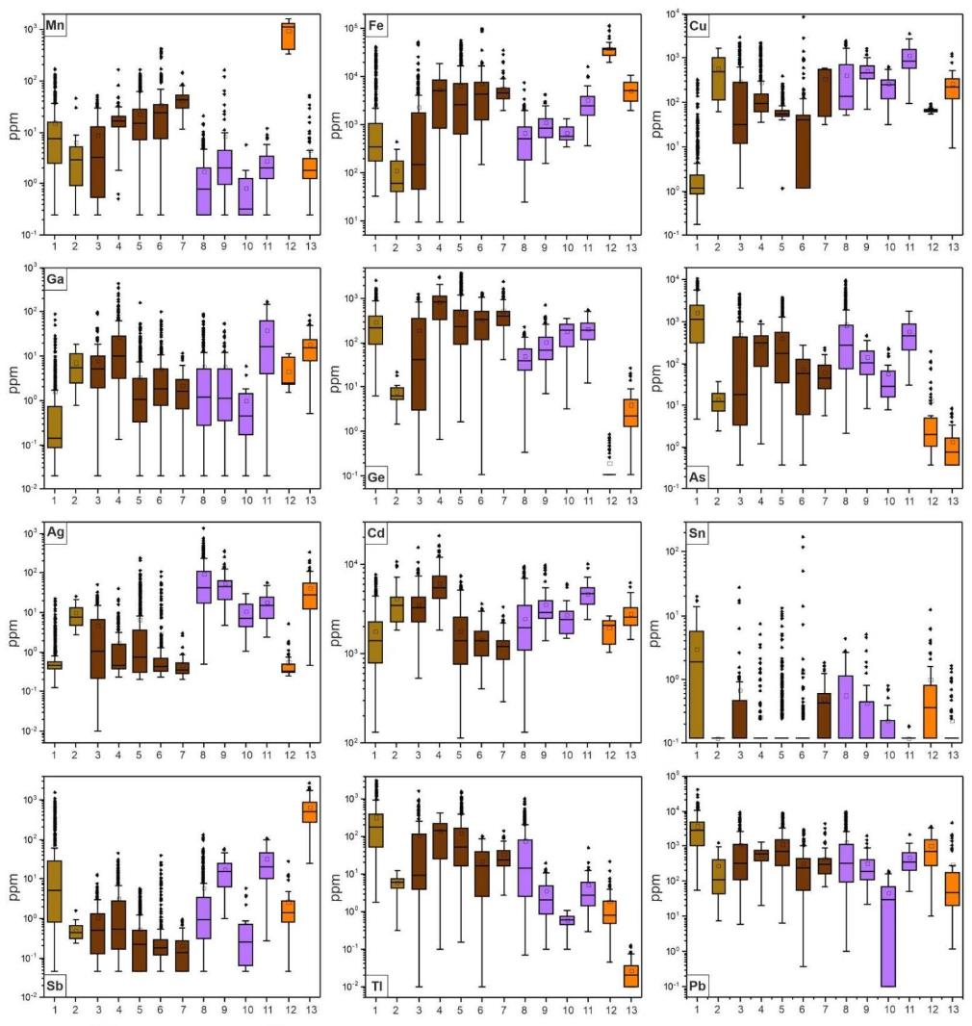
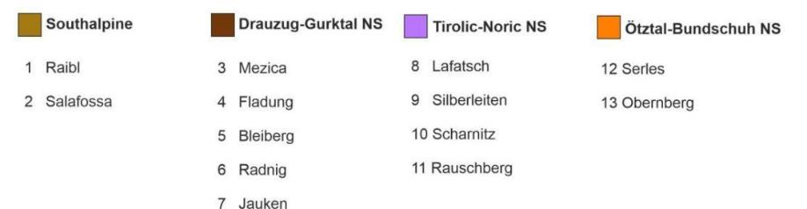
Trace element analysis of sphalerite (ppm)
Mn
Fe
Cu
Ga
Ge
As
Element | Md (max) | Element | Md (max)
Mn | 5,5 (1100) | Ag | 1,1 (44)
Fe | 2409 (3.5%) | Cd | 2509 (5515)
Cu | 136 (813) | Sn | 0,1 (1,9)
Ga | 2,2 (87) | Sb | 0,7 (499)
Ge | 196 (846) | Tl | 8 (179)
As | 51 (1122) | Pb | 311 (2860)
Ag
Cd
Sn
Median values of 14 deposits
Sb
Tl
Pb

Slide 42
Trace elements and colour - Raibl/Cave del Predil
Red and brown sphalerite have elevated Fe, As, Ge, Tl and Pb
As
Cd
Mn
Pb
Fe
Ge
Tl

Slide 43
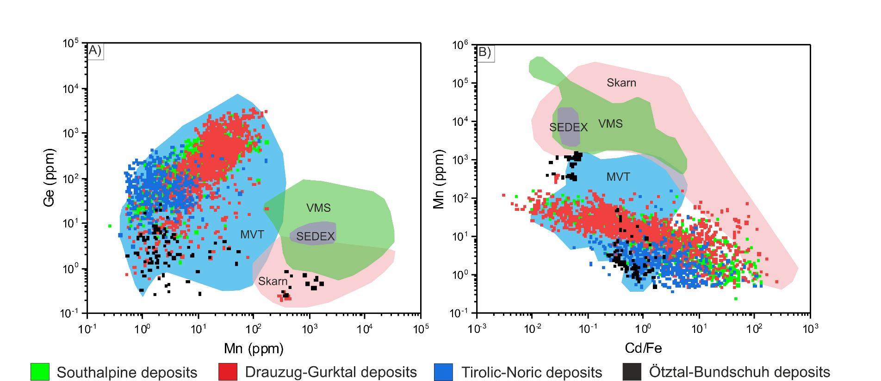
Sphalerite trace elements of APT fit MVT box

Slide 44
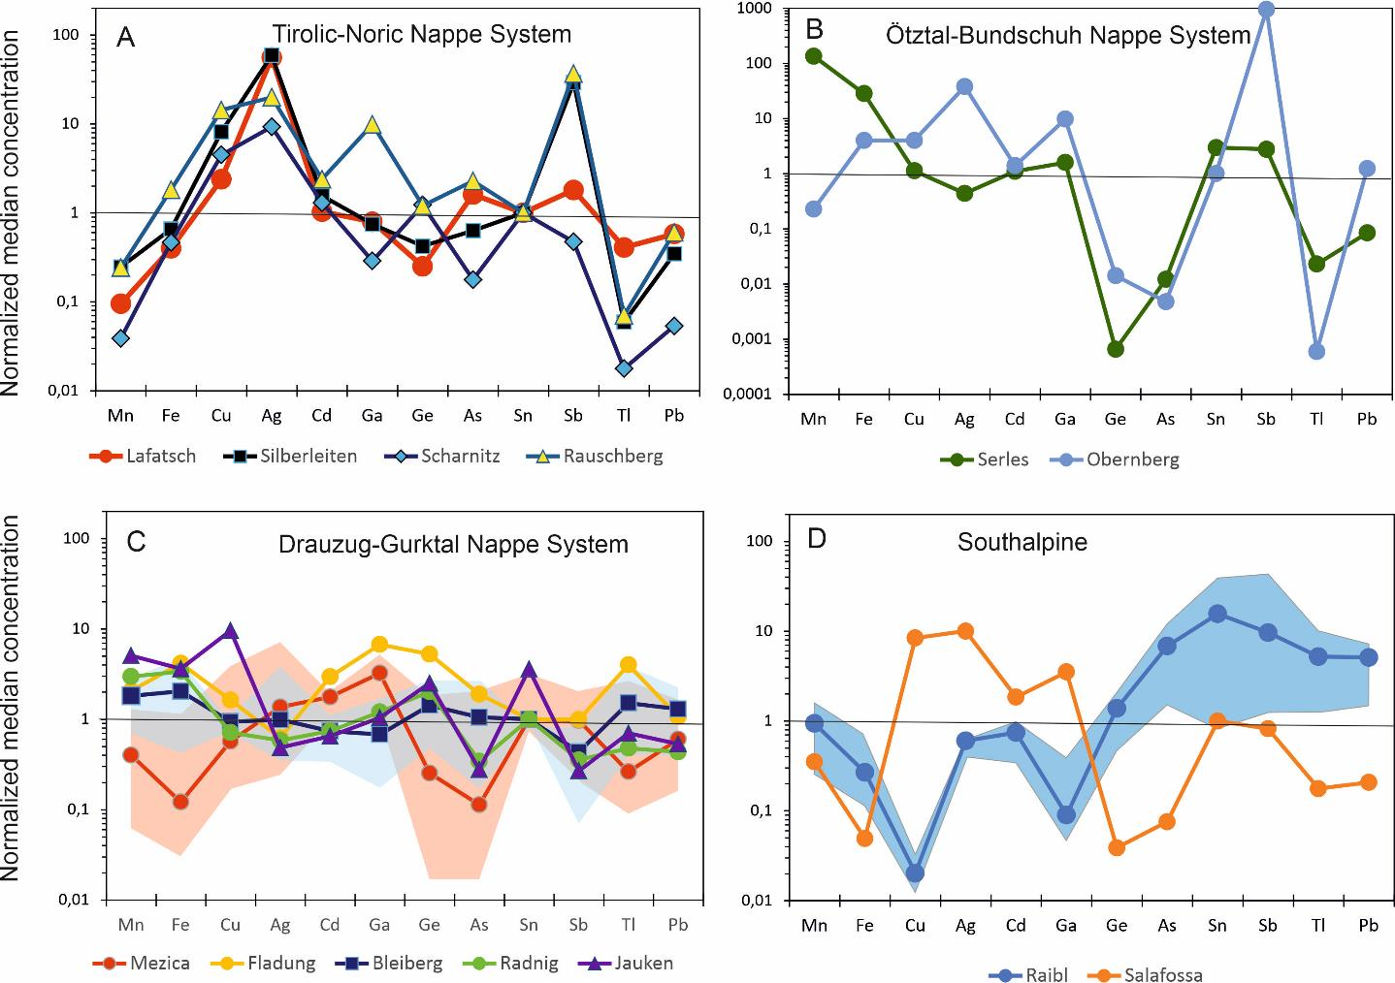

Slide 45
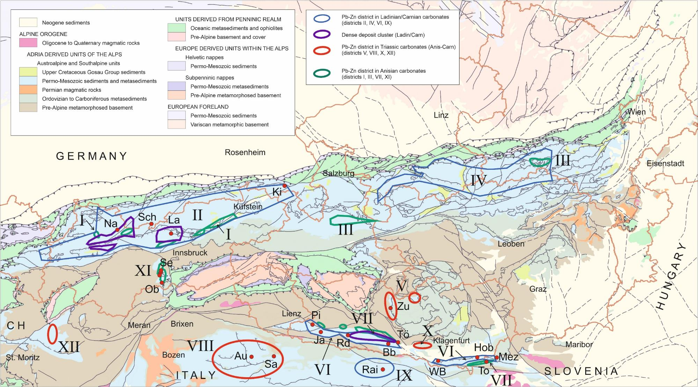
65°C
92°C
67°C
88°C
75°C
307°C
137°C
92°C
135°C
118°C
117°C
93°C
66°C
56°C
97°C

Slide 46
ZnS
PbS
Bleiberg
Lafatsch
Sulphur isotope variation Bleiberg (Schroll 2006), bulk data
³⁴S/³²S in sphalerite (in-situ LA-QQQ-ICP-MS, Ounk 2018)
Fladung
Jauken
Raibl

Slide 47
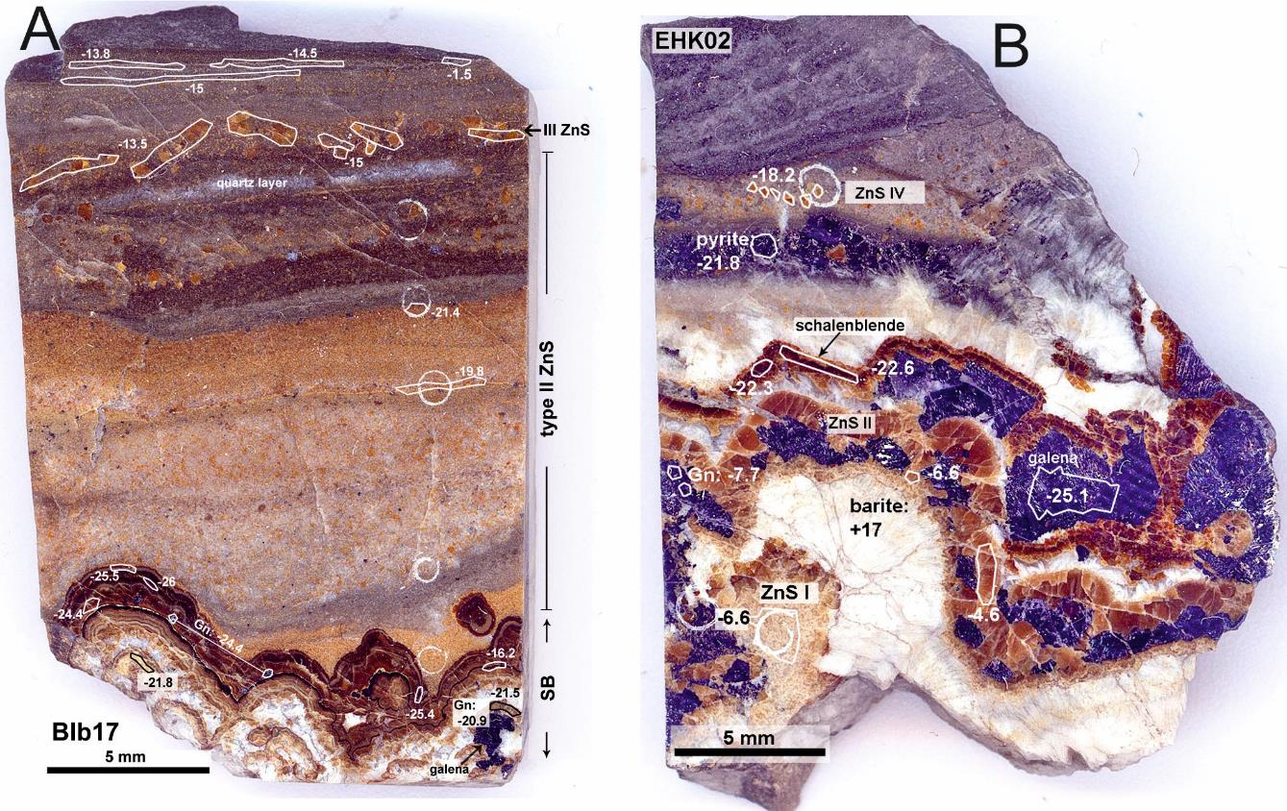
Sulphur isotope variation in ore samples from Bleiberg deposit
ZnS I -6.6 ‰
ZnS II -6.6 ‰
ZnS IV -18.2 ‰
Schalenblende -22 ‰
Galena -7.7 to -25.1 ‰
Pyrite -21.8 ‰
Barite +17 ‰
Layered sph
-1.5 to -21 ‰
Schalenblende
-16 to -26 ‰
Galena
-21 to -22 ‰
Maxer Bänke horizon (Wetterstein limestone)
Erzkalk horizon (Wetterstein limestone)
Henjes-Kunst, Boyce et al. 2017

Slide 48
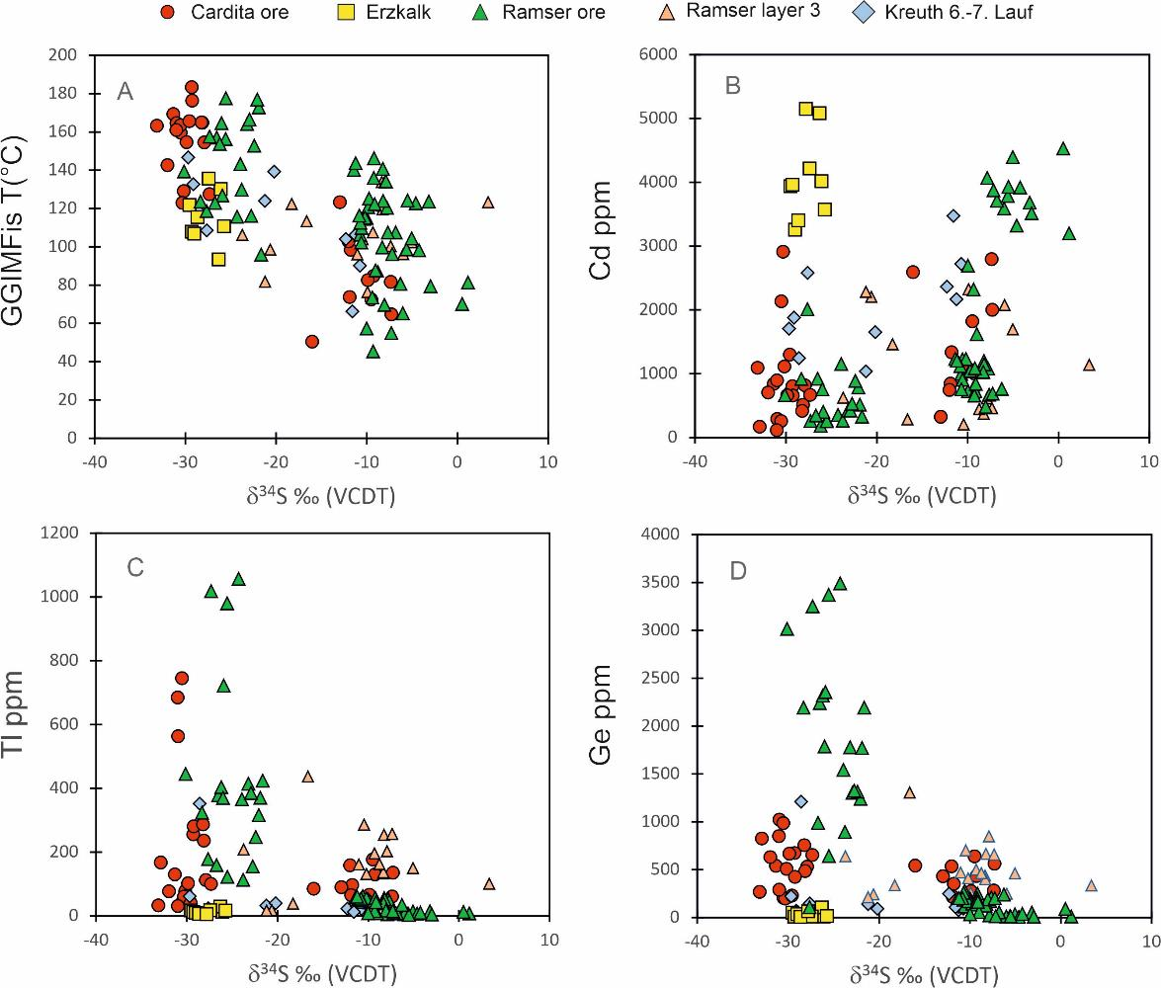
Sulphur isotopes and trace elements at the Bleiberg deposit

Slide 49
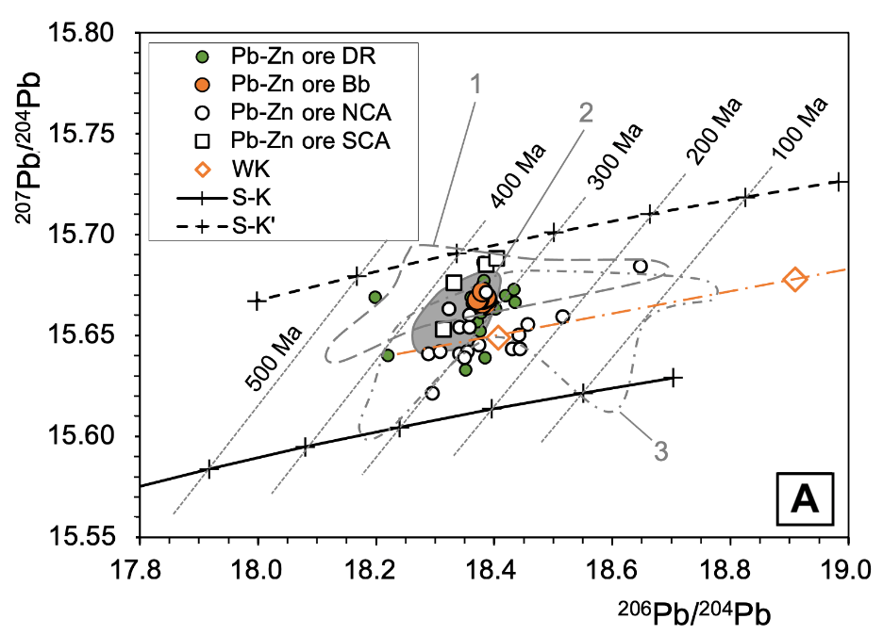
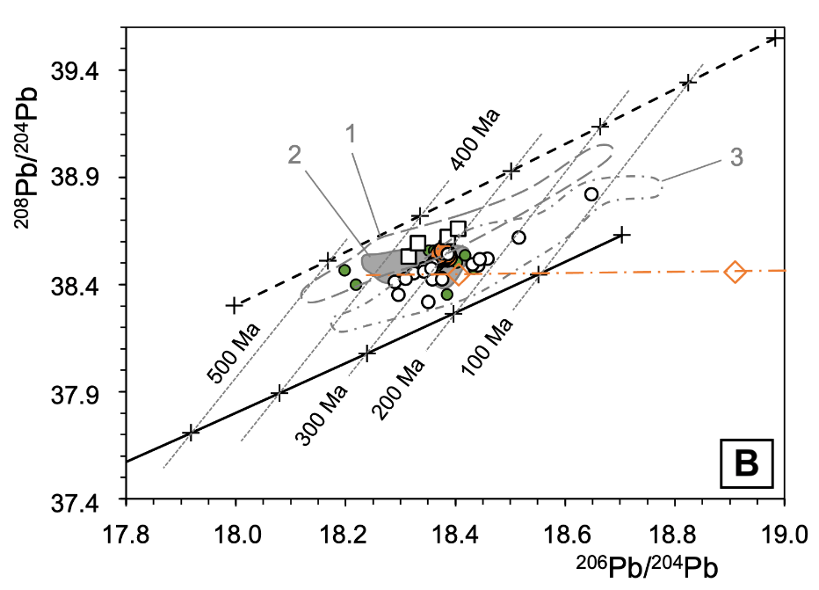
Pb isotope signature of ore lead from APT deposits
DR Drau Range; Bb Bleiberg; NCA Northern Calcareous Alps; SCA Southern Calcareous Alps

Slide 50
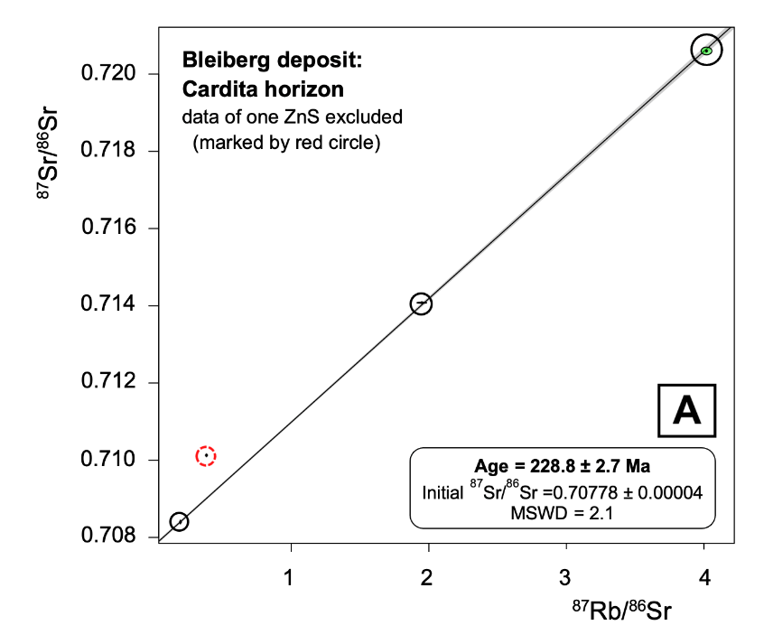
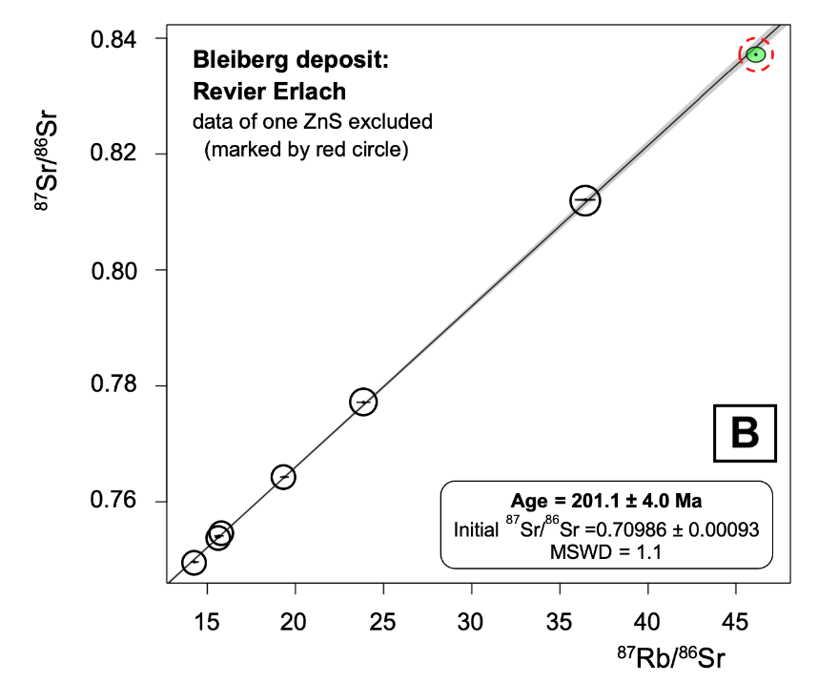
Rb-Sr dating of sphalerite from Bleiberg, Austria

Slide 51
What has been dated at Bleiberg?
Cardita ore
229 Ma
Crest ore
201 Ma

Slide 52
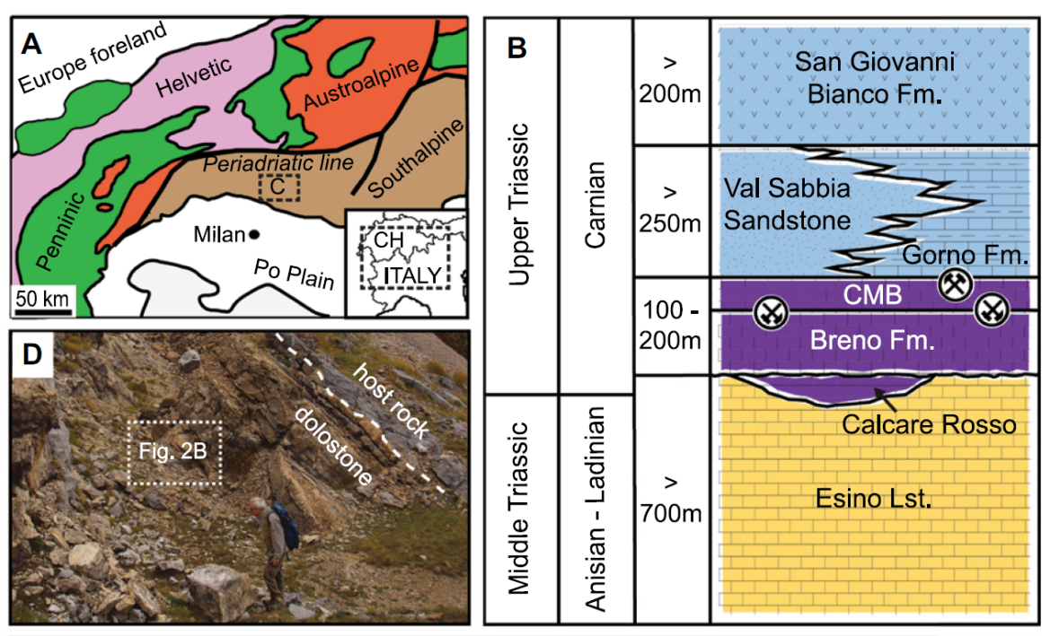
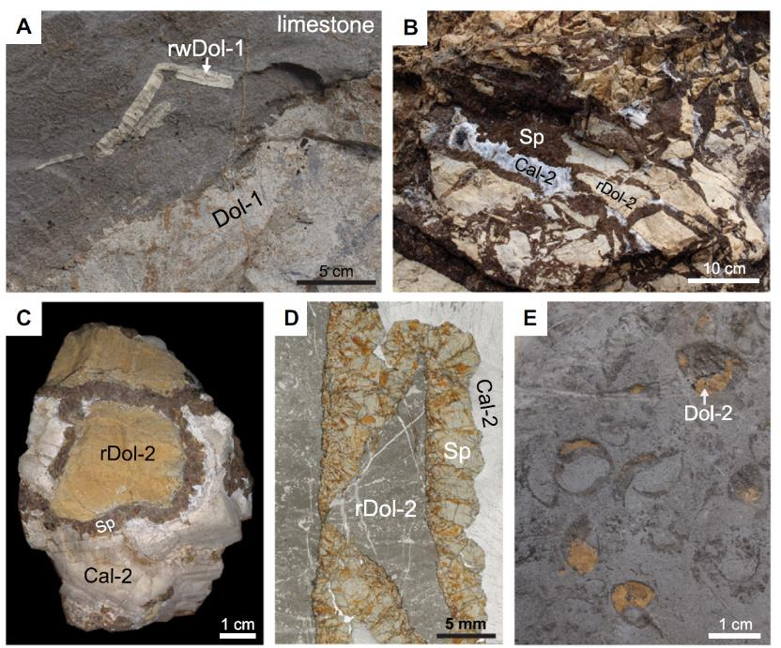
U-Pb dating of hydrothermal carbonate at Gorno, Italy
Giorno et al. 2022 Geology 50: 853-858

Slide 53
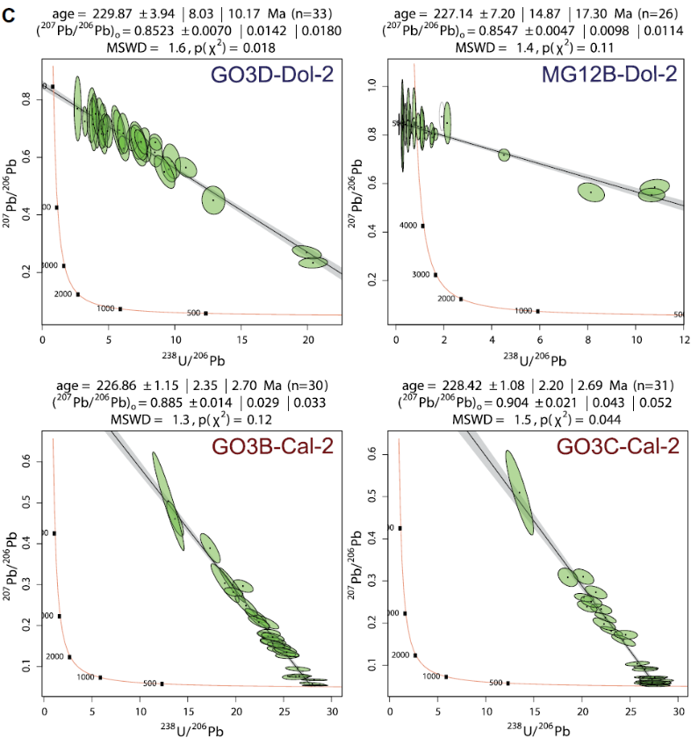
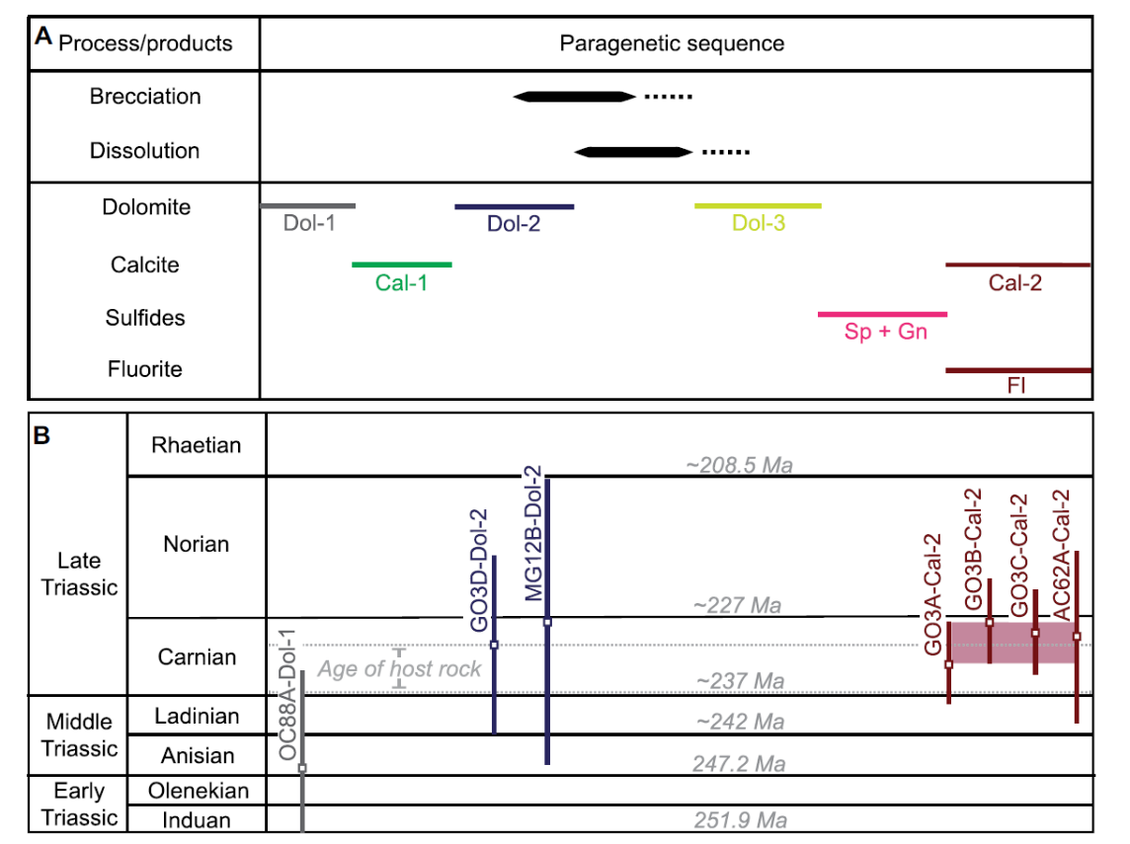
Giorno et al. 2022 Geology 50: 853-858

Slide 54
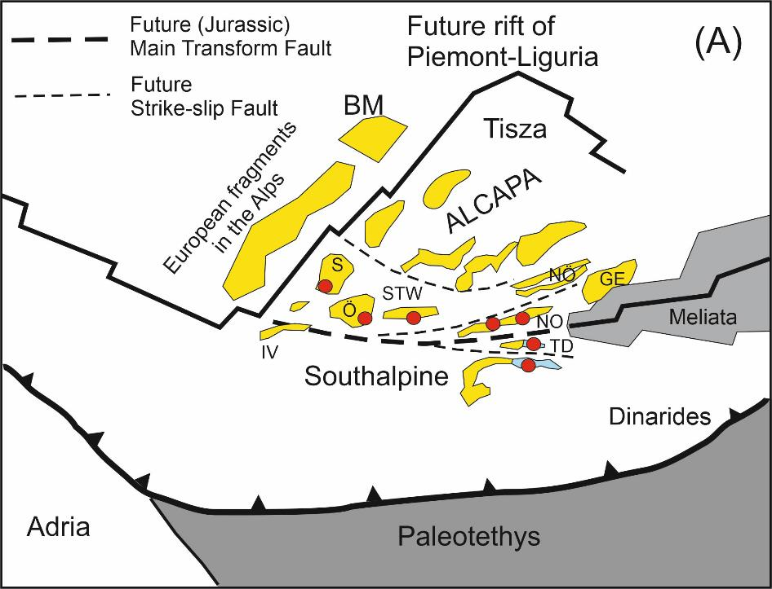
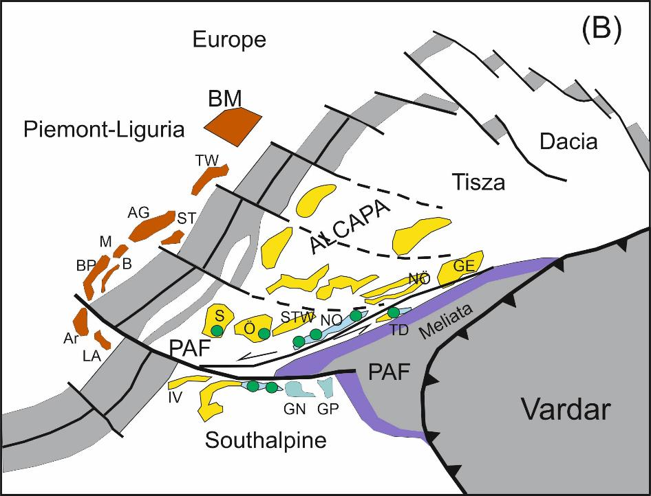
Paleogeographic reconstructions
Late Permian/Lower Triassic (A)
Late Jurassic (B)
modified after Haas et al. (2020)
Red circles indicate position of Middle Triassic (Anisian) APT occurrences overlying Lower Triassic clastic rocks
Green circles indicate position of Upper Triassic APT occurrences in rocks of the Wetterstein Platform and the Raibl Group

Slide 55
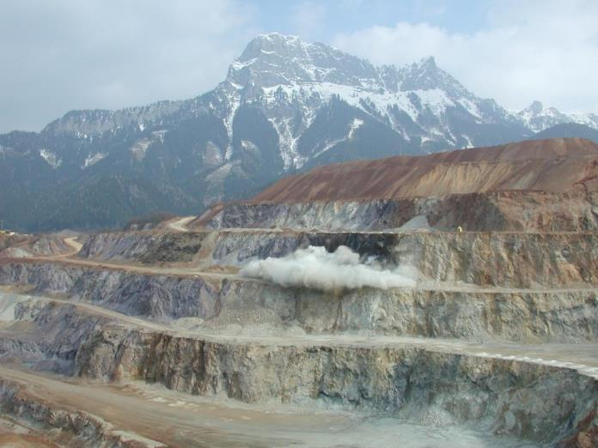
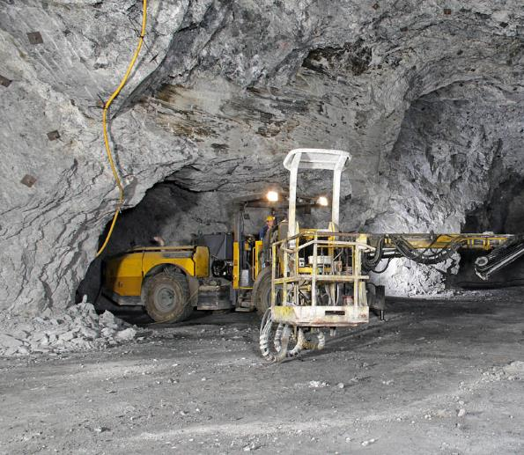
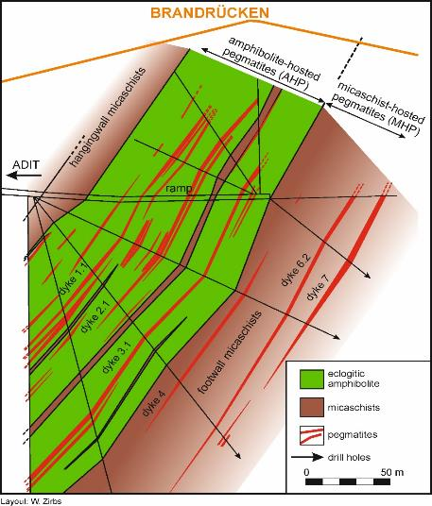
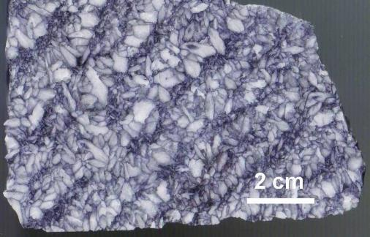
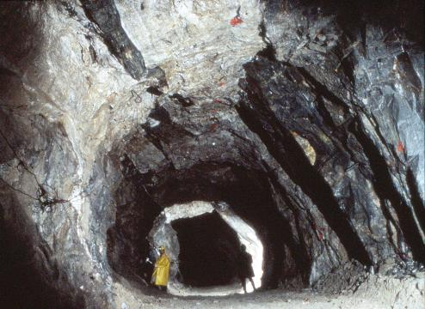
Mineral deposits of Permo-Triassic age in the Alps
„Erzberg“ Siderite (500 Mt @ 33% Fe)
208 ± 22 Ma (Sm-Nd)
Breitenau magnesite
221 ± 16 Ma (Sm-Nd)
Hohentauern magnesite
285 ± 15 Ma (Sm-Nd)
LCT pegmatites
247-277 Ma

Slide 56
Bleiberg
Seawater
Erzberg
Prochaska et al. 2014

Slide 57
Burisch, Markl, Gutzmer 2022 EPSL

Slide 58
Summary of APT deposits in the Eastern and Southern Alps
>500 Pb-Zn occurrences in 13 ore districts
Ores are restricted to Anisian and Carnian carbonate host rocks
Sphalerite is low in Fe, Mn, Co and In, but commonly contains elevated Cd, Ge, As, Tl and Pb, rarely also Ga and Ag
Sphalerite formation temperatures from 60 to 140°C
Galena is Ag-poor
Minor pyrite and marcasite display an As-Tl-(Hg) signature
Rb-Sr isochron dating of sphalerite at ≈229 Ma and at ≈207-201 Ma
Sulphur isotopes indicate bacteriogenic origin of sulphur, with minor thermogenic sources; barite shows seawater composition
Metal source from Paleozoic basement and pre-Triassic sedimentary rocks
Paleogeographic situation in an extensional/transtensional tectonic setting

Slide 59
MVT vs APT
 | APT | MVT
Host rock | Shallow marine carbonate | Shallow marine carbonate
Age of host | Middle-Upper Triassic | Paleozoic
Mineralogy | Sph (Fe- poor), Ga, Ft, Ba, (Py, Mc) | Sph (Fe- poor), Ga, Py, Mc, (Ft, Ba)
Trace elements | Cd, Ge, As, Tl, (Ga) | Cd, Ga, Ge, (Cu), Ag, Ni, Co
Fluid salinity | 10-30% | 10-30%
Fluid temperature | 60-140°C | 75-200°C
Fluid origin | Evaporated seawater | Formation water + meteoric water
Depth | Shallow, surface | Deeper levels
Textures | Colloform, rythmites, bacteriogenic | Coarse rystalline to fine-grained
Sulphur | BSR dominant; -40 to 0 permil | TSR dominant, evaporites
Lead | B-type (>300 Ma) | J-type (model age younger than host rocks)
Age | Triassic, 230-200 Ma | Postdating host by x10 to x100 Ma
Tectonic setting | Extensional, transtensional | compressional

Slide 60

„Good luck“

