Slide 1
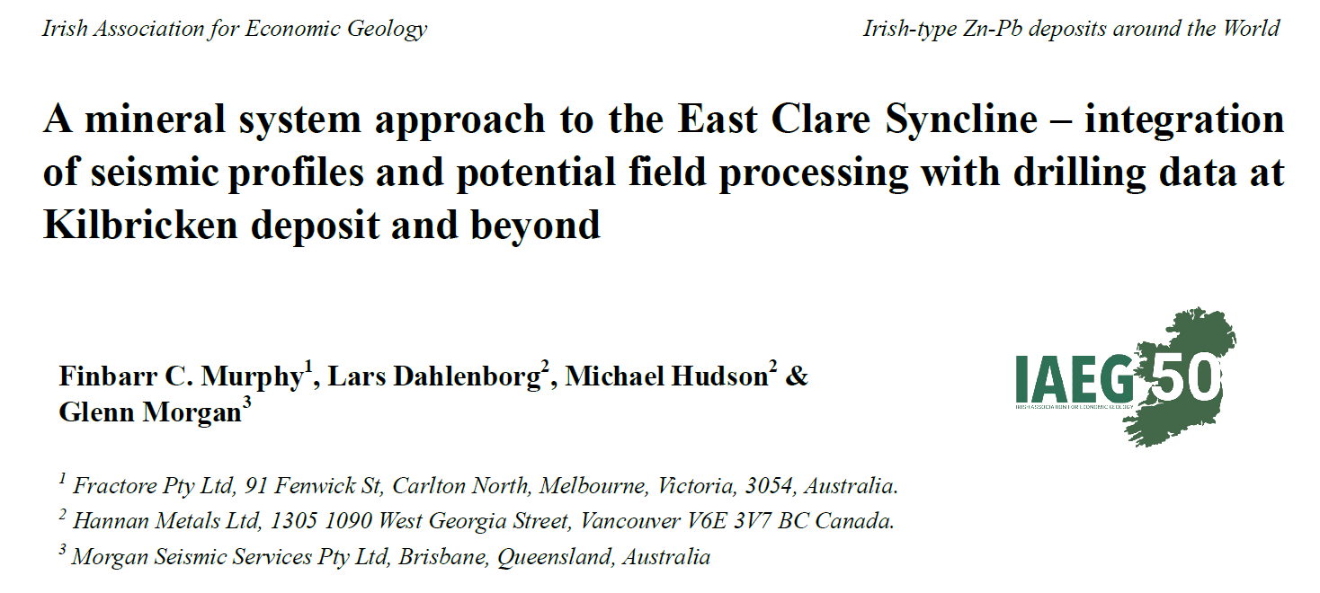
Barry Murphy
FRACTORE PTY LTD

Slide 2
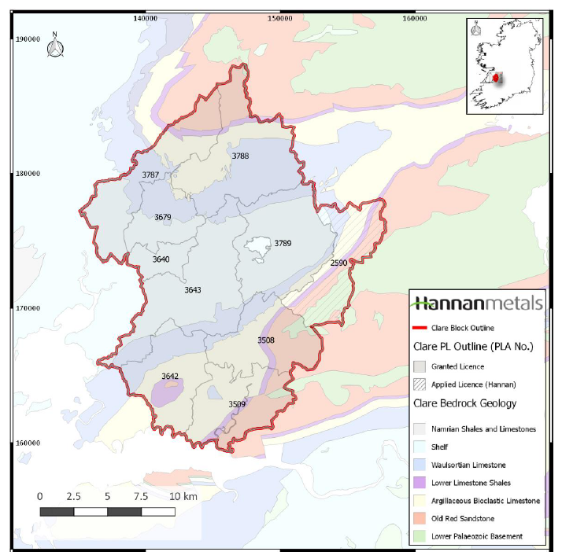
Thanks to IAEG
Thanks to co-authors
Thanks to Hannan Metals
Thanks for coming….!

Slide 3
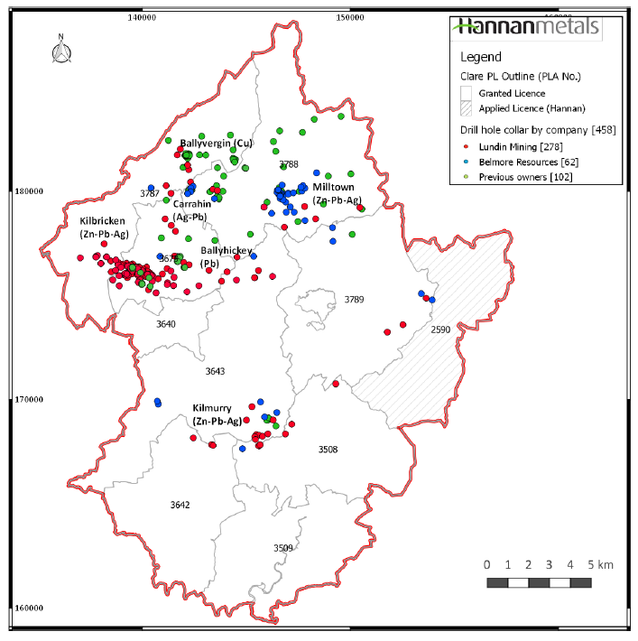
Discoveries in East Clare Syncline – Kilbricken, Kilmurry
Look at seismic and gravity data:
Comparison of seismic profiles, drilling and gravity gradients
Numerical modelling of Irish type deposits – where are mixing zones?
Implications for Targeting – Kilmurry Prospect and beyond
Mineral system – 5 Questions approach – things to consider

Slide 4
Mineral Systems – 5 Questions
Q1 – What is the geodynamic setting? Juiced up Suture Zone with heterogeneous basement; Carbonate platform “Successor basin” becomes Foreland Basin to the Variscan orogeny with progressive Inversion from south to north.
Q2 – What is the local setting? Block faulted, basement controlled architecture. Syn-depositional faulting. Sulphidic. Both Stinky and Salty.
Q3 – What are the fluids and fluid sources? 2 circulating fluids – upper reservoir accessed surficial fluids, lower reservoir accessed basinal/basement hotter metalliferous brines. Effectively separated by regional seal (ABL/LLS).
Q4 – What are the fluid flow drivers and pathways? Hanging walls of Faults in Extension, first carbonate above basement; SMB dewatering, Topography, Inversion and depth of burial at time of mineralization. Epigenetic vs Syngenetic
Q5 – What are the metal transport and depositional processes? …..Over to you….

Slide 5
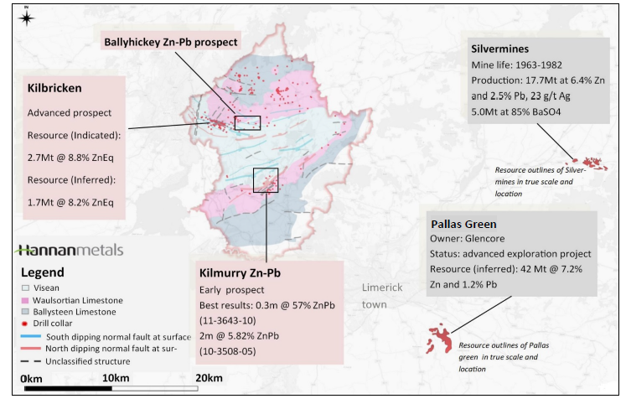
East Clare Syncline

Slide 6
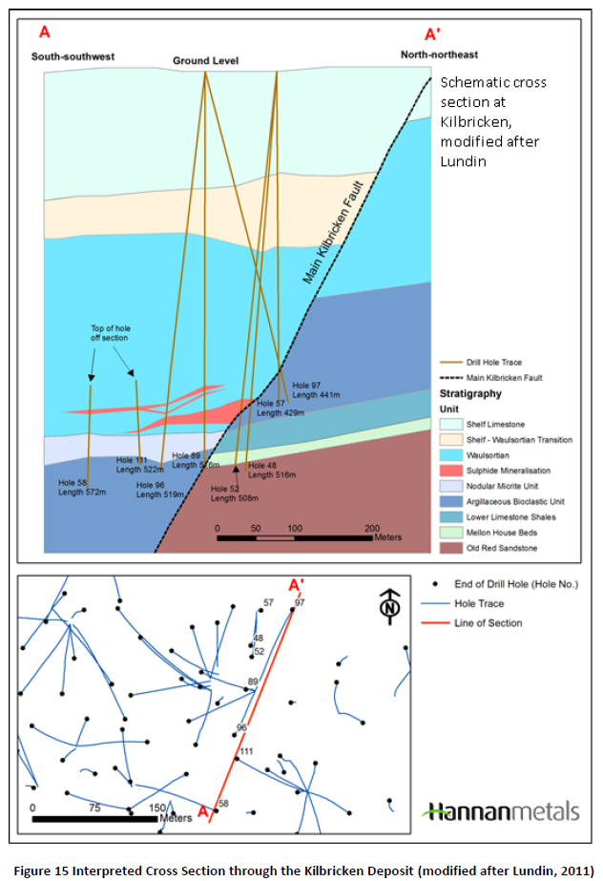
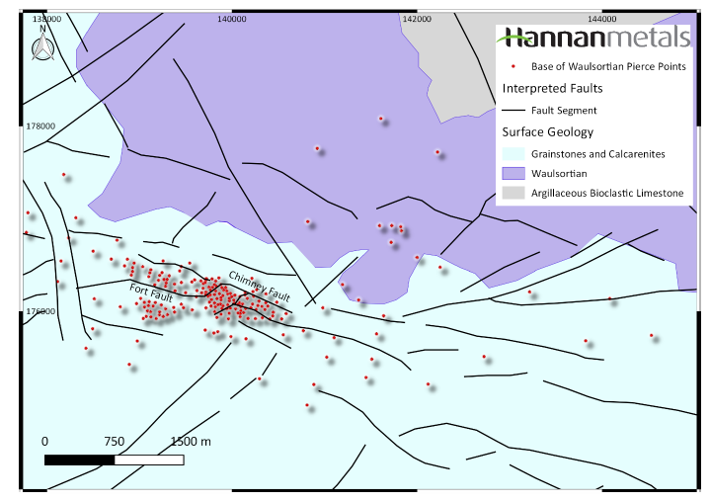
Kilbricken

Slide 7
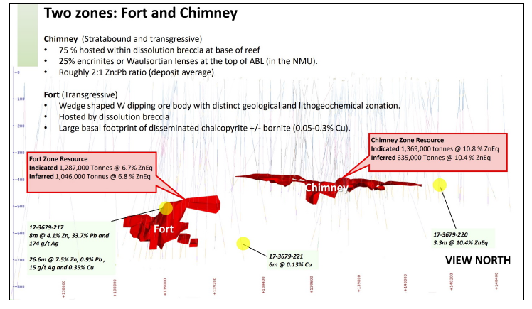
Kilbricken

Slide 8
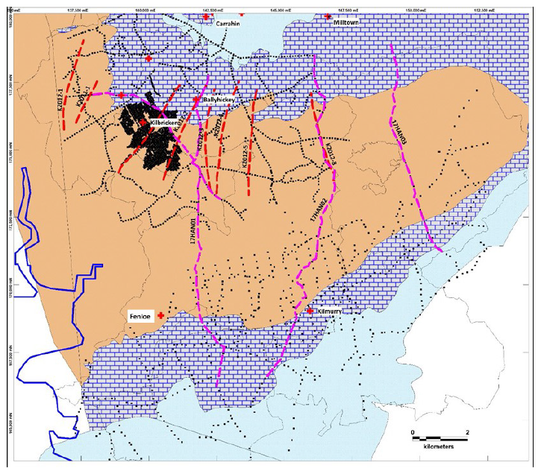
Extensive Seismic and Gravity Coverages

Slide 9
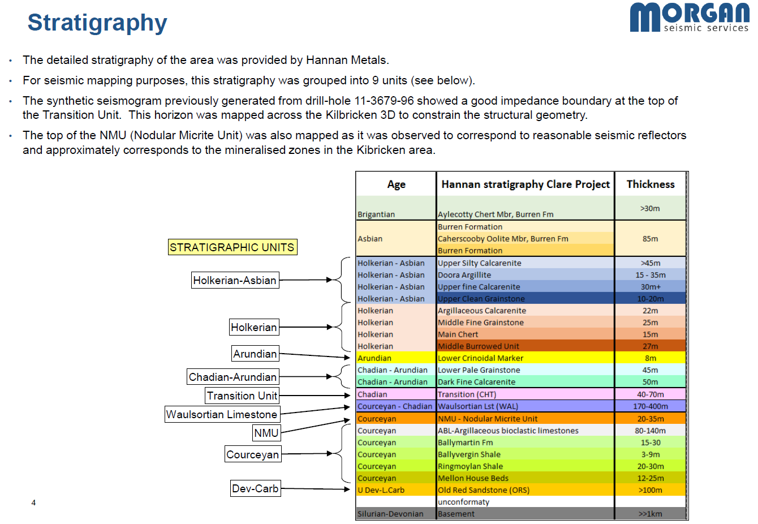

Slide 10
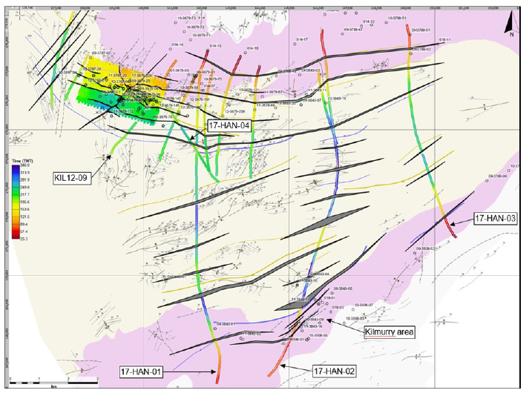
Seismic Lines
Interpreted Faults and
Seismic Lines coloured by TWT to TU marker horizon

Slide 11
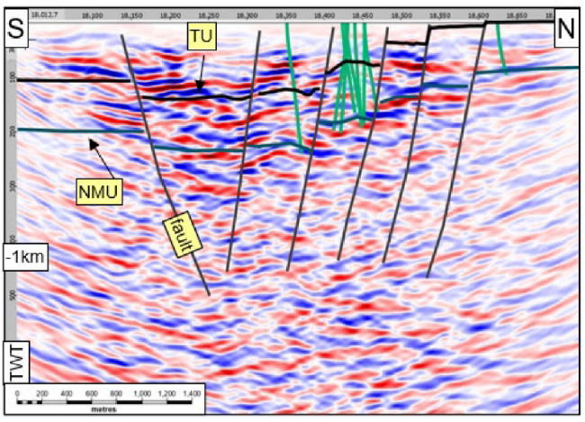
Seismic Profiles
Interpreted Faults and Marker Horizons (NMU, TU)
Drill holes traces - green
17-HAN-02 – Kilbricken
KIL-12-09 Kilmurry

Slide 12
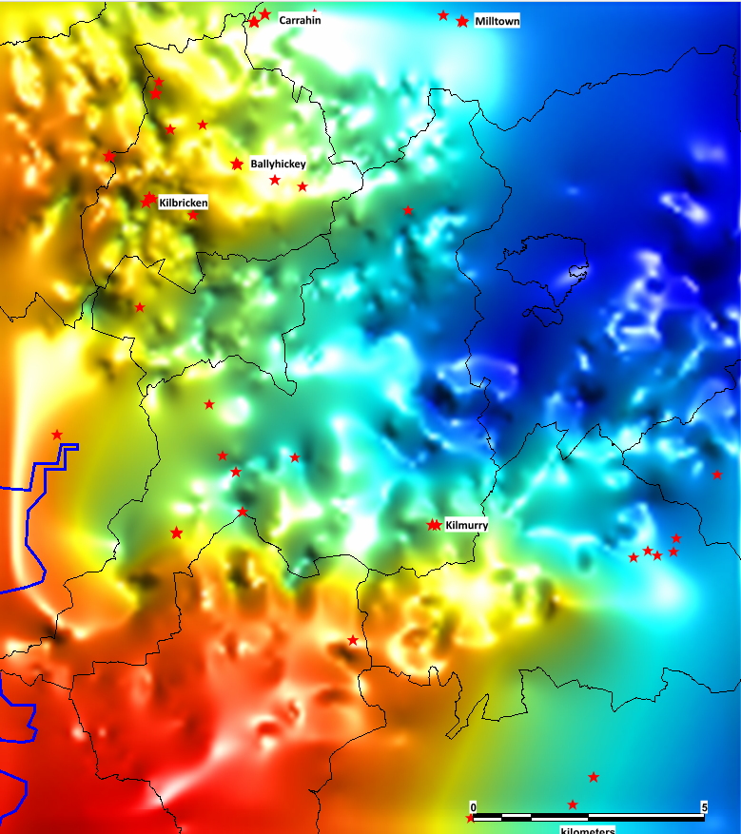
Gravity
Bouguer Anomaly image
- processing routine

Slide 13
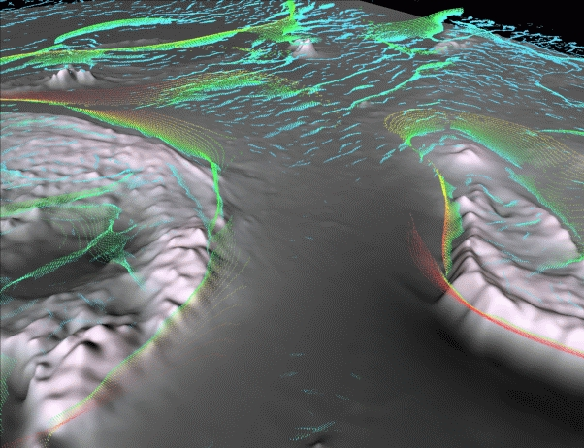
Potential Field Worms – automated edge detection

Slide 14
Synthetic models and derived worms
Points of maximum horizontal gradient computed across multiple height levels of upward continuation
- Worm Sheet dip can Mirror Image dip of below ground body
Worm Sheet Dip
Above ground worm sheets uc levels
Below ground body
Archibald et al 1999

Slide 15
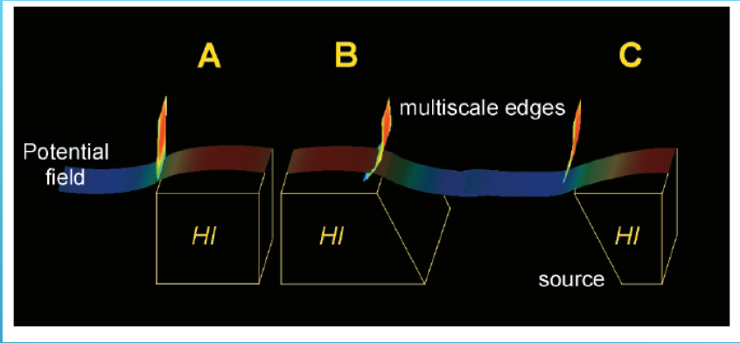
Synthetic models and derived worms
Worm Sheet Dip
Worm Sheet Dip
Worm Sheet Dip
Holden et al. 2000

Slide 16
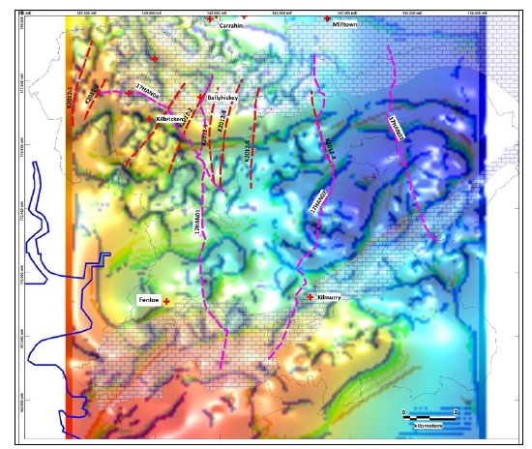
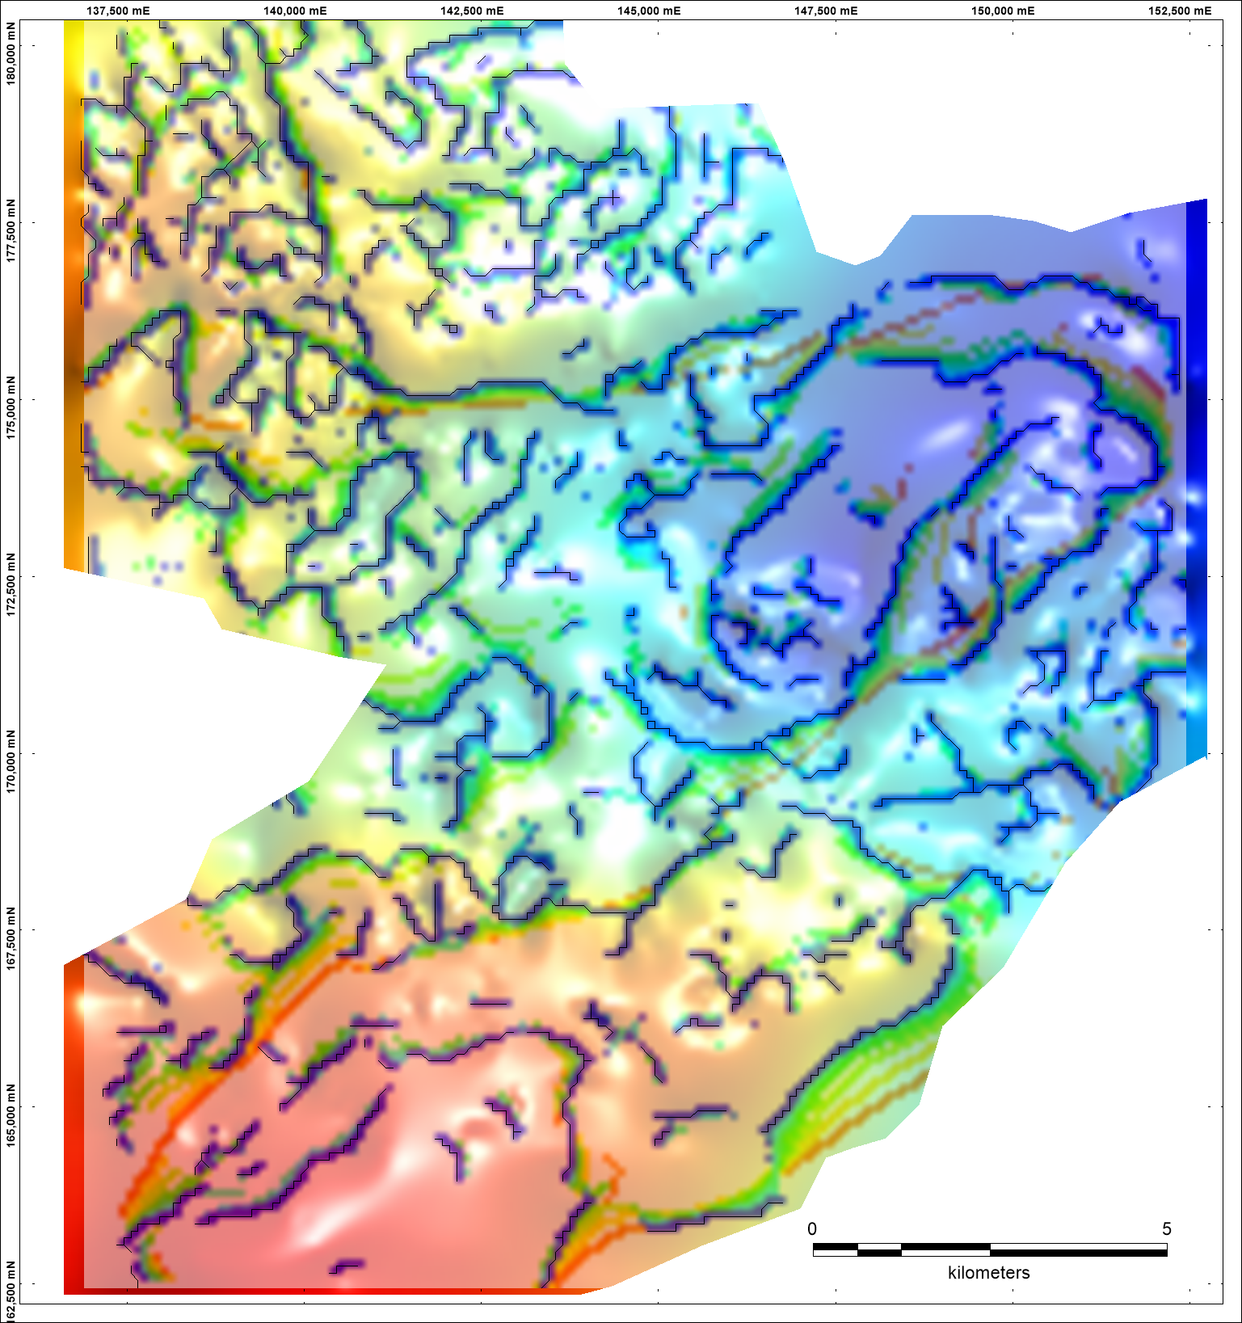
Gravity
BA image
Worm Processing

Slide 17
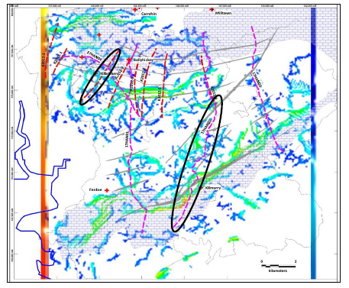
Seismic and Gravity

Slide 18
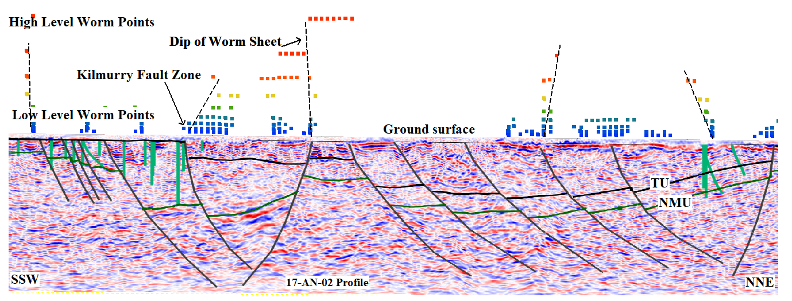
Kilmurry Profile
SSW
NNE

Slide 19
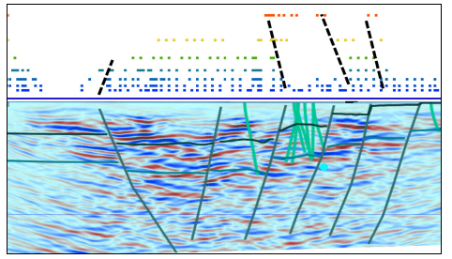
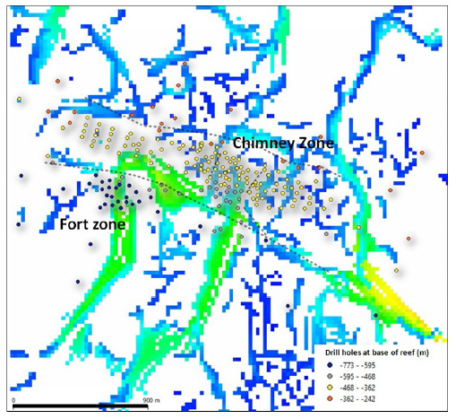
Kilbricken Profile
South
North
Kilbricken Fault

Slide 20
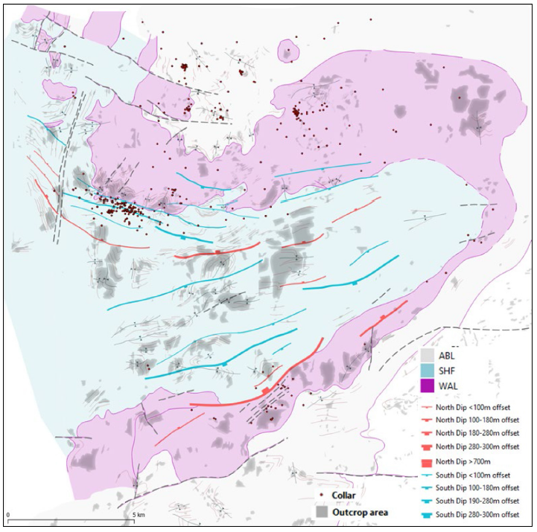
East Clare Summary Geology

Slide 21
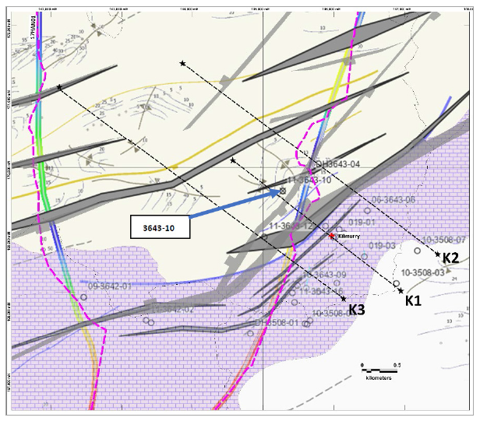
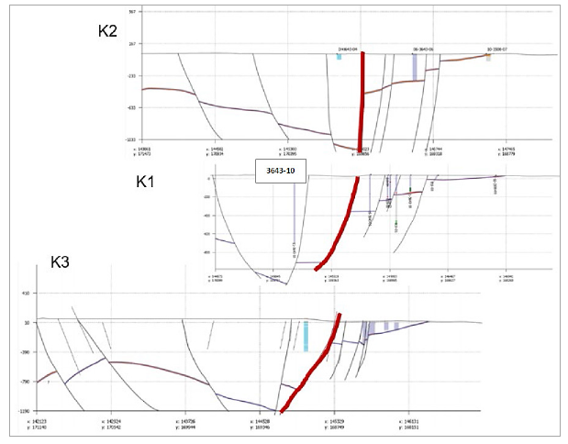
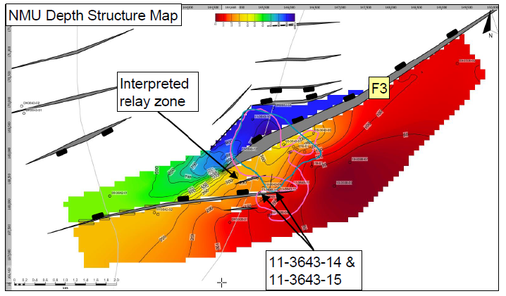
Northwest
Southeast
Kilmurry Fault

Slide 22
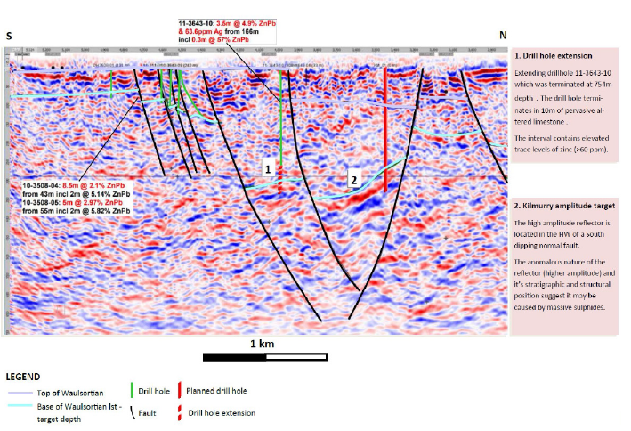

Slide 24
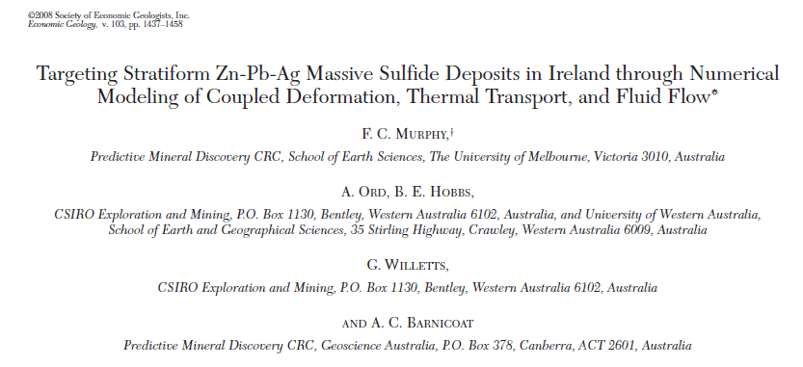
Numerical Modelling of coupled deformation, thermal transport and fluid flow in Irish Type Deposits …help or hinderance?
Wilkinson and Hitzman – “unrealistic geometries at time of mineralization”

Slide 25
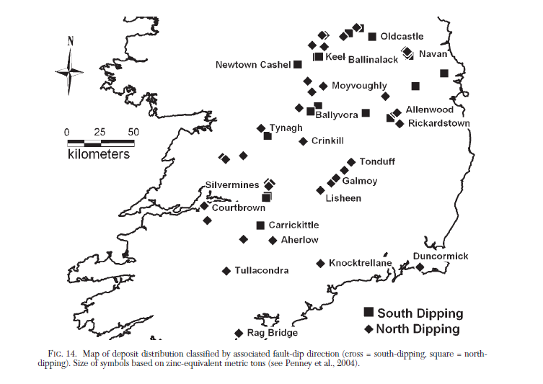
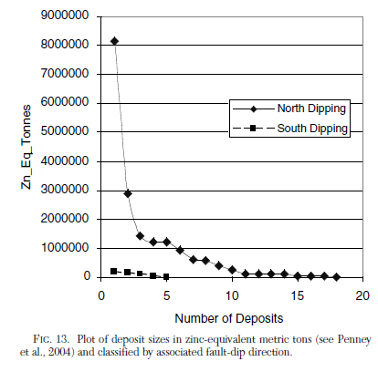
Observation: North dipping fault hanging walls appear more mineralised (Hitzman)
- happenstance of nature? better preservation potential? less inverted?
- or is there a genetic control? This bothered me for a long time.

Slide 26
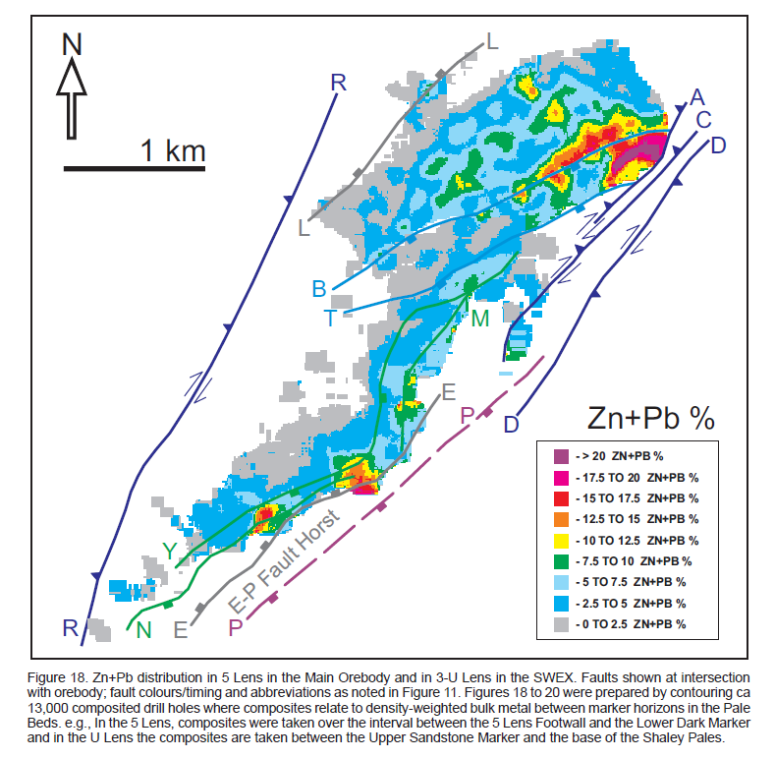
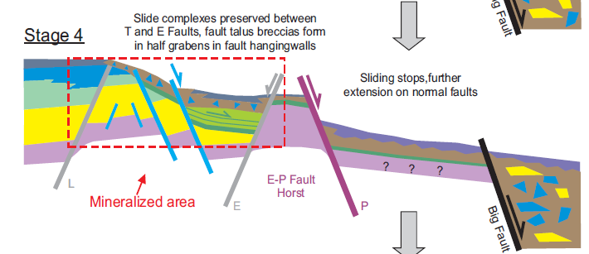
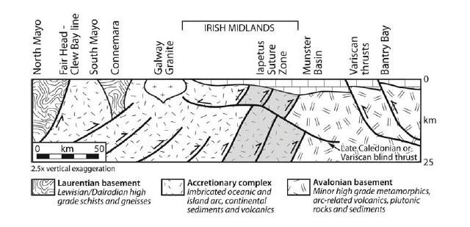
Navan
Ashton et al 2015
Wilkinson and Hitzman 2014 modified from Klemperer et al 1991

Slide 27
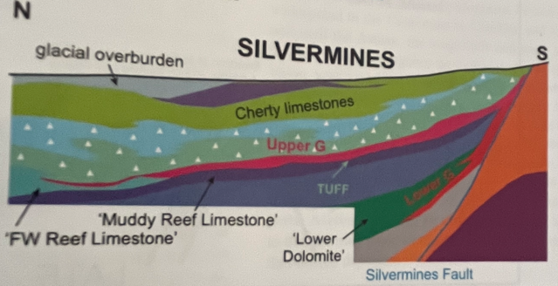
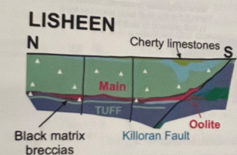
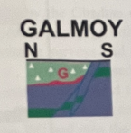
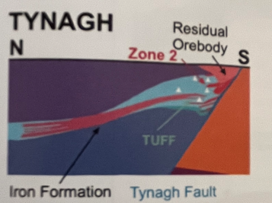
Ashton et al 2023 IAEG50 Lime Green Volume

Slide 28
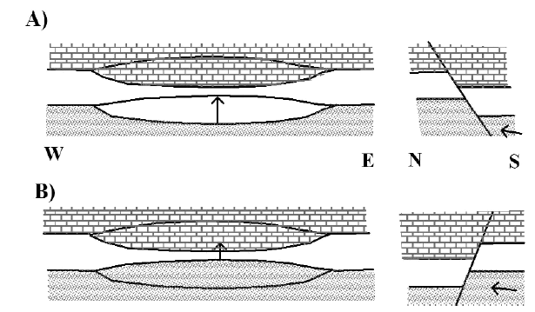
What If…?
2 fluids contained in block faulted template, separated by regional seal. Imposed topographic driver in south generates a polarity of fluid flow from south to north, along ORS aquifer and through basement. Fluid mixing at sites of maximum displacement on north dipping faults?
Tested this conceptual idea using numerical modelling by CSIRO, looked at a number of possible scenarios.

Slide 29
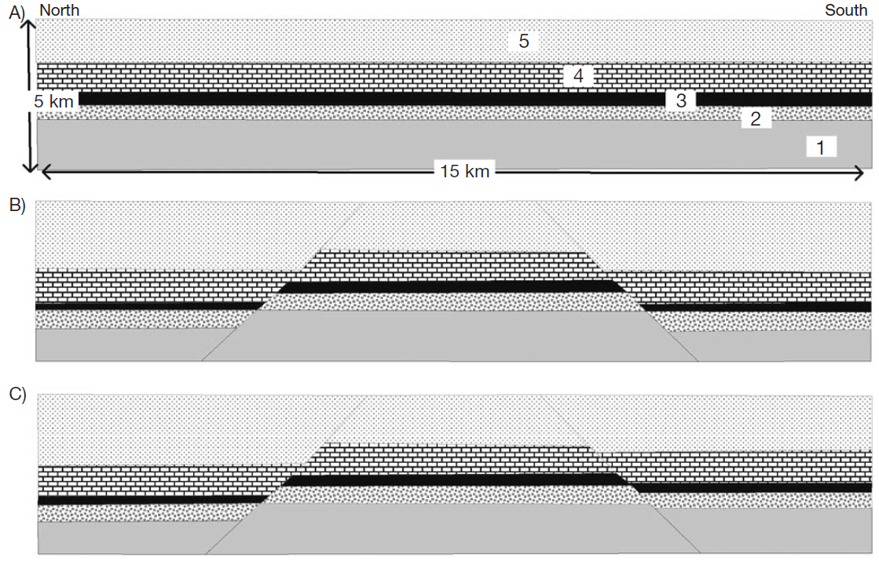
What If…? Local Scale 2D Models
Surficial Fluid Reservoir
Regional Seal
Basinal/Basement Fluid Reservoir
5 Layer Template
1 – Basement, 2 ORS, 3 – LLS/ABL, 4- Waulsortian, 5 – Supra-Waulsortian
Symmetrical Fault model, 600m throw (Models 1-6 and 8)
Asymmetrical Fault model, 200m throw on S dipping fault (Models 7 and 9-15)
Imposed Topo FF Driver

Slide 30
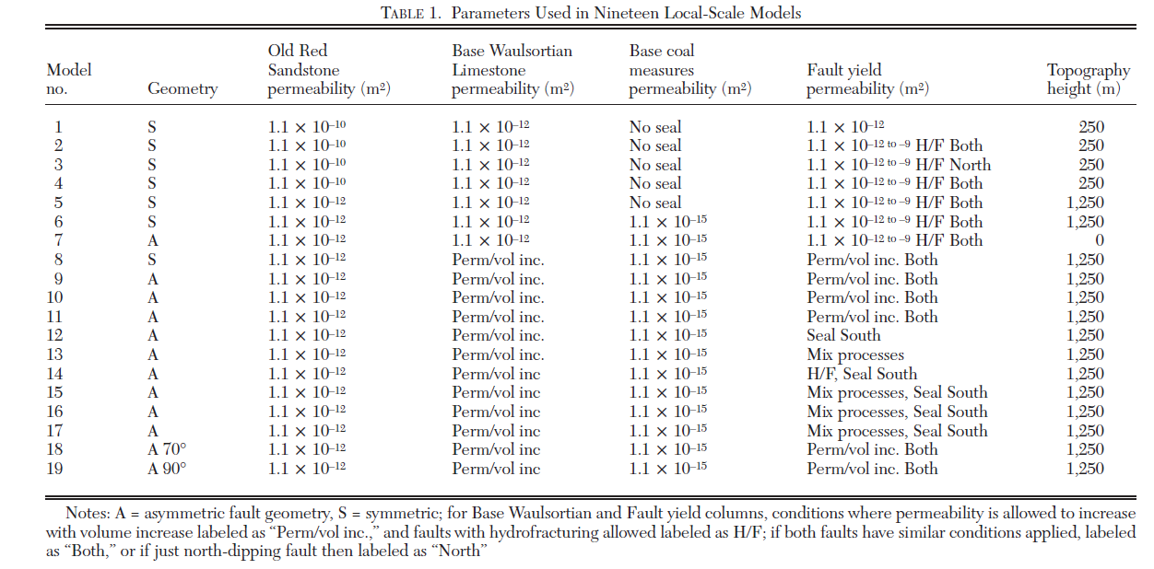
Range of Models (n=19)

Slide 31
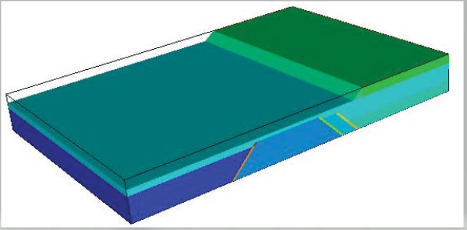
Regional Scale 3D Model
Block faulted geometry and Topographic Elevation
North
South

Slide 32
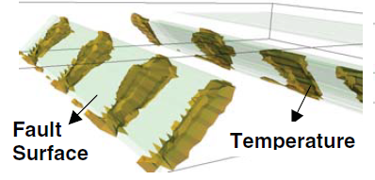
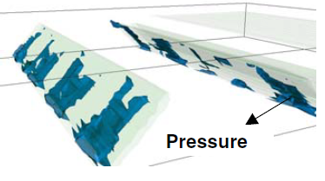
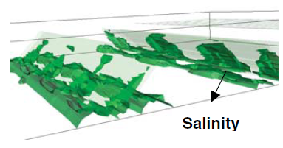
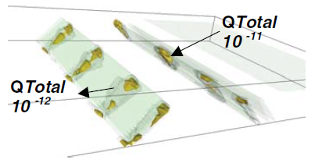
3D modelled faults with mineralizing rate isosurfaces for specific temperature, pressure and salinity gradients and Total mineralizing rate (Qtot, brown 10⁻¹¹, grey 10⁻¹² ppm/l/s. Note heterogenous gradients on fault surfaces.
North
South

Slide 33
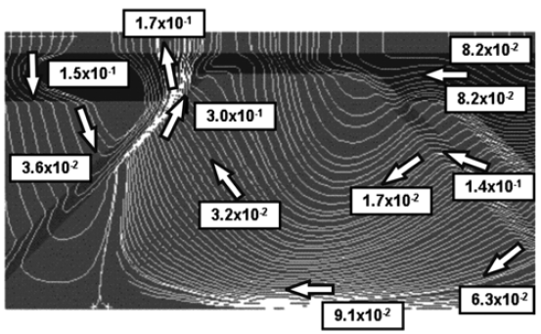
North
South
Regional Scale 2D model
Instantaneous Darcy flow velocities (my⁻¹) and particle tracks for model with NO deformation (Model 12)
Temperature distribution after 500,000yrs, contour internal 25ºC.

Slide 34
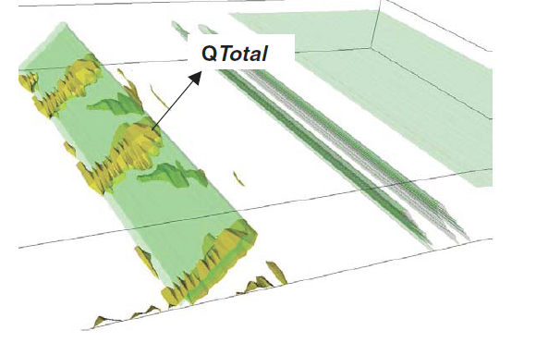
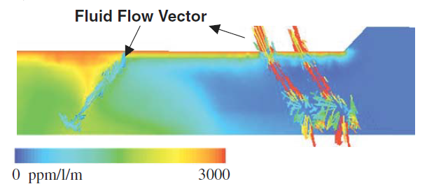
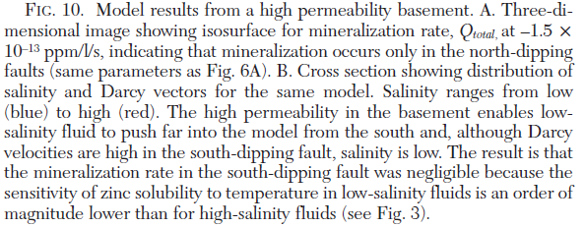

Slide 35
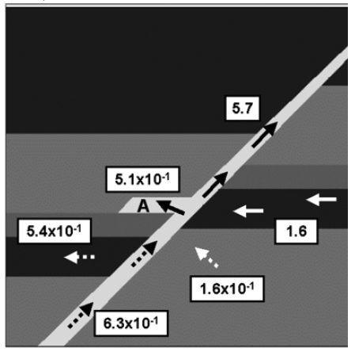
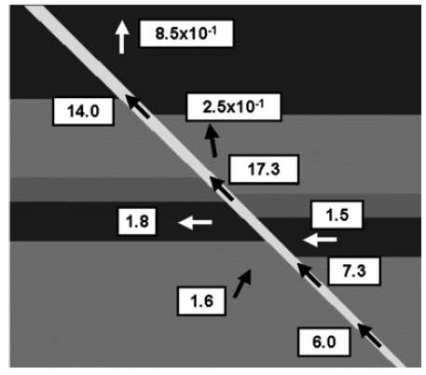
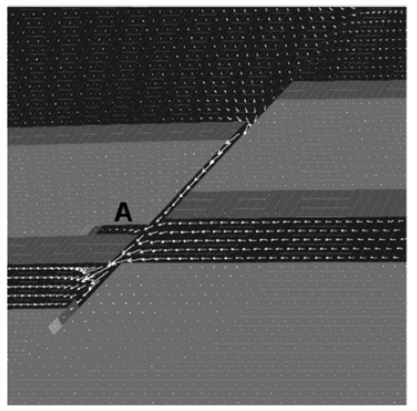
Local Scale 2D Models
Basinal/basement Fluids (solid arrows)
Seawater, convecting fluids (broken arrows)
North
South
N Dipper:
Low Darcy flow rates but with fluid mixing (A)
D>LLS
S Dipper:
High Darcy flow rates but no fluid mixing , D<LLS
Model 8, North dipping fault
Fluid Mixing at position A; D>LLS

Slide 36
if north dippers are more prospective…
What techniques narrow search area and chance of discovery?
Turn to Regional Worms as input….

Slide 37
Gravity Worms
Major Deposits

Slide 38
Tynagh

Slide 39
KILMURRY

Slide 40
Ballywire (Group 11 Resources)
7th Sept 2023
Major N dipping fault, outboard of “SIL”
Had this pre-GFC…

Slide 41
Conclusions
Kilmurry – major north dipping fault. High amplitude reflector at base of Waulsortian limestone.
Drilling 2023 – stopped short due to 30m cavity.!!!
Regionally, faults with displacements > thickness of the LLS/ABL are optimum – seal thickness/displacement relationship.
North dipping faults more mineralised – numerical modelling of range of scenaris – topography/no deformation/compression – point to fluid mixing zones being more likely to occur in north facing hanging walls. Not a failsafe, but good first pass.
Seismic works, but expensive.
Gravity works = long, deep seated structures, cost effective tool.
Drilling works best, but only in the right places..

