Slide 1
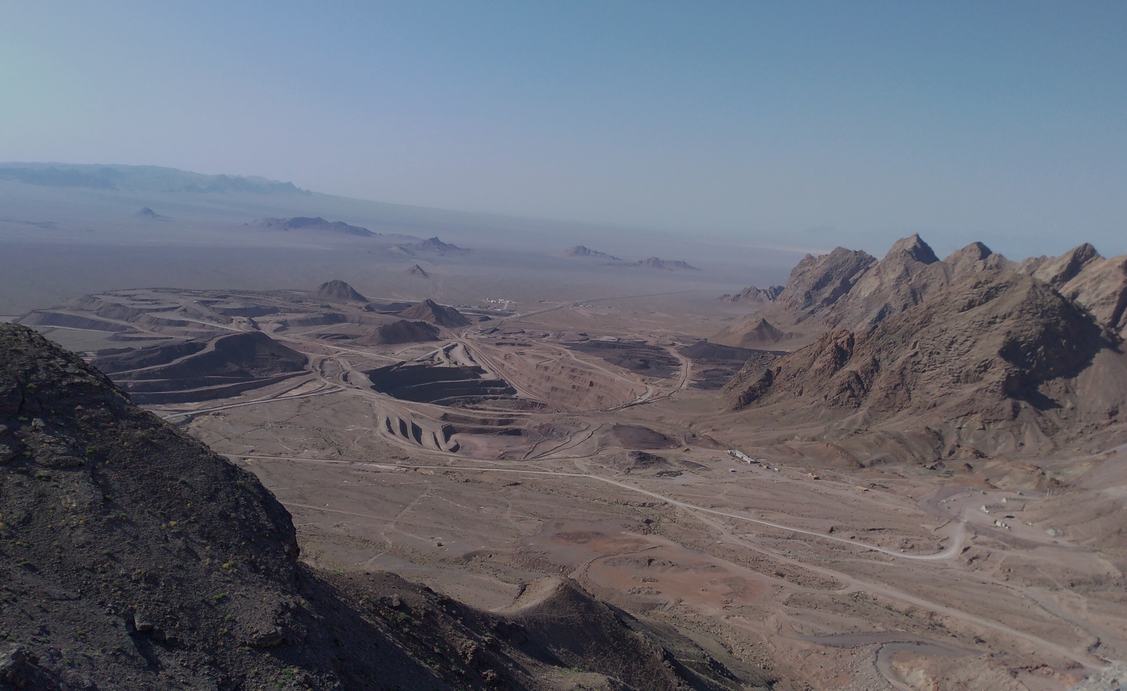
Irish-type Zn-Pb deposits around the world - 2023
An Introduction to Irish-type Zinc-Lead Deposits in Early Cretaceous carbonate rocks of Iran
Abdorrahman Rajabi*, Pouria Mahmoodi, Ebrahim Rastad, Carles Canet, Pura Alfonso,
Shojaedin Niroomand, Ali Yarmohammadi, Hamid Peernajmodin, Zahra Akbari
Mehdiabad Mining Camp
Yazd, Iran - 2019
* e-mail: rahman.rajabi@ut.ac.ir
Notes:
Good morning, everyone and welcome to this presentation. It is an honor to be here with you today.
My name is “Rahman” and I am glad to be here to talk about, the “Irish-type zinc-lead deposits in Early Cretaceous carbonate rocks of Iran. And, it can be interesting for many researchers because Iran hosts some of the giant zinc-lead deposits.
The background shows the Mehdiabad mining camp, the largest carbonate-hosted zinc-lead deposit in the world.

Slide 2
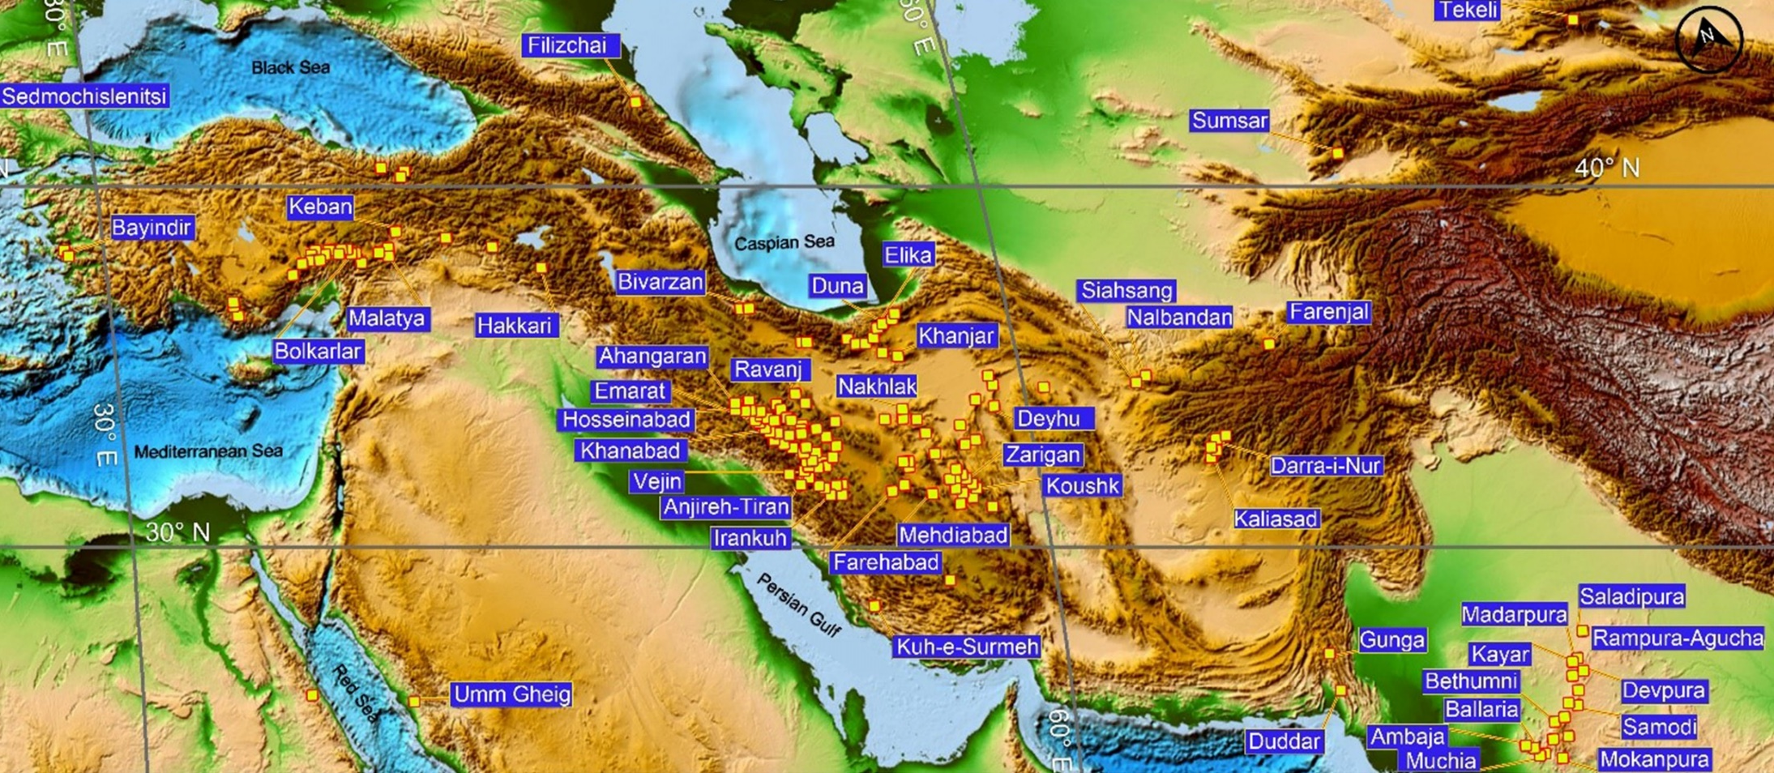
Irish-type Zn-Pb deposits around the world - 2023
Distribution map of sediment-hosted Zn-Pb deposits
Distribution map of sediment-hosted Zn-Pb (Ag-Ba-Cu+Fe) deposits in the Tethyan belt (Rajabi, 2022).
2
Notes:
This map represents the distribution of sediment-hosted zinc-lead deposits in the Tethyan belt, from Turkey to China. As you see, there’s a condensed accumulation of these deposits in Iran, especially here, in the Malayer-Esfahan and Yazd-Anarak metallogenic belts. The major question is why these deposits are concentrated in these areas.

Slide 3
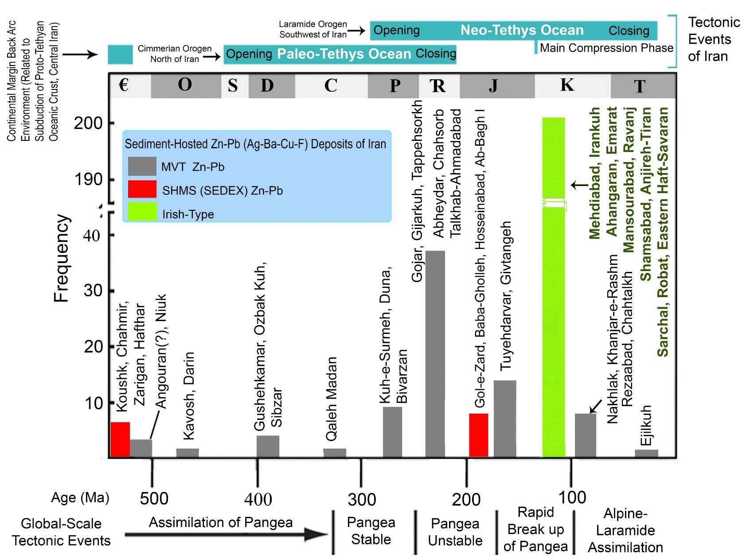
Irish-type Zn-Pb deposits around the world - 2023
Distribution of the CH Zn-Pb ore deposits
More than 350 sediment-hosted zin-lead deposits
Schematic age (host rocks) distribution of sediment-hosted Zn–Pb deposits in Iran plotted against tectonic evolution of Iran and global-scale tectonic events (modified after Rajabi et al., 2012a, 2013).
3
Notes:
More than 350 sediment-hosted zin-lead deposits have been reported in Iran.
This figure shows the host rocks’ age distribution of these deposits in Iran plotted against the tectonic events.
As you see, Shale-hosted zinc-lead deposits occurred in the Early Cambrian and Jurassic.
Carbonate-hosted deposits are widespread from Cambrian to Tertiary, with two peaks in Late Triassic and Early Cretaceous. The former peak indicates the orogenic-related MVT deposits in relation to the Main-Cimmerian orogeny.
The second peak is referred to those in Early Cretaceous deposits. Authors suggested Sedex, MVT and Irish-type models for the genesis of these deposits.
Here we will try to review the characteristics of these deposits in Iran.

Slide 4
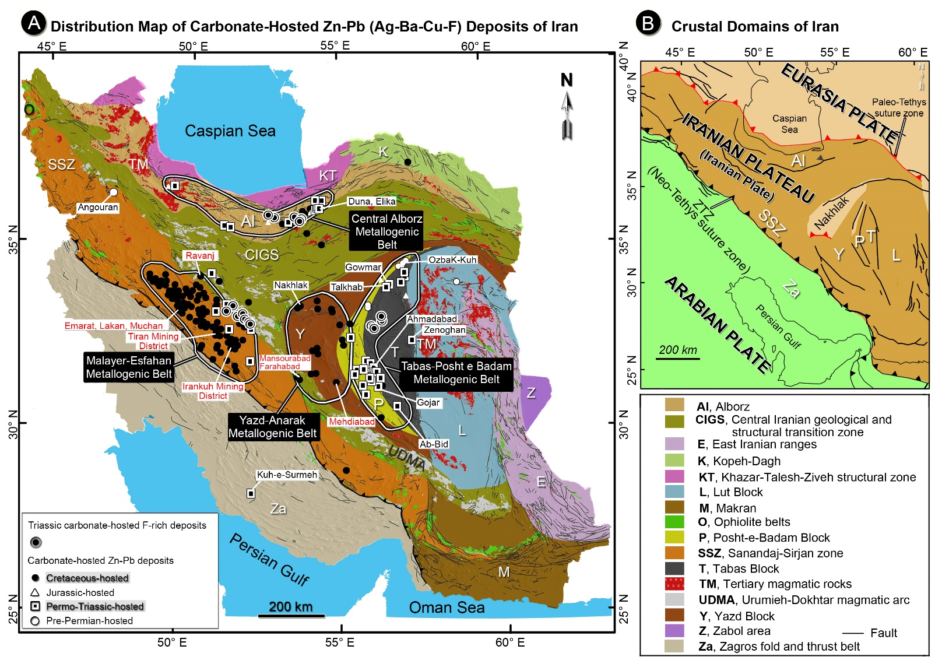
Irish-type Zn-Pb deposits around the world - 2023
Distribution of the CH Zn-Pb ore deposits
2
A) Simplified tectonic map of Iran (Aghanabati, 1998) and distribution map of carbonate‐hosted (MVT and Irish-type) Zn‐Pb and F‐rich deposits according to the age of host rocks in the Central Alborz, Tabas‐Posht e Badam, Malayer‐Esfahan, and Yazd‐Anarak metallogenic belts (Rajabi et al., 2012a; 2019a; 2022). Major Irish-type deposits are indicated with red font. B) Simplified terrane map of the western Tethysides, and crustal domains of Iran (Rajabi et al., 2019a).
4
Notes:
This map shows the distribution of carbonate‐hosted Zn‐Pb deposits in Iran. There are four major metallogenic belts that host these deposits, including the Central Alborz, Tabas‐Posht e Badam, Malayer‐Esfahan, and Yazd‐Anarak metallogenic belts.
The major Irish-type deposits are indicated with red font.
On the right, you can see the simplified map of the crustal domains of Iran.
Here the Zagros thrust belt indicates the orogenic boundary between the Arabian plate and the Iranian plateau.

Slide 5
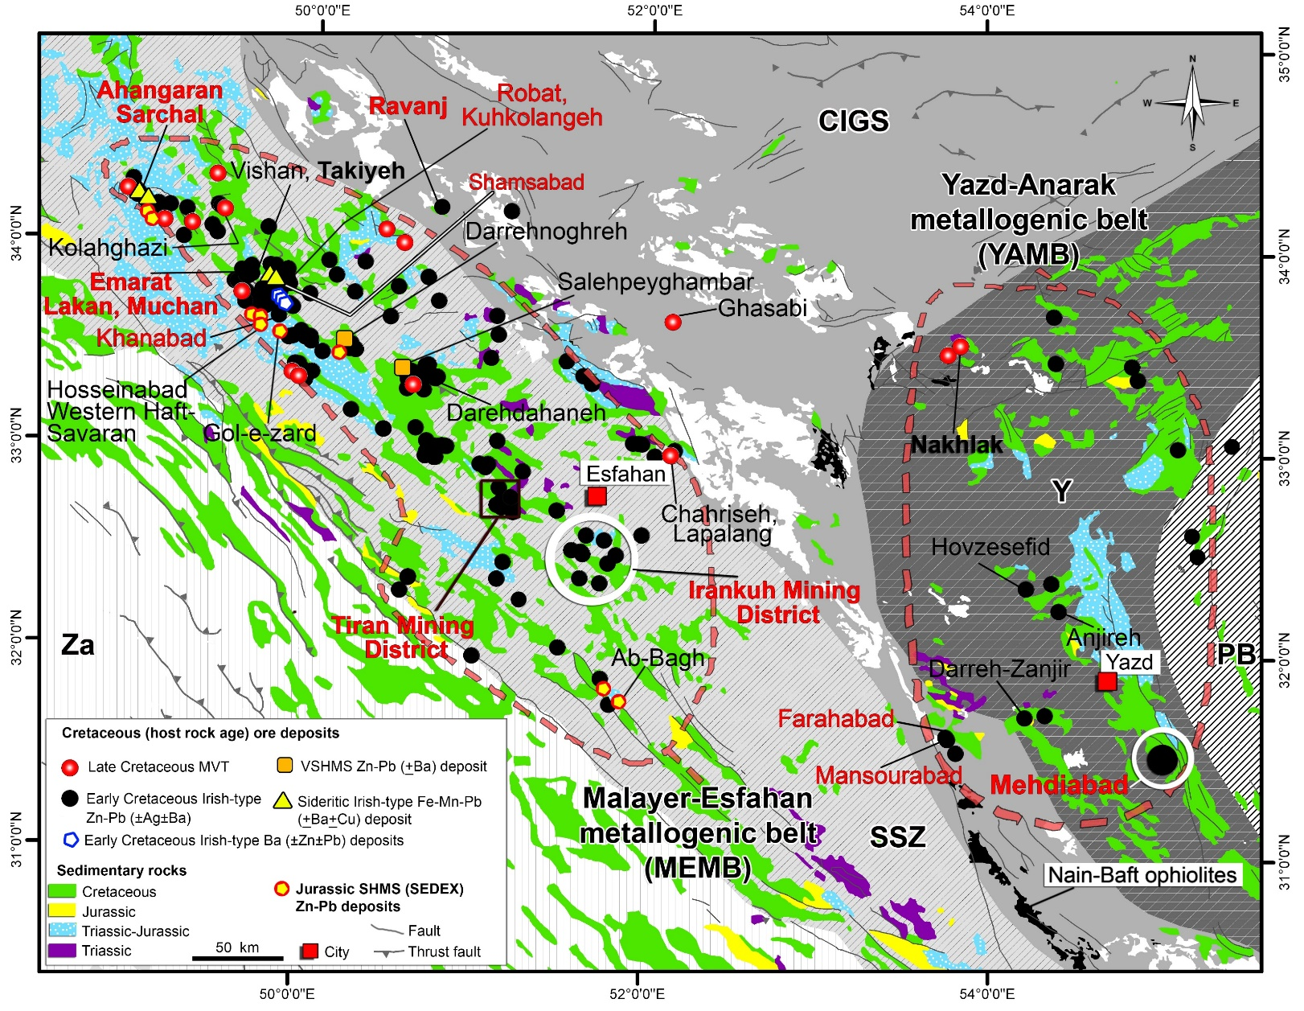
Irish-type Zn-Pb deposits around the world - 2023
The Malayer-Esfahan Metallogenic Belt (MEMB)
Distribution map of Irish-type, SHMS (SEDEX) and VSHMS deposits in the Malayer-Esfahan and Yazd-Anarak metallogenic belts of Iran (after Rajabi et al., 2012). These deposits occur on both sides of the Nain-Baft back-arc basin, characterized by ophiolites.
5
Notes:
Cretaceous carbonates are the most common host rocks for Irish-type deposits of Iran, which are largely concentrated in the Malayer-Esfahan metallogenic (MEMB), and the Yazd-Anarak (YAMB) metallogenic belts. These deposits occur on both sides of the Nain-Baft back-arc basin, characterized by ophiolites.

Slide 6
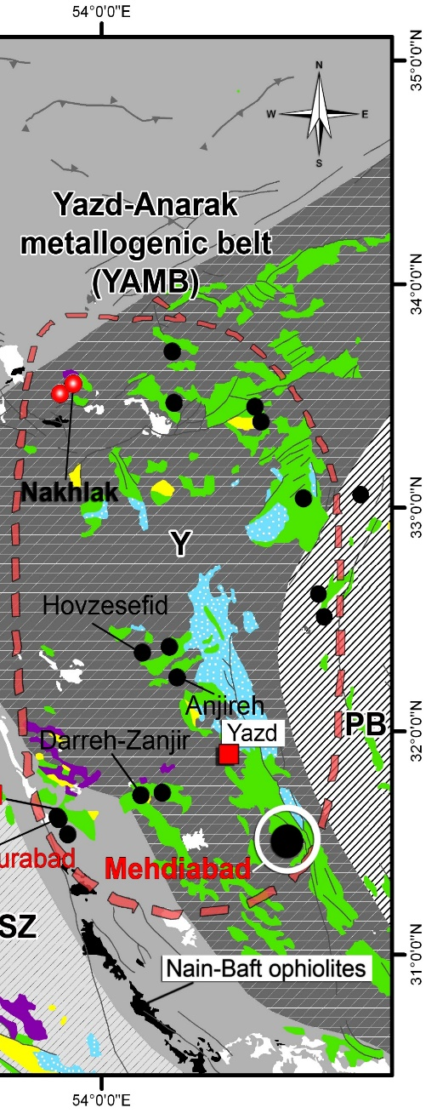
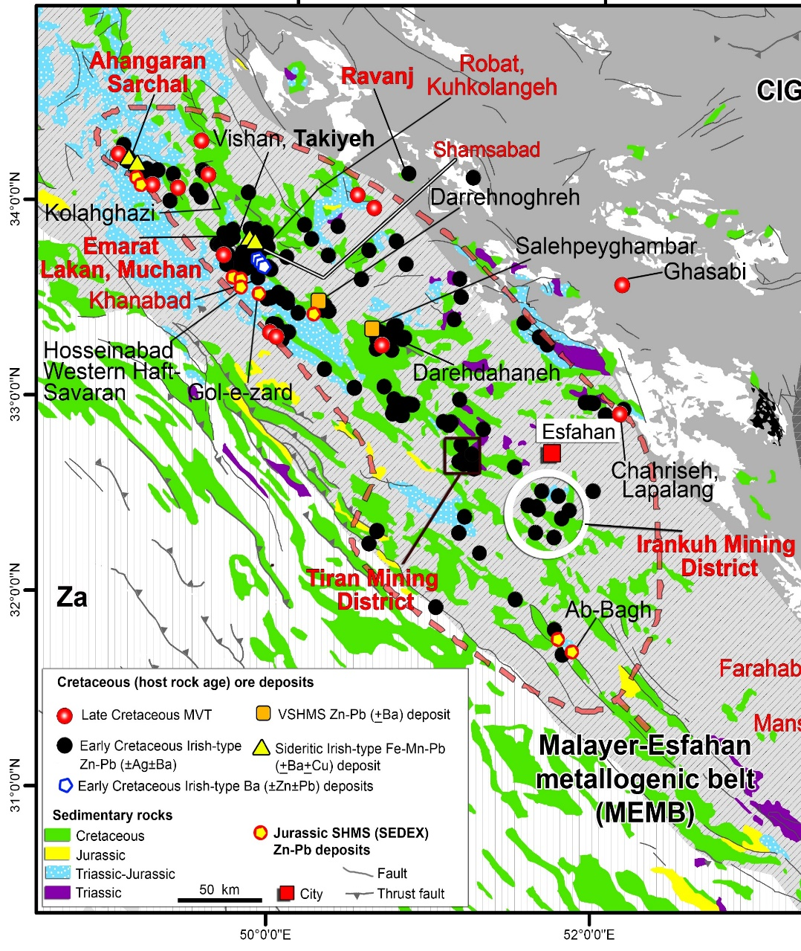
Irish-type Zn-Pb deposits around the world - 2023
The Malayer-Esfahan Metallogenic Belt (MEMB)
Irankuh: 20 Mt at 2.5% Pb and 11.0% Zn, remnant ore
Emarat: 10 Mt at 2.2% Pb and 6.0% Zn
Ahangaran: 40 Mt Fe ore, 6 Mt sulphide ore at 6% Pb and 0.5% Zn, 200 gr/t Ag
Shamsabad: 48.7 (proven) and 300 Mt (estimated), respectively; 40% Fe and 3% Mn; 1 Mt Pb+Zn
Sarchal: 30 Mt Fe ore, 1 Mt sulphide ore
Robat: 5 Mt ore at 3% Zn+Pb
Eastern Haft-Savaran: 2 Mt at 3% Zn and 2% Pb
Other main ore deposits: Saki, Ghezeldar, Arreh-Gijeh, Tiran, Khanabad and Takiyeh.
Some major prospects under exploration: Kuhkolangeh, Lakan, Muchan
More than 170 ore deposits and prospects
6
Notes:
Let’s have a look at the Malayer-Esfahan metallogenic belt. It contains more than 170 ore deposits and prospects. Here you see some data from the major ore deposits.
The Irish-type deposits are marked with black points, such as Irankuh, Tiran, and Robat. The Sideritic Fe-Mn-Pb deposits with yellow triangles, such as Ahangaran, Shamsabad and Sarchal. You can also see some shale-hosted zinc-lead deposits in Jurassic clastic rocks of the Malayer-Esfahan, indicated with yellow circles.

Slide 7
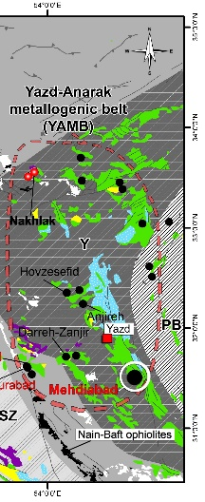
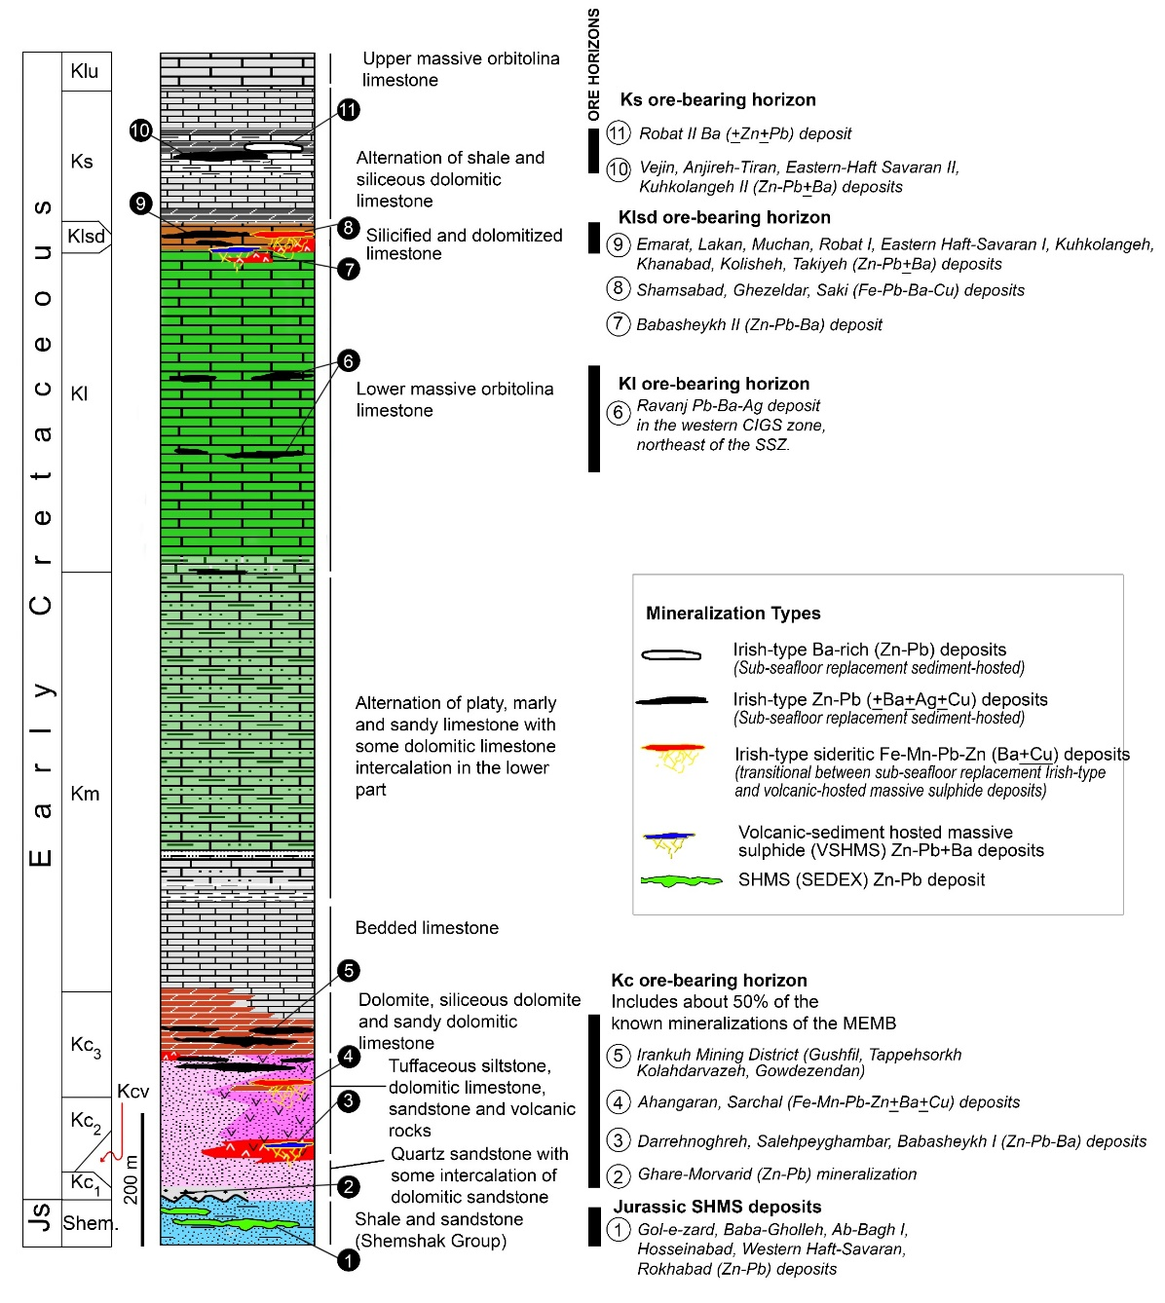
Irish-type Zn-Pb deposits around the world - 2023
The Malayer-Esfahan Metallogenic Belt (MEMB)
Generalized schematic columnar section of the Early Cretaceous sequence of the MEMB and western CIGS gradual zone, with the main ore-bearing strata (modified after Momenzadeh (1976) and Rajabi et al. (2012a; 2019a)).
7
Notes:
Here you see the general columnar section of the Early Cretaceous sequence of the Malayer-Esfahan belt, with the main ore-bearing strata.
In this belt, the Early Cretaceous sequence unconformably overly Late Jurassic shales, and sandstones.
The Early Cretaceous sequence starts with conglomerates and sandstones, pyroclastics and some volcanic rocks.
Then we have sandy dolomite and limestone.
An alternation of marly to sandy limestone, dolomitic limestone, marl, and shales.

Slide 8
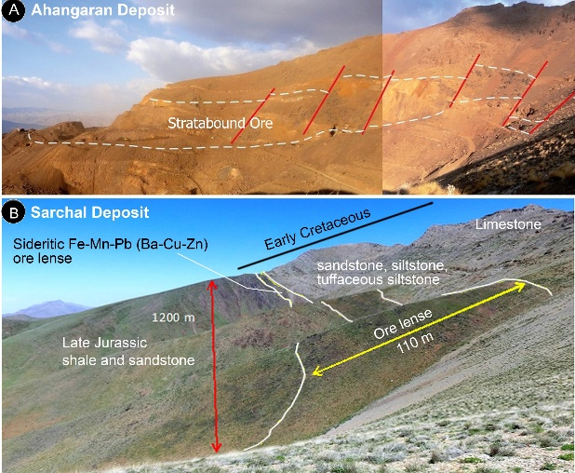
Irish-type Zn-Pb deposits around the world - 2023
The Malayer-Esfahan Metallogenic Belt (MEMB)
Generalized schematic columnar section of the Early Cretaceous sequence of the MEMB and western CIGS gradual zone, with the main ore-bearing strata (modified after Momenzadeh (1976) and Rajabi et al. (2012a; 2019a)).
8
Notes:
In this metallogenic belt, ore deposits are restricted to five main stratigraphic positions:
At the bottom, Late Jurassic shales and siltstones host shale-hosted zinc-lead deposits,
the second horizon, at the base of the Cretaceous sequence, hosts Irish-type Zn-Pb deposits, such as Irankuh. This horizon also hosts sideritic deposits.
Third, The Klsd horizon includes intense silicified and dolomitic limestone, and hosts some Irish-type Zn-Pb deposits (like Robat, Lakan, Emarat) and some sideritic deposits (such as Shamsabad, Saki and Ghezeldar).
Fourth, the Ks horizon hosts deposits such as the Anjireh-Tiran deposits.
Also, the stratabound Ravanj deposit is the only known mineralization in the Kl unit.

Slide 9
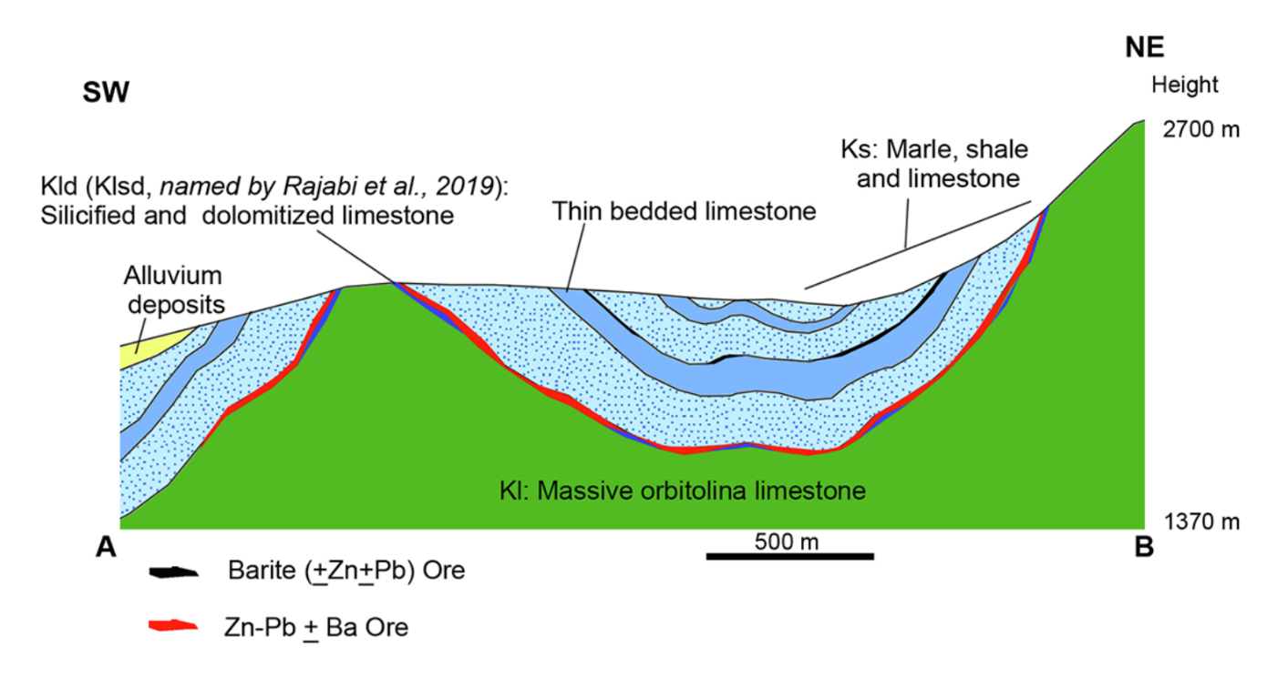
Irish-type Zn-Pb deposits around the world - 2023
The Irish-type Zn-Pb (±Ag±Ba) deposits in the MEMB
A, B) Sheet-like stratabound Zn-Pb (±Ba) mineralization in the silicified and dolomitized limestone (Klsd), best developed concordantly under the marls of the Ks unit, Robat deposit.
Southwest-northeast cross-section of the Robat deposit (Niroomand et al., 2019).
9
Notes:
As you saw before, there are two major groups of Early Cretaceous ore deposits in the MEMB:
the first one is zinc-lead and barite deposits, including Irankuh, Robat, Eastern Haftsavaran, Emarat, Muchan, and Lakan, that are widespread through the belt.
Except for a few mineralizations, most ore deposits are unrelated to thrust faults.
These deposits are stratabound, and most of them occur concordantly at the contact between the massive limestone and the upper shale and marl units, which show tabular shapes.
The major hydrothermal alteration are dolomitization and silicification.
The sulphide orebodies comprise sphalerite and galena with minor chalcopyrite, pyrite and tetrahedrite.
Ore sulphides represent complex textures including replacement, colloform, banded replacement, brecciated and minor laminated and framboidal pyrites.
Barite is an important gangue mineral, replaced by coarse-grained galena and sphalerite and some of the barite ores are economic.

Slide 10
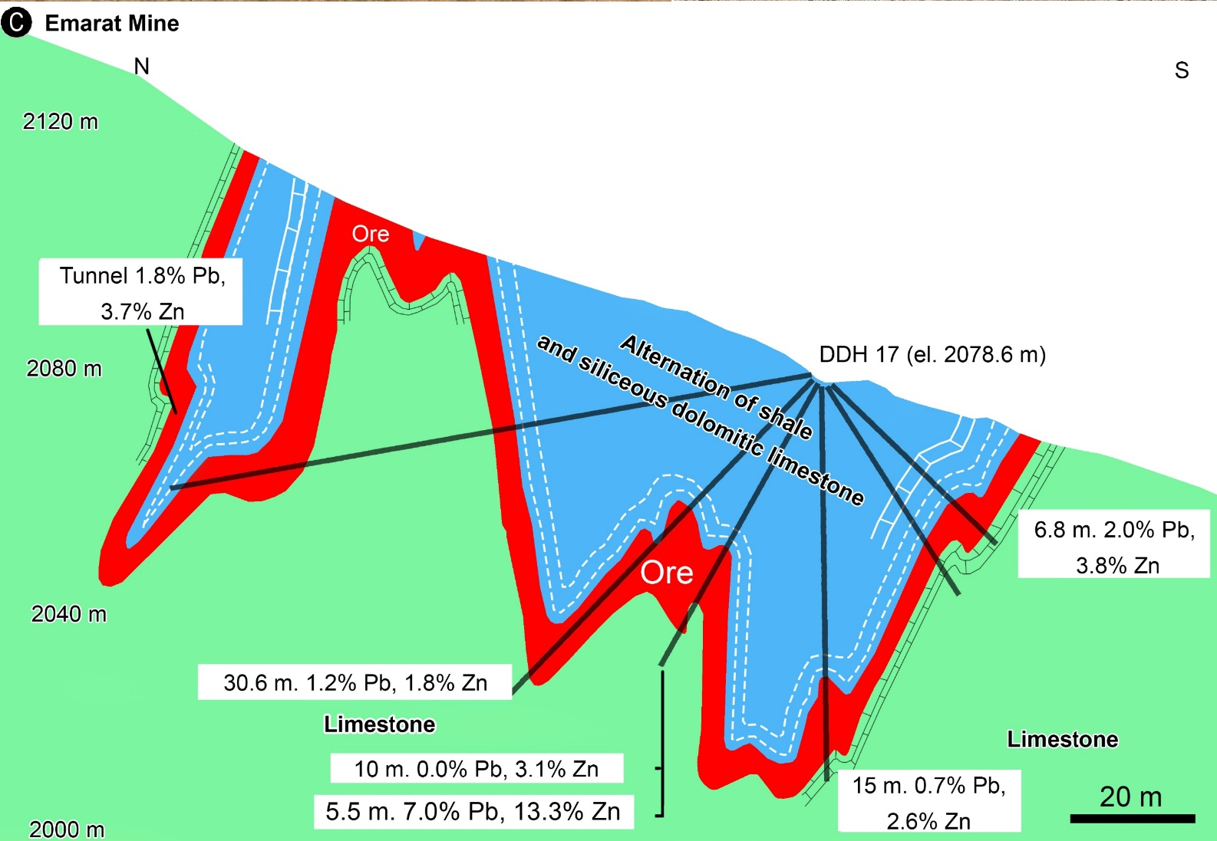
Irish-type Zn-Pb deposits around the world - 2023
The Irish-type Zn-Pb (±Ag±Ba) deposits in the MEMB
Geological cross-section no. 1000/1 from the Emarat deposit shows the orebody’s small-scale folding and its tabular shape (modified after Ehya et al., 2010).
10
Notes:
If we have a look at the Emarat orebody, we see the tabular shape and folding of the orebody in the KLSD unit, at the contact between the carbonates and upper shales. These ores are concordant with the host layers and show the same folding systems.
This indicates that orebodies formed before the compression and are not related to the thrust fault systems.

Slide 11
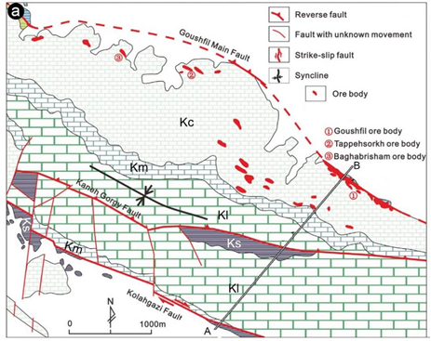
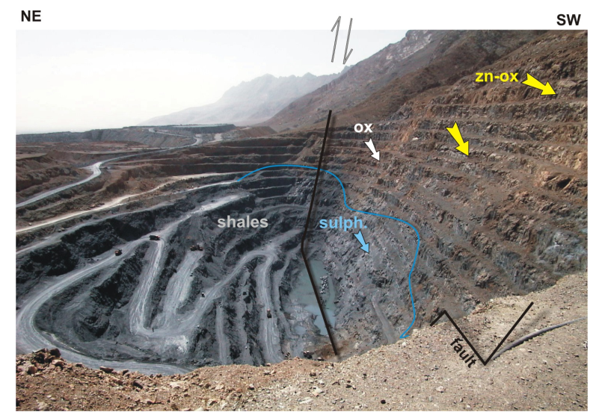
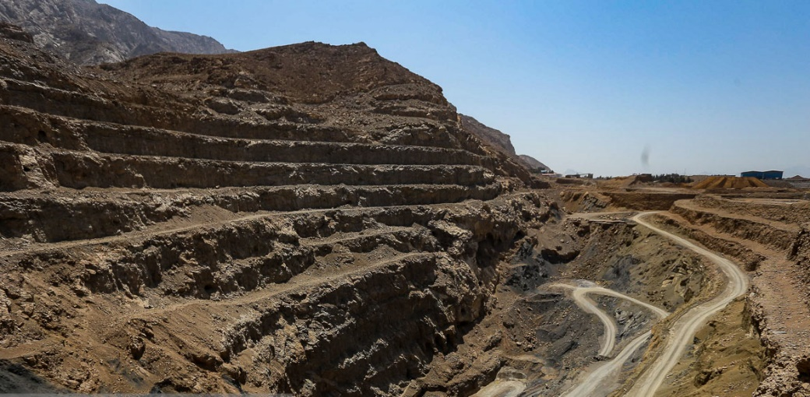
Irish-type Zn-Pb deposits around the world - 2023
The Irish-type Zn-Pb (±Ag±Ba) deposits in the MEMB
Irankuh Mining District
Goushfil Mine
Limestone
Jurassic shales
Kolahdarvazeh Mine
Limestone
Irankuh: 20 Mt @ 2.5% Pb and 11.0% Zn, remnant ore (primary total ore > 50 Mt).
11
Notes:
Irankuh is the famous mining district in this metallogenic belt and includes about 20 ore deposits.
On the left, you see the Gushfil and Kolahdarvazeh mines in this district. On the right, you see the geological map of the Irankuh district and zinc and lead mineralization near the Goushfil thrust fault and also here in carbonates and siltstones.

Slide 12
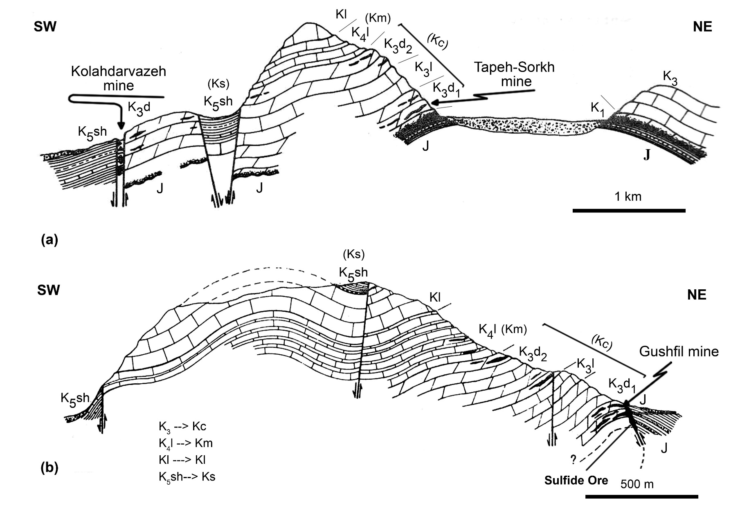
Irish-type Zn-Pb deposits around the world - 2023
The Irish-type Zn-Pb (±Ag±Ba) deposits in the MEMB
Jurassic shales
Limestone
Limestone
12
Notes:
As you see in these cross-sections of the Irankuh mining district, mineralizations occur in several horizons. Because in the Goushfil mine, the high-grade ore is located near the thrust fault, some authors consider it as an MVT mineralization.
Here is the Goushfil mine. The ore occurs in the lower part of the Early Cretaceous rocks and near a thrust fault.
and the Tape Sorkh mine formed far from the thrust fault and is hosted in black limy siltstone and dolomitic limestone.

Slide 13
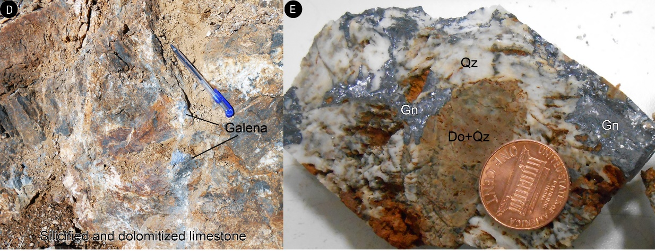
Irish-type Zn-Pb deposits around the world - 2023
The Irish-type Zn-Pb (±Ag±Ba) deposits in the MEMB
Jurassic shales
Limestone
A, B, and C) Hand specimen samples of coarse-grained sulphide mineralization in the Irankuh mining district..
photographs of the coarse-grained galena mineralization in the brecciated and silicified limestone, Robat deposit
13
Notes:
Here you can see the replacement ore texture of sulphides with dolomitization in Irankuh limestones and siltstones.
And coarse-grained galena in brecciated and silicified limestone of the Robat deposit. These features are similar to what we see in MVT deposits.
Barite also is an important gangue mineral, replaced by coarse-grained galena and sphalerite.

Slide 14
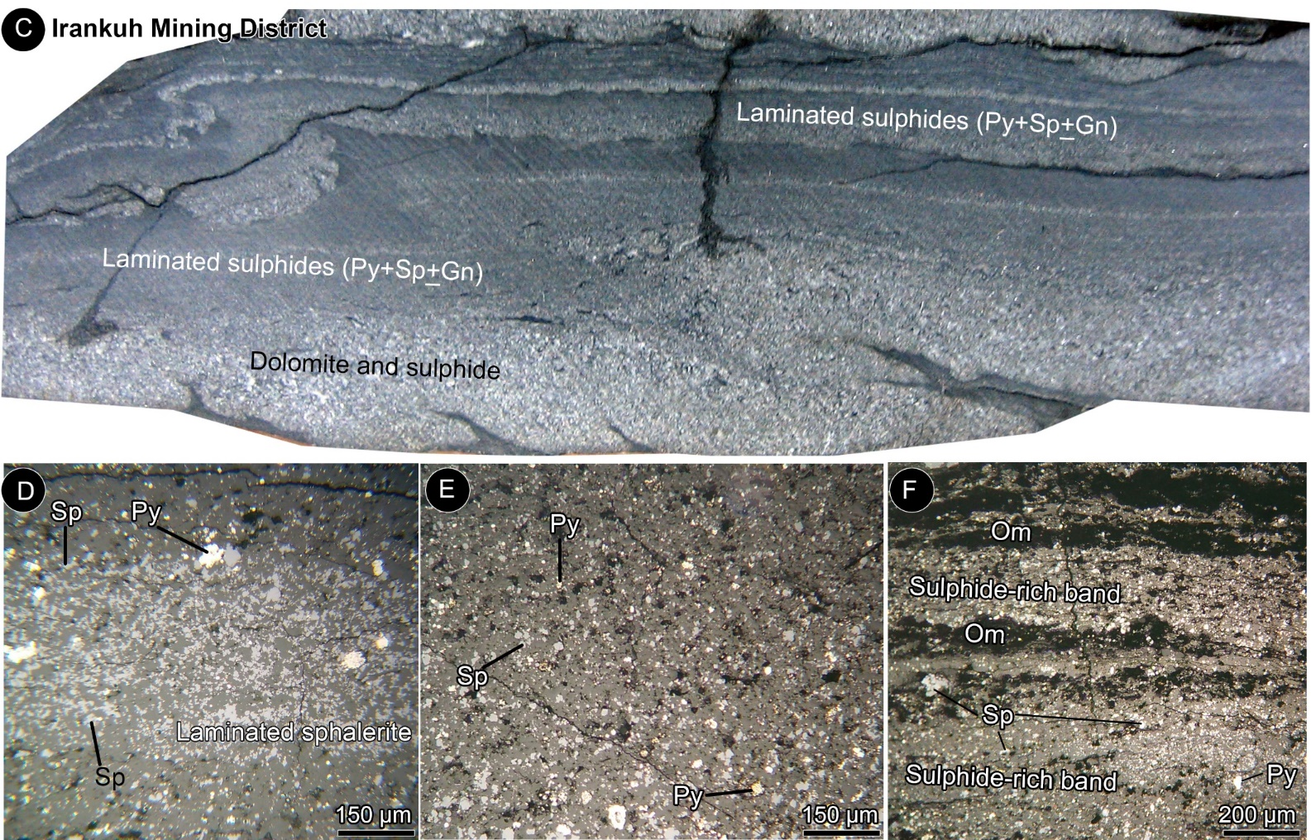
Irish-type Zn-Pb deposits around the world - 2023
The Irish-type Zn-Pb (±Ag±Ba) deposits in the MEMB
A) Folded laminated sulphides, Tiran mining district. B) Laminated barite, pyrite, galena, and sphalerite (Py + Gn + Sph) in organic matter-bearing limestone, Ravanj deposit. C) Laminated framboidal pyrite, fine-grained sphalerite, galena (light grey), and algal-laminated dolomite (dark grey). Folded dolomitic ore-bearing layers show typical convolute bedding texture
14
Notes:
But in addition to replacement and brecciated textures, there are also volumetrically minor, early fine-grained sulphides with disseminated and laminated textures, which in most deposits are associated with large amounts of framboidal pyrites.
At the top, laminated sulphides in silty dolomite show diagenetic convolute bedding in Irankuh.
At the bottom, you can see photographs of fine-grained laminated and disseminated sulphides in sulphide-rich bands, hosted in silty limestone of the Irankuh mining district.

Slide 15
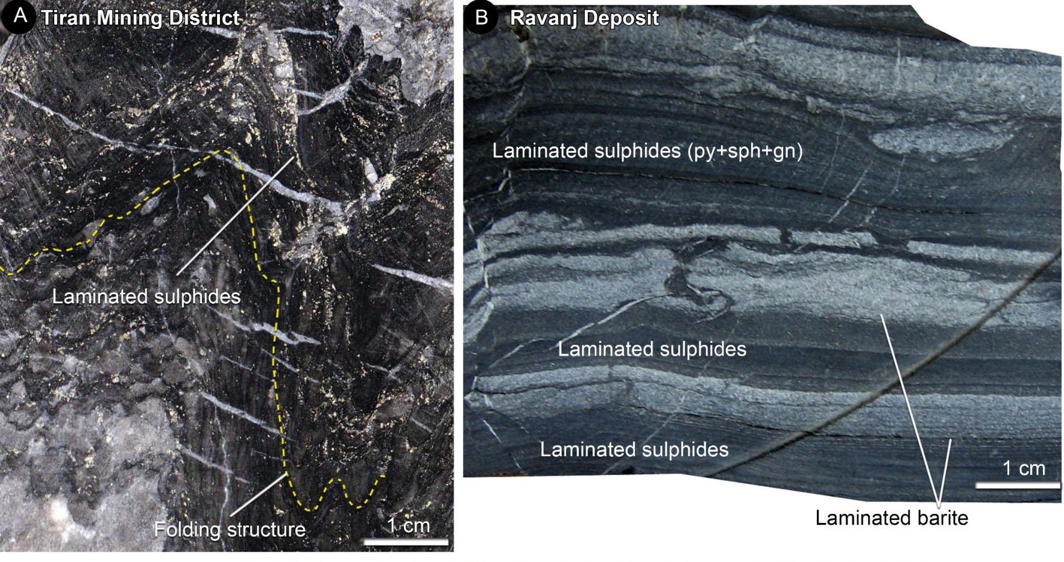
Irish-type Zn-Pb deposits around the world - 2023
The Irish-type Zn-Pb (±Ag±Ba) deposits in the MEMB
A) Folded laminated sulphides, Tiran mining district. B) Laminated barite, pyrite, galena, and sphalerite (Py + Gn + Sph) in organic matter-bearing limestone, Ravanj deposit.
15
Notes:
This slide represents similar folded laminated sulphides of the Tiran (on the left) and laminated fine-grained barite and sulphides Ravanj deposit (on the right).

Slide 16
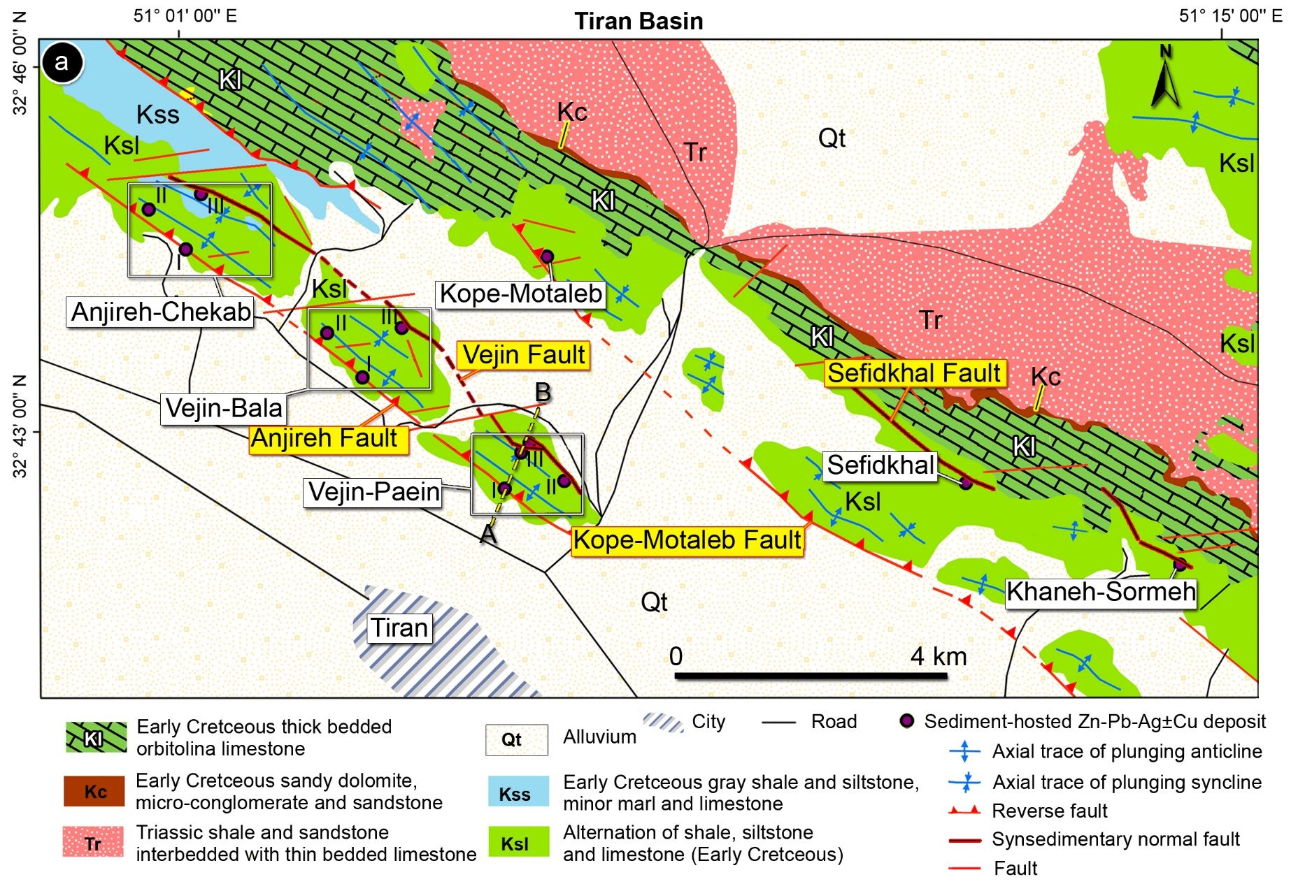
Irish-type Zn-Pb deposits around the world - 2023
The Irish-type Zn-Pb (±Ag±Ba) deposits in the MEMB
Tiran Mining District
16
Notes:
In the Tiran mining district, there are several active mines.
As you see in this map, some deposits are located adjacent to a northwest-southeast thrust fault.
But others occur far from the thrust faults and are related to some faults with normal movement.
Let's have a look at this cross-section.

Slide 17
Irish-type Zn-Pb deposits around the world - 2023
The Irish-type Zn-Pb (±Ag±Ba) deposits in the MEMB
Hand specimen photographs of debris flows occur interfingered with mineralized host rocks, Tiran mining district.
17
Notes:
Detailed tectonic studies show that the formation of these deposits is related to syn-sedimentary normal faults. But some of them were subsequently reactivated as reverse faults after the Late Cretaceous tectonic events. Here you see some samples of sedimentary breccias, and debris flows from the Vejin-Paein deposit.
Also, there are some igneous components near these faults.

Slide 18
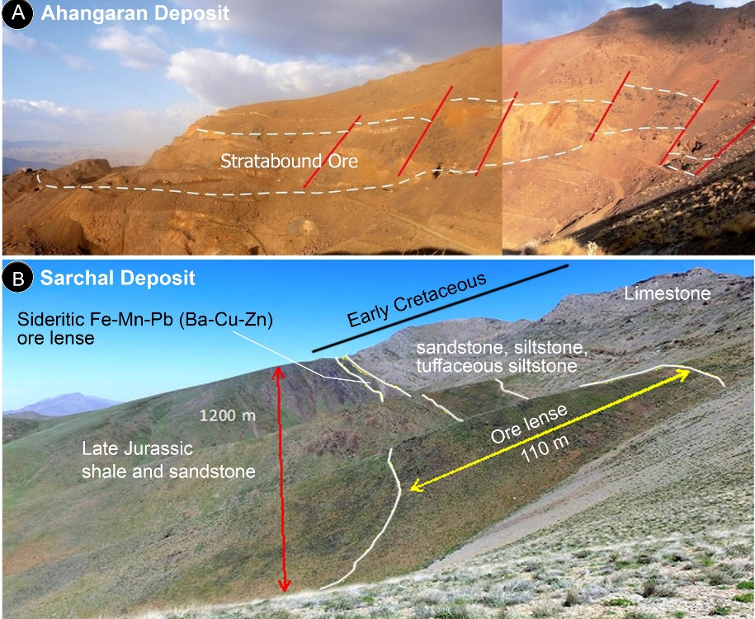
Irish-type Zn-Pb deposits around the world - 2023
The Sideritic Irish-type Fe-Mn-Pb-Zn (±Ag±Ba±Cu) deposits
Ahangaran, Shamsabad, Sarchal, Ghezeldar, and Saki deposits
18
Notes:
The northwestern part of the MEMB hosts several unusual base metal deposits, characterized by large iron ore along with copper, lead, zinc, and barite mineralizations. The five major deposits of this group include Ahangaran, Shamsabad, Sarchal, Ghezeldar, and Saki deposits. These ore deposits are hosted in Early Cretaceous sandstone, tuffaceous siltstone, dolomitized and silicified limestone and sandstone, and are associated with minor volcanic rocks.
On the right, you can see the stratabound ore lenses of the Ahangaran and Sarchal.

Slide 19
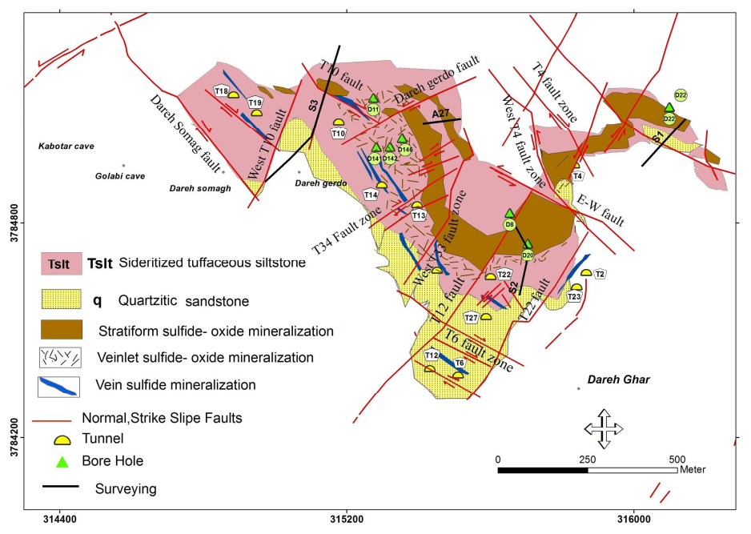
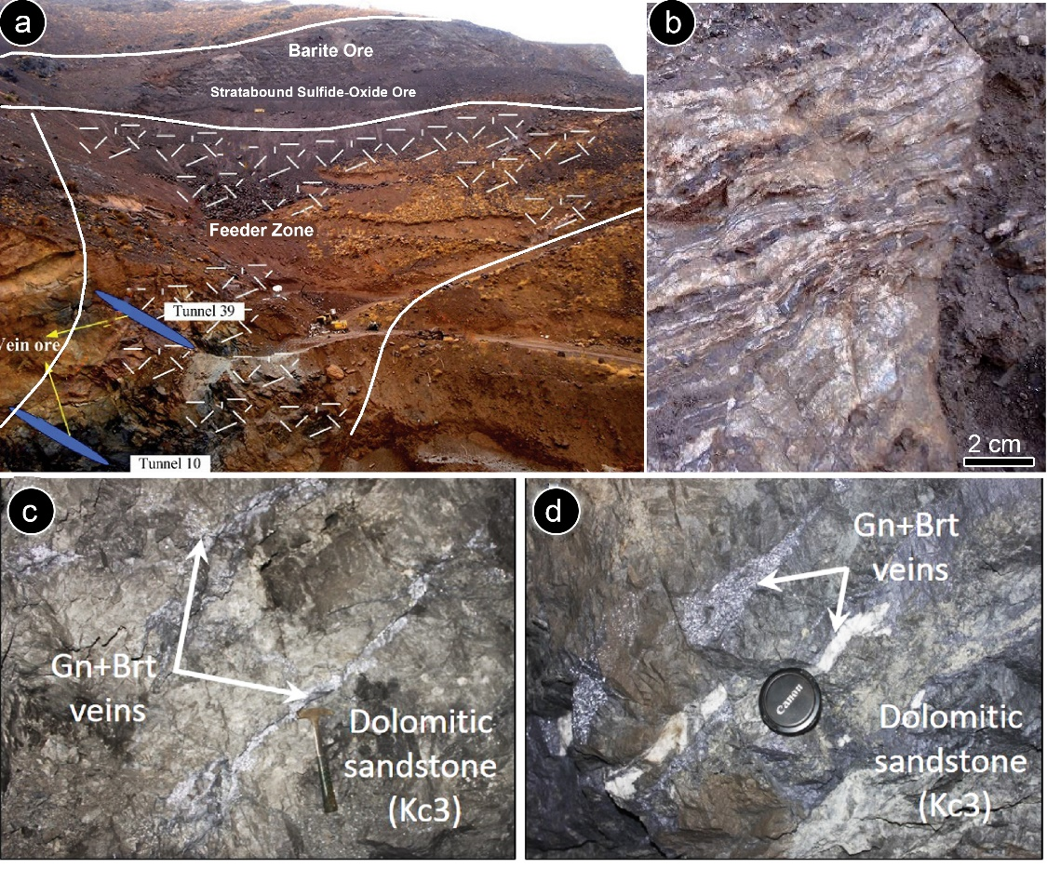
Irish-type Zn-Pb deposits around the world - 2023
The Sideritic Irish-type Fe-Mn-Pb-Zn (±Ag±Ba±Cu) deposits
Stratabound sulphide-oxide ore
Geological map of the Ahangaran deposit and the location of the main ore-bearing rocks and tunnels (Akbari et al., 2020)
Ahangaran: 40 Mt Fe ore, 6 Mt sulphide ore at 6% Pb and 0.5% Zn, 200 gr/t Ag, Cu?
19
Notes:
On the left, you see the geological map of the Ahangaran deposit.
On this map, we have Early cretaceous sandstone and tuffaceous siltstone with minor limestone and dolomite. The stratabound sulphide-oxide ore, and ore veins under the orebodies.
As you see, the orebodies are surrounded by sideritic rocks and minor ankerite.
On the right, you can see outcrops of the Ahangaran mineralization, the ore lens at the top, the feeder zone under the stratabound ore lens, barite ore with zebra texture, and sulfide and barite veins under the orebodies.
Fe-bearing carbonates (siderite and ankerite) are the most important hydrothermal minerals that are associated with barite, chalcopyrite, pyrite, galena, and pyrolusite.

Slide 20
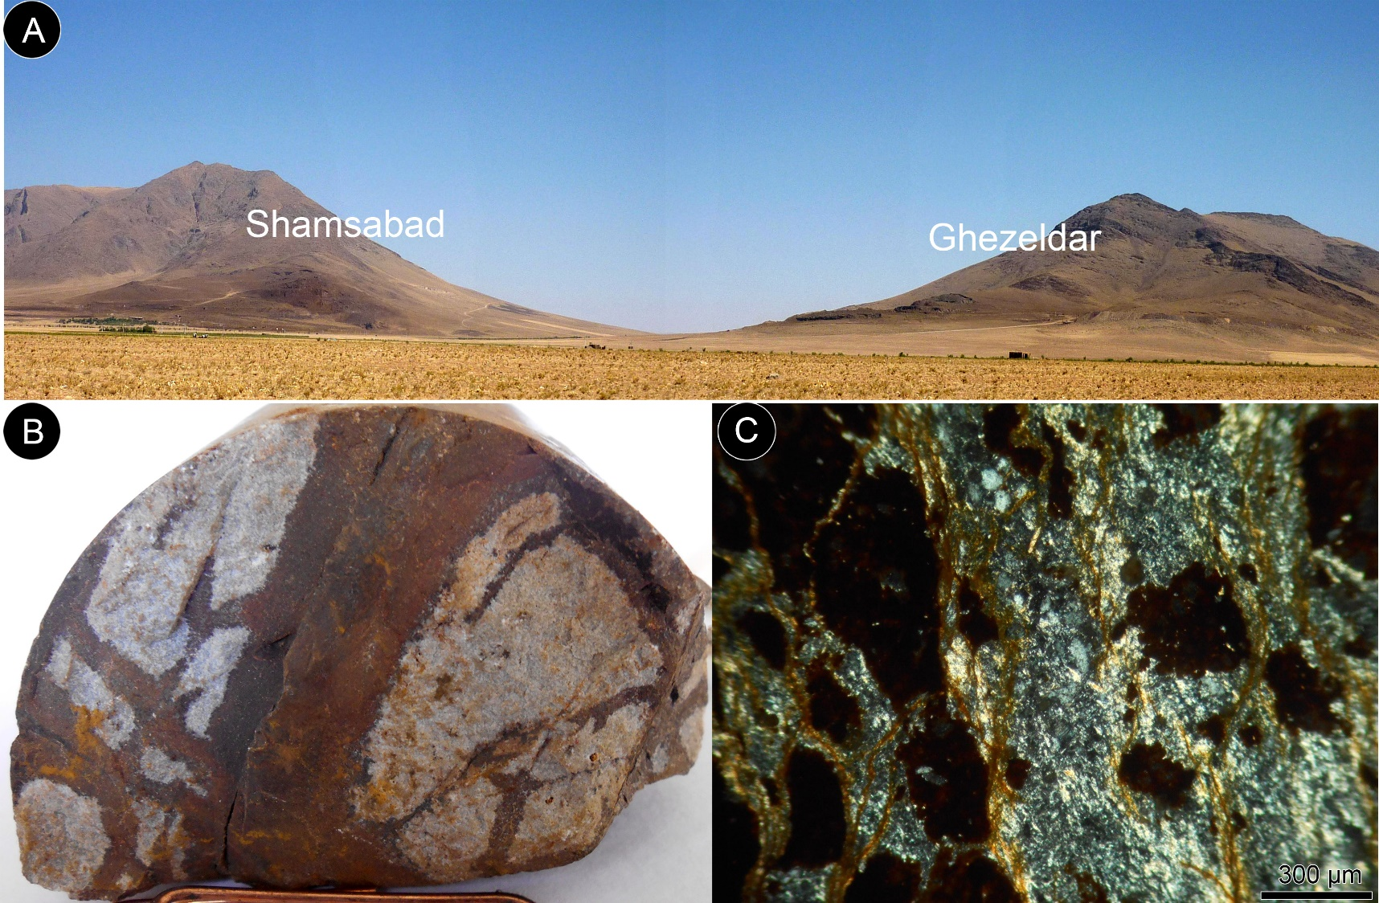
Irish-type Zn-Pb deposits around the world - 2023
The Sideritic Irish-type Fe-Mn-Pb-Zn (±Ag±Ba±Cu) deposits
Outcrop views from Shamsabad and Ghezeldar sideritic Fe-Mn-Pb-Zn (±Ag±Ba±Cu) deposits in silicified and dolomitized limestone (Klsd unit). B, C) Hand specimen (B) and microscopic (C) photographs of rhyolite with Fe-oxide/hydroxide venis, Shamsabad deposit.
20
Notes:
Here you see the outcrop view of the Shamsabad, Saki and Ghezeldar sideritic deposits in the silicified and dolomitized limestone of the Klsd unit.
Except for the sedimentary rocks, the host sequence includes pyroclastic and sometimes volcanic compounds.
Here you see a hand specimen and microscopic photographs of rhyolite in the Shamsabad deposit.
In the Shamsabad deposit, the dolomitic limestone host rocks were replaced by the siderite-ankerite mineralization.
Perhaps we can say that they have a transitional state with VMS deposits.

Slide 21
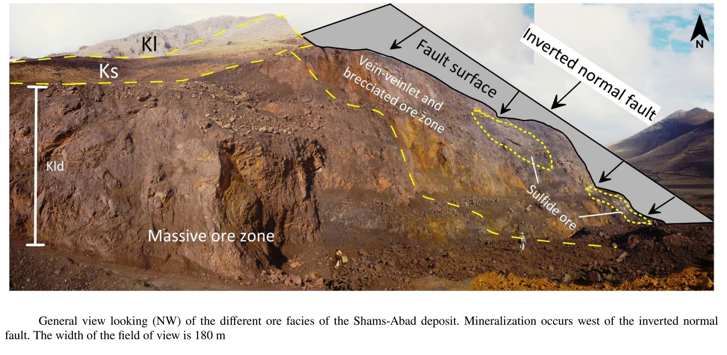
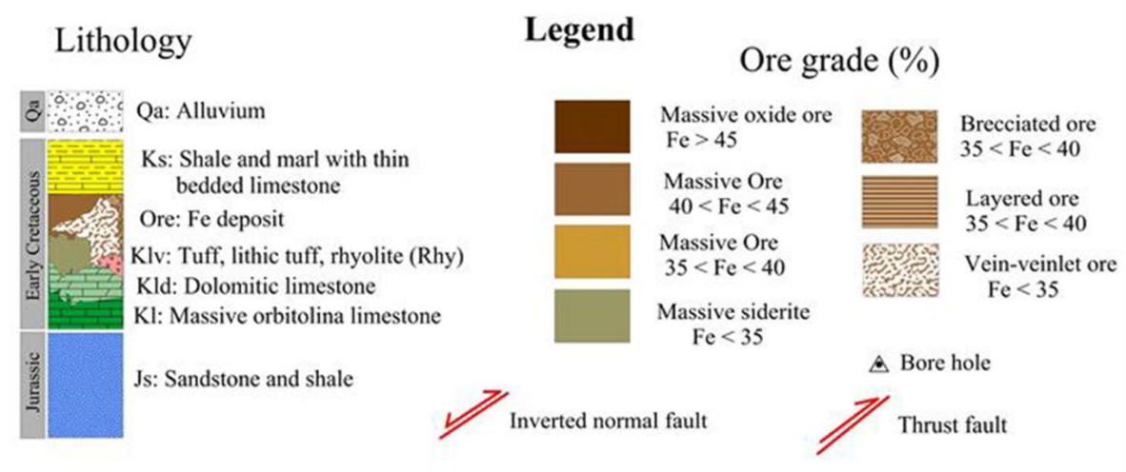
Irish-type Zn-Pb deposits around the world - 2023
The Sideritic Irish-type Fe-Mn-Pb-Zn (±Ag±Ba±Cu) deposits
Peernajmodin et al. (2023)
48.7 and 300 Mt, 40% Fe and 3% Mn; 1 Mt Pb+Zn
21
Notes:
Here is a general view from Shamsabad, showing the massive oxide ore, stringer brecciated zone and sulphide peaches.
The main ore body developed adjacent to an inverted normal fault.

Slide 22
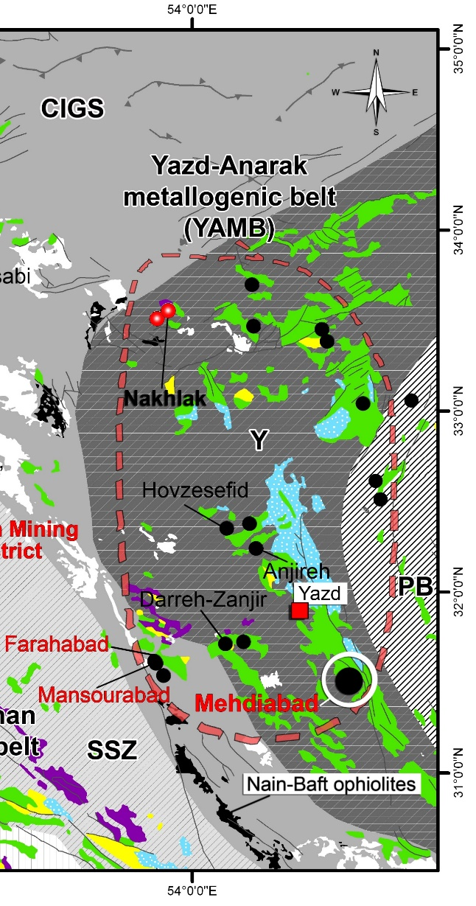
Irish-type Zn-Pb deposits around the world - 2023
The Yazd-Anarak metallogenic belt (YAMB)
22
Notes:
The second metallogenic belt of the early Cretaceous carbonate-hosted deposits of Iran is the Yazd-Anarak belt which hosts the Mehdiabad deposit, and some smaller ones, including Farahabad, and Mansourabad.
Let’s have a look at this metallogenic belt.

Slide 23
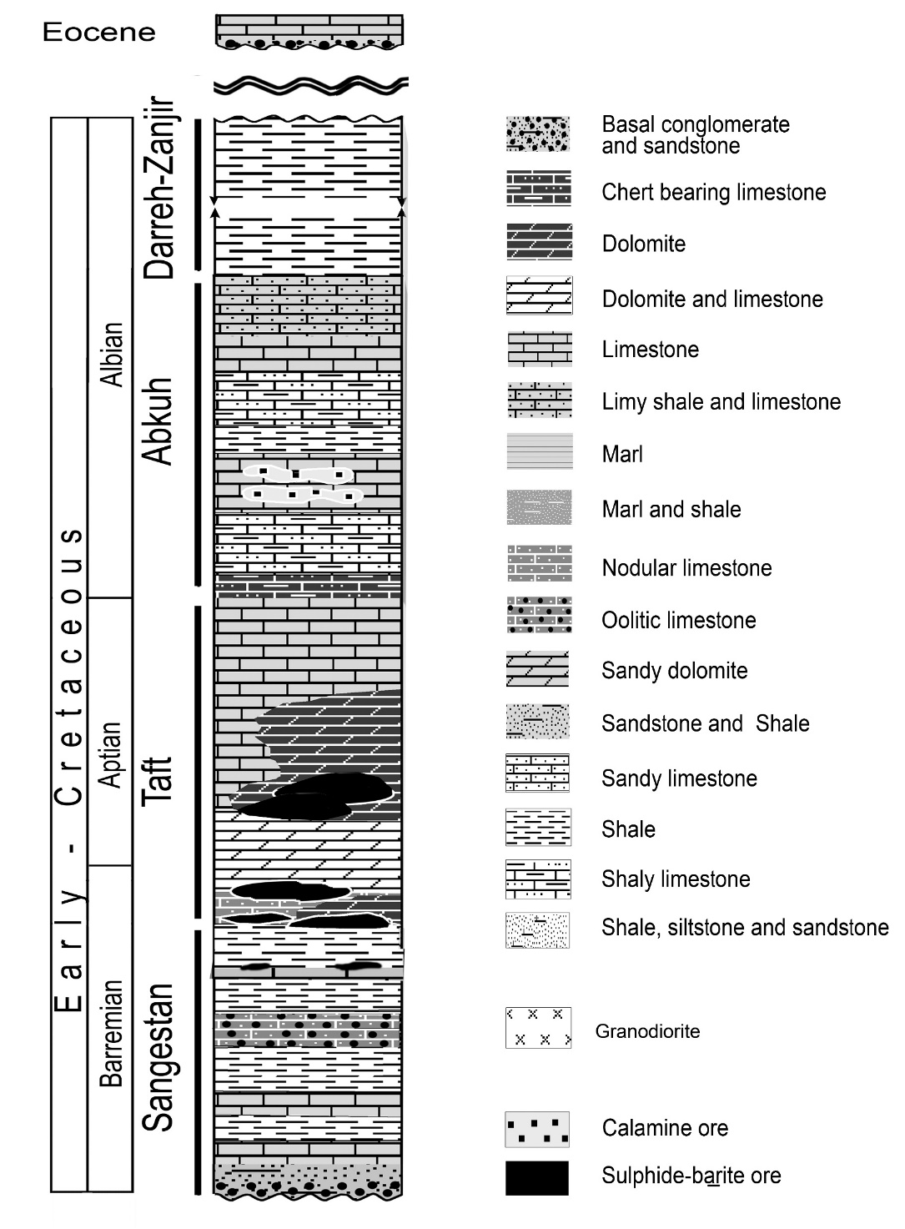
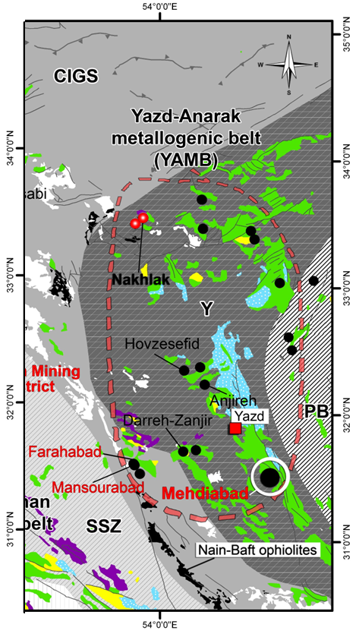
Irish-type Zn-Pb deposits around the world - 2023
Mehdiabad Zn-Pb-Ba-Cu (+Fe+Mn) deposit
Generalized lithostratigraphic columnar sections of Mehdiabad deposit (Modified after Rajabi et al., 2012; Khanmohammadi et al., 2023).
23
Notes:
Most deposits are hosted in the Early Cretaceous Taft Formation,
In this lithostratigraphic columnar, you see the major orebody of the Mehdiabab deposit at the lower part of the Taft formation.
The second ore horizon is only observed at the Calamine Mine, in the Abkuh Formation.

Slide 24
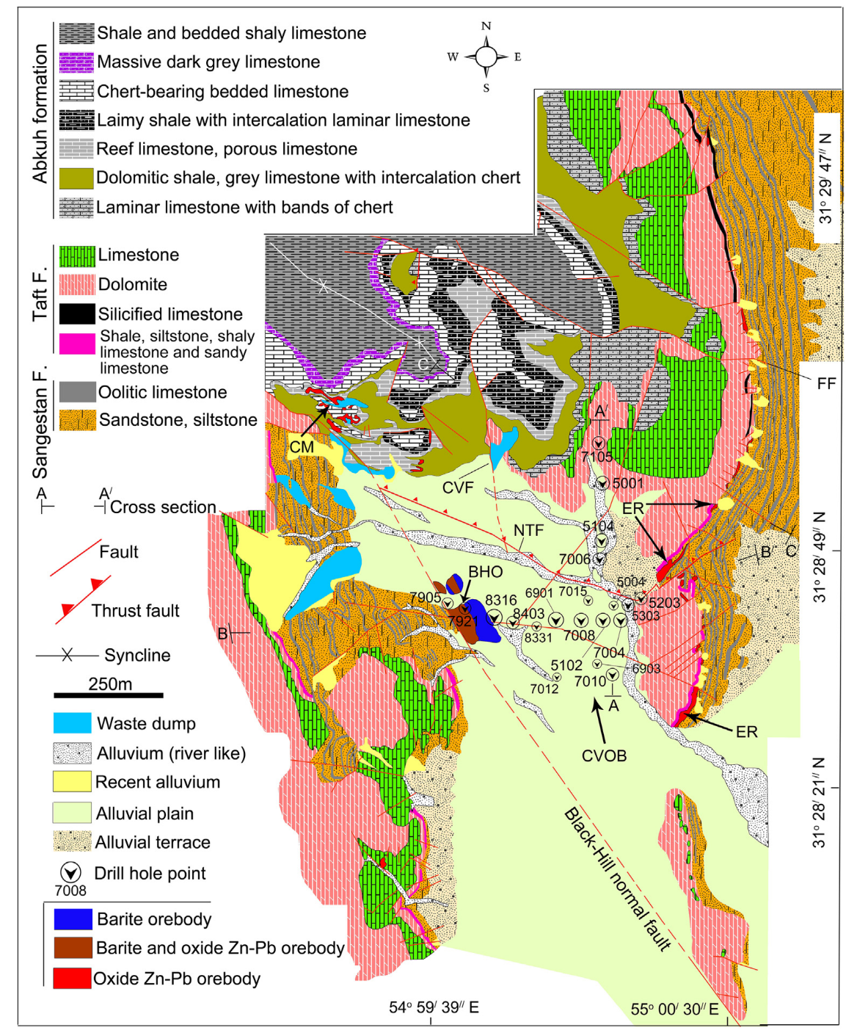
Irish-type Zn-Pb deposits around the world - 2023
The Yazd-Anarak metallogenic belt (YAMB)
Mehdiabad Zn-Pb-Ba-Cu (+Fe+Mn) deposit
Mehdiabad deposit:
Recent exploration revealed the total geological resource of this deposit of about 630 Mt at 4.2% Zn, 1.2% Pb, 5% Cu and 51 g/t Ag, along with tens of Mt of barite.
Geological map of the Mehdiabad deposit showing the location of the barite deposit in the east of the Black-Hill Fault and of the oxide Zn-Pb orebody in the northeast of the map. CVF: Central Valley fault; NTF: North Thrust fault; FF: Fourozandeh fault; BHO: Black-Hill ore; CVOB: Central Valley orebody; ER: East Ridge; CM: Calamine Mine (Maghfouri et al., 2019).
24
Notes:
Please look at the geological map of the Mehdiabad deposit. Here is the Sangestan formation, on the right and the Taft formation, on the top. Here is the Black-hill fault. The mineralization occurs on the right-hand hanging wall of this fault. You see a small outcrop of mineralization here.
Here in the northwest, you see the Abkuh calamine ore.

Slide 25
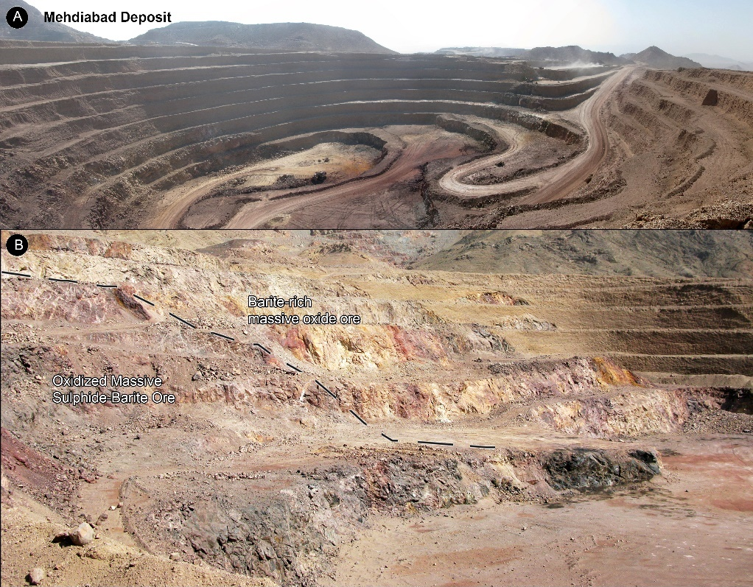
Irish-type Zn-Pb deposits around the world - 2023
The Yazd-Anarak metallogenic belt (YAMB)
A and B) Outcrop views from Mehdiabad deposit
25
Notes:
Here you see the main open pit of the Mehdiabad deposit, and the outcrop of the massive barite ore and the oxidized sulphide-barite ore at the bottom.

Slide 26
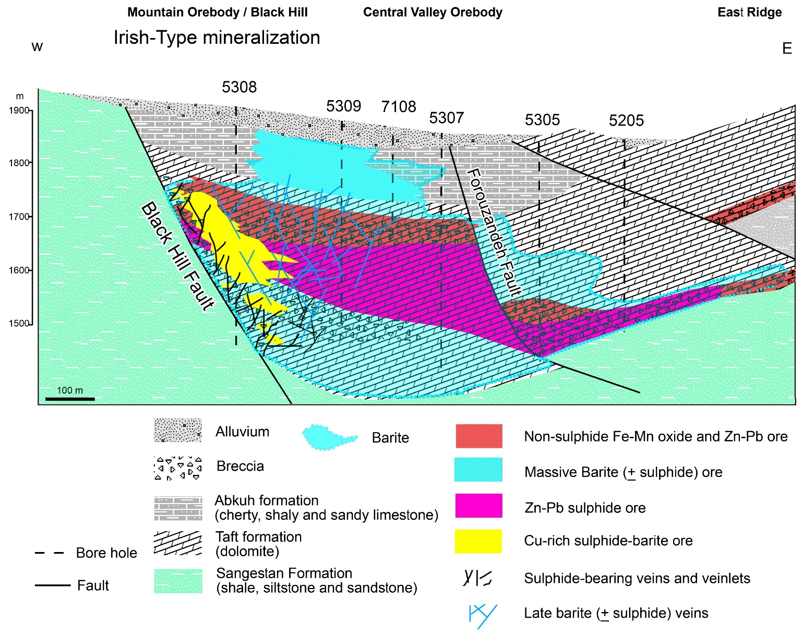
Irish-type Zn-Pb deposits around the world - 2023
The Yazd-Anarak metallogenic belt (YAMB)
Schematic cross-section of the Mehdiabad deposit (Khanmohammadi et al., 2023; modified after Reichert, 2007; Rajabi et al., 2012; Lui et al., 2023).
26
Notes:
Let’s have a look at a cross-section of the Mehdiabad deposit. Here is the Sangstan formation including shales, sandstones and siltstone, and the host dolomites in the Taft formation.
The main orebody of Mehdiabad occurs within a half-graben structure. The Black Hill is a syn-sedimentary fault, according to the occurrence of sedimentary breccias on the west side of the deposit.
The main mineralization is composed of three parts: the Mountain/Black Hill orebody, the Central Valley orebody, and the East Ridge.
Black Hill orebody consists of a feeder zone, copper-rich sulphide-barite ore, zinc-lead sulfide ore, non-sulphide orebody, and massive barite at the top.
The oxidized ore consists of smithsonite, cerussite, hydrozincite, and hemimorphite, along with hematite and goethite, but the sulphide mineralization includes sphalerite, galena, pyrite, chalcopyrite, covellite, and chalcocite.
Massive barite in the upper part of the deposit is economic.
The Mountain orebody is limited to the west by the Black Hill Fault and to the east by the Forouzandeh Fault.

Slide 27
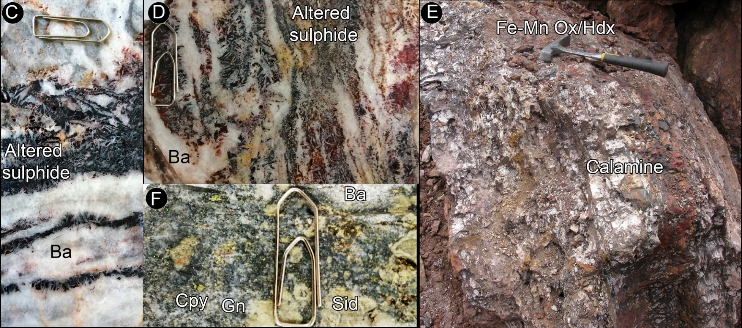
Irish-type Zn-Pb deposits around the world - 2023
The Yazd-Anarak metallogenic belt (YAMB)
C and D) Zebra texture from the Mehdiabad deposit consisting of interlayered barite and altered sulphides. E) Replacement of sideritic limestone (sid) and barite (Ba) with chalcopyrite (Cpy), and galena (Gn). F) Calamine ore and Fe-Mn oxides/hydroxides, East Ridge orebody, Mehdiabad.
27
Notes:
Massive replacement and zebra textures of barite and sulphide form the main face of the Mehdiabad deposit.
In this slide you can see the Zebra texture of layered barite and altered sulphides in C and D. ) Replacement of sideritic limestone and barite with chalcopyrite, and galena in F. And calamine ore and Fe-Mn oxides in the East Ridge orebody.
The important point in this deposit is the development of sulphide mineralization as a replacement in the host carbonate rock, barite, and previous sulphides.

Slide 28
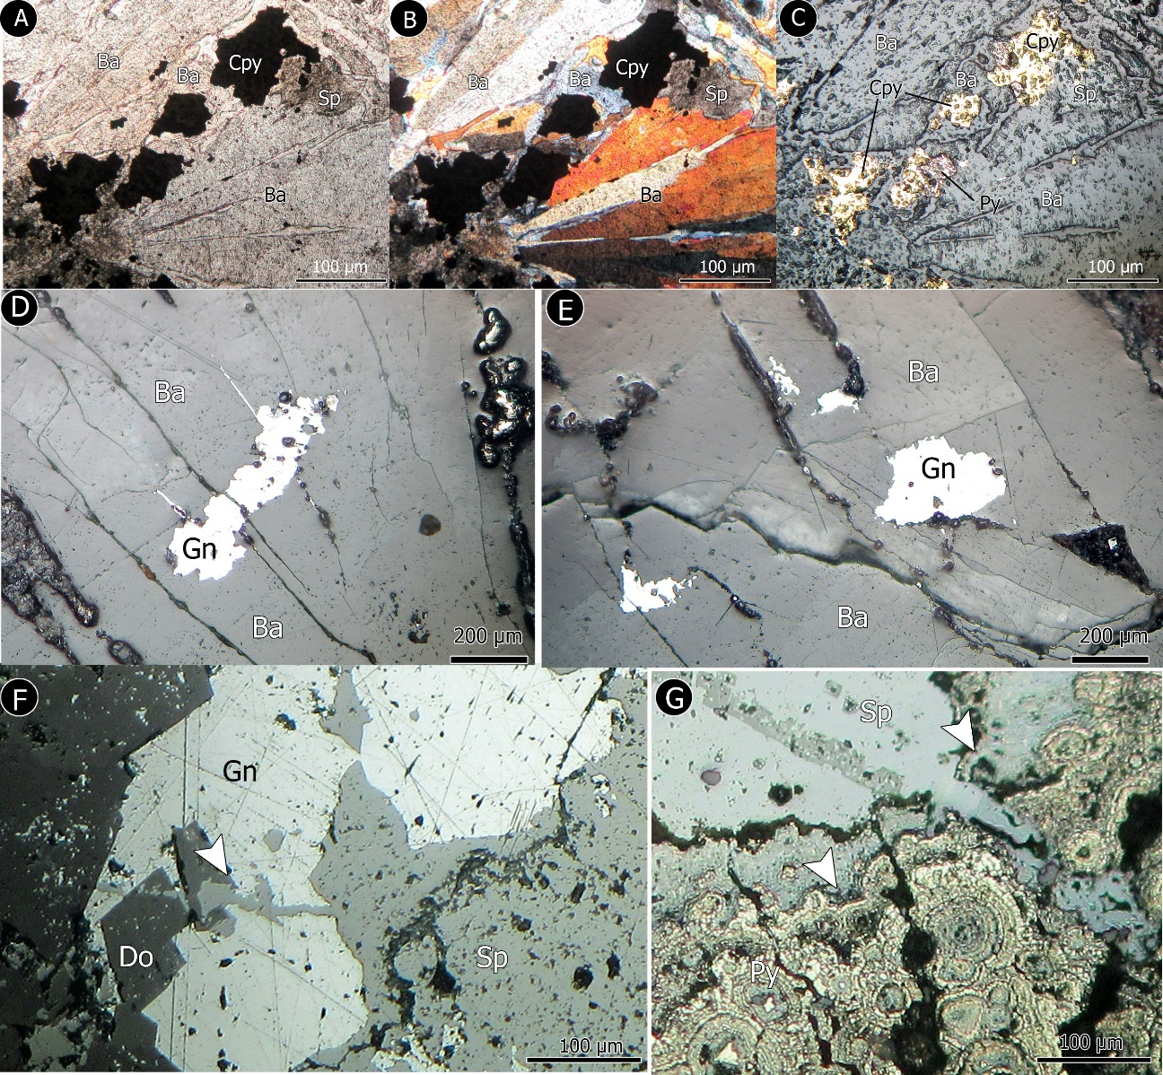
Irish-type Zn-Pb deposits around the world - 2023
The Yazd-Anarak metallogenic belt (YAMB)
Photomicrographs of replacement textures of sulphides and barite in the Mehdiabad deposit. A-C) Replacement of barite with pyrite (Py), chalcopyrite (Cpy) and sphalerite (Sp). D, E) Replacement of barite with galena (Gn). F, G) Replacement of dolomite (Do), galena and pyrite with sphalerite.
28
Notes:
Replacement is the main texture for sulfide mineralization in Mehdiabad. As you see, Sulphides replace primary barite almost in all ore zones. galena replaces carbonates and pyrite, Also sphalerite replaces previous galena and pyrite.
Similar to the Reddog deposit, in Mehdiabad, barite provided a host and a sulfur source for the later Zn-Pb mineralization.

Slide 29
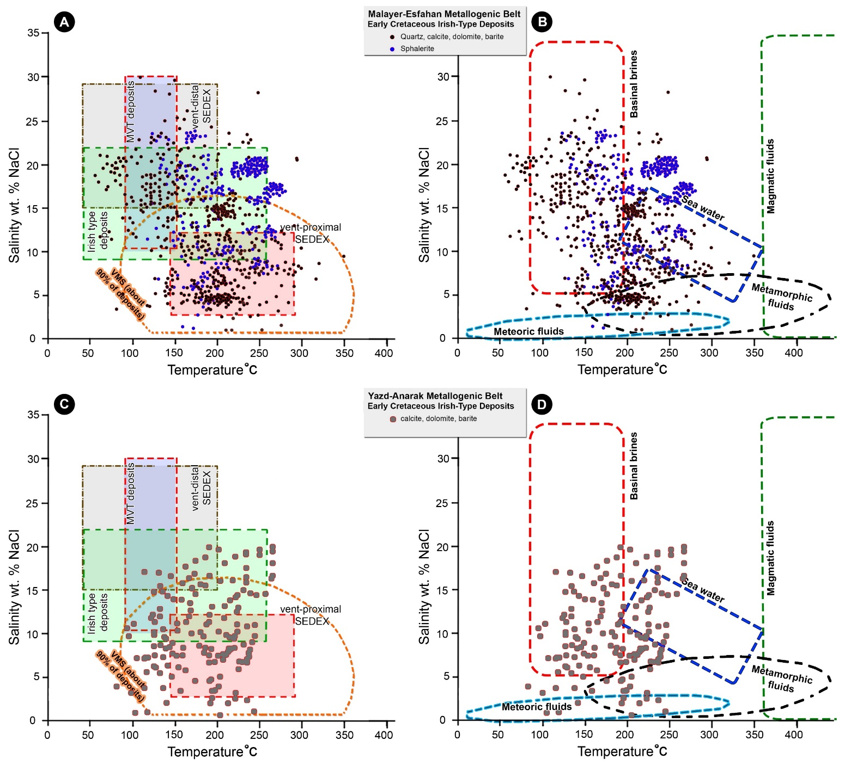
Irish-type Zn-Pb deposits around the world - 2023
Fluid inclusion studies
Summary of published fluid inclusion homogenization temperature–salinity pairs from Irish-type ore deposits of Iran (modified after Rajabi et al., 2019)
29
Notes:
let’s have a look at fluid inclusion studies in the Malayer-Esfahan and Yazd-Anarak metallogenic belts.
In the Malayer-Esfahan metallogenic belt, sphalerite shows higher homogenization temperature than hydrothermal gangue minerals, and these data are more compatible with Irish-type deposits. On the right, these data represent basinal brine and seawater sources for ore fluids.
In the Yazd-Anarak metallogenic belt, we see similar patterns to those we have in the Malayer-Esfahan belt.

Slide 30
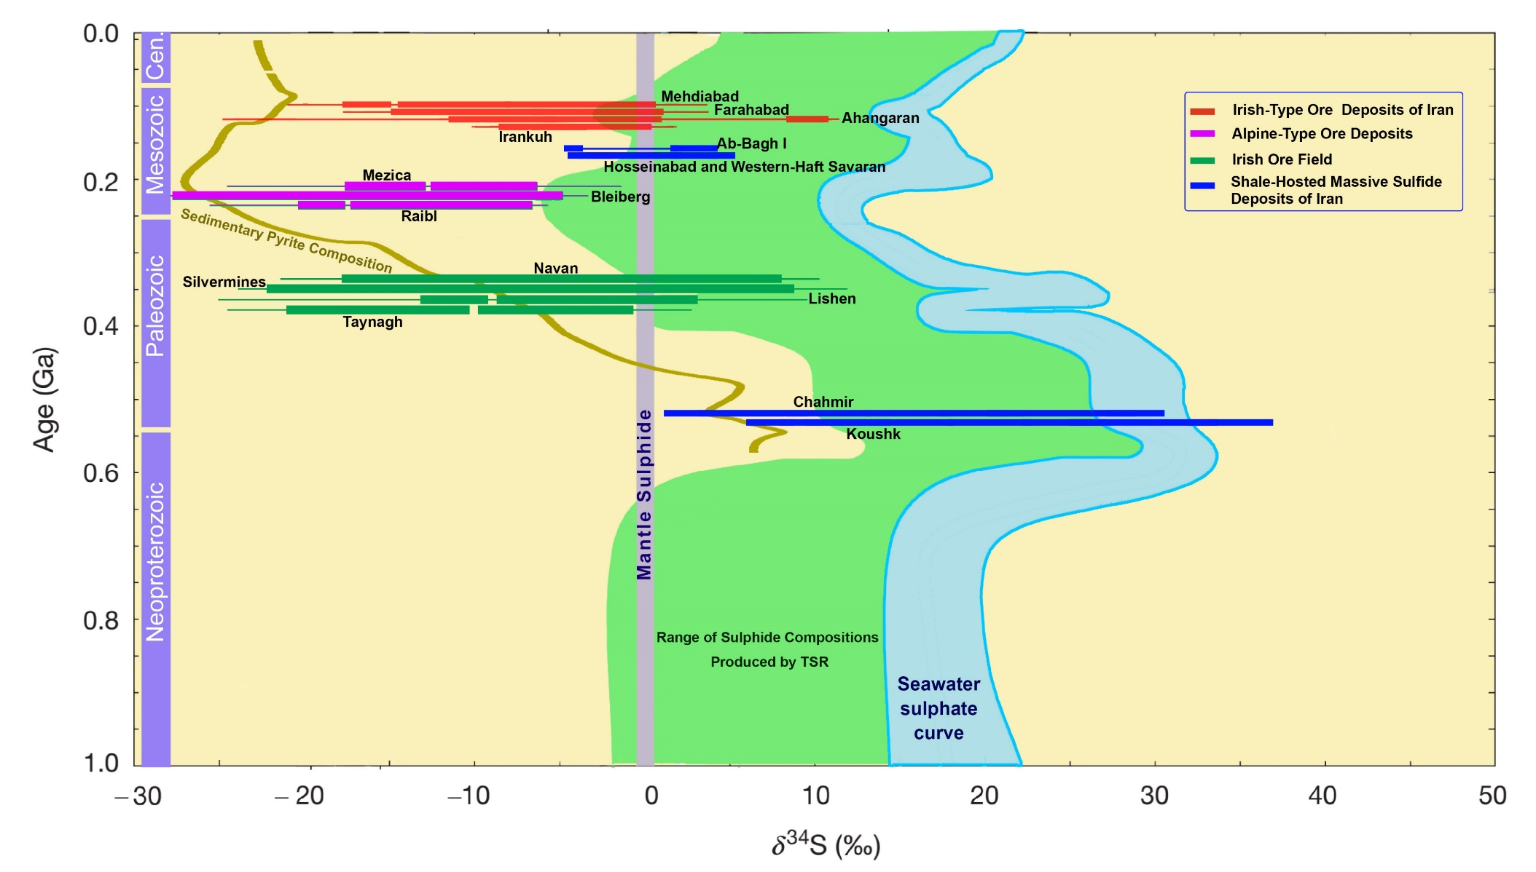
Irish-type Zn-Pb deposits around the world - 2023
Sulphur sources
Diagram illustrating the range of δ³⁴S values of sulphides in selected Early Cretaceous Irish-type and SHMS (SEDEX) deposits of Iran in comparison with the δ³⁴S values of sulphides in Irish ore field deposits, and Alpine-Type Zn-Pb ores (Leach et al., 2005; Farquhar et al., 2010; Wilkinson, 2014), seawater sulphate curve (Bottrell and Newton, 2006), mantle sulphide, and mean sedimentary pyrite composition (olive line) as produced by bacterial sulphate reduction (BSR; Wilkinson, 2014). The green‐shaded field indicates the likely range of sulphide compositions produced by thermochemical sulphate reduction (TSR) of seawater‐derived sulphate at 150 °C (Kiyosu and Krouse, 1990).
30
Notes:
This diagram represents the range of Sulphur isotope values of sulphide minerals in selected Early Cretaceous Irish-type and SHMS deposits of Iran in comparison with those in Irish ore field deposits, and Alpine-Type Zn-Pb ores.
The Early Cretaceous deposits in both metallogenic belts represent a light negative isotope.
This isotopic composition is similar to the Irish ore field and Alpine-type ore deposits.
Wilkinson suggested that the light isotopic composition in Irish deposits shows the development of early seawater convection models for mineralization.
However, the fluid inclusion studies show high temperatures for ore fluids that are not consistent with BSR.
It can be explained by the mobilization of older, Jurassic brines that generated or passed from Jurassic coal-bearing shales and sandstones. Another possible mechanism is the direct replacement of pyrite framboids by later sulphides.

Slide 31
Irish-type Zn-Pb deposits around the world - 2023
Type of mineralizations
Consideration of the geologic and geochemical characteristics operating in the discussed deposits leads to a recognition of the following features in these deposits:
They formed in extensional and passive margin environments that are related to the Nain-Baft back-arc basin
Most ore deposits represent an indirect temporal link with igneous rocks.
Formation of these deposits is controlled with syn-sedimentary, normal faults that may act as feeder zones and conduits for ore fluids and generated debris flow breccias.
These deposits are stratabound and comprise wedge-shaped to tabular sulphide-barite orebodies, and mineralizations occur in several different stratigraphic horizons/strata.
Replacement textures are common, and orebodies represent complex textures of sulphides and barite, such as brecciated, replacement, colloform, zebra, minor laminated, and banded replacement.
Barite is an important gangue mineral in the MEMB and YAMB deposits, partly replaced by coarse-grained galena and sphalerite
Sulfur isotope composition reveals light δ³⁴S values (with the majority falling between -25 to +5 per mil) with mostly BSR origin.
31
Notes:
We can summarize the main characteristics of ore deposits in both metallogenic belts as follows:
I avoid repeating the previous specifications here.
They formed in extensional and passive margin environments related to a back-arc basin
Most ore deposits represent an indirect temporal link with igneous rocks.
The formation of these deposits is controlled with syn-sedimentary normal faults that may act as feeder zones and conduits for ore fluids.
They are stratabound and comprise wedge-shaped to tabular sulphide-barite orebodies.
Replacement textures are common, and orebodies represent complex textures.
Barite is an important gangue mineral, partly replaced by coarse-grained sulphides.
Sulfur isotope composition reveals light values with mostly BSR origin.

Slide 32
Irish-type Zn-Pb deposits around the world - 2023
Type of mineralizations
Consideration of the geologic and geochemical characteristics operating in the discussed deposits leads to a recognition of the following features in these deposits:
Temperatures of ore deposition are typically 120 to about 280 °C (majority 150-270 °C), and salinities range from 2 to 18 wt% NaCl equiv., with the majority falling between 8 and 22 wt%.
Alteration consists mainly of dolomitization and silicification. Fe-dolomite, siderite and ankerite are common in some deposits.
The dominant minerals are sphalerite, galena, pyrite, and chalcopyrite. Barite is common in most deposits and is replaced with later sulphides.
Laminated sulphides are minor and there is no evidence (or it is so weak) of exhalation in the formation of orebodies.
Given these data and evidence, the Early Cretaceous Zn-Pb-Ba deposits of the Malayer-Esfahan and Yazd-Anarak metallogenic belts are more like to the Irish Midland ore deposits and show a significant difference from the orogenic MVT deposits.
32
Notes:
Temperatures and salinities are similar to Irish-type deposits.
Alteration consists mainly of dolomitization and silicification. Fe-dolomite, siderite and ankerite are common in some deposits.
The dominant minerals are sphalerite, galena, pyrite, and chalcopyrite.
Laminated sulphides are minor and there is no evidence (or it is so weak) of exhalation in the formation of orebodies.
Given these data, the Early Cretaceous Zinc-lead and sideritic deposits are more like the Irish Midland ore deposits and show a significant difference from the orogenic MVT deposits.

Slide 33
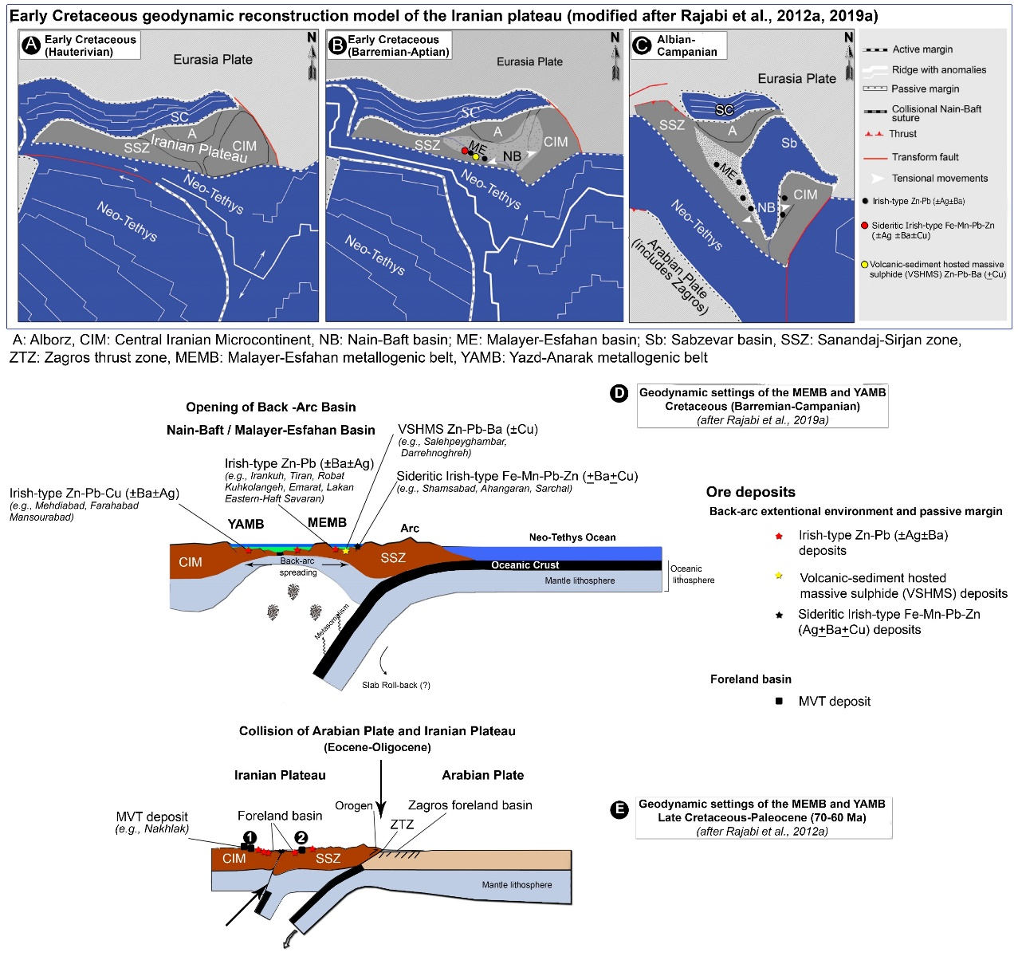
Irish-type Zn-Pb deposits around the world - 2023
Spatial distribution of deposits and their relation to the tectonic environment
A-C) Geodynamic reconstruction model of the Iranian plateau (dark grey) from the Early to Late Cretaceous (modified after Rajabi et al., 2012a) and Zn-Pb (Ag ± Cu ± Ba) mineralizations around the Nain-Baft suture zone. D, E) Comparison of tectonic setting models for Irish-type ore deposits in Early Cretaceous extensional environment and orogenic-related MVT deposits of the Late Cretaceous and Paleocene in the MEMB and YAMB of Iran (modified after Rajabi et al., 2012a, 2019a). These deposits are concentrated around the Nain-Baft suture zone in the Iranian plateau.
33
Notes:
However, some authors suggest an orogenic MVT model for the Early Cretaceous deposits of Iran, but it can not explain all geological and geochemical aspects of these deposits.
The Early Cretaceous Irish-Type deposits of Iran occur around the Nain-Baft suture zone, far from the Zagros collisional thrust zone.
Recent evidence of the Nain-Baft ophiolites shows that the suture between the Sanandaj-Sirjan zone and Central Iran is in fact a major structure resulting from a series of back-arc basins.
Following the subduction of Neo-Tethyan oceanic crust beneath the southern margin of the Iran plateau in the Early Cretaceous, the Nain-Baft back-arc basin began opening.
We suggest that the extensional back-arc environment between the Sanandaj-Sirjan zone and Central Iran in Early Cretaceous time created favourable conditions for the formation of VHMS ore deposits within the riftogenic sequence and Irish-type deposits in the passive marginal carbonate platforms on both edges of the basin.

Slide 34
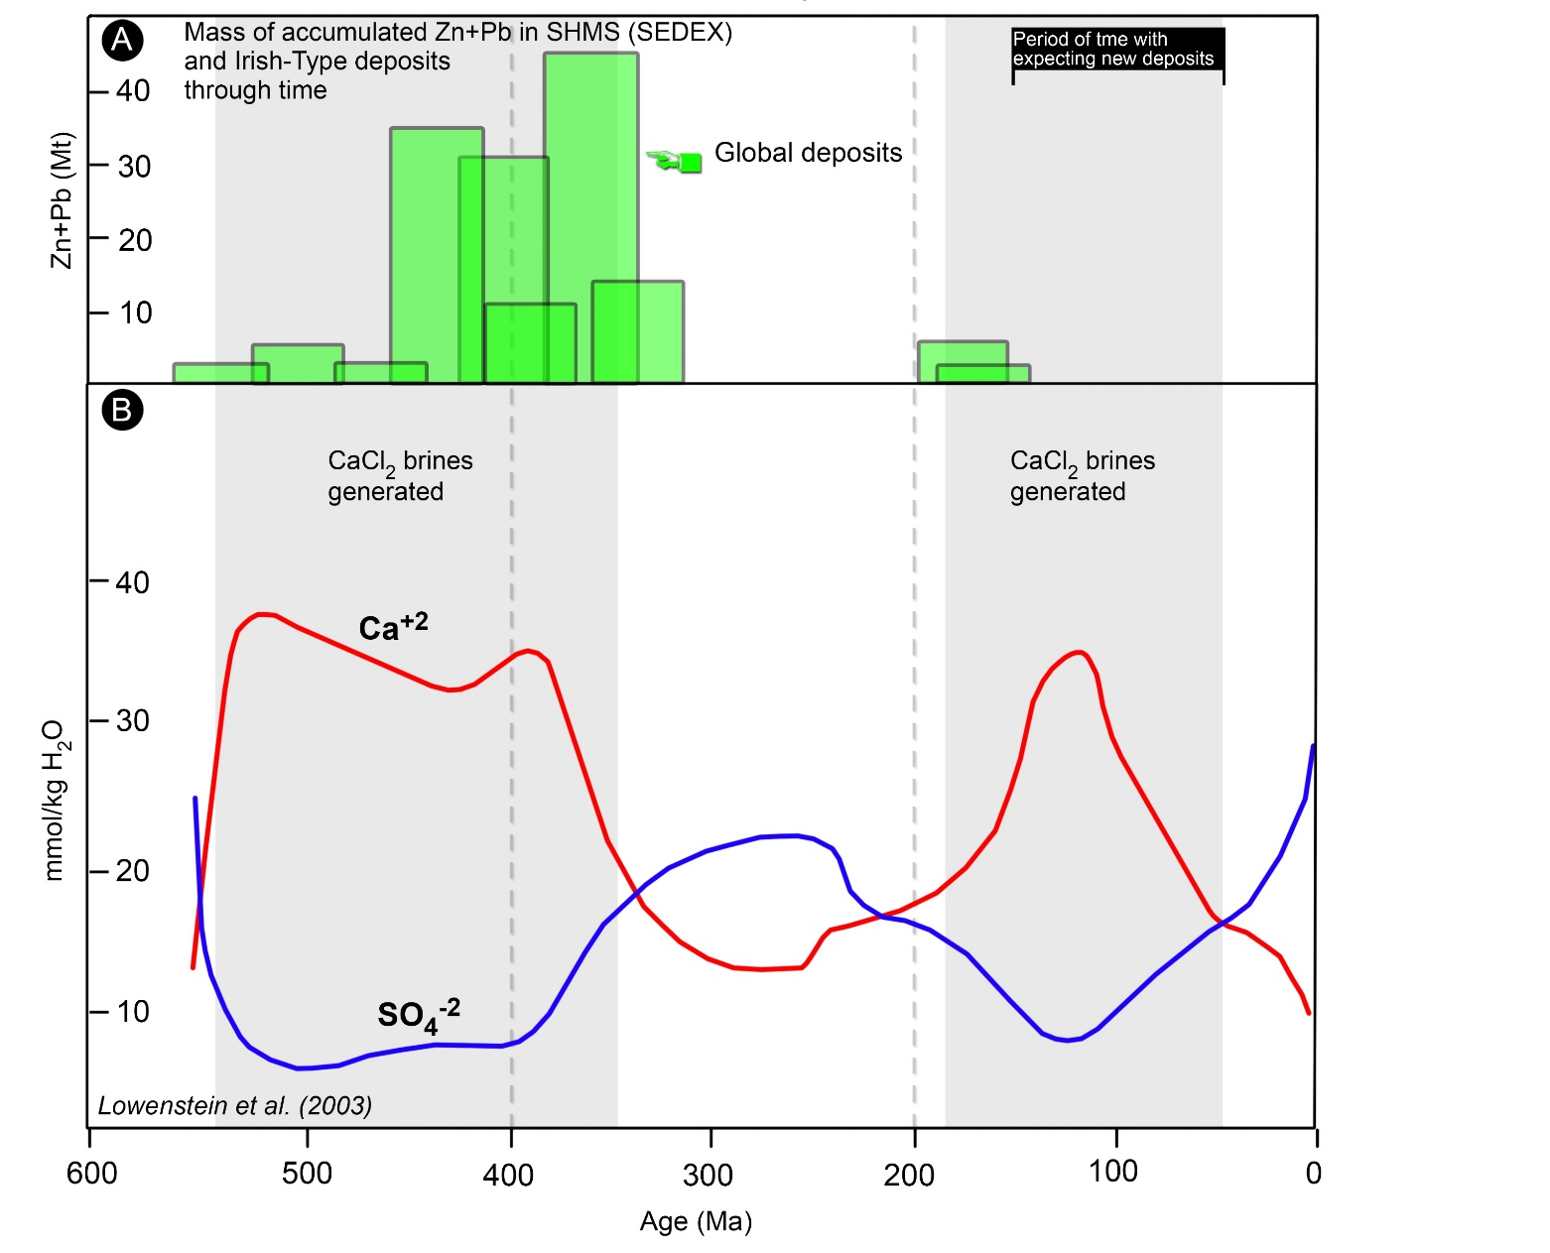
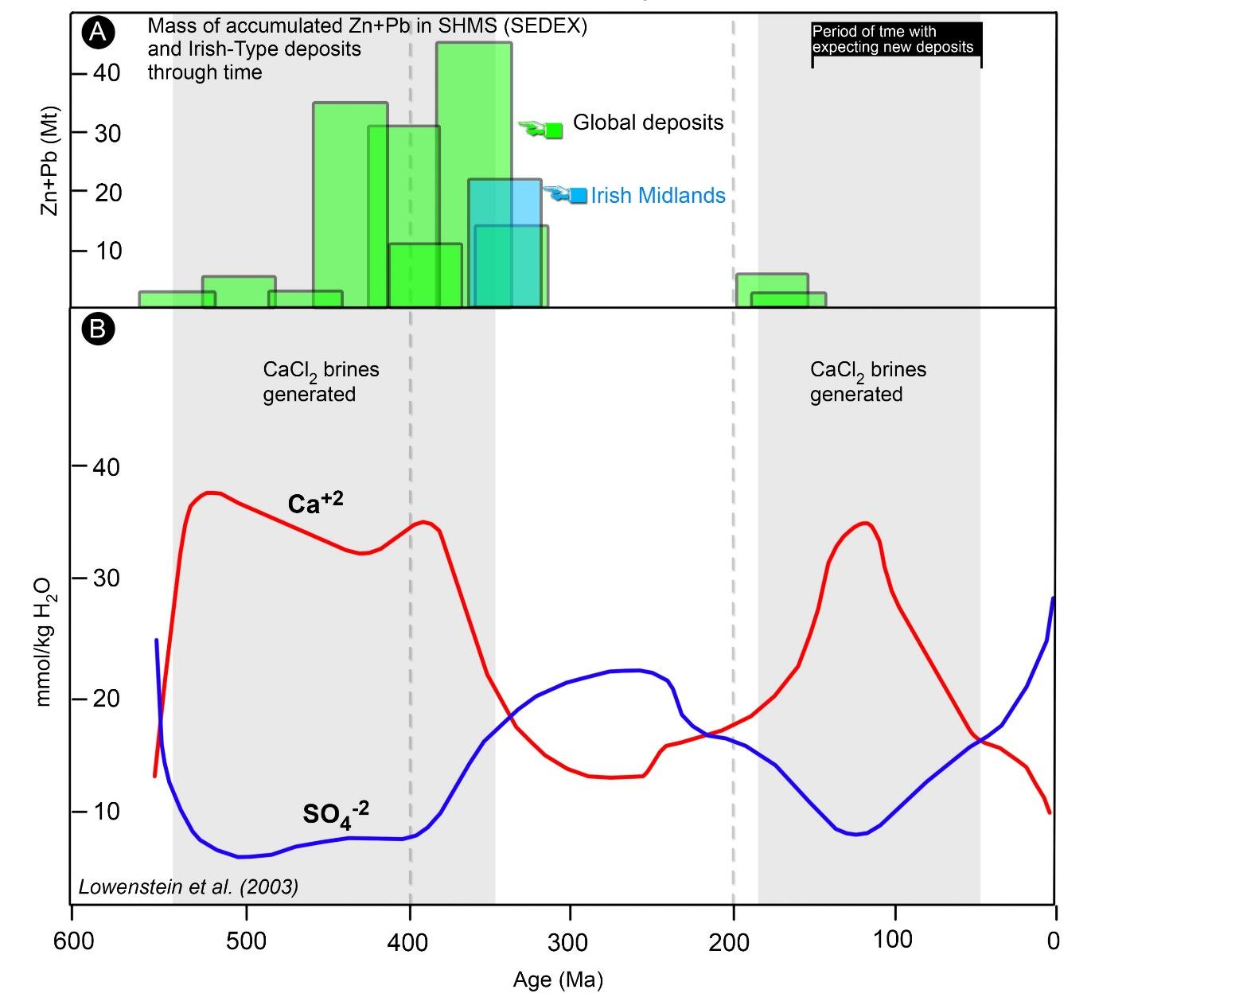
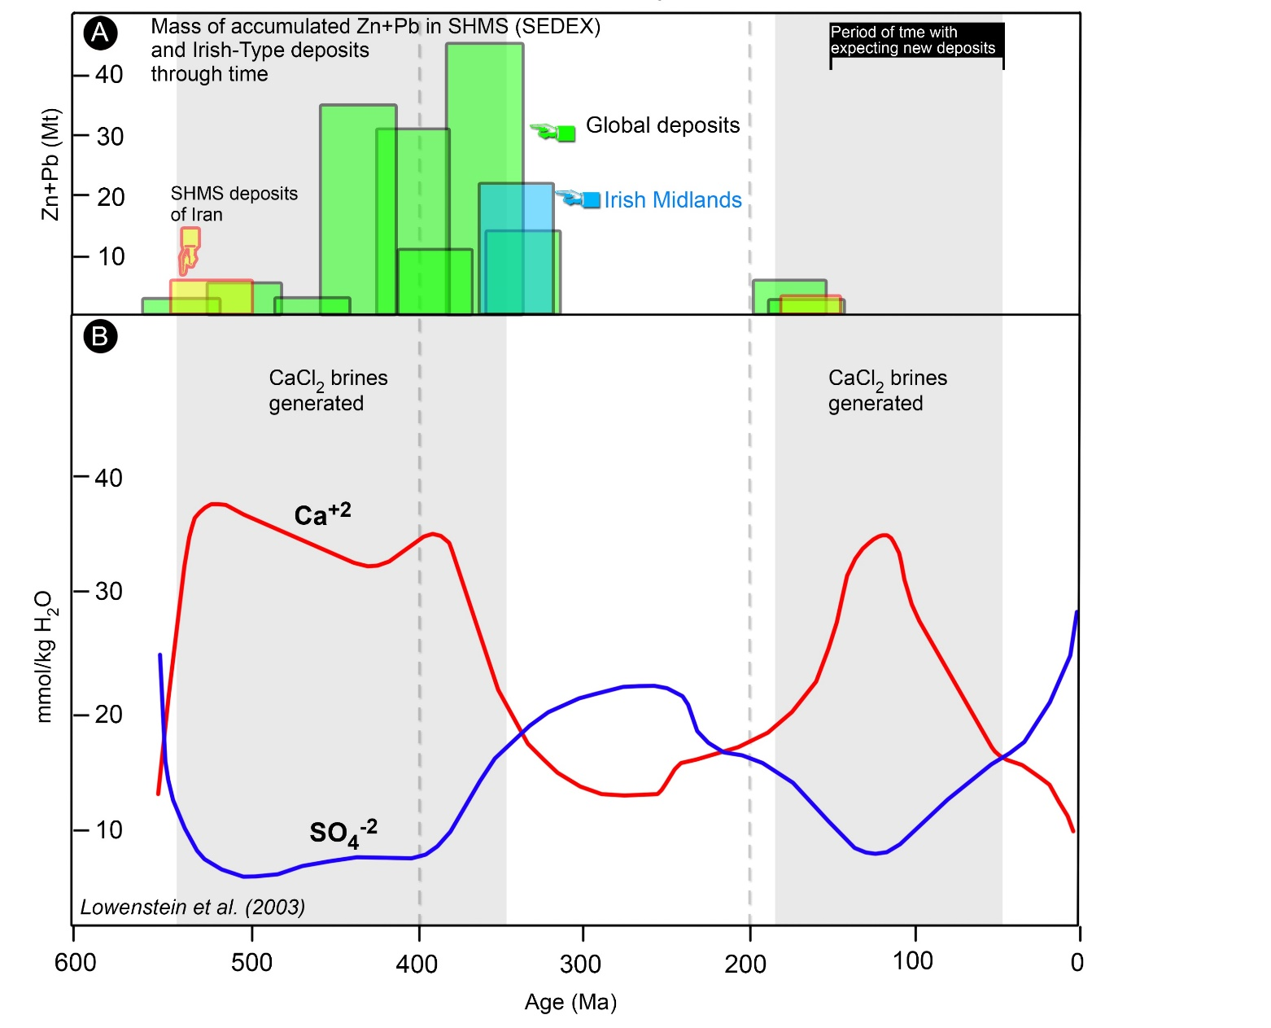
Irish-type Zn-Pb deposits around the world - 2023
Distribution of Irish-type deposits and temporal variation
Age distribution vs. Pb + Zn (Mt) contents for Phanerozoic SHMS (SEDEX) and Irish-type ore deposits (data from Leach et al., 2001; Wilkinson, 2014; Rajabi et al., 2012a; Rajabi, 2000) compared with ocean chemistry (Lowenstein et al., 2003). Modified after Wilkinson (2014).
34
Notes:
Finally, I’d like to conclude with this figure. It shows the age distribution of Phanerozoic SHMS and Irish-type ore compared with ocean chemistry.
Wilkinson suggested that there is a close link between evolving ocean chemistry and the formation of these deposits.
Plotting of these deposits against the SO₄²⁻ and Ca²⁺ curves for seawater shows that the intervals of this mineralization coincide with times with CaCl₂-rich seas. He suggested a period of time with expected new deposits right here.
If we add the Irish midland deposits and then the shale-hosted zinc-lead deposits of Iran, those also show similar patterns.

Slide 35
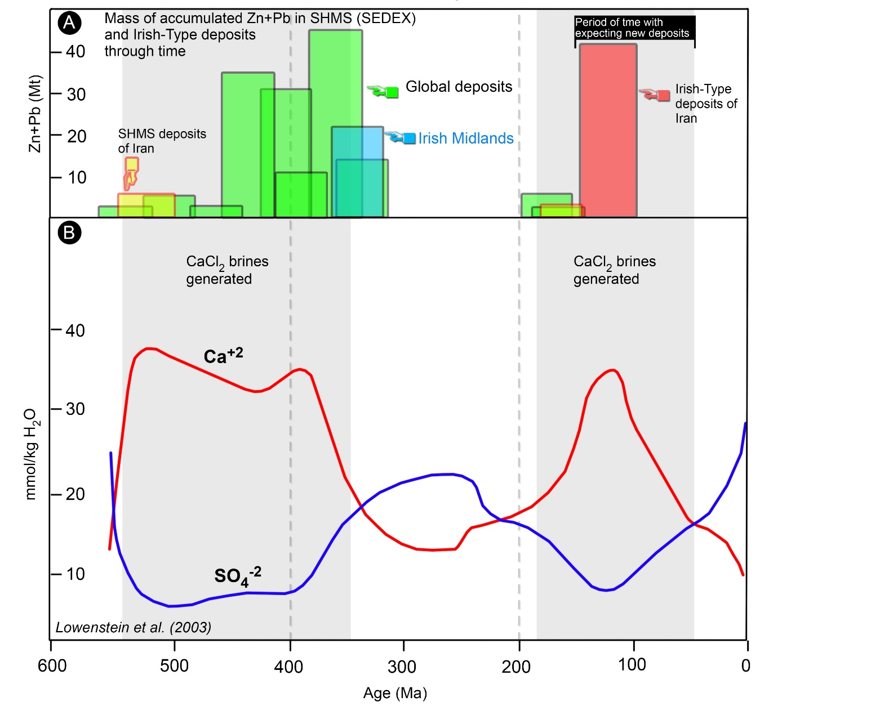
Irish-type Zn-Pb deposits around the world - 2023
Distribution of Irish-type deposits and temporal variation
Age distribution vs. Pb + Zn (Mt) contents for Phanerozoic SHMS (SEDEX) and Irish-type ore deposits (data from Leach et al., 2001; Wilkinson, 2014; Rajabi et al., 2012a; Rajabi, 2000) compared with ocean chemistry (Lowenstein et al., 2003). Modified after Wilkinson (2014).
35
Notes:
Now, if we add Early Cretaceous deposits of Iran, the temporal distributions of these deposits, also show similar patterns.
that periods of CaCl2-rich seawater are favorable to generate brines via evaporation, which could then change into highly metalliferous ore fluids during convective circulation. This is compatible with the evaporitic brine reflux model for the formation of Zinc-lead deposits in extensional and passive margin environments.
In a reflux model, seawater evaporitic brines infiltrated the underlying rocks of the host basins or fractured basement rocks. Such reflux brines could have provided much of the chlorine necessary as a ligand for large-scale metal transport.

Slide 36
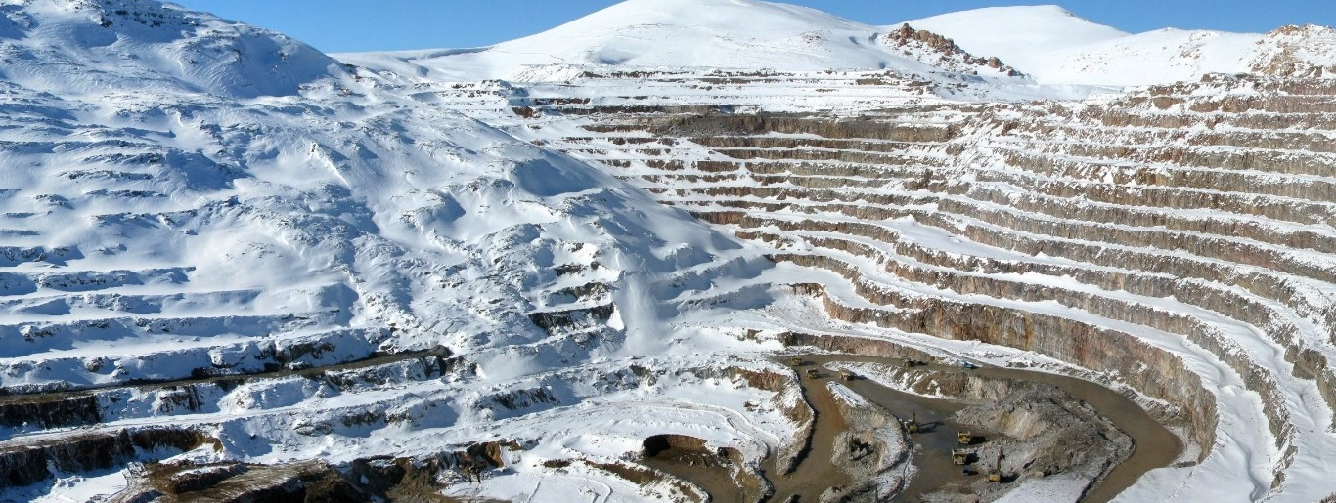
Irish-type Zn-Pb deposits around the world - 2023
To memorialize Dr. Donald F. Sangster, for his love and support, guidance, and patience in dealing with the investigation of the metallogeny of the sediment-hosted Zn-Pb deposits of Iran, from 2007 to 2018.
Donald F Sangster August 3 1935 December 28 2018
rahman.rajabi@ut.ac.ir
abdorrahmanrajabi.ut@gmail.com
Angouran Open Pit
2020
36
Notes:
That brings me to the end of my presentation. Thank you for listening.
I’ll gladly answer any of your questions at the end if I can.

Slide 37
Irish-type Zn-Pb deposits around the world - 2023
Metallogeny of zinc and lead
Average values of lead and zinc in (a) different parts of the earth and (b) igneous and sedimentary rocks (Rajabi, 2022; data from Taylor, 1964; Wedepohl, 1991; McDonough, 2003; Palme and O'Neill, 2007; Rudnick and Gao, 2003; Kelemen et al., 2007; Houston et al., 2015)
3
Notes:
This slide may help us focus on why zinc deposits occur in a metallogenic belt. This figure illustrates the average values of lead and zinc in different parts of the earth (on the left) and in igneous and sedimentary rocks (on the right).
Zinc shows a uniform distribution in different parts of the earth, but lead is much more concentrated in the continental crust. This can be extended to most rocks so that except for carbonates, zinc shows approximately a uniform distribution than lead.
The uniform distribution of zinc shows that the major drivers of its metallogeny are not sources but processes that extract and concentrate zinc in a metallogenic belt or province.
This fact is in contrast to lead metallogeny, which highly depends on the amount of metal in the source rock.

Slide 38
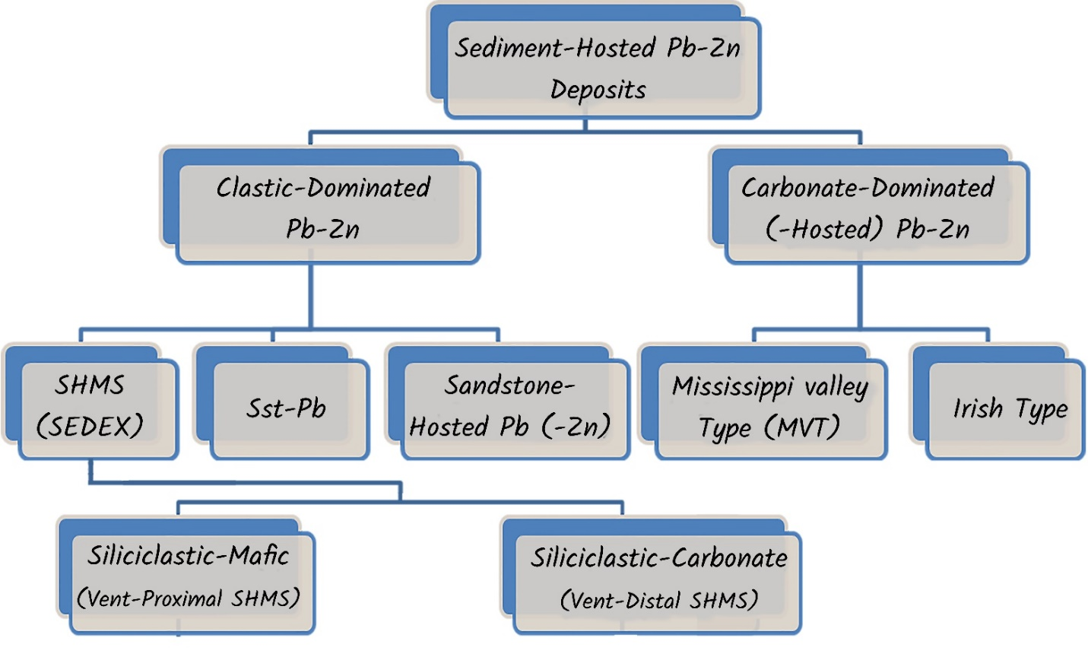
Irish-type Zn-Pb deposits around the world - 2023
Types of the SH Zn-Pb ore deposits
Leach et al. (2010)
Leach et al. (2005)
Houston et al. (2015)
(Goodfellow, 2004)
Classification of sediment-hosted Zn-Pb deposits (chart from Rajabi, 2022)
Notes:
This chart shows different kinds of sediment-hosted zinc-lead deposit classifications, including the clastic-dominated and Carbonate-dominated deposits. The common method is the genetic classification suggested by Leach et al. (2005). We also prefer to use genetic classification of these deposits that mainly includes Shale-Hosted massive sulphide, the Irish-type and MVT deposits. Other groups are not very extensive.

Slide 39
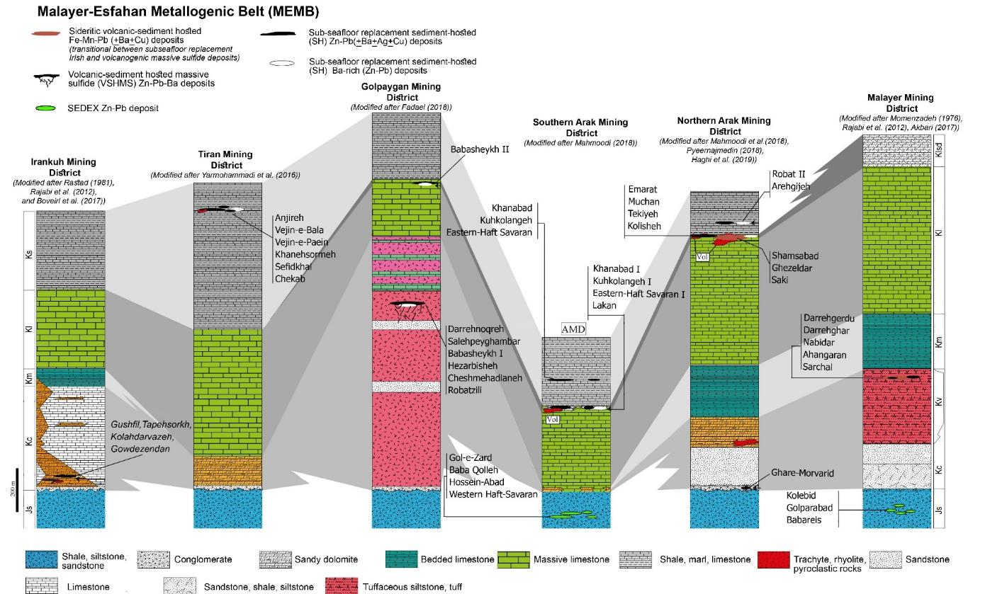
Irish-type Zn-Pb deposits around the world - 2023
The Irish-type Zn-Pb (±Ag±Ba) deposits in the MEMB
Generalized lithostratigraphical columnar sections of selected mining districts in the MEMB, SSZ (Rajabi et al., 2019).
Notes:
Tabular shape and folding of the ore layers are the major characteristics of the Early Cretaceous zinc-lead deposits, especially at the upper ore horizons of the Malayer-Esfahan metallogenic belt. If we have a look at the Emarat orebodies, we see the folding of orebodies in the KLSD unit, at the contact between the carbonates and upper shales.

Slide 40
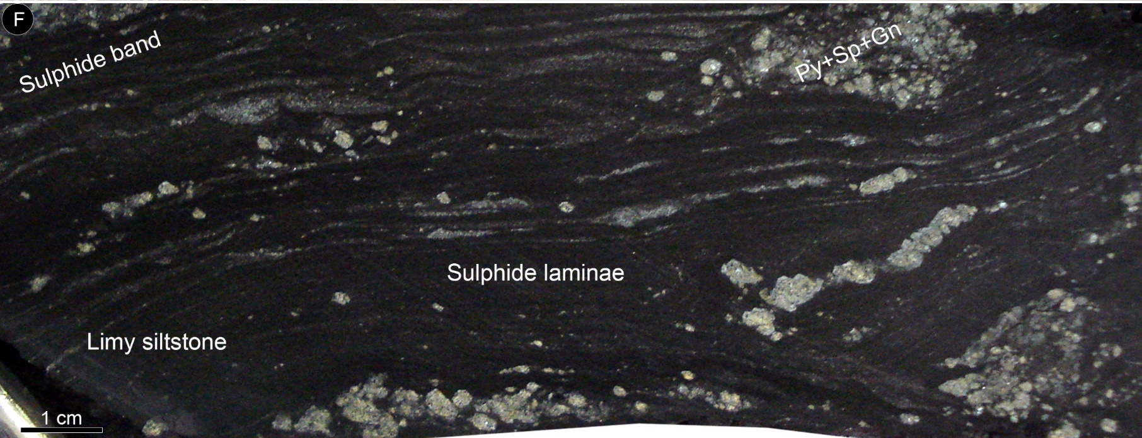
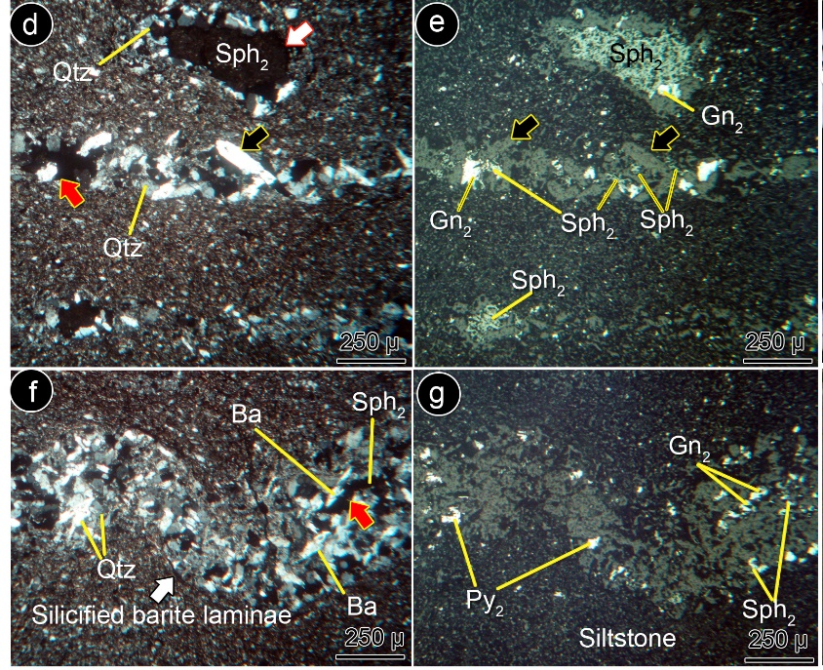
Irish-type Zn-Pb deposits around the world - 2023
The Irish-type Zn-Pb (±Ag±Ba) deposits in the MEMB
Notes:
This slide shows some hand spacemen and microphotographs of the banded replacement ore in black limy siltstone of the Tiran area. As you see sulphides replace limy bands and barite in the host rock.

Slide 41
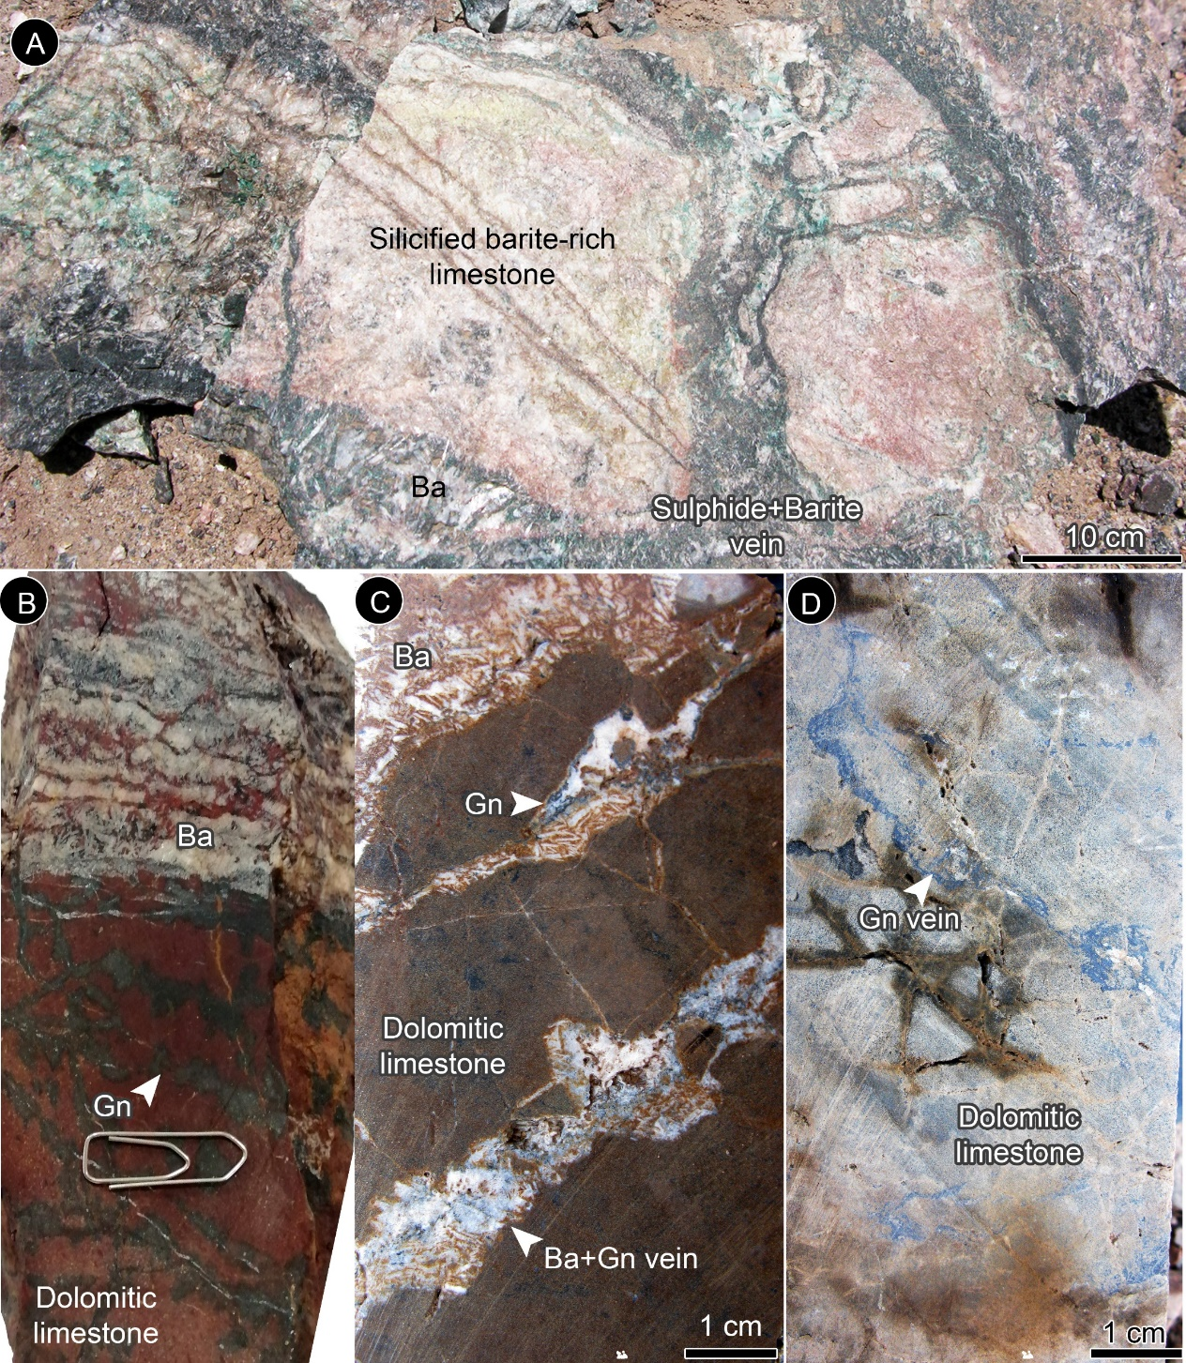
Irish-type Zn-Pb deposits around the world - 2023
The Yazd-Anarak metallogenic belt (YAMB)
Complex veins and veinlets of sulphides and barite in the feeder zone of the Mehdiabad deposit. Gn: galena, Ba: barite,
7
Notes:
This figure represents the complex veins and veinlets of sulphides and barite in the feeder zone of the Mehdiabad deposit.
These veins are developed near the black hill fault, under the massive barite ore.

Slide 42
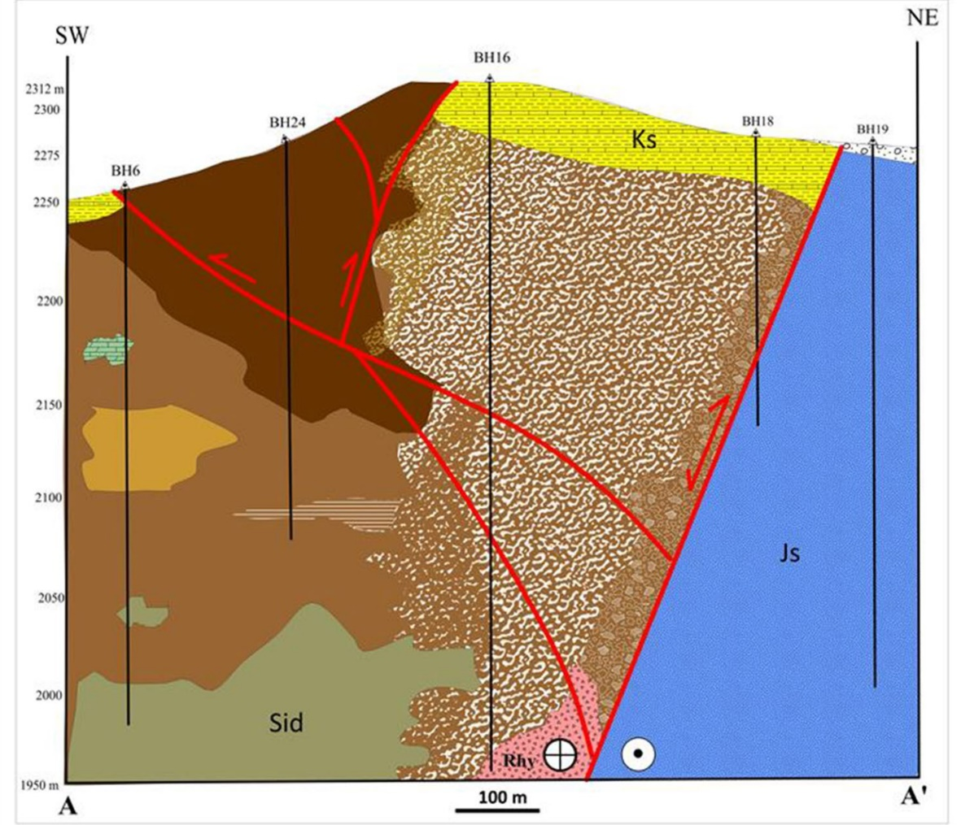
Irish-type Zn-Pb deposits around the world - 2023
The Sideritic Irish-type Fe-Mn-Pb-Zn (±Ag±Ba±Cu) deposits
Northeast-southwest cross-section of the Shamsabad sideritic iron deposit, showing the different ore facies and ore grades (Peernajmodin et al., 2023).
Notes:
Let’s have a close look at a cross-section of the Shamsabad deposit. Here we can see the position of the ore zones related to the inverted normal fault.
Here we have massive sideritic ore, massive oxide ore, brecciated ore, layered (?) ore, and stringer zone.

Slide 43
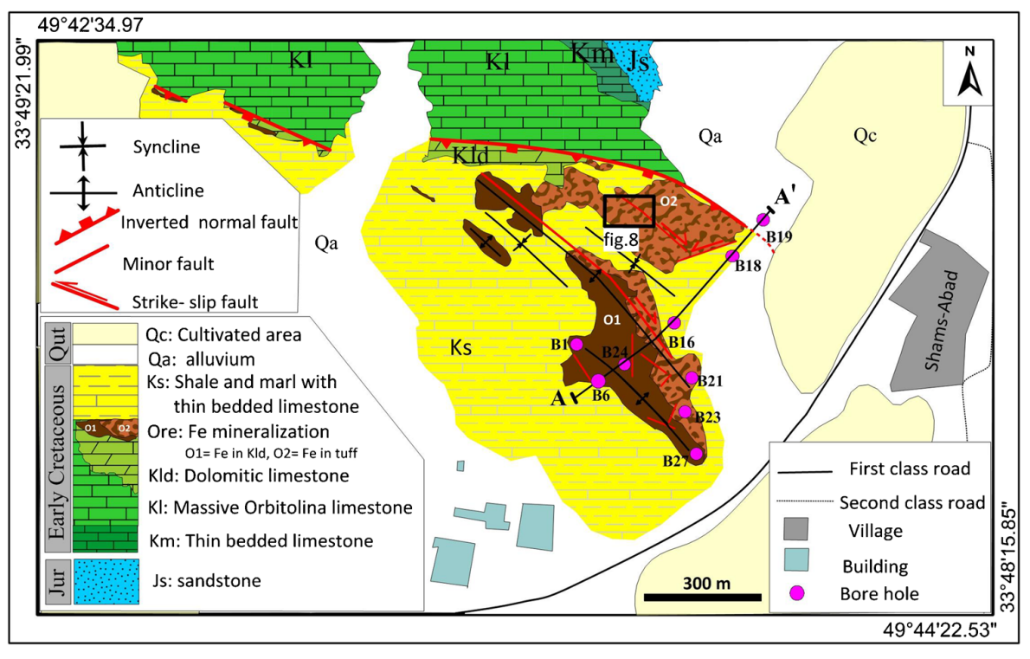
Irish-type Zn-Pb deposits around the world - 2023
The Sideritic Irish-type Fe-Mn-Pb-Zn (±Ag±Ba±Cu) deposits

