Slide 1

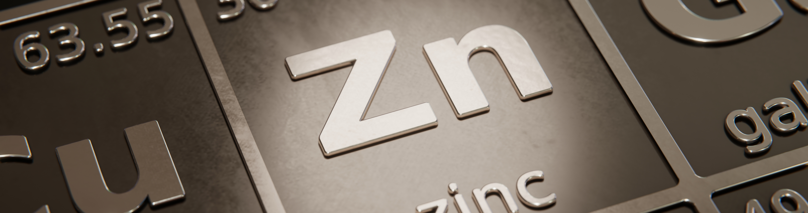

Global Irish – Diversity of the Diaspora
Neal Reynolds, Mark Allen, Peter Muhling & Charlie Gianfriddo
IAEG 50, Galway 10-12 September 2023
© Copyright 2023 by ERM Worldwide Group Limited and/or its affiliates (‘ERM’). All Rights Reserved. No part of this work may be reproduced or transmitted in any form or by any means, without prior written permission of ERM.
Notes:
Good morning and Failte roimh ar gcuairteori go Gaillimh, though also a visitor
A pleasure to speak here 23 yrs after presenting on Irish and Lennard Shelf with John Kelly, my erstwhile colleague
Ideas presented then based on work in Ireland, Australia and elsewhere have been further developed in the intervening years through work by myself and colleagues on many carbonate-hosted districts globally, and especial thanks to Peter Muhling and Mark Allen neither of whom were able to attend
These ideas are practical and exploration focused rather than deeply scientific for which no apologies
Finally to note that this will be my last presentation as part of CSA Global – the brand will be retired in the coming weeks after almost 40 years, while for me it has been almost 32 years
Better get started, poorly prepared and much to present, hopefully time management will not be as bad as I fear

Slide 2
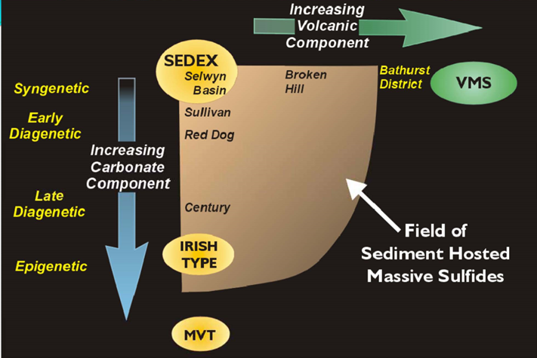

Zn-Pb Deposit Models – a Classification Nightmare!
Multiple overlapping terms and acronyms – VMS/VHMS, SHMS/Sedex/CD, BHT, Irish-type, MVT, CRD/Manto, Skarn, Diatreme/epithermal …… not to mention Cobar-type, Kipushi-type, Outokumpu-type etc.
Confusion often due to hybrid features and/or limited data
A systems-based approach is preferred to guide targeting and exploration
Broadly group:
“Magmatic arc systems” formed within fluid systems driven by intrusion, typically sub-volcanic porphyries – CRD/skarn, diatreme & epithermal
“Basinal systems” formed within large- or regional-scale fluid-flow systems in basin settings – SHMS, BHT, Irish-type, MVT, Cobar-type, Kipushi-type, and VMS with increasing magmatic input to heat and/or metal source
Basinal Zn spectrum, from Cam Allen 2003
Notes:
Others such as Cam Allen, Murray, Jamie Wilkinson

Slide 3
The epitome of the classification nightmare – what is an Irish-type deposit? And how useful is the concept?
Irish Type Zn-Pb Systems
Low-temperature Carbonate-hosted Zn-Pb Models
Irish-type Deposits
Stratabound predominantly replacive semi-massive to disseminated Zn-Pb-Ag-Fe ±Cu deposits in carbonate-dominated platforms marginal to, or above, sediment-dominated basins
‘High-grade MVT Deposits’
Stratabound predominantly cavity-fill Zn-Pb-Fe ±Ag ±Cu deposits hosted in carbonate-dominated platforms marginal to, or above, sediment-dominated basins.
‘Typical’ MVT Deposits
Stratabound or transgressive predominantly cavity-fill Zn-Pb-Fe ±Ag ±Cu deposits hosted in thick platform carbonate sequences marginal to, or above sediment-dominated basins.
Deposits of similar style occur in different settings, while dissimilar deposits occur in similar settings – Irish-type deposits have many features of MVT’s while ‘high-grade’ MVT’s can form in
settings similar to Irish-type deposits
A systems-based approach can deal with this reality where a deposit-based model cannot

Slide 4
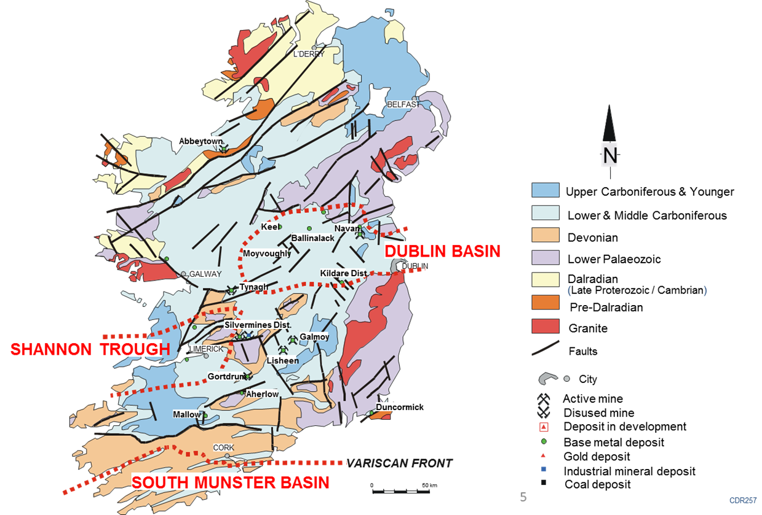
Irish n-Pb Systems
‘MVT’ Spectrum
Irish-type Deposits – the Irish Midlands
Deposits are usually viewed through the lens of ‘typical’ Waulsortian-hosted (e.g. Lisheen) and Pale Beds-hosted (Navan) deposits,
but
The Irish Midlands mineral system also encompasses diverse deposits such as Pallas Green, Keel, Harberton Bridge, Abbeytown, Gortdrum etc.
Replacement, open-space fill, and structurally-hosted styles
Multiple deposit types, or target plays, are related to different fluid focus and trap environments, of which two have been demonstrated to host economic mineralization

Slide 5
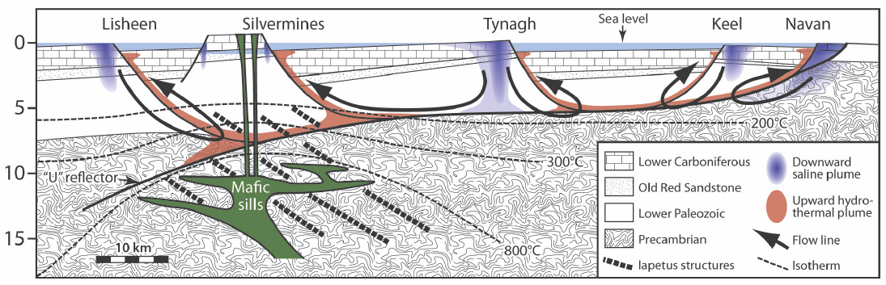
Irish n-Pb Systems
‘MVT’ Spectrum
Irish-type Systems – the Irish Midlands
Tectonically unstable carbonate platform with sub-basins, marginal to flysch basin to south
Basinal metal source encompasses the underlying Ordovician-Silurian flysch basin
Trigger provided by Chadian tectonism and volcanism
Large-scale fluid focus provided by major structural basin-architecture compartmentalisation related to reactivated Caledonian structure
Local fluid focus by fault relays zones related to obliquity of extension direction to Caledonian grain, dolostone aquifers, aquicludes
Trapping related to reactive carbonates, dolomite aquifers, aquicludes, fluid mixing, and BSR sulphur source

Slide 6
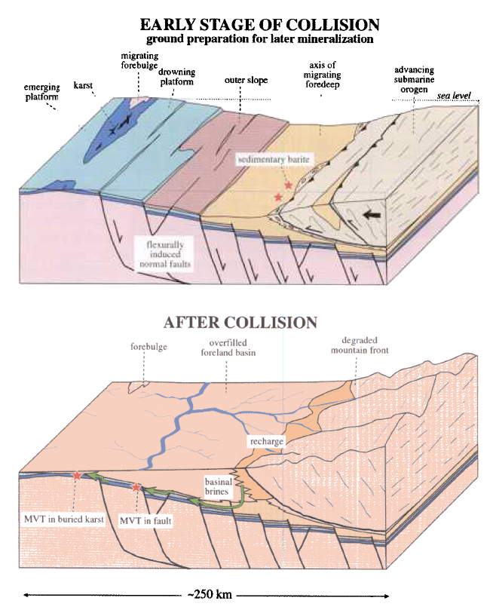
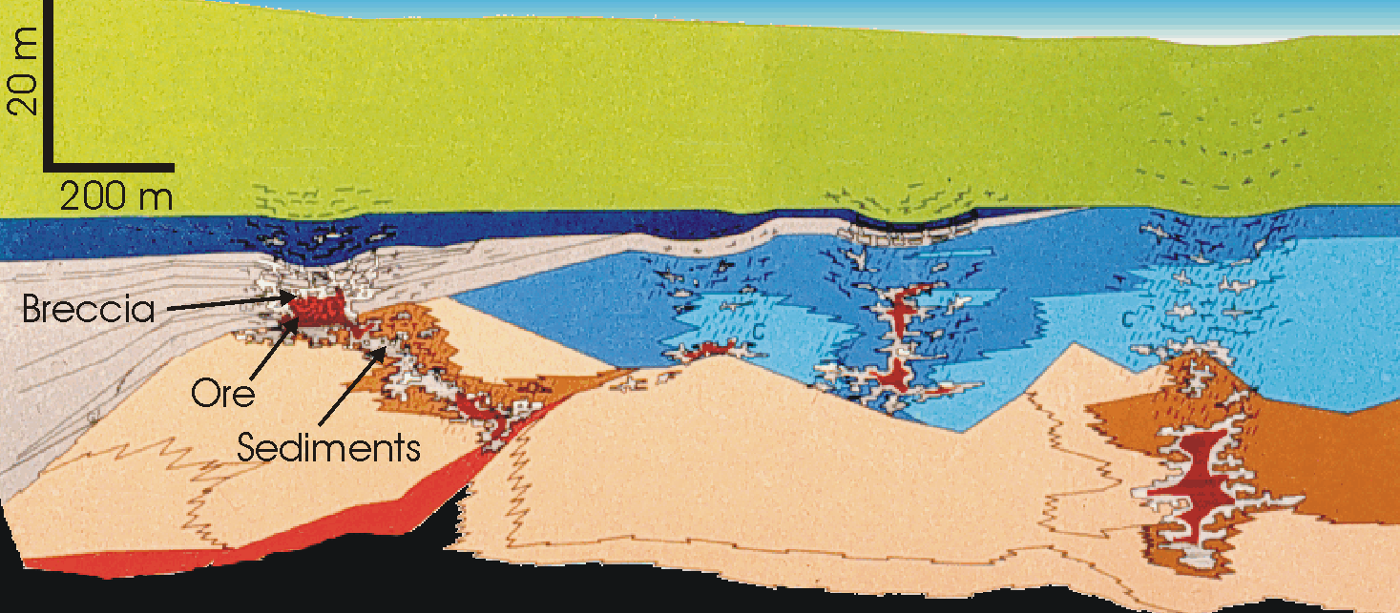
Irish n-Pb Systems
‘MVT’ Spectrum
MVT Systems
‘Typical’ MVT systems (e.g. East and Central Tennessee, Silesia, Pine Point, etc.) provide foundation for the syn-orogenic foreland basin mineralization model (Bradley and Leach, 2003, etc.)
Basinal metal source, mineralizing fluid-flow systems driven by orogenic uplift
Mineralization deposited in paleokarst in older platform carbonates
Lower temperature than Irish Midlands system and typically TSR sulphur and radiogenic Pb
Many deposits described as MVT do not readily fit this unifying system model
Pine Point, from Dereck Rhodes , 2003
Model for MVT mineralisation in paleokarst in foreland basins during collisional orogeny, from Bradley and Leach, 2003

Slide 7
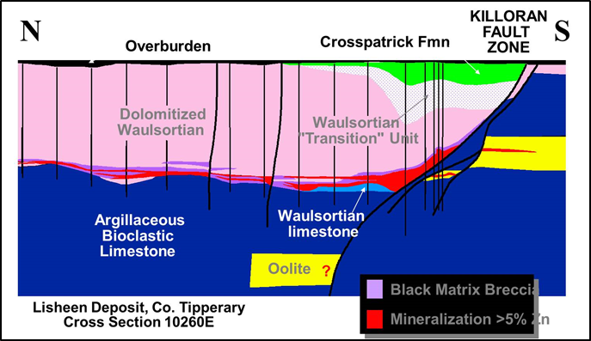
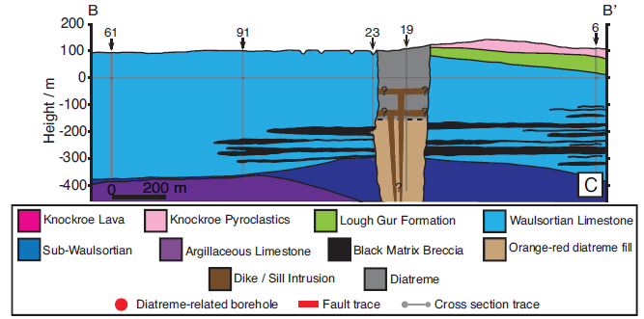
Irish n-PbA meningful Systems
‘MVT’ Spectrum
Global Irish? A Useful Concept?
A useful concept, because Irish-type deposits can be very economically attractive, and because the concept can improve project generation and targeting
Deposits previously described as ‘Irish-type’ include the Triassic Alpine deposits, Morro Agudo, Gays River, amongst others
Perception of Irish deposits as only Silvermines or Navan style, and of ‘Sedex’ affinity, may have hampered recognition of global system analogues
Analogous system implies large-scale fluid-flow driven by syn-basin tectonic triggers, in contrast to syn-orogenic MVT systems
BUT, diversity is the reality …….
Stonepark, from Elliott et al., 2019

Slide 8
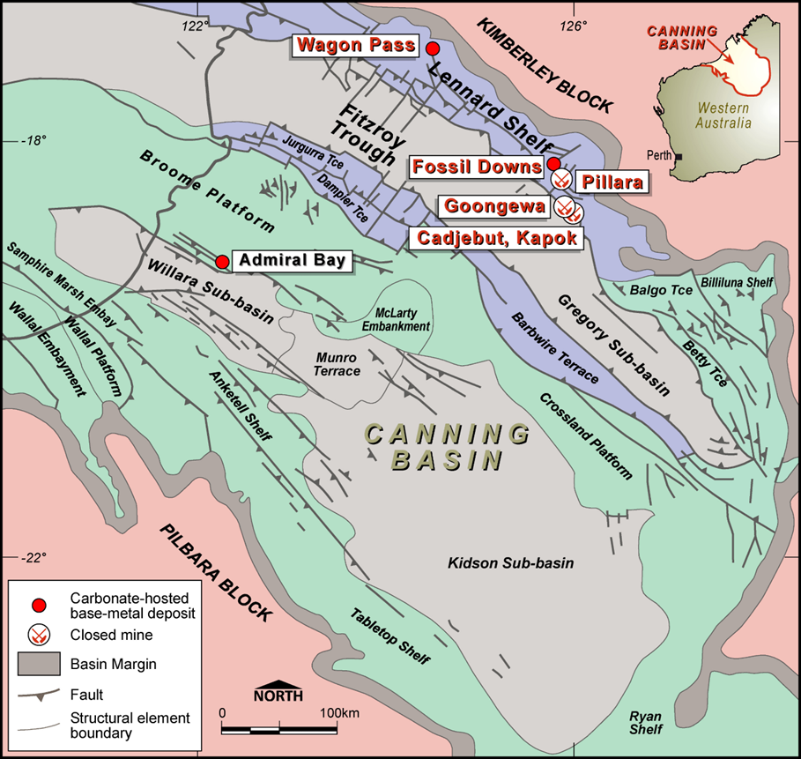
Irish n-Pb Systems
‘MVT’ Spectrum
Admiral Bay – Canning Basin
Long-lived Ordovician to Early Cretaceous intracratonic rift-sag basin
Admiral Bay Zn-Pb-Ag-Ba deposit associated with the Lower Ordovician to Silurian Willara–Kidson rift-sag event
Lennard Shelf Zn-Pb-Ba deposits associated with the Upper Devonian Fitzroy Trough rift-sag event
Admiral Bay – c. 20 km of the Admiral Bay Fault Zone at depths of 1200-1500 m
2015 Metalicity Inferred Mineral Resource 72 Mt at 3.1% Zn, 2.9% Pb and 18g/t Ag
Notes:
Complex of basins and platforms

Slide 9
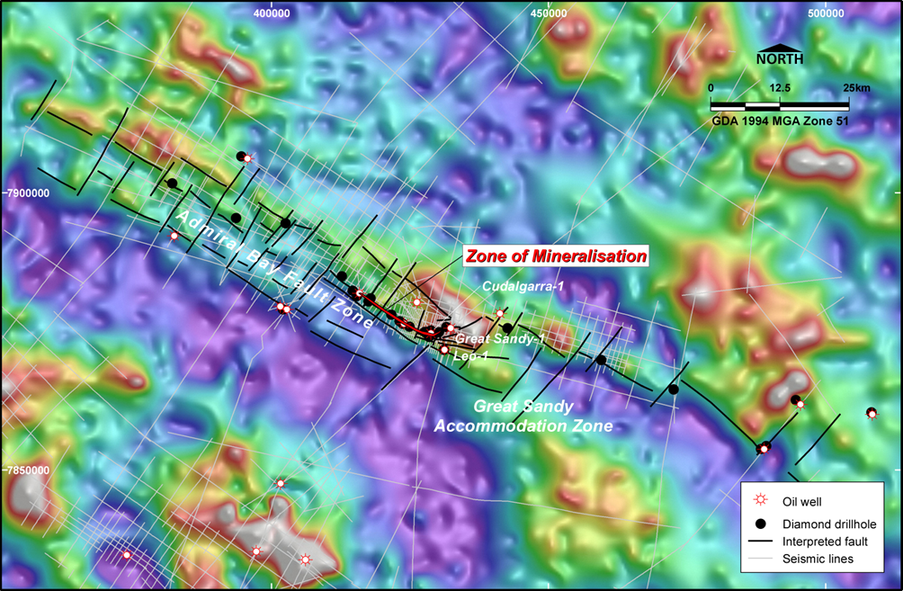
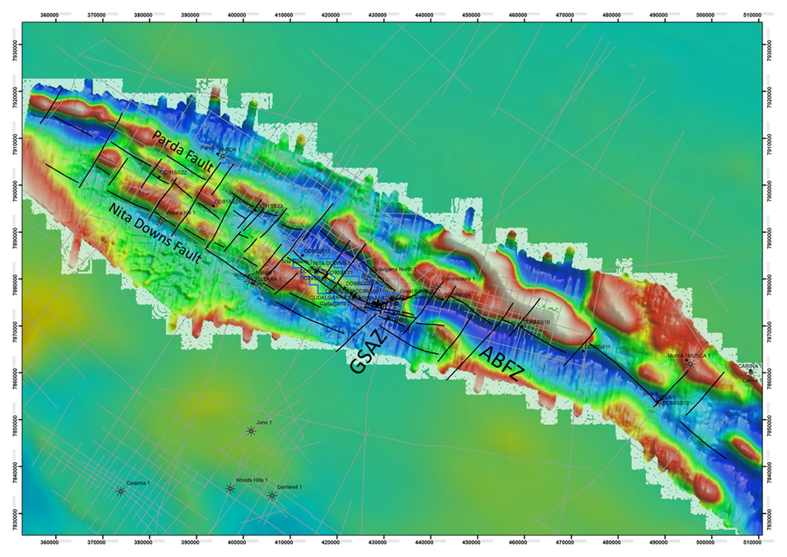
Irish n-Pb Systems
‘MVT’ Spectrum
Admiral Bay – Canning Basin
Mineralization localised at a relay ramp (Great Sandy Accommodation Zone) along the ABFZ
Residual magnetic image showing the ABFZ and GSAZ and drill holes
1VD of Bouguer gravity showing the ABFZ and GSAZ and drill holes

Slide 10
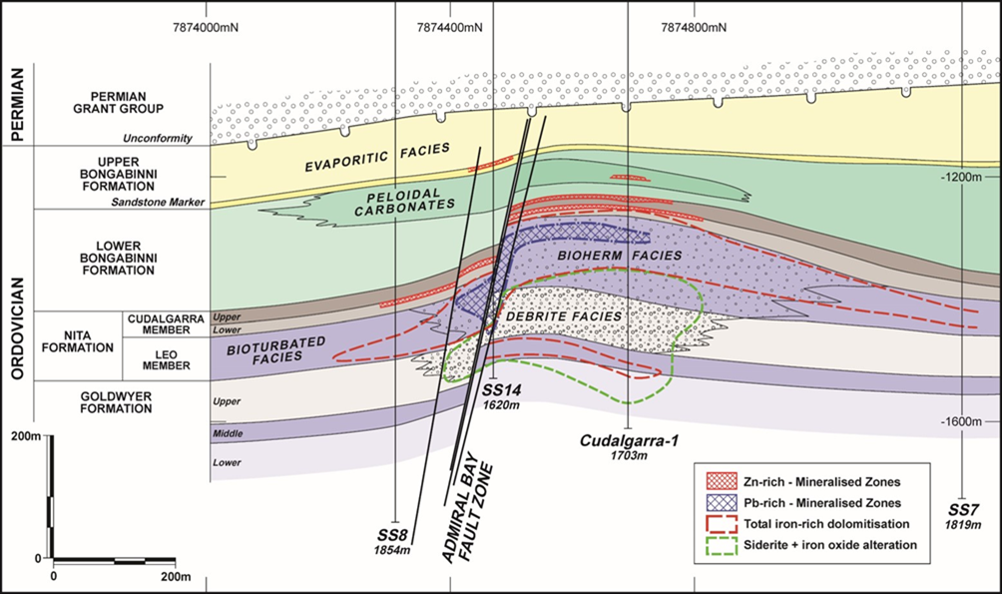
Irish n-Pb Systems
‘MVT’ Spectrum
Admiral Bay – Canning Basin
Sag-phase outer- to inner-ramp and intertidal carbonates and siliciclastics
Footwall fault-controlled debrites
Upper Zinc Zone in undolomitised bioclastic and micritic lithofacies
Low-iron sphalerite, galena, minor pyrite; replacement, small-scale open-space fill, veinlets and crackle breccia
Lower Lead-Barite Zone – irregular barite-galena veins in bioherm dolostone
Overprints early replacive barite-siderite-galena-sphalerite with hematite and magnetite
Late large-scale massive and banded barite veins, latest minor chalcopyrite and sphalerite in calcite veins

Slide 11
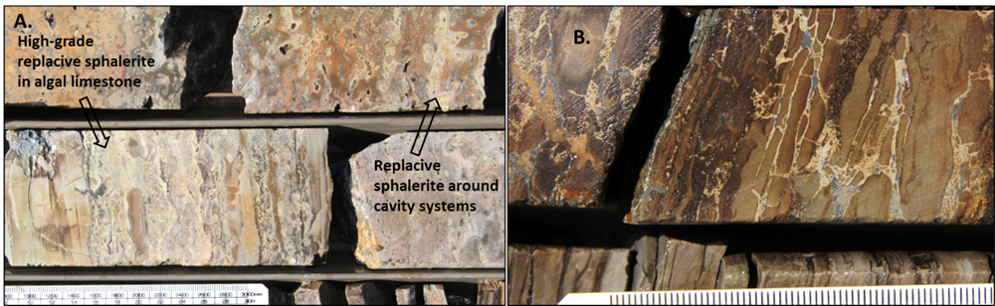
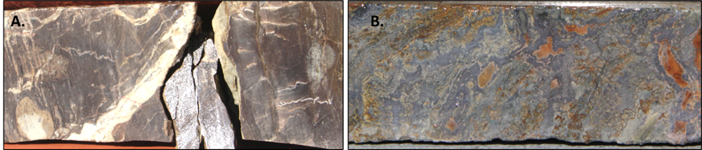
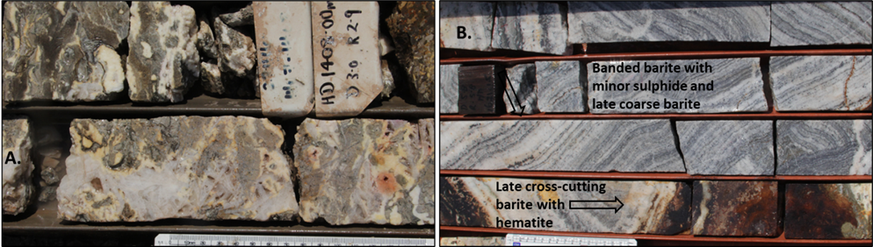
Irish n-Pb Systems
‘MVT’ Spectrum
Admiral Bay – Canning Basin
Replacement of algal limestone by pale sphalerite and as rims to cavity systems
B. Pale sphalerite-galena lamination-parallel jack-apart veins and ‘breakthrough’ fluid-escape veinlets and microbreccias
Algal organic-rich horizon cut by pale contorted sphalerite veinlets terminating against lamination planes
Microbial limestone replaced by galena with intergrown pale sphalerite and marcasite
Bladed barite veining overprinting ferroan dolomite in cavity fill systems in bioherm
Laminated barite veining, dark bands with minor pyrite and galena, late white crystalline barite, latest bladed barite veins with hematite
Notes:
Run through textures

Slide 12
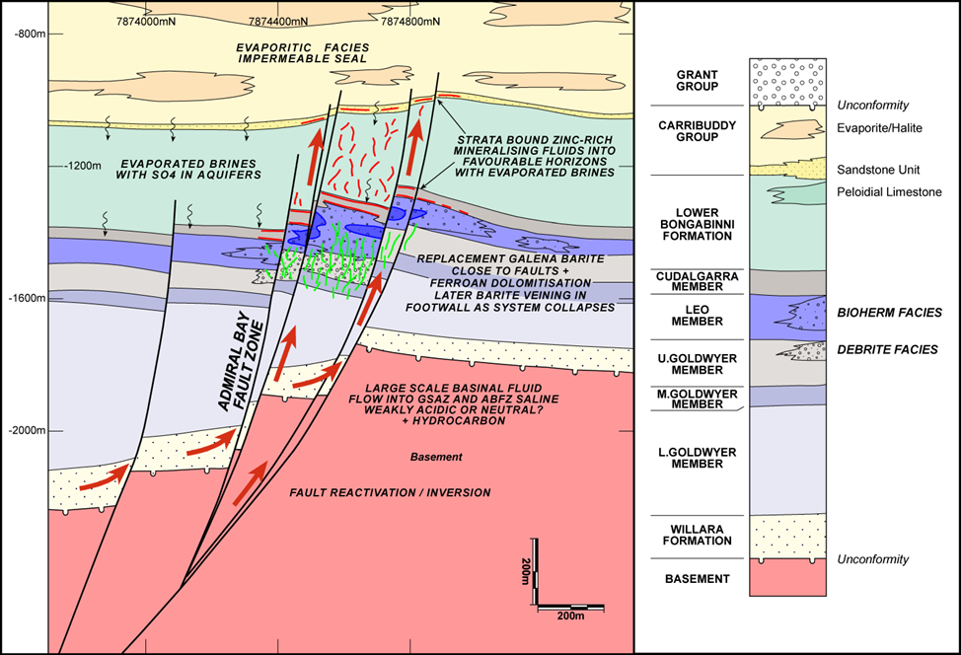
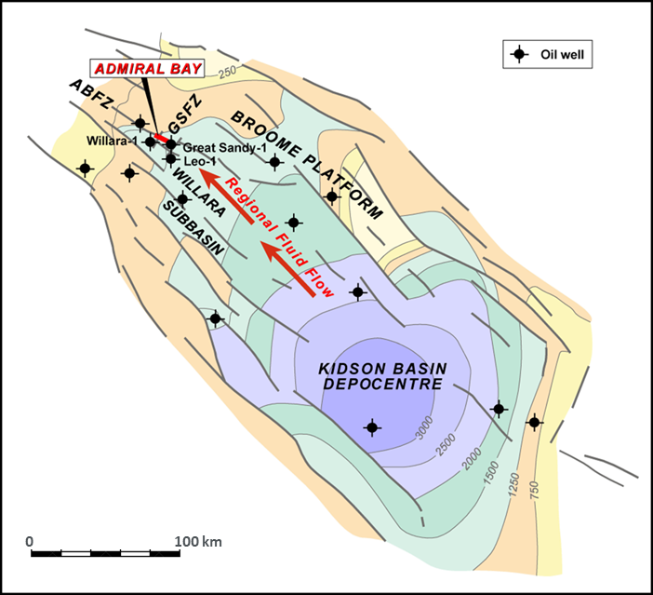
Irish n-Pb Systems
‘MVT’ Spectrum
Admiral Bay – Canning Basin
Long-lived and large-scale fluid-flow event, partly overlapping hydrocarbon migration
Focused by basin architecture structure
Syn-diagenetic mineralisation, ± 800 m deep
Local focus by structure and dolostone aquifers
Trapping – reaction and reduction; hydrocarbon and sour gas
Evolution to oxidising barite-dominant system

Slide 13
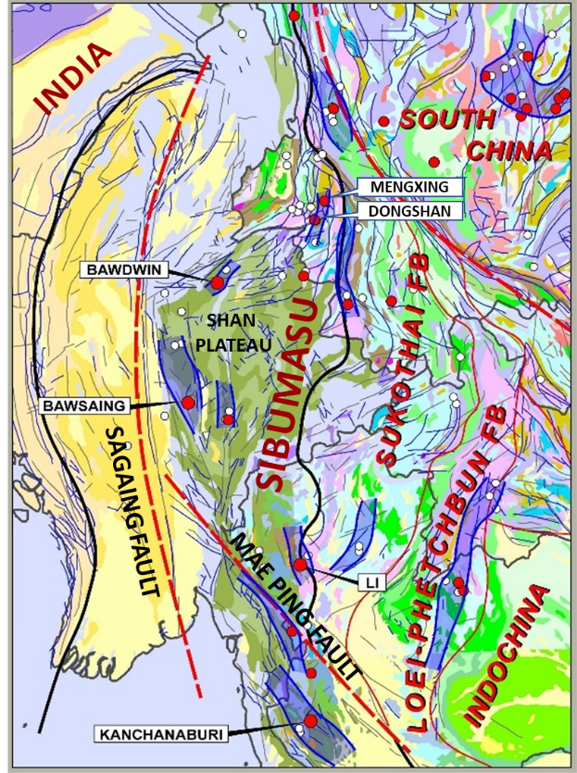
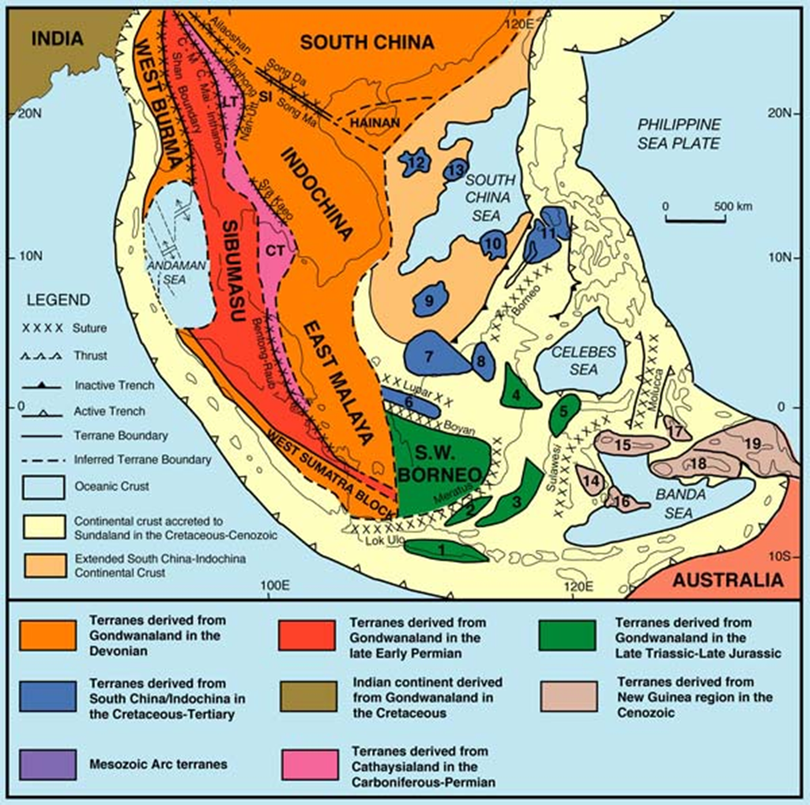
Irish n-Pb Systems
‘MVT’ Spectrum
Sibumasu Ordovician – SE Asia
Sibumasu terrane – close to NW Australia in the Lower Ordovician
Stratabound Zn-Pb deposits in Lower/Middle Ordovician platform carbonates – 1400 km belt from Kanchanaburi to Yunnan
Marginal to a rift-sag basin on the NW-Gondwana margin – Neoproterozoic to Cambrian turbiditic to shallow marine to deltaic siliciclastics
Tuff horizons within platform rocks
Sub-alkaline volcanic centres at Bawdwin and Kuala Lumpur
Notes:
Point out deposits and districts

Slide 14
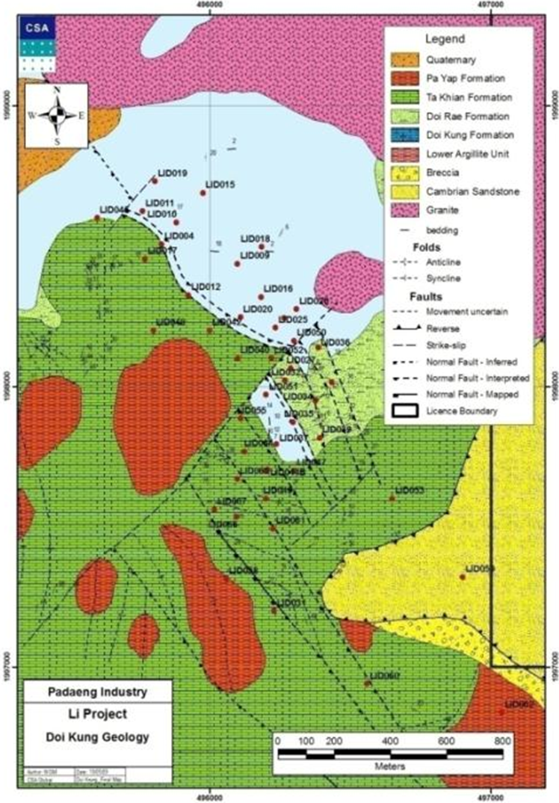
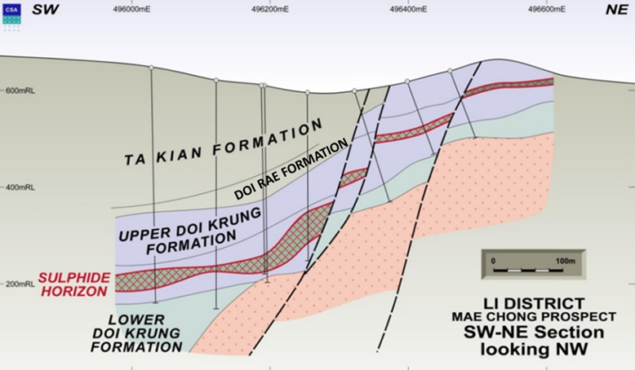
Irish n-Pb Systems
‘MVT’ Spectrum
Li District
Stratabound Zn-Pb mineralisation and alteration over 7 km x 2 km at Mae Chong
Phu Mai Tong barite mine 20 km to south, ‘global resource’ c. 7 Mt
Padaeng 2009 ‘resource’ of 2.2 Mt at 7.3% Zn and 1.3% Pb at Doi Kung, one of three prospects in the Mae Chong area
Intersections up to 24 m at 13.5% Zn and 2.4% Pb.
Notes:
Incompletely drilled, deep and open with grades increasing

Slide 15
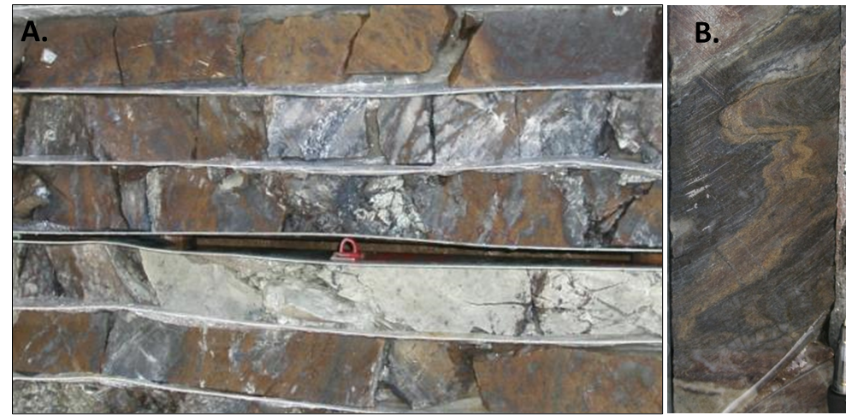
Irish n-Pb Systems
‘MVT’ Spectrum
Li District
Mineralisation in interval of medium- to dark grey limestone with pale green diopsidic calc-silicate and grey silicified limestone
Massive to semi-massive laminated sphalerite and minor galena with pyrrhotite or pyrite
Pre-deformation sulphide-matrix breccias
Sulphide remobilised in the S1 and S2 fabric and syn-deformational durchbewegung breccias in massive sulphide
Minor barite, recrystallised and interbanded with iron sulphide
Pyrrhotite halo
High-grade banded and brecciated sphalerite in pale green diopsidic calc-silicate and medium-grey fine-grained cherty silica.
Laminated sphalerite parallel to S0/1 folded by F2 with small-scale mobilisation into S2 fabric

Slide 16
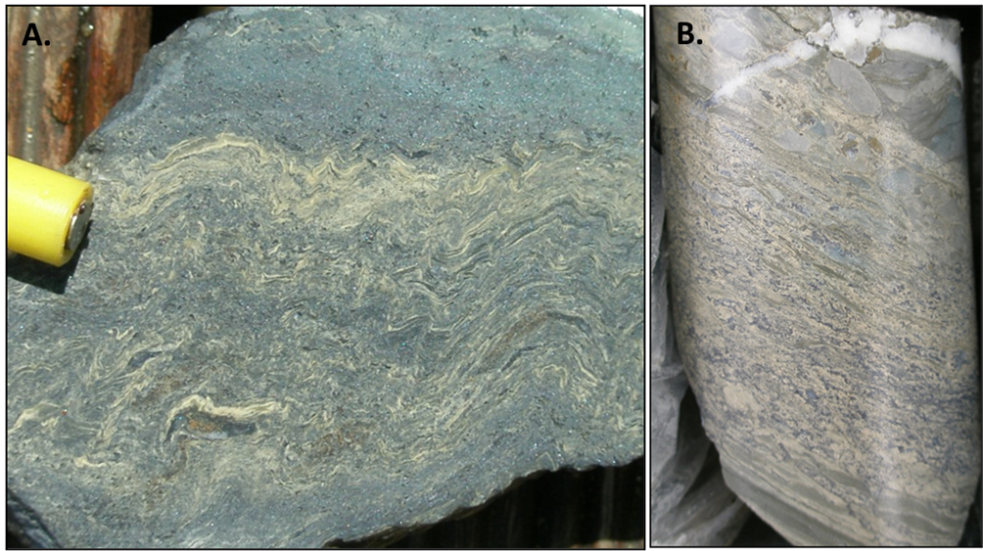
Irish n-Pb Systems
‘MVT’ Spectrum
Kanchanaburi and Bawsaing
Kanchanaburi deposits along a c. 30 km trend
‘Global’ resources c. 8 Mt at grades of c. 7% Pb, 3% Zn and 100g/t Ag
Mineralisation is deformed, isoclinally folded, metamorphosed at lower greenschist facies
Bawsaing district in Myanmar is less metamorphosed and extensively oxidised
Mineralisation similar to Li, low-Fe sphalerite, galena, associated barite, with high Ag, elevated Sb, and Hg at Kanchanaburi
High grade laminated sphalerite-galena mineralisation at Song Tho (Kanchanaburi) showing F2 folding and S2 cleavage.
High-grade pale sphalerite-rich mineralisation replacing coarse intraclastic limestone breccia at Thong Pha Phum (Kanchanaburi)

Slide 17
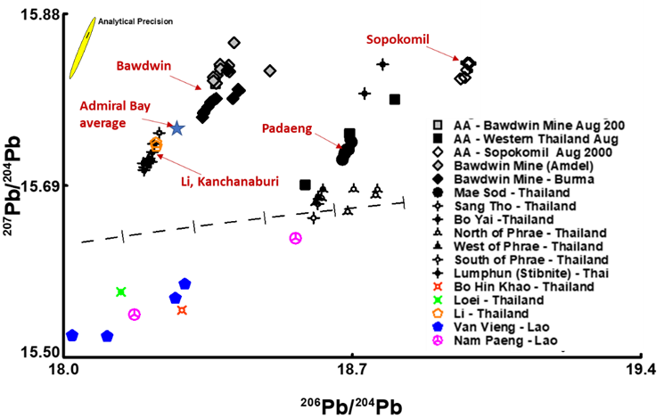
Irish n-Pb Systems
‘MVT’ Spectrum
Sibumasu Ordovician – SE Asia
High heat-flow, synchronous volcanism
Style, setting, and chemistry suggest early replacement origin
Regional basinal fluid-flow event required, initiated by a tectonic trigger
Homogenous, conformable lead-isotope signature – large-scale basinal metal source with similar crustal signature to Admiral Bay and Bawdwin
Lead isotope signatures of selected Southeast Asia mineral deposits (G. Carr, pers. comm., 2005) and Admiral Bay, showing the Stacey & Kramner crustal growth curve
Notes:
Similarities Admiral Bay and Bawdwin

Slide 18
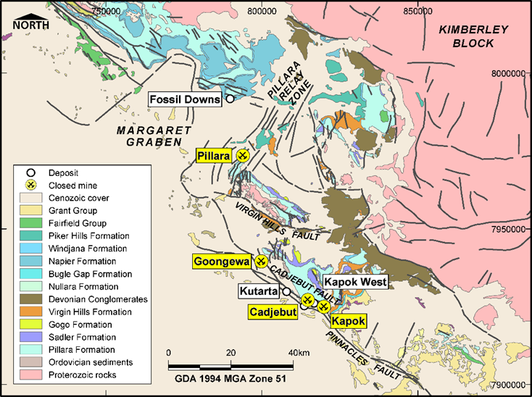
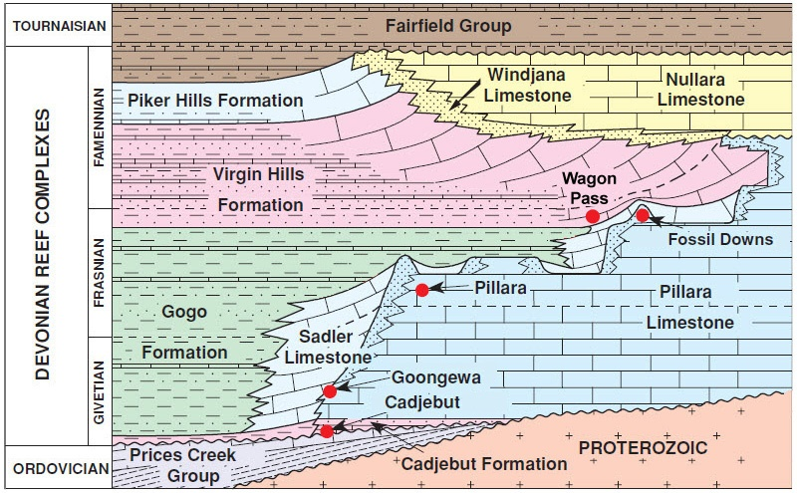
Irish n-Pb Systems
‘MVT’ Spectrum
Lennard Shelf – Canning Basin
Classic Australian MVT district in platform carbonates marginal to the Upper Devonian Fitzroy Trough rift
‘Global’ pre-mining resources >40 Mt at c. 8% Zn and 3% Pb
Mineralisation mostly in unstable syn-rift Pillara Cycle platform, overlain by post-rift Nullara Cycle
Mineralisation is independently dated to earliest Tournaisian, predating any documented inversion or deformation event
Notes:
Point to faults and relays

Slide 19
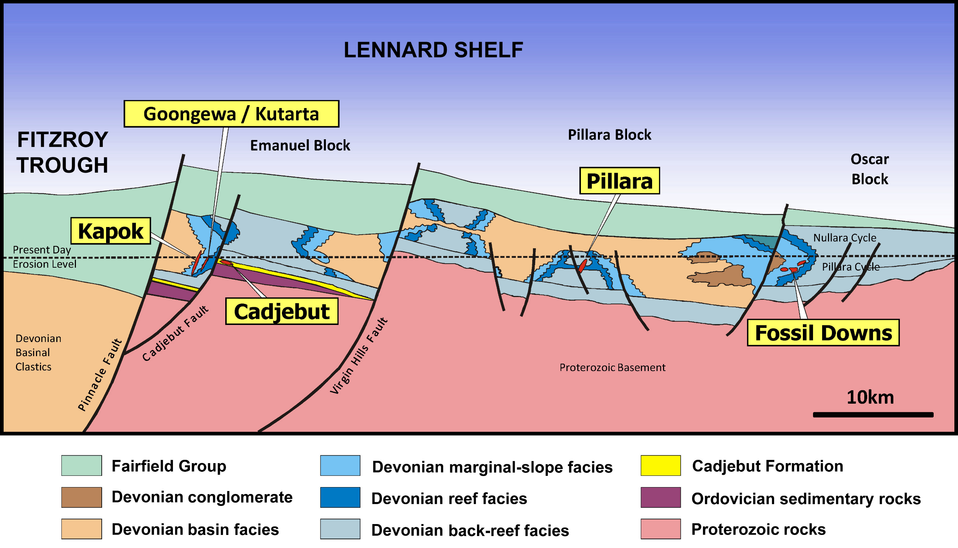
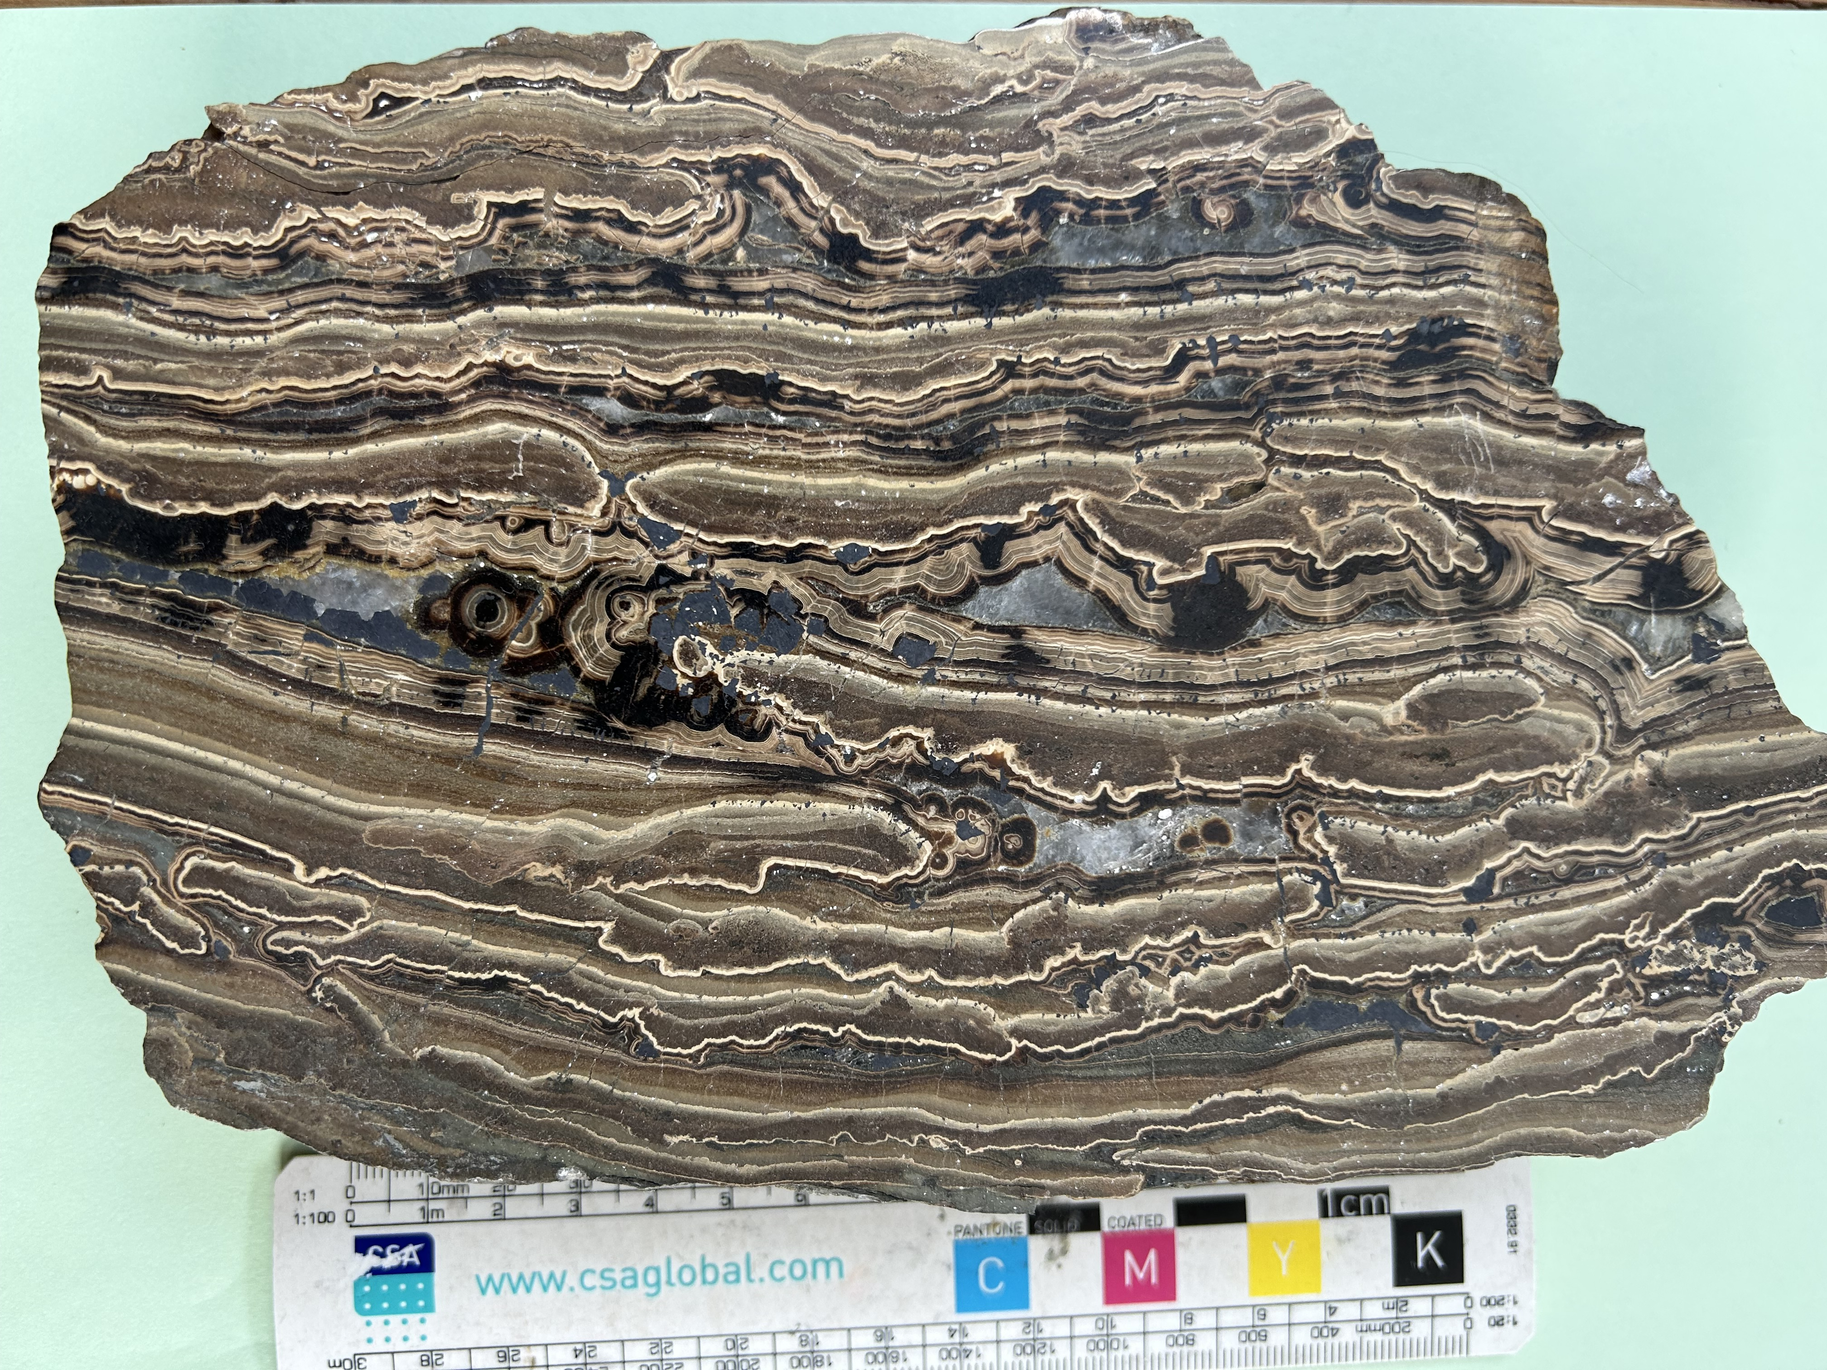
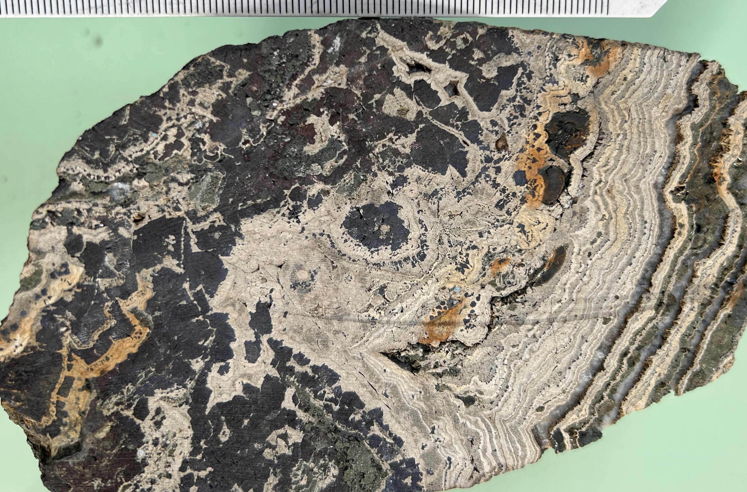
Irish n-Pb Systems
‘MVT’ Spectrum
Lennard Shelf – Canning Basin
Mineralisation on fault-controlled paleohighs
Strongly structurally controlled in relay zones
Mostly in limestone, usually close to a dolomite front
Stratabound replacement (Cadjebut 5.2 Mt at 11.2% Zn, 3.2% Pb)
Hydrothermal karst open-space fill (Goongewa 2.6 Mt at 8.5% Zn, 2.8% Pb, 32 g/t Ag)
Hydrothermal breccia and replacement (Kutarta 2.3 Mt at 7.3% Zn, 0.5% Pb, 39 g/t Ag)
Fault-hosted (Kapok 3.4Mt at 9.3% Zn, 8.2% Pb)
Fault and hydraulic breccia-hosted (Pillara 23 Mt at 7.1% Zn, 2.2% Pb)
Low-iron sphalerite, galena and marcasite, low Ag, barite halo at Cadjebut, some hydrocarbon
Low temperature of formation, TSR, and radiogenic Pb typical of MVT
But mineralisation is syn-late diagenetic, structurally controlled, open-space fill and replacive, and high grade
Notes:
Classic MVT schalenblende textures

Slide 20
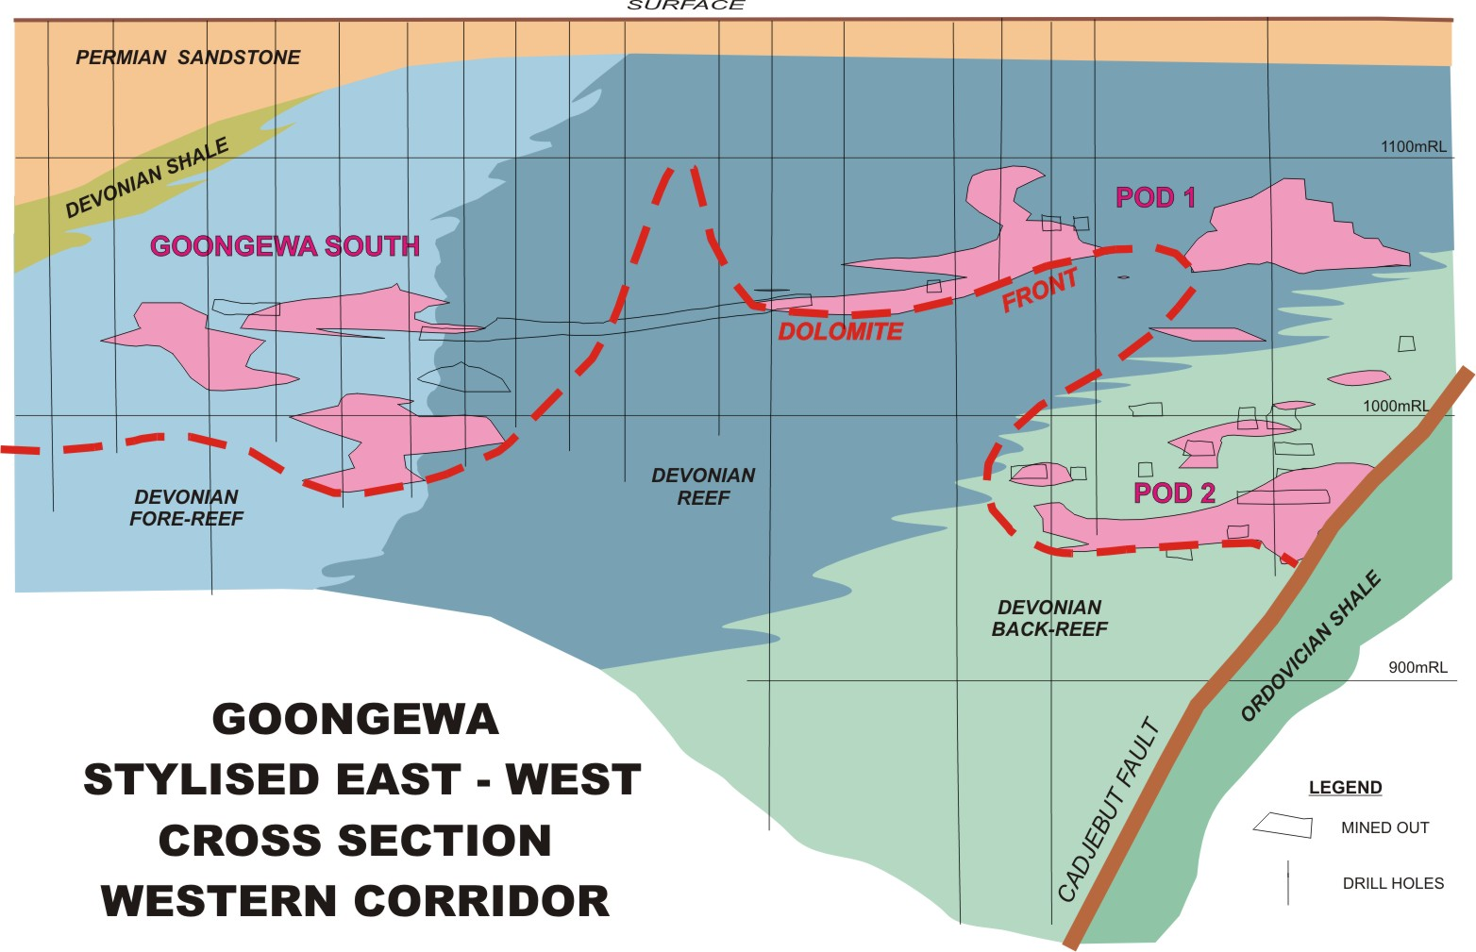
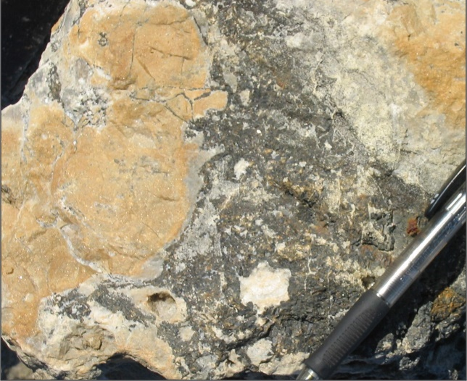
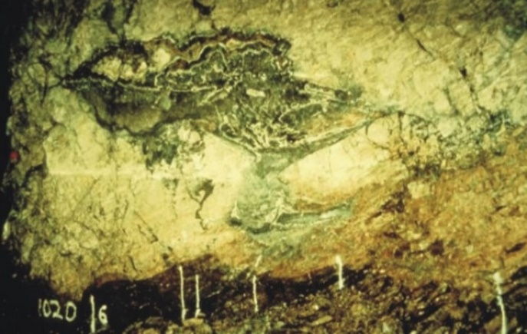
Irish n-Pb Systems
‘MVT’ Spectrum
Lennard Shelf – Goongewa
Mineralisation is localized on fault-controlled
Goongewa hydrothermal karst, cavity fill, and hydrothermal breccias along dolomite front above a fault aquiclude

Slide 21
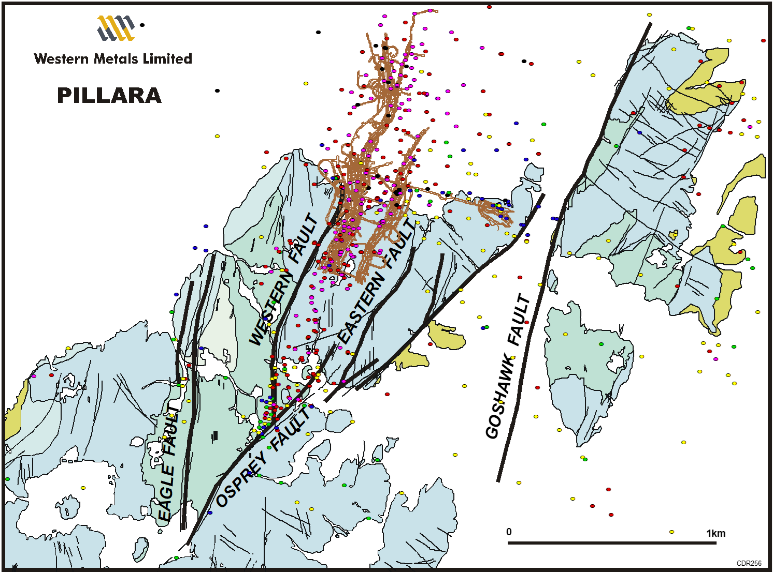
Irish n-Pb Systems
‘MVT’ Spectrum
Lennard Shelf – Pillara
Pillara mineralised hydraulic breccias focused in brittle fenestral unit above the Western Fault and Eastern Fault splay

Slide 22
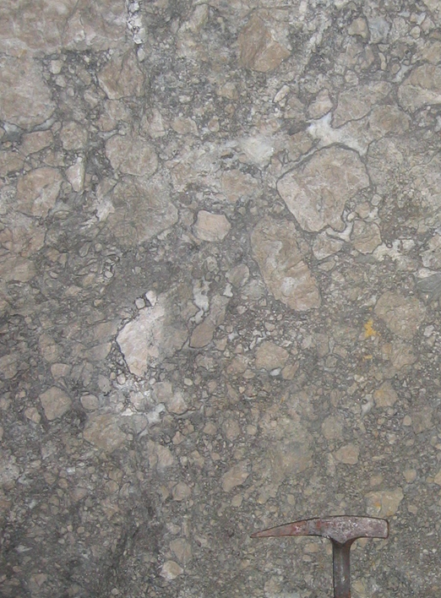
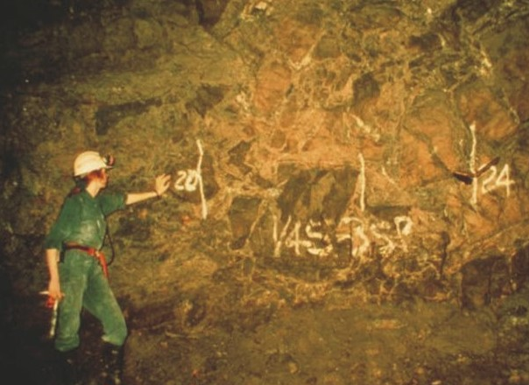
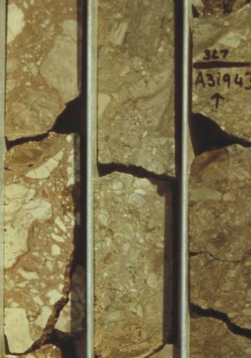
Irish n-Pb Systems
‘MVT’ Spectrum
Lennard Shelf – Canning Basin
Hydraulic to hydrothermal breccias, Pillara, Kutarta, and Cadjebut

Slide 23
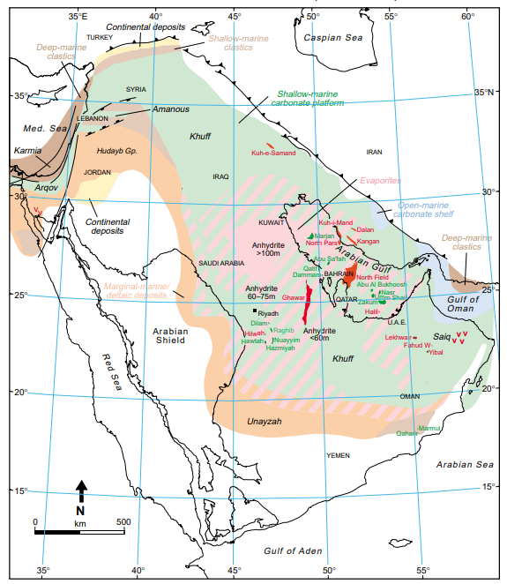
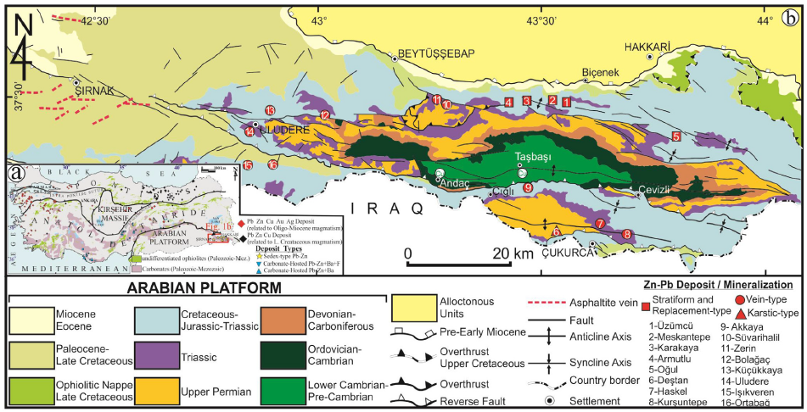
Irish n-Pb Systems
‘MVT’ Spectrum
Hakkâri – SE Anatolia
Stratabound Zn-Pb mineralisation in Triassic carbonates, evaporites and siliciclastics in a c. 80 km belt
Permo-Triassic rift, Triassic-Jurassic sag on northern Gondwana margin
Neogene south-verging fold-and-thrust belt – collision with Central Anatolia along the ophiolite-bearing Bitlis belt
Notes:
N edge of Arabian platform, deformed equivalent of hydrocarbon source regions

Slide 24
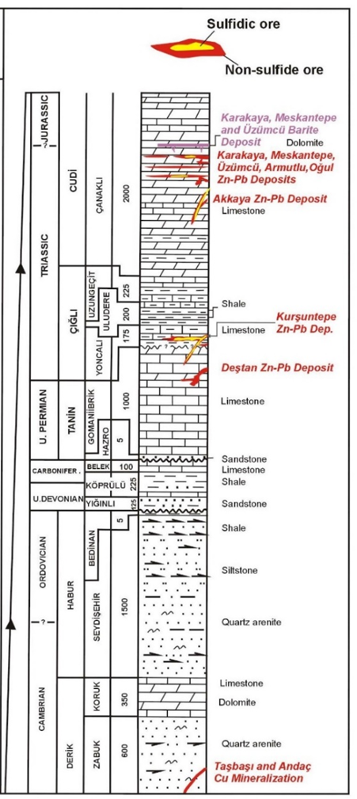
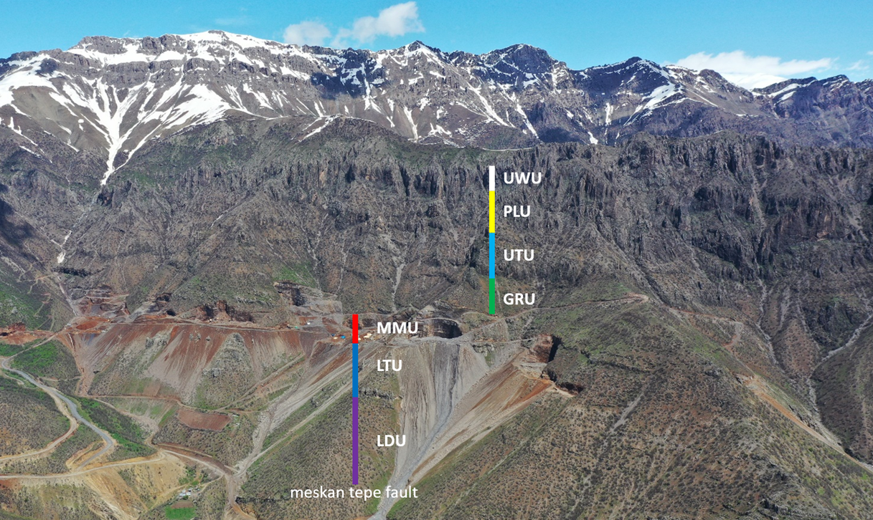
Irish n-Pb Systems
‘MVT’ Spectrum
Hakkâri – Meskan Deposit
Stratabound oxidized mineralisation over c. 10 km
Host bituminous peloidal wackestone, fenestral and algal-laminated micrite; lagoonal to sabkha facies with evaporites
Footwall reduced siliclastic and silty limestone, hangingwall cyclic reduced silty limestone and mudstone up into clean, thick-bedded platform dolostone
Notes:
Worked on for 14 years, great to see FQM committing to serious evaluation
Team in audience
Point to strat on photo

Slide 25
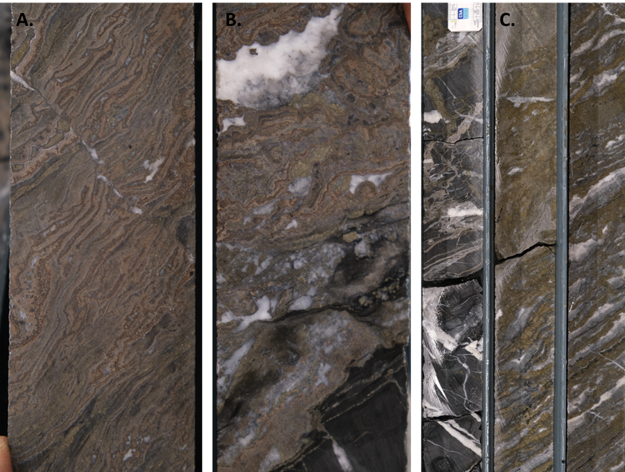
Irish n-Pb Systems
‘MVT’ Spectrum
Hakkâri – Meskan Deposit
Two main 2-10 m horizons in a c. 30 m interval
Preferential replacement of laminated algal limestone within the bituminous to silty limestone sequence
Breccia- and vein-hosted mineralisation especially in interbedded dark-grey bituminous silty limestone
High-grade pale to brown colloform sphalerite with galena, minor pyrite and calcite gangue
Pyrite-carbonate halo with similar zebra textures
Moderate Ag content, elevated As, Sb and Tl
Moderate salinities (2 to 22 equiv. wt% NaCl), evaporated brine component, mineralisation temperatures 160 to 220 °C, BSR sulphur
Colloform sphalerite mineralisation cut by late calcite
Colloform mineralisation with late calcite gangue and mineralised veins cutting underlying dark-grey limestone
Laminated pyrite-calcite fringing the main mineralised zone cut by later pale-brown sphalerite.

Slide 26
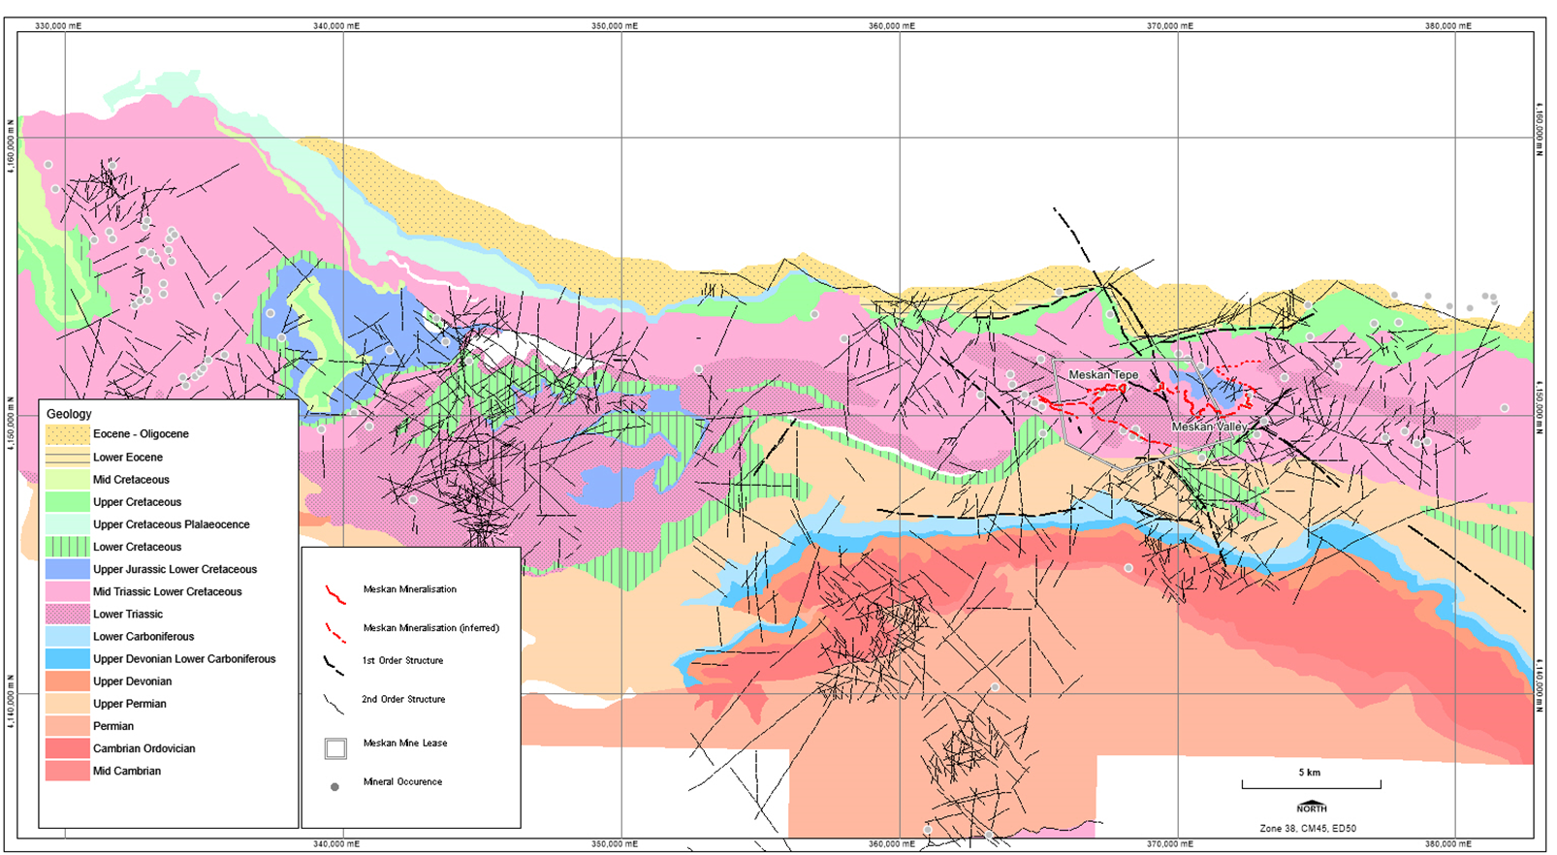
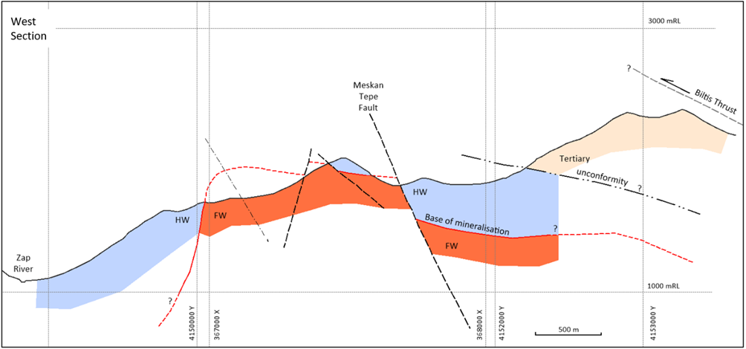
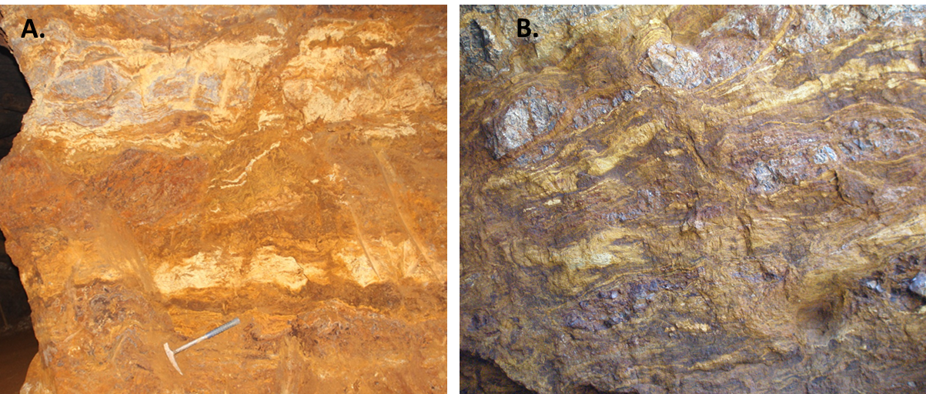
Irish n-Pb Systems
‘MVT’ Spectrum
Hakkâri – Meskan Deposit
Mineralisation predates extensive spar veining related to late folding and faulting
Large, homogenising basinal fluid system, effective bituminous and algal host trap with shale aquicludes in the hangingwall
Lead isotope data are homogenous with a broadly conformable model age
Steep limb of the Armutlu anticline localised by inversion of an earlier extensional structure that fed the system?
Lateral extent and continuity of mineralisation more like a sedimentary copper deposit

Slide 27
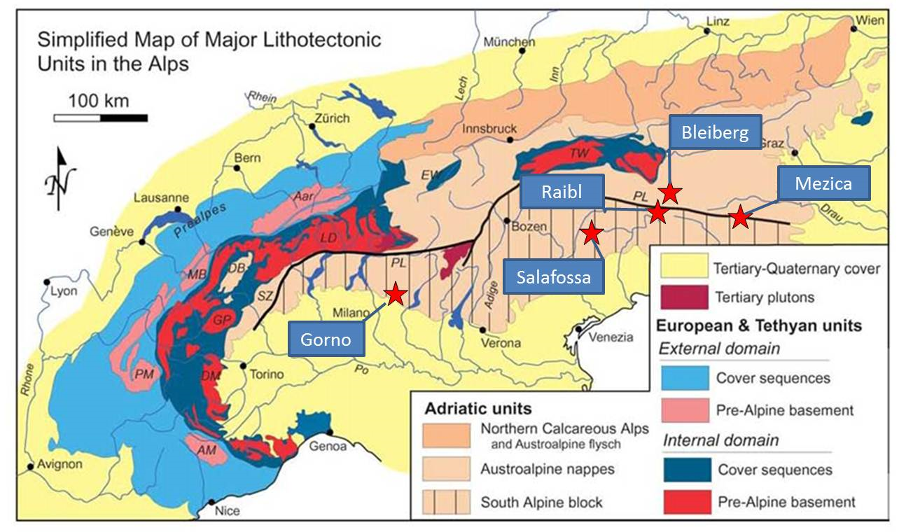
Irish n-Pb Systems
‘MVT’ Spectrum
Alpine District
Adequately described elsewhere, long posited as Irish Midlands analogue and strong similarities to Hakkari
Deposits within Upper Triassic platform carbonates in the southern Alps over a distance of about 400 km
Extensional rift-sag basin setting
Laterally extensive mineralisation with similar lead-isotope signature
Early diagenetic timing with BSR and biogenic sphalerite
Trapping reflects interaction of a metalliferous brine with a BSR sulphur source in a reducing carbonate environment
Bleiberg (global resources of c. 2.5 Mt of Zn+Pb), Mežica (global resource of c. 19 Mt at 5.3% Zn, 2.7% Pb) and Gorno (Mineral Resource of 7.06 Mt at 6.9% Zn, 1.8% Pb, and 33 g/t Ag

Slide 28
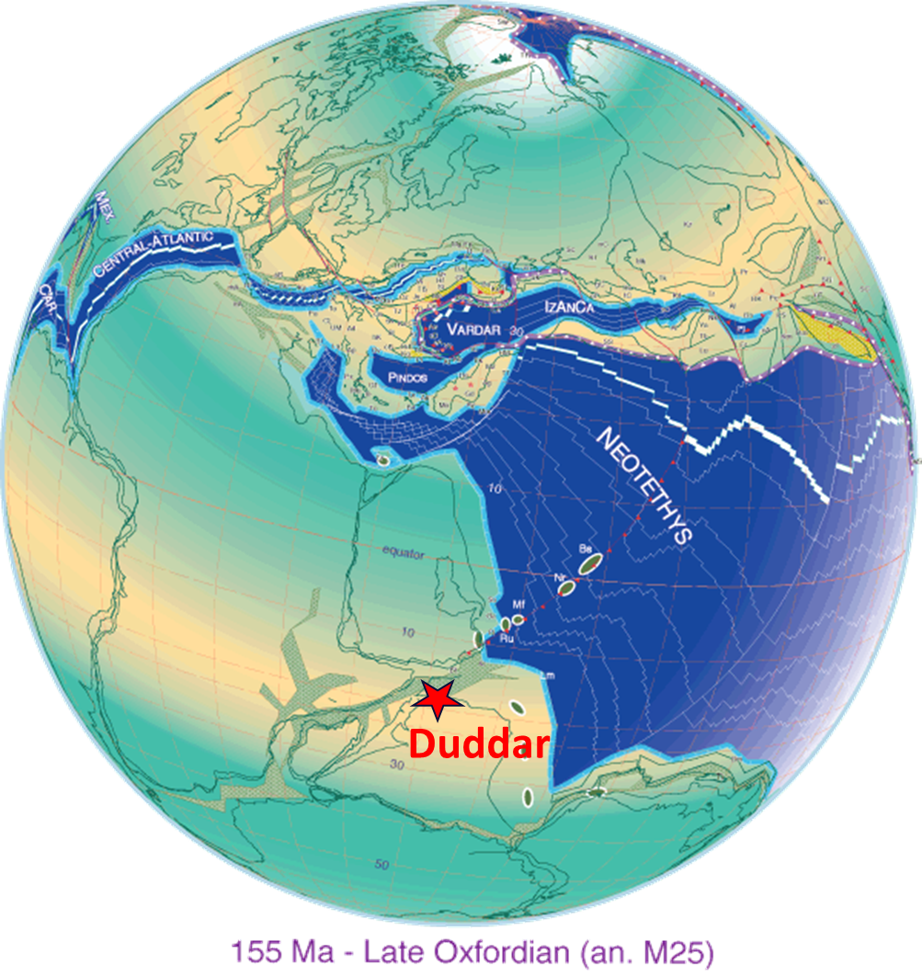
Irish n-Pb Systems
‘MVT’ Spectrum
Duddar – Lasbela-Khuzdar belt
Triassic to Cretaceous rift-sag basin on margin of Indian plate
Easterly verging fold-and-thrust belt resulted from Paleocene-Eocene collision with the Iran-Afghanistan plate
Mineralisation near the base of the sag phase sediment in reduced Jurassic carbonate rocks
One of a number of deposits in Jurassic carbonates in the belt
Location of Duddar in the Middle Jurassic
Location of Duddar and Gunga Zn-Pb Deposits

Slide 29
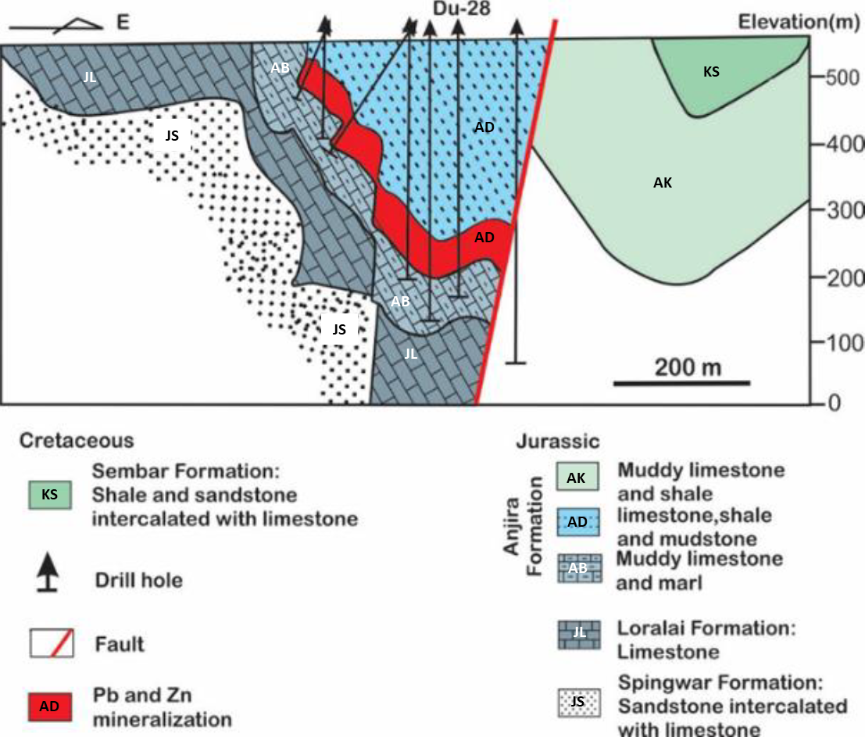
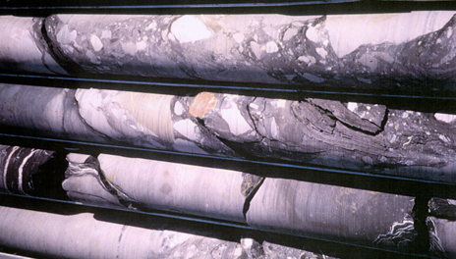
Irish n-Pb Systems
‘MVT’ Spectrum
Duddar – Lasbela-Khuzdar belt
Hangingwall mass flow sediments
1990s exploration by Pasminco reported a resource of 14.3 Mt at 8.6% Zn and 3.2% Pb to 500 m, with high-grade mineralisation extending to 1,400 m
Stratabound mineralisation replaces thin bedded carbonaceous argillaceous limestone with algal laminites and anhydrite pseudomorphs
Hangingwall, fault-controlled wedge of mass flow sediments thins southward from 600 m to 0 m in the extreme south – sinistral strike-slip pull apart sub-basin
Hangingwall mass flow sediments
Sp clast
Sag
Rift
East-west cross section of the Duddar deposit. Modified after Song et al. (2019).

Slide 30
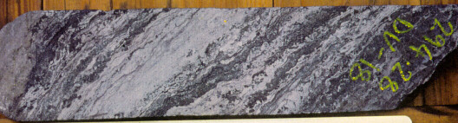
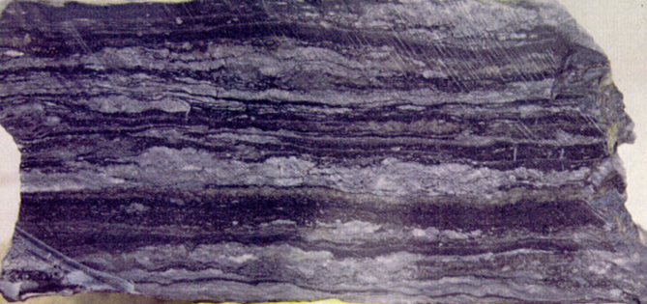
Irish n-Pb Systems
‘MVT’ Spectrum
Duddar – Lasbela-Khuzdar belt
Lower Zinc Zone: sphalerite replaces thin-bedded laminated algal limestone interbedded with carbonaceous limestone and mudstone
8 to 10 m of nodular limestone and calcareous mudstones separates from
Upper Pyrite Zone: nodular to massive pyrite in carbonaceous and calcareous mudstone
Progressively replaced by sphalerite to the north (proximal), passes into banded barite to the south and west
Stockwork vein-hosted sphalerite-galena with minor chalcopyrite underlies stratiform zones in the north and cuts upwards
Associated with proximal silicification, and ankerite and dolomite alteration extending hundreds of metres
High-grade pale fine-grained sphalerite replaces algal or bacterial laminite in bedded carbonaceous limestone and mudstone, NQ core
Laminated barite and mudstone laterally equivalent to the Pyrite Zone mineralisation to the north. Field of view 10 cm

Slide 31


Irish n-Pb Systems
‘MVT’ Spectrum
Basin Côtier - Gabon
Gabon sector of the ‘Aptian Salt Basin’ complex on the West African margin
Zn-Pb discoveries by BRGM (1960s-1980s)
2022 Apollo Minerals Exploration Target of 140 to 300 Mt at between 2.0% and 3.4% Zn+Pb
Mineralisation over c. 135 km on NNE-trending segment of South Gabon sub-basin margin; right-step syn-rift relay across the N’Komi lineament
Neocomian-Barremian rifting: up to 4 km of alluvial and lacustrine sandstones, shales, organic-rich mudstone and marl, with syn-rift volcanism
Overlain by 800-1000 m Late Aptian evaporites (Ezanga Formation)
Albian to Turonian ramp- and shelf-carbonate deposition with lateral thickness variation resulting from initiation of halokinesis

Slide 32


Irish n-TredPb Systems
‘MVT’ Spectrum
Kroussou Trend – Dikaki Embayment
Middle Aptian host sediments unconformably overlie Paleoproterozoic with km-scale E-W embayments or paleochannels
Rift shoulder – syn-rift sediments highly attenuated or absent
Dikaki embayment: basal fanglomerate breccia, alluvial channels and lacustrine dolostone, overlain by a carbonate-cemented alluvial siliciclastic sequence with lacustrine dolostone interbeds, overlain by organic-rich calcareous sandstone and siltstone
Major rift-stage basin margin faults lie under cover to the east of the unconformity; airborne EM indicates rotated fault blocks within the mineralised zones in the footwall

Slide 33



Irish n-TredPb Systems
‘MVT’ Spectrum
Kroussou Trend – Dikaki Embayment
Stratabound disseminated galena and sphalerite over a c. 100 m interval, strongest in c. 5-20 m interval replacing carbonate cement or clasts in siliciclastic units
Highest grades in clean, coarse arkosic sandstone (2 to 8% Zn and 2 to 30% Pb), controlled by channel geometry
Also semi-massive replacement of dolostone, and veins in basement
Higher grade mineralisation at Niambokamba Embayment, including 6 m at 16.1% Zn and 2.0% Pb, with 4.8 g/t Ag
Similar style, replacing cement in calcareous clastic rocks and more massive replacement in algal carbonate intervals
Top, laminar lacustrine dolostone disrupted in arkose, high grade galena-sphalerite replacement in dolostone and sandstone
Base, coarse arkose with replacive pale sphalerite and galena in matrix
Right, high-grade sphalerite-galena replacing permeable algal carbonate at Niambokamba

Slide 34

Irish n-TredPb Systems
‘MVT’ Spectrum
Kroussou Trend – Dikaki Embayment
Fertile basin – thick reduced arkosic rift sequence with evaporite cap
Large-scale basinal fluid-flow event to bring mineralising brines onto the eastern rift shoulder
Trigger may have been initiation of halokinesis in the Upper Cretaceous in response to extension and sediment loading
Large-scale focus by rift relay zone, local focus by structure, aquifers, channels, and pinch-outs
Trapping through reaction with carbonate and/or reduction by hydrocarbons and the reduced host sequence
Similarities to sedimentary Cu systems, but South Atlantic rift characterised by reduced restricted basin setting rather than thick oxidised rift red-beds
Sedimentary Cu is known in Gabon, Congo and Angola

Slide 35

Irish n-TredPb Systems
‘MVT’ Spectrum
Atlas Miocene – Tunisia
Numerous Zn-Pb deposits across N Africa generally interpreted as ‘orogenic MVT’
In Tunisia, stratabound Zn-Pb deposits occur within post-collisional Upper Miocene-Pliocene fault-controlled pull-apart basins
Bou Aouane (global resource c. 5 Mt at c. 5% Zn+Pb), Djebba, and Sidi Driss produced into the 1980s
Neotethys Permo-Triassic rifting and evaporites, Jurassic to Eocene passive margin carbonate-dominated sedimentation, Oligocene regression
Mid-Miocene collision, foreland fold-and-thrust belt with allochtonous ‘Numidian’ flysch nappes
Late Miocene to Pliocene extensional collapse, playa basins controlled by right-lateral transtensional ENE- and NW-trending faults
Bimodal alkaline volcanism and intrusion
Inverted and uplifted prior to renewed extension and development of Quaternary alluvial rifts
Notes:
Subduction roll-back

Slide 36


Irish n-TredPb Systems
‘MVT’ Spectrum
Atlas Miocene – Tunisia
Majerda basin; Bou Aouane, El Haouaria and Djebba deposits in sub-basins with basal lacustrine carbonates and marls, carbonate-cemented sandstones and conglomerates, overlain by coarse alluvial siliciclastics
Bou Aouane: fault-controlled stratabound mineralisation up to 30 m thick replaces limestone, calcite matrix in sandstone, and in small-scale irregular cross-stratal veins and breccias
Ductile disruption of lamination and bladed barite into soft sediment; mineralisation predates complete lithification
Low-iron sphalerite, galena, very little pyrite, late calcite and minor Sr-rich barite. Footwall vein mineralisation in the Cretaceous has similar mineralogy
Galena-sphalerite in laminated algal limestone
Galena-sphalerite breccia vein with alteration rim, contortion of lamination
High-grade replacive pale sphalerite-galena
High-grade replacement of evaporite-dissolution breccia
Micritic limestone with laminated galena-rich replacement and bladed barite
Bou Aouane cross section
Notes:
Run through textures

Slide 37


Irish n-TredPb Systems
‘MVT’ Spectrum
Atlas Miocene – Tunisia
Sedjnane basin; Sidi Driss, Douahria and Gantra el Haichichi deposits in basal lacustrine algal limestone, reduced bituminous limestone and marl, and calcareous sandstone, coarsening up into younger alluvials
Oued Belif Triassic dome on SW edge of the basin – evaporitic breccias, sediments, Tortonian-Messinian granodiorite, rhyolite and basalt
Sidi Driss: fault-controlled stratabound mineralisation replaces calcareous breccia, sandy limestone and algal limestone within argillaceous and silty marls
Grades and thickness increase to the southeast close to the basin-controlling fault. Minor vein mineralisation occurs in limestone beds within the Eocene marl in the footwall of the controlling fault
Sidi Driss long section
Limestone breccia with replacive galena and pale sphalerite
Recrystallised limestone with replacive galena and pale sphalerite

Slide 38


Irish n-TredPb Systems
‘MVT’ Spectrum
Atlas Miocene – Tunisia
Mineralisation contemporaneous with extensional collapse and localised bimodal alkaline magmatism
Fluid flow triggered by high heat-flow extensional event following Atlas thrust stacking
Metal source in older passive margin sediments tectonically loaded by nappe emplacement
Deposits controlled by fault architecture and relays
Trapping by reaction of oxidised or mildly reduced basinal metal-bearing brine with carbonate and/or reduction by hydrocarbons in reduced sequences; local sulphur source and BSR at Sidi Driss
Barite and celestite may also reflect a local evaporitic source for sulphur
Similarities with other Neogene syn- to late-orogenic systems, such as Angouran (Iran) and Jinding (Yunnan) in the Tethyan belt
Notes:
Rif arc collision

Slide 39

Irish n-TredPb Systems
‘MVT’ Spectrum
Other Districts
Morro Agudo in the Neoproterozoic Bambui Basin in Brazil, dolostone host overlain by mudstones in fault hangingwall
Deposits in Neoproterozoic to Silurian platform carbonates on the ancestral N American margin, marginal to the Selwyn Basin and equivalent settings; Robb Lake, Prairie Creek, Pend Oreille etc.
Gays River in the Visean in Nova Scotia – similar geological setting, temperature, and isotopic characteristics to Irish deposits
Reocín and other late Aptian-hosted deposits in the Basque-Cantabrian basin, uncertainty remains over age of mineralisation
Mehdi Abad in Iran (c. 218 Mt at 7.2% Zn, 2.3% Pb, and 51 g/t Ag), tectonically unstable platform Aptian carbonates; setting, geometry, syn-diagenetic replacement, chemistry, and alteration are similar to Irish deposits
Nanisivik in Mesoproterozoic carbonates bordering the Borden Basin, dominated by replacement, mineralisation age constrained to slightly younger than the host rocks following extensional faulting

Slide 40


Irish Type Zn-Pb Systems
Irish Type Zn-Pb Systems
Irish Type Zn-Pb Systems
Implications – is this important?
Irish Midlands Zn deposits are the most economically attractive deposits after SHMS, more favourable metallurgy than VMS or CRD
Falling discovery rates and higher discovery costs – the imperative for an improved systems-driven exploration paradigm to guide exploration under cover and in new provinces
Identifying analogous systems is important for project generation and identification of fertile basins, and in guiding exploration within basins
The complexity of mineral systems demands a heuristic and empirical targeting approach, incorporating mineral system understanding, rather than theoretical models and modelling
Data source S&P Global Market Intelligence, 2017
Zn metal discovered (adjusted for estimated Zn metal that has been or will be produced), production, and predicted future discovery; Richard Schodde 2017

Slide 41
Irish Type Zn-Pb Systems
Irish Type Zn-Pb Systems
Irish Type Zn-Pb Systems
Mineral Systems Targeting
Syn-basinal mineral systems encompass a range of carbonate-hosted deposit characteristics and economics
Need to define empirical criteria for mineral systems that host economically attractive deposits most analogous to the Irish Midlands, including (amongst others):
        Large and long-lived rift-sag basin with thick (>4 km) immature arkosic and lithic rift fill (and/or successor basin setting)
        High heat flow with volcanism in rift and/or sag phase
        Low-latitude setting with carbonate platforms, evaporative brine-generating margins, and hydrocarbons
        Tectonically active platform, extensional event
        Mixed carbonate and siliciclastic facies, fine grained and reduced limestone
        Absence of paleokarst, excluding early microkarst
Higher temperature, large-scale alteration, strong structural control & feeders, replacement, high Fe content, evaporated brine signature, conformable Pb isotopes, elevated Ag-Sb-As-Hg, BSR v. TSR, etc.
Thermal maturity, metal extraction from fertile source, fluid focus
Effective leaching & transport
Fluid flow trigger and focus
Fluid flow focus & trapping
Notes:
We have illustrated the diversity of deposit styles and economics

Slide 42




Irish Type Zn-Pb Systems
Irish Type Zn-Pb Systems
Irish Type Zn-Pb Systems
Aspects of the Irish Mineral System

Slide 43
Irish Type Zn-Pb Systems
Irish Type Zn-Pb Systems
Irish Type Zn-Pb Systems
Targeting Basinal Zn-Pb Systems
Targeting new basins without demonstrated mineralisation presents the greatest challenge in generative sediment-hosted exploration for Zn or Cu
Understanding of different types of carbonate-hosted systems, and relationship to other basinal systems, is critical in basin-scale targeting and ground selection
Especially challenging in tectonically dismembered basins – focus on empirical criteria and signature of known mineralisation and ‘smoke’
Shared basinal criteria for SHMS and Irish-type deposits can facilitate a more effective approach in basins which are exclusive of ‘typical’ syn-orogenic MVT systems
But a systems-based, bespoke approach recognising diversity is essential …..
Targeting in each basin should be based on understanding developed in that basin, in the context of a broader system model, rather than on attempting to classify deposits that defy easy classification

Slide 44

Irish Type/MVT – Model
Irish Type Zn-Pb Systems
Irish Type Zn-Pb Systems
Irish Type/MVT - Model
These are not new ideas, but we remain fixated by models; attempts at mineral deposit taxonomies are fruitless and often misleading
Synthesis of MVT and Irish-type/high grade MVT systems, Peter Muhling, c. 2000

Slide 45


Dr Neal Reynolds
Partner
Neal.Reynolds@csaglobal.com

