Slide 1
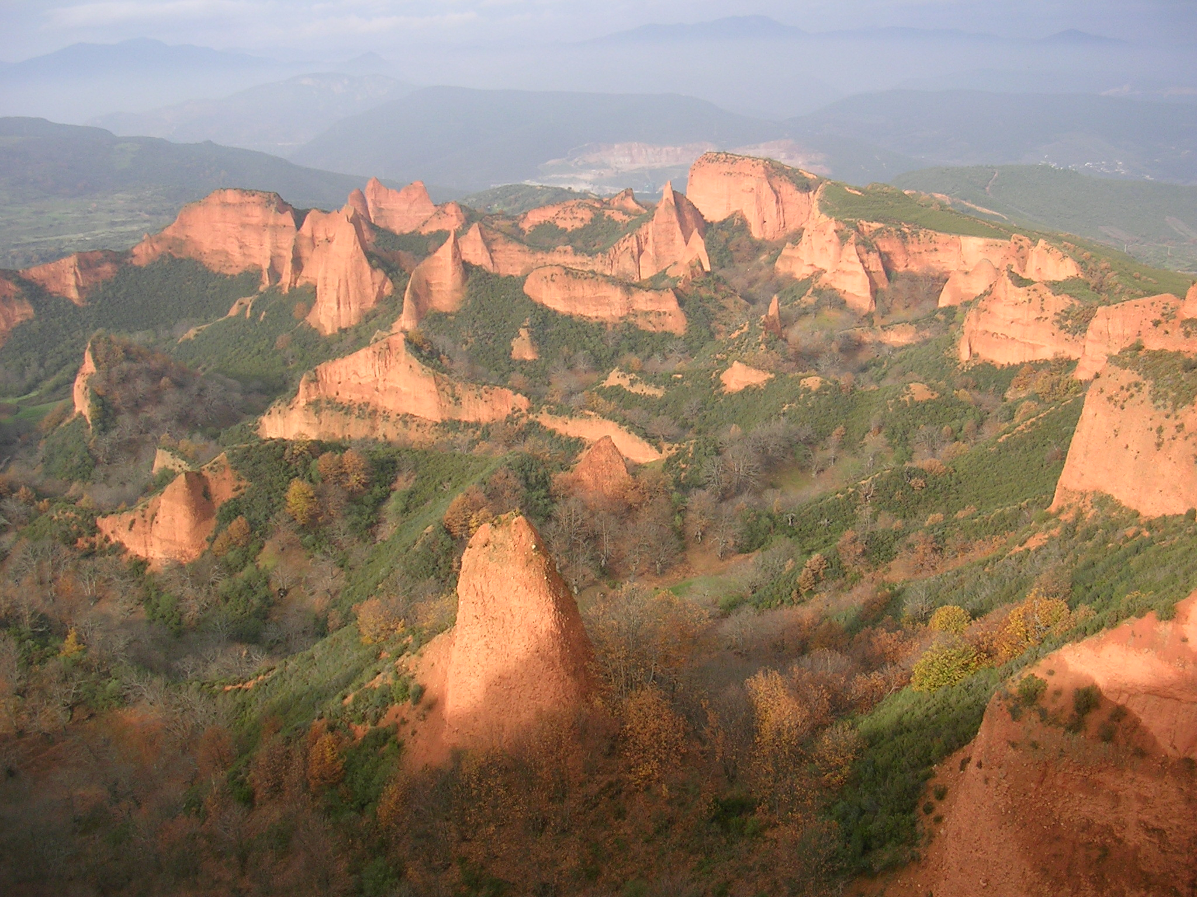




The Zn-Pb-rich belt of NW Iberia.
A syn-tectonic stratabound mineralization?
Fernando Tornos, Lluis Boixet, Maria Zaparain, Luis Perez & Fidel Ribera
Notes:
A lo largo de los más de 30 años de actividad investigadora he seguido una línea de investigación uniforme con un motivo central y único: EL ESTUDIO DE LAS ROCAS GRANÍTICAS con un fin esencial: CONOCER LOS PROCESOS DE GENERACIÓN Y RECICLAJE DE CORTEZA CONTINENTAL

Slide 2
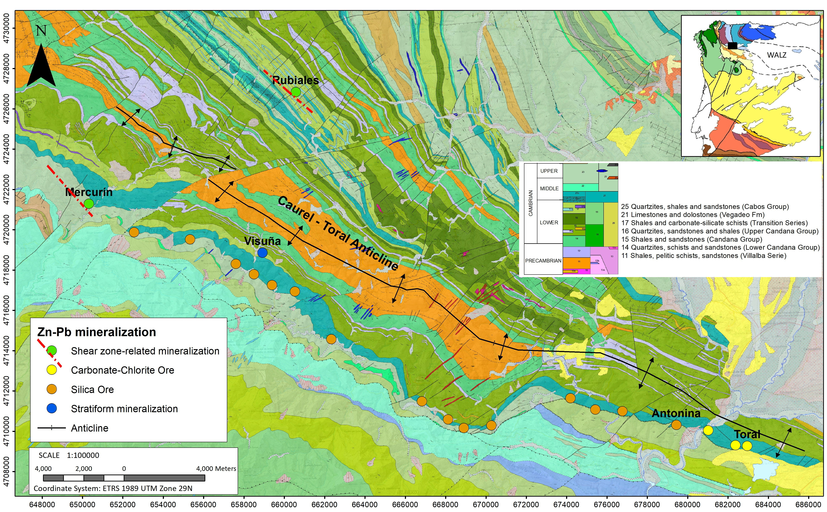
The Zn-Pb Belt
Discovered 1967
Mined out 1977-1991 (EXMINESA)
18.6 Mt @ 17.3%Zn & 1.3%Pb
Zn
Zn+Pb
Discovered 1975
Unmined
Evaluated 1975-1980 (SMMPE), 1980-1985 (ENADIMSA), 2018- (Europa Metals)
20 Mt @ 4.4%Zn, 2.8%Pb & 23 g/t Ag
Historical mine
1965-1972 (Rio Kumer)
Evaluated 1972-1978 SMMPE
4.74 Mt @ 5.5% Zn & 4.39%Pb

Slide 3
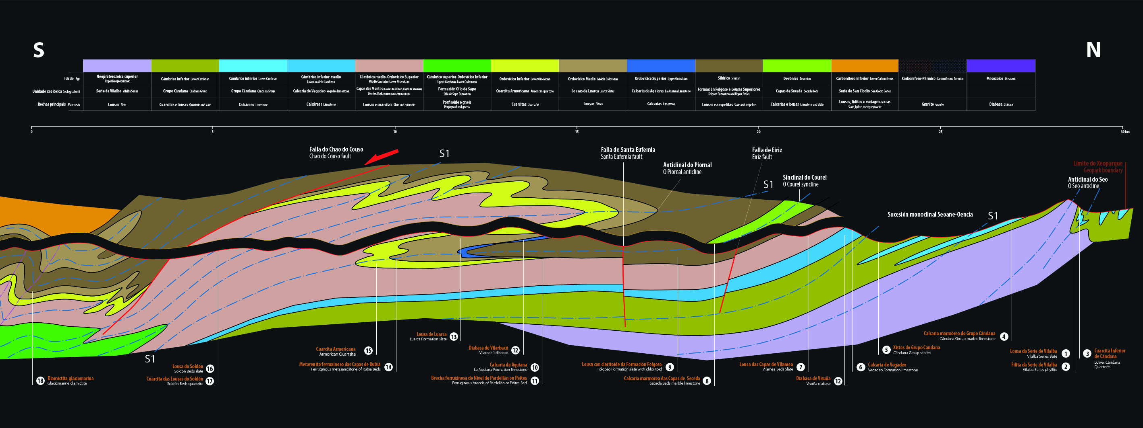
Stratabound control

Slide 4
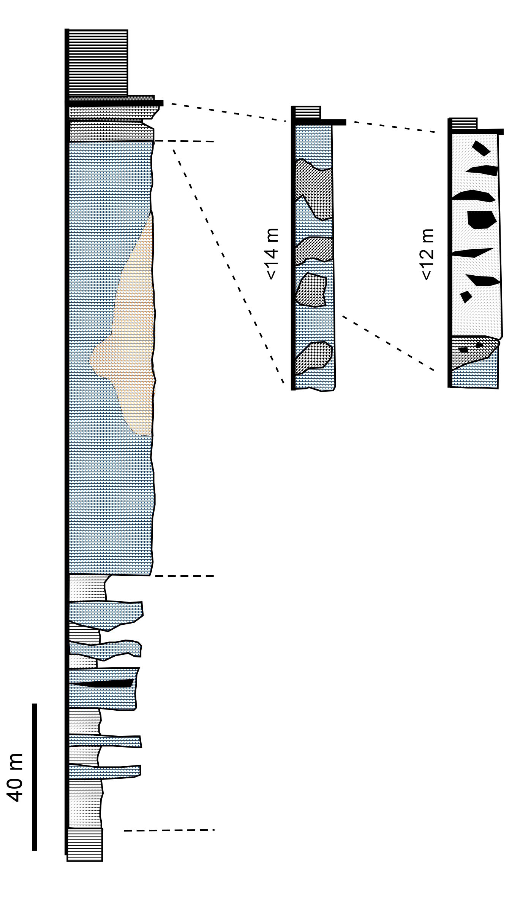
Stratigraphic section and mineralization
Los Cabos Fm (>1,000 m; CA₂-O₁)
Early Cambrian regionally extensive limestone unit
Regionally extensive (barren) dolomitization
Discontinuous Zn-Pb Belt in SW Europe
  Sardinia & Massif central
Four types of mineralization
  (A) Stratiform mineralization in V₁ (+barite)
  (B) Silica-rich ore in V₃
  (C) Carbonate-chlorite ore in V₃
  (D) Shear-zone controlled in V₁
Fe-poor Hg-bearing sphalerite – galena
Pyrite, chalcopyrite, As-Co-Ni sulfides, tetrahedrite, bismuthinite, Pb-Bi-Ag sulfosalts
V₃
B
C
V₂
Vegadeo Fm (CA₁₋₂)
Silica Ore
Carbonate-chlorite Ore
A
V₁
D
Candana Fm (≈1,600m; CA₁)

Slide 5
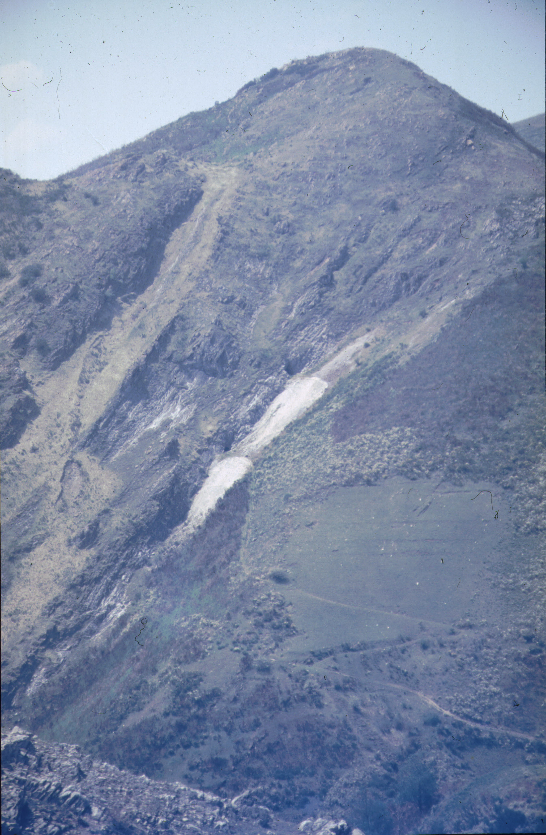
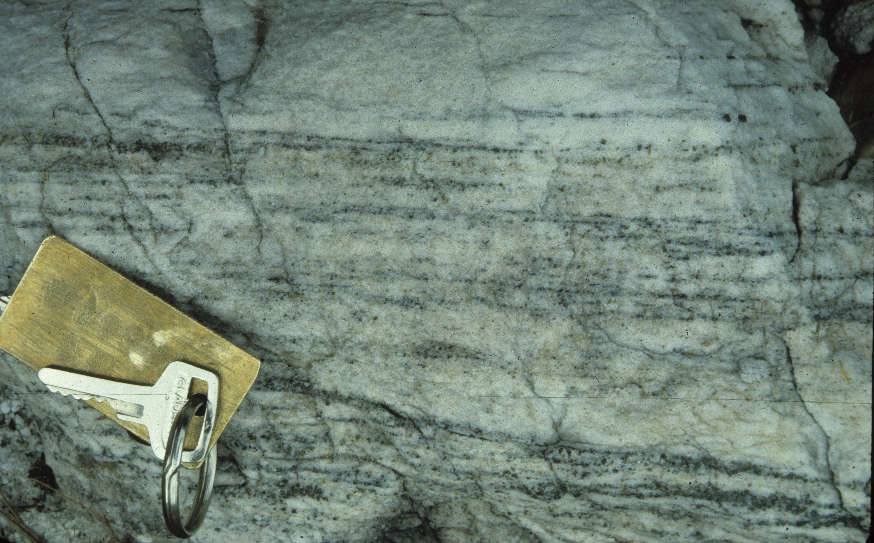
The protore: early diagenetic stratiform mineralization?
Abundant low grade stratiform mineralization in V₁
Hosted by unaltered oolitic bars
Most likely protore: do high grade deposits represent their hydrothermal remobilization?

Slide 6
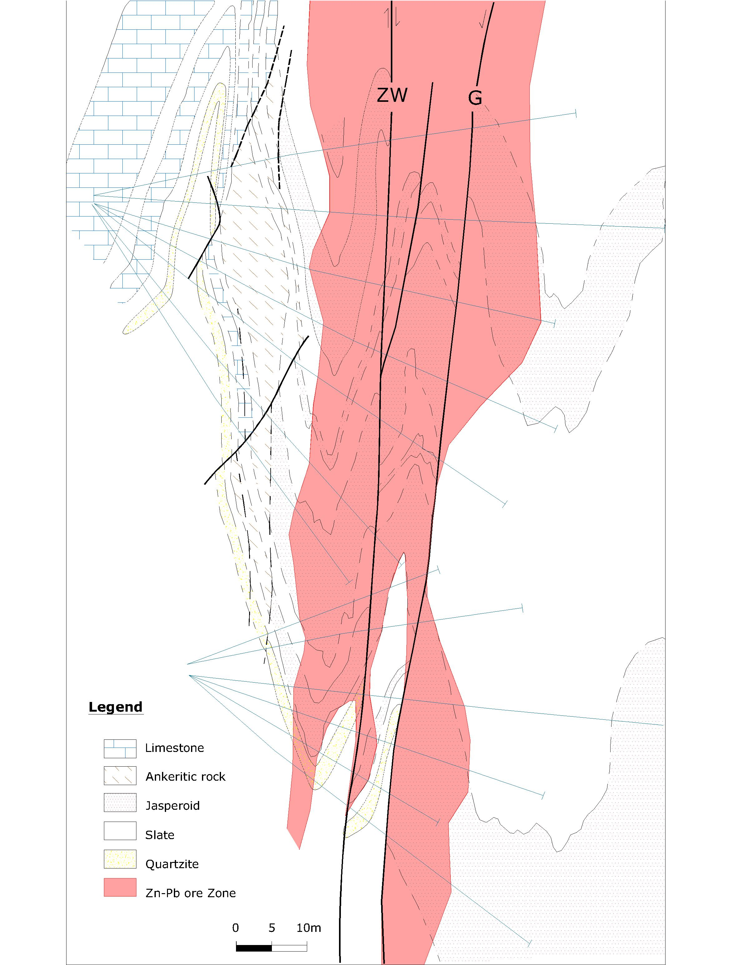
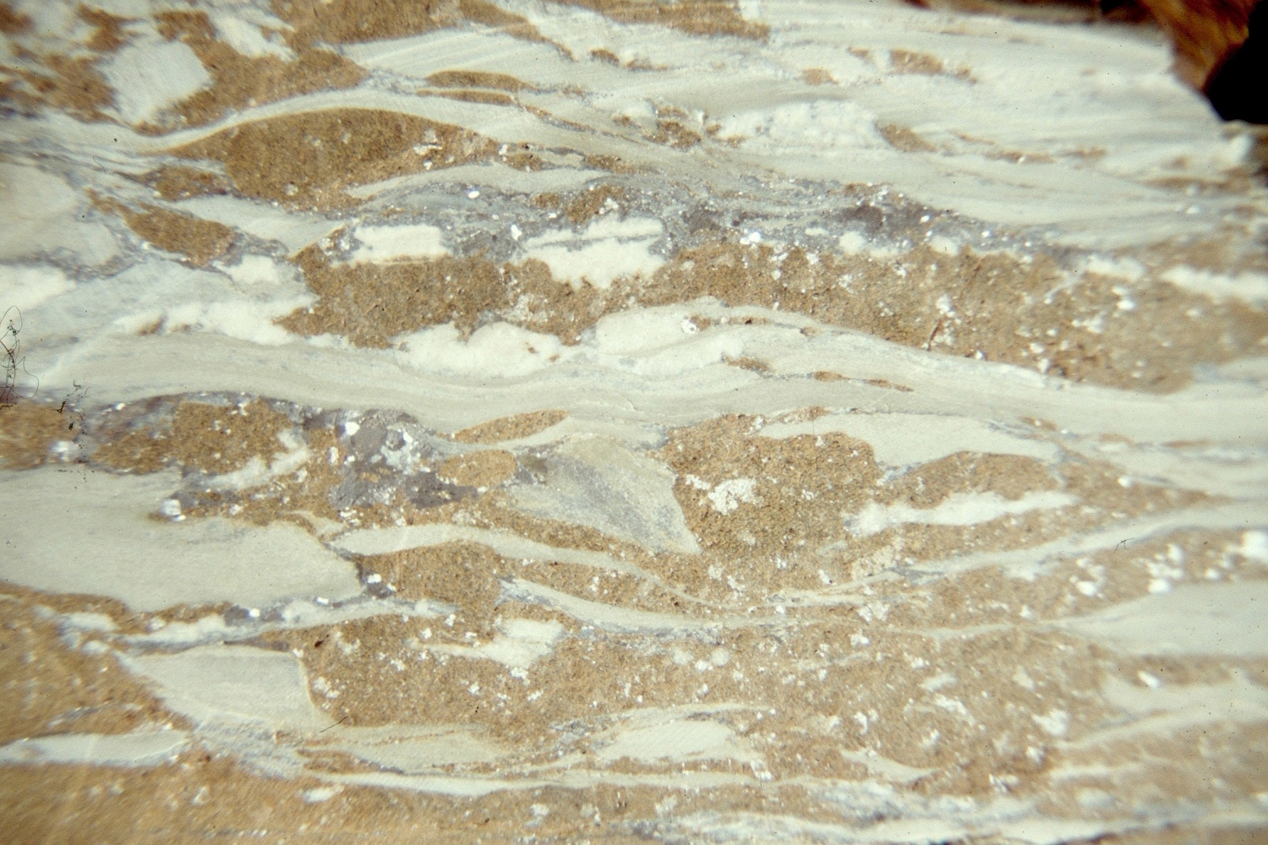
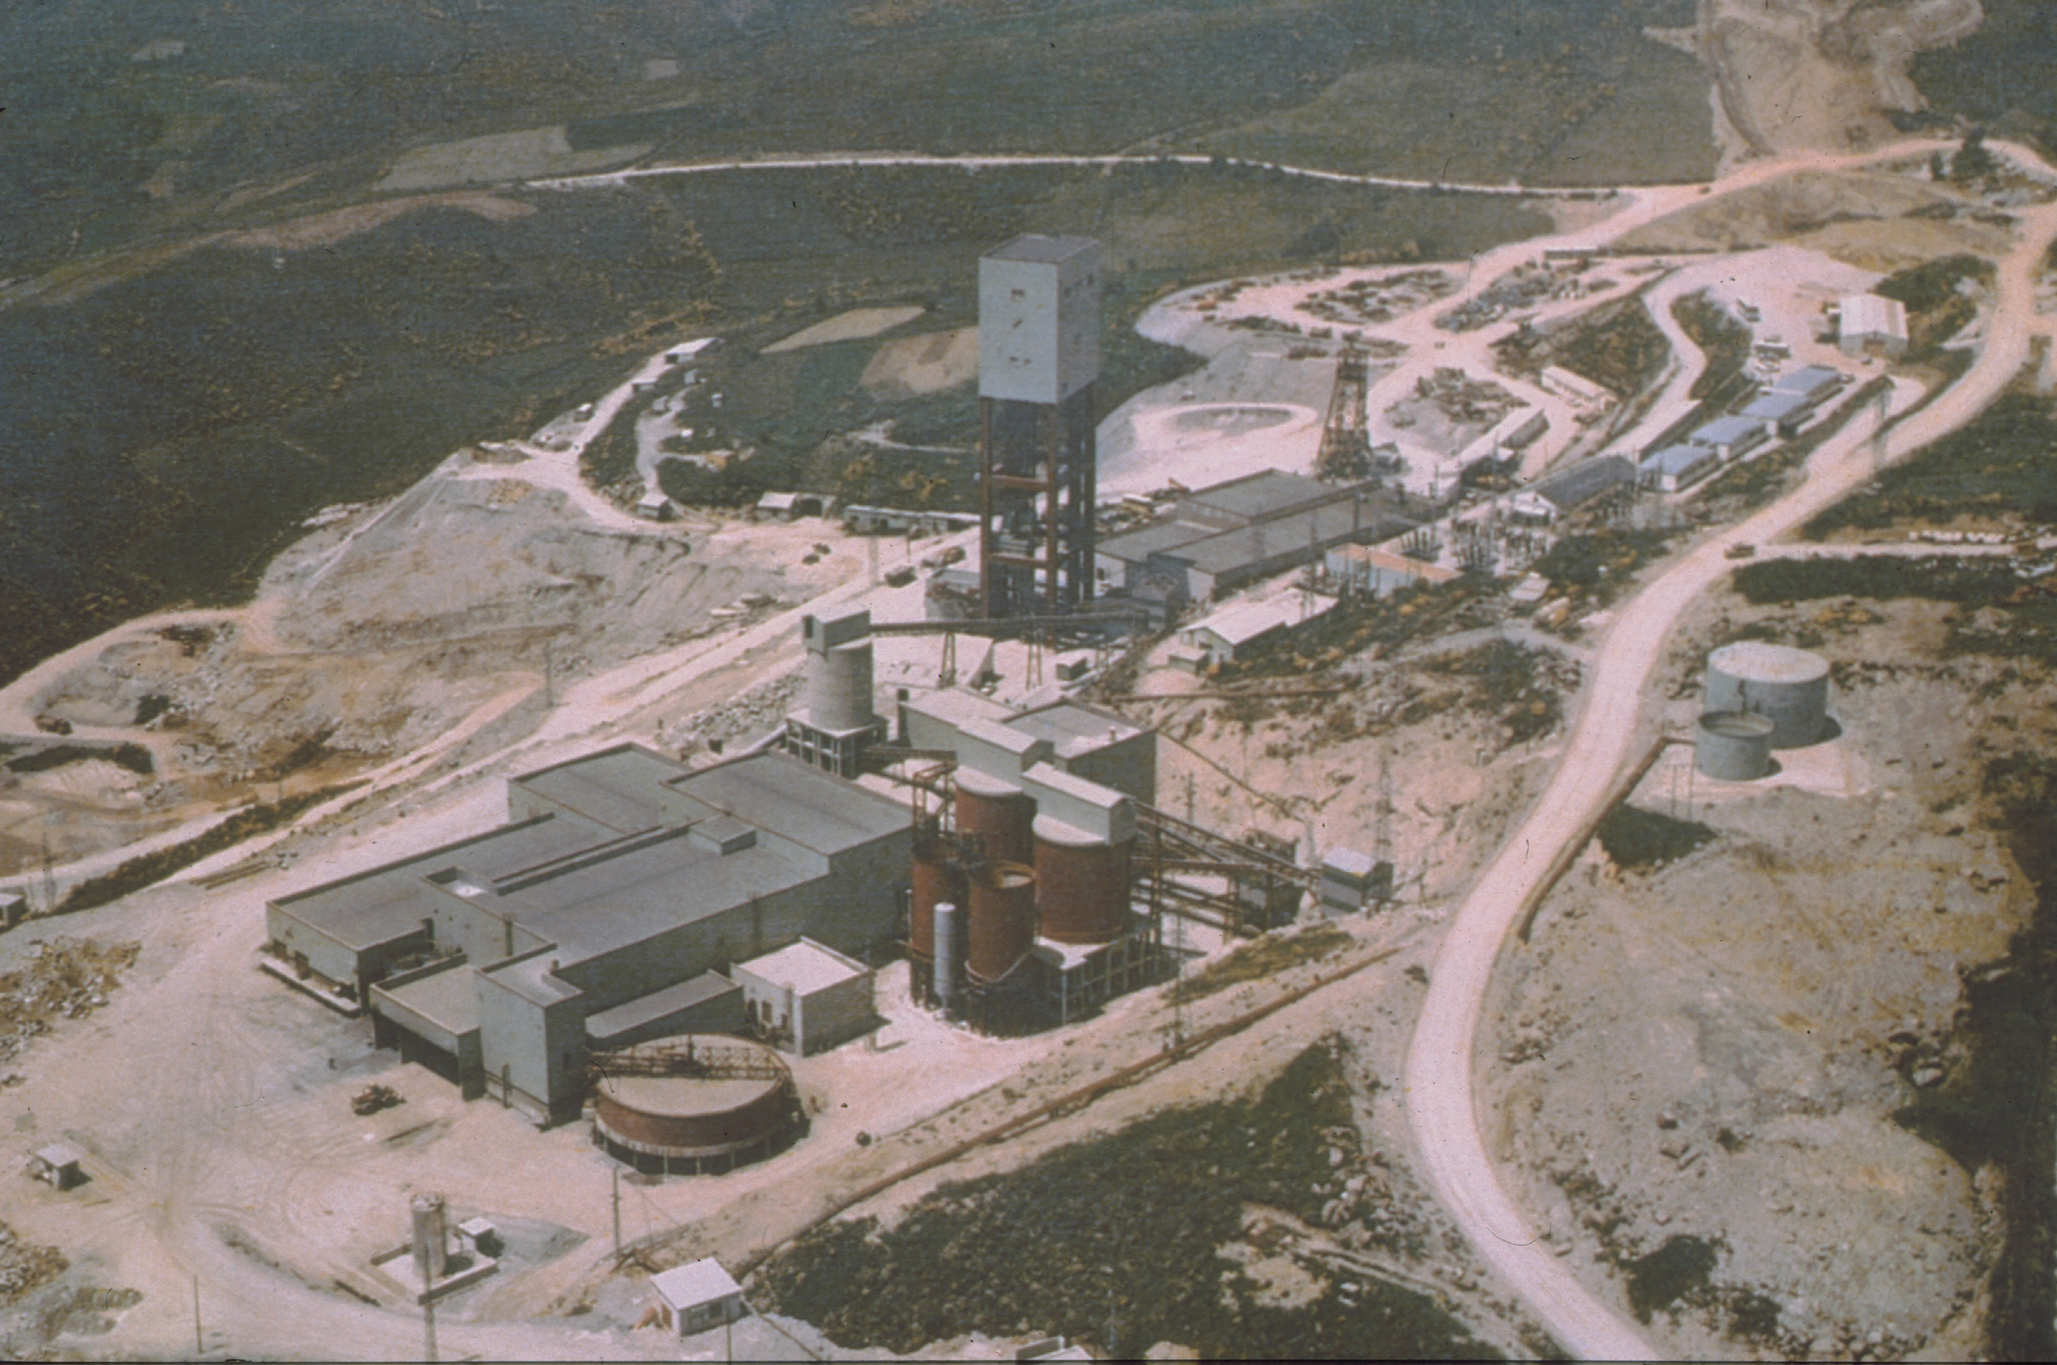
Shear zone-related mineralization (V₁)
Rubiales mine (+ Mercurin)
Ore controlled by D₃ vertical shear zones
  Massive ore replacing silicified limestone
    External halo of ankerite
  Veins and breccias in shale with phyllic alteration
Significant enrichment in py-po / late chloritization
Rubiales

Slide 7
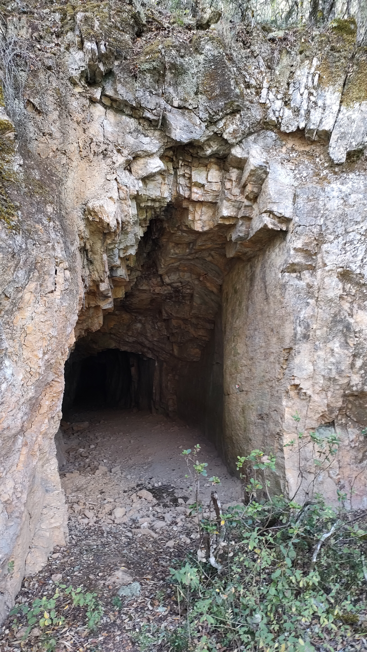
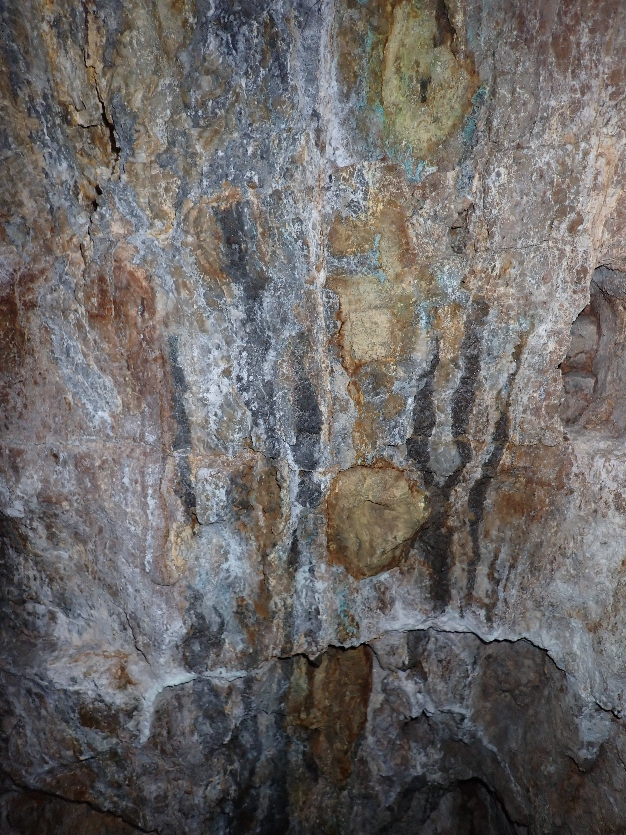
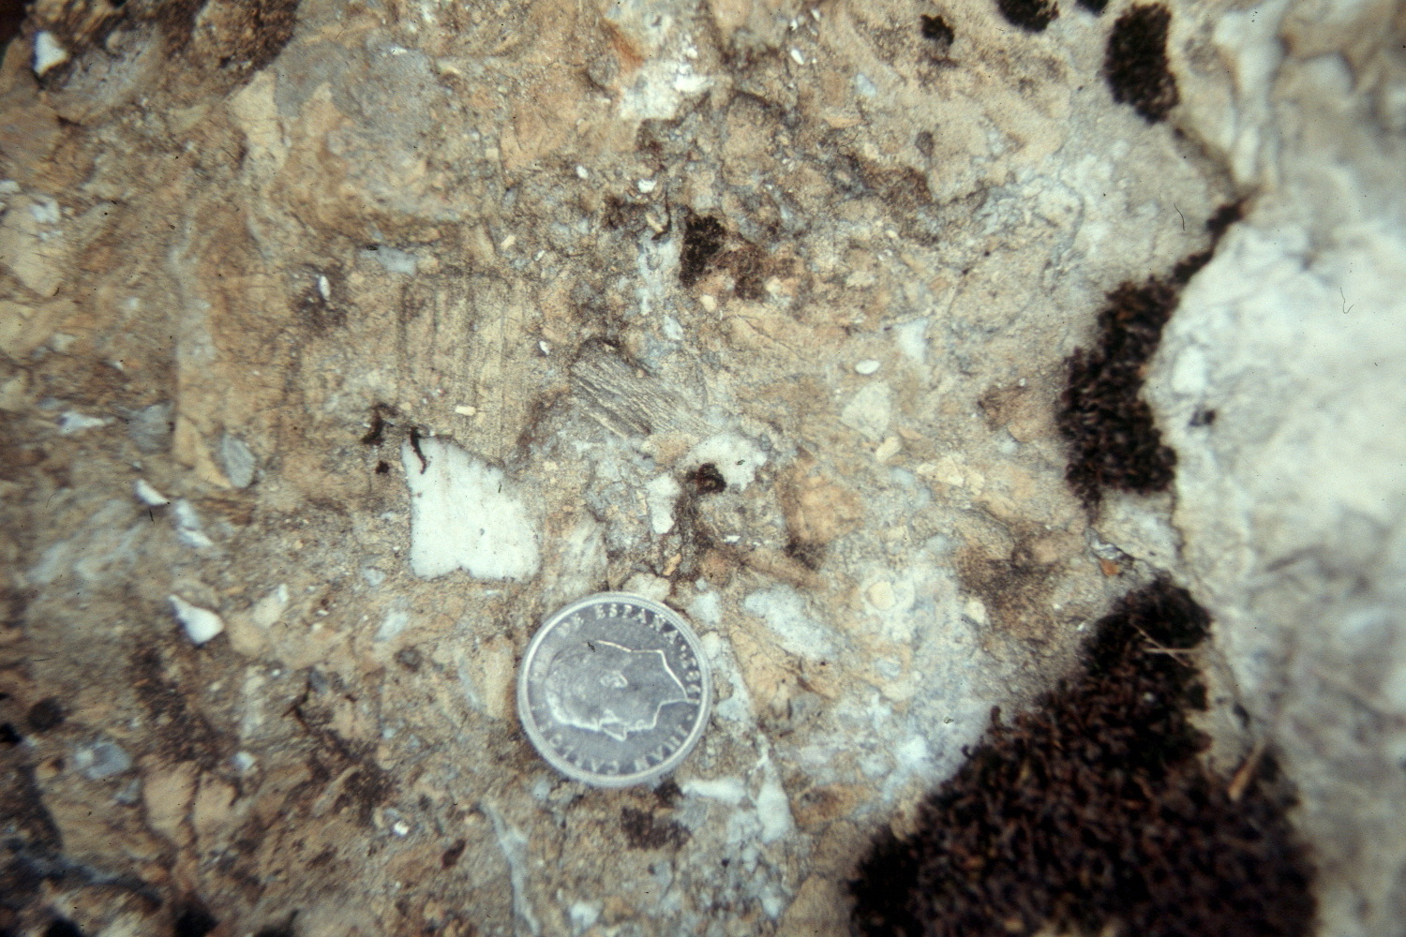
Stratabound mineralization: silica ore (V₃)
Contact V₃ - shale
Tens of small prospects variable grade & tonnage
Regionally extensive multistage silicification (>40 km)
Small front of mineralized polymictic breccia supported by dolostone
do
shale

Slide 8
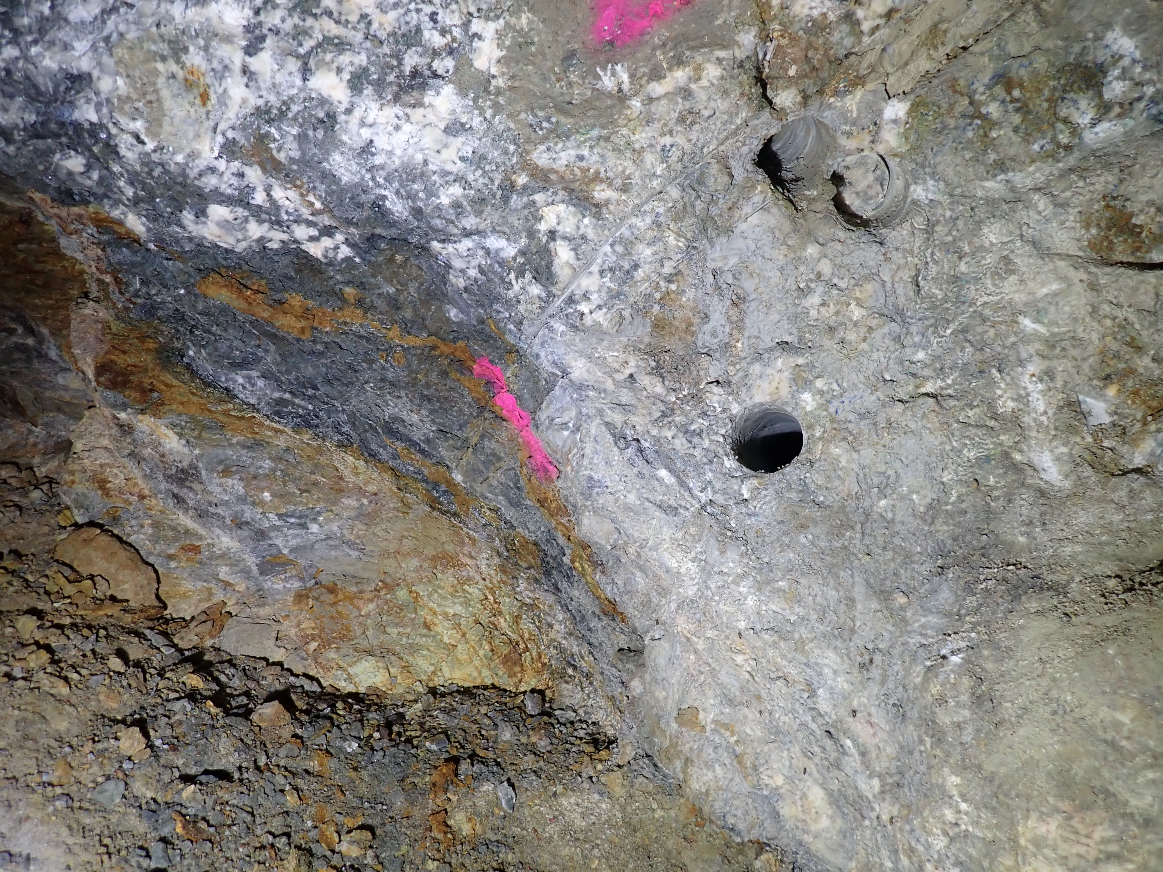
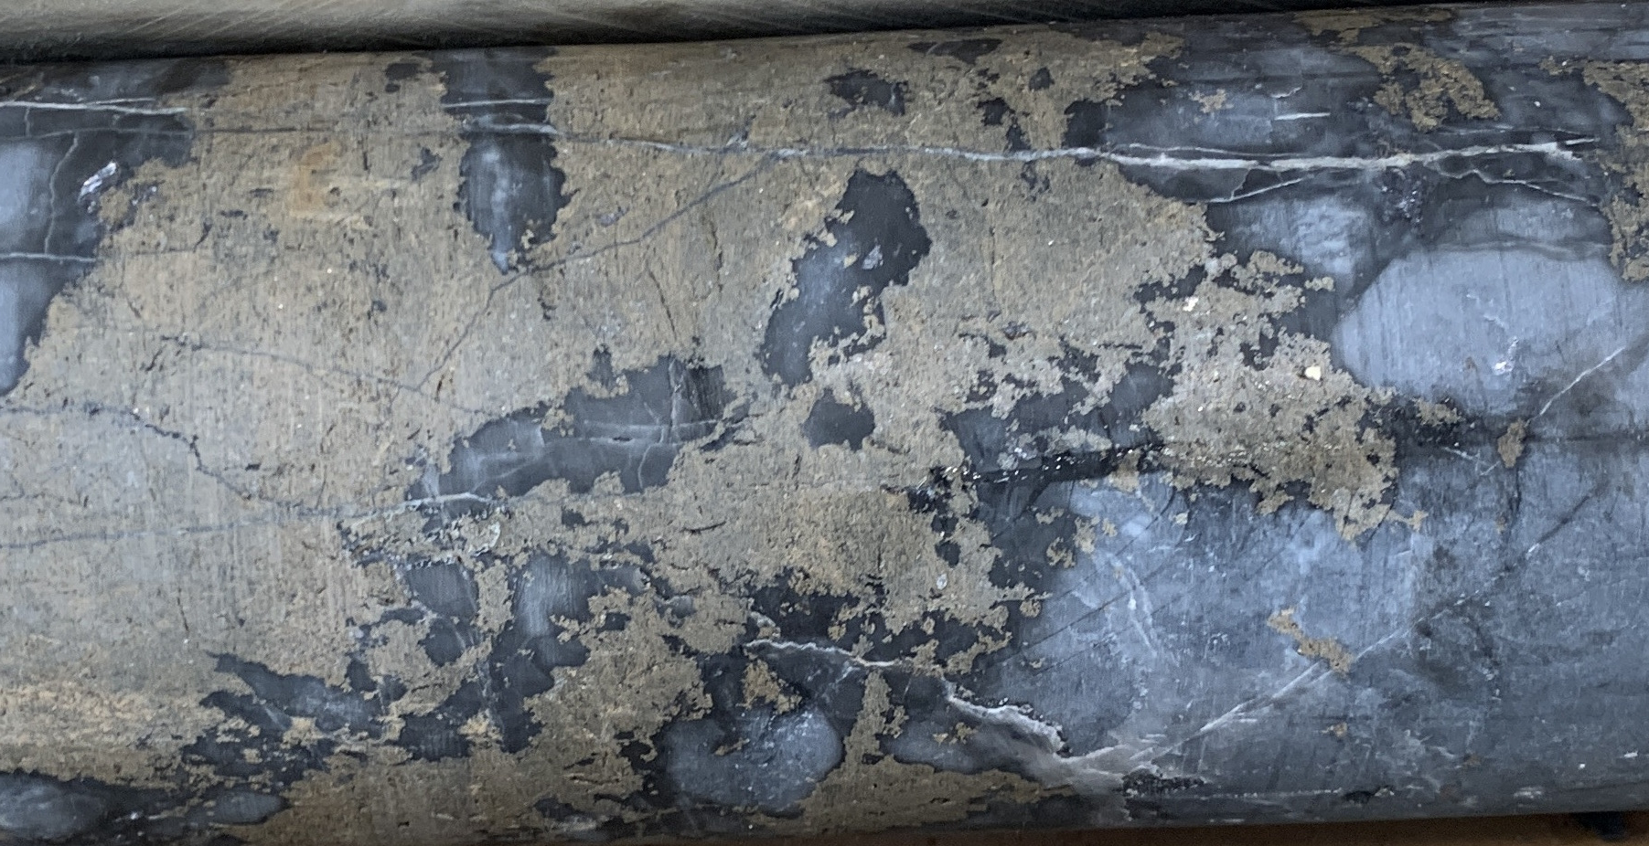
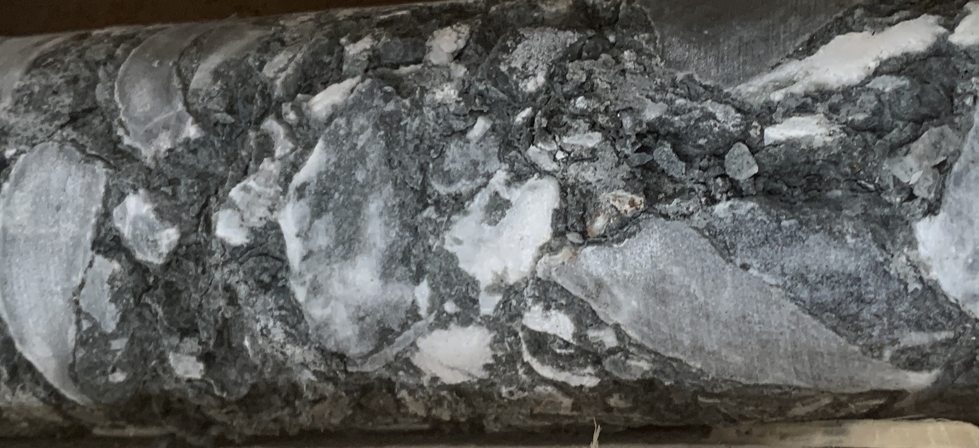
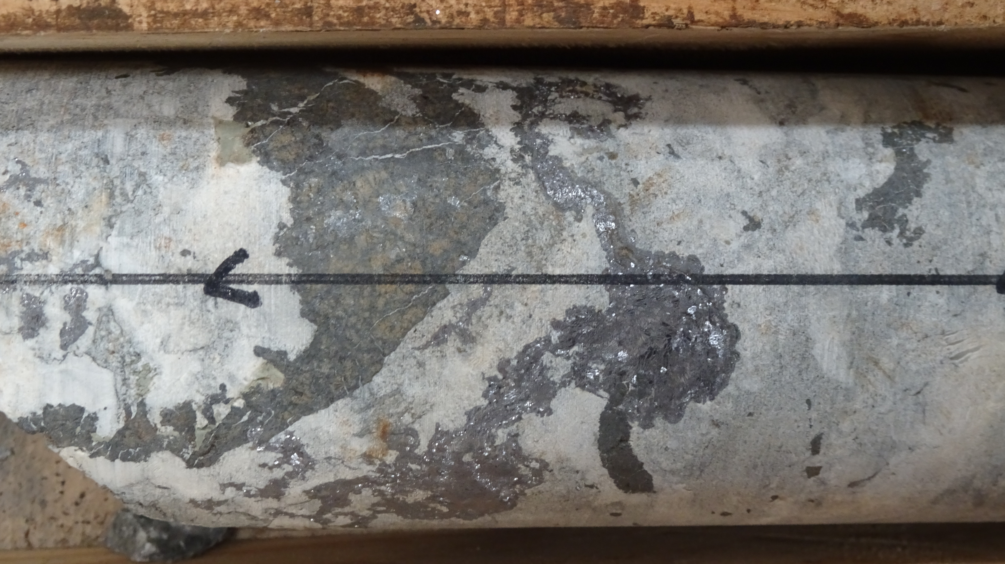
Stratabound mineralization: carbonate-chlorite ore (V₃)
In the southern part: Toral and Antonina projects
Lateral to silica ore: Sharp contact (?)
Replacing limestone and stockwork/veins in external halo
Chlorite ± clays ± calcite supporting carbonate-(shale) breccia: crackle to heterogeneous
Dissolution of limestone accompanied by precipitation of phyllosilicates and sulfides
Breccia
Silica ore

Slide 9
Origin of metals and fluids: lead isotopes

Slide 10
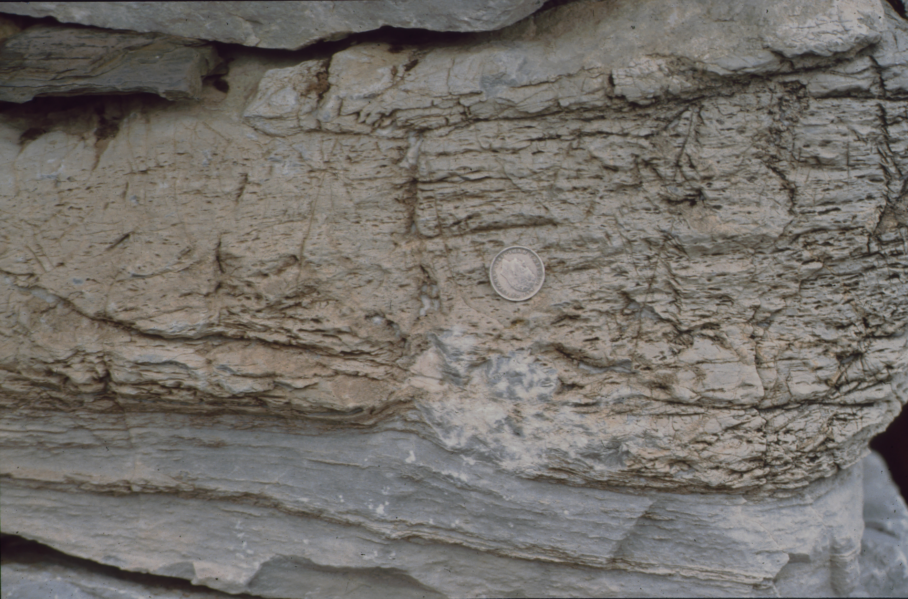
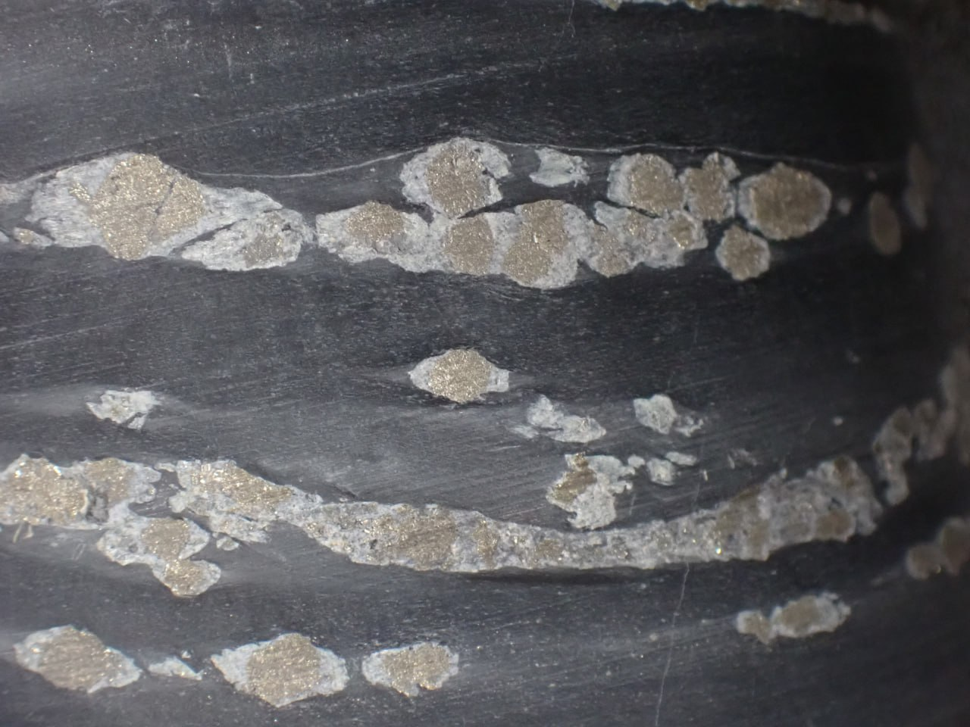
Sulfur isotopes
Seawater sulfate
δ³⁴S ≈+27 to +30‰
Algal/microbial mats
(Fast) biogenic reduction in a system poor in organic matter
minimal fractionation
Stratiform mineralization (V₁)
δ³⁴S +28.2 to +35.0‰
Ghosts of evaporites
Shear zone-related mineralization (V₁)
δ³⁴S +25.6 ±0.5 (sph) 22.5±0.5 (gn)
Stratabound mineralization (V₃)
δ³⁴S +18.2 to +25.3‰
Diagenetic pyrite in shale
δ³⁴S +9.8 to +15.9‰
Mixing from two sources (ca 50%?)

Slide 11
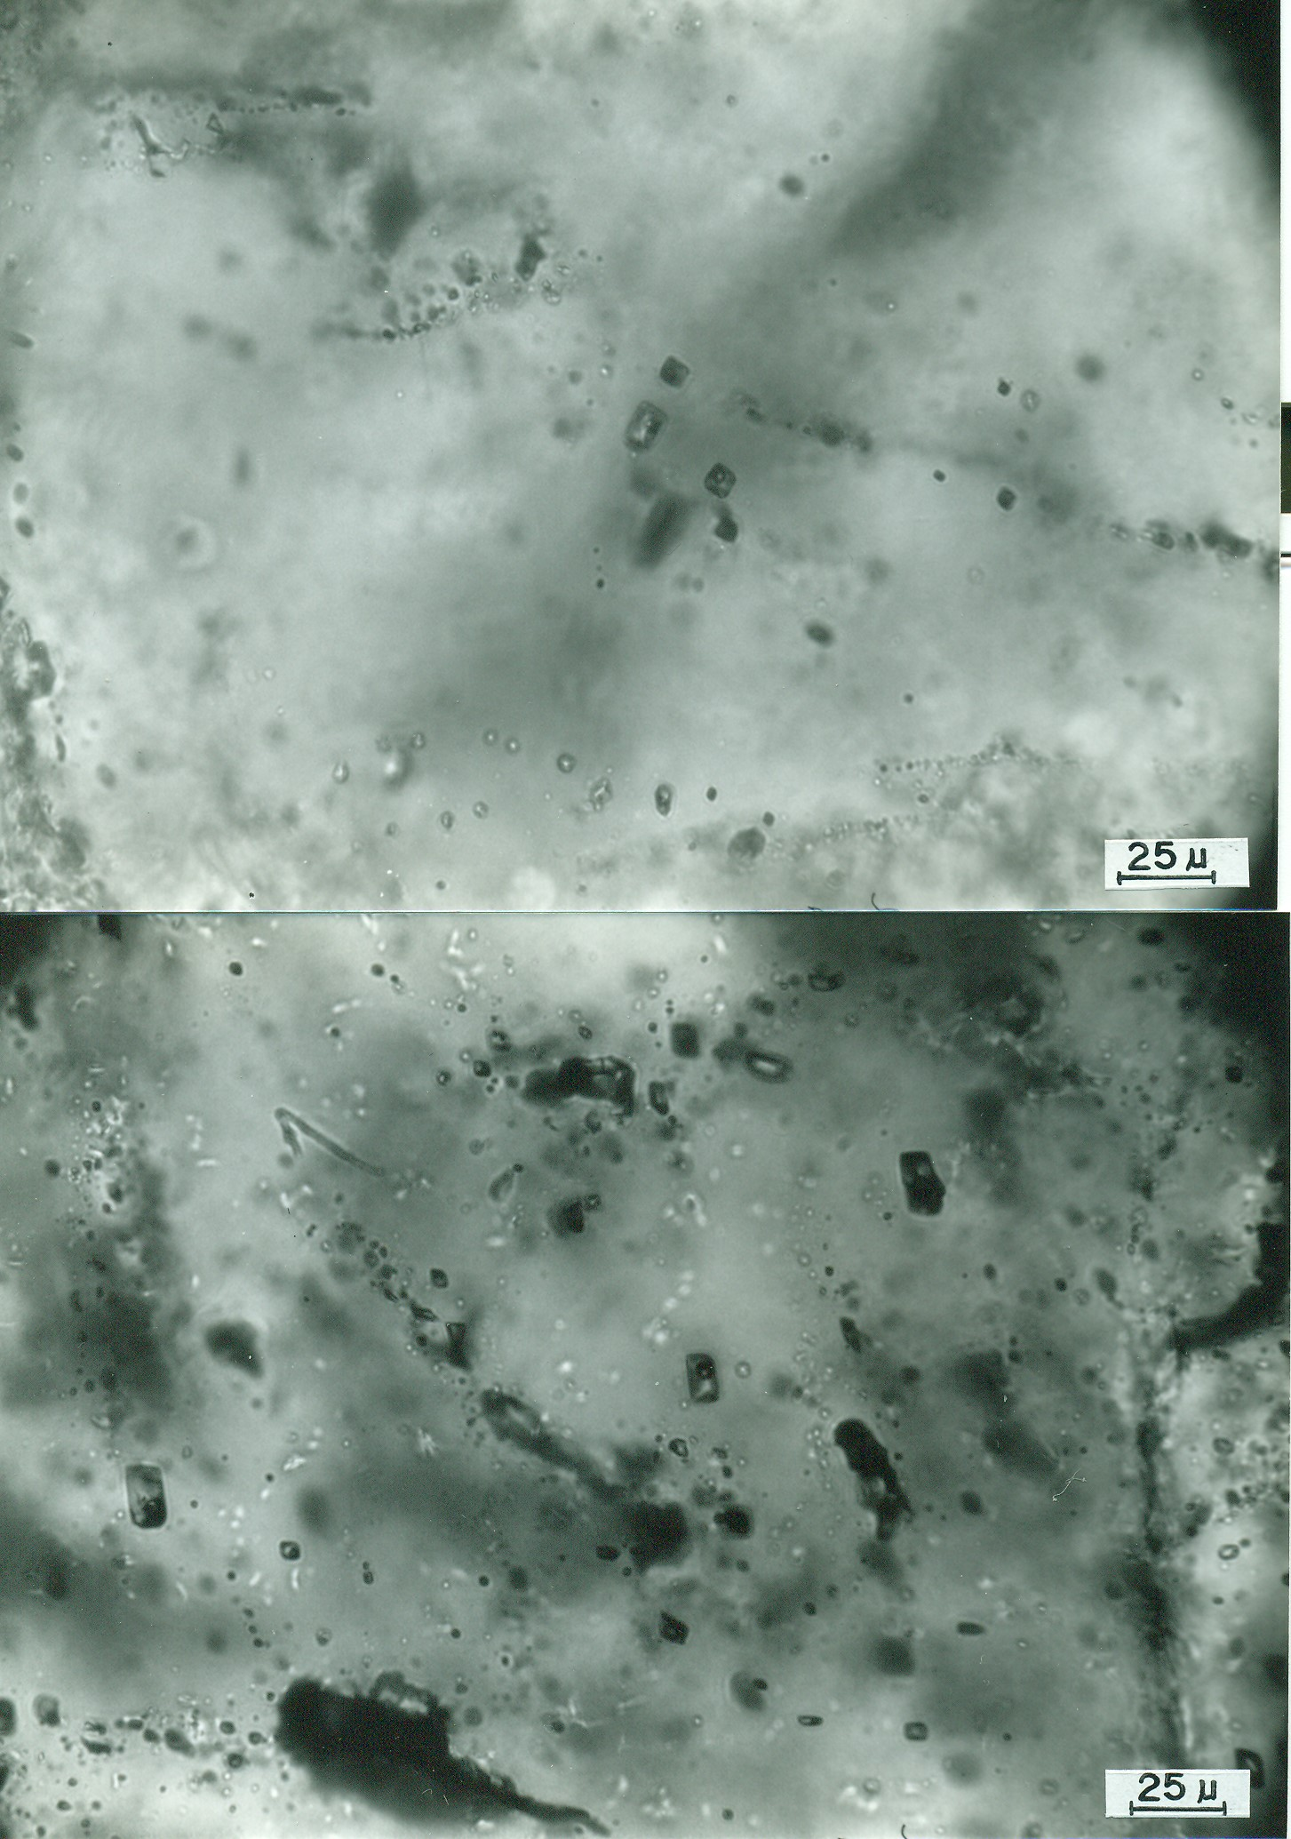
A bit more of geochemistry…
δ¹⁸O-δD values suggest fluids equilibrated with siliciclastic rocks
δ¹⁸O_{fluid}: +4.8 to +6.1; δD: -53 to -48‰
Basinal/low grade metamorphic fluids
⁸⁷Sr/⁸⁶Sr > 0.7149: not equilibrated with carbonates (≈ 0.7098) - more radiogenic shale or basement
Fluids temperature 150-200°C; aqueous low salinity (<7 wt%)?
These fluids are different than those related to regional dolomitization

Slide 12
Timing of the mineralization
Variscan Deformation: 360-340 Ma (D₁-D₂) → 315-304 Ma (D₃)
Breccias includes fragments of shale
  Postdate deposition (and cleavage) of shale
Rubiales: 307±7 Ma (K-Ar)
Silica Ore: 323±7 & 320±6 Ma (K-Ar)
Paleomagnetism: post-folding event (Ruiz et al. submitted)
Main mineralization is late Variscan in age: coeval with D₃ shearing
  Protore (stratiform mineralization) probably early Cambrian

Slide 13
Genetic models
Few equivalents: dissimilar MVT, Irish Type and sediment hosted
“Siliceous Crust Type”? (Brigo et al. 2001)
  Early diagenetic
“Syn-sedimentary”
  Related to karst + paleosoils in vadose setting (Rabu, 1977; Hermosa, 1995)
  Sedimentary exhalative (Luque, 1985)
Stratiform mineralization: Early diagenetic (equivalent to others in SW Variscan Belt)
Rubiales: shear-zone controlled (Luque & Ruiz, 1990; Arias et al. 1991)
Stratabound: Late Variscan replacement
Different to other carbonate-hosted deposits of the Variscan Belt

Slide 14
Some numbers…
Fluids can transport large amounts of Zn-Pb (but low H₂S) between ca. 240-310°C
Reaction with limestone produces silicification but small mineralization
Cooling does not work, either
Need an extra source of reduced sulfur: fluid mixing!
9 wt% NaCl eq.
L-V
Tornos & Heinrich (2008)

Slide 15
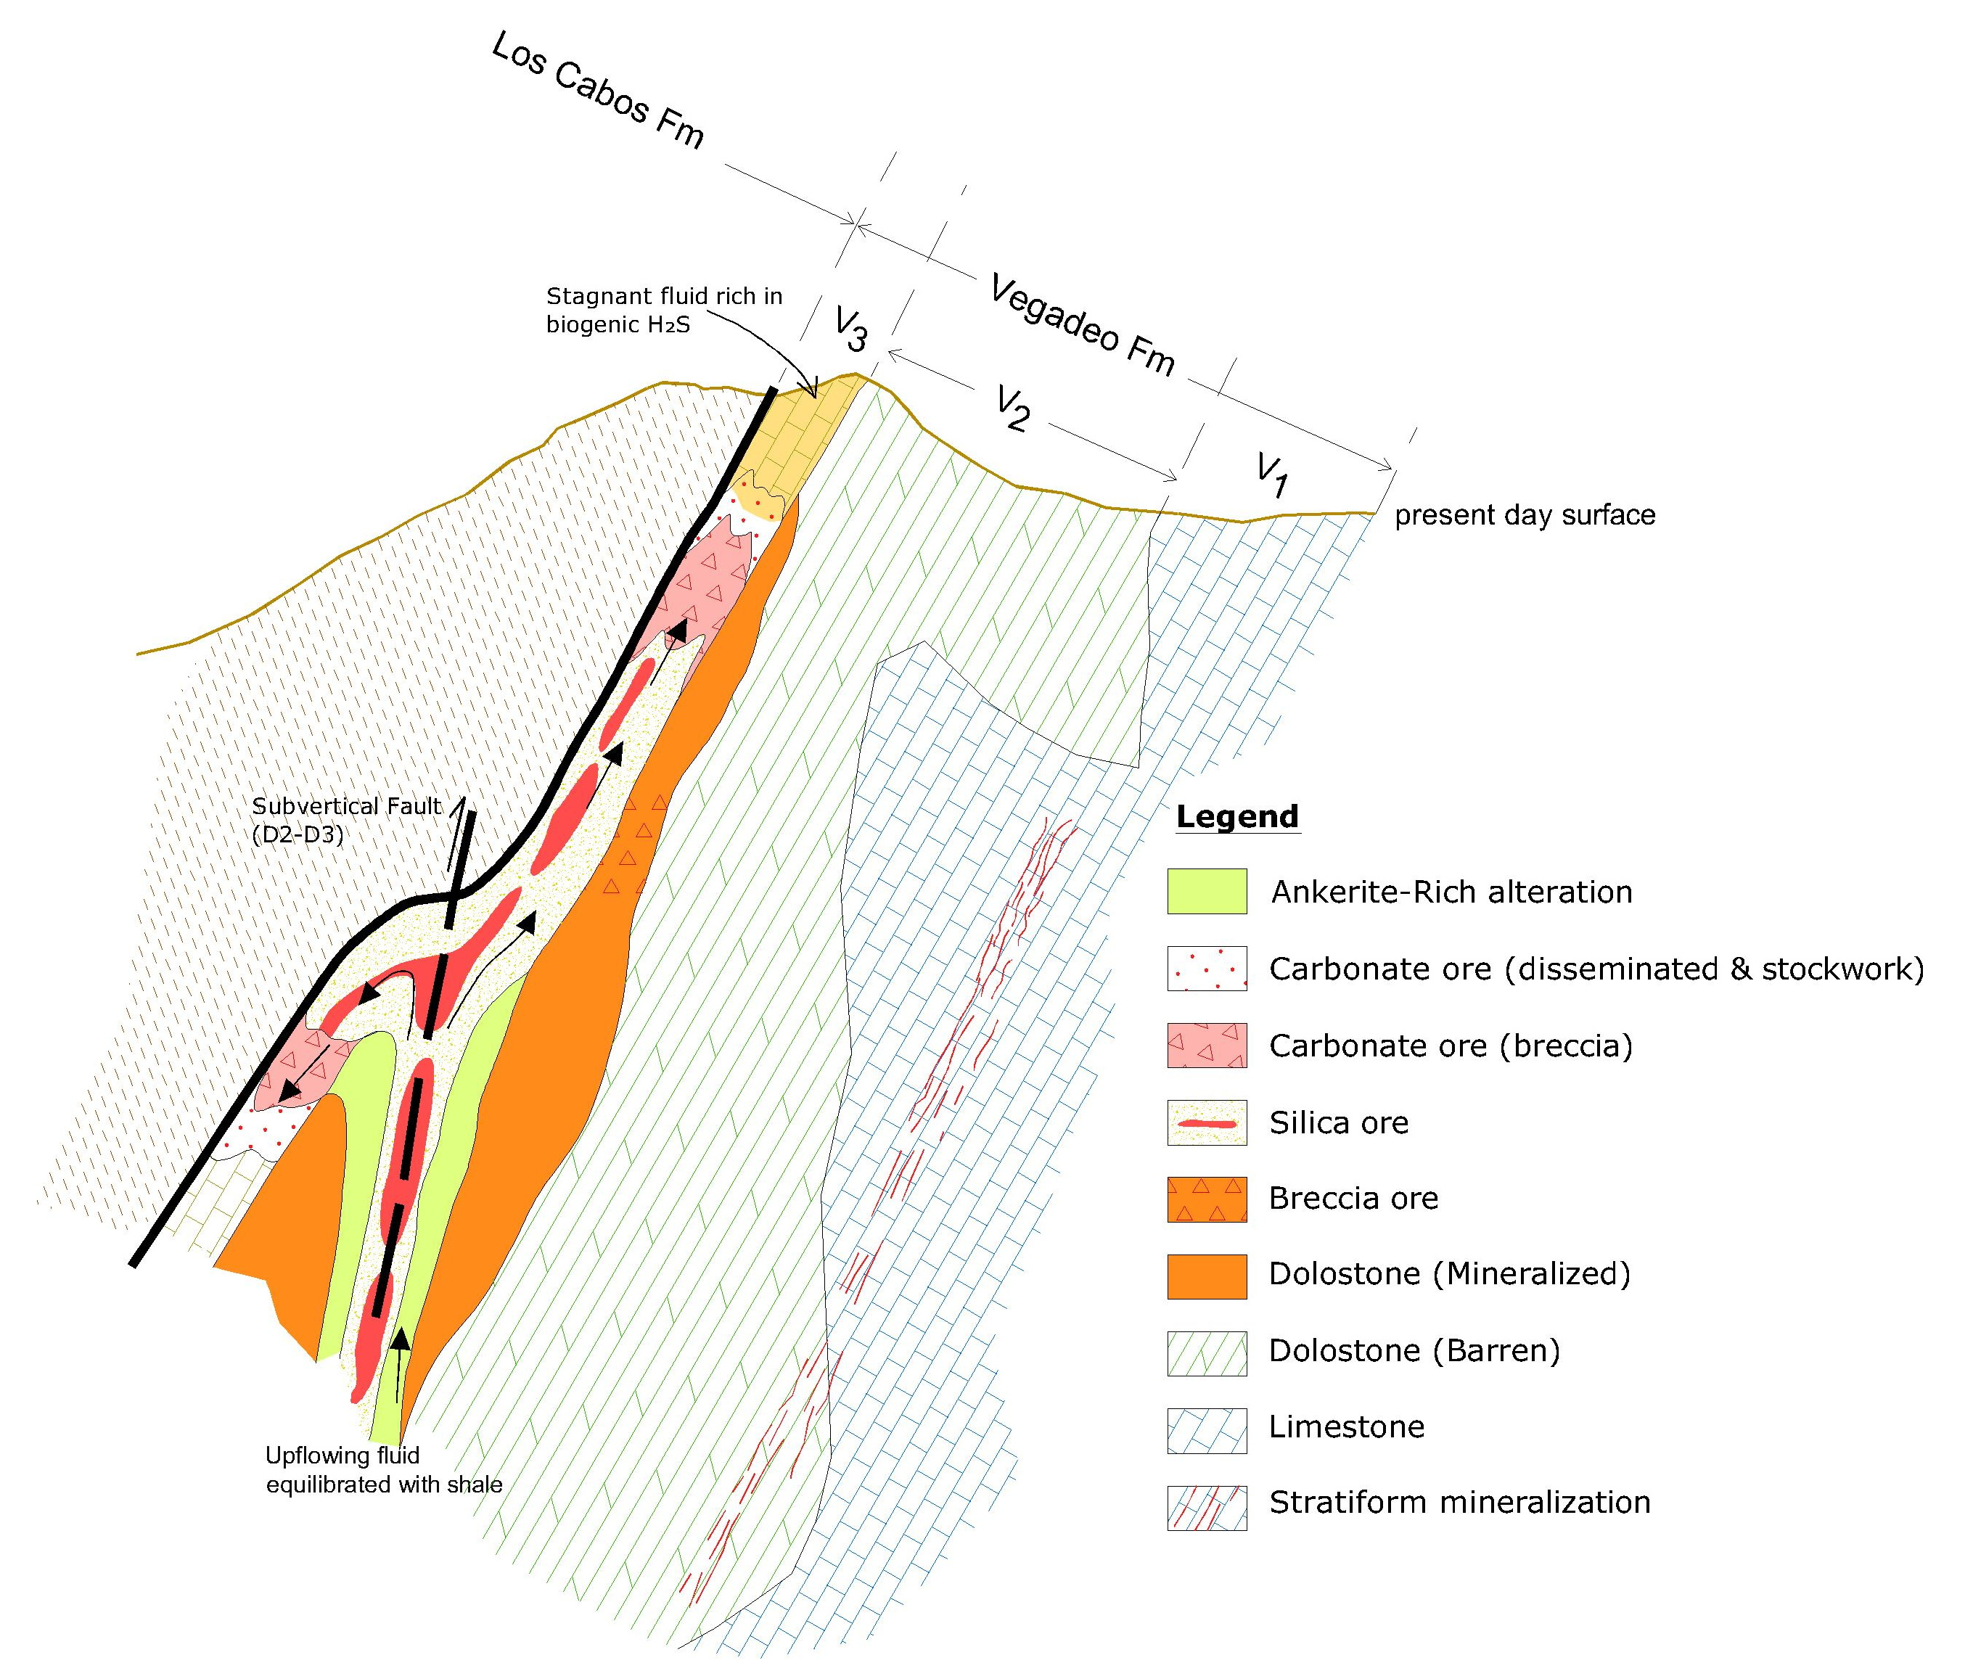
Fluid mixing along paleoaquifers is the key
Ascent of fluids along shear zones during D₃
Partial dissolution of the stratiform mineralization (protore)
Fluid circulation along a paleoaquifer controlled by the carbonate-shale contact
Reaction with limestone + fluid mixing with stagnant fluid rich in H₂S
Breccias?
  Metasomatic front?
  Consistent with metal zonation

Slide 16
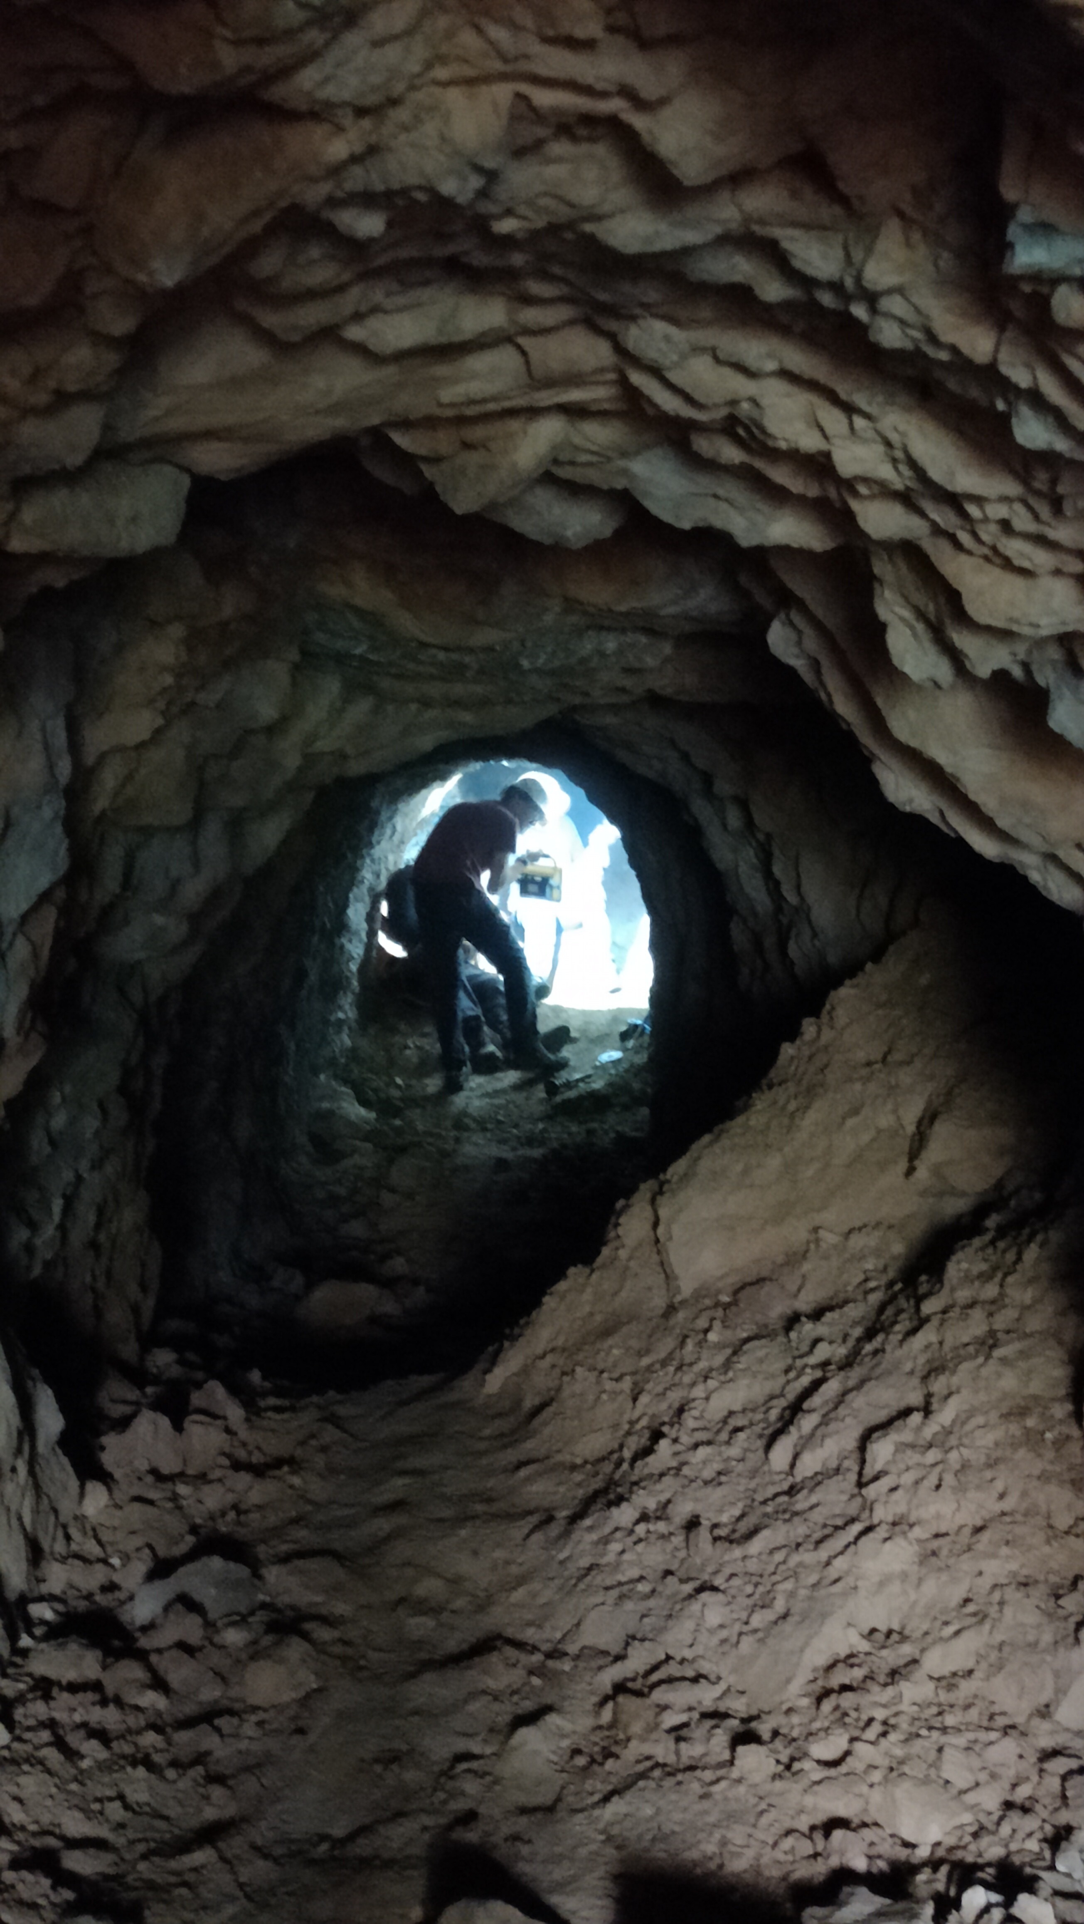
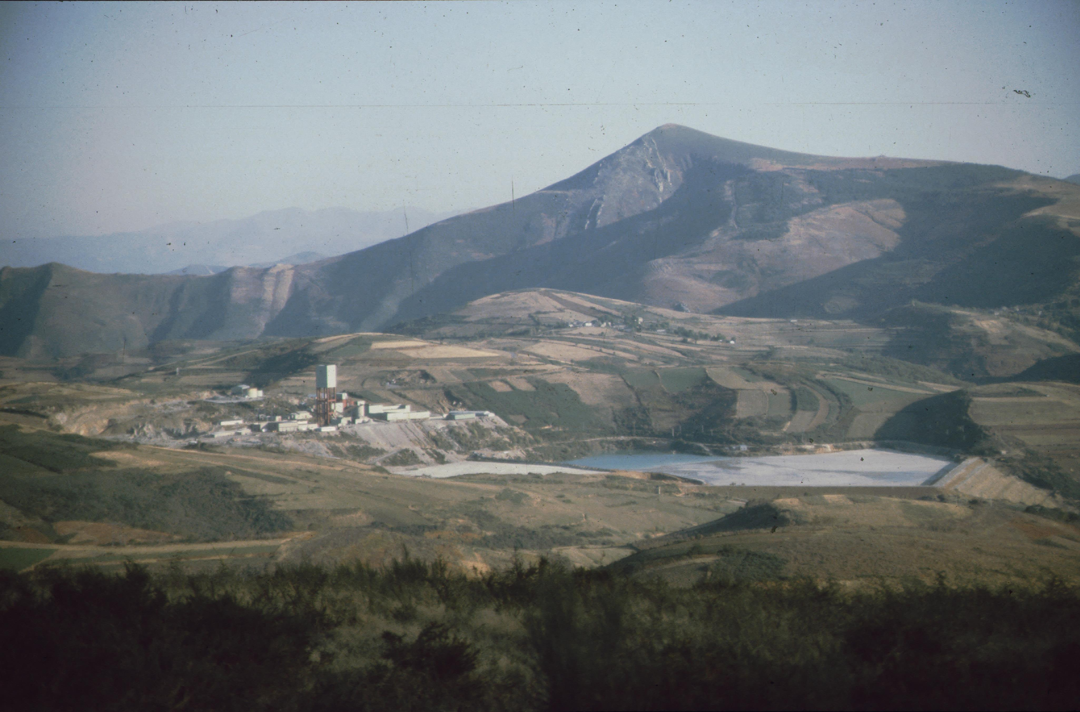
Implications for exploration
Underexplored area
Syn-Variscan mineral system
  Large proportion of potential hosts in the area
  Large volumes of potential sources for fluids and metals
  Channelways for hot fluids
Two major traps
  Shear zones when crosscutting carbonatic rocks
  Contacts between shale and carbonatic rocks
Broadly equivalent to MVT/Irish deposits but in internal parts of orogens
  Higher temperature allows silica precipitation
  Wonder, why not more?

Slide 17
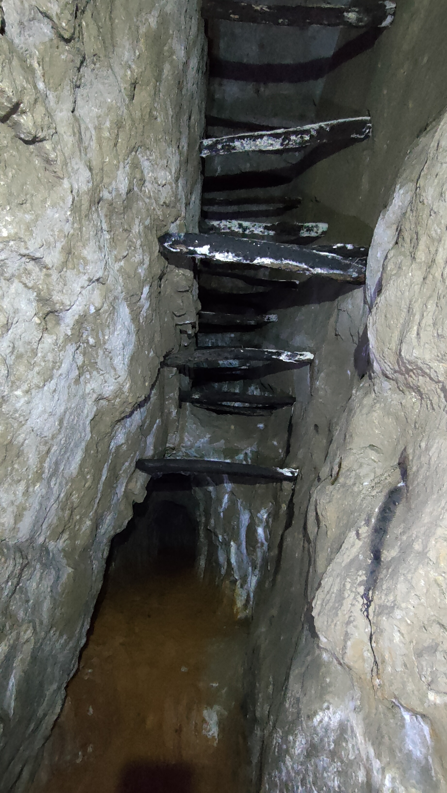


Thanks to…
Thanks to:
Carmen Galindo & J.M. Fuenlabrada (UCM)
Tom J. Shepherd & Baruch Spiro
Jose Luis Hermosa
Carlos Ruiz (UCM)
And IAEG for the invitation!!
f.tornos@csic.es

