Slide 1
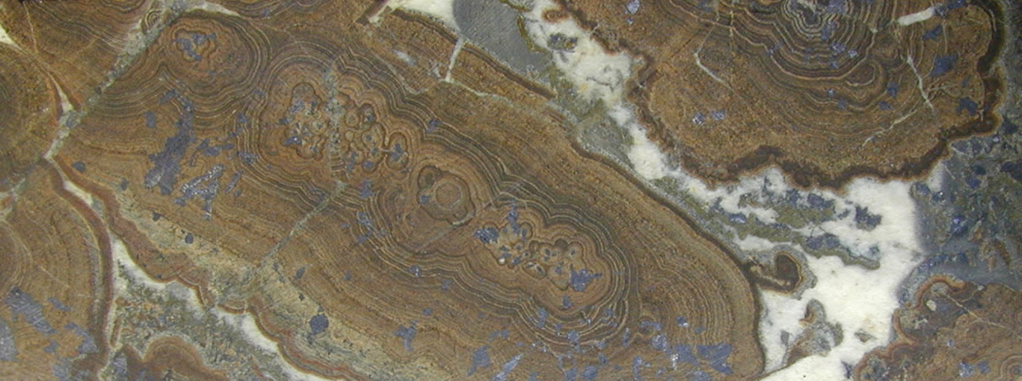



Tracing metals from source to sink in Irish-type Zn-Pb(-Ba-Ag) deposits
Prof. Jamie Wilkinson
Maximising predictability in porphyry exploration using data analytics and AI
AMIRA EMC23 – August 23-24th 2023
High grade colloform sphalerite(-galena-pyrite-calcite), Galmoy

Slide 2
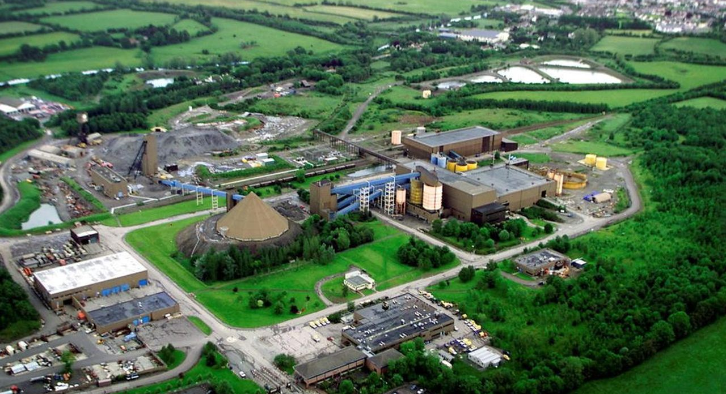


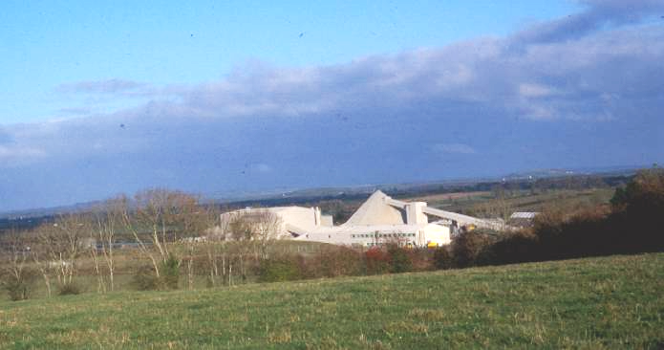


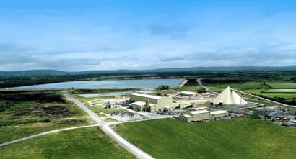



Thanks to…
David Cooke
Jamie Laird
Chris Ryan
IAEG 50th Anniversary Conference, Galway

Slide 3
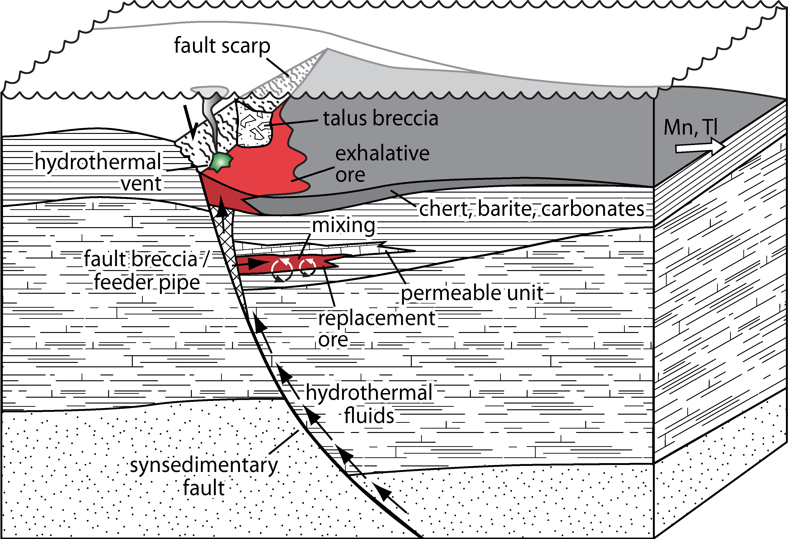
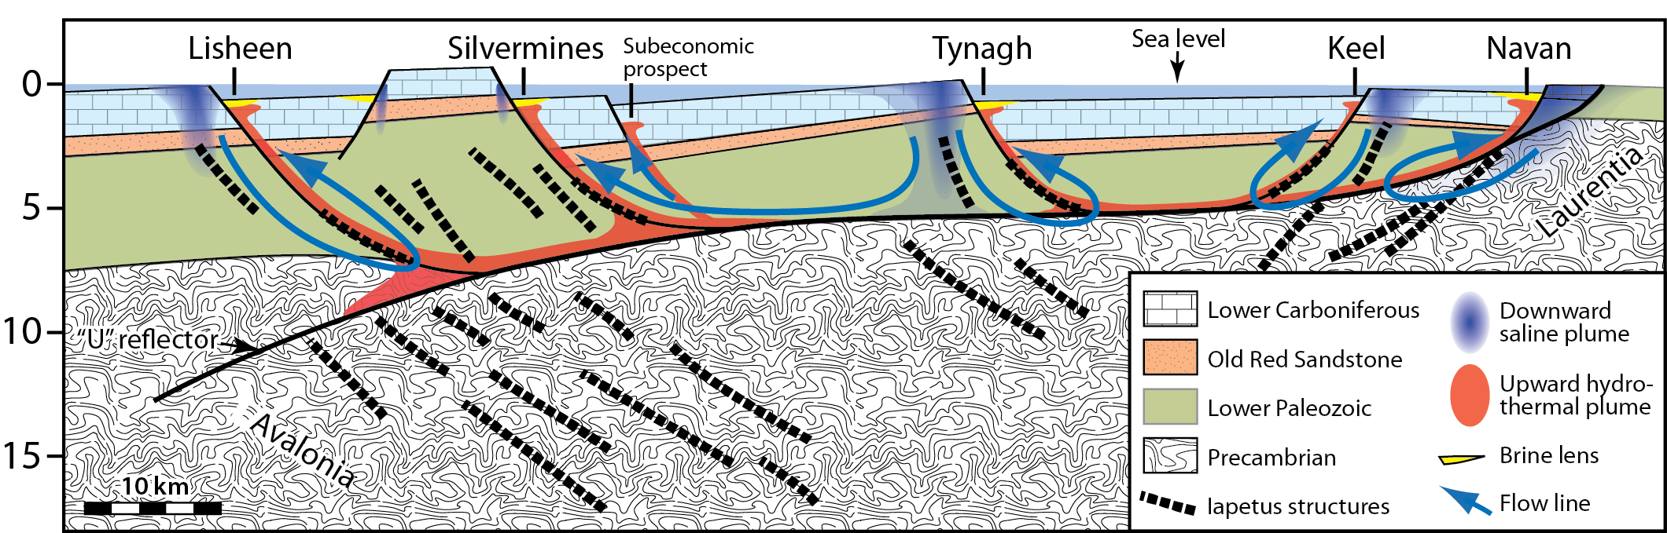
Irish-type model
Forming close to lithosphere-hydrosphere interface, interrupting diagenesis [cool brine + S]
Possible local exhalation
Deep crustal circulation of evaporated seawater into precursor arc wedge [hot fluid + metals]
500 m
Up to 280ºC
km
Wilkinson (2014)
Modified after Wilkinson and Hitzman (2015)

Slide 4
Aim
To establish pathways of metals through the Irish paleo-hydrothermal system using:
  Geological observations
  Rock leaching experiments (LP, ORS)
  Fluid inclusion compositions (LP-, ORS- and LC-hosted veins)
  Mass transfer analysis of fresh → altered rocks (ORS)
  Metal deportment studies (LP)
  Deposit metal zonation patterns (LC)
Lower Carboniferous (LC) ore deposit trap
++
-
LC
Old Red Sandstone (ORS) trap/source
+
-
ORS
Lower Paleozoic (LP) trap
+
- -
+
Lower Paleozoic (LP) reaction zone source (trap for Mg, Na)
LP
IAEG 50th Anniversary Conference, Galway

Slide 5
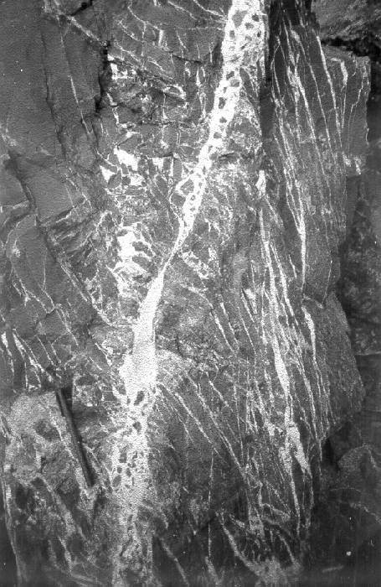
LP BASEMENT SOURCE
LP-hosted feeder veins (Everett et al., 1999)

Slide 6
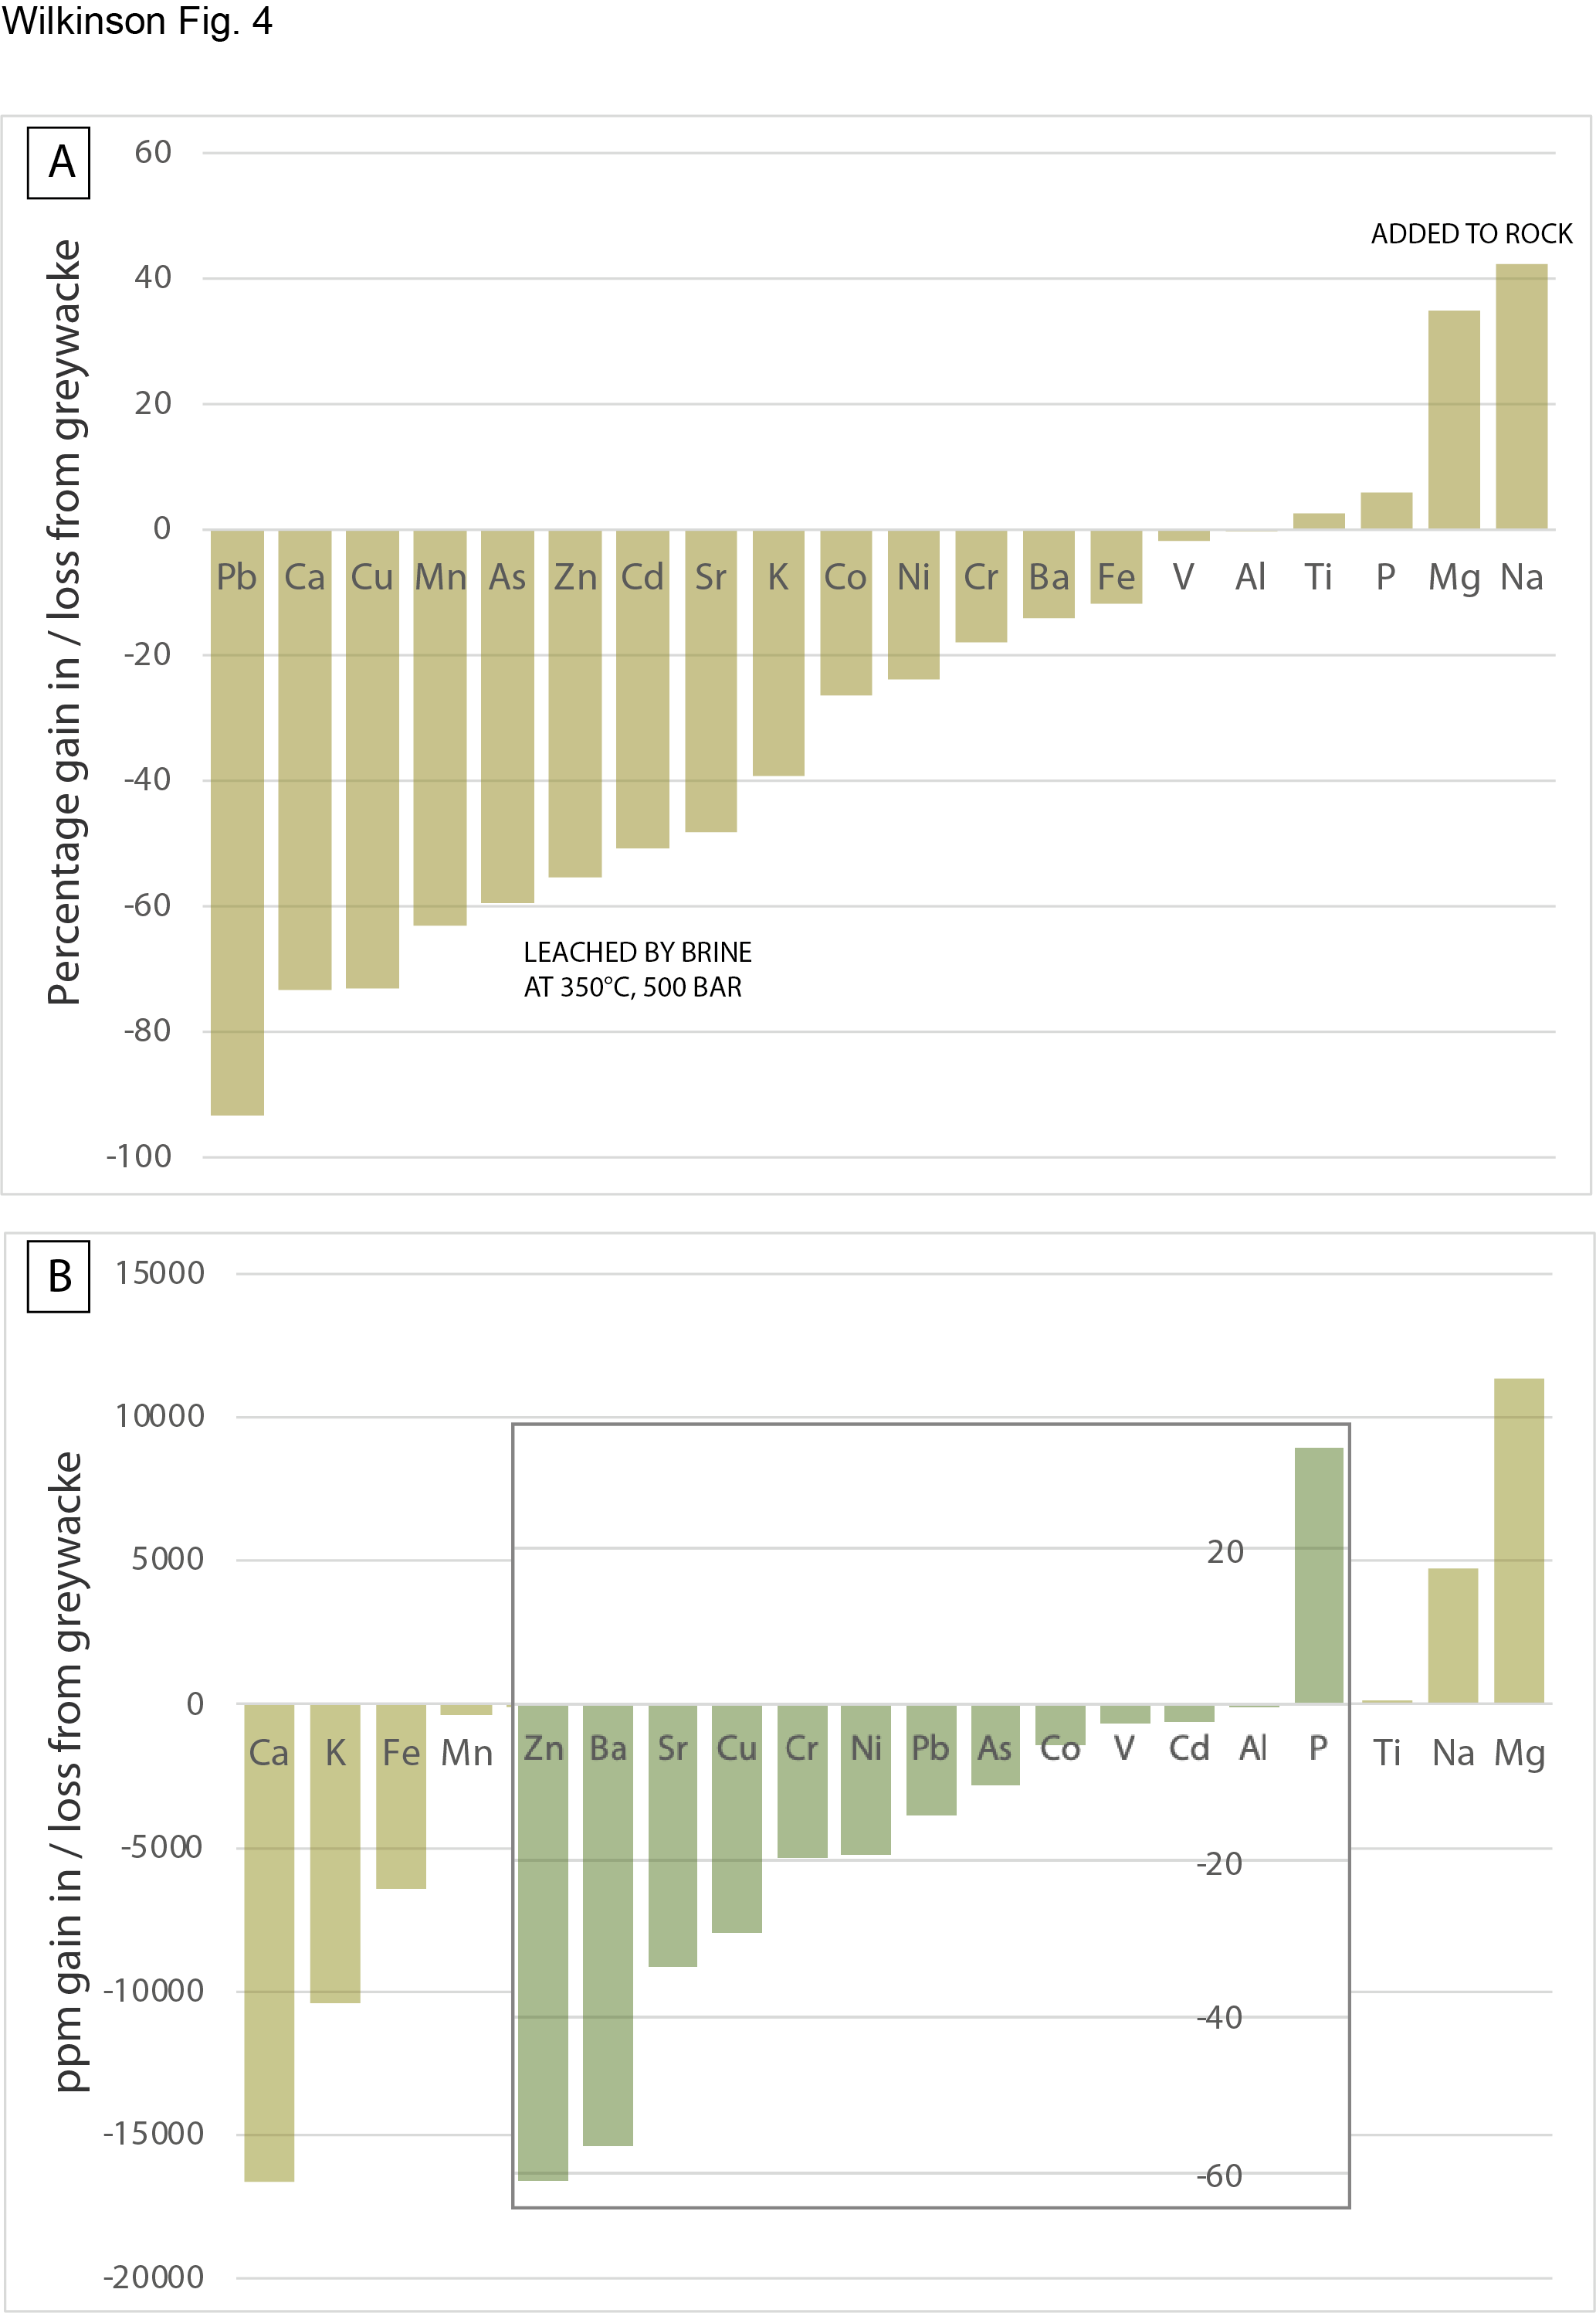
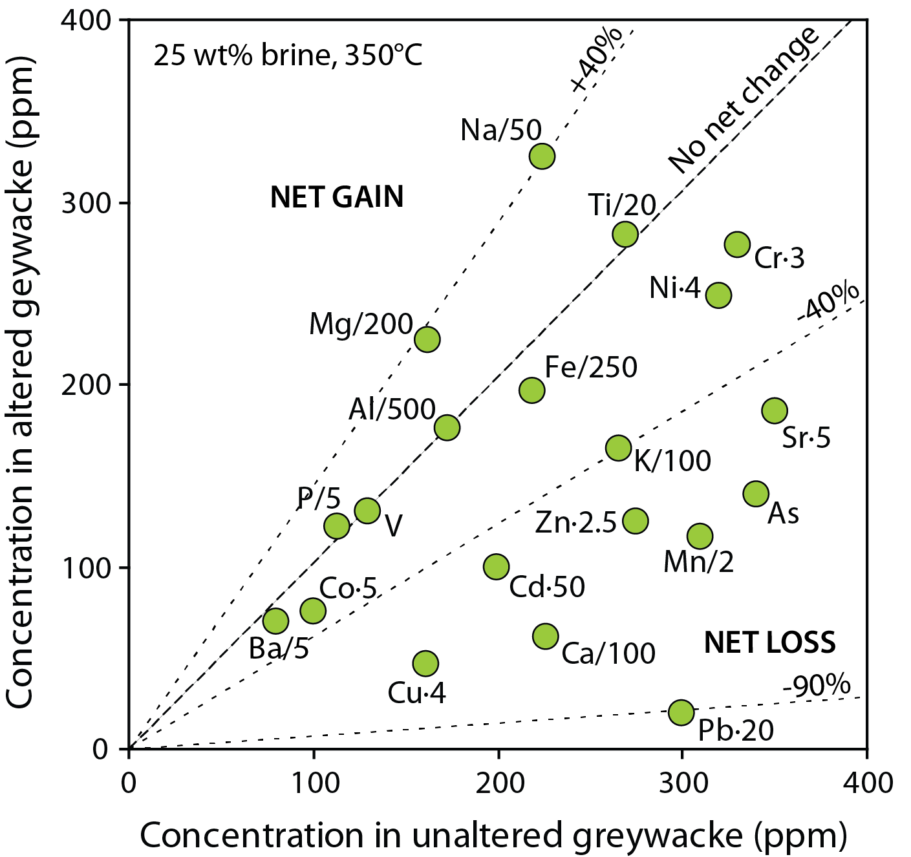
Bischoff experiments
% gain / loss
Irish LP greywacke + brine @ 350ºC
Data from Bischoff et al. (1981); experiments suggested by Mike Russell
absolute gain / loss
Pb most efficiently extracted
Fe, Mn, Zn, Ba highest concentrations
Variety of trace metals mobile: Cu, Cr, Ni, As, Co, V, Cd

Slide 7
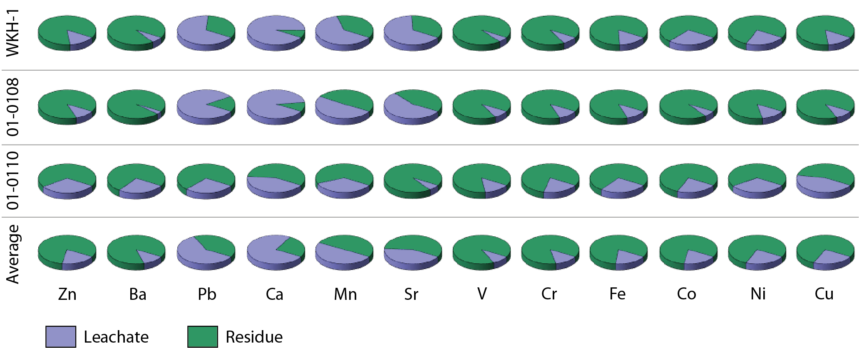
Cold acid leach experiments
Irish LP greywacke + 6N HCl @ 20ºC
% of total leached vs. amount remaining in residue
Data from Crowther (2007)
Pb most efficiently extracted
Fe, Mn, Ba, Ni highest concentrations
Variety of trace metals mobile: Cr, V, Co, Cu, As
IAEG 50th Anniversary Conference, Galway

Slide 8
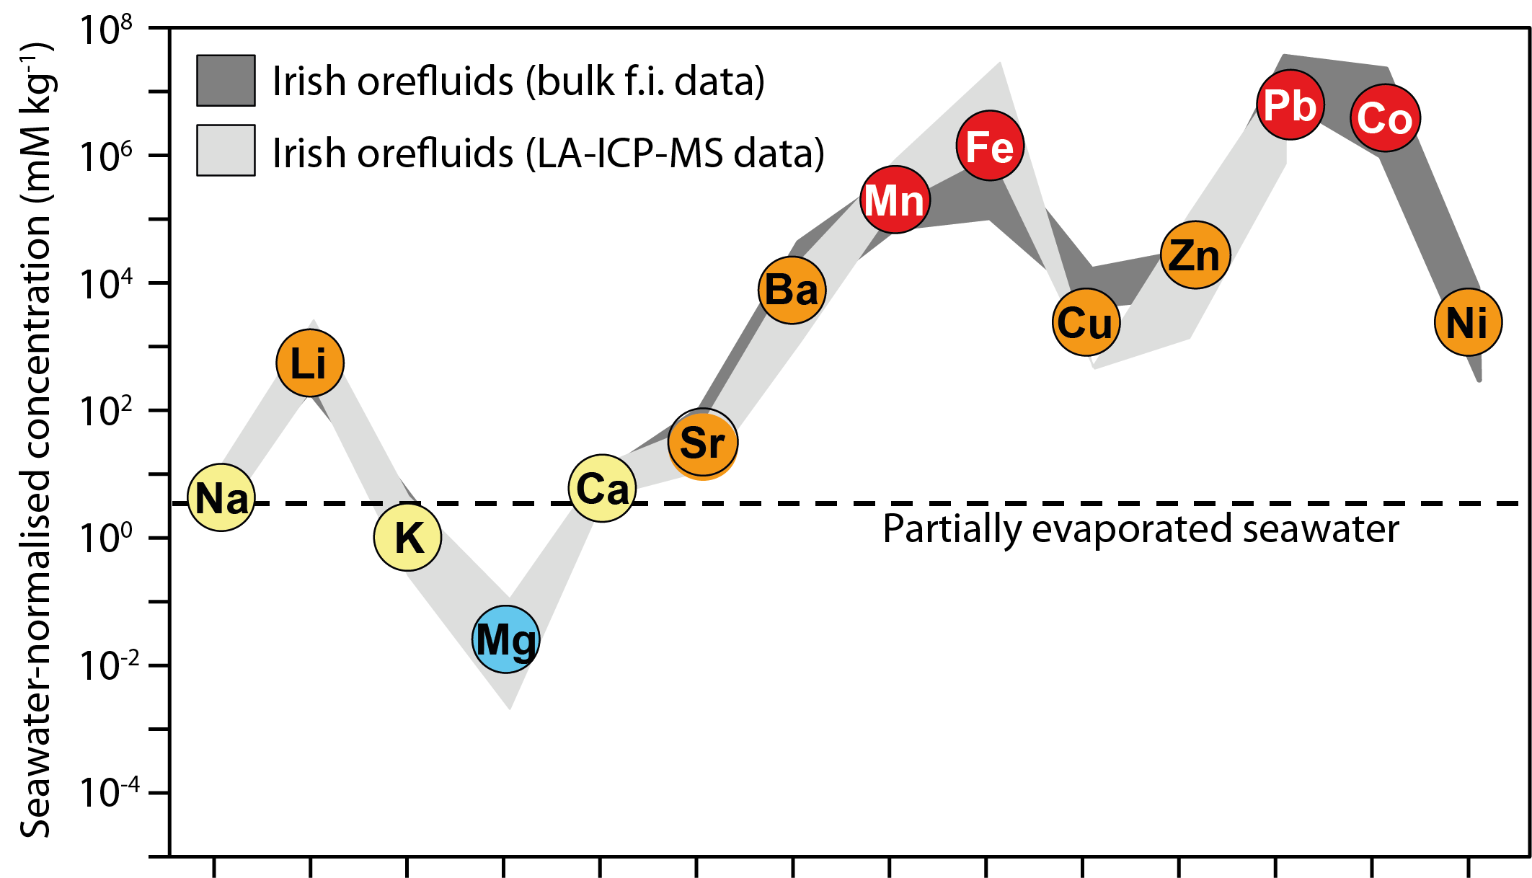
True orefluid compositions
“Principal orefluid” compositions derived from fluid inclusion analyses on feeder veins
Data normalised to modern seawater
Modified after Wilkinson et al. (2005), with data from Everett et al. (1999a) and Wilkinson et al. (2007)
Pb, Co, Fe, Mn most efficiently extracted from source rocks (scavenged during sedimentation?)
Zn, Ba, Cu, Ni significantly mobilised
Mg lost to rock
IAEG 50th Anniversary Conference, Galway

Slide 9
Metal ratios in crustal fluids
Marked contrast in Zn/Pb ratios between basalt- and clastic-interacted fluids
Limited feeder vein data from Navan/Keel suggest mafic rock interaction (or significant Pb loss in LP)
LP fluids in south consistent with acid leachates of LP rocks but more Pb-rich than bulk ores suggesting Zn gain in ORS and/or trapping of Pb in ORS/LC footwall
Basalt-interacted fluids
Zn/Pb ratio (mass)
See conference paper for references
Clastic-interacted fluids
Irish ores
Normal Score
IAEG 50th Anniversary Conference, Galway

Slide 10
Hosts for metals in source rocks
Particle-induced X-Ray emission maps highlight the distribution of metals in LP greywacke
Fe maps out chlorite grains
Zn is fairly dispersed apart from one Zn-rich grain
Pb, Ba and Cu are erratically distributed (rare, high concentration grains)
A
B
C
IAEG 50th Anniversary Conference, Galway

Slide 11
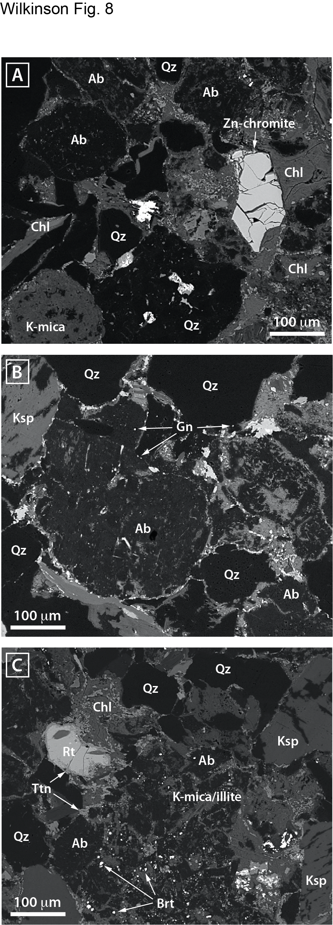
Hosts for metals in source rocks
Zn in rare Zn-chromite and chlorite (+ illitic matrix)
Pb in very fine-grained galena and much lower concentrations in K-feldspar
Ba in fine-grained barite
IAEG 50th Anniversary Conference, Galway

Slide 12
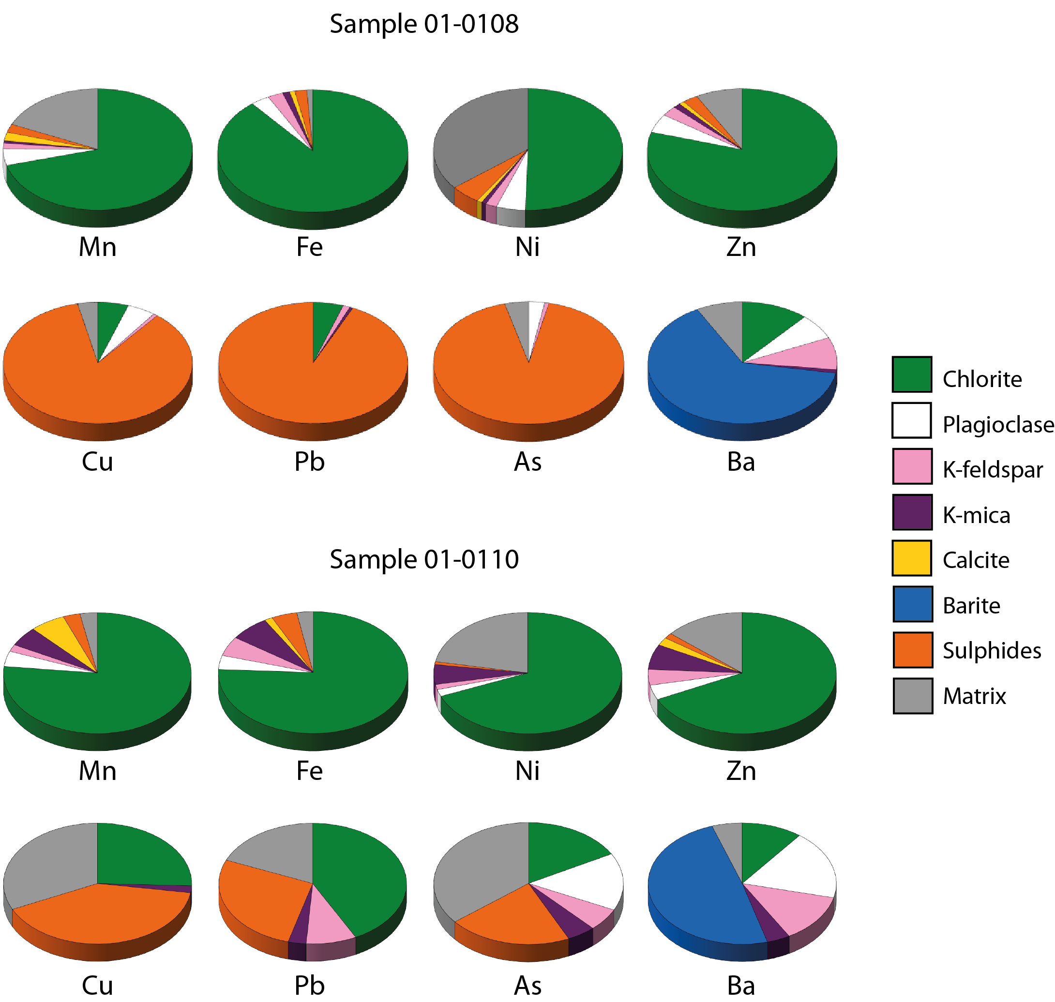
Metal deportment in source rocks
Combining modal mineralogy with mineral density and metal content estimates allows deportment to be quantified
Zn, Fe, Mn and Ni primarily in chlorite
Cu, Pb and As primarily in trace sulphides (plus matrix)
Ba primarily in barite
Differences in experimental leaching behaviour can be linked to variations in rock mineralogy
Extraction of metals requires conditions in the reaction zone where these host phases can break down
IAEG 50th Anniversary Conference, Galway

Slide 13
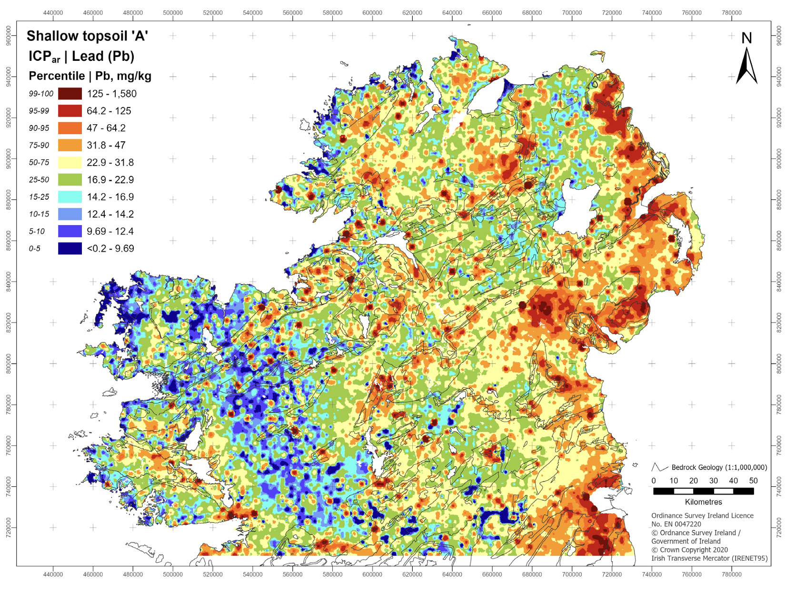
Lower Paleozoic transit
Galena-bearing veins (+zinc-copper-silver) worked in antiquity in the Longford Down, Wicklow and other LP inliers and S. Uplands
Evidence for LC age
Likely that some Pb (and other metals) preferentially fractionated from fluids at this level
Tellus map
Longford Down inlier
Wicklow Mts
www.gsi.ie
IAEG 50th Anniversary Conference, Galway

Slide 14
ORS SOURCE AND SINK
Altered ORS, Silvermines (Everett et al., 2003)

Slide 15
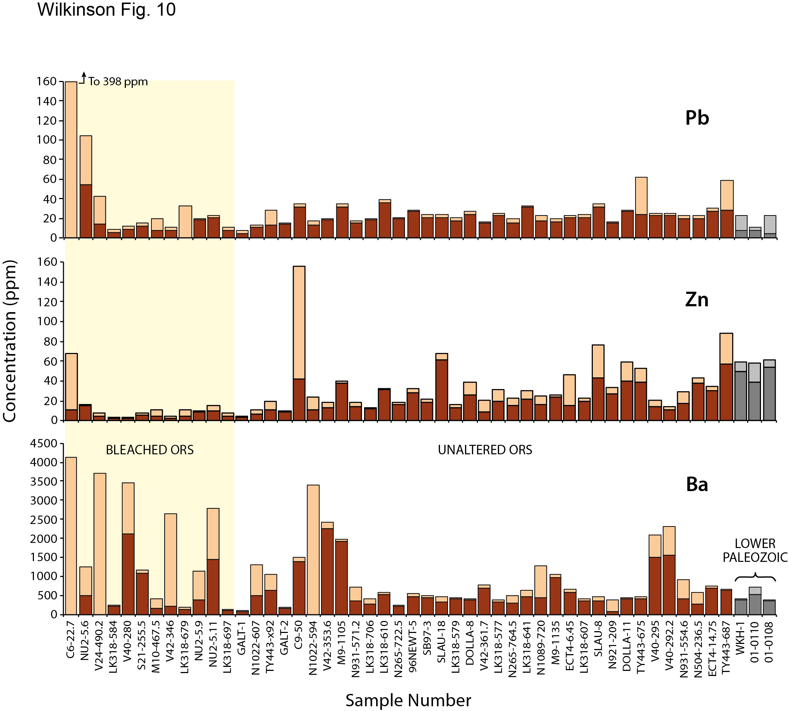
ORS cold acid leach experiments
Low leachable fraction of Pb in unaltered samples
Moderate (~25%) leachable Zn
Zn removal during alteration
Variably leachable Ba
Leachate
Residue
Data from Everett (1999)
IAEG 50th Anniversary Conference, Galway

Slide 16
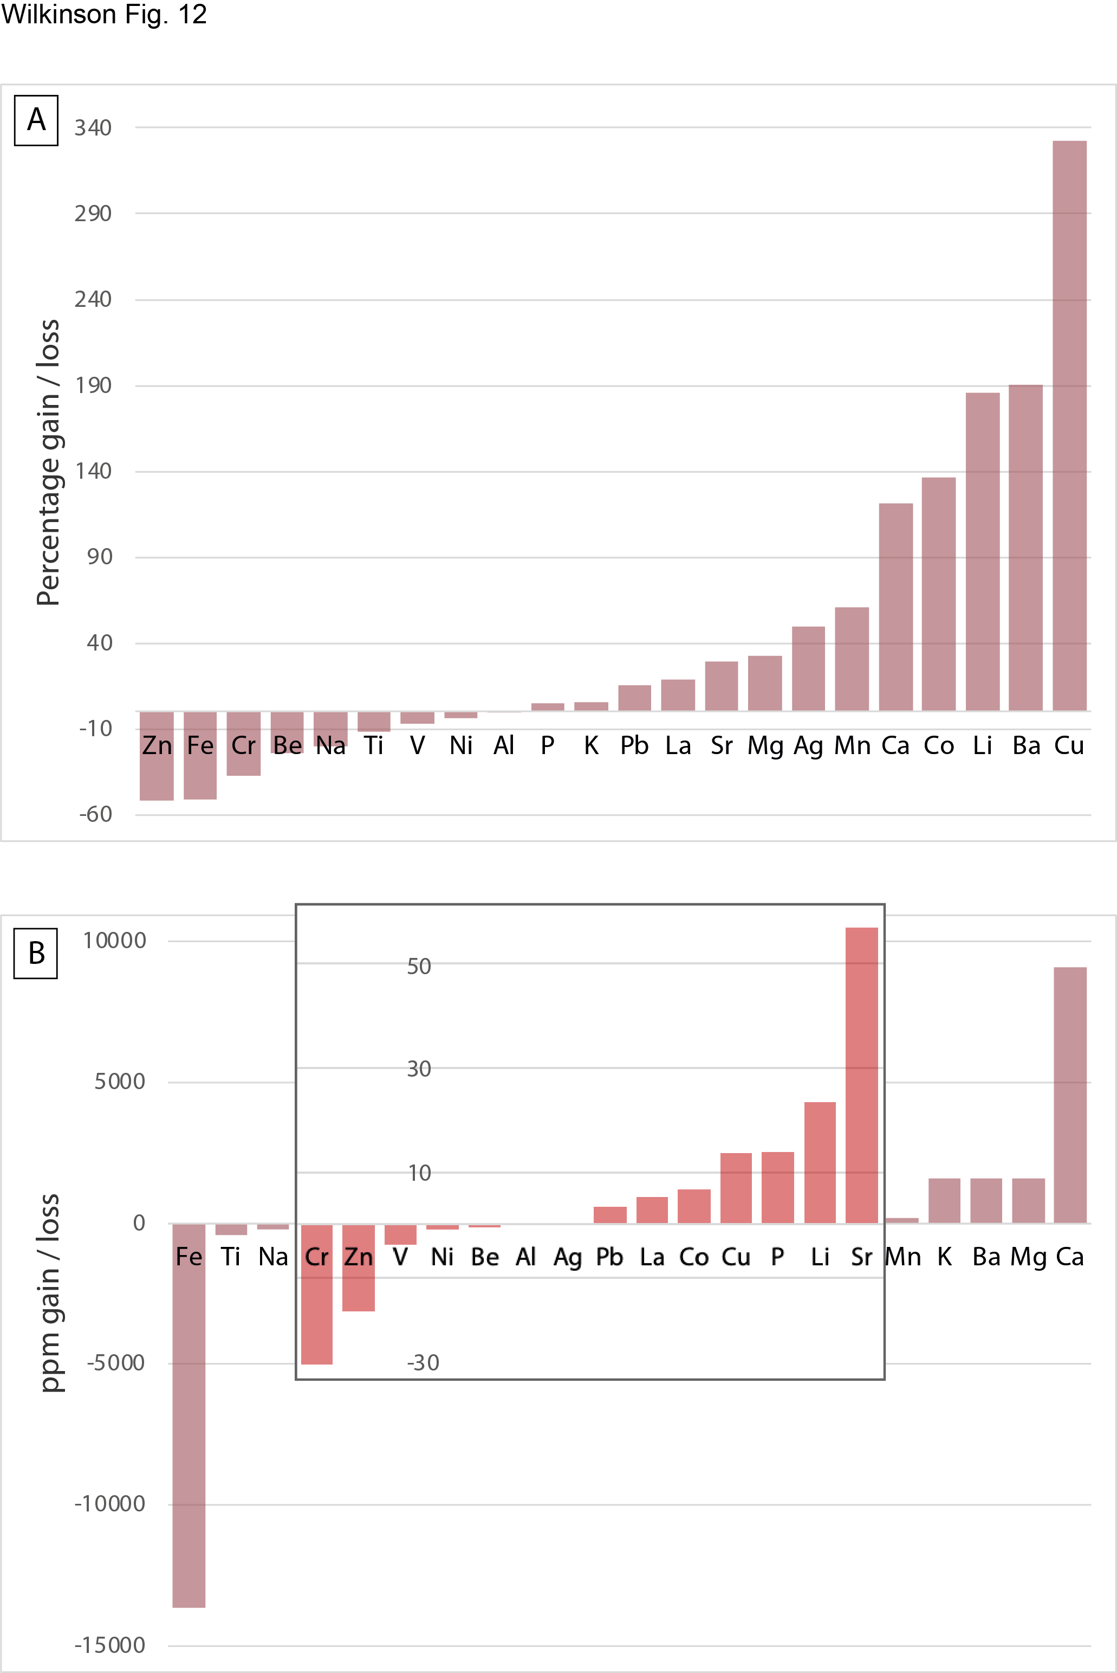
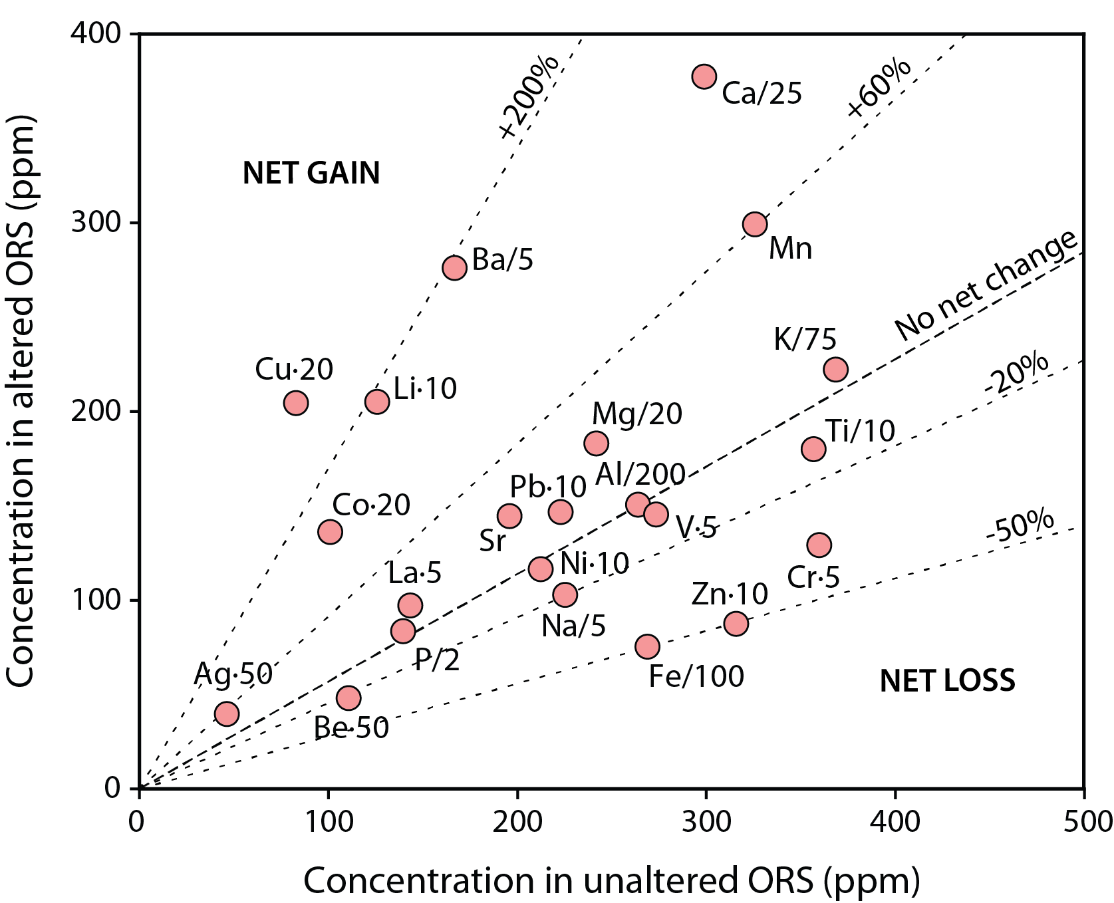
ORS mass transfer analysis
Modified after Wilkinson (2014)
Fe, Zn and Cr significantly removed during hydrothermal alteration
Significant % addition of Cu, Co, Ag, Pb, Li, Ba, Ca and Mn
Mass balance estimate at Silvermines suggests <2 to 8% of the Zn resource could have been ORS-sourced
Potentially significant exchange of elements across redox boundary where ORS is thick in S/SW Ireland
IAEG 50th Anniversary Conference, Galway

Slide 17
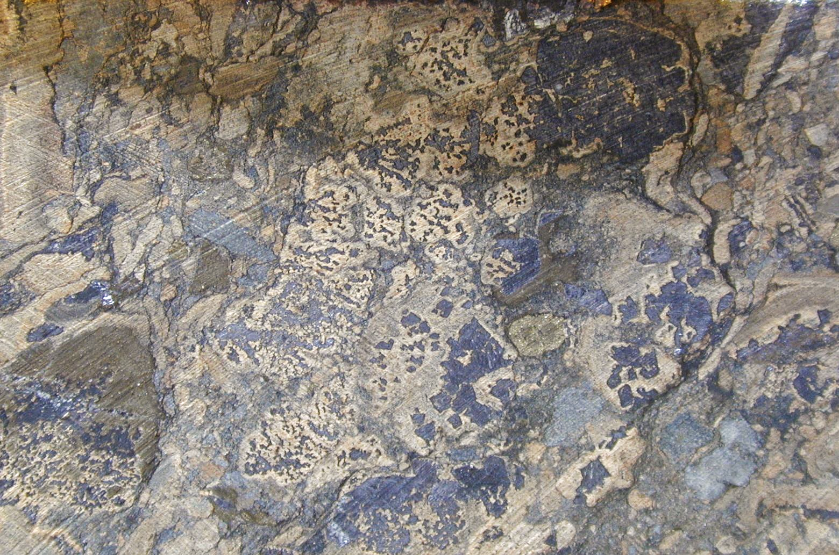
DEPOSIT TRAP
High grade ore, R-zone Galmoy

Slide 18
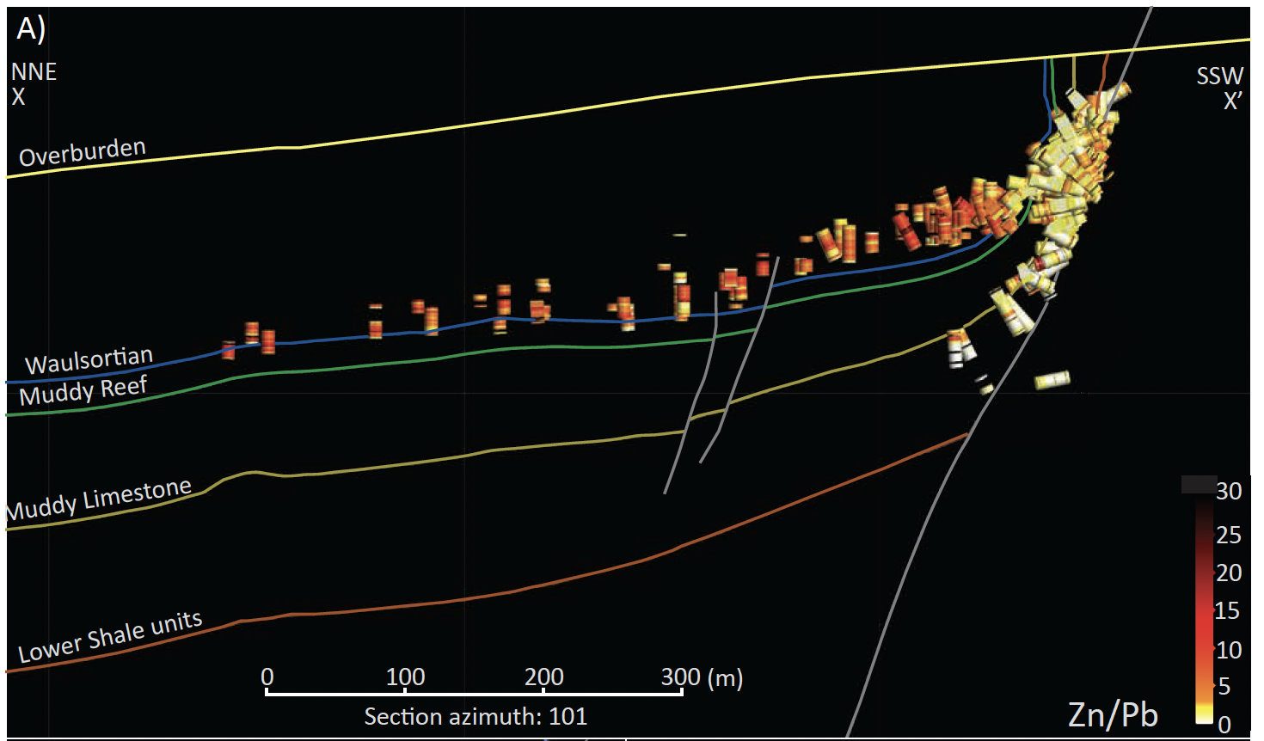
Ore deposit zonation
Silvermines
General increase in Zn/Pb upwards from LC footwall into stratiform ores and outwards from fault conduits
Torremans et al.(2018)
IAEG 50th Anniversary Conference, Galway

Slide 19
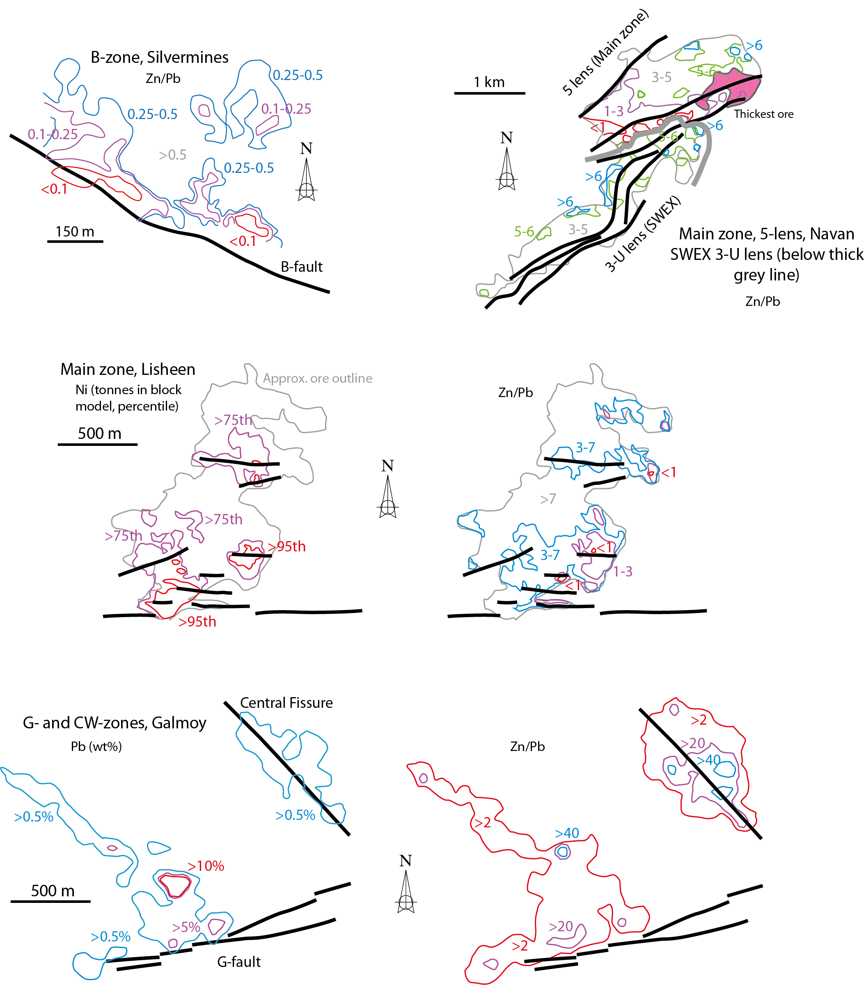
Ore deposit zonation
Silvermines
Navan
Zn/Pb
Highest temperature feeders enriched in Pb, Ni, Cu, Ag
Similar patterns at Lisheen and Silvermines but the latter is more Pb-rich
Higher Zn/Pb at Galmoy (especially CW zone) and Lisheen Island pod
Inverted lateral zonation at Galmoy and Navan-west (with decreasing Zn/Pb outward), potentially due to non-linear mixing relationships (brine-dominant domains)
Zn/Pb
Zn/Pb
Ni
Lisheen
Zn/Pb
Pb
Galmoy
Data from Taylor (1984), Fusciardi et al. (2003), Torremans et al. (2018), Ashton et al. (2015) and Lowther et al. (2003)
IAEG 50th Anniversary Conference, Galway

Slide 20
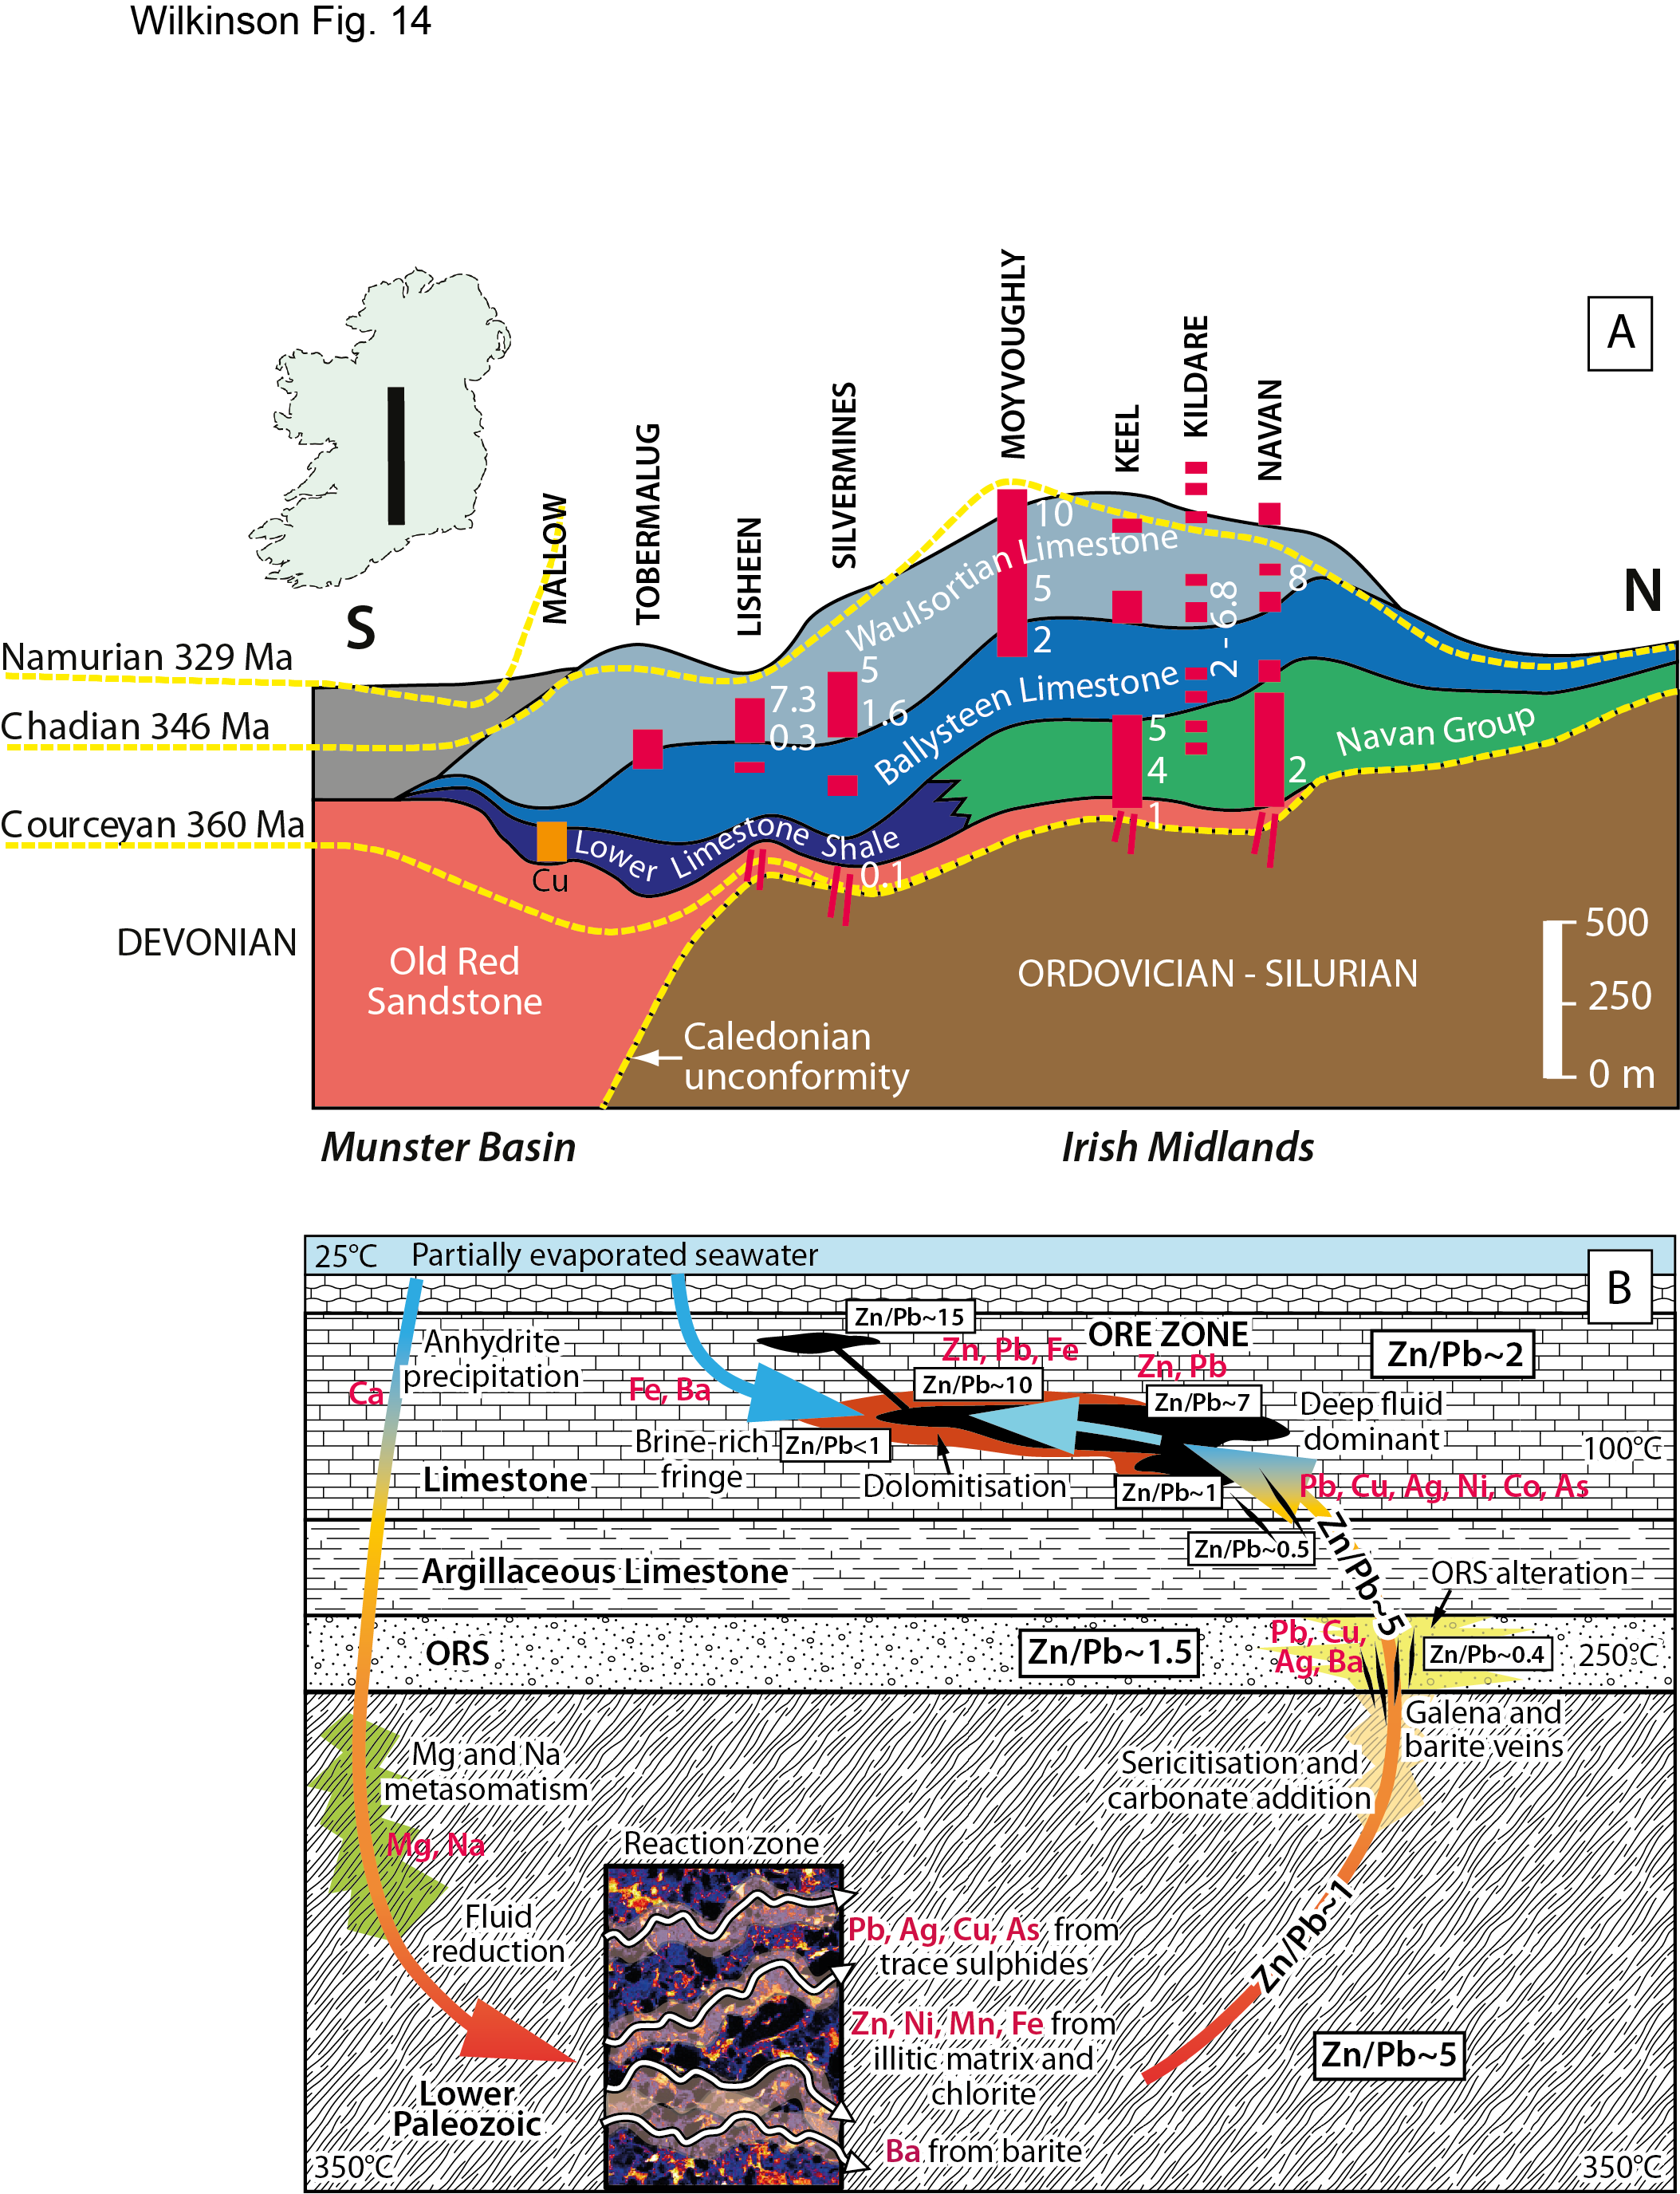
Regional scale zonation
Broad pattern of Pb-rich footwall (LP, ORS, lower LC)
  Relatively Pb-rich fluids exiting LP source, precipitating galena with cooling on ascent
More Zn-rich higher in stratigraphy
  Increased Zn/Pb by prior Pb precipitation, Zn contribution from ORS (?)
More Zn-rich further north
  Zn contribution from LP mafic rocks?
Based on Johnston (1999) from the stratigraphic cross-section of Andrew (1993), with additional data from cross-sections in Torremans et al. (2018)
IAEG 50th Anniversary Conference, Galway

Slide 21
Metal fractionation from source to sink
Early loss of Ca-SO₄ then Mg-Na in reaction zone
Max T > 300-350ºC required to liberate Pb-Cu-Co-As from trace sulphides in fertile LP arc rocks (+ H₂S)
T > 300ºC required to liberate Zn-Mn-Fe-Ni from chlorite (and illitic matrix)
Trace barite (weathered Ksp?) dissolved by hot, reduced fluids
Pb-Ag-Cu-Ba trapped in ORS alteration zones; Zn-Cr-Fe mobilized
Pb and minor metals concentrated near feeders
High Zn/Pb in exhaust zones
Paleozoic arc detritus is a fertile source of a diverse range of metals
IAEG 50th Anniversary Conference, Galway

Slide 22
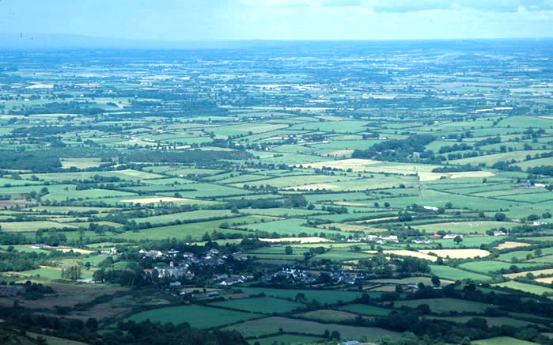
Thank you!

Slide 23
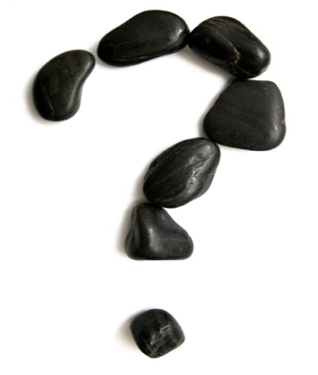
j.wilkinson@nhm.ac.uk
nhm.ac.uk/our-science/our-work/sustainability/lode.html
IAEG 50th Anniversary Conference, Galway

