Slide 1
Zinc Supply and Influences from Geology
Friday 8th September 2023

Slide 2
Agenda
IAEG 50 – Friday 8th September
Friday 8th September 2023
01
Market outlook
02
Mine project funding
03
Deposit Types and concentrates

Slide 3
Market outlook

Slide 4
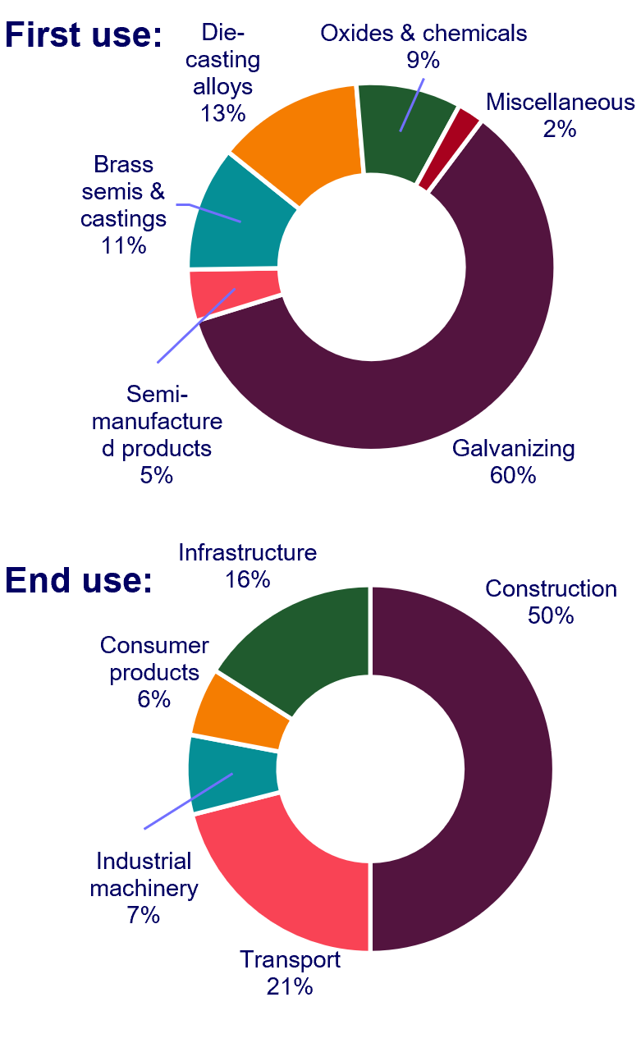
Zinc: from ore to metal
IAEG 50 – Friday 8th September
First use:
Outline of the industry
Mining and milling
2. Smelting
3. Consumers
End use:
Various methods: open pit, underground, both.
Converting ore to concentrate.
Varying concentrate qualities
Sold to smelters
TCs or integrated
freight
Converting concentrate to metal
Various technologies, various downstream possibilities, wide range of emission intensities
Electrolytic
Imperial
Vertical Retort
First use
End use
Warehouses
Notes:
Before looking at the supply-demand outlook, I wanted to start off by focusing on the zinc industry, and how ore in converted to metal and delivered to the consumers. Based on resource and rserve studies, ore and waste are mined, separated to the best possible extent, and ore is delivered to a mill or process plant often located on the minesite. The aim of the mill is to further reduce the waste components of the ore and produce a saleable concentrate with enriched zinc grades. The mill manager will aim to balance the concentrate grade and metal recovery with the tools available to him.
The concentrate is often the main source of revenue for a mine and are sold to smelters using treatment contracts that may or may not include bonus revenue for the content of by-product metals such as gold, silver or germanium. In a similar way that red wine tastes different, sometimes even when it is made from the same grape using the same techniques, concentrates have similar but different properties and mineral constituents based on their deposit type and geological history.
Moving on to smelters, these convert concentrates to metal(s) and aim to make money by doing so. There are three main smelter types that use different processes to produce saleable metal, and each method will favour a particular blend of concentrate for optimum production at the cheapest cost. Whilst it is often the case that a smelter may be owned and operated by separate company from the mine, there are instances when this is not so, and we call these integrated smelters.
Consumers will buy zinc metal, often in many different shapes and sizes fit for their needs, often customizable if required. The basis of the LME ZN price is the SHG in 25kg slab format. Looking at the sources of demand, on a first usage basis, galvanising dominates demand, followed by diecasting alloys, brass semis and castings, and chemical usage. And as would be expected, construction, transport and infrastructure dominate end usages, followed by machinery and consumer products.
ISP: don’t just try and get as much zinc out as possible. Rely on all sorts of feeds to make zinc stream and by-product stream.

Slide 5
Global concentrate exports by country
IAEG 50 – Friday 8th September
Zinc concentrate is traded globally and has complex trade flows
(>100kt zinc or bulk conc.)
Exporting country
Importing country
Exporting and importing
country
100 - 150 kt
150 - 300 kt
> 300 kt
Notes:
To summarise, the Zinc market is a global and complex one, here is a snapshot of the global trade flow of zinc concentrate in an average year, on a country basis. To simplify the picture, we can categorise countries into exporting, importing or both exporting and importing ones. A key point to take out here, is the fact that as with other metals, the flow of concentrates is heavily affected by demand from China.

Slide 6
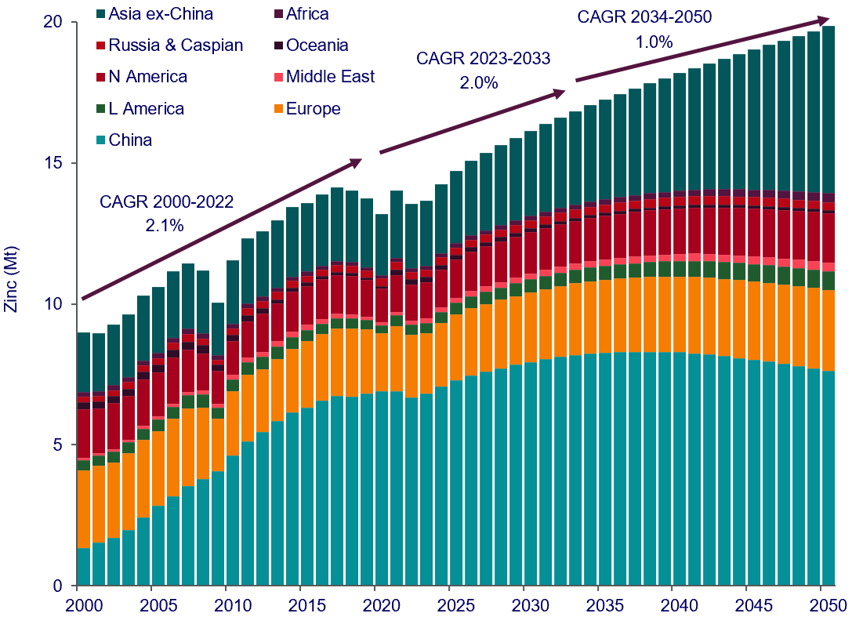
Zinc consumption to grow from 14Mt in 2022 to 20Mt in 2050
IAEG 50 – Friday 8th September
Global zinc consumption is forecasted to grow by 2% until 2032 and then slow to 1% until 2050
Changes to regional demand 2022 vs 2050
Global zinc consumption by region
Notes:
Zinc consumption is primarily driven by urbanisation and industrialisation. It is fair to say that they are largely propelled by developing rather than developed economies. Eg, economic liberalisation in China and other Asian countries resulted in an acceleration in these two phenomena and saw much of zinc growth up until 2021. (2000 and 2021 (2.4% p.a.)).
Going forwards, restructuring of the Chinese economy from one driven by investment in infrastructure and exports to one driven by domestic consumption will mean that Chinese economic growth will become less zinc intensive.
Continued urbanisation and industrialisation in other Asian economies, particularly India, will continue at a faster pace, Though overall growth of global zinc consumption will slow to 2 % p.a. until the early 2030s and 1% p.a. to 2050.
Developed economies are facing ageing and shrinking populations and will see diminishing growth.
Structural shifts will continue to decrease zinc’s intensity of use.
A key shift in the 80s in first use consumption was that of car manufacturing dominated by zinc die-casting alloys and brass to galvanized steel which resulted in a sharp reduction in zinc’s intensity of use. Post fabrication galvanising continues to face competition from paints, whilst zinc-magnesium-aluminium (ZAM) coatings for continuous galvanising are starting to be taken up, especially in construction materials. ZAM coatings reduce zinc usage by over a third and offers superior corrosive protection properties.
Global zinc consumption is forecasted to grow by 2% until 2032 and then slow to 1% until 2050. This equates to consumption growing from roughly 14Mt (13.6Mt in 2022) to 20Mt (19.8Mt) in 2050.

Slide 7
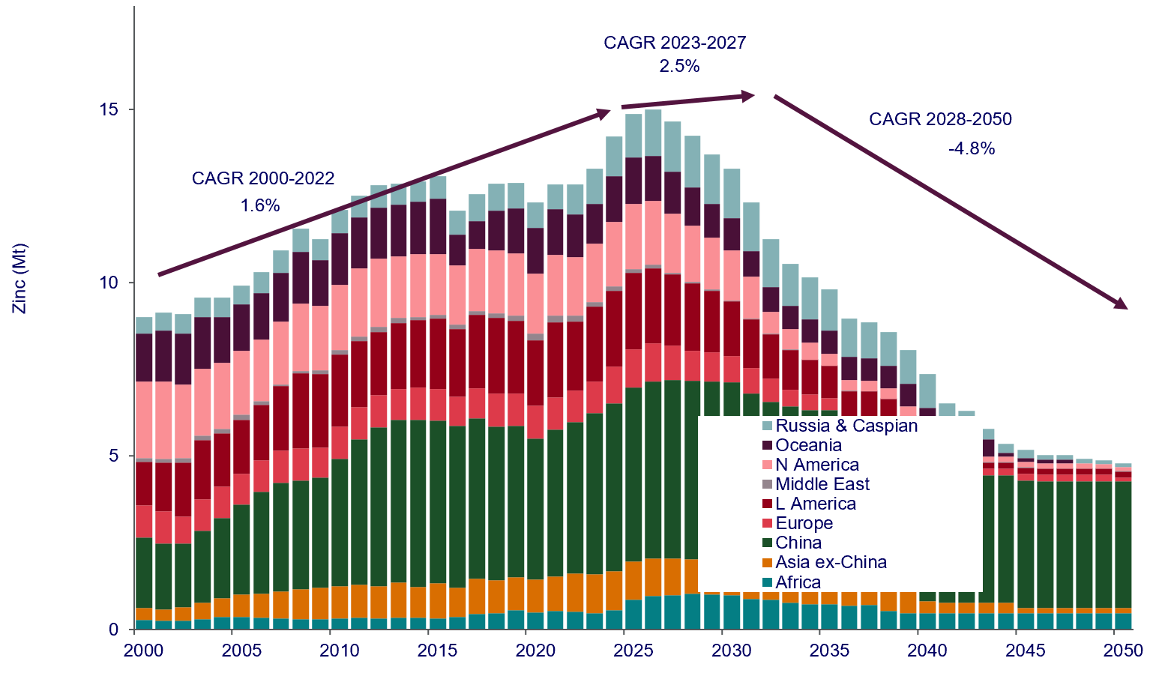
Mine supply requirement to be 5.6Mt by 2032, rising to 14.5Mt by 2050
IAEG 50 – Friday 8th September
Additional mine supply and smelting capacity required post 2030
Increased smelter production capability
needed from 2030
Identified mine production capability expected to peak by 2025/2026
 | 2023 | 2025 | 2030
ROW
Capacity (kt) | 7987 | 8442 | 8607
Production est. (kt) | 7199 | 7841 | 8292
Utilisation rate (%) | 90% | 93% | 96%
China
Capacity (kt) | 8242 | 8702 | 8712
Production est. (kt) | 6452 | 7297 | 7787
Utilisation rate (%) | 78% | 84% | 89%
Global
Capacity (kt) | 16229 | 17144 | 17319
Production est. (kt) | 13651 | 15138 | 16079
Utilisation rate (%) | 84% | 88% | 93%
Notes:
How are we going to supply the raw material needed to meet the demand outlook? If we re-cap back to the overview of the industry, There are two areas dealing with supply, mines and smelters. Looking at smelters first, two options are available on the table, increase productivity and utilization rates or build new capacity (new smelters). In 2023, we are looking at utilization of 84% globally, that is the difference between production and capacity. We think that this could be increased to 93% by 2030. However, this isup to individual smelters to do and ins not guaranteed. The other option is to build new smleters. China, which accounts for about 45% of global refined metal production, is closing older, more polluting smelters and replacing them with newer ones that meet environmental regulation.
However in summary, by the end of the decade additional smelting capacity will be needed to keep up with projected demand.
Moving over to mining, in 2022, global zinc mine production averaged about 12.8Mt, with growth dipping by 5% in 2020 due to the Covid pandemic. In the next three years, production see 2.5%/a growth as around 30 new mine projects come online. These additions to mine capability, will likely grow forecast large concentrate surpluses that began in 2022 following on from Covid related disruptions and is forecast to continue until the latter part of the decade. Unfortunately for miners and a positive for smelters, is that TCs are likely to remain high. This will delay development of some projects in the medium term.
However, with the requirement for new mine supply to be 5.6Mt by 2032, rising to 14.5Mt by 2050, the medium to long term outlook remains positive for new projects. Production capability will fall from 2.8%p.a. in 2028 to 1.7% by 2032, with additional new projects required to contribute 5.6Mt/a to global mine. This supply requirement translates to an average 240kt/a of new production until 2040. For zinc mines, this is equivalent to the construction of three medium sized mines every year.

Slide 8
Mine project funding

Slide 9
14 years: average lead time for project to start production
IAEG 50 – Friday 8th September
Time taken for projects to move into production suggests supply constraints will return
Average project lead time from scoping to production
* ** Base Case projects under construction as of Q4 2022
Notes:
The supply outlook is positive for the industry and will provide incentives for zinc mine projects to move forward. However, there is another risk, a side from price and demand forecasts. The time it takes to bring a zinc project into production, after evaluations, technical studies and permitting, is roughly 14 years. Which currently takes us into mid next decade.

Slide 10
Growth in capital expenditure and intensities increasing for zinc projects
IAEG 50 – Friday 8th September
Capex spend below expectation on supply outlook, whilst project capital intensity trending above historical
Project growth capital expenditure spend and capital intensity of current project pipeline
Notes:
Recent company spending is below the highs of the boom years, and the cost of actually building a mine up to production, from the projects coming online in the next few years, is higher than for historical mines, and unfortunately are looking way higher for potential projects. These are evaluated on a $/t/a Zneq tonnage, taking into account capex, the actual forecast metal production for the project.

Slide 11
Availability of funding improving over the last 5 years
IAEG 50 – Friday 8th September
Fund raising on public markets points to growing investor interest towards junior zinc companies
Breakdown of the type of capital raising between 2018 and May 2023. Total capital raises have steadily been increasing
Types of capital raises used fully or partially towards funding of activities on projects between January 2018 - May 2023.
Notes:
However, on the positive side, junior zinc company project funding has been on the rise over the last five years. The two charts here show a snapshot of raises that have taken place on public markets and points to growing interest from investors into zinc. Whilst each raise roughly varied between 1-10million$, these are exactly the amounts required to push project studies through. Interestingly the methods of financing have evolved, giving junior companies some variety in the financing route that they so choose.

Slide 12
Influences from Geology

Slide 13
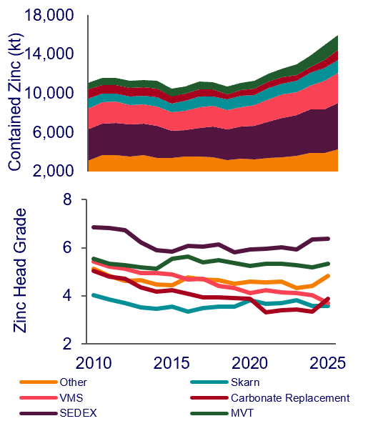
Zinc deposit types and grade relationship
IAEG 50 – Friday 8th September
Whilst tonnage is important, having other valuable metals in your deposit can make up for it
Contained zinc and zinc head grade by deposit type
Average milled grades in 2022 by deposit type. On a Zneq. basis, revenue from by/co-metals can be very important to the asset.
Notes:
Now I wanted to finish off on some high level stats on zinc production. Classifying zinc mines into a broad group of deposit types, give us some characteristics of zinc mines. On the left we can see that the majority of zinc production, some 45%, is derived from Sedexes and MVTs, followed by VMS type deposits. Their large tonnages are exploited using both underground and open pit mining methods. SedEx-type deposits have one of the highest average zinc grades although there is a large range from around 2% Zn at a number of mines mostly in China to around 15% Zn at some of the larger SedEx-type deposits, Red Dog being a notable example.
Another key theme is that Zinc mines have been increasingly polymetallic in nature since the turn of the millennium. Being polymetallic from a business point of view means more financial risk diversification through the exposure to more than one metal price. Whilst large tonnages make SedEx-type deposits attractive operations, mines exploiting other deposit types can prove to be more attractive from a financial perspective due to their polymetallic nature, such as VMS-type deposits. Analysing 2022 head grades from zinc producing mines shows that VMS-type deposits had an 8% zinc equivalent grade in comparison to 6.6% for SedEx-type deposits. Carbonate Replacement-type deposits came closely behind with the third highest zinc equivalent grade at 5.6%.

Slide 14
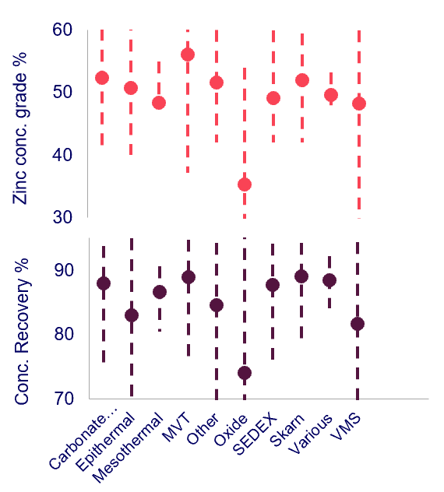
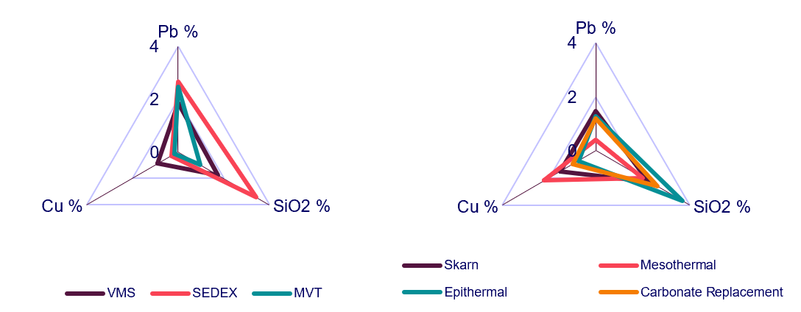
Zinc deposit types and grade relationship
IAEG 50 – Friday 8th September
The nature of the deposit can have an impact on zinc concentrate qualities and hence offtake negotiations
Average zinc grade and recovery to zinc concentrates
Lead-Copper-SiO2 content in zinc concentrates – the <5% rule of thumb
Notes:
SedEx-type and MVT deposits produce mildly dirty zinc concentrates with zinc grades averaging between 50-52%. By dirty I mean that these concentrates tend to contain unwanted elements, not the worst ones though, such as iron, silica and lead close to penalty thresholds and the meaning of this is that they often attract additional smelting charges, or penalties.
On the right, we can compare concentrates derived from various deposit types relative to their combined copper + lead + silica grade, three elements generally looked at poorly in combination with zinc, due to the difficulty in treating these three components by smelters, and we can used a 5% total grade threshold to determine, on a first pass method, the cleanliness of a concentrate. Due to geology, SedEx-type deposits have relatively high SiO2 and lead grades which can push the concentrates into penalty territory. However, they often sit below the combined 5% grade and because of their large deposit size and reasonable zinc grades SEDEX and good concentrates to have.
Whilst generally low in silver or gold, their concentrates can contain other bonus elements that are recoverable and in payable amounts. An example is germanium which requires an additional treatment route but nevertheless is currently sourced from zinc concentrates. However, low concentrations of other valuable metals means that the concentrates are amenable to smelters that use a week acid leach only for zinc recovery.

